Slide 1
Introduction to Machine Learning – Linear Regression and KNN
Dr. Ab Mosca (they/them)
Slides based off slides courtesy of Jordan Crouser (https://jcrouser.github.io/)

Slide 2
Plan for Today
Finish more considerations for regression modeling
Potential problems
Comparing LR and KNN Regression

Slide 3
Warm Up: Breaking Linear Regression
Potential issues
Correlated error terms
Non-constant variance of error terms
Outliers
High leverage points
Collinearity
How do we check for correlated error terms? Where do we see them most often?
How do we check for non-constant variance of error terms? How can we ”fix” them?

Slide 4
Correlated Error Terms
LR assumes that the error terms are uncorrelated
If these terms are correlated, the estimated standard error will tend to underestimate the true standard error. As a result,
CI’s will be narrower than they should be and
p-values will be lower than they should be
Notes:
Cis are lower bc SE is lower than it should be
p-values are lower bc

Slide 5
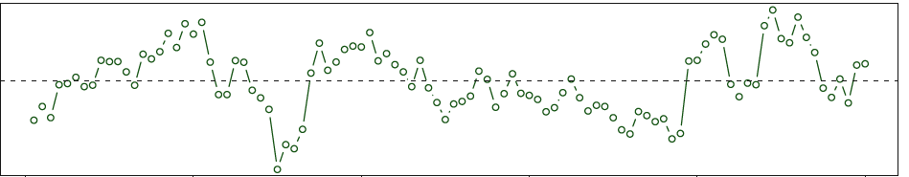
Correlated Error Terms
Checking for correlated error terms in time-series data
Plot residuals as a function of time
If error are uncorrelated, there will be no discernable pattern
If errors are correlated, we will see tracking (adjacent residuals with similar values)
“tracking”
Notes:
Cis are lower bc SE is lower than it should be
p-values are lower bc

Slide 6
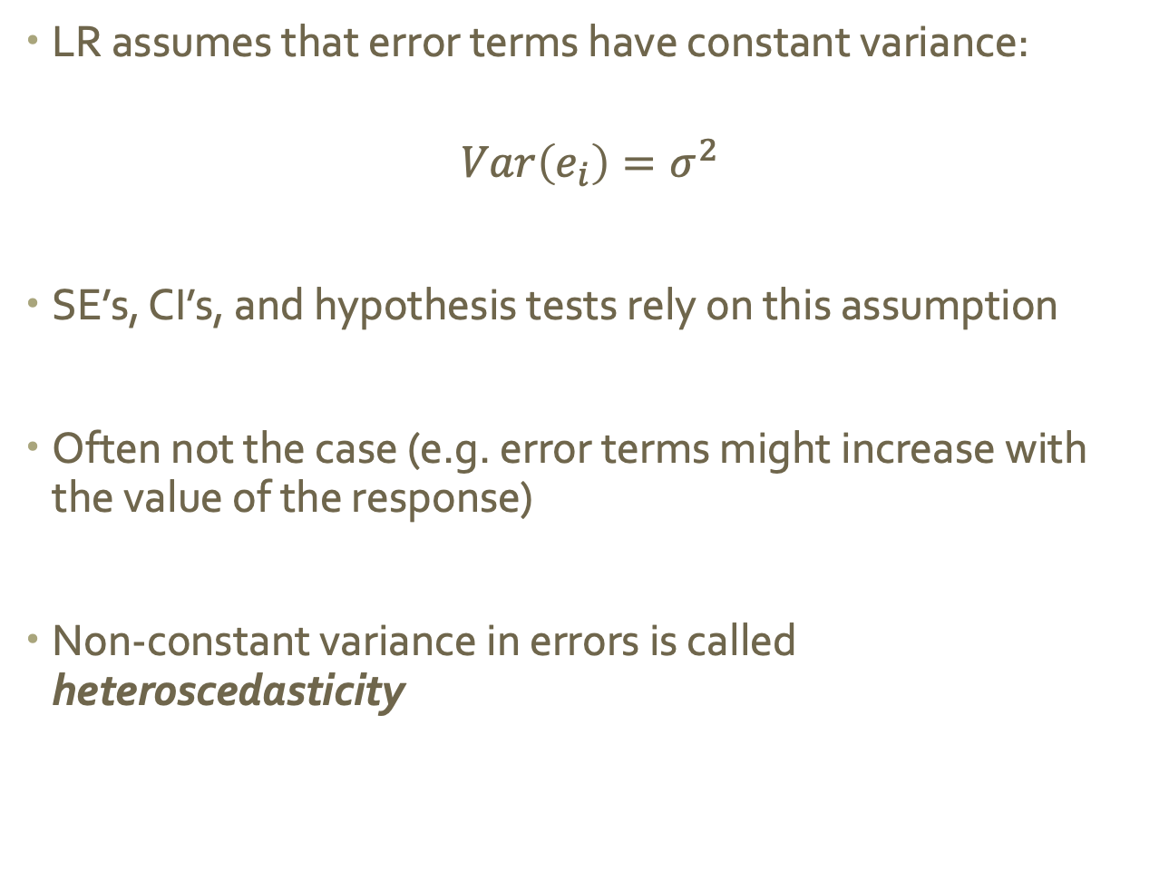
Non-constant variance of error terms
LR assumes that error terms have constant variance:
$$Var\left(e_{i}\right)=σ^{2}$$
SE’s, CI’s, and hypothesis tests rely on this assumption
Often not the case (e.g. error terms might increase with the value of the response)
Non-constant variance in errors is called heteroscedasticity
Notes:
Cis are lower bc SE is lower than it should be
p-values are lower bc

Slide 7
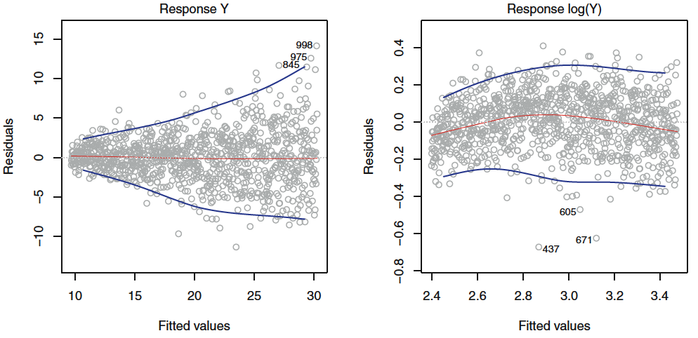
Identify and Fix Heteroscedasticy
Identifying: The residuals plot will show a funnel shape
Fixing:
transform the response using a concave function (like log or sqrt)
weight the observations proportional to the inverse variance
Notes:
Cis are lower bc SE is lower than it should be
p-values are lower bc

Slide 8
Outliers
An outlier is an observation whose true response is REALLY FAR from the one predicted by the model
Sometimes indicate a problem with the model (i.e. a missing predictor), or might just be a data collection error
Can mess with RSE and R², which can lead us to misinterpret the model’s fit
Notes:
Cis are lower bc SE is lower than it should be
p-values are lower bc

Slide 9
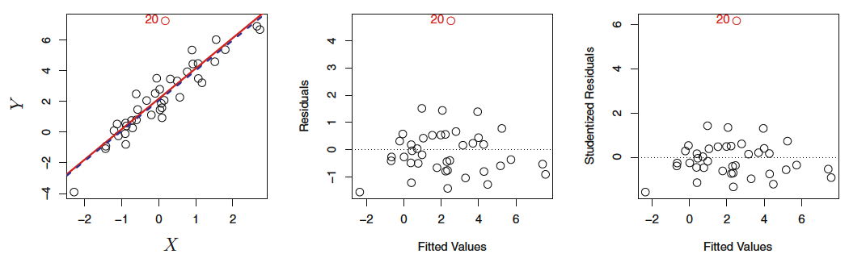
Identify and Fix Outliers
Identify: Residual plots can help identify outliers, but sometimes it’s hard to pick a cutoff point (how far is “too far”?)
Fix:
Divide each residual by dividing by its estimated standard error (studentized residuals), and flag anything larger than 3 in absolute value
Notes:
Studentizing == dud who came up with published under the name student

Slide 10
High Leverage Points
Outliers are unusual values in the response
High leverage points are unusual values in the predictor(s)
The more predictors you have, the harder they can be to spot
These points can have a major impact on the least squares line, which could invalidate the entire fit
We don’t want only one or a few inputs to cause large changes in the entire model
Notes:
Cis are lower bc SE is lower than it should be
p-values are lower bc

Slide 11
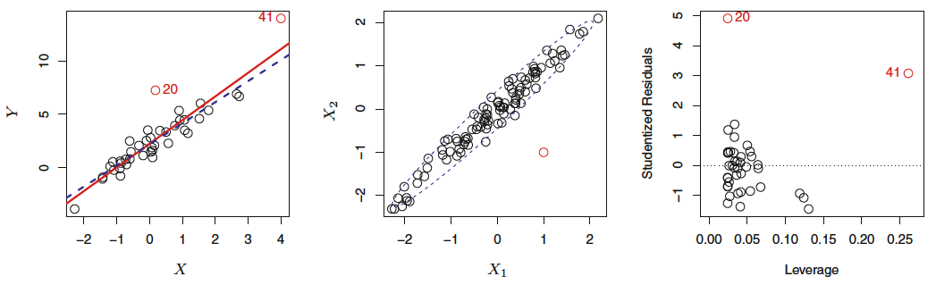

Identify High Leverage Points
Compute the leverage statistic. For SLR:
$$h_{i}=\frac{1}{n}+\frac{{\left(x_{i}−\overline{x}\right)}^{2}}{\sum_{i=1}^{n}{{\left(x_{i}−\overline{x}\right)}^{2}}}$$
The leverage statistic is always a value between $\frac{1}{n}$ and $n$
The average for all observations is $\frac{p+1}{n}$, if a statistic is much greater than the average, the point is probably a high leverage point
Notes:
41 has high leverage, 20 does not

Slide 12
Collinearity
Collinearity is when two or more predictor variables are closely related to one another
This makes it hard to isolate the individual effects of each predictor, which increases uncertainty in coefficient estimates
As a result, it is harder to detect whether or not an effect is actually present (because SE has increased)
Notes:
41 has high leverage, 20 does not

Slide 13
Identify Collinearity
Look at the correlation matrix of the predictors
Auto dataset: just about everything is highly correlated
Note: multicollinearity is when more than two variables are correlated; this will not show in this correlation matrix.
Notes:
41 has high leverage, 20 does not

Slide 14
Dealing with Collinearity
Options include:
Drop one of the problematic variables from the regression (collinearity implies they’re redundant)
Combine collinear variables into a single predictor (ex. take the average)
Notes:
41 has high leverage, 20 does not

Slide 15
Linear Regression and KNN Regression
Notes:
41 has high leverage, 20 does not

Slide 16

Parametric vs. Non Parametric
Linear Regression is a parametric approach to modeling
It assumes a linear function, $f(X)$
Parametric models
Are easy to fit (there are few coefficients to estimate)
(For LR) coefficients have simple interpretations and tests of statistical significance are easy to perform
Notes:
41 has high leverage, 20 does not

Slide 17

Parametric vs. Non Parametric
Linear Regression is a parametric approach to modeling
It assumes a linear function, $f(X)$
Parametric models
Are easy to fit (there are few coefficients to estimate)
(For LR) coefficients have simple interpretations and tests of statistical significance are easy to perform
However…
They make strong assumptions about the form of $f(X)$, and if reality is far from this form predictions will be very poor
Notes:
41 has high leverage, 20 does not

Slide 18

Parametric vs. Non Parametric
Non-parametric models
No not explicitly assume a parametric form for $f(X)$, allowing for more flexibility in regression
A common approach is K-nearest neighbors regression (KNN regression)
Notes:
41 has high leverage, 20 does not

Slide 19

KNN Regression
Given a value for $K$ and a prediction point, $x_{0}$, KNN regression will
identify the $K$ training observations that are closest to $x_{0}$ (we will call these $N_{0}$)
estimate $f(x_{0})$ using the average of all training responses in $N_{0}$
Notes:
41 has high leverage, 20 does not

Slide 20
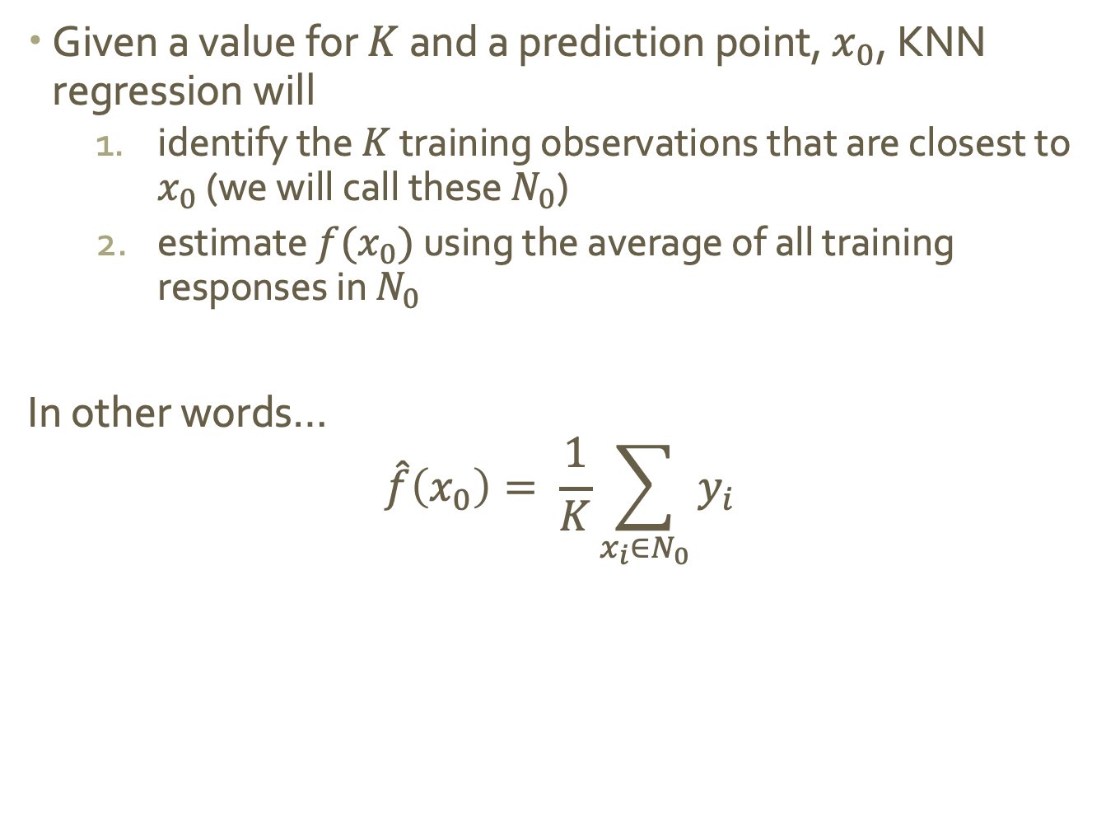
KNN Regression
Given a value for $K$ and a prediction point, $x_{0}$, KNN regression will
identify the $K$ training observations that are closest to $x_{0}$ (we will call these $N_{0}$)
estimate $f(x_{0})$ using the average of all training responses in $N_{0}$
In other words…
$$\hat{f}\left(x_{0}\right)= \frac{1}{K}\sum_{x_{i}∈N_{0}}{y_{i}}$$
Notes:
41 has high leverage, 20 does not

Slide 21
KNN Regression
Given a value for $K$ and a prediction point, $x_{0}$, KNN regression will
identify the $K$ training observations that are closest to $x_{0}$ (we will call these $N_{0}$)
estimate $f(x_{0})$ using the average of all training responses in $N_{0}$
In other words…
$$\hat{f}\left(x_{0}\right)= \frac{1}{K}\sum_{x_{i}∈N_{0}}{y_{i}}$$
Notes:
41 has high leverage, 20 does not

Slide 22
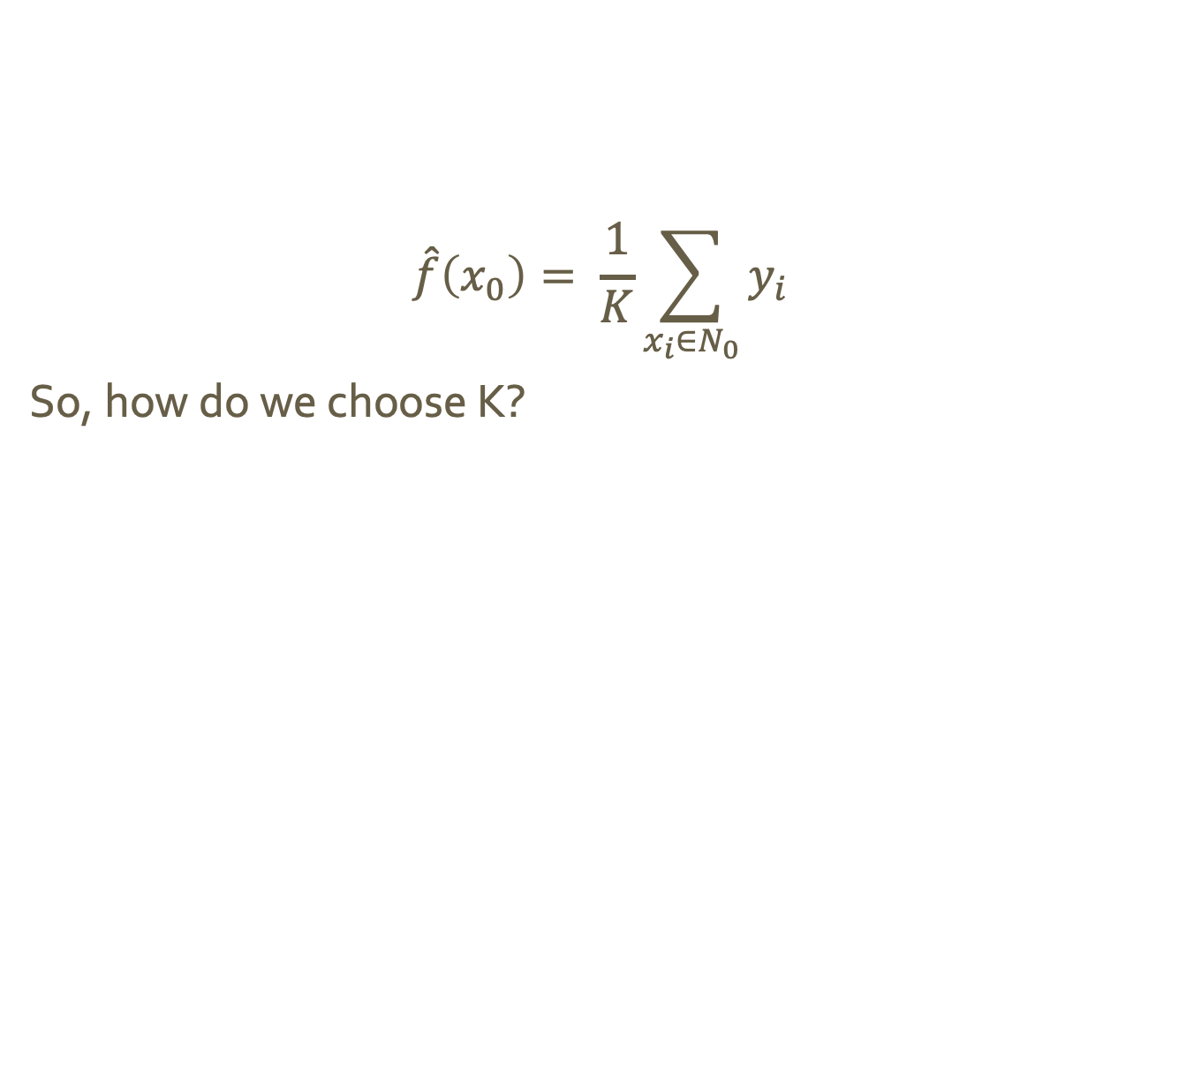
KNN Regression
$$\hat{f}\left(x_{0}\right)= \frac{1}{K}\sum_{x_{i}∈N_{0}}{y_{i}}$$
So, how do we choose K?
Notes:
41 has high leverage, 20 does not

Slide 23
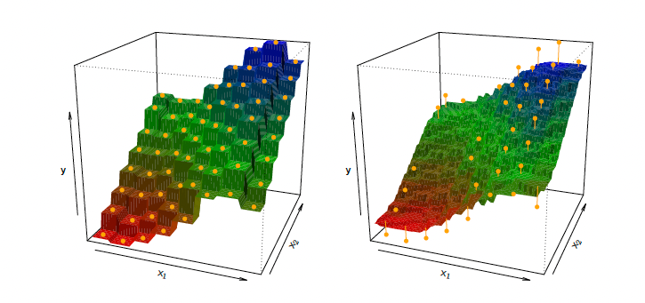
KNN Regression
What can you say about bias and variance for the two plots below? Do they seem to relate to K? If so, how?
$$\hat{f}\left(x_{0}\right)= \frac{1}{K}\sum_{x_{i}∈N_{0}}{y_{i}}$$
So, how do we choose K?
K = 1
K = 9
Notes:
small K == more flexible == low bias but high variance
big K = less flexible == higher bias lower variance

Slide 24
LR vs. KNN Regression
When is parametric better than non-parametric? And vice versa?
Notes:
small K == more flexible == low bias but high variance
big K = less flexible == higher bias lower variance

Slide 25
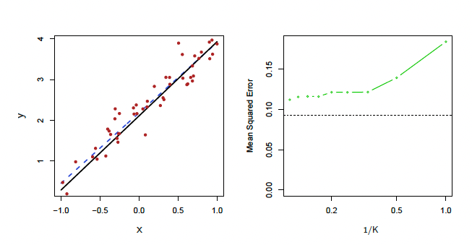
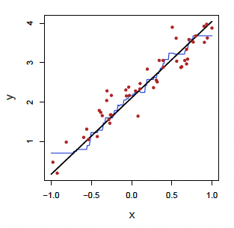
LR vs. KNN Regression
When is parametric better than non-parametric? And vice versa?
True relationship = black solid line
Left: blue curve is KNN regression with K = 9
Right: blue curve is LR regression
Notes:
True relationship is black solid line

Slide 26
LR vs. KNN Regression
When is parametric better than non-parametric? And vice versa?
True relationship = black solid line
Left: blue curve is KNN regression with K = 9
Right: blue curve is LR regression
Dashed black = MSE for LR
Dashed green = MSE for KNN as a function of 1/K
Notes:
True relationship is black solid line

Slide 27
LR vs. KNN Regression
What happens to MSE as K increases?
Which fit is better?
When is parametric better than non-parametric? And vice versa?
True relationship = black solid line
Left: blue curve is KNN regression with K = 9
Right: blue curve is LR regression
Dashed black = MSE for LR
Dashed green = MSE for KNN as a function of 1/K
Notes:
True relationship is black solid line

Slide 28
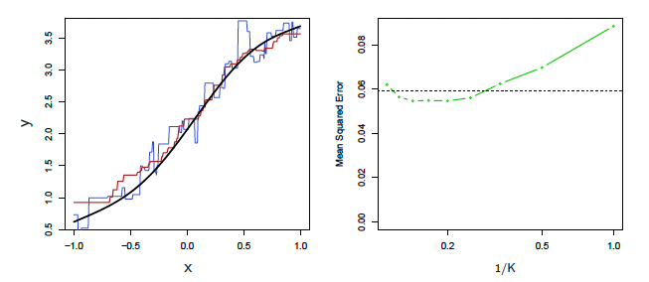
LR vs. KNN Regression
What happens to MSE as K increases?
Which fit is better?
When is parametric better than non-parametric? And vice versa?
True relationship = black solid line
Blue curve is KNN regression with K = 1
Red curse is KNN regression with K = 9
Dashed black = MSE for LR
Dashed green = MSE for KNN as a function of 1/K
Notes:
True relationship is black solid line

Slide 29
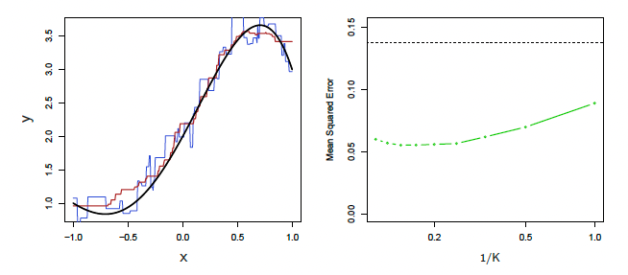
LR vs. KNN Regression
What happens to MSE as K increases?
Which fit is better?
When is parametric better than non-parametric? And vice versa?
True relationship = black solid line
Blue curve is KNN regression with K = 1
Red curse is KNN regression with K = 9
Dashed black = MSE for LR
Dashed green = MSE for KNN as a function of 1/K
Notes:
True relationship is black solid line

Slide 30
LR vs. KNN Regression
When is parametric better than non-parametric? And vice versa?
Parametric will always win for linear relationships
Non-parametric will often win for. non-linear relationships
Notes:
True relationship is black solid line

Slide 31
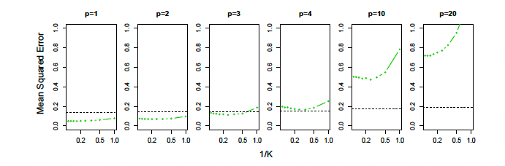
LR vs. KNN Regression
When is parametric better than non-parametric? And vice versa?
Parametric will always win for linear relationships
Non-parametric will often win for. non-linear relationships
KNN performance will degrade more quickly as noise (number of predictors) increases
Notes:
curse of dimensionality. That is, curse of dithe
K observations that are nearest to a given test observation x0 mensionality may be
very far away from x0 in p-dimensional space when p is large, leading to a
very poor prediction of f(x0) and hence a poor KNN fit.

