Slide 1
Introduction to Machine Learning – Shrinkage Methods
Dr. Ab Mosca (they/them)
Slides based off slides courtesy of Jordan Crouser (https://jcrouser.github.io/)

Slide 2
Reminder
It is your responsibility to submit your assignments on Gradescope (and quizzes on PLATO) on time
A lot of people are missing submissions – I will not track you down and I will not accept late assignments

Slide 3
Plan for Today
Shrinkage Methods
Ridge Regression
The Lasso
Selecting the Tuning Parameter

Slide 4
Warm Up: Subset Selection
Form 3 groups.
With your group write out the algorithm for your assigned subset selection method.
Best Subset
Forward Selection
Backward Selection
What are the pros and cons of your method?
Notes:
Best subset: try all possible combinations of predictors
Forward: start with no predictors, greedily add one at a time
Backward: start with all predictors, greedily remove one at a time

Slide 5
Motivation
So far, we looked at methods that determine good subsets of predictors to use when fitting linear models using least squares.
Notes:
we’re exploring the space of possible models as if there were only finitely many of them, but there are actually infinitely many (why?)

Slide 6

Motivation
So far, we looked at methods that determine good subsets of predictors to use when fitting linear models using least squares.
An alternative approach is to fit a model containing all $p$ predictors, but to constrain or regularize the coefficient estimates.

Slide 7

Ridge Regression
Big idea: minimize RSS plus an additional penalty that rewards small (sum of) coefficient values.
Least squares fits by finding coefficients that minimize
$$RSS=\sum_{i=1}^{n}{{\left(y_{i}−β_{0}−\sum_{j=1}^{p}{β_{j}x_{ij}}\right)}^{2}}$$

Slide 8
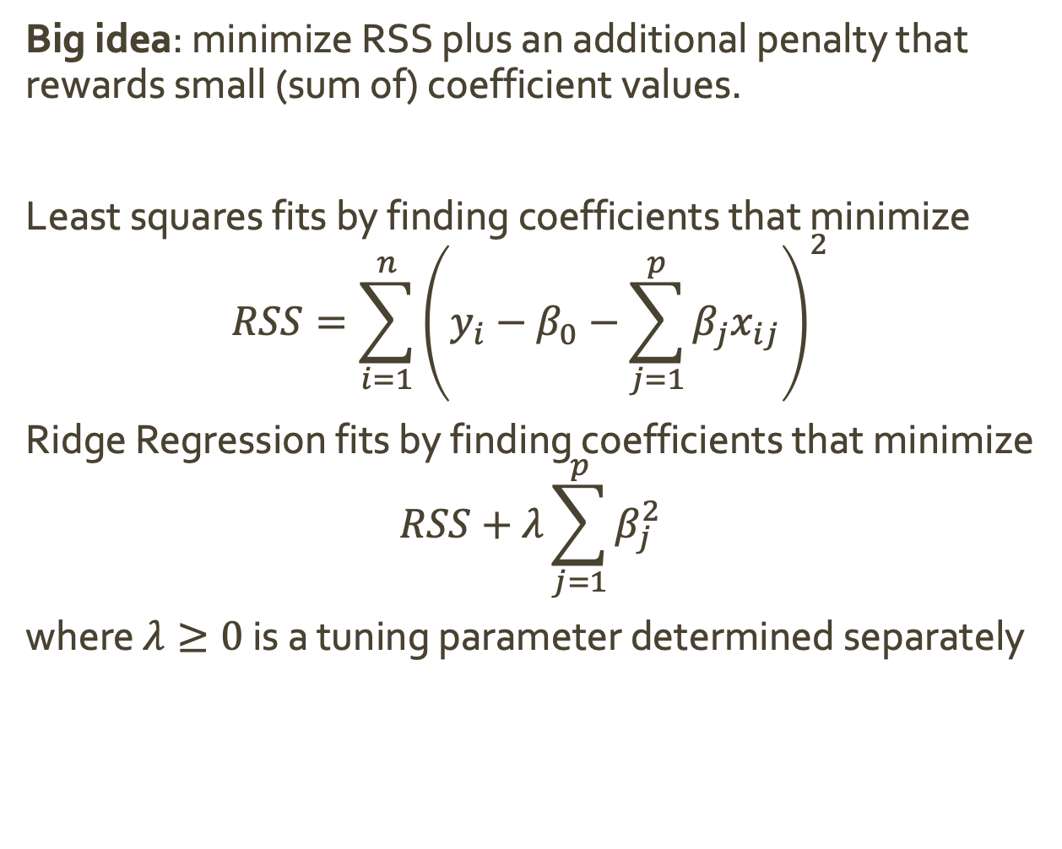
Ridge Regression
Big idea: minimize RSS plus an additional penalty that rewards small (sum of) coefficient values.
Least squares fits by finding coefficients that minimize
$$RSS=\sum_{i=1}^{n}{{\left(y_{i}−β_{0}−\sum_{j=1}^{p}{β_{j}x_{ij}}\right)}^{2}}$$
Ridge Regression fits by finding coefficients that minimize
$$RSS+λ\sum_{j=1}^{p}{β_{j}^{2}}$$
where $λ≥0$ is a tuning parameter determined separately
Shrinkage Penalty
What will the shrinkage penalty reward?
Notes:
estimates close to 0, less added to the RSS, which we want to minimize

Slide 9

Ridge Regression
Big idea: minimize RSS plus an additional penalty that rewards small (sum of) coefficient values.
Least squares fits by finding coefficients that minimize
$$RSS=\sum_{i=1}^{n}{{\left(y_{i}−β_{0}−\sum_{j=1}^{p}{β_{j}x_{ij}}\right)}^{2}}$$
Ridge Regression fits by finding coefficients that minimize
$$RSS+λ\sum_{j=1}^{p}{β_{j}^{2}}$$
where $λ≥0$ is a tuning parameter determined separately
Shrinkage Penalty
What does $λ$ do in this equation? What happens when it is small (near 0)? Large (near infinity)?
Notes:
lambda controls the relative impact of RSS and the penalty
As lambda grows, the shrinkage penalty grows and estimates will shrink towards 0
Selecting a good lambda is critical! we will discuss how later
Good news! we only have to fit one model per lambda!

Slide 10
Ridge Regression
Big idea: minimize RSS plus an additional penalty that rewards small (sum of) coefficient values.
Least squares fits by finding coefficients that minimize
$$RSS=\sum_{i=1}^{n}{{\left(y_{i}−β_{0}−\sum_{j=1}^{p}{β_{j}x_{ij}}\right)}^{2}}$$
Ridge Regression fits by finding coefficients that minimize
$$RSS+λ\sum_{j=1}^{p}{β_{j}^{2}}$$
where $λ≥0$ is a tuning parameter determined separately
Shrinkage Penalty
RSS is scale invariant (multiplying any predictor by a constant won’t change RSS). Is the shrinkage penalty?
Notes:
No! Having predictors at different scales would influence our estimate
we need to first standardize predictors by dividing by the SD

Slide 11
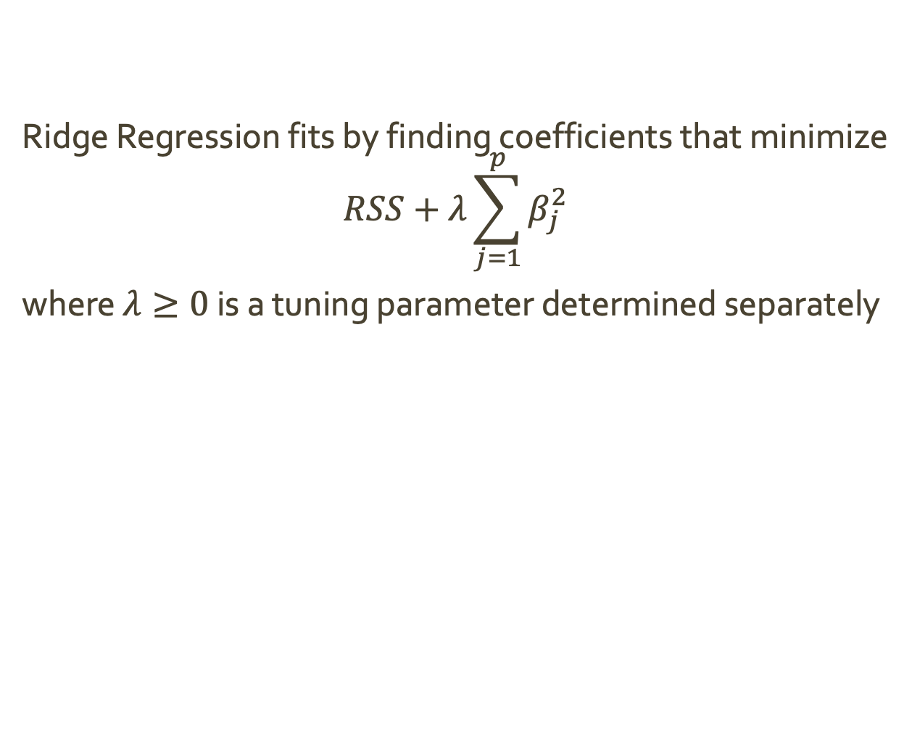
Ridge Regression
Ridge Regression fits by finding coefficients that minimize
$$RSS+λ\sum_{j=1}^{p}{β_{j}^{2}}$$
where $λ≥0$ is a tuning parameter determined separately
Why would ridge regression improve the fit over least-squares regression?
Notes:
bias-variance trade off
as lambda increases, flexability decreases so variance goes down and bias goes up
as lambda decreases, flexability increases, so variance goes up and bias goes down
ridge regression works best in situations where least squares estimates have high variance: trades a small increase in bias for a large reduction in variance

Slide 12
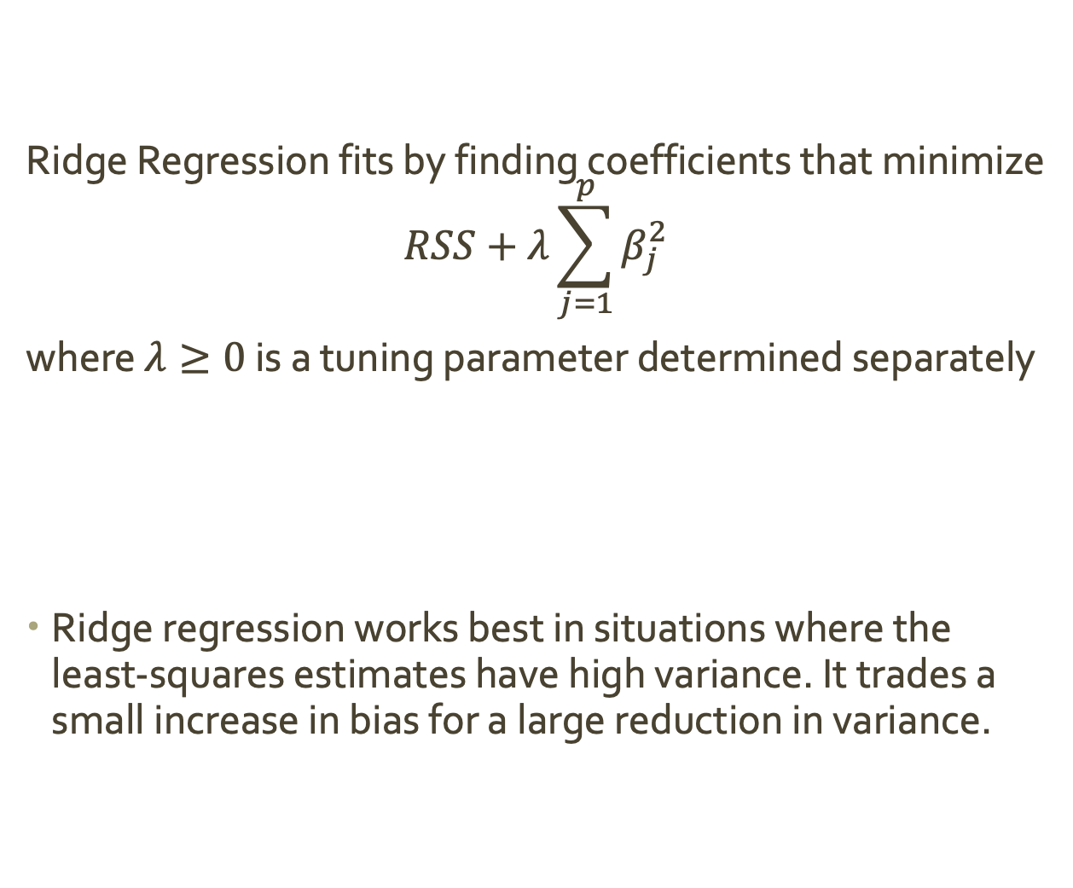
Ridge Regression
Ridge Regression fits by finding coefficients that minimize
$$RSS+λ\sum_{j=1}^{p}{β_{j}^{2}}$$
where $λ≥0$ is a tuning parameter determined separately
Ridge regression works best in situations where the least-squares estimates have high variance. It trades a small increase in bias for a large reduction in variance.
Why would ridge regression improve the fit over least-squares regression?

Slide 13
Ridge Regression
Drawback:
Does not actually perform variable selection
Our final model will include all predictors
If all we care about is prediction accuracy, this is not a problem
However, if we also care about model interpretability, it does pose a problem

Slide 14
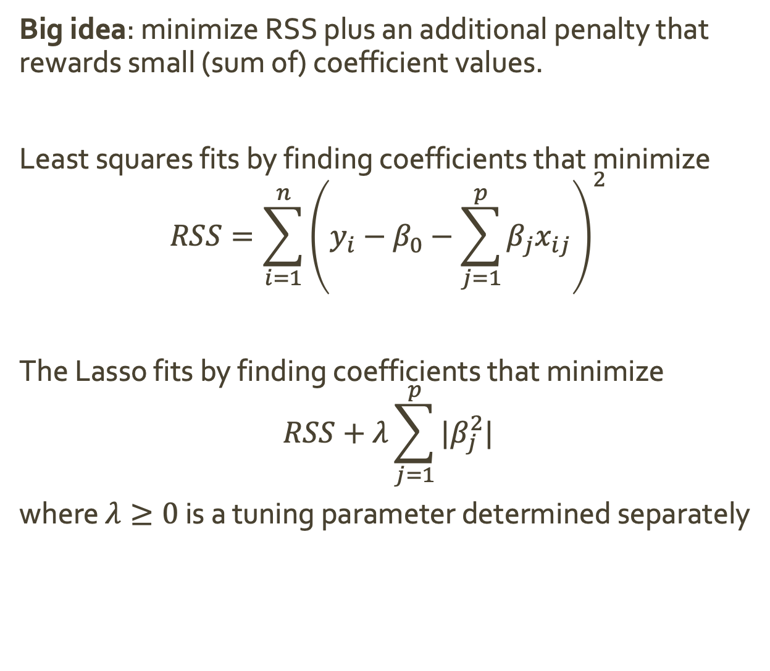
The Lasso
Big idea: minimize RSS plus an additional penalty that rewards small (sum of) coefficient values.
Least squares fits by finding coefficients that minimize
$$RSS=\sum_{i=1}^{n}{{\left(y_{i}−β_{0}−\sum_{j=1}^{p}{β_{j}x_{ij}}\right)}^{2}}$$
The Lasso fits by finding coefficients that minimize
$$RSS+λ\sum_{j=1}^{p}{|β_{j}^{2}|}$$
where $λ≥0$ is a tuning parameter determined separately
Shrinkage Penalty

Slide 15
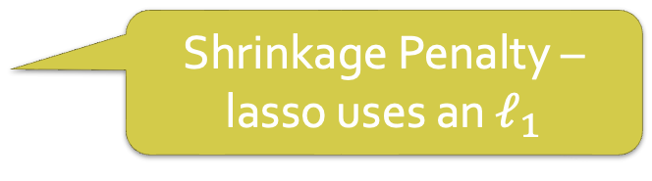
The Lasso
Big idea: minimize RSS plus an additional penalty that rewards small (sum of) coefficient values.
Least squares fits by finding coefficients that minimize
$$RSS=\sum_{i=1}^{n}{{\left(y_{i}−β_{0}−\sum_{j=1}^{p}{β_{j}x_{ij}}\right)}^{2}}$$
The Lasso fits by finding coefficients that minimize
$$RSS+λ\sum_{j=1}^{p}{|β_{j}^{2}|}$$
where $λ≥0$ is a tuning parameter determined separately
Shrinkage Penalty – lasso uses an $ℓ_{1}$

Slide 16

The Lasso
How does the lasso get coefficients exactly equal to 0?
For each value of $λ$, there exists a value for $s$ such that:
Ridge Regression
$\min_{β}{(RSS)}$ subject to $\sum_{j=1}^{p}{β_{j}^{2}≤s}$
Lasso
$\min_{β}{(RSS)}$ subject to $\sum_{j=1}^{p}{|β_{j}| ≤s}$

Slide 17
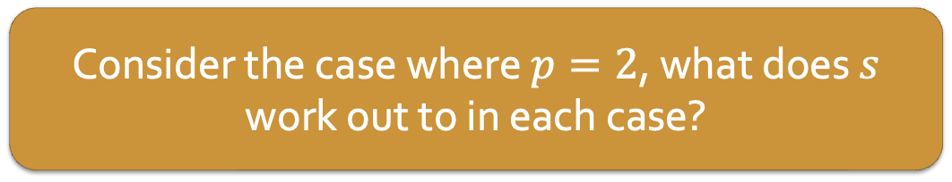
The Lasso
How does the lasso get coefficients exactly equal to 0?
For each value of $λ$, there exists a value for $s$ such that:
Ridge Regression
$\min_{β}{(RSS)}$ subject to $\sum_{j=1}^{p}{β_{j}^{2}≤s}$
Lasso
$\min_{β}{(RSS)}$ subject to $\sum_{j=1}^{p}{|β_{j}| ≤s}$
Consider the case where $p=2$, what does $s$ work out to in each case?
Notes:
circle
diamond

Slide 18
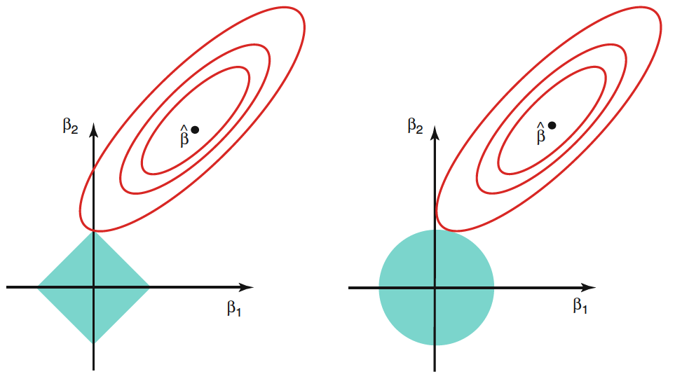
The Lasso
Ridge regression
Lasso
Notes:
trying to find the smallest betas such that there is a budget for s
so, we need coefficients in the shaded area
however, that might not overlap with least squares coeffieients

Slide 19
The Lasso
Ridge regression
Lasso
Notes:
here, ellipses are contours centered on least squares solution (B hat)
contour means that all points on the ellipse have the same RSS value
As ellipses expand away from least squares, RSS increases
Solution is the first point where the ellipses intersect with a shaded region
Since ridge regression has a circular constraint with no sharp points, this intersection will not generally occur on an axis, and so the ridge regression coefficient estimates will be exclusively non-zero.
lasso has corners at each axis, and the ellipse will often intersect at one of these axes, when this occurs one coefficient is 0
same holds in higher dimensions

Slide 20

Tuning Parameter Selection
We choose the appropriate $λ$ using cross validation
Choose a grid of $λ$
Use CV to compute test error for each
Select the $λ$ for which CV test error is smallest

Slide 21

Inventory
So far, we’ve talked about solving the problem of $n≤p$ in linear regression via subset selection (best and stepwise approaches), and via shrinkage methods (ridge regression and the lasso).
Let’s recap and take inventory of these options. Break into 4 groups. Each group will be assigned one option.
With your group:
If you’ve been assigned a subset selection approach
Write out the algorithm in pseudo code
Visualize the algorithm running on an example
ID the pro’s and con’s to your approach compared to others
If you’ve been assigned a shrinkage method
Write out the shrinkage penalty for your approach
Show how the penalty works with an example
ID the pro’s and con’s to your approach compared to others
Be prepared to share with the class

