Slide 1
Introduction to Machine Learning – Generative Models
Dr. Ab Mosca (they/them)
Slides based off slides courtesy of Jordan Crouser (https://jcrouser.github.io/)

Slide 2
Plan for Today
Quadratic Discriminant Analysis
Naive Bayes

Slide 3
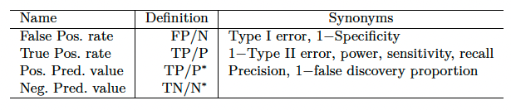
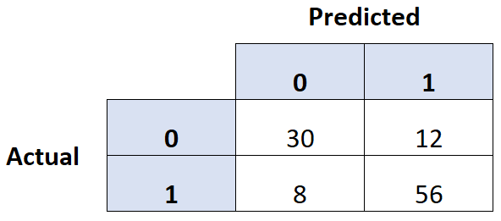
Warm Up: Classification Errors
Calculate specificity, sensitivity, and precision for the model that produced this confusion matrix.

Slide 4

Generative Models
Logistic Regression directly models $Pr⁡(Y=k|X=x)$
i.e., we model the conditional distribution of Y given the predictor(s) X
Alternatively, we can model the distribution of predictors, X, separately for each response class. Then use Bayes Theorem to flip them into estimates for $Pr⁡(Y=k|X=x)$

Slide 5

LDA
LDA makes 2 assumptions:
Observations within class are normally distributed
All classes have common variance
LDA assigns an observation, $X=x$ to the class for which the discriminant is largest.
LDA discriminant function:
$$δ_{k}\left(x\right)=\frac{x^{T}{\hat{μ}}_{k}}{Σ}−\frac{{\hat{μ}}_{k}^{T}{\hat{μ}}_{k}}{2Σ}+log⁡({\hat{π}}_{k})$$

Slide 6

LDA
LDA makes 2 assumptions:
Observations within class are normally distributed
All classes have common variance
LDA assigns an observation, $X=x$ to the class for which the discriminant is largest.
LDA discriminant function:
$$δ_{k}\left(x\right)=\frac{x^{T}{\hat{μ}}_{k}}{Σ}−\frac{{\hat{μ}}_{k}^{T}{\hat{μ}}_{k}}{2Σ}+log⁡({\hat{π}}_{k})$$
What if we relax this assumption?
Notes:
sigma is the cov

Slide 7

LDA
Relax the LDA assumption that classes have uniform variance
That means we now have
$$Σ→Σ_{k}$$

Slide 8

LDA
Relax the LDA assumption that classes have uniform variance
That means we now have
$$Σ→Σ_{k}$$
If we plus this into Bayes we get:
$$δ_{k}\left(x\right)=−\frac{x^{T}x}{2Σ_{k}}+\frac{x^{T}μ_{k}}{Σ_{k}}−\frac{μ_{k}^{T}μ_{k}}{2Σ_{k}}−\frac{\log\left|Σ_{k}\right|}{2}+logπ_{k}$$

Slide 9

QDA
LDA → Quadratic Discriminant Analysis
Relax the LDA assumption that classes have uniform variance
That means we now have
$$Σ→Σ_{k}$$
If we plus this into Bayes we get:
$$δ_{k}\left(x\right)=−\frac{x^{T}x}{2Σ_{k}}+\frac{x^{T}μ_{k}}{Σ_{k}}−\frac{μ_{k}^{T}μ_{k}}{2Σ_{k}}−\frac{\log\left|Σ_{k}\right|}{2}+logπ_{k}$$
Multiplying two x terms together → quadratic

Slide 10

LDA vs QDA
Bias-Variance Tradeoff
If we have $p$ predictors….
Estimating a covariance matrix requires estimating $\frac{p(p+1)}{2}$ parameters
LDA assumes one covariance matrix, and is linear so there are $Kp$ linear coefficients to estimate
QDA estimates a covariance matrix for each class, $K$, for a total of $\frac{Kp(p+1)}{2}$ parameters to estimate
Which model has higher bias? Which has higher variance?
Notes:
LDA tends to be a better bet than QDA if there are relatively few training observations and so reducing
variance is crucial.
QDA is recommended if the training set is very large, so that the variance of the classifier is not a major concern, or ifthe assumption of a common covariance matrix for the K classes is clearly untenable

Slide 11
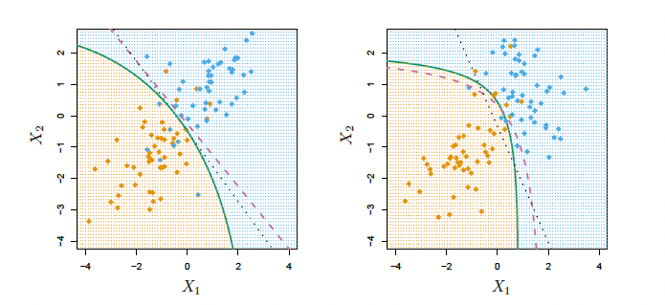


LDA vs QDA
Bias-Variance Tradeoff
Purple dashed = Bayes
Black dotted = LDA
Green = QDA
$$Σ_{1}=Σ_{2}$$
$$Σ_{1}≠Σ_{2}$$
Notes:
LDA tends to be a better bet than QDA if there are relatively few training observations and so reducing
variance is crucial.
QDA is recommended if the training set is very large, so that the variance of the classifier is not a major concern, or ifthe assumption of a common covariance matrix for the K classes is clearly untenable

Slide 12

Bayes Theorem
Remember…
Bayes Theorem
$$\operatorname{Pr}\left(Y=k | X=x\right)=\frac{π_{k}f_{k}(x)}{\sum_{l=1}^{K}{π_{l}f_{l}(x)}}$$
$π_{k}$ is the prior probability that a randomly chosen observation come from the $k$th class
$f_{k}\left(X\right)≡Pr⁡(X|Y=k)$ is the density function of $X$ for an observation that comes from the $k$th class
$Pr⁡(Y=k|X=x)$ is the posterior probability, i.e. the probability that an observation belongs to the $k$th class given the predictor value ($x$) for the observation
Easy to estimate! How?
Hard to estimate, many options
Notes:
pi_k is proportion in dataset

Slide 13

Naive Bayes
Remember…
Bayes Theorem
$$\operatorname{Pr}\left(Y=k | X=x\right)=\frac{π_{k}f_{k}(x)}{\sum_{l=1}^{K}{π_{l}f_{l}(x)}}$$
$f_{k}\left(X\right)≡Pr⁡(X|Y=k)$ is the density function of $X$ for an observation that comes from the $k$th class
LDA and QDA assume $f_{k}(x)$ is multivariate normal
naive Bayes classifier assumes:
Within the kth class, the p predictors are independent
Hard to estimate, many options
Notes:
pi_k is proportion in dataset

Slide 14

Naive Bayes
Assumes
Within the kth class, the p predictors are independent
$$f_{k}\left(x\right)=f_{k1}\left(x_{1}\right)×f_{k2}\left(x_{2}\right)×…×f_{kp}(x_{p})$$
$f_{kj}$ is the density function for the jth predictor among observations in the kth class
Notes:
pi_k is proportion in dataset

Slide 15

Naive Bayes
Assumes
Within the kth class, the p predictors are independent
$$f_{k}\left(x\right)=f_{k1}\left(x_{1}\right)×f_{k2}\left(x_{2}\right)×…×f_{kp}(x_{p})$$
$f_{kj}$ is the density function for the jth predictor among observations in the kth class
This assumption eliminates the need to estimate covariance (there is no covariance if everything is independent!)
In practice, do you expect all predictors to be independent?
Notes:
def not,
BUT, hard to estimate covar without a TON of data
naive Bayes assumption introduces some bias, but reduces variance, leading to a classifier that works quite well in practice as a result of the bias-variance trade-off.

Slide 16

Naive Bayes
Posterior probability:
$$\operatorname{Pr}\left(Y=k\right)\left|X=x\right)= \frac{π_{k}×f_{k1}\left(x_{1}\right)×f_{ks}\left(x_{2}\right)×…×f_{kp}\left(x_{p}\right)}{\sum_{l=1}^{K}{π_{l}×f_{l1}\left(x_{1}\right)×f_{ls}\left(x_{2}\right)×…×f_{lp}\left(x_{p}\right)}}$$
Options for estimating $f_{kj}$:
If $X_{j}$ is quantitative, assume univariate normal distributions for each predictor within each class
If $X_{j}$ is quantitative, use non-parametric estimate. Make a histogram for observations of the jth predictor within each class and estimate $f_{kj}(x_{j})$ as the fraction of training observations in the kth class in the same histogram bin as $x_{j}$
If $X_{j}$ is qualitative, count the proportion of training observation for the jth predictor corresponding to each class
Notes:
prob of k times density for k from each predictor
over sum of all

Slide 17
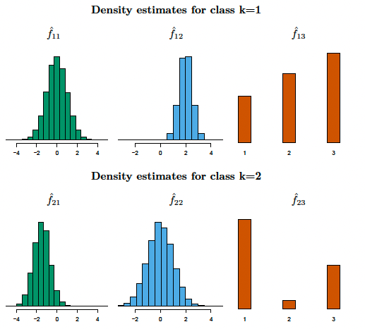

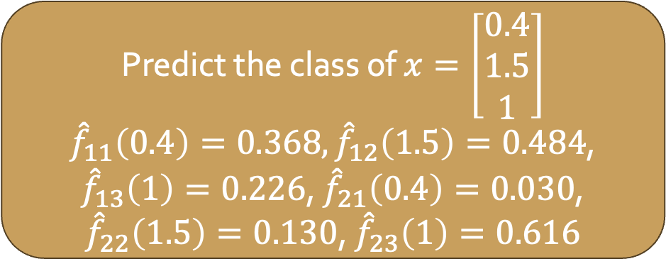
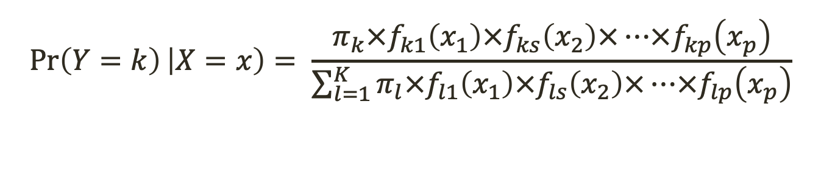
Naive Bayes
Example:
$p=3$, $K=2$
The first two predictors are quantitative, third is qualitative
${\hat{π}}_{1}={\hat{π}}_{2}=0.5$
$$\operatorname{Pr}\left(Y=k\right)\left|X=x\right)= \frac{π_{k}×f_{k1}\left(x_{1}\right)×f_{ks}\left(x_{2}\right)×…×f_{kp}\left(x_{p}\right)}{\sum_{l=1}^{K}{π_{l}×f_{l1}\left(x_{1}\right)×f_{ls}\left(x_{2}\right)×…×f_{lp}\left(x_{p}\right)}}$$
Predict the class of $x=\left[\begin{matrix}0.4 \\ 1.5 \\ 1\end{matrix}\right]$
${\hat{f}}_{11}\left(0.4\right)=0.368,{\hat{f}}_{12}\left(1.5\right)=0.484$, ${\hat{f}}_{13}\left(1\right)=0.226$, ${\hat{f}}_{21}\left(0.4\right)=0.030$, ${\hat{f}}_{22}\left(1.5\right)=0.130$, ${\hat{f}}_{23}\left(1\right)=0.616$
Notes:
f_class_p
Pr(Y = 1|x) = 0.944, Pr(Y=2|x) = 0.056

Slide 18
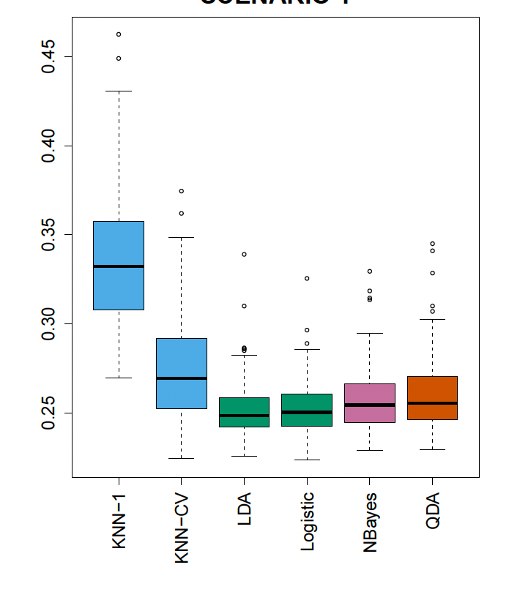
Comparing Models
Scenario 1:
K = 2, p = 2 (both quantitative), true relationship is linear
20 training observations in each class
Observations are uncorrelated random normal variables
How do model performances compare? Why do we see the ranking we see?
Notes:
-LDA performed well in this setting, as one would expect since this is the model assumed by LDA.
-Logistic regression also performed quite well, since it assumes a linear decision boundary.
-KNN performed poorly because it paid a price in terms of variance that was not offset by a reduction in bias.
-QDA also performed worse than LDA, since it fit a more flexible classifier than necessary.
-The performance of naive Bayes was slightly better than QDA, because the naive Bayes assumption of independent predictors is correct.

Slide 19
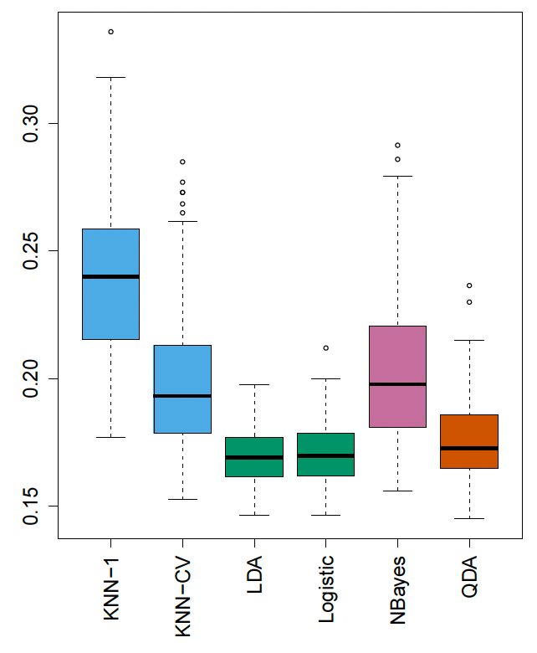
Comparing Models
Scenario 2:
K = 2, p = 2 (both quantitative), true relationship is linear
20 training observations in each class
Within each class, predictors have a correlation of -0.5
How do model performances compare? Why do we see the ranking we see?
Notes:
The notable exception is naive Bayes, which performs very poorly here, since the naive Bayes assumption of independent predictors is violated.

Slide 20
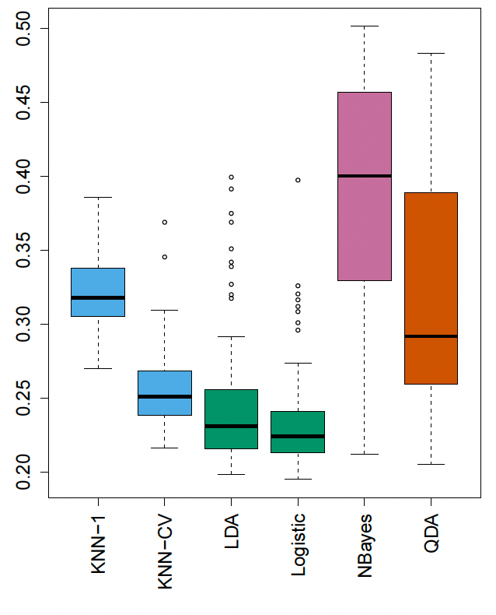

Comparing Models
Scenario 3:
K = 2, p = 2 (both quantitative), true relationship is linear
50 training observations in each class
Within each class, predictors have a correlation of -0.5
$X_{1}$ and $X_{2}$ are generated from the t-distribution (similar to normal, but with longer tails)
How do model performances compare? Why do we see the ranking we see?
Notes:
-In this setting, the decision boundary was still linear, and so fit into the logistic regression framework.
-The set-up violated the assumptions of LDA, since the observations were not drawn from a normal distribution.
-The right-hand panel of Figure 4.11 shows that logistic regression outperformed LDA, though both methods were superior to the other
approaches.
-QDA results deteriorated considerably as a consequence of non-normality.
-Naive Bayes performed very poorly because the independence assumption is violated.

Slide 21
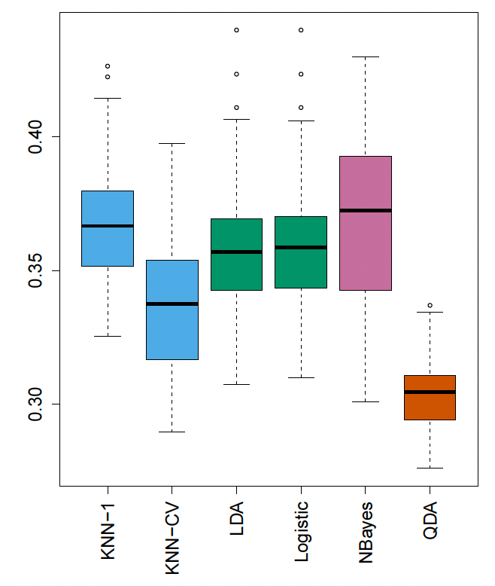

Comparing Models
Scenario 4:
K = 2, p = 2 (both quantitative), true relationship is non-linear
Within class 1, predictors have a correlation of 0.5
Within class 2, predictors have a correlation of -0.5
$X_{1}$ and $X_{2}$ are generated from the normal distribution
How do model performances compare? Why do we see the ranking we see?
Notes:
This setup corresponded to the QDA assumption, and resulted in quadratic decision boundaries

Slide 22
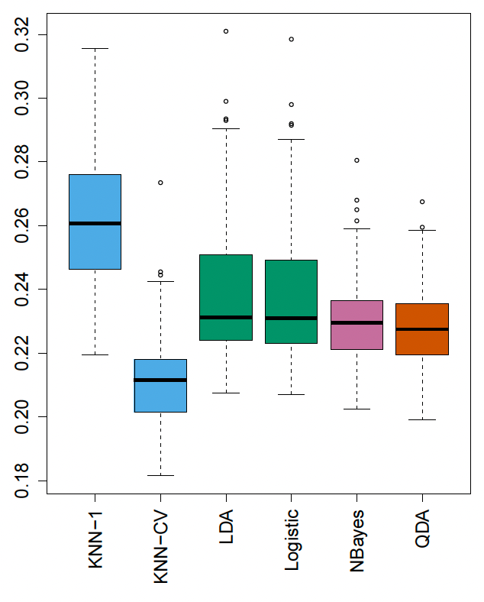
Comparing Models
Scenario 5:
K = 2, p = 2 (both quantitative), true relationship is non-linear
Responses were first generated from the normal distribution with uncorrelated predictors. Then responses were sampled from the logistic function applied to a complicated non-linear function of predictors
How do model performances compare? Why do we see the ranking we see?
Notes:
-both QDA and naive Bayes gave slightly better results than the linear methods,
- while the much more flexible KNN-CV method gave the best results.
-But KNN with K = 1 gave the worst results out of all methods. This highlights the fact that even when the data exhibits a complex non-linear relationship, a non-parametric method such as KNN can still give poor results if the level of smoothness is not chosen correctly.

Slide 23
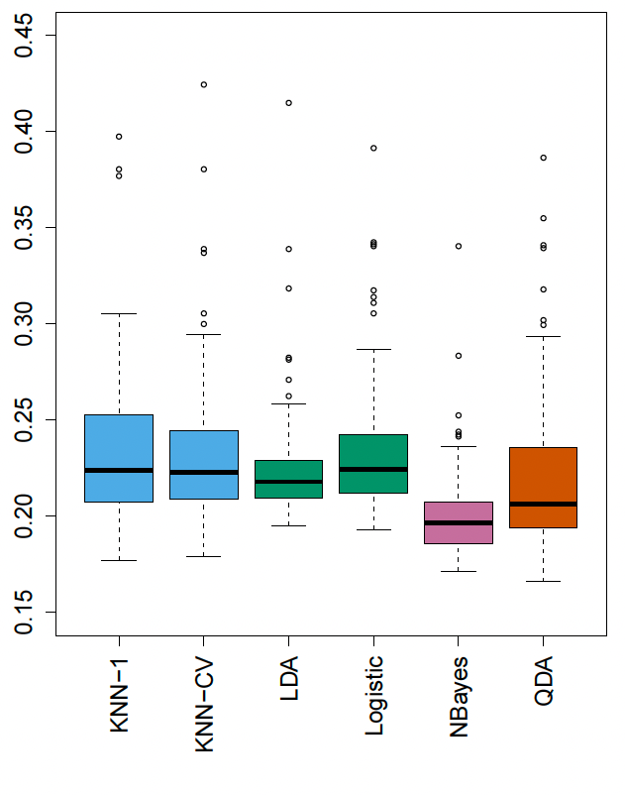
Comparing Models
Scenario 6:
K = 2, p = 2 (both quantitative), true relationship is non-linear
Responses were generated from the normal distribution with different covariance for each class
6 training observations in each class
How do model performances compare? Why do we see the ranking we see?
Notes:
-Naive Bayes performed very well, because its assumptions are met.
LDA and logistic regression performed poorly because the true decision boundary is non-linear, due to the unequal covariance matrices.
-QDA performed a bit worse than naïve Bayes, because given the very small sample size, the former incurred too much variance in estimating the correlation between the predictors within each class.
-KNN’s performance also suffered due to the very small sample size.

