Slide 1
Introduction to Machine Learning – Dimension Reduction
Dr. Ab Mosca (they/them)
Slides based off slides courtesy of Jordan Crouser (https://jcrouser.github.io/)

Slide 2
Plan for Today
Dimension Reduction:
Principle components regression
Partial least squares
Linear Models and Regularization Lab

Slide 3
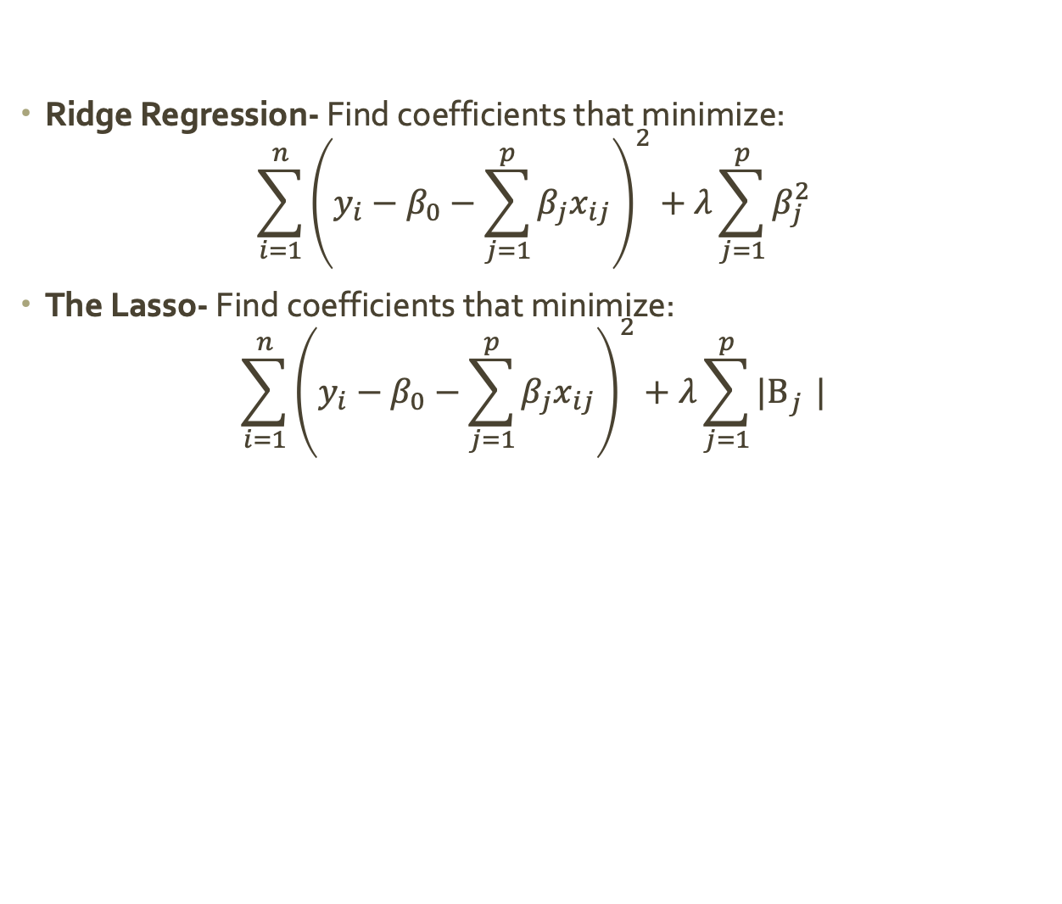
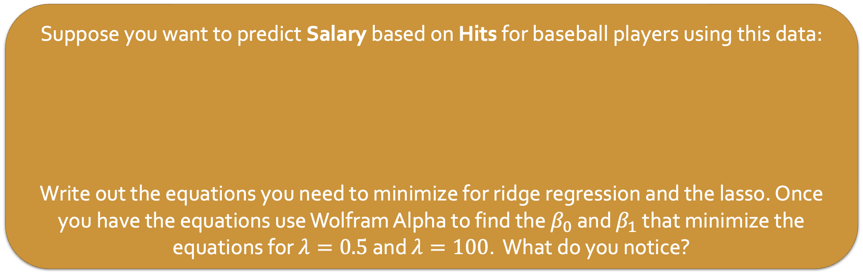
Warm Up: Ridge Regression and The Lasso
Ridge Regression- Find coefficients that minimize:
$$\sum_{i=1}^{n}{{\left(y_{i}−β_{0}−\sum_{j=1}^{p}{β_{j}x_{ij}}\right)}^{2}}+λ\sum_{j=1}^{p}{β_{j}^{2}}$$
The Lasso- Find coefficients that minimize:
$$\sum_{i=1}^{n}{{\left(y_{i}−β_{0}−\sum_{j=1}^{p}{β_{j}x_{ij}}\right)}^{2}}+λ\sum_{j=1}^{p}{{|Β}_{j}^{}|}$$
Suppose you want to predict Salary based on Hits for baseball players using this data:
Write out the equations you need to minimize for ridge regression and the lasso. Once you have the equations use Wolfram Alpha to find the $β_{0}$ and $β_{1}$ that minimize the equations for $λ=0.5$ and $λ=100$. What do you notice?
Player | Salary | Hits
Alan Ashby | 475.0 | 81
Alvin Davis | 480.0 | 130
Andre Dawson | 500.0 | 141
Notes:
Ridge: (1455 – 3beta_0-352beta_1)^2+ lambda*beta_1^2 (0.5 → 0, 4.13), (100 -> 0, 4.13)
Lasso: (1455 – 3beta_0-352beta_1)^2+ lambda*|beta_1| (0.5 → 0, 4.13), (100 -> 0, 4.13)

Slide 4
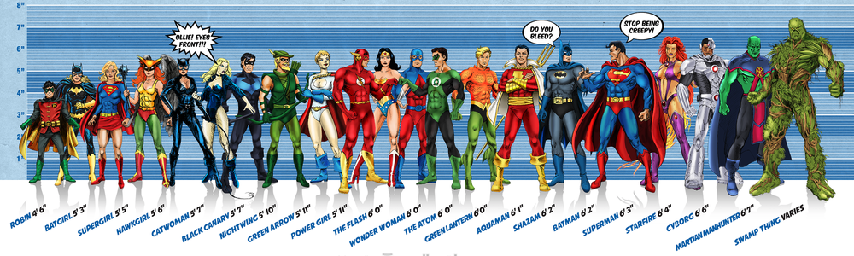



Flashback: superheroes
Image credit: Ming Malaykham

Slide 5


Estimating Height
Notes:
Drax
Gamora
Rocket Racoon
Starlord / Peter Quill
Groot

Slide 6
Estimate for β
When we try to estimate coefficients using OLS, we get the following:
Notice the (relatively) big difference between actual and estimated coefficients.
6
estimated
true
4
i
2
0
-2
i

Slide 7
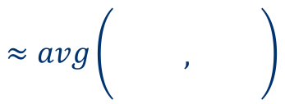
What’s going on here?
$$≈avg\left(\begin{matrix} & & \\ & , & \\ & & \end{matrix}\right)$$
Some dimensions are redundant
Little information in 3rd dimension not captured by the first two
In linear regression, redundancy causes noise to be amplified

Slide 8
Dimension reduction
Current situation: our data live in p-dimensional space, but not all p dimensions are equally useful
Subset selection: throw some out
Pro: pretty easy to do
Con: lose some information

Slide 9
Dimension reduction
Current situation: our data live in p-dimensional space, but not all p dimensions are equally useful
Subset selection: throw some out
Pro: pretty easy to do
Con: lose some information
Alternate approach: create new features that are combinations of the old ones

Slide 10
Dimension reduction
Current situation: our data live in p-dimensional space, but not all p dimensions are equally useful
Subset selection: throw some out
Pro: pretty easy to do
Con: lose some information
Alternate approach: create new features that are combinations of the old ones
In other words: We can project the data into a new feature space to reduce variance in the estimate of coefficients

Slide 11
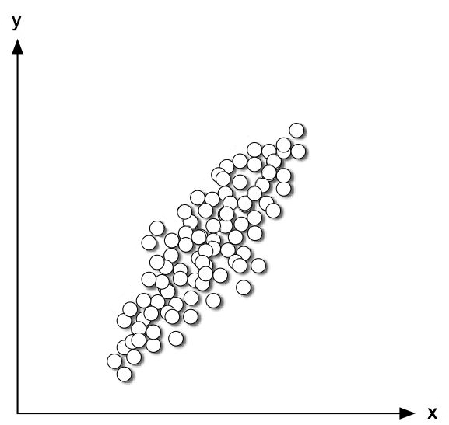
Projection

Slide 12
Projection
SMOOSH!
SMOOSH!

Slide 13
Projection

Slide 14
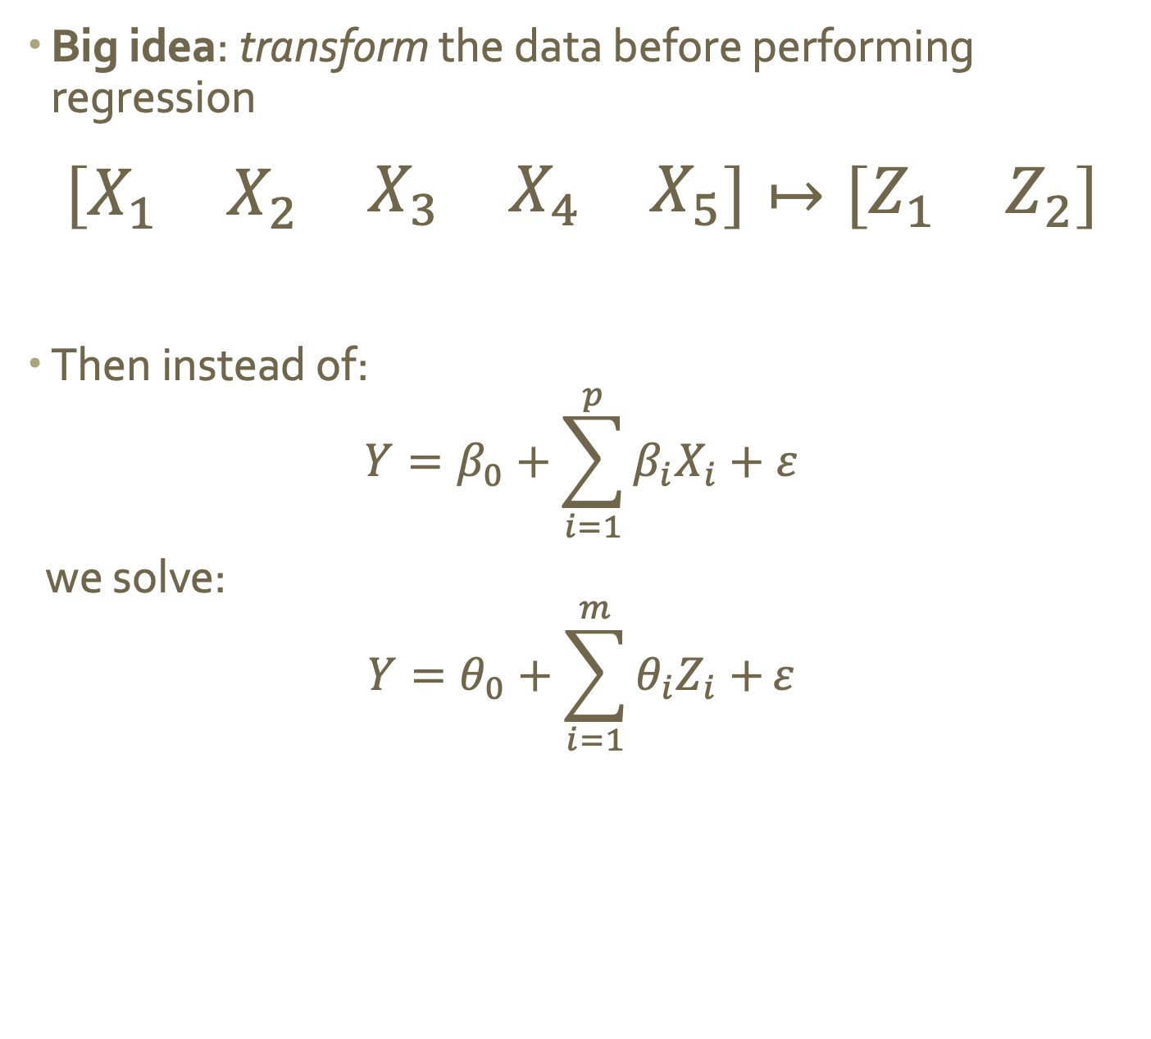
Dimension reduction via projection
Big idea: transform the data before performing regression
$$\left[\begin{matrix}X_{1} & X_{2} & \begin{matrix}X_{3} & X_{4} & X_{5}\end{matrix}\end{matrix}\right]↦\left[\begin{matrix}Z_{1} & Z_{2}\end{matrix}\right]$$
Then instead of: $Y=β_{0}+\sum_{i=1}^{p}{β_{i}X_{i}}+ε$
we solve:
$$Y=θ_{0}+\sum_{i=1}^{m}{θ_{i}Z_{i}+}ε$$

Slide 15
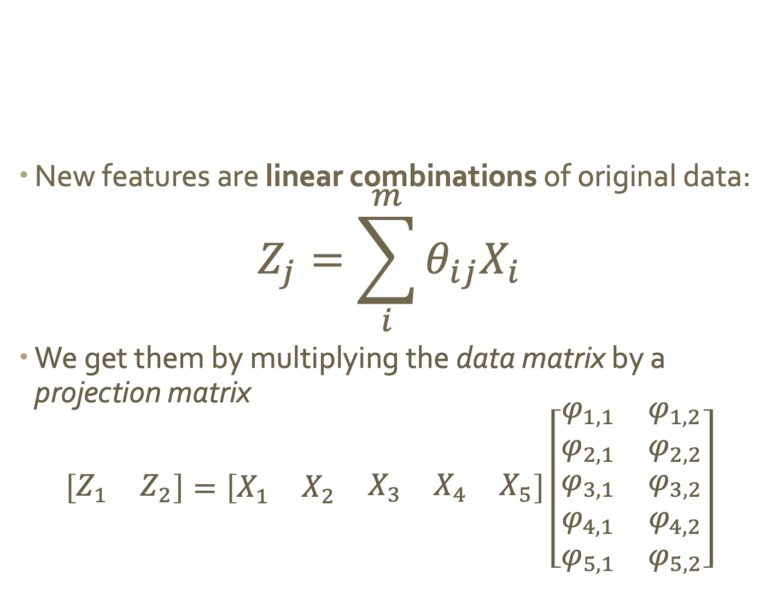
Linear projection
New features are linear combinations of original data:
$$Z_{j}=\sum_{i}^{m}{θ_{ij}X_{i}}$$
We get them by multiplying the data matrix by a projection matrix
$$\left[\begin{matrix}Z_{1} & Z_{2}\end{matrix}\right]=\left[\begin{matrix}X_{1} & X_{2} & \begin{matrix}X_{3} & X_{4} & X_{5}\end{matrix}\end{matrix}\right]\left[\begin{matrix}\begin{aligned}φ_{1,1} \\ φ_{2,1}\end{aligned} & \begin{aligned}φ_{1,2} \\ φ_{2,2}\end{aligned} \\ \begin{aligned}φ_{3,1} \\ φ_{4,1} \\ φ_{5,1}\end{aligned} & \begin{aligned}φ_{3,2} \\ φ_{4,2} \\ φ_{5,2}\end{aligned}\end{matrix}\right]$$

Slide 16
What’s the deal with projection?
Data can be rotated, scaled, and translated without changing the underlying relationships
This means you’re allowed to look at the data from whatever angle makes your life easier…

Slide 17
Flashback: why did we pick this line?

Slide 18
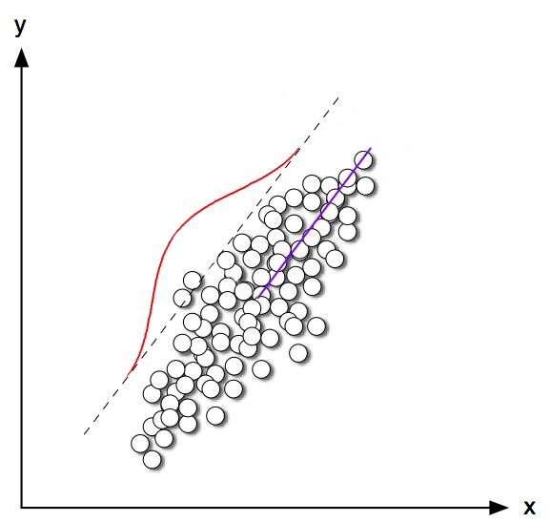
Explains the most variance in the data
Most variance

Slide 19
Imagine this line as a new dimension…
Most variance

Slide 20
“Principal component”
Most variance

Slide 21
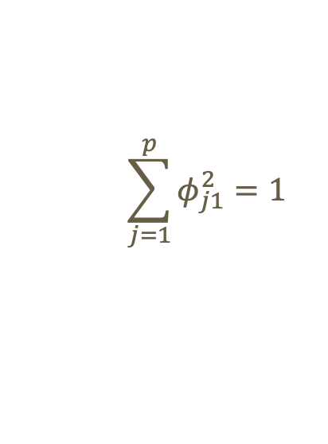
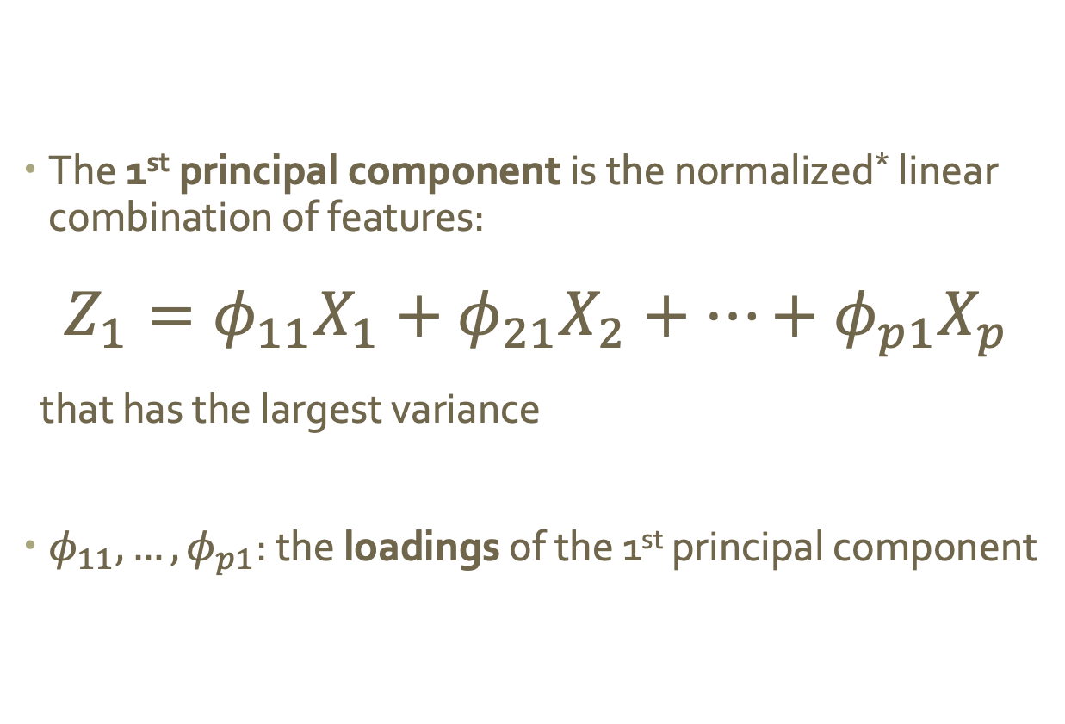
Mathematically
The 1st principal component is the normalized* linear combination of features:
$$Z_{1}=φ_{11}X_{1}+φ_{21}X_{2}+…+φ_{p1}X_{p}$$
that has the largest variance
$φ_{11},…,φ_{p1}$: the loadings of the 1st principal component
$$\sum_{j=1}^{p}{φ_{j1}^{2}=1}$$
* By normalized we mean:

Slide 22
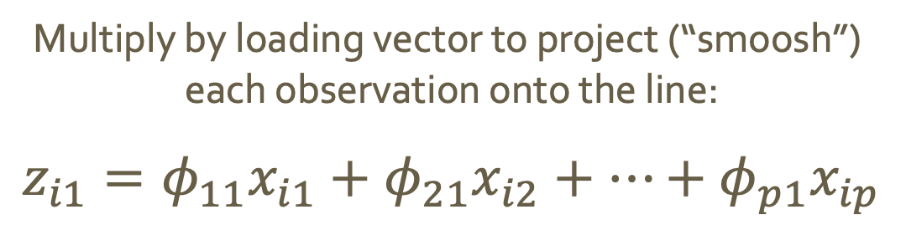
Using loadings to project
Multiply by loading vector to project (“smoosh”)
each observation onto the line:
$$z_{i1}=φ_{11}x_{i1}+φ_{21}x_{i2}+…+φ_{p1}x_{ip}$$
These values are called the scores
of the 1st principal component

Slide 23
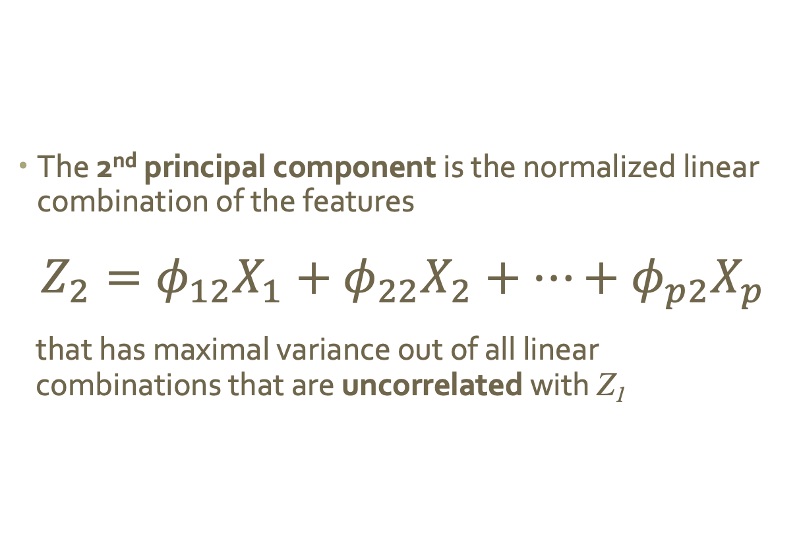
Additional principal components
The 2nd principal component is the normalized linear combination of the features
$$Z_{2}=φ_{12}X_{1}+φ_{22}X_{2}+…+φ_{p2}X_{p}$$
that has maximal variance out of all linear combinations that are uncorrelated with Z₁
Notes:
We want uncorrelated because we’re trying to reduce redundancy!!!

Slide 24
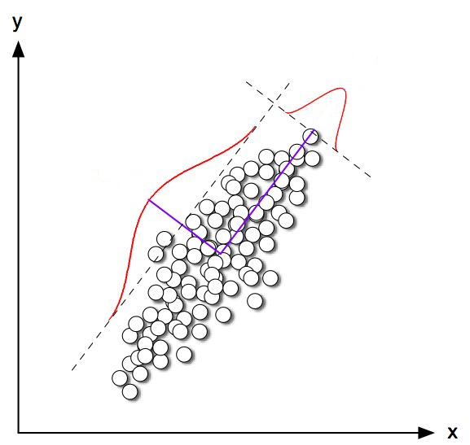
Principal components are orthogonal
2nd most variance

Slide 25
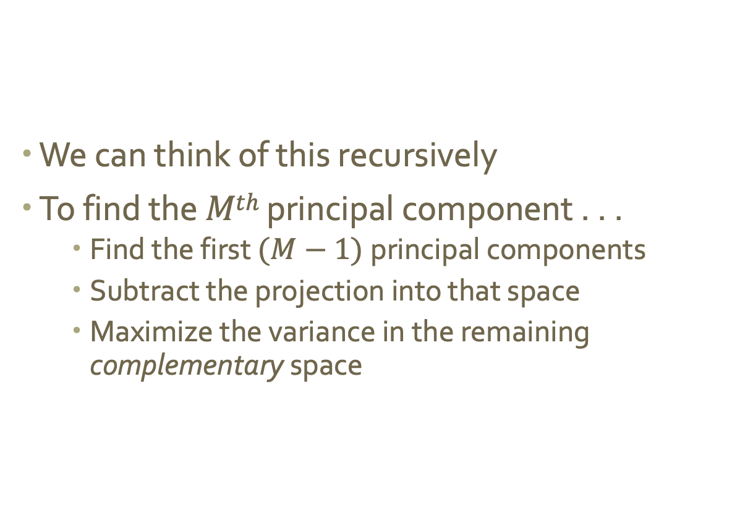
Generating additional principal components
We can think of this recursively
To find the $Mth$ principal component . . .
Find the first $(M−1)$principal components
Subtract the projection into that space
Maximize the variance in the remaining complementary space

Slide 26
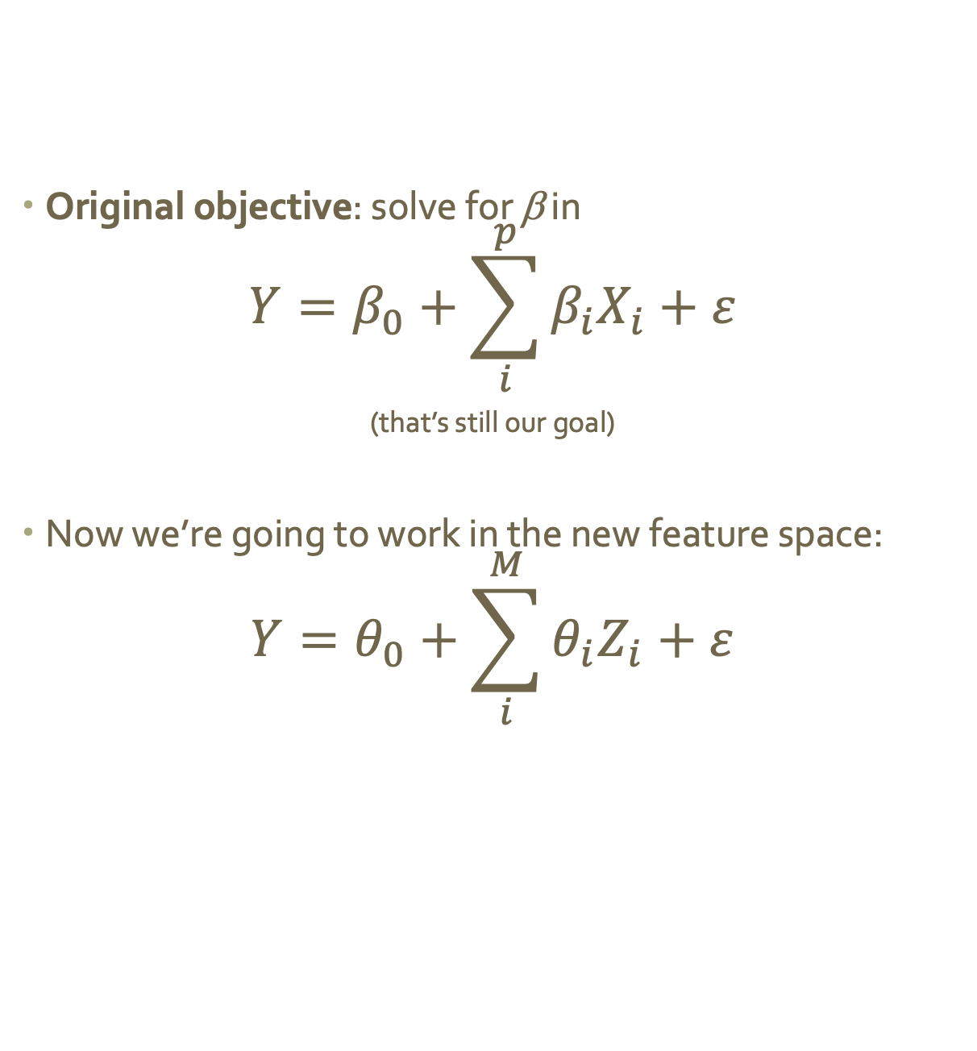
Regression in the principal components
Original objective: solve for β in
$$Y=β_{0}+\sum_{i}^{p}{β_{i}X_{i}+ε}$$
(that’s still our goal)
Now we’re going to work in the new feature space:
$$Y=θ_{0}+\sum_{i}^{M}{θ_{i}Z_{i}+ε}$$

Slide 27
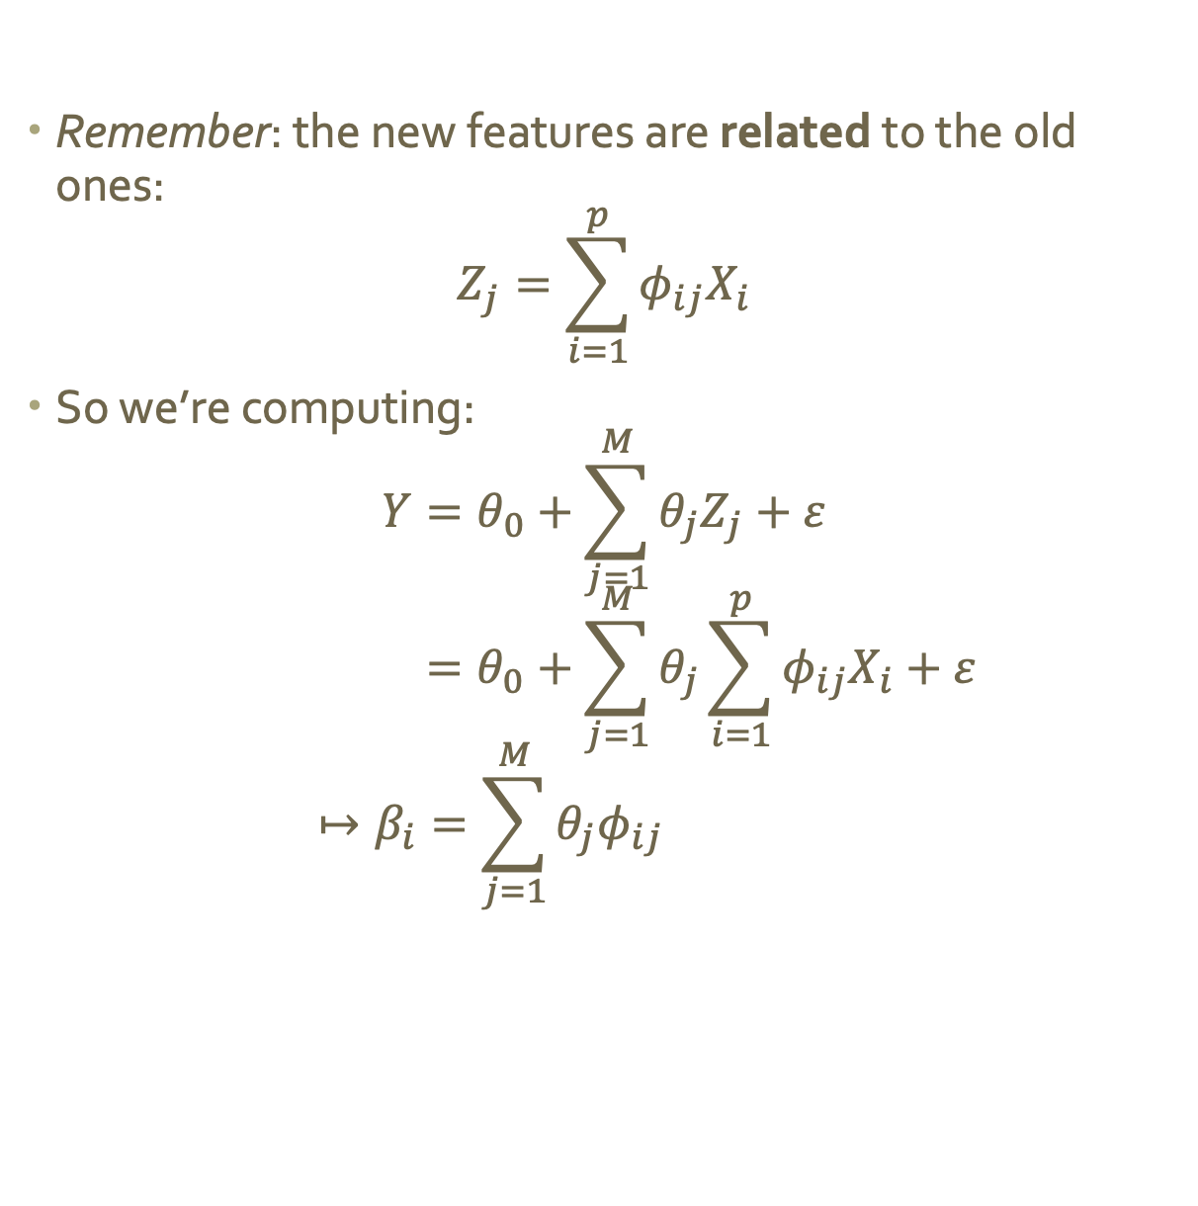
Regression in the principal components
Remember: the new features are related to the old ones:
$$Z_{j}=\sum_{i=1}^{p}{φ_{ij}X_{i}}$$
So we’re computing:
$$Y=θ_{0}+\sum_{j=1}^{M}{θ_{j}Z_{j}+ε}$$
$$=θ_{0}+\sum_{j=1}^{M}{θ_{j}\sum_{i=1}^{p}{φ_{ij}X_{i}}+ε}$$
$$↦β_{i}=\sum_{j=1}^{M}{θ_{j}φ_{ij}}$$

Slide 28
Back to estimating height
Notes:
Drax
Gamora
Rocket Racoon
Starlord / Peter Quill
Groot

Slide 29
Back to the Guardians
What happens if we use 2 components instead of 3?
Using principle components dramatically increases our estimates.
6
estimated - OLS
true
4
estimated - PCR
i
2
0
-2
i

Slide 30
Comparison with ridge regression and the lasso
What similarities do you see between principle component regression and ridge regression and the lasso?
Notes:
Reduces dimensionality of the solution space (like Lasso)
Finds a solution in the space of all features (like RR)
Results can be difficult to interpret (like RR)

Slide 31
Problems with PCR
We selected principal components based on predictors (not what we’re trying to predict!)
Why could this be problematic?
Notes:
What if the values you’re trying to predict aren’t correlated with the first few components?
You lose all predictive power!
These directions (components) are identified in an unsupervised way, since the response Y is
not used to help determine the principal component directions.

Slide 32
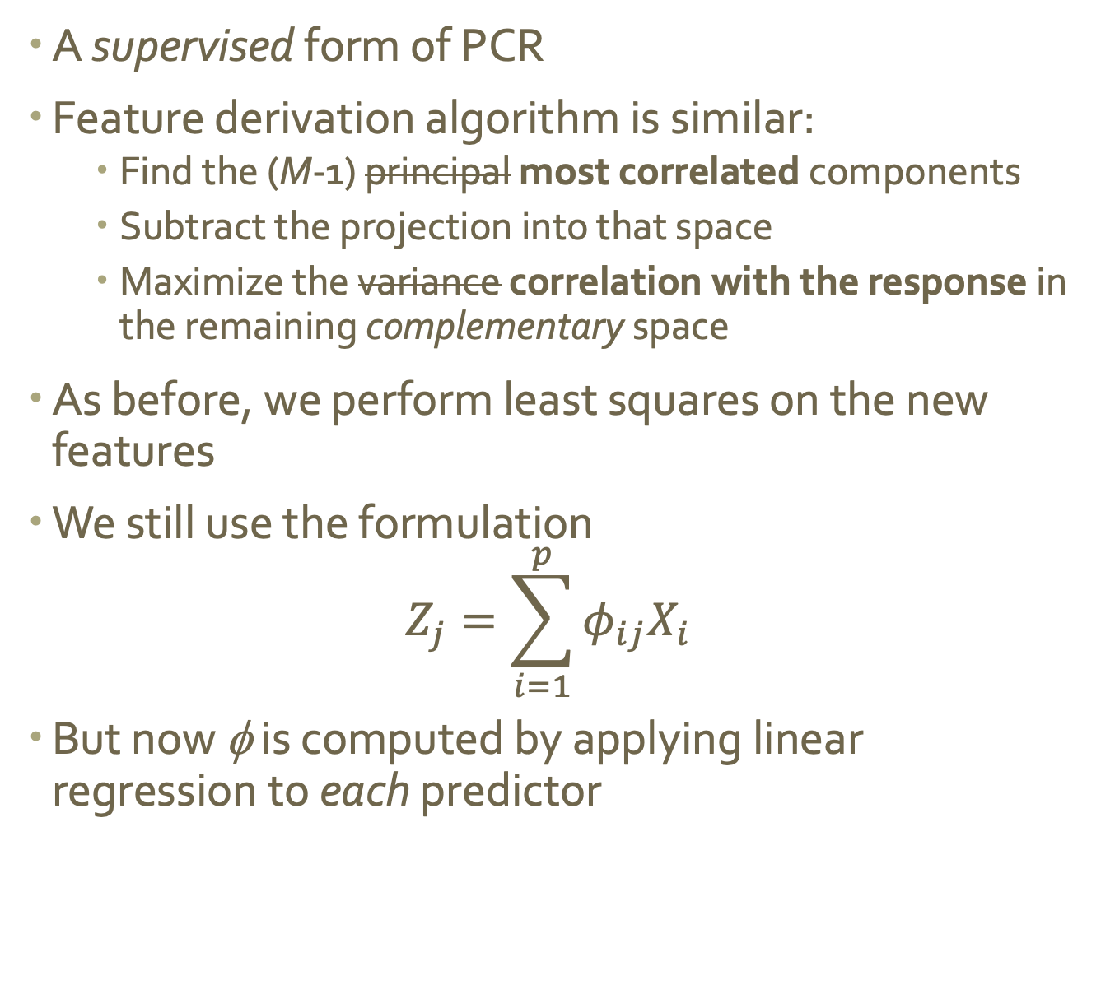
Partial least squares (PLS)
A supervised form of PCR
Feature derivation algorithm is similar:
Find the (M-1) principal most correlated components
Subtract the projection into that space
Maximize the variance correlation with the response in the remaining complementary space
As before, we perform least squares on the new features
We still use the formulation
$$Z_{j}=\sum_{i=1}^{p}{φ_{ij}X_{i}}$$
But now φ is computed by applying linear regression to each predictor
Notes:
now fi is the correlation between the predictor and the response

Slide 33
Wrapping up: PCR/PLS comparison
Both derive a small number of orthogonal predictors for linear regression
PCR is more biased
Emphasizes stability at the expense of versatility
PLS estimates have higher variance
May build new features that aren’t as stable
But high variance is better than infinite variance

