Slide 1
Introduction to Machine Learning – Logistic Regression
Dr. Ab Mosca (they/them)
Slides based off slides courtesy of Jordan Crouser (https://jcrouser.github.io/)

Slide 2
Plan for Today
The Logistic Model
Multiple Logistic Regression
Multinomial Logistic Regression

Slide 3

Warm Up: Linear Regression
Parametric models
Are easy to fit (there are few coefficients to estimate)
(For LR) coefficients have simple interpretations and tests of statistical significance are easy to perform
Non-parametric models
Do not explicitly assume a parametric form for $f(X)$, allowing for more flexibility in regression
When would you use a parametric vs non-parametric regression model?

Slide 4
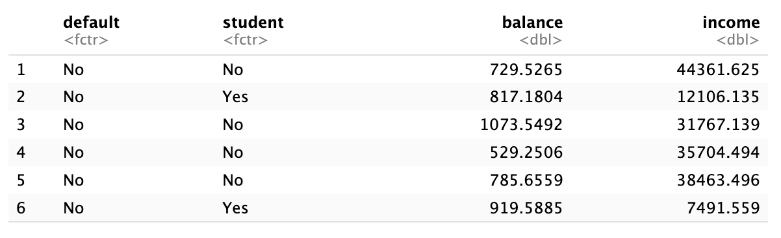
Motivation
Default dataset
What is one observation in this dataset? What are the variables and variable types?

Slide 5
Motivation
Default dataset
Let’s say we want to model default with balance as the predictor
default is either Yes or No
Can we model default (Y) directly? Should we model something else?

Slide 6
Motivation
Default dataset
Let’s say we want to model default with balance as the predictor
We will model the probability that default is Yes or No using Logistic Regression

Slide 7

Motivation
We will model the probability of default being Yes or No based on balance.
$$Pr⁡(default=Yes|balance)$$

Slide 8

Motivation
We will model the probability of default being Yes or No based on balance.
$$Pr⁡(default=Yes|balance)$$
We’ll abbreviate to $p(balance)$, which will range between 0 and 1
Once we have our model, for any given value of balance we can make a prediction for default
Ex. we might predict default = Yes for any observation where $p(balance)>0.5$

Slide 9
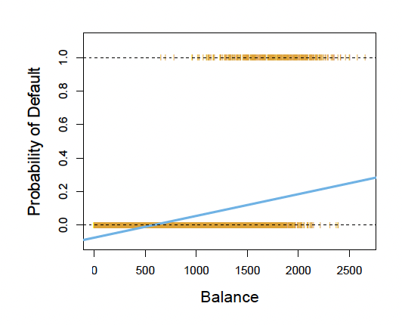
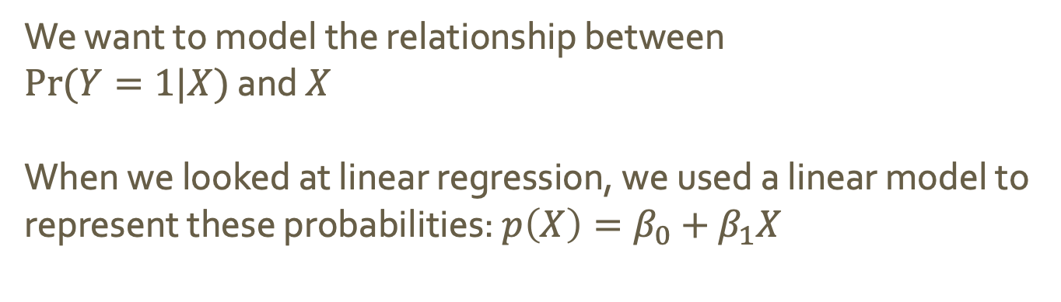
Logistic Model
We want to model the relationship between
$Pr⁡(Y=1|X)$ and $X$
When we looked at linear regression, we used a linear model to represent these probabilities: $p\left(X\right)=β_{0}+β_{1}X$
What problems do you see here?
Notes:
LR give us model here
Notice for balance close to 0 we get negative probabilities
For balance big we get probabilities over 1
This is true in all LR cases for prob

Slide 10
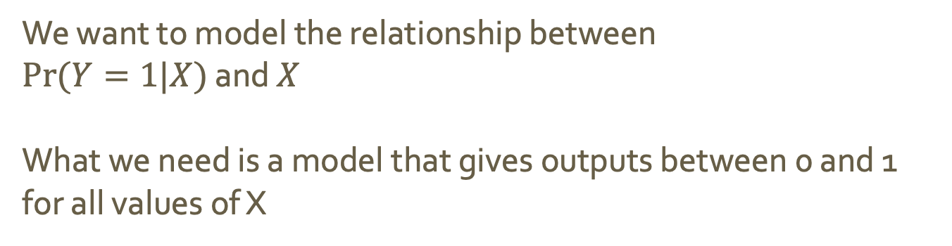
Logistic Model
We want to model the relationship between
$Pr⁡(Y=1|X)$ and $X$
What we need is a model that gives outputs between 0 and 1 for all values of X

Slide 11
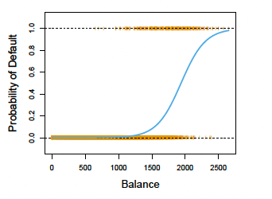

Logistic Model
We want to model the relationship between
$Pr⁡(Y=1|X)$ and $X$
What we need is a model that gives outputs between 0 and 1 for all values of X
The solution: the logistic function
$$p\left(X\right)= \frac{e^{β_{0}+β_{1}X}}{1+e^{β_{0}+β_{1}X}}$$

Slide 12
Logistic Model
We want to model the relationship between
$Pr⁡(Y=1|X)$ and $X$
What we need is a model that gives outputs between 0 and 1 for all values of X
The solution: the logistic function
$$p\left(X\right)= \frac{e^{β_{0}+β_{1}X}}{1+e^{β_{0}+β_{1}X}}$$
Notes:
Notice prob predictions makes sense now!
S-shaped curve

Slide 13


Logistic Model
The logistic function: $p\left(X\right)= \frac{e^{β_{0}+β_{1}X}}{1+e^{β_{0}+β_{1}X}}$
This function can be manipulated to give us odds:
$\frac{p(X)}{1−p(X)}= e^{β_{0}+β_{1}X}$
[the fraction, $\frac{p(X)}{1−p(X)}$ is called the odds for the response]
What does an odds of 0 mean?
How about an odds of $∞$?
Notes:
infinity means high P
0 means low p
Odds = prob of occurring over prob of not occurring

Slide 14

Logistic Model
The logistic function: $p\left(X\right)= \frac{e^{β_{0}+β_{1}X}}{1+e^{β_{0}+β_{1}X}}$
This function can be manipulated to give us odds:
$\frac{p(X)}{1−p(X)}= e^{β_{0}+β_{1}X}$
[the fraction, $\frac{p(X)}{1−p(X)}$ is called the odds for the response]
How about an odds of $\frac{1}{4}$?
How about an odds of 9?
Notes:
infinity means high P
0 means low p

Slide 15
Logistic Model
The logistic function: $p\left(X\right)= \frac{e^{β_{0}+β_{1}X}}{1+e^{β_{0}+β_{1}X}}$
This function can be manipulated to give us odds:
$\frac{p(X)}{1−p(X)}= e^{β_{0}+β_{1}X}$
[the fraction, $\frac{p(X)}{1−p(X)}$ is called the odds for the response]
How about an odds of $\frac{1}{4}$?
How about an odds of 9?
Notes:
means p(X) = 0.2, because (0.2)/(1-0.2) = ¼
means p(X) = 0.9, because (0.9)/(1-0.9) = 9

Slide 16

Logistic Model
The logistic function: $p\left(X\right)= \frac{e^{β_{0}+β_{1}X}}{1+e^{β_{0}+β_{1}X}}$
This function can be manipulated to give us odds:
$\frac{p(X)}{1−p(X)}= e^{β_{0}+β_{1}X}$
[the fraction, $\frac{p(X)}{1−p(X)}$ is called the odds for the response]
Taking the log of both sides gives:
$$\log\left(\frac{p(X)}{1−p(X)}\right)= β_{0}+β_{1}X$$
The left-hand side is called the log odds or logit
Notice that our logistic regression has a logit that is linear in X
Notes:
means p(X) = 0.2, because (0.2)/(1-0.2) = ¼
means p(X) = 0.9, because (0.9)/(1-0.9) = 9

Slide 17
Logistic Model
log odds or logit: $\log\left(\frac{p(X)}{1−p(X)}\right)= β_{0}+β_{1}X$
How does increasing X by one unit affect log odds?
Notes:
A one-unit increase increases log odds by beta_1

Slide 18

Logistic Model
log odds or logit: $\log\left(\frac{p(X)}{1−p(X)}\right)= β_{0}+β_{1}X$
How does increasing X by one unit affect log odds?
odds: $\frac{p(X)}{1−p(X)}= e^{β_{0}+β_{1}X}$
How does increasing X by one unit affect odds?
Notes:
A one-unit increase increases log odds by beta_1
Multiplies odds by another e^beta_1

Slide 19
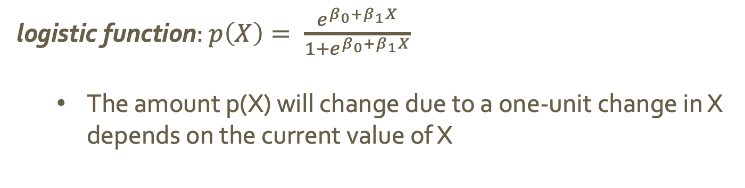

Logistic Model
log odds or logit: $\log\left(\frac{p(X)}{1−p(X)}\right)= β_{0}+β_{1}X$
odds: $\frac{p(X)}{1−p(X)}= e^{β_{0}+β_{1}X}$
logistic function: $p\left(X\right)= \frac{e^{β_{0}+β_{1}X}}{1+e^{β_{0}+β_{1}X}}$
The amount p(X) will change due to a one-unit change in X depends on the current value of X

Slide 20

Logistic Model
log odds or logit: $\log\left(\frac{p(X)}{1−p(X)}\right)= β_{0}+β_{1}X$
odds: $\frac{p(X)}{1−p(X)}= e^{β_{0}+β_{1}X}$
logistic function: $p\left(X\right)= \frac{e^{β_{0}+β_{1}X}}{1+e^{β_{0}+β_{1}X}}$
The amount p(X) will change due to a one-unit change in X depends on the current value of X
How does the sign of $β_{1}$ influence the change in p(X) dues to a one-unit increase X?
Notes:
positive will increase p(x)
neg will decrease p(X)

Slide 21

Estimating Coefficients
logistic function: $p\left(X\right)= \frac{e^{β_{0}+β_{1}X}}{1+e^{β_{0}+β_{1}X}}$
Maximum likelihood is used to estimate $β_{0}$ and $B_{1}$
The intuition behind maximum likelihood is that we’re looking for coefficients such that the predicted probability $\hat{p}\left(x_{i}\right)$ corresponds as close as possible to the observed data.
For the default example, we want coefficients that give a number close to 1 for all individuals who defaulted and close to 0 for all individuals who did not.
Notes:
positive will increase p(x)
neg will decrease p(X)

Slide 22
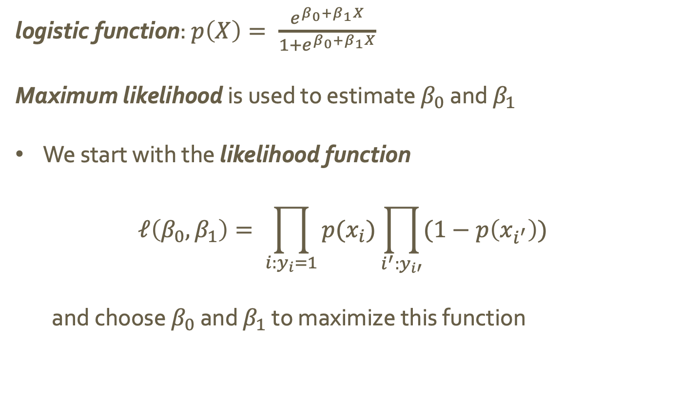
Estimating Coefficients
logistic function: $p\left(X\right)= \frac{e^{β_{0}+β_{1}X}}{1+e^{β_{0}+β_{1}X}}$
Maximum likelihood is used to estimate $β_{0}$ and $β_{1}$
We start with the likelihood function
$$ℓ\left(β_{0}, β_{1}\right)= \prod_{i:y_{i}=1}{p(x_{i})}\prod_{i^{′}:y_{i′}}{(1−p\left(x_{i^{′}}\right))}$$
and choose $β_{0}$ and $β_{1}$ to maximize this function
Notes:
positive will increase p(x)
neg will decrease p(X)

Slide 23

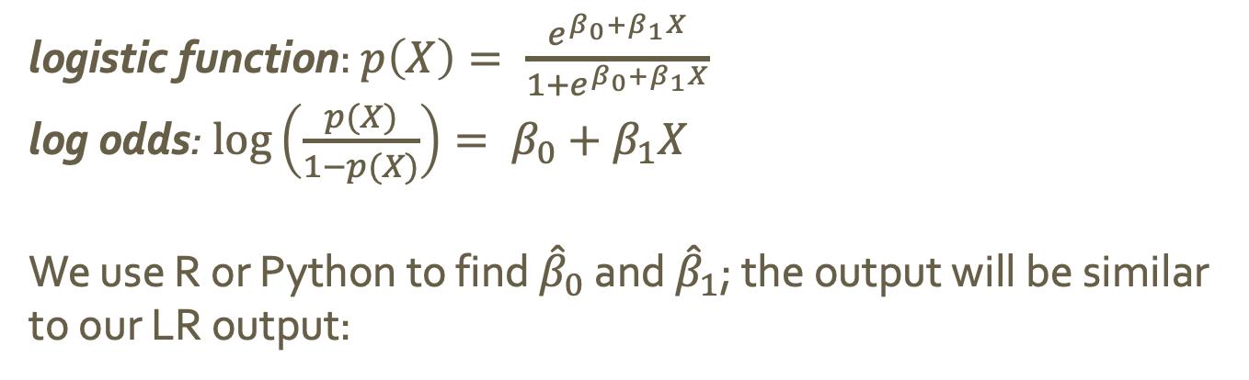


Estimating Coefficients
logistic function: $p\left(X\right)= \frac{e^{β_{0}+β_{1}X}}{1+e^{β_{0}+β_{1}X}}$
log odds: $\log\left(\frac{p(X)}{1−p(X)}\right)= β_{0}+β_{1}X$
We use R or Python to find ${\hat{β}}_{0}$ and ${\hat{β}}_{1}$; the output will be similar to our LR output:
$$β_{0}$$
$$β_{1}$$
Is an increase in balance associated with an increase or decrease in the probability of default?
How does a one-unit increase in balance effect the log odds of default?

Slide 24
Estimating Coefficients
logistic function: $p\left(X\right)= \frac{e^{β_{0}+β_{1}X}}{1+e^{β_{0}+β_{1}X}}$
log odds: $\log\left(\frac{p(X)}{1−p(X)}\right)= β_{0}+β_{1}X$
We use R or Python to find ${\hat{β}}_{0}$ and ${\hat{β}}_{1}$; the output will be similar to our LR output:
$$β_{0}$$
$$β_{1}$$
Does this output indicate balance is a significant predictor?

Slide 25
Prediction
logistic function: $p\left(X\right)= \frac{e^{β_{0}+β_{1}X}}{1+e^{β_{0}+β_{1}X}}$
log odds: $\log\left(\frac{p(X)}{1−p(X)}\right)= β_{0}+β_{1}X$
We use R or Python to find ${\hat{β}}_{0}$ and ${\hat{β}}_{1}$; the output will be similar to our LR output:
$$β_{0}$$
$$β_{1}$$
What is the default probability for an individual with a balance of $1000? What is the odds?
What about a balance of $2000?
Notes:
0.00576
0.586

Slide 26
Qualitative Predictors
Default dataset
Let’s say we want to model default predicted by student status.
We will model the probability that default is Yes or No using Logistic Regression and a dummy variable like we did for LR.
Notes:
0.00576
0.586

Slide 27

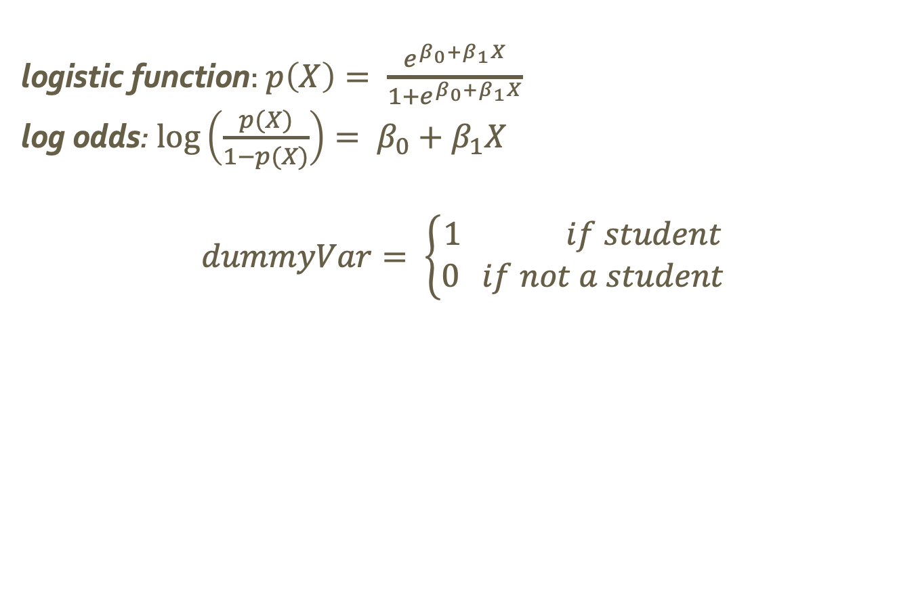
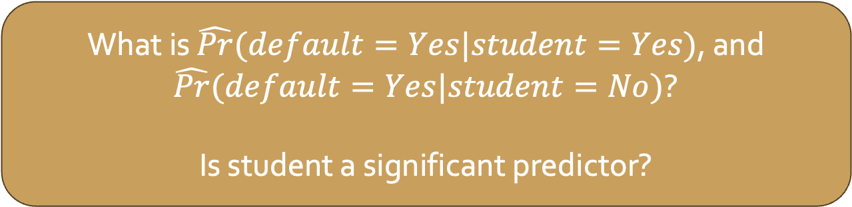
Qualitative Predictors
logistic function: $p\left(X\right)= \frac{e^{β_{0}+β_{1}X}}{1+e^{β_{0}+β_{1}X}}$
log odds: $\log\left(\frac{p(X)}{1−p(X)}\right)= β_{0}+β_{1}X$
$$dummyVar= \left\{\begin{aligned}1 if student \\ 0 if not a student\end{aligned}\right.$$
What is $\hat{Pr}(default=Yes|student=Yes)$, and $\hat{Pr}(default=Yes|student=No)$?
Is student a significant predictor?
Notes:
0.0431
0.0292

Slide 28

Multiple Logistic Regression
logistic function: $p\left(X\right)= \frac{e^{β_{0}+β_{1}X}}{1+e^{β_{0}+β_{1}X}}$
$p\left(X\right)= \frac{e^{β_{0}+β_{1}X_{1}+…+β_{k}X_{k}}}{1+e^{β_{0}+β_{1}X_{1}+…+β_{k}X_{k}}}$
log odds: $\log\left(\frac{p(X)}{1−p(X)}\right)= β_{0}+β_{1}X$
$\log\left(\frac{p(X)}{1−p(X)}\right)= β_{0}+β_{1}X_{1}+…+β_{k}X_{k}$
Notes:
0.0431
0.0292

Slide 29
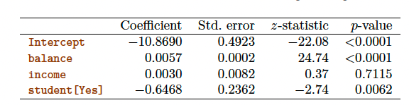
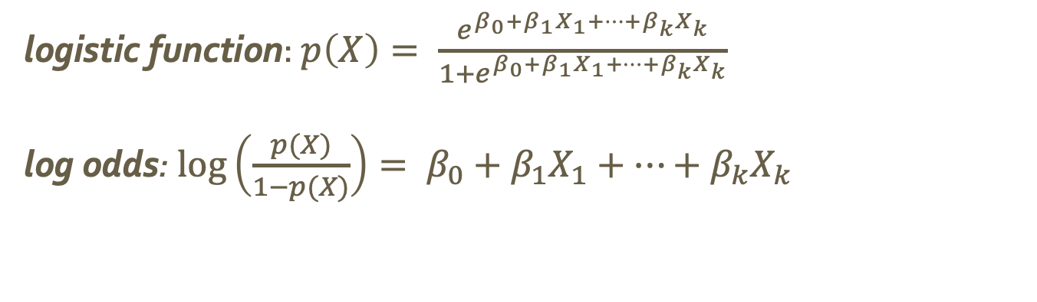
Multiple Logistic Regression
logistic function: $p\left(X\right)= \frac{e^{β_{0}+β_{1}X_{1}+…+β_{k}X_{k}}}{1+e^{β_{0}+β_{1}X_{1}+…+β_{k}X_{k}}}$
log odds: $\log\left(\frac{p(X)}{1−p(X)}\right)= β_{0}+β_{1}X_{1}+…+β_{k}X_{k}$
Which predictors are significant?
What do the coefficients for these tell you? Are they what you expected?
Notes:
student has neg coefficient so yes student means less likely to default
this is the opposite of what we say in the earlier regression

Slide 30
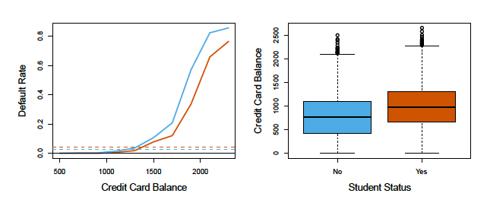
Multiple Logistic Regression
Taking a closer look…
Solid line = default rate as a function of balance
Dashed line = average default rate
Blue = non-students
Orange = students
Compare the functions to the averages. What do you notice?
Notes:
as a function of balance, student default rate is always lower
As average, nonstudent default rate is lower
For a fixed value of student and balance, default rate is lower hence negative we saw before

Slide 31
Multiple Logistic Regression
Taking a closer look…
Solid line = default rate as a function of balance
Dashed line = average default rate
Blue = non-students
Orange = students
Is balance related to student status?
Notes:
Yes!
Overall students are more likely to have a high balance, which means overall they are more likely to default
However, given one balance, a student is less risky than a non-student

Slide 32
Multiple Logistic Regression
Taking a closer look…Confounding is what is happening here
Solid line = default rate as a function of balance
Dashed line = average default rate
Blue = non-students
Orange = students
Notes:
Yes!
Overall students are more likely to have a high balance, which means overall they are more likely to default
However, given one balance, a student is less risky than a non-student

Slide 33
Multiple Logistic Regression
logistic function: $p\left(X\right)= \frac{e^{β_{0}+β_{1}X_{1}+…+β_{k}X_{k}}}{1+e^{β_{0}+β_{1}X_{1}+…+β_{k}X_{k}}}$
log odds: $\log\left(\frac{p(X)}{1−p(X)}\right)= β_{0}+β_{1}X_{1}+…+β_{k}X_{k}$
What is p(default) for a student with a credit card balance of $1,500 and an income of $40,000? What about a non-student? [income was measured in thousands]
Notes:
0.058
0.105
income is measured in 1,000’s in the table

Slide 34

Multinomial Logistic Regression
Multinomial Logistic Regression extends logistic regression to cases where K > 2
i.e., to predicting outcomes with more than two levels
First, we pick the Kth class as our baseline. Then, we get
Pr$\left(Y=k|X=x\right)= \frac{e^{β_{k0}+β_{k1}x_{1}+…+β_{kp}x_{p}}}{1+\sum_{l=1}^{K−1}{e^{β_{l0}+β_{l1}x_{1}+…+β_{lp}x_{p}}}}$
for $k=1,…,K−1$ and
Pr$\left(Y=K|X=x\right)= \frac{1}{1+\sum_{l=1}^{K−1}{e^{β_{l0}+β_{l1}x_{1}+…+β_{lp}x_{p}}}}$
$$\log\left(\frac{Pr(Y=k|X=x)}{Pr⁡(Y=K|x=X}\right)= β_{k0}+β_{k1}x_{1}+…+β_{kp}x_{p}$$
Notes:
These are not often used in practice (more on that later!)

Slide 35
Multinomial Logistic Regression
Multinomial Logistic Regression extends logistic regression to cases where K > 2
i.e., to predicting outcomes with more than two levels
First, we pick the Kth class as our baseline. Then, we get
Pr$\left(Y=k|X=x\right)= \frac{e^{β_{k0}+β_{k1}x_{1}+…+β_{kp}x_{p}}}{1+\sum_{l=1}^{K−1}{e^{β_{l0}+β_{l1}x_{1}+…+β_{lp}x_{p}}}}$
for $k=1,…,K−1$ and
Pr$\left(Y=K|X=x\right)= \frac{1}{1+\sum_{l=1}^{K−1}{e^{β_{l0}+β_{l1}x_{1}+…+β_{lp}x_{p}}}}$
$$\log\left(\frac{Pr(Y=k|X=x)}{Pr⁡(Y=K|x=X}\right)= β_{k0}+β_{k1}x_{1}+…+β_{kp}x_{p}$$
These are not often used in practice. We’ll see why later.
Notes:
These are not often used in practice (more on that later!)

