Slide 1
Introduction to Machine Learning – Generative Models
Dr. Ab Mosca (they/them)
Slides based off slides courtesy of Jordan Crouser (https://jcrouser.github.io/)

Slide 2
Plan for Today
Bayes Classifier
Linear Discriminant Analysis
Quadratic Discriminant Analysis
Naive Bayes

Slide 3
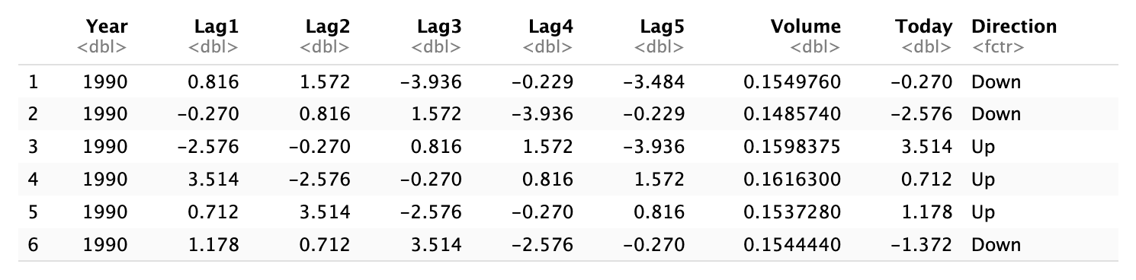
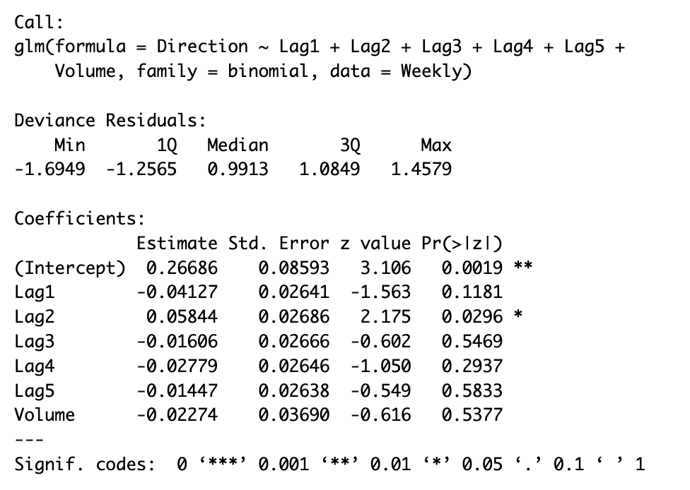
Warm Up: Logistic Regression
Which predictors are significant?

Slide 4
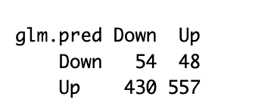
Warm Up: Logistic Regression
Confusion Matrix for our model:
Predicted
What is the error rate for our model’s predictions?
Actual

Slide 5

Generative Models
Logistic Regression directly models $Pr⁡(Y=k|X=x)$
i.e., we model the conditional distribution of Y given the predictor(s) X
Alternatively, we can model the distribution of predictors, X, separately for each response class. Then use Bayes Theorem to flip them into estimates for $Pr⁡(Y=k|X=x)$

Slide 6
Generative Models
Why bother?
When there is substantial separation between the two classes, Logistic Regression parameter estimates are unstable
If the distribution of the predictors is approximately normal in each class and the sample size is small Generative Models will tend to outperform Logistic Models
Generative Models extend to more than two classes much more seamlessly

Slide 7

Generative Models
Bayes Theorem
$$\operatorname{Pr}\left(Y=k | X=x\right)=\frac{π_{k}f_{k}(x)}{\sum_{l=1}^{K}{π_{l}f_{l}(x)}}$$
$π_{k}$ is the prior probability that a randomly chosen observation come from the $k$th class
$f_{k}\left(X\right)≡Pr⁡(X|Y=k)$ is the density function of $X$ for an observation that comes from the $k$th class
$Pr⁡(Y=k|X=x)$ is the posterior probability, i.e. the probability that an observation belongs to the $k$th class given the predictor value ($x$) for the observation
Notes:
f(X) is high if it’s likely X came from that class and low if it is unlikely

Slide 8
Generative Models
Bayes Theorem
$$\operatorname{Pr}\left(Y=k | X=x\right)=\frac{π_{k}f_{k}(x)}{\sum_{l=1}^{K}{π_{l}f_{l}(x)}}$$
$π_{k}$ is the prior probability that a randomly chosen observation come from the $k$th class
$f_{k}\left(X\right)≡Pr⁡(X|Y=k)$ is the density function of $X$ for an observation that comes from the $k$th class
$Pr⁡(Y=k|X=x)$ is the posterior probability, i.e. the probability that an observation belongs to the $k$th class given the predictor value ($x$) for the observation
Easy to estimate! How?
Notes:
pi_k calculate proportion for dataset

Slide 9
Generative Models
Bayes Theorem
$$\operatorname{Pr}\left(Y=k | X=x\right)=\frac{π_{k}f_{k}(x)}{\sum_{l=1}^{K}{π_{l}f_{l}(x)}}$$
$π_{k}$ is the prior probability that a randomly chosen observation come from the $k$th class
$f_{k}\left(X\right)≡Pr⁡(X|Y=k)$ is the density function of $X$ for an observation that comes from the $k$th class
$Pr⁡(Y=k|X=x)$ is the posterior probability, i.e. the probability that an observation belongs to the $k$th class given the predictor value ($x$) for the observation
Easy to estimate! How?
Hard to estimate, many options
Notes:
pi_k calculate proportion for dataset

Slide 10
Generative Models
Bayes Theorem
$$\operatorname{Pr}\left(Y=k | X=x\right)=\frac{π_{k}f_{k}(x)}{\sum_{l=1}^{K}{π_{l}f_{l}(x)}}$$
$π_{k}$ is the prior probability that a randomly chosen observation come from the $k$th class
$f_{k}\left(X\right)≡Pr⁡(X|Y=k)$ is the density function of $X$ for an observation that comes from the $k$th class
$Pr⁡(Y=k|X=x)$ is the posterior probability, i.e. the probability that an observation belongs to the $k$th class given the predictor value ($x$) for the observation
Easy to estimate! How?
Hard to estimate, many options
If we had the **perfect** f, then we’d have a Bayes classifier
Notes:
pi_k calculate proportion for dataset

Slide 11

LDA
For generative models, we need to estimate $f_{k}(x)$ to plug into $\operatorname{Pr}\left(Y=k | X=x\right)=\frac{π_{k}f_{k}(x)}{\sum_{l=1}^{K}{π_{l}f_{l}(x)}}$
Linear Discriminant Analysis (LDA) with one predictor (p=1)
Assumption 1:
$f_{k}\left(x\right)$ is normal or Gaussian
Then, $f_{k}\left(x\right)= \frac{1}{\sqrt{2π_{k}σ_{k}}}∗ e^{\left(\frac{−1}{2σ_{k}^{2}}{\left(x−μ_{k}\right)}^{2}\right)}$
where $μ_{k}$ and $σ_{k}^{2}$ are the mean and variance of the kth class

Slide 12

LDA
For generative models, we need to estimate $f_{k}(x)$ to plug into $\operatorname{Pr}\left(Y=k | X=x\right)=\frac{π_{k}f_{k}(x)}{\sum_{l=1}^{K}{π_{l}f_{l}(x)}}$
Linear Discriminant Analysis (LDA) with one predictor (p=1)
Assumption 2:
classes have equal variance, i.e.
$σ_{1}^{2}= …=σ_{k}^{2}$
So we can use one variance term, $σ^{2}$

Slide 13
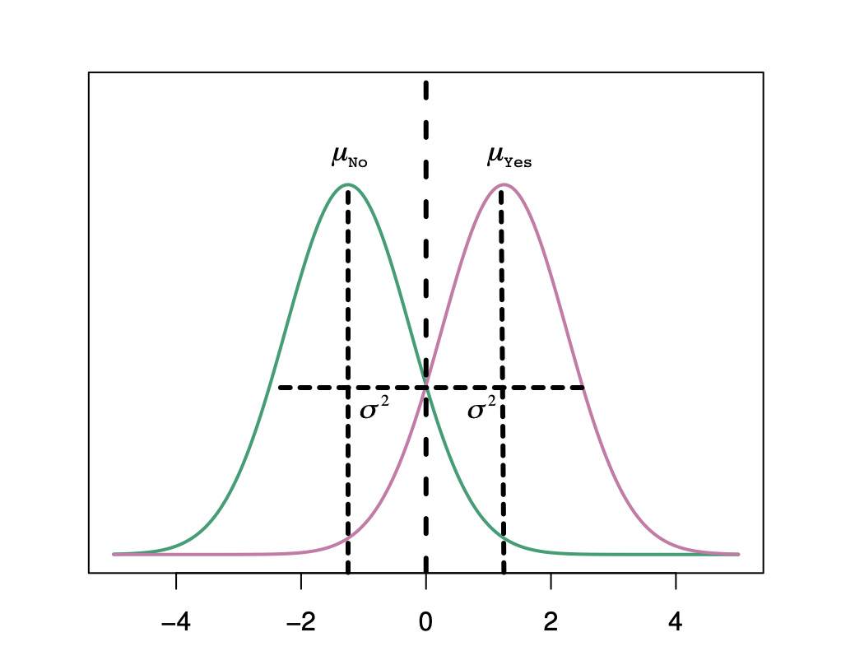

LDA
For generative models, we need to estimate $f_{k}(x)$ to plug into $\operatorname{Pr}\left(Y=k | X=x\right)=\frac{π_{k}f_{k}(x)}{\sum_{l=1}^{K}{π_{l}f_{l}(x)}}$
Linear Discriminant Analysis (LDA) with one predictor (p=1)
Assumption 2:
classes have equal variance, i.e.
$σ_{1}^{2}= …=σ_{k}^{2}$
So we can use one variance term,
$σ^{2}$

Slide 14
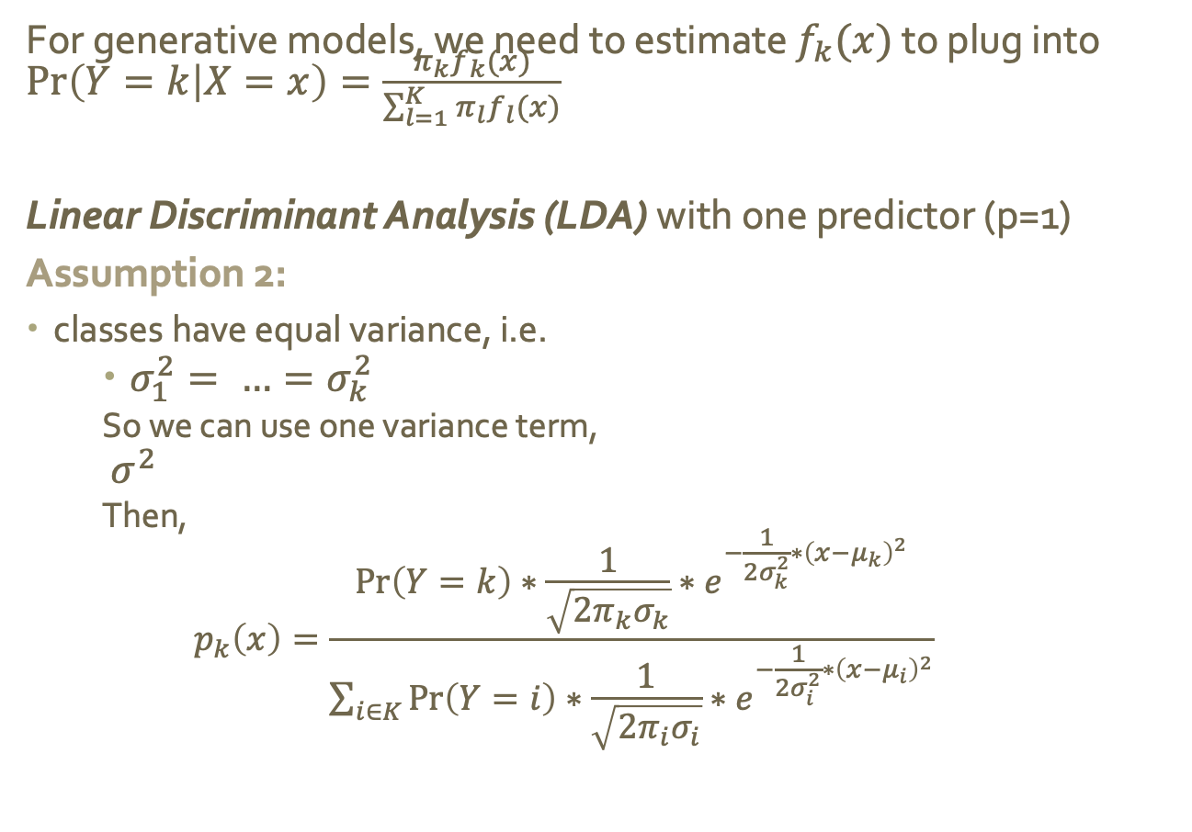
LDA
For generative models, we need to estimate $f_{k}(x)$ to plug into $\operatorname{Pr}\left(Y=k | X=x\right)=\frac{π_{k}f_{k}(x)}{\sum_{l=1}^{K}{π_{l}f_{l}(x)}}$
Linear Discriminant Analysis (LDA) with one predictor (p=1)
Assumption 2:
classes have equal variance, i.e.
$σ_{1}^{2}= …=σ_{k}^{2}$
So we can use one variance term,
$σ^{2}$
Then,
$$p_{k}\left(x\right)=\frac{\operatorname{Pr}\left(Y=k\right)∗\frac{1}{\sqrt{2π_{k}σ_{k}}}∗e^{−\frac{1}{2σ_{k}^{2}}∗{\left(x−μ_{k}\right)}^{2}}}{\sum_{i∈K}{\operatorname{Pr}\left(Y=i\right)∗\frac{1}{\sqrt{2π_{i}σ_{i}}}∗e^{−\frac{1}{2σ_{i}^{2}}∗{\left(x−μ_{i}\right)}^{2}}}}$$

Slide 15
LDA
For generative models, we need to estimate $f_{k}(x)$ to plug into $\operatorname{Pr}\left(Y=k | X=x\right)=\frac{π_{k}f_{k}(x)}{\sum_{l=1}^{K}{π_{l}f_{l}(x)}}$
Linear Discriminant Analysis (LDA) with one predictor (p=1)
Assumption 2:
classes have equal variance, i.e.
$σ_{1}^{2}= …=σ_{k}^{2}$
So we can use one variance term,
$σ^{2}$
Then,
$$p_{k}\left(x\right)=\frac{\operatorname{Pr}\left(Y=k\right)∗\frac{1}{\sqrt{2π_{k}σ_{k}}}∗e^{−\frac{1}{2σ_{k}^{2}}∗{\left(x−μ_{k}\right)}^{2}}}{\sum_{i∈K}{\operatorname{Pr}\left(Y=i\right)∗\frac{1}{\sqrt{2π_{i}σ_{i}}}∗e^{−\frac{1}{2σ_{i}^{2}}∗{\left(x−μ_{i}\right)}^{2}}}}$$
For our purposes, this is a constant

Slide 16

LDA
For generative models, we need to estimate $f_{k}(x)$ to plug into $\operatorname{Pr}\left(Y=k | X=x\right)=\frac{π_{k}f_{k}(x)}{\sum_{l=1}^{K}{π_{l}f_{l}(x)}}$
$$p_{k}\left(x\right)=\frac{\operatorname{Pr}\left(Y=k\right)∗\frac{1}{\sqrt{2π_{k}σ_{k}}}∗e^{−\frac{1}{2σ_{k}^{2}}∗{\left(x−μ_{k}\right)}^{2}}}{\sum_{i∈K}{\operatorname{Pr}\left(Y=i\right)∗\frac{1}{\sqrt{2π_{i}σ_{i}}}∗e^{−\frac{1}{2σ_{i}^{2}}∗{\left(x−μ_{i}\right)}^{2}}}}$$
So we really just need to maximize:
$$\operatorname{Pr}\left(Y=k\right)∗\frac{1}{\sqrt{2π_{k}σ_{k}}}∗e^{−\frac{1}{2σ_{k}^{2}}∗{\left(x−μ_{k}\right)}^{2}}$$
For our purposes, this is a constant

Slide 17

LDA
So we really just need to maximize:
$$\operatorname{Pr}\left(Y=k\right)∗\frac{1}{\sqrt{2π_{k}σ_{k}}}∗e^{−\frac{1}{2σ_{k}^{2}}∗{\left(x−μ_{k}\right)}^{2}}$$
$$δ_{k}\left(x\right)=x∗\frac{μ_{k}}{σ^{2}}−\frac{μ_{k}^{2}}{2σ^{2}}+log⁡(\operatorname{Pr}\left(Y=k\right))$$
This is called a discriminant function of x

Slide 18

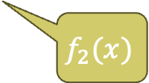
LDA
Example
Bayes’ Decision Boundary at x=0
$$f_{1}(x)$$
$$f_{2}(x)$$
Notes:
Bayes classifier classifies on which is bigger, p_k(x)

Slide 19
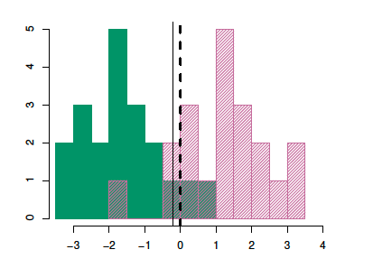

LDA
Example
The decision boundary is where $δ_{1}\left(x\right)=δ_{2}\left(x\right)$
x values to the left of the boundary are assigned to green, and to the right are assigned to purple
LDA Decision Boundary
$$f_{1}(x)$$
$$f_{2}(x)$$

Slide 20

LDA
Estimating parameters
In practice, we don’t know the actual values for the parameters, so we have to estimate them
The LDA method uses the following estimate:
$${\hat{μ}}_{k}= \frac{1}{n_{k}}\sum_{i:y_{i}=k}{x_{i}}$$
(the average of all the training examples from class k)

Slide 21
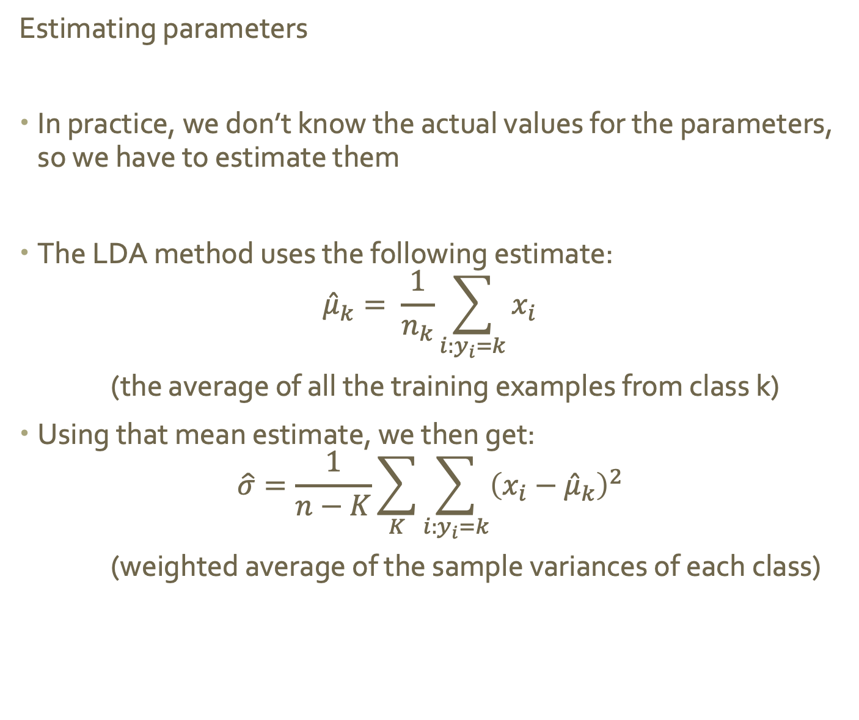
LDA
Estimating parameters
In practice, we don’t know the actual values for the parameters, so we have to estimate them
The LDA method uses the following estimate:
$${\hat{μ}}_{k}= \frac{1}{n_{k}}\sum_{i:y_{i}=k}{x_{i}}$$
(the average of all the training examples from class k)
Using that mean estimate, we then get:
$$\hat{σ}=\frac{1}{n−K}\sum_{K}{\sum_{i:y_{i}=k}{{\left(x_{i}−{\hat{μ}}_{k}\right)}^{2}}}$$
(weighted average of the sample variances of each class)

Slide 22
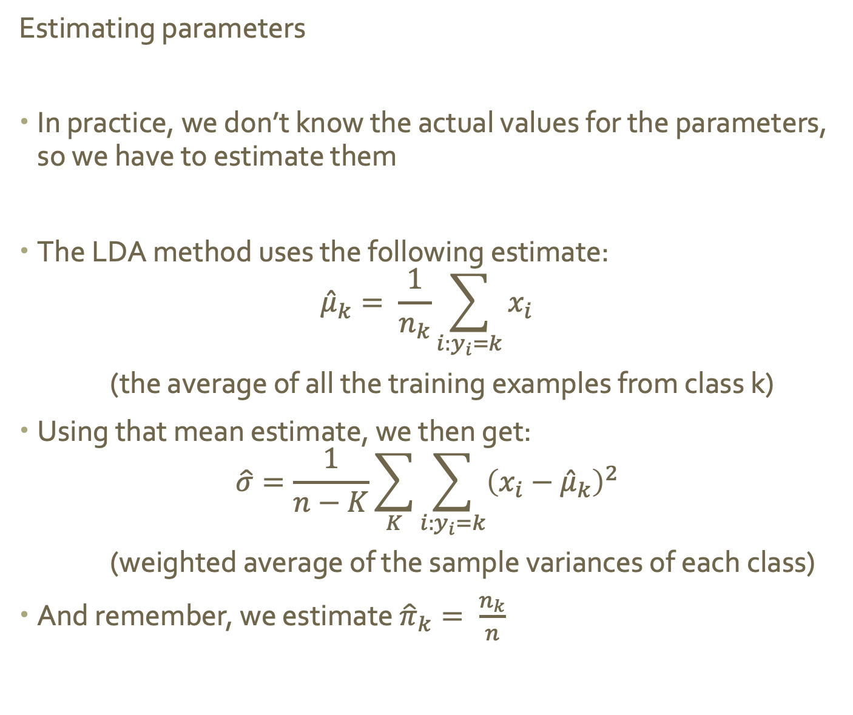
LDA
Estimating parameters
In practice, we don’t know the actual values for the parameters, so we have to estimate them
The LDA method uses the following estimate:
$${\hat{μ}}_{k}= \frac{1}{n_{k}}\sum_{i:y_{i}=k}{x_{i}}$$
(the average of all the training examples from class k)
Using that mean estimate, we then get:
$$\hat{σ}=\frac{1}{n−K}\sum_{K}{\sum_{i:y_{i}=k}{{\left(x_{i}−{\hat{μ}}_{k}\right)}^{2}}}$$
(weighted average of the sample variances of each class)
And remember, we estimate ${\hat{π}}_{k}= \frac{n_{k}}{n}$

Slide 23

LDA
LDA uses all of those estimates to get the discriminant function, and assigns an observation to the class for which the function is largest.
$$δ_{k}\left(x\right)=x∗\frac{μ_{k}}{σ^{2}}−\frac{μ_{k}^{2}}{2σ^{2}}+log⁡(\operatorname{Pr}\left(Y=k\right))$$
$$δ_{k}\left(x\right)=x∗\frac{{\hat{μ}}_{k}}{{\hat{σ}}^{2}}−\frac{{\hat{μ}}_{k}^{2}}{2{\hat{σ}}^{2}}+log⁡({\hat{π}}_{k})$$
The linear in LDA comes form the fact that this function is linear in x

Slide 24
LDA
LDA on one predictor makes 2 assumptions:
Observations within class are normally distributed
All classes have common variance
What do you think we need to change to work with multiple predictors?

Slide 25
LDA
LDA on one predictor makes 2 assumptions:
Observations within class are normally distributed
All classes have common variance
What do you think we need to change to work with multiple predictors?

Slide 26
LDA
LDA on multiple predictors
Assume observations within class are multivariate normally distributed
uncorrelated
correlation or
unequal variance
Notes:
uncorr and equal variance = can slice and get normal curves even all around
corr and unequal variance, still get normal slices, but different shapes in difference directions

Slide 27

LDA
LDA on multiple predictors
Assume observations within class are multivariate normally distributed
What happens to the mean?
$μ_{k}:scalar →vector$ (with p components)
What happens to the variance?
$σ^{2}:scalar →Σ:matrix$ (p x p covariance matrix of X)
Notes:
uncorr and equal variance = can slice and get normal curves even all around
corr and unequal variance, still get normal slices, but different shapes in difference directions

Slide 28
LDA
LDA on one predictor makes 2 assumptions:
Observations within class are normally distributed
All classes have common variance

Slide 29
LDA
LDA on multiple predictors
Assume observations within class are multivariate normally distributed
What happens to the mean?
$μ_{k}:scalar →vector$ (with p components)
What happens to the variance?
$σ^{2}:scalar →Σ:matrix$ (p x p covariance matrix of X)
Assume equal for all classes, K
Notes:
uncorr and equal variance = can slice and get normal curves even all around
corr and unequal variance, still get normal slices, but different shapes in difference directions

Slide 30

LDA
LDA on multiple predictors
Assume observations within class are multivariate normally distributed
What happens to the mean?
$μ_{k}:scalar →vector$ (with p components)
What happens to the variance?
$σ^{2}:scalar →Σ:matrix$ (p x p covariance matrix of X)
Plugging in, we get the matrix version of our previous equation:
$$δ_{k}\left(x\right)=x^{T}∗\frac{{\hat{μ}}_{k}}{Σ}−\frac{{\hat{μ}}_{k}^{T}{\hat{μ}}_{k}}{2Σ}+log⁡({\hat{π}}_{k})$$
Notes:
uncorr and equal variance = can slice and get normal curves even all around
corr and unequal variance, still get normal slices, but different shapes in difference directions

Slide 31
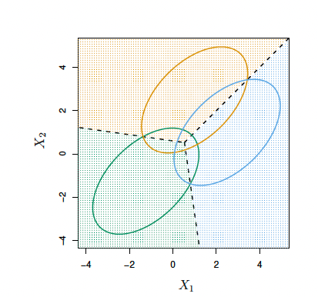
LDA
Class 1 vs Class 2
p = 2
Ellipses represent 95% of the probability for each class
Dashed lines are the Bayes decision boundaries
Class 1 vs Class 3
Class 2 vs Class 3

Slide 32
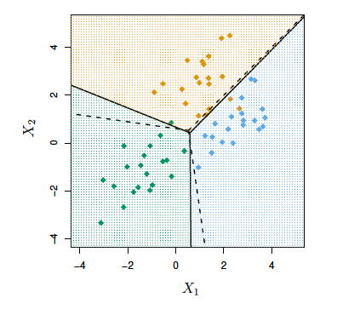
LDA
Class 1 vs Class 2
p = 2
Ellipses represent 95% of the probability for each class
Dashed lines are the Bayes decision boundaries
Solid lines are LDA decision boundaries
Class 1 vs Class 3
Class 2 vs Class 3

Slide 33
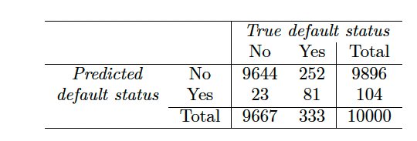
LDA
LDA on Default data (from logistic regression lecture)
Confusion matric on training data
What is the overall error rate? Does that seem good or bod?
Hint: Think about the error rate you’d get just from saying no one defaults.
Notes:
error = 2.75%
3.33% error with null classifier

Slide 34
LDA
LDA on Default data (from logistic regression lecture)
Confusion matric on training data
There are two types (or categories) of error here. What are they?
Notes:
error = 2.75%
3.33% error with null classifier

Slide 35
LDA
LDA on Default data (from logistic regression lecture)
Confusion matric on training data
False Negative
False Positive
Does the model perform equally well within each error type?
Notes:
No
False neg 75% of defaults were missed

Slide 36
LDA
LDA on Default data (from logistic regression lecture)
Confusion matric on training data
sensitivity refers to the percent of true positives
specificity refers to the percent of true negatives
False Negative
False Positive
What is the sensitivity and specificity of our model?
Notes:
sensitivity = 24.3
specificity = 99.8

Slide 37

LDA
LDA on multiple predictors
We will relax the assumption that classes have uniform variance
$$Cov\left(x\right)→Cov_{k}\left(x\right) for each k$$

Slide 38

LDA
LDA on multiple predictors
We will relax the assumption that classes have uniform variance
$$Cov\left(x\right)→Cov_{k}\left(x\right) for each k$$
If we plus this into Bayes we get:
$$δ_{k}\left(\vec{x}\right)=−\frac{1}{2}{\left(\vec{x}−{\vec{μ}}_{k}\right)}^{T}Cov_{k}{\left(X\right)}^{−1}\left(\vec{x}−{\vec{μ}}_{k}\right)+log⁡(π_{k})$$

Slide 39

QDA
LDA on multiple predictors → Quadratic Discriminant Analysis
We will relax the assumption that classes have uniform variance
$$Cov\left(x\right)→Cov_{k}\left(x\right) for each k$$
If we plus this into Bayes we get:
$$δ_{k}\left(\vec{x}\right)=−\frac{1}{2}{\left(\vec{x}−{\vec{μ}}_{k}\right)}^{T}Cov_{k}{\left(X\right)}^{−1}\left(\vec{x}−{\vec{μ}}_{k}\right)+log⁡(π_{k})$$
Multiplying two x terms together → quadratic

