Slide 1
Introduction to Machine Learning – CV and Bootstrap
Dr. Ab Mosca (they/them)
Slides based off slides courtesy of Jordan Crouser (https://jcrouser.github.io/)

Slide 2
Plan for Today
Cross Validation
Bootstrap

Slide 3
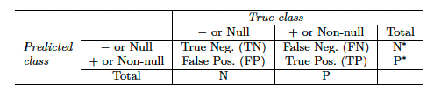
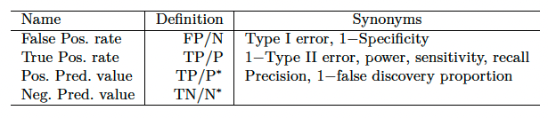
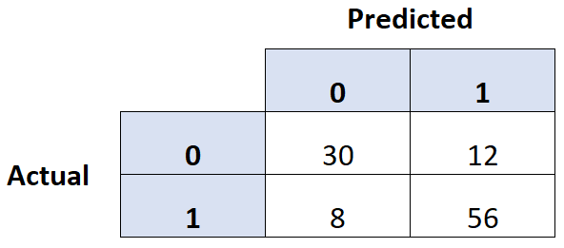
Warm Up: Classification Errors
Calculate specificity, sensitivity, and precision for the model that produced this confusion matrix.
34
14
85
42

Slide 4
Resampling
Resampling involves repeatedly drawing samples from a training dataset and refitting the model of interest on each sample to obtain additional information about the fitted model
What exactly do you think this method allows us to measure?
Notes:
variability!

Slide 5
Resampling
Resampling involves repeatedly drawing samples from a training dataset and refitting the model of interest on each sample to obtain additional information about the fitted model
Model assessment is the process of evaluating a model’s performance
Model selection is the process of selecting the proper level of flexibility for a model
Notes:
variability!

Slide 6
Resampling
Resampling involves repeatedly drawing samples from a training dataset and refitting the model of interest on each sample to obtain additional information about the fitted model
Model assessment is the process of evaluating a model’s performance
Model selection is the process of selecting the proper level of flexibility for a model
Cross validation is a resampling method used for model assessment and selection.
Bootstrap is a resampling method commonly used for measuring accuracy of a parameter estimate.
Notes:
variability!

Slide 7



Fitting a Supervised ML Model
Recall: Supervised means we fit our model using data that includes the responses we are trying to predict
Therefore, we can see how well our model performs (via error) on the data we used to train it. This is called the model’s training error.
Ideally, we would also have new, unseen data on which to test our model. The model’s performance on this data is called its test error.
Notes:
variability!

Slide 8
Fitting a Supervised ML Model
Recall: Supervised means we fit our model using data that includes the responses we are trying to predict
Therefore, we can see how well our model performs (via error) on the data we used to train it. This is called the model’s training error.
Ideally, we would also have new, unseen data on which to test our model. The model’s performance on this data is called its test error.
Notes:
variability!

Slide 9

Fitting a Supervised ML Model
Ideally, we would also have new, unseen data on which to test our model. The model’s performance on this data is called its test error.
Notes:
variability!

Slide 10
Validation Set
Ideally, we would also have new, unseen data on which to test our model. The model’s performance on this data is called its test error.
This usually isn’t the case, so instead we hold out part of our training data to act as testing data.
The hold out is also called a validation set, and is used to estimate test error.
Notes:
variability!

Slide 11
Validation Set
Ideally, we would also have new, unseen data on which to test our model. The model’s performance on this data is called its test error.
This usually isn’t the case, so instead we hold out part of our training data to act as testing data.
The hold out is also called a validation set, and is used to estimate test error.
Would you expect the same of different error given a different validation set?
Notes:
variability!

Slide 12
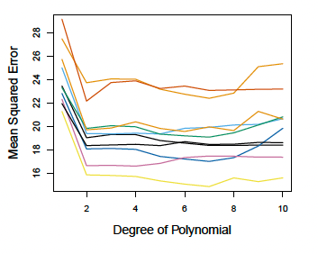
Validation Set
Different validation sets will yield different error rates.
Ex. Below are curves plotting MSE for different regression models predicting mpg on horsepower from the Auto dataset (ranging from linear to x¹⁰ ). Each line represents the models with a different validation set.
What do these curves tell you about the appropriate regression model for this data?
Notes:
that linear is def bad
not much about the others; no clear “winner”

Slide 13
Validation Set
Drawbacks of the validation set approach:
Validation set error rate can be highly variable depending on what observations were included in the validation and training sets
Only a subset of observations are used to fit our model. Statistical methods tend to perform worse when trained on fewer observations. Therefor, validation set error tends to overestimate test error rate for a model fit on the entire dataset.
Notes:
that linear is def bad
not much about the others; no clear “winner”

Slide 14
Validation Set
Drawbacks of the validation set approach:
Validation set error rate can be highly variable depending on what observations were included in the validation and training sets
Only a subset of observations are used to fit our model. Statistical methods tend to perform worse when trained on fewer observations. Therefor, validation set error tends to overestimate test error rate for a model fit on the entire dataset.
Cross-validation refines this approach to address these issues.
Notes:
that linear is def bad
not much about the others; no clear “winner”

Slide 15
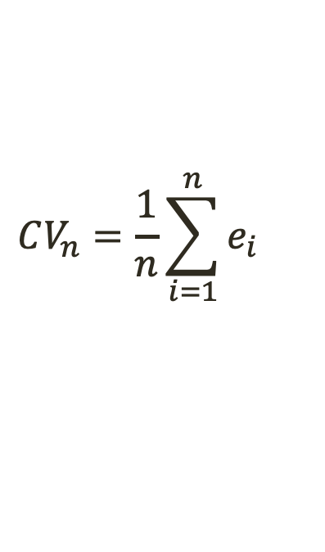
Leave-One-Out Cross-Validation
LOOCV
Uses one observation for the validation set and all remaining observations for the training set
Repeats this approach for every observation in the dataset
Error across all validation sets is averaged to estimate test error
Test
Train
Train
Train
Train
Train
Train
Test
Test
Train
Train
Test
Train
Test
Train
Test
error₀
error₁
error₂
error₃
error₄
error₅
$$CV_{n}=\frac{1}{n}\sum_{i=1}^{n}{e_{i}}$$
Notes:
that linear is def bad error₀
not much about the others; no clear “winner”

Slide 16
Leave-One-Out Cross-Validation
Benefits of LOOCV
Tends to not overestimate test error rate as much as the validation set approach.
There is no randomness in the training/validation splits, so we will always get the same estimated test error rate (unlike with the validation set approach)
Notes:
that linear is def bad error₀
not much about the others; no clear “winner”

Slide 17
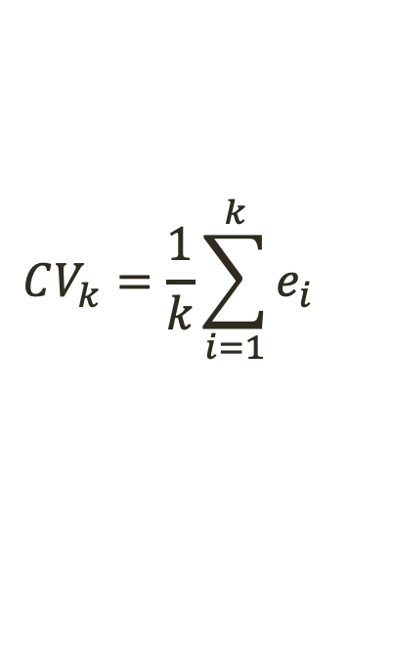
k-Fold Cross-Validation
k-Fold CV (an alternative to LOOCV)
Randomly divides the dataset into k groups, or folds of about equal size
Uses one fold for the validation set and all remaining folds for the training set
Repeats this for every fold
Error across all validation sets is averaged to estimate test error
Test
Train
Train
Train
Test
Train
Test
error₀
error₁
error₂
$$CV_{k}=\frac{1}{k}\sum_{i=1}^{k}{e_{i}}$$

Slide 18
k-Fold Cross-Validation
Benefits of k-Fold CV
As long as k is not 1, less computationally expensive than LOOCV (usually k is 5 or 10)
Estimated test error rate will vary (unlike LOOCV), but only slightly (unlike the validation set method).
Notes:
that linear is def bad error₀
not much about the others; no clear “winner”

Slide 19
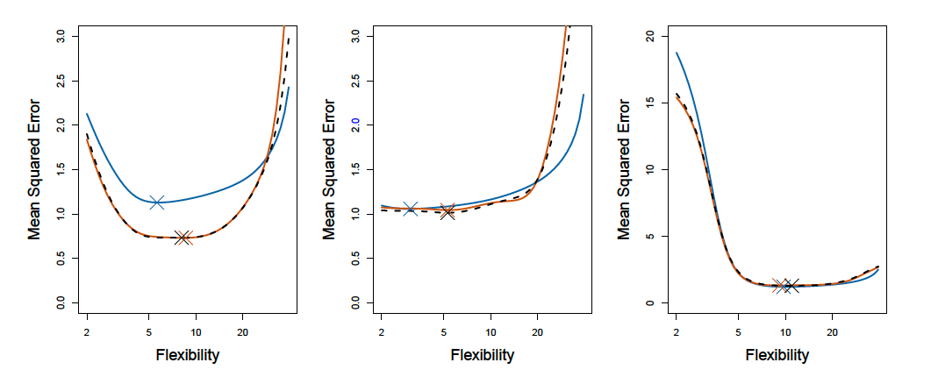
Comparing LOOCV and 10-fold CV
Below are curves plotting MSE against flexibility for smoothing splines. Each chart represents a different dataset.
The true test MSE (from a true test set) is shown in blue.
The LOOCV estimate is shown in dashed black.
The 10-fold CV estimate is shown in orange.
The X’s represent minimum MSE.
What do you notice across these charts?
Notes:
- two CV methods are very similar
CV curves sometimes don’t estimate MSE perfectly, but almost always id the correct level of flexibility

Slide 20

Bias-Variance Tradeoff
The validation set approach will train on about half of observation, $\frac{n}{2}$
The LOOCV approach will train on almost all observations, $n−1$
The k-fold CV approach will train on about $\frac{\left(k−1\right)n}{k}$ observations
Which of these trains on the most observations? The least?
As a result, which model would you expect to have the most bias? The least?
Notes:
LOOCV will have the lowest bias; it trains on almost all the data
validation set will have the highest bias
kCV will have intermediate bias

Slide 21

Bias-Variance Tradeoff
The LOOCV approach will train on almost all observations, $n−1$
The k-fold CV approach will train on about $\frac{\left(k−1\right)n}{k}$ observations
Which of these will produce the most correlated error estimates (on each run)? The least?
As a result, which model would you expect to have the most variance? The least?
Notes:
LOOCV will be highly correlated, because all sets are very similar, more correlated values lead to higher variance in the mean → more variance
k-fold will be less correlated, because sets have less overlap, leading to a mean with lower variance

Slide 22
Bias-Variance Tradeoff
k-fold CV is usually performed with 5 or 10 folds because empirically these values have shown to yield test error rate estimates that balance the bias-variance tradeoff.
Notes:
LOOCV will be highly correlated, because all sets are very similar, more correlated values lead to higher variance in the mean → more variance
k-fold will be less correlated, because sets have less overlap, leading to a mean with lower variance

Slide 23
Bootstrap
Bootstrap is a statistical tool that can be used to quantify the uncertainty associated with a given estimator or statistical learning method.
Notes:
LOOCV will be highly correlated, because all sets are very similar, more correlated values lead to higher variance in the mean → more variance
k-fold will be less correlated, because sets have less overlap, leading to a mean with lower variance

Slide 24

Bootstrap
Bootstrap is a statistical tool that can be used to quantify the uncertainty associated with a given estimator or statistical learning method.
Motivation:
Suppose we want to invest a fixed sum of money into two financial assets that yield (variable) returns of X and Y, respectively. We will invest a fraction, $α$, of our money in X and the rest in Y.
We want to choose $α$ to minimize the total variance of our investment.

Slide 25

Bootstrap
Bootstrap is a statistical tool that can be used to quantify the uncertainty associated with a given estimator or statistical learning method.
Motivation:
Suppose we want to invest a fixed sum of money into two financial assets that yield (variable) returns of X and Y, respectively. We will invest a fraction, $α$, of our money in X and the rest in Y.
We want to choose $α$ to minimize the total variance of our investment.
In other words, we want to minimize:
$$Var(αX+\left(1−α\right)Y)$$

Slide 26

Bootstrap
Suppose we want to invest a fixed sum of money into two financial assets that yield (variable) returns of X and Y, respectively. We will invest a fraction, $α$, of our money in X and the rest in Y.
We want to choose $α$ to minimize the total variance of our investment.
In other words, we want to minimize:
$$Var(αX+\left(1−α\right)Y)$$
To do that we want
$$α=\frac{σ_{Y}^{2} −σ_{XY}}{σ_{X}^{2}+σ_{Y}^{2}−2σ_{XY}}$$
Notes:
sigma = variance
sigma XY is cov XY

Slide 27

Bootstrap
Suppose we want to invest a fixed sum of money into two financial assets that yield (variable) returns of X and Y, respectively. We will invest a fraction, $α$, of our money in X and the rest in Y.
We want to choose $α$ to minimize the total variance of our investment.
In other words, we want to minimize:
$$Var(αX+\left(1−α\right)Y)$$
To do that we want
$$α=\frac{σ_{Y}^{2} −σ_{XY}}{σ_{X}^{2}+σ_{Y}^{2}−2σ_{XY}}$$
Using past data to estimate, we get an ideal $α$ of
$$\hat{α}=\frac{{\hat{σ}}_{Y}^{2} −{\hat{σ}}_{XY}}{{\hat{σ}}_{X}^{2}+{\hat{σ}}_{Y}^{2}−2{\hat{σ}}_{XY}}$$
Notes:
sigma = variance
sigma XY is cov XY

Slide 28
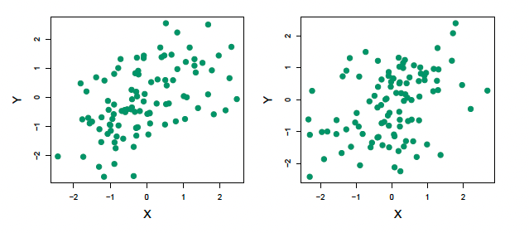
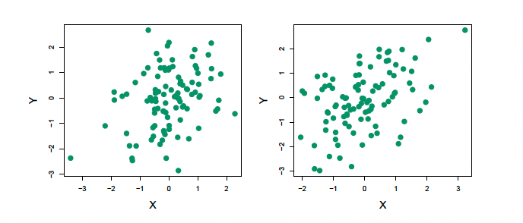





Bootstrap
What if we want to quantify the accuracy of our estimate for $α$?
Let’s use simulated data (based on the true data) to get additional estimates for $α$. In this simulation, $σ_{X}^{2}=1, σ_{Y}^{2}=1.25, σ_{XY}=0.5$. (So the true $α=0.6$)
$$α=0.576$$
$$α=0.576$$
$$α=0.576$$
$$α=0.576$$
Each plot shows 100 simulated data points.
Notes:
sigma = variance
sigma XY is cov XY

Slide 29
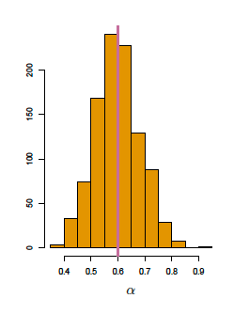

Bootstrap
If we repeat the simulation 1,000 times we get an average $α$ of 0.5996, with a standard deviation of 0.083, which equates to $SE(\hat{α})≈0.083$.
On average, we would expect $\hat{α}$ to differ from $α$ by about 0.08.
histogram from 1000 simulations
Notes:
sigma = variance
sigma XY is cov XY

Slide 30


Bootstrap
If we repeat the simulation 1,000 times we get an average $α$ of 0.5996, with a standard deviation of 0.083, which equates to $SE(\hat{α})≈0.083$.
On average, we would expect $\hat{α}$ to differ from $α$ by about 0.08.
In practice, we cannot use this procedure for estimating SE, because for real data we cannot generate new samples from the original population.
Bootstrap allows us to leverage computing to emulate this process of obtaining new sample sets so that we can estimate variability of $\hat{α}$.
histogram from 1000 simulations
Notes:
sigma = variance
sigma XY is cov XY

Slide 31

Bootstrap
If we repeat the simulation 1,000 times we get an average $α$ of 0.5996, with a standard deviation of 0.083, which equates to $SE(\hat{α})≈0.083$.
On average, we would expect $\hat{α}$ to differ from $α$ by about 0.08.
In practice, we cannot use this procedure for estimating SE, because for real data we cannot generate new samples from the original population.
Bootstrap allows us to leverage computing to emulate this process of obtaining new sample sets so that we can estimate variability of $\hat{α}$.
Instead of obtaining independent data sets from the population, we obtain distinct sets by repeatedly sampling (with replacement) observations from the original dataset.
histogram from 1000 simulations
Notes:
sigma = variance
sigma XY is cov XY

Slide 32
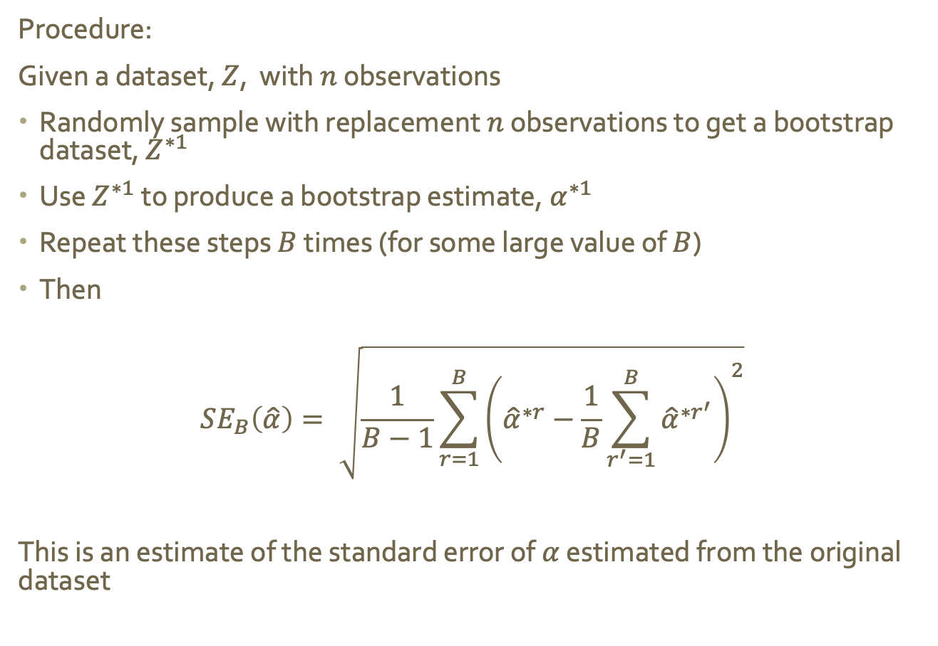
Bootstrap
Procedure:
Given a dataset, $Z$, with $n$ observations
Randomly sample with replacement $n$ observations to get a bootstrap dataset, $Z^{∗1}$
Use $Z^{∗1}$ to produce a bootstrap estimate, $α^{∗1}$
Repeat these steps $B$ times (for some large value of $B$)
Then
$$SE_{B}\left(\hat{α}\right)= \sqrt{\frac{1}{B−1}\sum_{r=1}^{B}{{\left({\hat{α}}^{∗r}−\frac{1}{B}\sum_{r^{′}=1}^{B}{{\hat{α}}^{∗r^{′}}}\right)}^{2}}}$$
This is an estimate of the standard error of $α$ estimated from the original dataset
Notes:
sigma = variance
sigma XY is cov XY

Slide 33
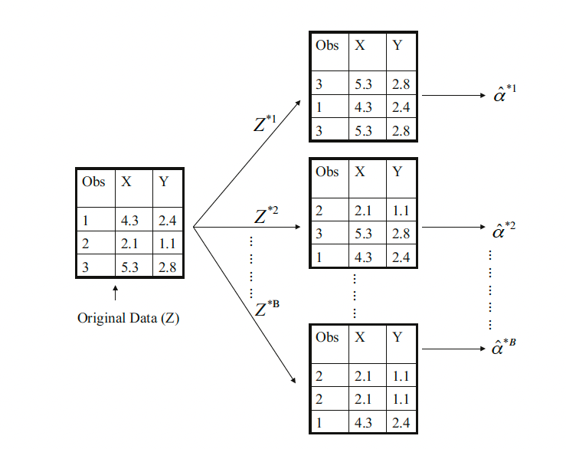
Bootstrap
Notes:
sigma = variance
sigma XY is cov XY

Slide 34
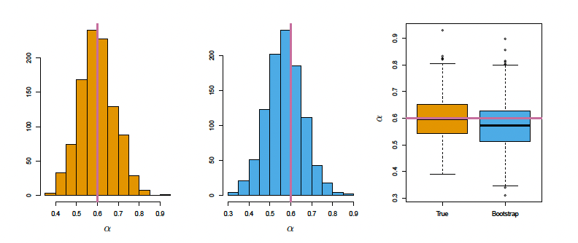
Bootstrap
If we repeat the simulation 1,000 times we get an average $α$ of 0.5996, with a standard deviation of 0.083, which equates to $SE(\hat{α})≈0.083$.
On average, we would expect $\hat{α}$ to differ from $α$ by about 0.08.
histogram from 1000 bootstrap samples from a single dataset
histogram from 1000 simulations
Notes:
pink = true value of alpha

