Slide 1
Introduction to Machine Learning – Subset Selection
Dr. Ab Mosca (they/them)
Slides based off slides courtesy of Jordan Crouser (https://jcrouser.github.io/)

Slide 2
Plan for Today
Validation / Error
Linear Model selection and Regularization
Best Subset Selection
Stepwise Selection
Choosing the Optimal Model

Slide 3
Motivation
So far, we’ve thought about how to evaluate our models using error calculations.
Besides fit, what else might influence the effectiveness / accuracy of our models?

Slide 4
Motivation
So far, we’ve thought about how to evaluate our models using error calculations.
Besides fit, what else might influence the effectiveness / accuracy of our models?
https://www.ted.com/talks/joy_buolamwini_how_i_m_fighting_bias_in_algorithms?language=en
http://gendershades.org/overview.html

Slide 5

Motivation
Moving back to linear models…
In regression, the standard model is:
$$Y=β_{0}+β_{1}X_{1}+…+β_{p}X_{p}$$
How did we find the coefficients for this model?

Slide 6


Motivation
Flashback: minimizing RSS

Slide 7
Motivation
Flashback: minimizing RSS
Why do we minimize RSS?

Slide 8
Motivation
Least Squares
Assumption 1: we’re fitting a linear model
Assumption 2: the true relationship between the predictors and the response is linear
What can we say about the bias of our least-squares estimates?
Notes:
should be low

Slide 9
Motivation
Least Squares
Assumption 1: we’re fitting a linear model
Assumption 2: the true relationship between the predictors and the response is linear
Consider:
Case 1: the number of observations in the training data is much larger than the number of predictors (n >>p)
Variance should be low; our model will perform well on test observations
Notes:
Should also be low → model should perform well on test observations

Slide 10

Motivation
Least Squares
Assumption 1: we’re fitting a linear model
Assumption 2: the true relationship between the predictors and the response is linear
Consider:
Case 2: the number of observations is not much larger than the number of predictors (n $≈$ p)
Variance will get (pretty) high; performance of the model will suffer
Notes:
Uh oh… variance is starting to get really high... Performance is going to suffer

Slide 11

Motivation
Least Squares
Assumption 1: we’re fitting a linear model
Assumption 2: the true relationship between the predictors and the response is linear
Consider:
Case 3: the number of observations smaller than the number of predictors (n $<$ p)
Variance will be infinite; we will no longer get a unique least squares estimate
Notes:
Uh oh… variance is starting to get really high... Performance is going to suffer

Slide 12

Motivation
So what can we do in cases where n <p or n $≈$ p?
Ideas?

Slide 13

Subset selection
So what can we do in cases where n <p or n $≈$ p?
Subset selection
If we have too many predictors, we can get rid of some to improve model performance
But how will we choose?
Ideas?

Slide 14

Subset selection
So what can we do in cases where n <p or n $≈$ p?
Subset selection
If we have too many predictors, we can get rid of some to improve model performance
But how will we choose?
For each possible subset of predictors
Fit least squares
Choose the “best” model from the collection

Slide 15



Subset selection
Superhero Example

Slide 16
Subset selection
Superhero Example

Slide 17
Subset selection
Superhero Example

Slide 18

Subset selection
Algorithm
Start with the null model, $M_{0}$ (no predictors)
For $k=1, 2, …, p$
Fit all $\left({p \atop k}\right)$ models that contain exactly $k$ predictors
Keep only the one that has the smallest RSS. Call it $M_{k}$
Select the “best” model from $M_{0}, M_{1},…M_{p}$
Notes:
Now in order to select a single best model, we must simply choose among
these p + 1 options.
This task must be performed with care, because the
RSS of these p + 1 models decreases monotonically, and the R2 increases
monotonically, as the number of features included in the models increases.
Therefore, if we use these statistics to select the best model, then we will
always end up with a model involving all of the variables

Slide 19

Subset selection
Algorithm
Start with the null model, $M_{0}$ (no predictors)
For $k=1, 2, …, p$
Fit all $\left({p \atop k}\right)$ models that contain exactly $k$ predictors
Keep only the one that has the smallest RSS. Call it $M_{k}$
Select the “best” model from $M_{0}, M_{1},…M_{p}$
Can we do this for models that are not least-squares regression models?

Slide 20
Subset selection
Algorithm
Start with the null model, $M_{0}$ (no predictors)
For $k=1, 2, …, p$
Fit all $\left({p \atop k}\right)$ models that contain exactly $k$ predictors
Keep only the one that has the smallest RSS. Call it $M_{k}$
Select the “best” model from $M_{0}, M_{1},…M_{p}$

Slide 21
Subset selection
Algorithm
Start with the null model, $M_{0}$ (no predictors)
For $k=1, 2, …, p$
Fit all $\left({p \atop k}\right)$ models that contain exactly $k$ predictors
Keep only the one that has the smallest RSS. Call it $M_{k}$
Select the “best” model from $M_{0}, M_{1},…M_{p}$
What drawbacks do you see to this approach?

Slide 22

Subset selection
Model overload
Number of possible models on a set of $p$ predictors is
$$\sum_{k=1}^{p}{\left({p \atop k}\right)}=2^{p}$$
How many possible models do we get for 10 predictors? For 20?
Notes:
1024
1048576

Slide 23
Subset selection
Model overload
Number of possible models on a set of $p$ predictors is
$$\sum_{k=1}^{p}{\left({p \atop k}\right)}=2^{p}$$
As we fit more and more models, what happens to our estimated coefficients?
Notes:
The larger the search space, the higher the chance of finding
models that look good on the training data, even though they might not
have any predictive power on future data
larger search space means larger variance, which means we’re overfitting!!!

Slide 24
Subset selection
What if we could eliminate some of our model options?
Notes:
what if in the first round, I see strength is the strongest predictor so I only look at models that include it in the next round?

Slide 25

Subset selection
Ex. when $p=5$
{ }
A B C D E
AB AC AD AE BC BD BE CD CE DE
ABC ABD ABE ACD ACE ADE BCD BCE BDE CDE
ABCD ABCE ABDE ACDE BCDE
ABCDE
Notes:
what if in the first round, I see strength is the strongest predictor so I only look at models that include it in the next round?

Slide 26

Forward selection
Algorithm
Start with the null model, $M_{0}$ (no predictors)
For $k=1, 2, …, p$
Fit all $\left(p−k\right)$ models that augment $M_{k−1}$ with exactly one predictor
Keep only the one that has the smallest RSS. Call it $M_{k}$
Select the “best” model from $M_{0}, M_{1},…M_{p}$

Slide 27

Stepwise selection
Far fewer models than best subset
Number of possible models on a set of $p$ predictors is
$$\sum_{k=0}^{p−1}{\left(p−k\right)}=1+\frac{p(p+1)}{2}$$
How many possible models do we get for 10 predictors? For 20?
Notes:
51
211

Slide 28

Forward selection
Algorithm
Start with the null model, $M_{0}$ (no predictors)
For $k=1, 2, …, p$
Fit all $\left(p−k\right)$ models that augment $M_{k−1}$ with exactly one predictor
Keep only the one that has the smallest RSS. Call it $M_{k}$
Select the “best” model from $M_{0}, M_{1},…M_{p}$
What potential downsides do you see?
Notes:
there’s a risk we might prune an important predictor too early. While this method usually does well in practice, it is not guaranteed to give the optimal solution.

Slide 29

Backward selection
Algorithm
Start with the full model, $M_{p}$ (all predictors)
For $k=p, p−1, …, 1$
Fit all $k$ models that reduce $M_{k+1}$ by exactly one predictor
Keep only the one that has the smallest RSS. Call it $M_{k}$
Select the “best” model from $M_{0}, M_{1},…M_{p}$
Notes:
there’s a risk we might prune an important predictor too early. While this method usually does well in practice, it is not guaranteed to give the optimal solution.

Slide 30

Backward selection
Algorithm
Start with the full model, $M_{p}$ (all predictors)
For $k=p, p−1, …, 1$
Fit all $k$ models that reduce $M_{k+1}$ by exactly one predictor
Keep only the one that has the smallest RSS. Call it $M_{k}$
Select the “best” model from $M_{0}, M_{1},…M_{p}$
Notes:
there’s a risk we might prune an important predictor too early. While this method usually does well in practice, it is not guaranteed to give the optimal solution.

Slide 31

Choosing the Optimal Model
Recall: measures of training error (RSS and $R^{2}$) are not good predictors of test error.
In addition, they are not good ways of comparing models with different numbers of predictors.
Why?
Notes:
In particular, the training error will decrease as more variables are included in the model,
but the test error may not.
Therefore, training set RSS and training set R2 cannot be used to select from among a set of models with different numbers of variables

Slide 32

Choosing the Optimal Model
Recall: measures of training error (RSS and $R^{2}$) are not good predictors of test error
We have two options for estimating test error:
Directly estimate using a validation set or CV
Indirectly estimate by making an adjustment to the training error to account for bias

Slide 33


Adjusted $R^{2}$
Intuition: once all of the useful variables have been included in the model, adding additional junk variables will lead to only a small decrease in RSS
$$R^{2}=1 −\frac{RSS}{TSS}, (TSS=∑{\left(y_{i}−\overline{y}\right)}^{2})$$
$$R_{Adj}^{2}=1 −\frac{\frac{RSS}{n−d−1}}{\frac{TSS}{n−1}}, d=num_predictors$$
To maximize $R_{Adj}^{2}$ (get the best fit), we need to minimize $\frac{RSS}{n−d−1}$
As d increases, what will happen to this term?
Notes:
TSS = sum (y_i – mean_y)^2
RSS increases with more vars but TSS is constant, so R^2 increases with more var
once all of the correct variables have been included in the model, adding additional noise variables will lead to only a very small decrease in RSS.
Since adding noise variables leads to an increase in d, such variables will lead to an increase in RSS n−d−1 , and consequently a decrease in the adjusted R2.
Therefore, in theory, the model with the largest adjusted R2 will have only correct variables and no noise variables.
Unlike the R2 statistic, the adjusted R2 statistic pays a price for the inclusion of unnecessary variables in the model.

Slide 34

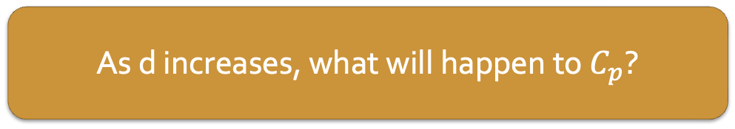
AIC, BIC, and C_{p}
Other ways to penalize RSS when more predictors are added:
$$C_{p}=\frac{1}{n}\left(RSS+2d{\hat{σ}}^{2}\right), {\hat{σ}}^{2}=estimate of variance of ε_{i}$$
As d increases, what will happen to $C_{p}$?
Notes:
Mallow’s Cp, named for English statistician Colin Lingwood Mallows, currently a researcher at AT&T Labs
AIC = (ah-KAI-uh-keh) Akaike information criterion, named for Japanese statistician Akaike Hirotsugu
BIC = Bayesian Information Criterion (a.k.a. the Schwartz criterion), names for Austrian statistician Gideon Schwartz
C_p adds a penalty of 2dsigma^2 to the training RSS in order to adjust for the fact that the training error tends to underestimate the test error
C_p statistic tends to take on a small value for models with a low test error, so when determining which of a set of models is best, we choose the model with the lowest

Slide 35

AIC, BIC, and C_{p}
Other ways to penalize RSS when more predictors are added:
$$C_{p}=\frac{1}{n}\left(RSS+2d{\hat{σ}}^{2}\right), {\hat{σ}}^{2}=estimate of variance of ε_{i}$$
$$AIC=\frac{1}{n}(RSS+2d{\hat{σ}}^{2})$$
Notes:
Mallow’s Cp, named for English statistician Colin Lingwood Mallows, currently a researcher at AT&T Labs
AIC = (ah-KAI-uh-keh) Akaike information criterion, named for Japanese statistician Akaike Hirotsugu
BIC = Bayesian Information Criterion (a.k.a. the Schwartz criterion), names for Austrian statistician Gideon Schwartz
AIC criterion is defined for a large class of models fit by maximum likelihood.
In the case of the linear regression with Gaussian errors, maximum likelihood and least squares are the same thing

Slide 36

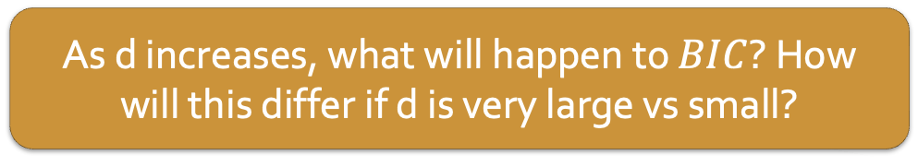
AIC, BIC, and C_{p}
Other ways to penalize RSS when more predictors are added:
$$C_{p}=\frac{1}{n}\left(RSS+2d{\hat{σ}}^{2}\right), {\hat{σ}}^{2}=estimate of variance of ε_{i}$$
$$AIC=\frac{1}{n}(RSS+2d{\hat{σ}}^{2})$$
$$BIC=\frac{1}{n}(RSS+\log\left(n\right)d{\hat{σ}}^{2})$$
As d increases, what will happen to $BIC$? How will this differ if d is very large vs small?
Notes:
Mallow’s Cp, named for English statistician Colin Lingwood Mallows, currently a researcher at AT&T Labs
AIC = (ah-KAI-uh-keh) Akaike information criterion, named for Japanese statistician Akaike Hirotsugu
BIC = Bayesian Information Criterion (a.k.a. the Schwartz criterion), names for Austrian statistician Gideon Schwartz
BIC is derived from a Bayesian point of view,
BIC statistic generally places a heavier penalty on models with many variables, and hence results in the selection of smaller models than Cp.

Slide 37

AIC, BIC, and C_{p}
Other ways to penalize RSS when more predictors are added:
$$C_{p}=\frac{1}{n}\left(RSS+2d{\hat{σ}}^{2}\right), {\hat{σ}}^{2}=estimate of variance of ε_{i}$$
$$AIC=\frac{1}{n}(RSS+2d{\hat{σ}}^{2})$$
$$BIC=\frac{1}{n}(RSS+\log\left(n\right)d{\hat{σ}}^{2})$$
All of these measures are supported by statistical theory. AIC and BIC are also defined for more general models beyond least squares.
Notes:
Mallow’s Cp, named for English statistician Colin Lingwood Mallows, currently a researcher at AT&T Labs
AIC = (ah-KAI-uh-keh) Akaike information criterion, named for Japanese statistician Akaike Hirotsugu
BIC = Bayesian Information Criterion (a.k.a. the Schwartz criterion), names for Austrian statistician Gideon Schwartz
BIC is derived from a Bayesian point of view,
BIC statistic generally places a heavier penalty on models with many variables, and hence results in the selection of smaller models than Cp.

Slide 38
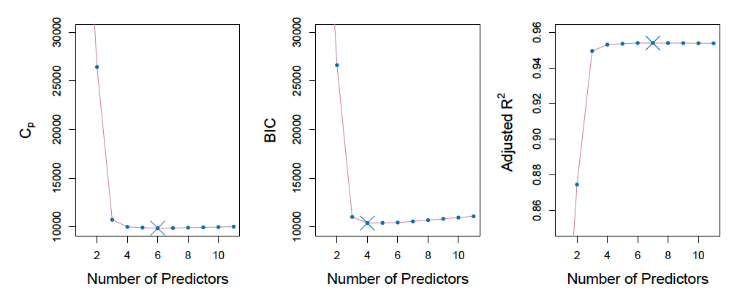
AIC, BIC, and C_{p}
Credit dataset
Notes:
C_p and BIC are estimates of MSE
In the middle, BIC increases after 4 variables are added
In the other 2 we see a plateau after 4

Slide 39
Choosing the optimal model
We have two options for estimating test error:
Directly estimate using a validation set or CV
Indirectly estimate by making an adjustment to the training error to account for bias
When do we use one vs the other?
CV used to be very computationally expensive, so indirect measurements were developed
With the computers we have today, CV is no longer as expensive and is the preferred method
Notes:
C_p and BIC are estimates of MSE
In the middle, BIC increases after 4 variables are added
In the other 2 we see a plateau after 4

Slide 40
Choosing the optimal model
We have two options for estimating test error:
Directly estimate using a validation set or CV
Indirectly estimate by making an adjustment to the training error to account for bias
When do we use one vs the other?
CV used to be very computationally expensive, so indirect measurements were developed
With the computers we have today, CV is no longer as expensive and is the preferred method
What if all models have about the same error (within one SE of each other)?
Go with the simplest!
Notes:
C_p and BIC are estimates of MSE
In the middle, BIC increases after 4 variables are added
In the other 2 we see a plateau after 4

