Slide 1
Data Science for Everyone – Data Wrangling
Dr. Ab Mosca (they/them)
Slides based off slides courtesy of Jordan Crouser (https://jcrouser.github.io/)

Slide 2
Plan for Today
Wrangling Data in one Table

Slide 3
The 5 Verbs
select()
filter()
mutate()
arrange()
summarize()

Slide 4
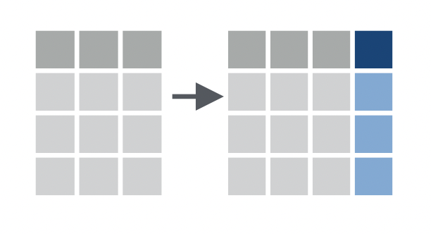
The 5 Verbs: dplyr
mutate() the data i.e. add or modify a column
Add a column to the dataset as a product of existing column. Ex.
a0
a1
b1
a0
a1
b1
c1
4
4
8
2
2
4
2
2
4
data %>%
mutate(c1 = a0 * 2)

Slide 5
The 5 Verbs: dplyr
mutate() the data i.e. add or modify a column
Add a column to the dataset as a product of existing column(s). Ex.
a0
a1
b1
a0
a1
b1
c1
4
3
4
3
7
2
7
2
7
9
2
1
2
1
3
data %>%
mutate(c1 = a0 + b1)

Slide 6
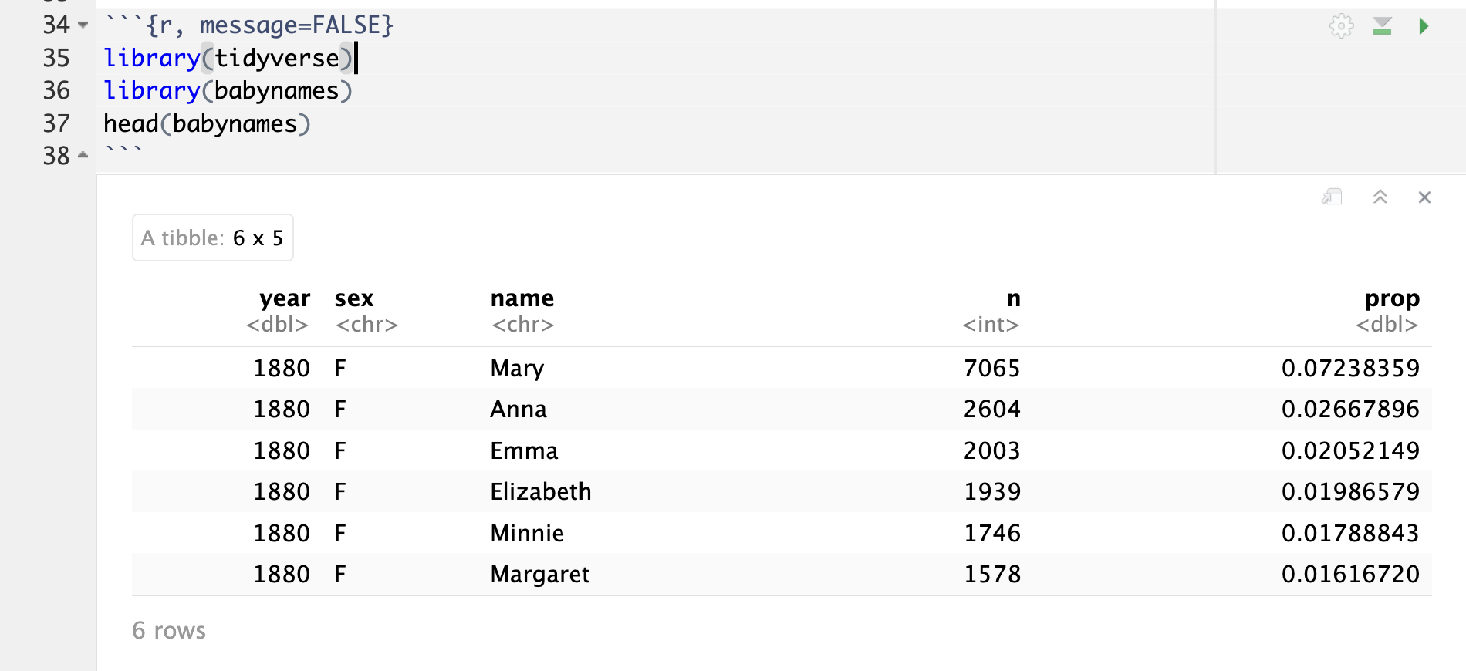
The 5 Verbs: dplyr
mutate() the data i.e. add or modify a column
Add a column to the dataset as a product of existing column(s). Ex.
a0
a1
b1
a0
a1
b1
c1
4
3
4
3
7
2
7
2
7
9
2
1
2
1
3
data %>%
mutate(c1 = a0 + b1)

Slide 7
The 5 Verbs: dplyr
mutate() the data i.e. add or modify a column
Work with whoever is near you to add a column to babynames called popular that is TRUE if a name was assigned to more than 1% of all babies in a given year

Slide 8
The 5 Verbs: dplyr
mutate() the data i.e. add or modify a column
Work with whoever is near you to add a column to babynames called popular that is TRUE if a name was assigned to more than 1% of all babies in a given year
babynames <- babynames %>%
mutate(popular = prop > 0.01)

Slide 9
rename
rename() change the name of a variable
babynames <- babynames %>%
rename(is_popular = popular)

Slide 10
Review
Use is_popular and filter() to create a subset of babynames that contains only popular names

Slide 11
Review
Use is_popular and filter() to create a subset of babynames that contains only popular names
popular <- babynames %>%
filter(is_popular)

Slide 12
Review
Use is_popular and filter() to create a subset of babynames that contains only popular names
How many names are popular?
popular <- babynames %>%
filter(is_popular)

Slide 13
Review
Use is_popular and filter() to create a subset of babynames that contains only popular names
How many names are popular?
3878
popular <- babynames %>%
filter(is_popular)
nrow(popular)

Slide 14
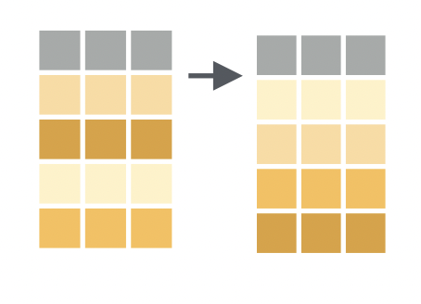
The 5 Verbs: dplyr
arrange() the rows in a specific order
Order rows by value of a column(s) from low to high. Ex.
a0
a1
b1
a0
a1
b1
2
0
5
2
0
3
3
5
data %>%
arrange(a0)

Slide 15
The 5 Verbs: dplyr
arrange() the rows in a specific order
Order rows by value of a column(s) from low to high. Use desc() to go from high to low. Ex.
a0
a1
b1
a0
a1
b1
3
5
0
3
5
2
2
0
data %>%
arrange(desc(a0))

Slide 16
The 5 Verbs: dplyr
arrange() the rows in a specific order
Work with whoever is near you to find the most popular names of all time

Slide 17
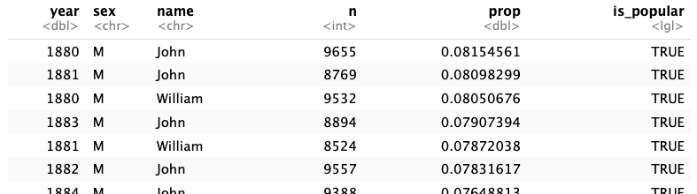
The 5 Verbs: dplyr
arrange() the rows in a specific order
Work with whoever is near you to find the most popular names of all time
popular %>%
arrange(desc(prop))

Slide 18
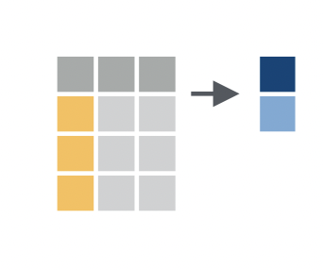
The 5 Verbs: dplyr
summarize() column with a single value(s)
Apply a summary function to a column. Ex.
a0
a1
b1
3
4
4
5
data %>%
summarize(mean(a0))

Slide 19
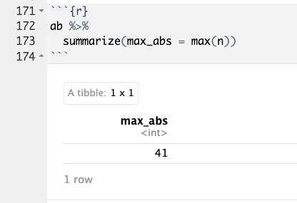
The 5 Verbs: dplyr
summarize() column with a single value(s)

Slide 20
The 5 Verbs: dplyr
summarize() column with a single value(s)
Tip: use the function n() inside of summarize to keep track of how many rows were summarized
a0
a1
b1
3
4
4
5

Slide 21
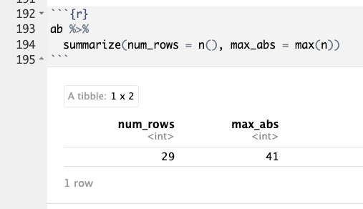
The 5 Verbs: dplyr
summarize() column with a single value(s)

Slide 22
Your Turn!
Work with classmates:
Choose a name and find the year it was used most frequently
What was the most popular name that year?
In which year was the name you picked given to M and F babies most equally? i.e. closest to a 50/50 split

