Slide 1
Data Science for Everyone – Grammar of Graphics Extra Stuff
Dr. Ab Mosca (they/them)
Slides based off slides courtesy of Jordan Crouser (https://jcrouser.github.io/)

Slide 2
Plan for Today
Look at faceting
Practice using ggplot

Slide 3
Faceting
Faceting is ggplot2 parlance for small multiples
The idea is to create separate graphs for subsets of data
ggplot2 offers two functions for creating small multiples:
facet_wrap(): define subsets as the levels of a single grouping variable
facet_grid(): define subsets as the crossing of two grouping variables
Facilitates comparison among plots, not just of geoms within a plot

Slide 4
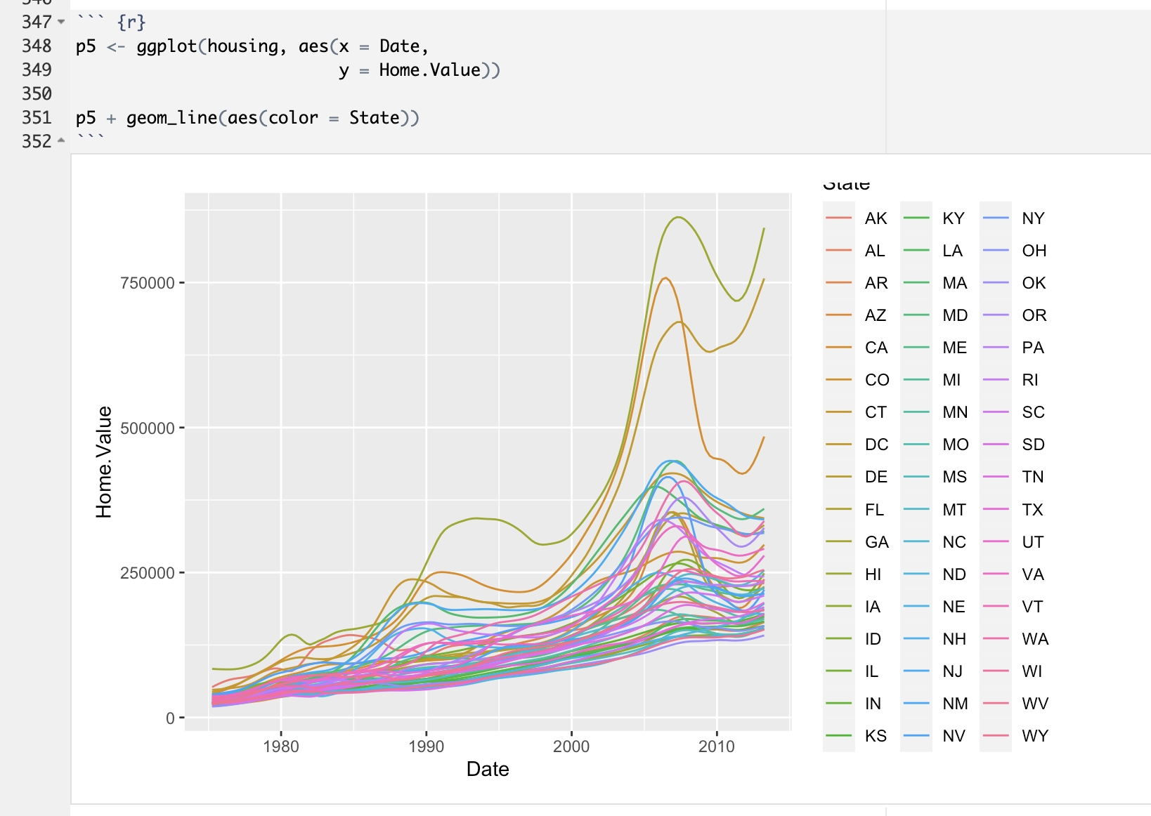
Faceting
Example: what is the trend in housing prices in each state?

Slide 5
Faceting
Example: what is the trend in housing prices in each state?
Yikes that’s impossible to read…

Slide 6
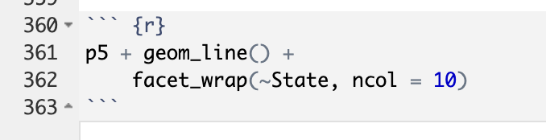
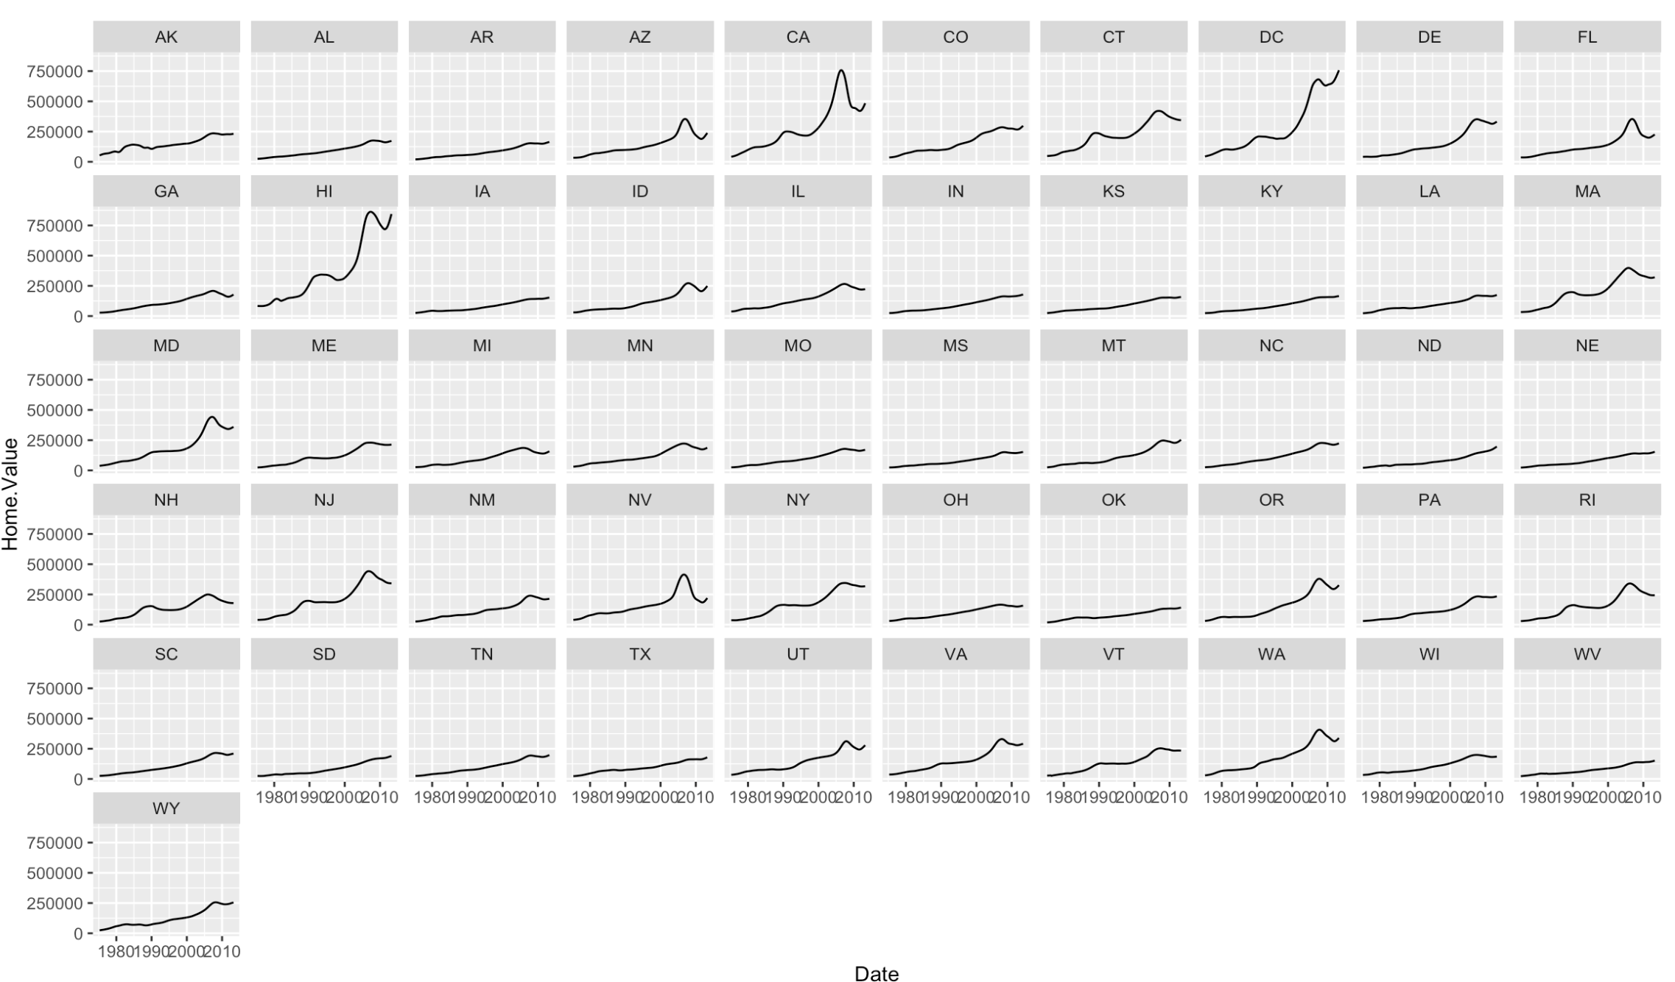
Faceting
Example: what is the trend in housing prices in each state?

Slide 7
Try it out!
Download ggplots Lab from the Labs tab of the course website
Work through the lab with 1-2 other people
Let me know when you have questions ☺

