Slide 1
Data Science for Everyone – Data Wrangling
Dr. Ab Mosca (they/them)
Slides based off slides courtesy of Jordan Crouser (https://jcrouser.github.io/)

Slide 2
Plan for Today
Wrangling Data in one Table

Slide 3
Using Data
What are some things we might want (or need) to do with data in order to analyze it?

Slide 4
Using Data
What are some things we might want (or need) to do with data in order to analyze it?
Select some (but not all) columns
Filter to some (but not all) rows
Mutate the data i.e. add or modify a column
Arrange the rows in a specific order
Summarize column with a single value(s)

Slide 5
The 5 Verbs: dplyr
What are some things we might want (or need) to do with data in order to analyze it?
select() some (but not all) columns
filter() to some (but not all) rows
mutate() the data i.e. add or modify a column
arrange() the rows in a specific order
summarize() column with a single value(s)

Slide 6

dplyr
R package for data wrangling (cleaning, reshaping, and analyzing data)
Big ideas:
Each “verb” (function) takes as input a tbl_df and returns a tbl_df
Verbs can be combined with “chaining” via the pipe operator (%>%)
Cheatsheet: https://www.rstudio.com/resources/cheatsheets/

Slide 7

tbl_df
“tibble”
object of class tbl
re-imagining of data.frame (makes them easier to work with!)
tidyverse (which includes dplyr) works with tibbles

Slide 8
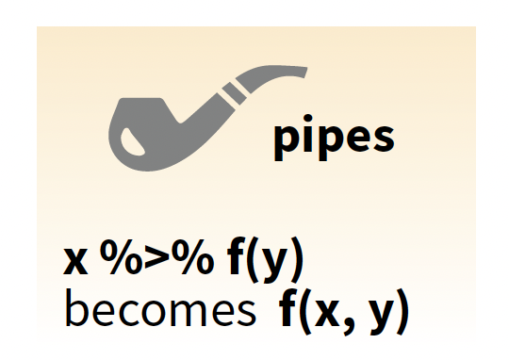
Pipe Operator
Verbs are used with the pipe (%>%) operator

Slide 9
Pipe operator
%>% (pipe operator)
With the pipe operator the expression
becomes
verb(mydata, arguments)
mydata %>%
verb(arguments)

Slide 10
Pipe operator
%>% (pipe operator)
More generally,
becomes
function(x, args)
x %>%
function(args)

Slide 11
Pipe operator
%>% (pipe operator)
This helps A LOT with readability!
Work with the person next to you to rewrite this using pipes:
select(data, arg)

Slide 12
Pipe operator
%>% (pipe operator)
This helps A LOT with readability!
data %>%
select(arg)

Slide 13
Pipe operator
%>% (pipe operator)
This helps A LOT with readability!
Work with the person next to you to rewrite this using pipes:
select(filter(mutate(data, args1), args2), args3)

Slide 14
Pipe operator
%>% (pipe operator)
This helps A LOT with readability!
vs.
select(filter(mutate(data, args1), args2), args3)
data %>%
mutate(args1) %>%
filter(args2) %>%
select(args3)

Slide 15
The 5 Verbs
select()
filter()
mutate()
arrange()
summarize()

Slide 16
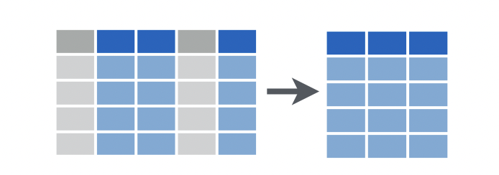
The 5 Verbs: dplyr
select() some (but not all) columns
Select column(s) by name. Ex:
a0
a1
b1
b2
c1
a1
b1
c1
data %>%
select(“a1”, “b1”, “c1”)

Slide 17
The 5 Verbs: dplyr
select() some (but not all) columns
Select column(s) by name or use other helper functions. Ex.
contains(match), ends_with(match), matches(match), starts_with(match)
a0
a1
b1
b2
c1
a1
b1
c1
data %>%
select(contains(“1”))
Notes:
some but not all == subset

Slide 18
The 5 Verbs: dplyr
select() some (but not all) columns
Select column(s) by specifying exclusions. Ex.
a0
a1
b1
b2
c1
a1
b1
c1
data %>%
select(-a0, -b2)
Notes:
some but not all == subset

Slide 19
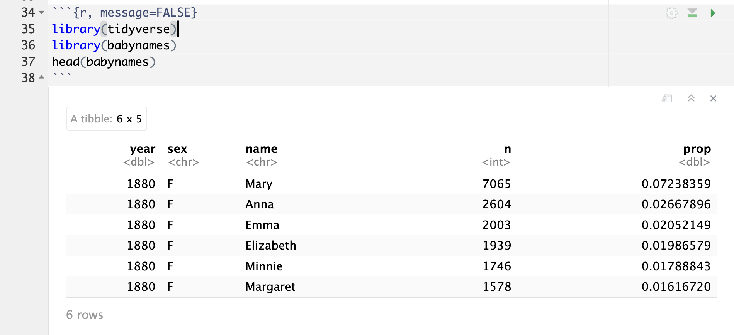
The 5 Verbs: dplyr
select() some (but not all) columns
Notes:
some but not all == subset

Slide 20
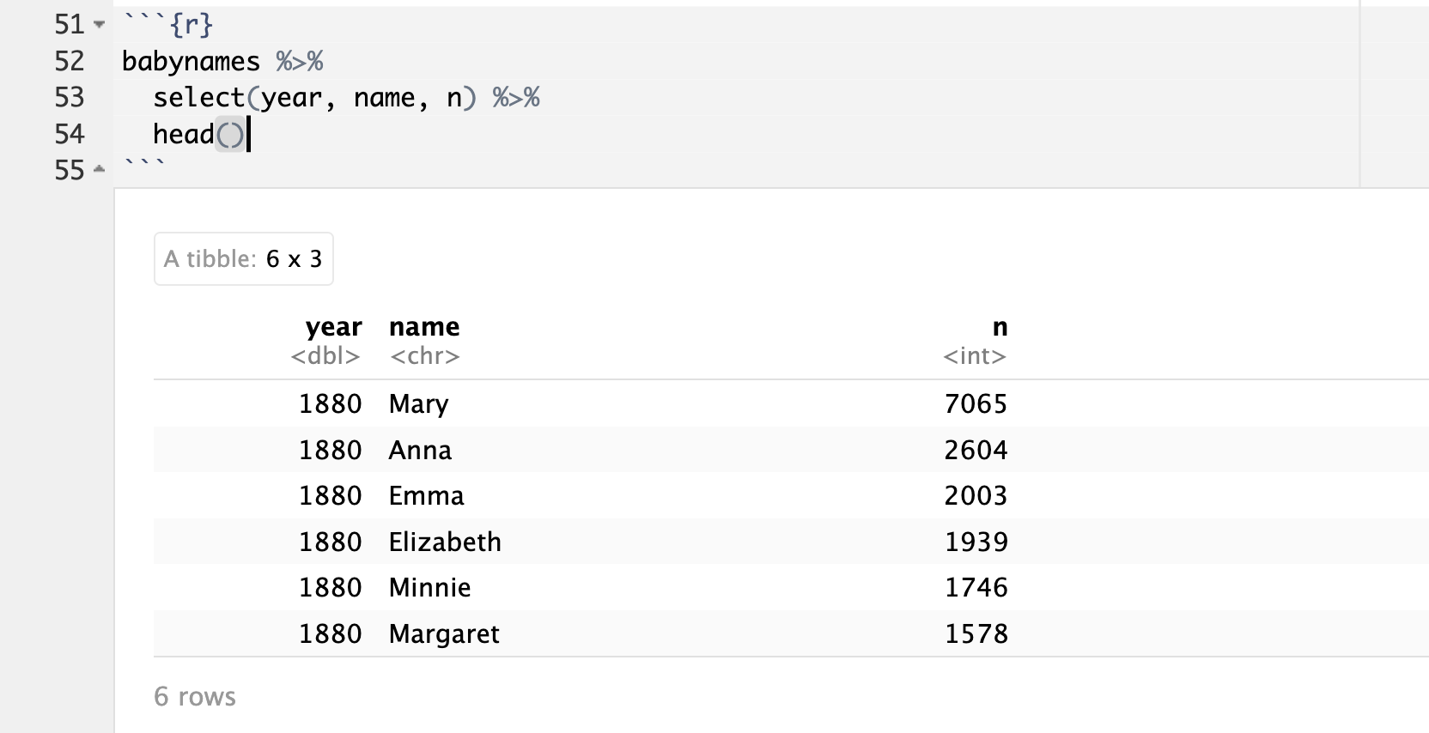
The 5 Verbs: dplyr
select() some (but not all) columns
Notes:
some but not all == subset

Slide 21
The 5 Verbs: dplyr
select() some (but not all) columns
Work with whoever is near you to select all columns of babynames except sex and n
Notes:
some but not all == subset

Slide 22
The 5 Verbs: dplyr
select() some (but not all) columns
Work with whoever is near you to select all columns of babynames except sex and n
babynames %>%
select(-sex, -n)
Notes:
some but not all == subset

Slide 23
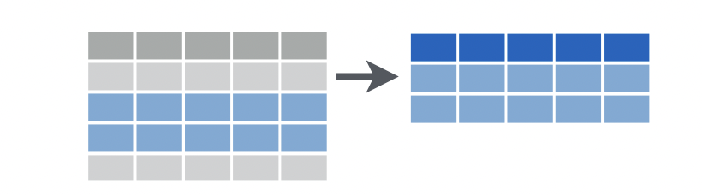
The 5 Verbs: dplyr
filter() to some (but not all) rows
Select rows that meet logical criteria. Ex:
a0
a1
b1
b2
c1
a0
a1
b1
b2
c1
4
2
2
2
2
1
data %>%
filter(a1 == 2)

Slide 24
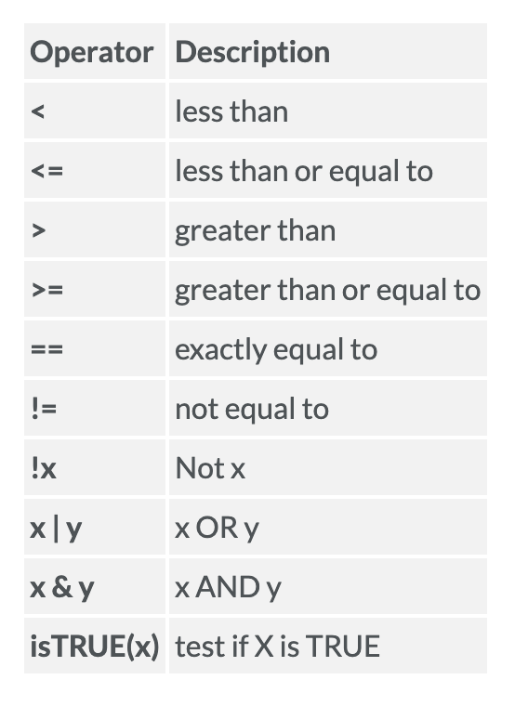
The 5 Verbs: dplyr
filter() to some (but not all) rows
Select rows that meet logical criteria. Ex:
a0
a1
b1
b2
c1
a0
a1
b1
b2
c1
4
2
2
2
2
1
data %>%
filter((a1 < 3) & (a1 > 1))

Slide 25
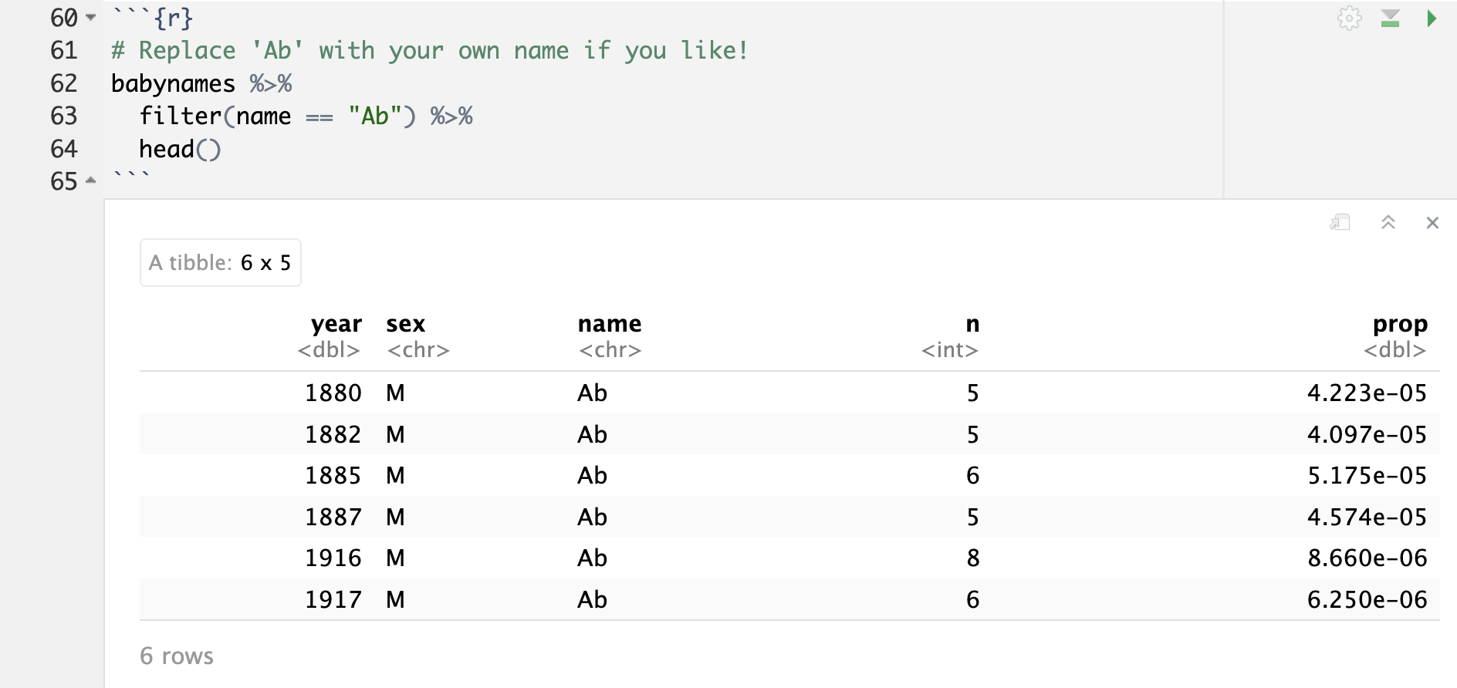
The 5 Verbs: dplyr
filter() to some (but not all) rows

Slide 26
The 5 Verbs: dplyr
filter() to some (but not all) rows
Work with whoever is near you to filter babynames to only years after 1920
Work with whoever is near you to filter babynames to only popular names (let popular be names that more than 15% of babies were named in a given year)

Slide 27
The 5 Verbs: dplyr
filter() to some (but not all) rows
Work with whoever is near you to filter babynames to only years after 1920
Work with whoever is near you to filter babynames to only popular names (let popular be names that at least 15% of babies were named in a given year)
babynames %>%
filter(year > 1920)
babynames %>%
filter(prop >= 0.15)

Slide 28
The 5 Verbs: dplyr
I want to plot counts of the name Ab over the years by sex
How do I get the dataset I need to make this plot?
Talk it out with whoever is near you!

Slide 29
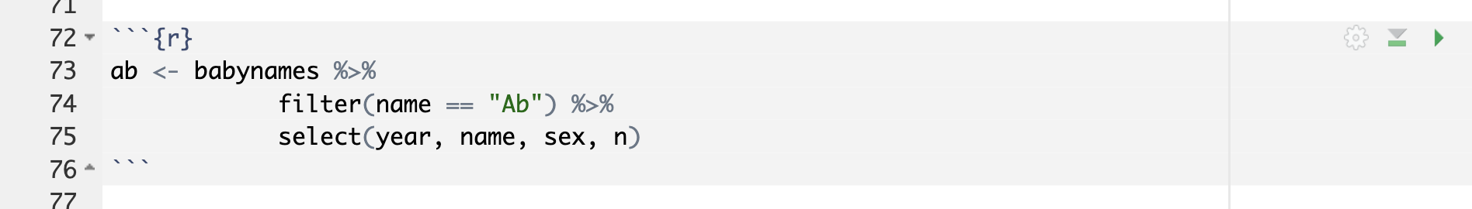
The 5 Verbs: dplyr
Combining verbs

Slide 30
The 5 Verbs: dplyr
Combining verbs
babynames is filtered to rows where name == “Ab”

Slide 31
The 5 Verbs: dplyr
Combining verbs
babynames is filtered to rows where name == “Ab”
we select year, name, sex, and n columns from filtered babynames

Slide 32

The 5 Verbs: dplyr
I want to plot counts of the name Ab over the years by sex
Now, make the plot!
Talk it out with whoever is near you!

Slide 33
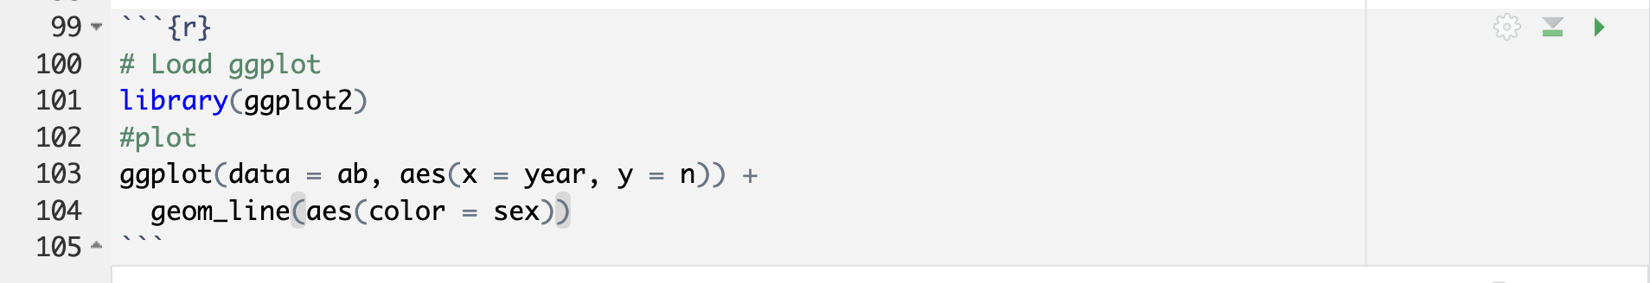
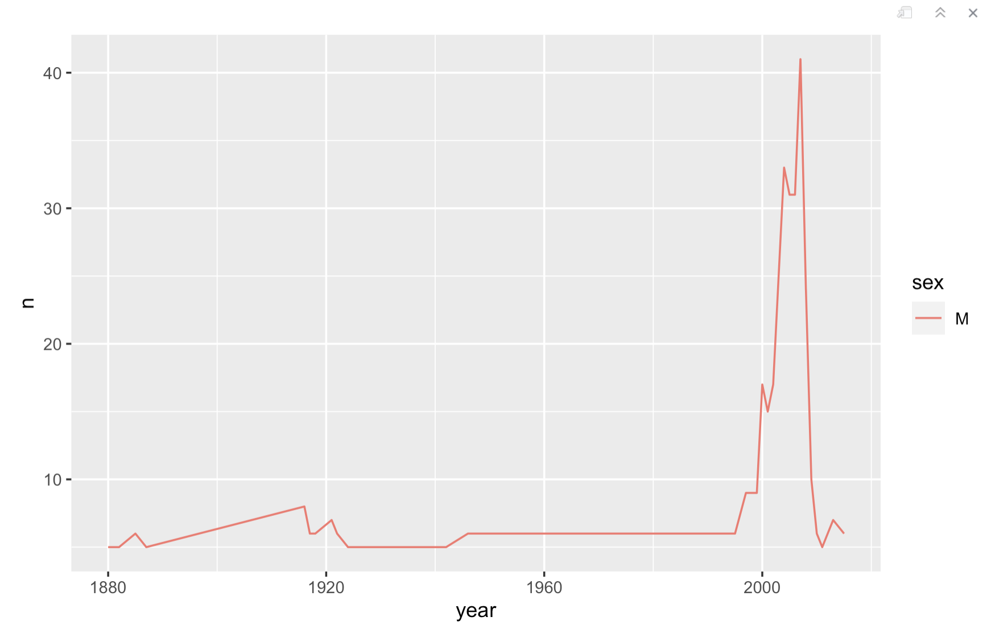
The 5 Verbs: dplyr

