Slide 1
Data Science for Everyone – Data Wrangling
Dr. Ab Mosca (they/them)
Slides based off slides courtesy of Jordan Crouser (https://jcrouser.github.io/)

Slide 2
Plan for Today
Wrangling Data in one Table

Slide 3
The 5 Verbs
select()
filter()
mutate()
arrange()
summarize()

Slide 4
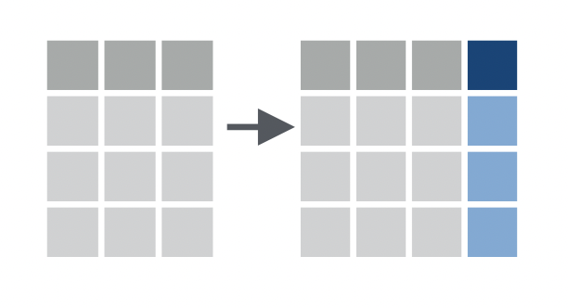
The 5 Verbs: dplyr
mutate() the data i.e. add or modify a column
Add a column to the dataset as a product of existing column(s). Ex.
a0
a1
b1
a0
a1
b1
c1
4
4
8
2
2
4
2
2
4
data %>%
mutate(c1 = a0 * 2)

Slide 5
The 5 Verbs: dplyr
mutate() the data i.e. add or modify a column
Add a column to the dataset as a product of existing column(s). Ex.
a0
a1
b1
a0
a1
b1
c1
4
3
4
3
7
2
7
2
7
9
2
1
2
1
3
data %>%
mutate(c1 = a0 + b1)

Slide 6
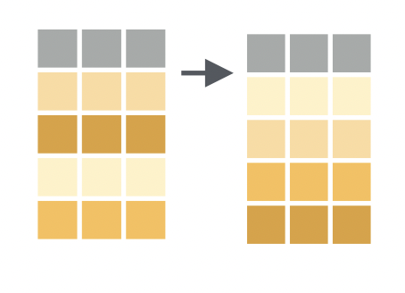
The 5 Verbs: dplyr
arrange() the rows in a specific order
Order rows by value of a column(s) from low to high. Ex.
a0
a1
b1
a0
a1
b1
2
0
5
2
0
3
3
5
data %>%
arrange(a0)

Slide 7
The 5 Verbs: dplyr
arrange() the rows in a specific order
Order rows by value of a column(s) from low to high. Use desc() to go from high to low. Ex.
a0
a1
b1
a0
a1
b1
3
5
0
3
5
2
2
0
data %>%
arrange(desc(a0))

Slide 8
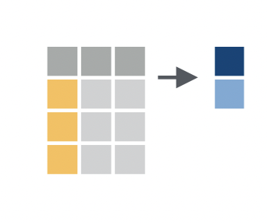
The 5 Verbs: dplyr
summarize() column with a single value(s)
Apply a summary function to a column. Ex.
a0
a1
b1
3
4
4
5
data %>%
summarize(mean(a0))

