Slide 1
Data Science for Everyone – Welcome!
Dr. Ab Mosca (they/them)
Slides based off slides courtesy of Jordan Crouser (https://jcrouser.github.io/)

Slide 2
Plan for Today
Who am I?
Who are you?
What will we do in this class?
What is Data Science?

Slide 3



Who Am I?

Slide 4


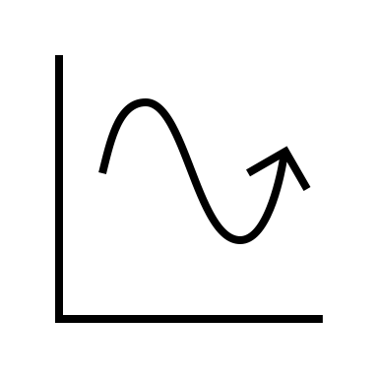
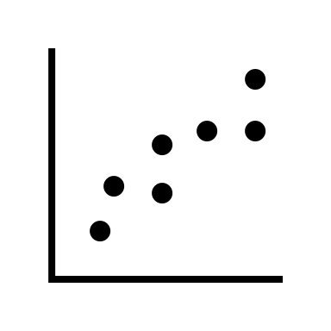

Who Am I?
Dr.

Slide 5



Who Am I?
Dr.

Slide 6
Who Are You?
Form groups of 3
Introduce yourselves (name, pronouns)
Share:
A highlight of your summer
Find 1 thing that your entire group has in common (favorite color? hometown? left-handed? Be creative!)
After about 5 minutes we will go around, introduce ourselves, and share what each group has in common

Slide 7
Who Are You?
Form new groups of 3 (move around!)
Introduce yourselves (name, pronouns)
Share:
Would you rather be able to read any book in seconds OR remember everything you ever read perfectly?
Find 1 thing that your entire group has in common (favorite color? hometown? left-handed? Be creative!)
After about 5 minutes we will go around, introduce ourselves, and share what each group has in common

Slide 8
Who Are You?
Form new new groups of 3 (move around!)
Introduce yourselves (name, pronouns)
Share:
Would you rather have school 7 days a week for 6 months + 6 months off OR have school 3 days a week year-round?
Find 1 thing that your entire group has in common (favorite color? hometown? left-handed? Be creative!)
After about 5 minutes we will go around, introduce ourselves, and share what each group has in common

Slide 9
What You Will Learn & Logistics

Slide 10
What Is This Class?
An introduction to the field of Data Science assuming no prior knowledge of the subject
You will learn…
How to do data science (basic techniques and foundations)
How data science shows up in different fields (public health, city planning, etc.)
How to be a critical consumer of data science

Slide 11
**Important Info**
Course website (write this down!): https://amosca01.github.io/Intro-DS-F23/
Slack: https://join.slack.com/t/slack-5iy4385/shared_invite/zt-20pmy0gm9-GtGfeiVqejOx5Gs5MomdFA (please use slack for all course related communication)
OH’s: T/R 11:30 – 13:30 (stop by and say hi!)

Slide 12
**Important Info**
Textbook: Modern Data Science with R, 2nd Edition
Available free of charge here: https://mdsr-book.github.io/mdsr2e/
Assignments:
Turn in with Gradescope (entry code - 57E78Y): https://www.gradescope.com/courses/556961
Homeworks – largely effort based
Quizzes – open book / notes / google
Projects – group based, application of skills
Due Dates: As listed on course schedule.
24hr grace period; no late submissions
Lowest homework and quiz dropped
No regrades; see syllabus for revise and resubmit instructions

Slide 13
**Important Info**
I’m here to help you succeed
Please come to office hours or reach out on Slack if you need any additional support

Slide 14
Now the good stuff

Slide 15
Defining Data Science
How would you define data science?
Talk it out with the person sitting next to you then add your definition to the board

Slide 16
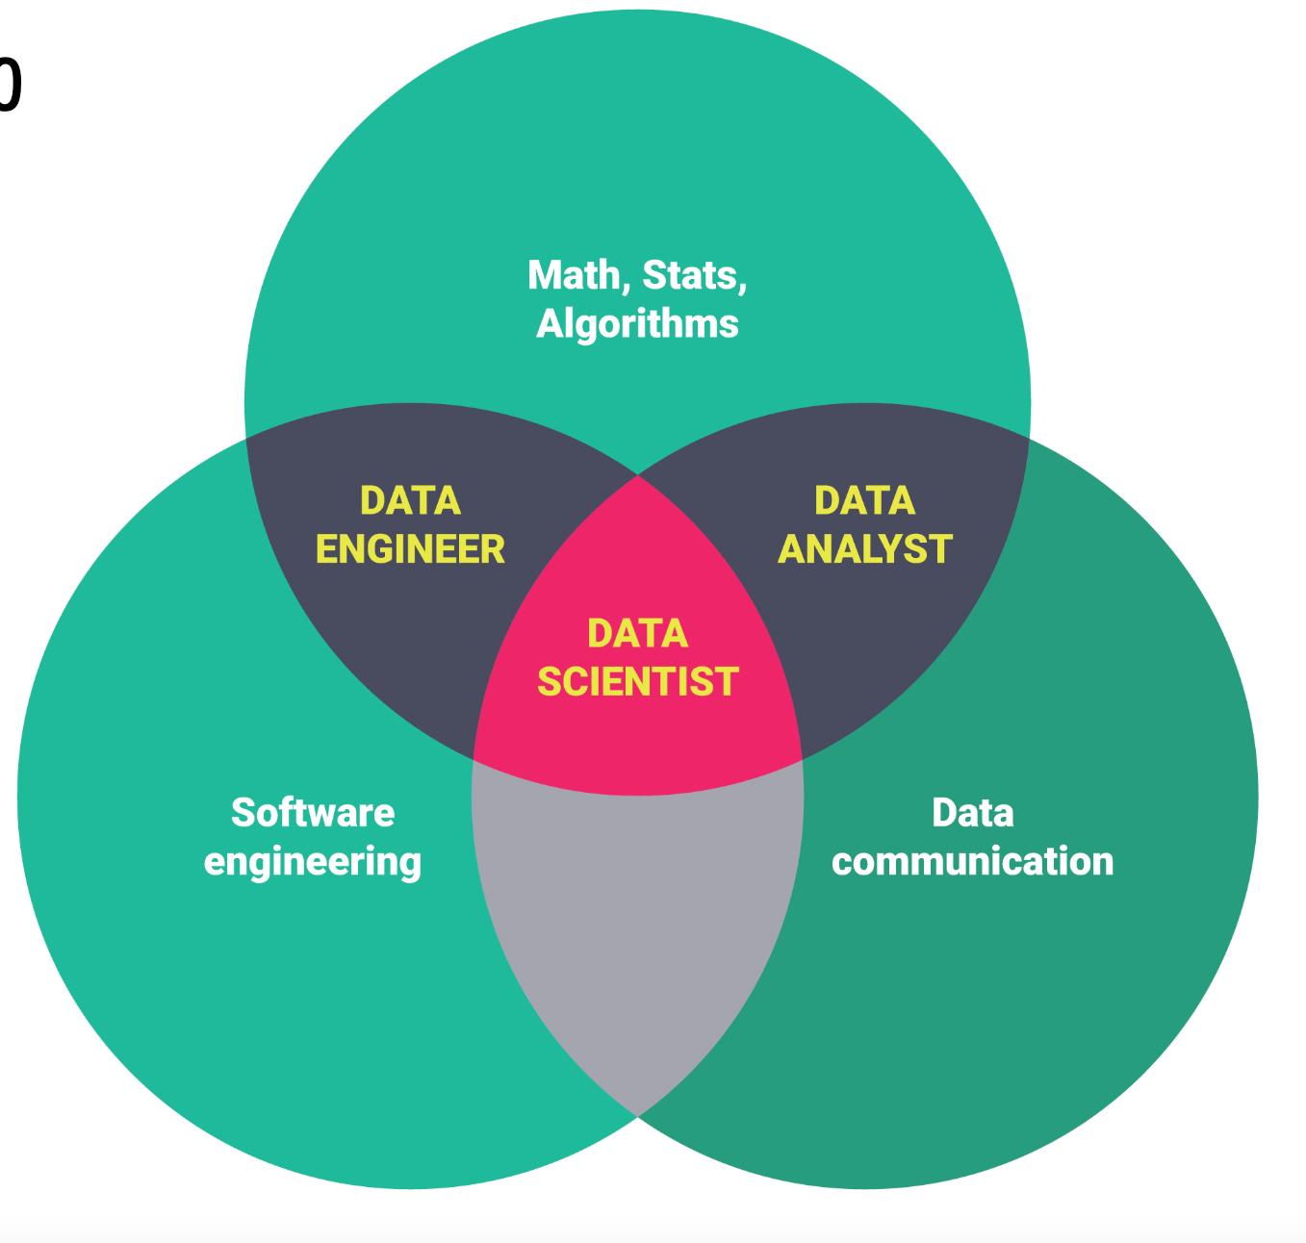
Definition: Data Science

Slide 17
Defining Ethics
How would you define ethics?
Talk it out with the person sitting next to you then add your definition to the board

Slide 18
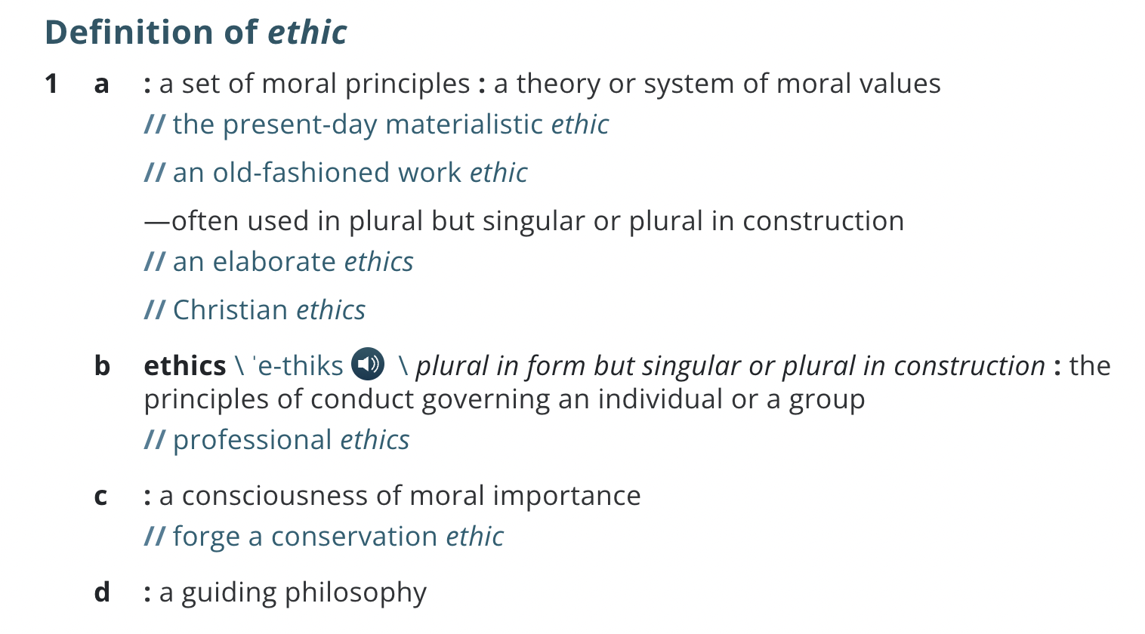
Definition: Ethics
https://www.merriam-webster.com/dictionary/ethic

Slide 19
Defining Ethical Data Science
How would you define ethical data science?

Slide 20
Definition: Ethical Data Science
Applying theories and systems of moral values (ethics) to our data science work

Slide 21
Ethical Data Science
Applying theories and systems of moral values (ethics) to our data science work
Why is this important?

Slide 22
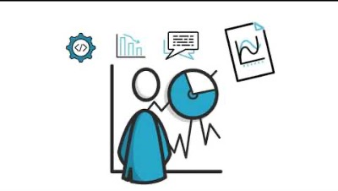
Ethical Data Science
Applying theories and systems of moral values (ethics) to our data science work
Why is this important?

Slide 23
Ethical Data Science
Applying theories and systems of moral values (ethics) to our data science work
Why is this important?
Can you think of other examples of things that can go wrong with data science?

Slide 24
Ethical Data Science
Applying theories and systems of moral values (ethics) to our data science work
Why is this important?
To combat algorithmic bias
To protect personal, identifying information
To increase reproducibility and replicability
Systems of power are woven into our society, and so are misunderstandings of what data science is and how it works

