Slide 1
Data Science for Everyone – Functions Pt2
Dr. Ab Mosca (they/them)
Slides based off slides courtesy of Jordan Crouser (https://jcrouser.github.io/)

Slide 2
Plan for Today
Recap user defined functions
Scope
Default values

Slide 3
User-defined Functions
Defining your own functions
name_of_function <- function(data, var = "value") {
...
...
<valid R code>
...
...
return(x)
}

Slide 4
User-defined Functions
Scope
Global environment
The general space in which you’re working
Global variable
Variable declared in your script outside of the body of a function
Global variables exist everywhere

Slide 5
User-defined Functions
Scope
Global environment
The general space in which you’re working
Global variable
Variable declared in your script outside of the body of a function
Global variables exist everywhere
Ex.
# global variable
global_var <- mtcars
top_cars <- function() {
# function body has access to global_var
local_var <- head(global_var)
return(local_var)
}
# Can print global_var outside of the function too
global_var

Slide 6
User-defined Functions
Scope
Local environment
Body of a function
Local variable
Variable declared within the body of a function
Local variables exist only within the body of the function in which they are declared

Slide 7
User-defined Functions
Scope
Local environment
Body of a function
Local variable
Variable declared within the body of a function
Local variables exist only within the body of the function in which they are declared
Ex.
# global variable
global_var <- mtcars
top_cars <- function() {
# declare local_var
local_var <- head(global_var)
return(local_var)
}
# Cannot print local_var outside of the function
local_var # causes error

Slide 8
User-defined Functions
Default Values
When defining a function, you can set default values for the arguments
This can make functions easier to use
Any default value can be overwritten

Slide 9
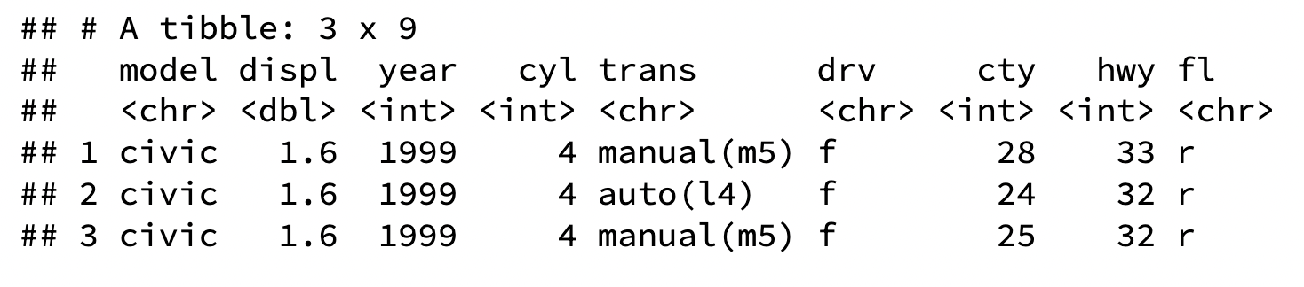
User-defined Functions
Default Values
my_car_info <- function(mod = "civic", n = 3) {
mpg %>%
filter(model == mod) %>%
select(-manufacturer, -class) %>%
head(n)
}
my_car_info()

Slide 10
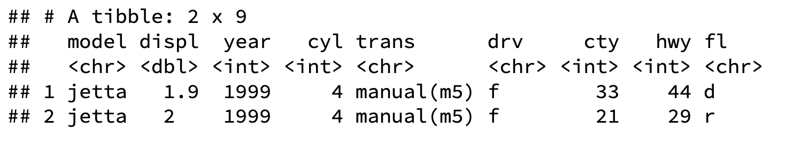
User-defined Functions
Overriding Default Values
my_car_info <- function(mod = "civic", n = 3) {
mpg %>%
filter(model == mod) %>%
select(-manufacturer, -class) %>%
head(n)
}
my_car_info()
my_car_info(mod = “jetta”, n = 2)

Slide 11
User-defined Functions
Naming Arguments
Optional

Slide 12
User-defined Functions
Naming Arguments
Optional
my_car_info(mod = “jetta”, n = 2)
my_car_info( “jetta”, 2)

Slide 13
User-defined Functions
Naming Arguments
Optional
But order matters if arguments are unnamed

Slide 14
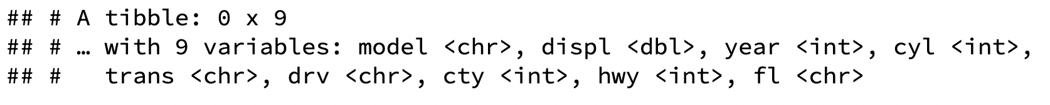
User-defined Functions
Naming Arguments
Optional
But order matters if arguments are unnamed
my_car_info(2, “jetta”)
my_car_info(n = 2, mod = “jetta”)

Slide 15
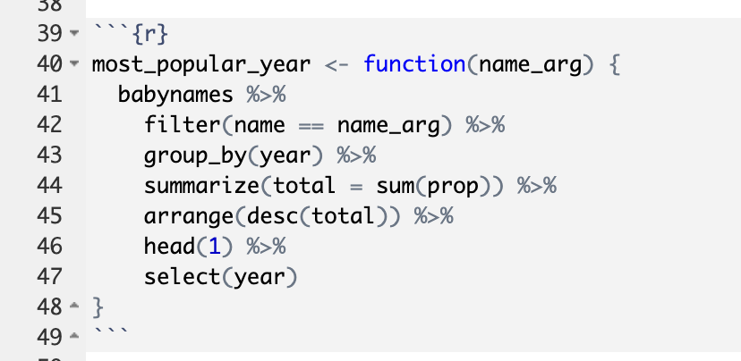
Practice
Remember our most_popular_year function? Re-write this function to:
Take data as an argument, with the default being babynames
Then, call your function for the name “Scout” for M and F babies separately

Slide 16
Practice
Write a function that will computer the 10 most popular baby names for a given dataset

Slide 17
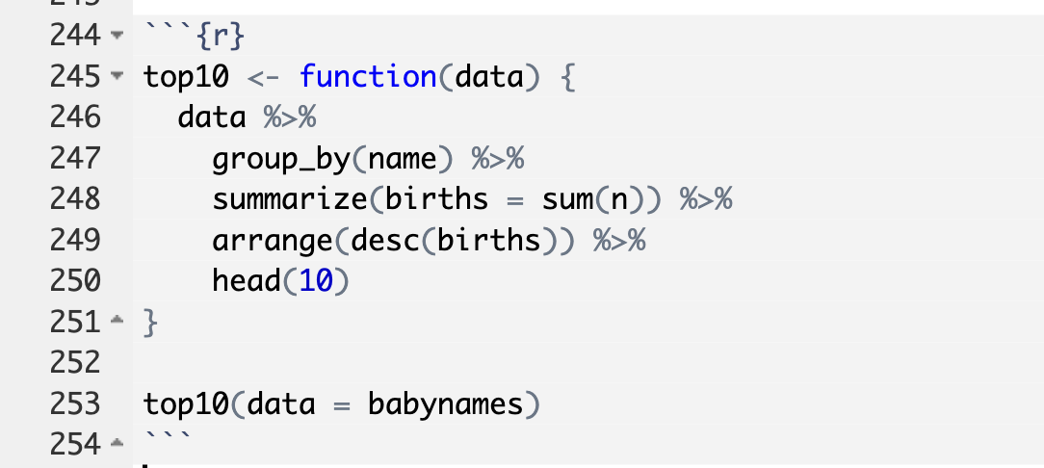
Practice
Write a function that will computer the 10 most popular baby names for a given dataset

Slide 18
Practice
Write a function that will computer the 10 most popular baby names for a given dataset
Call this function for each of the most recent three decades in the babynames dataset

