Slide 1
Data Science for Everyone – Data Wrangling – Joins 2
Dr. Ab Mosca (they/them)
Slides based off slides courtesy of Jordan Crouser (https://jcrouser.github.io/)

Slide 2
Plan for Today
Left and right joins
Full joins

Slide 3
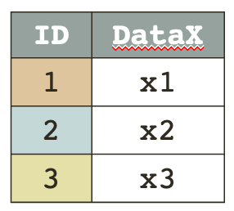
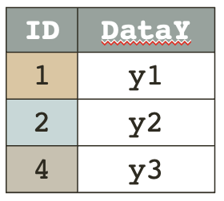
Joins
inner_join()
Resulting table has only rows in both tables
Table_X %>%
inner_join(Table_Y, by = “ID”)
key | DataX | DataY
1 | x1 | y1
2 | x2 | y2
Notes:
What’s the key?

Slide 4
Example
Let’s check that these have the same counts of babies
What column do SSA births and Census births share?
Do they have identical values in that column?

Slide 5
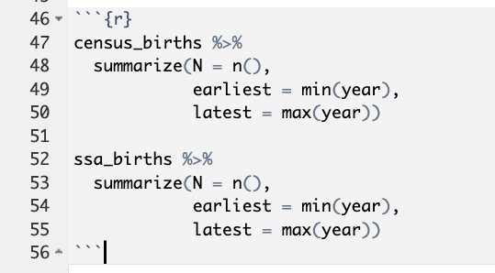
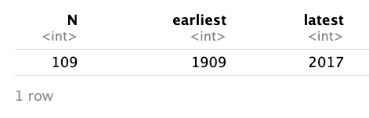
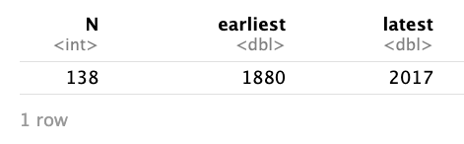
Example
Let’s check that these have the same counts of babies
What column do SSA births and Census births share?
Do they have identical values in that column?

Slide 6
Example
Let’s check that these have the same counts of babies
What column do SSA births and Census births share?
Do they have identical values in that column?
What will happen if we do an inner join?
census_births
ssa_births

Slide 7
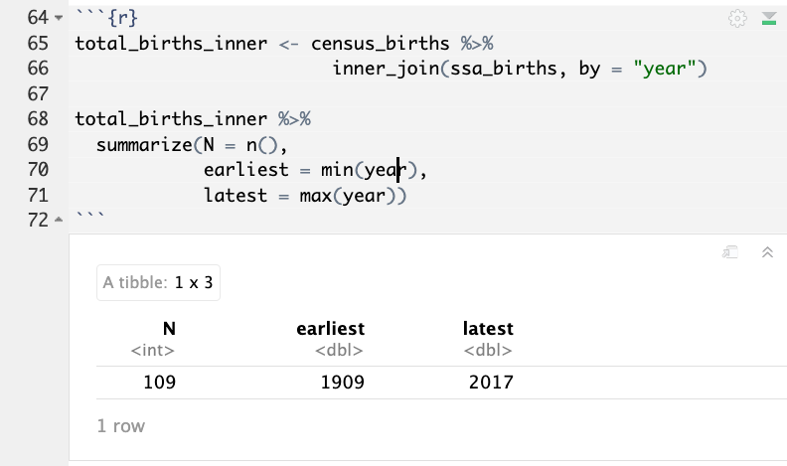
Example
Let’s check that these have the same counts of babies
What column do SSA births and Census births share?
Do they have identical values in that column?
What will happen if we do an inner join?
census_births
ssa_births

Slide 8
Joins
left_join()
What do you think a left join does?
Notes:
What’s the key?

Slide 9

Joins
left_join()
Resulting table has all rows in left table
Table_X %>%
left_join(Table_Y, by = “ID”)
key | DataX | DataY
1 | x1 | y1
2 | x2 | y2
3 | x3 | NA
Notes:
What’s the key?

Slide 10
Joins
left_join()
Resulting table has all rows in left table
Table_X %>%
left_join(Table_Y, by = “ID”)
How would you left join census_births and ssa_births?
What years would be in the output table?
key | DataX | DataY
1 | x1 | y1
2 | x2 | y2
3 | x3 | NA
census_births
ssa_births
Notes:
What’s the key?

Slide 11
Joins
left_join()
Resulting table has all rows in left table
Resulting table would have years 1909 - 2017
census_births %>%
left_join(ssa_births, by = “year”)
census_births
ssa_births
Notes:
What’s the key?

Slide 12
Joins
right_join()
What do you think a right join does?
Notes:
What’s the key?

Slide 13

Joins
right_join()
Resulting table has all rows in right table
Table_X %>%
right_join(Table_Y, by = “ID”)
key | DataX | DataY
1 | x1 | y1
2 | x2 | y2
4 | NA | y3
Notes:
What’s the key?

Slide 14
Joins
right_join()
Resulting table has all rows in right table
Table_X %>%
right_join(Table_Y, by = “ID”)
How would you right join census_births and ssa_births?
What years would be in the output table?
key | DataX | DataY
1 | x1 | y1
2 | x2 | y2
4 | NA | y3
census_births
ssa_births
Notes:
What’s the key?

Slide 15
Joins
right_join()
Resulting table has all rows in right table
Resulting table would have years 1880 - 2017
census_births%>%
right_join(ssa_births, by = “year”)
census_births
ssa_births
Notes:
What’s the key?

Slide 16
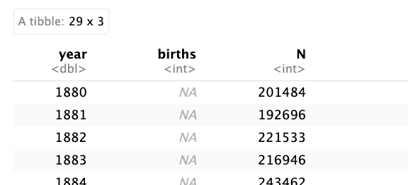
Joins
right_join()
Resulting table has all rows in right table
Resulting table would have years 1880 – 2017
Years missing in census_births would have NA data
census_births%>%
right_join(ssa_births, by = “year”)
census_births
ssa_births
Notes:
What’s the key?

Slide 17
Joins
full_join()
What do you think a full join does?
Notes:
What’s the key?

Slide 18
Joins
full_join()
Resulting table has all rows in both tables
Table_X %>%
full_join(Table_Y, by = “ID”)
key | DataX | DataY
1 | x1 | y1
2 | x2 | y2
3 | x3 | NA
4 | NA | y3
Notes:
What’s the key?

Slide 19
Joins
full_join()
Resulting table has all rows in both tables
Table_X %>%
full_join(Table_Y, by = “ID”)
How would you full join census_births and ssa_births?
What years would be in the output table?
key | DataX | DataY
1 | x1 | y1
2 | x2 | y2
3 | x3 | NA
4 | NA | y3
census_births
ssa_births
Notes:
What’s the key?

Slide 20
Joins
full_join()
Resulting table has all rows in both tables
Resulting table has years 1880 – 2017
census_births %>%
full_join(ssa_births, by = “year”)
census_births
ssa_births
Notes:
What’s the key?

Slide 21
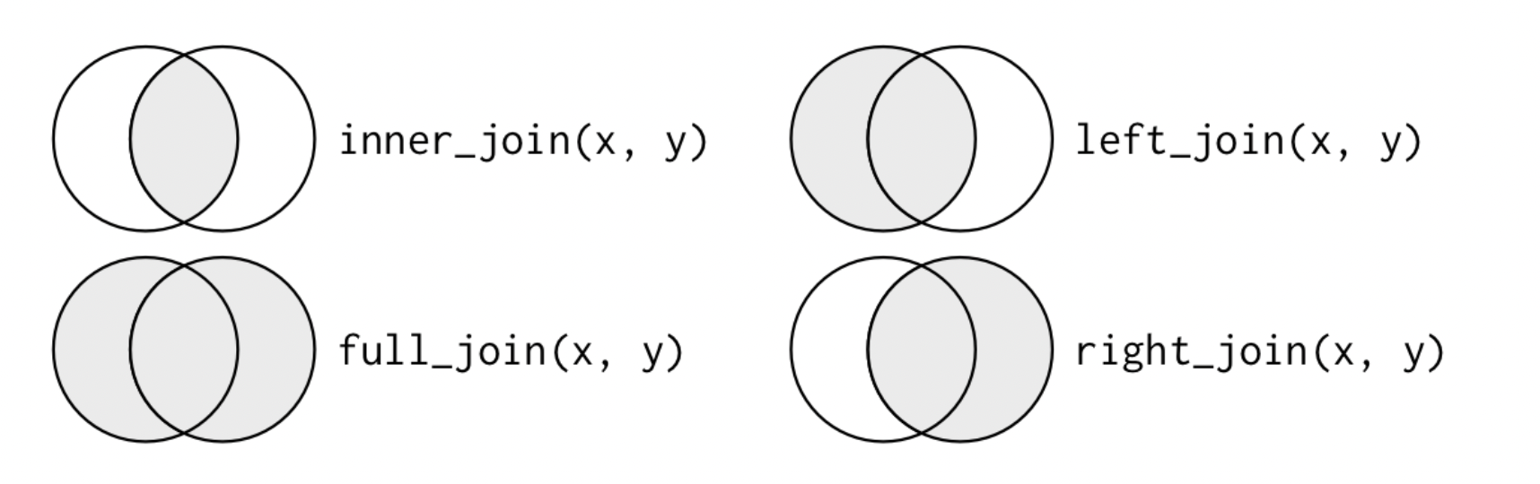
Joins
Another way to visualize joins
Notes:
What’s the key?

Slide 22
Exercise
What is the difference between
left joining census_births and ssa_births
and
right joining ssa_births and census_births
?
Notes:
What’s the key?

Slide 23
Exercise
Open R Studio in posit cloud
Do a full join of ssa_births and census_births
Add a variable indicating if the count for each year from the datasets are equal
Are all the counts equal?
Create a plot to compare the counts over time
Notes:
What’s the key?

