Slide 1
Data Science for Everyone – Data Wrangling – Joins 3
Dr. Ab Mosca (they/them)
Slides based off slides courtesy of Jordan Crouser (https://jcrouser.github.io/)

Slide 2
Plan for Today
Look more at keys

Slide 3
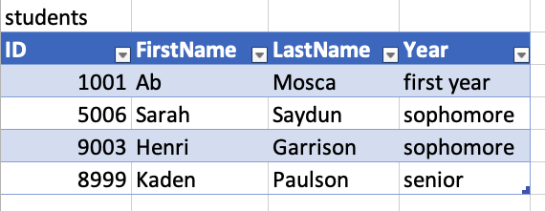
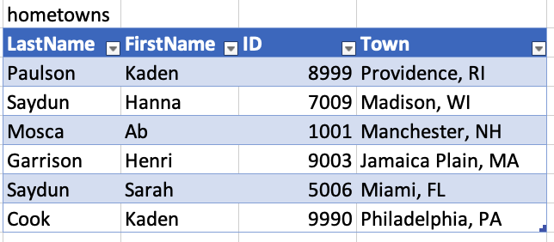
Keys
What uniquely links one row in students to one row in hometowns?

Slide 4
Keys
What uniquely links one row in students to one row in hometowns?

Slide 5
Keys
full_table <- students %>%
full_join(hometowns, by = “ID”)
What uniquely links one row in students to one row in hometowns?

Slide 6
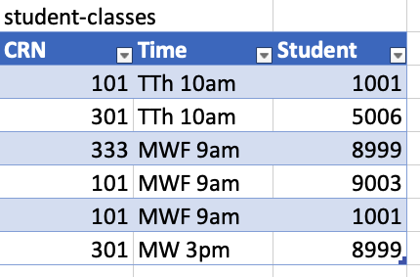
Keys
What uniquely links one row in students to one row in student-classes?

Slide 7
Keys
What uniquely links one row in students to one row in student-classes?

Slide 8
Keys
full_table <- students %>%
full_join(student-classes, by = c(“ID” = “Student”)
What uniquely links one row in students to one row in student-classes?

Slide 9
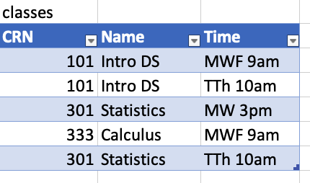
Keys
What uniquely links one row in student-classes to one row in classes?

Slide 10
Keys
full_table <- student-classes %>%
full_join(classes, by = c(“CRN”, “Time”)
What uniquely links one row in student-classes to one row in classes?

Slide 11
Your turn
Work with 1-2 other classmates on lab-join.Rmd

