Slide 1
Data Science for Everyone – Data Wrangling – Tidy Data
Dr. Ab Mosca (they/them)
Slides based off slides courtesy of Jordan Crouser (https://jcrouser.github.io/)

Slide 2
Plan for Today
Define Tidy data
Clean messy data

Slide 3
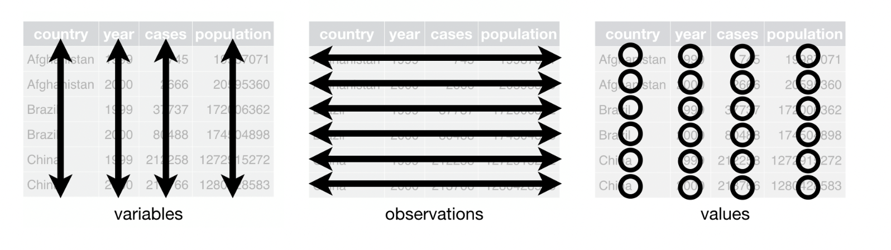
Reminder: Table Vocabulary
columns
rows
cells

Slide 4
Reminder: Table Vocabulary
When data is tidy, every column is a variable, every row is an observation, and every value has it’s own cell
We won’t always get data in this format; sometimes data collectors record data in different ways
columns
rows
cells

Slide 5
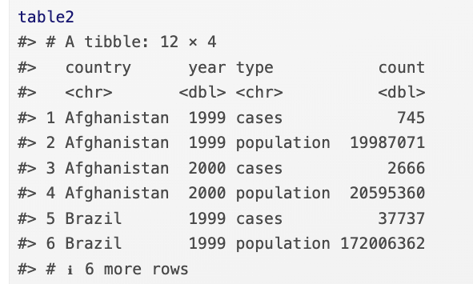
Messy / Tidy Data
When data is tidy, every column is a variable, every row is an observation, and every value has it’s own cell
Tidy or messy? Why?

Slide 6
Messy / Tidy Data
When data is tidy, every column is a variable, every row is an observation, and every value has it’s own cell
Tidy or messy? Why?
Notes:
One observation spans 2 rows

Slide 7
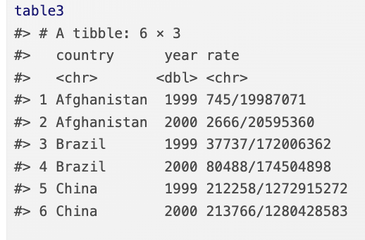
Messy / Tidy Data
When data is tidy, every column is a variable, every row is an observation, and every value has it’s own cell
Tidy or messy? Why?

Slide 8
Messy / Tidy Data
When data is tidy, every column is a variable, every row is an observation, and every value has it’s own cell
Tidy or messy? Why?
Notes:
multiple values in a cell

Slide 9
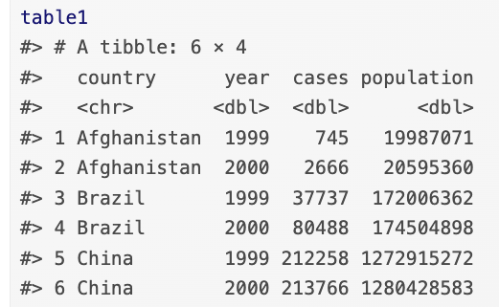
Messy / Tidy Data
When data is tidy, every column is a variable, every row is an observation, and every value has it’s own cell
Tidy or messy? Why?

Slide 10
Messy / Tidy Data
When data is tidy, every column is a variable, every row is an observation, and every value has it’s own cell
Tidy or messy? Why?
Notes:
multiple values in a cell

Slide 11
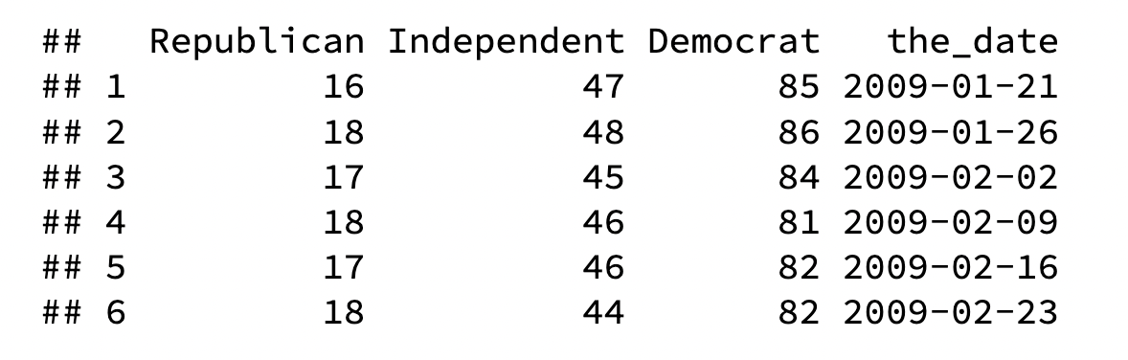
Messy / Tidy Data
When data is tidy, every column is a variable, every row is an observation, and every value has it’s own cell
Tidy or messy? Why?

Slide 12
Messy / Tidy Data
When data is tidy, every column is a variable, every row is an observation, and every value has it’s own cell
Tidy or messy? Why?
Notes:
Separate observations in one row (What if I want to compare Republican, Independent, and Democrat?)

Slide 13
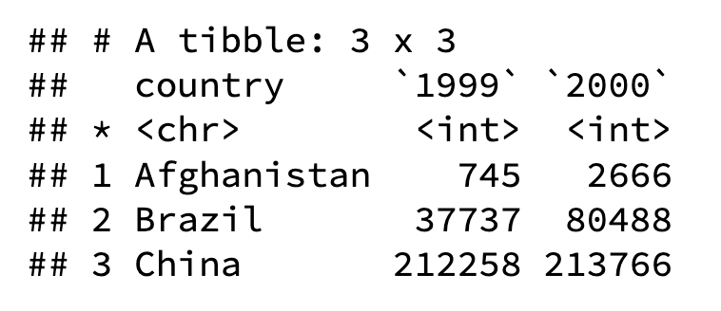
Messy / Tidy Data
When data is tidy, every column is a variable, every row is an observation, and every value has it’s own cell
Tidy or messy? Why?
Notes:
Primary key is student_id + subject_id. But teacher only needs subject_id to be retrieved. Thus, teacher is partially dependent on the table’s primary key.

Slide 14
Messy / Tidy Data
When data is tidy, every column is a variable, every row is an observation, and every value has it’s own cell
Tidy or messy? Why?
Notes:
Columns 1999 and 2000 contain separate observations for two different years (and should therefore be separate rows)
Column names contain important information (and should therefore be values)

Slide 15
Why care?
Uniformity makes learning tools easier
Most functions in the tidyverse are designed to work with tidy data (tidyverse, get it? ☺ )
Ex. ggplot, dplyr
Notes:
multiple values in a cell

Slide 16
Why care?
Uniformity makes learning tools easier
Most functions in the tidyverse are designed to work with tidy data (tidyverse, get it? ☺ )
Ex. ggplot, dplyr
Can you calculate case rate with one line of code for table3?
Notes:
multiple values in a cell

Slide 17
Why care?
Uniformity makes learning tools easier
Most functions in the tidyverse are designed to work with tidy data (tidyverse, get it? ☺ )
Ex. ggplot, dplyr
What about table1?
Notes:
multiple values in a cell

Slide 18
Why care?
table1 %>%
mutate(rate = cases / population * 10000)
Uniformity makes learning tools easier
Most functions in the tidyverse are designed to work with tidy data (tidyverse, get it? ☺ )
Ex. ggplot, dplyr
What about table1?
Notes:
multiple values in a cell

Slide 19
Why care?
How would you plot a line chart for this data with a line for each party?
Notes:
Primary key is student_id + subject_id. But teacher only needs subject_id to be retrieved. Thus, teacher is partially dependent on the table’s primary key.

Slide 20
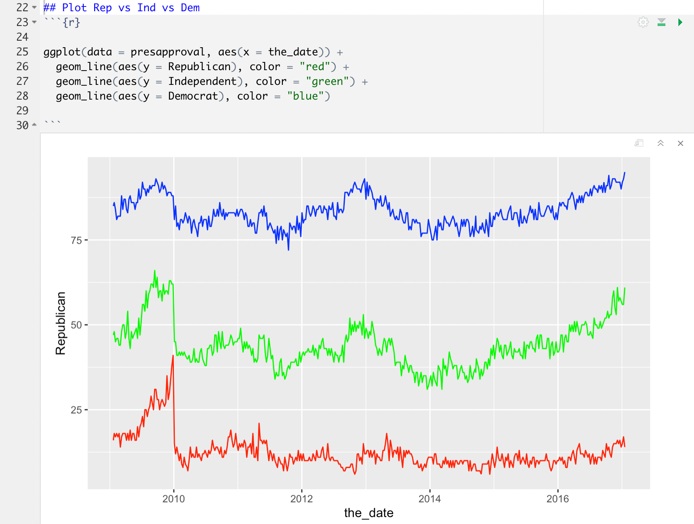
Why care?
Notes:
Primary key is student_id + subject_id. But teacher only needs subject_id to be retrieved. Thus, teacher is partially dependent on the table’s primary key.

Slide 21
Tidy Data
How do we make data Tidy?

Slide 22
Tidy Data
How do we make data Tidy?
Re-write this table in a tidy format
These values are approval ratings

Slide 23
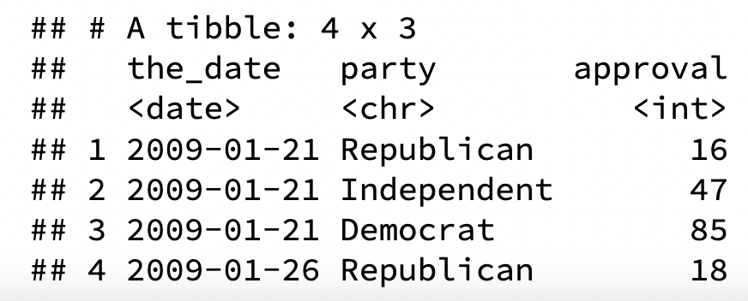
Tidy Data
How do we make data Tidy?
Re-write this table in a tidy format

Slide 24
Tidy Data
How do we make data Tidy?
Re-write this table in a tidy format
These values are cases
Notes:
Primary key is student_id + subject_id. But teacher only needs subject_id to be retrieved. Thus, teacher is partially dependent on the table’s primary key.

Slide 25
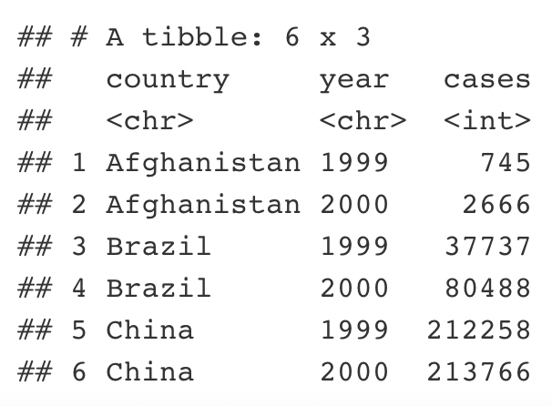
Tidy Data
How do we make data Tidy?
Re-write this table in a tidy format
Notes:
Primary key is student_id + subject_id. But teacher only needs subject_id to be retrieved. Thus, teacher is partially dependent on the table’s primary key.

Slide 26
Tidy Data
What was similar in these two cases?
What is similar in these two cases?

Slide 27
Tidy Data
Sometimes column headers contain data

Slide 28
Tidy Data
Sometimes column headers contain data
To correct this, we need to pivot our table

Slide 29
Tidy Data
Sometimes column headers contain data
To correct this, we need to pivot our table
When we move column headers to a variable, we pivot_longer

Slide 30
Tidy Data
pivot_longer
Each observation gets its own row
Number of rows increases (table gets longer)
Notes:
Primary key is student_id + subject_id. But teacher only needs subject_id to be retrieved. Thus, teacher is partially dependent on the table’s primary key.

Slide 31
Tidy Data
pivot_longer
Each observation gets its own row
Number of rows increases (table gets longer)
Notes:
Primary key is student_id + subject_id. But teacher only needs subject_id to be retrieved. Thus, teacher is partially dependent on the table’s primary key.

Slide 32
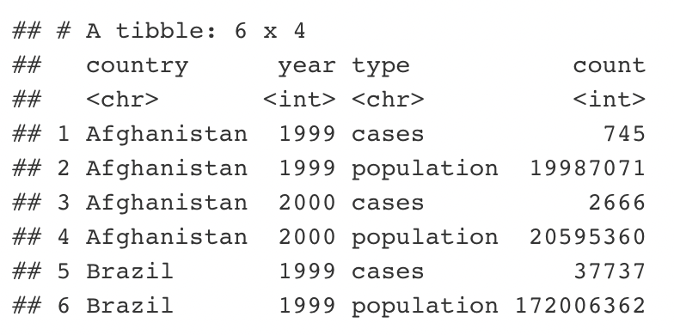
Tidy Data
How do we make data Tidy?
Re-write this table in a tidy format
Notes:
Primary key is student_id + subject_id. But teacher only needs subject_id to be retrieved. Thus, teacher is partially dependent on the table’s primary key.

Slide 33
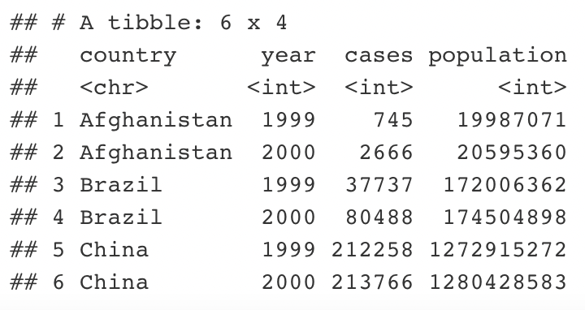
Tidy Data
How do we make data Tidy?
Re-write this table in a tidy format
Notes:
Primary key is student_id + subject_id. But teacher only needs subject_id to be retrieved. Thus, teacher is partially dependent on the table’s primary key.

Slide 34
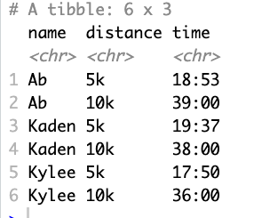
Tidy Data
How do we make data Tidy?
Re-write this table in a tidy format
Notes:
Primary key is student_id + subject_id. But teacher only needs subject_id to be retrieved. Thus, teacher is partially dependent on the table’s primary key.

Slide 35
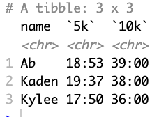
Tidy Data
How do we make data Tidy?
Re-write this table in a tidy format
Notes:
Primary key is student_id + subject_id. But teacher only needs subject_id to be retrieved. Thus, teacher is partially dependent on the table’s primary key.

Slide 36
Tidy Data
What was similar in these two cases?
What is similar in these two cases?

Slide 37
Tidy Data
Sometimes observations are split between rows

Slide 38
Tidy Data
Sometimes observations are split between rows
To correct this we need to pivot the table

Slide 39
Tidy Data
Sometimes observations are split between rows
To correct this we need to pivot the table
When we move observations from multiple rows to one row, we pivot_wider

Slide 40
Tidy Data
pivot_wider
Each observation gets its own row
Number of rows decreases
Notes:
Primary key is student_id + subject_id. But teacher only needs subject_id to be retrieved. Thus, teacher is partially dependent on the table’s primary key.

Slide 41
Tidy Data
pivot_wider
Each observation gets its own row
Number of rows decreases
Notes:
Primary key is student_id + subject_id. But teacher only needs subject_id to be retrieved. Thus, teacher is partially dependent on the table’s primary key.

Slide 42

tidyr
R package that helps make data tidy
We will primarily use two functions:
pivot_longer()
pivot_wider()
Notes:
Primary key is student_id + subject_id. But teacher only needs subject_id to be retrieved. Thus, teacher is partially dependent on the table’s primary key.

Slide 43
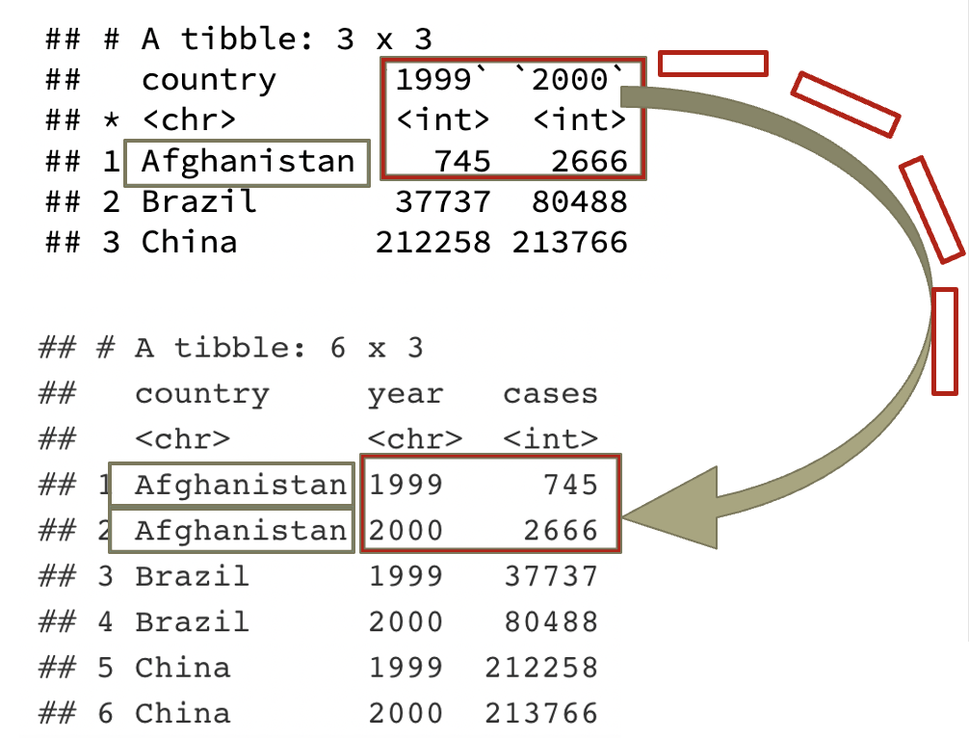
tidyr
pivot_longer()
wide → narrow
table4a %>%
pivot_longer(-country,
names_to = "year", values_to = "cases")
Notes:
Primary key is student_id + subject_id. But teacher only needs subject_id to be retrieved. Thus, teacher is partially dependent on the table’s primary key.

Slide 44
tidyr
pivot_longer()
wide → narrow
-country: pivot all columns except country
names_to = “year”: make a new column called year (into which we'll put the pivoted column names)
values_to = “cases”: make another new column called cases (into which we'll put the pivoted values)
table4a %>%
pivot_longer(-country,
names_to = "year", values_to = "cases")
Notes:
Primary key is student_id + subject_id. But teacher only needs subject_id to be retrieved. Thus, teacher is partially dependent on the table’s primary key.

Slide 45
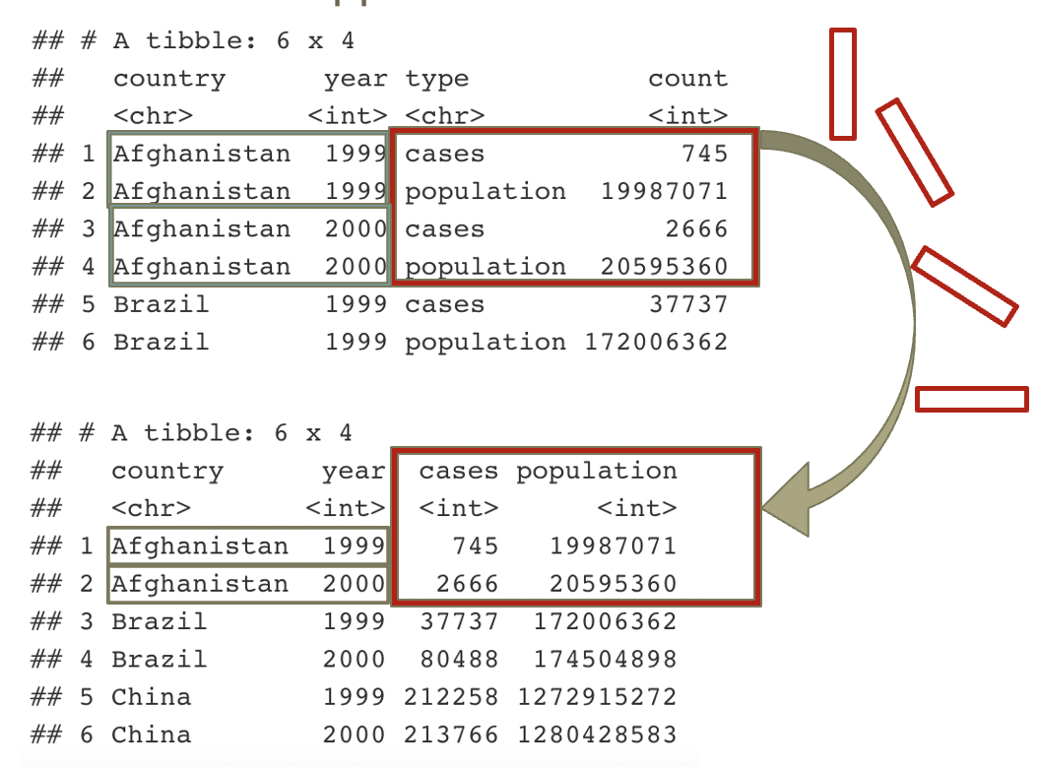
tidyr
pivot_wider()
narrow → wide
table2 %>%
pivot_wider(names_from = type,
values_from = count)
Notes:
Primary key is student_id + subject_id. But teacher only needs subject_id to be retrieved. Thus, teacher is partially dependent on the table’s primary key.

Slide 46
tidyr
pivot_wider()
narrow → wide
names_from = type: grab the values in the column called type (we'll pivot these values out to become the names of our new columns)
values_from = count: grab the values in the column called count (we'll pivot these across their corresponding columns)
table2 %>%
pivot_wider(names_from = type,
values_from = count)
Notes:
Primary key is student_id + subject_id. But teacher only needs subject_id to be retrieved. Thus, teacher is partially dependent on the table’s primary key.

Slide 47
Tidy Data
We tend to use pivot_longer() most often
Fill in the missing code below to pivot presapproval from wide form to long form.
presapproval_tidy <- presapproval %>%
pivot_longer(- ,
names_to = "",
values_to = "")
Notes:
Primary key is student_id + subject_id. But teacher only needs subject_id to be retrieved. Thus, teacher is partially dependent on the table’s primary key.

Slide 48
Tidy Data
-the_date: pivot everything except the_date
names_to = “party”: make a new column called party into which we’ll put pivoted column names
values_to = “approval”: make a new column called approval into which we’ll put pivoted values
presapproval_tidy <- presapproval %>%
pivot_longer(-the_date,
names_to = "party",
values_to = "approval")
Notes:
Primary key is student_id + subject_id. But teacher only needs subject_id to be retrieved. Thus, teacher is partially dependent on the table’s primary key.

Slide 49
Tidy Data
Notes:
Primary key is student_id + subject_id. But teacher only needs subject_id to be retrieved. Thus, teacher is partially dependent on the table’s primary key.

Slide 50
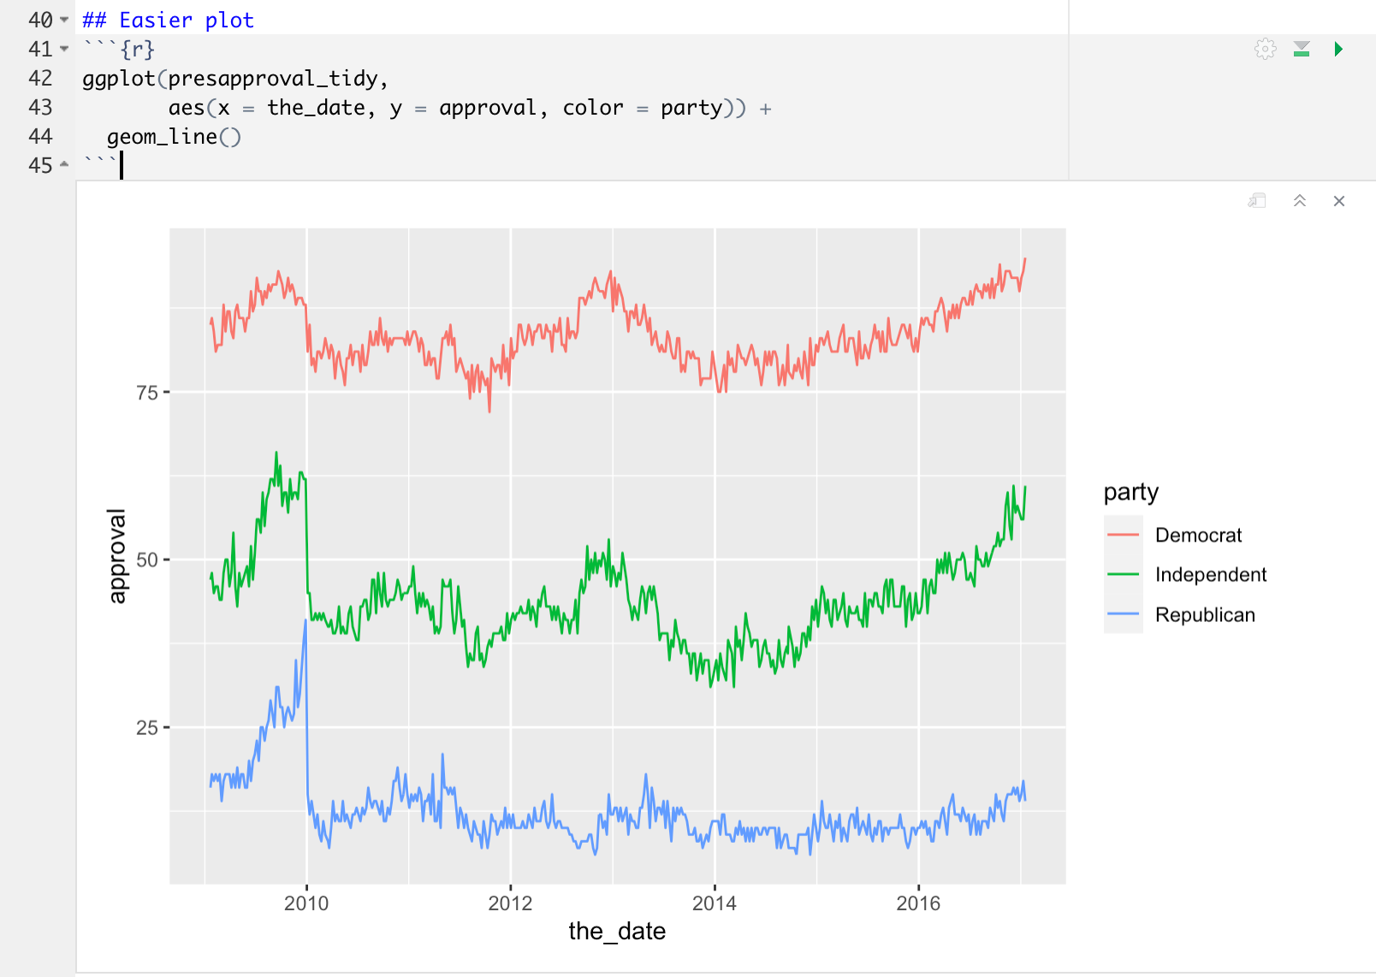
Tidy Data
Notes:
Primary key is student_id + subject_id. But teacher only needs subject_id to be retrieved. Thus, teacher is partially dependent on the table’s primary key.

