Slide 1
Data Science for Everyone – Data Wrangling – Tidy Data
Dr. Ab Mosca (they/them)
Slides based off slides courtesy of Jordan Crouser (https://jcrouser.github.io/)

Slide 2
Plan for Today
Clean messy data with R

Slide 3
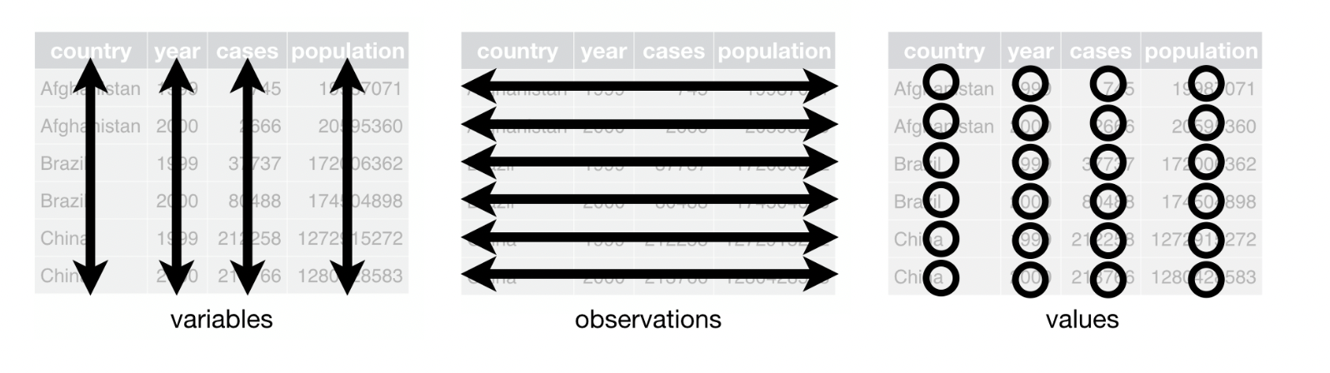
Reminder: Table Vocabulary
When data is tidy, every column is a variable, every row is an observation, and every value has its own cell
columns
rows
cells

Slide 4
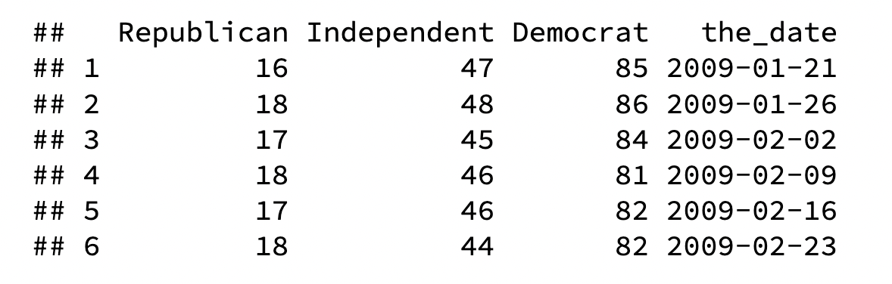
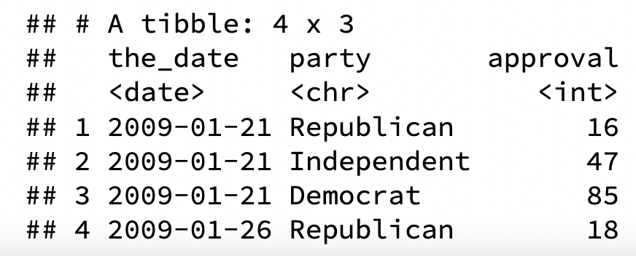
Tidy Data
pivot_longer
Each observation gets its own row
Number of rows increases (table gets longer)
Notes:
Primary key is student_id + subject_id. But teacher only needs subject_id to be retrieved. Thus, teacher is partially dependent on the table’s primary key.

Slide 5
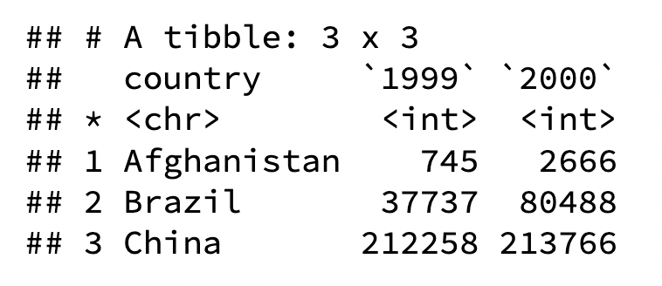
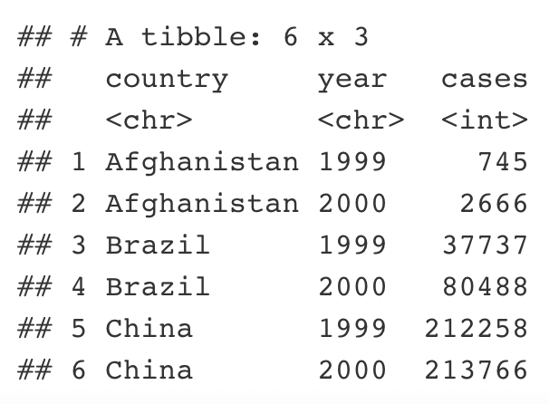
Tidy Data
pivot_longer
Each observation gets its own row
Number of rows increases (table gets longer)
Notes:
Primary key is student_id + subject_id. But teacher only needs subject_id to be retrieved. Thus, teacher is partially dependent on the table’s primary key.

Slide 6
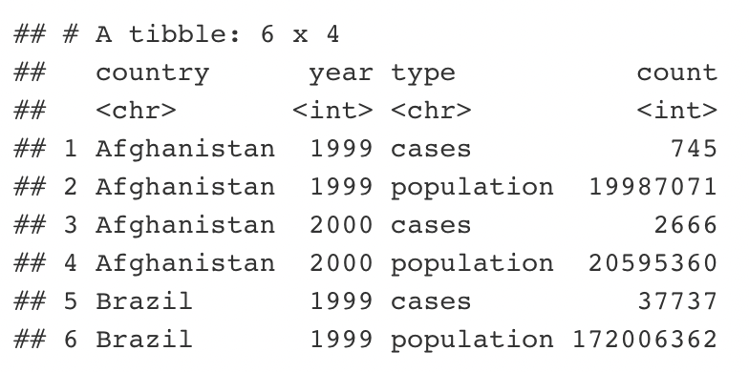
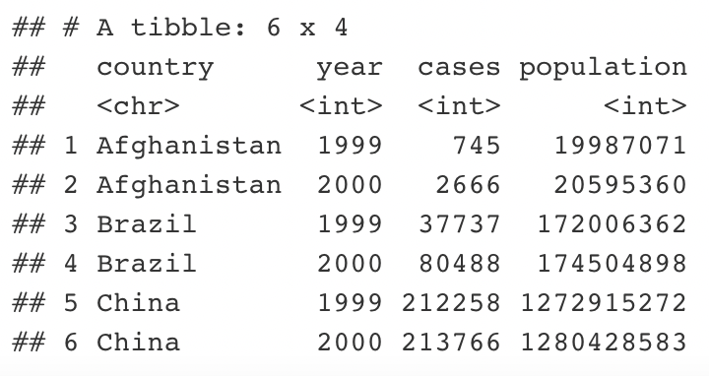
Tidy Data
pivot_wider
Each observation gets its own row
Number of rows decreases
Notes:
Primary key is student_id + subject_id. But teacher only needs subject_id to be retrieved. Thus, teacher is partially dependent on the table’s primary key.

Slide 7
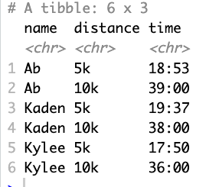
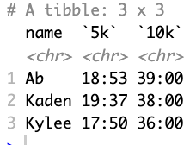
Tidy Data
pivot_wider
Each observation gets its own row
Number of rows decreases
Notes:
Primary key is student_id + subject_id. But teacher only needs subject_id to be retrieved. Thus, teacher is partially dependent on the table’s primary key.

Slide 8

tidyr
R package that helps make data tidy
We will primarily use two functions:
pivot_longer()
pivot_wider()
Notes:
Primary key is student_id + subject_id. But teacher only needs subject_id to be retrieved. Thus, teacher is partially dependent on the table’s primary key.

Slide 9
pivot_longer()
Used when column headers contain data
Increases number of rows
table %>%
pivot_longer(<value-columns>, names_to = , values_to = )
Set of columns with values
New column name for column data
New column name for cell data
Notes:
Primary key is student_id + subject_id. But teacher only needs subject_id to be retrieved. Thus, teacher is partially dependent on the table’s primary key.

Slide 10
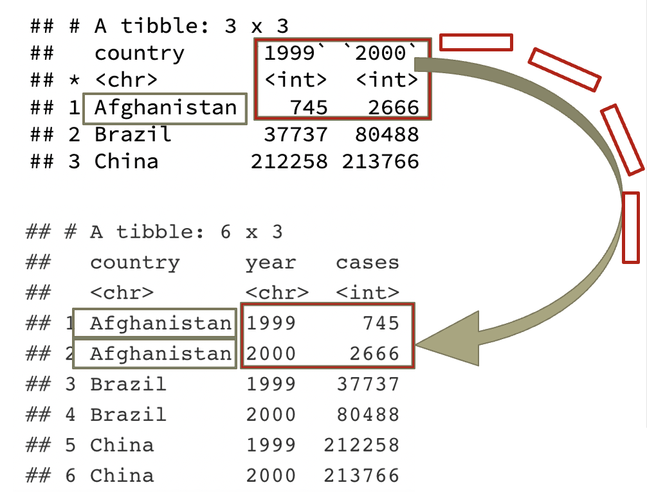
pivot_longer()
Used when column headers contain data
Increases number of rows
Set of columns with values
New column name for column data
New column name for cell data
table4a %>%
pivot_longer(-country,
names_to = "year", values_to = "cases")
Notes:
Primary key is student_id + subject_id. But teacher only needs subject_id to be retrieved. Thus, teacher is partially dependent on the table’s primary key.

Slide 11
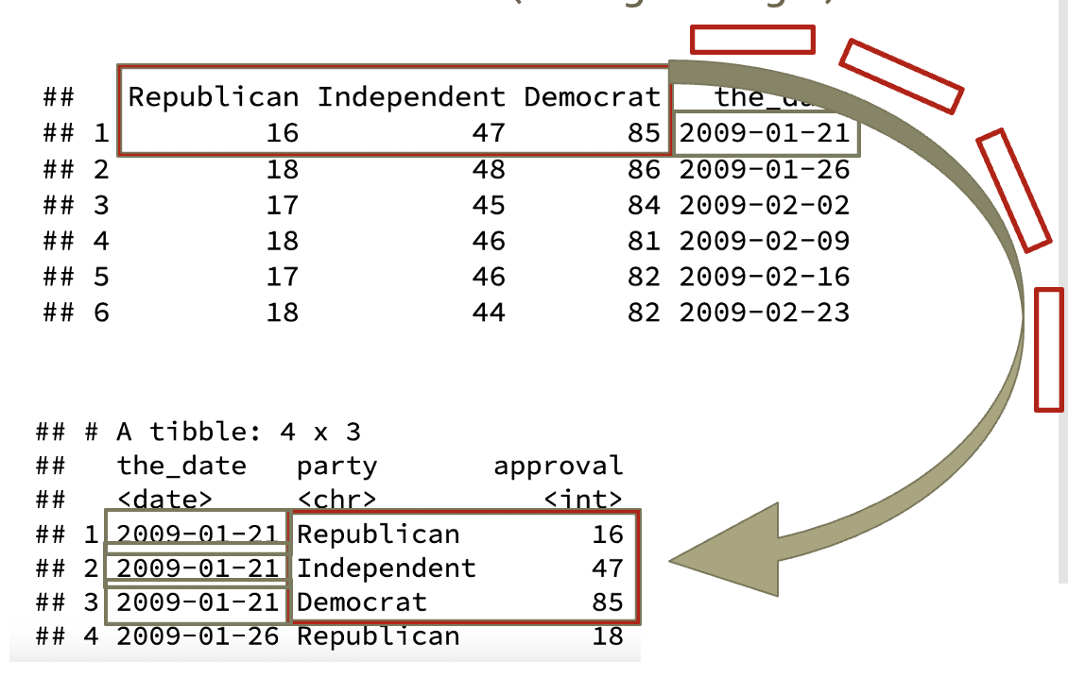
pivot_longer()
Used when column headers contain data
Increases number of rows
What would the code for this pivot be?
Notes:
Primary key is student_id + subject_id. But teacher only needs subject_id to be retrieved. Thus, teacher is partially dependent on the table’s primary key.

Slide 12
pivot_longer()
Used when column headers contain data
Increases number of rows
What would the code for this pivot be?
New column name for cell data
Set of columns with values
New column name for column data
table %>% pivot_longer(-the_date,
names_to = ”party", values_to = ”approval")
Notes:
Primary key is student_id + subject_id. But teacher only needs subject_id to be retrieved. Thus, teacher is partially dependent on the table’s primary key.

Slide 13
pivot_wider()
Used when observations are split between rows
Decreases number of rows
table %>%
pivot_wider(names_from =, values_from = )
Column to take new column names from
Column to take values from
Notes:
Primary key is student_id + subject_id. But teacher only needs subject_id to be retrieved. Thus, teacher is partially dependent on the table’s primary key.

Slide 14
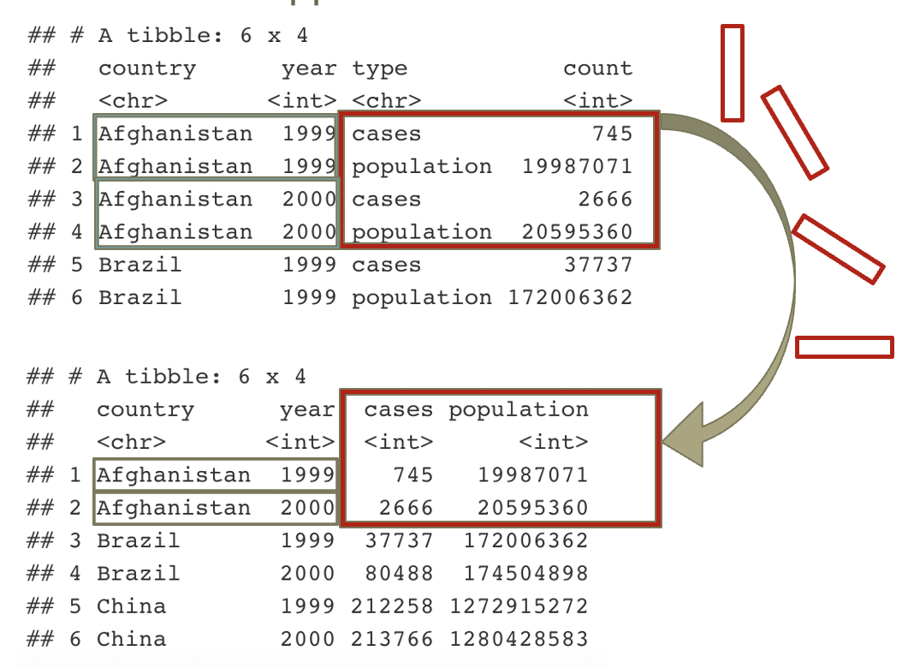
pivot_wider()
Used when observations are split between rows
Decreases number of rows
Column to take new column names from
Column to take values from
table2 %>%
pivot_wider(names_from = type,
values_from = count)
Notes:
Primary key is student_id + subject_id. But teacher only needs subject_id to be retrieved. Thus, teacher is partially dependent on the table’s primary key.

Slide 15
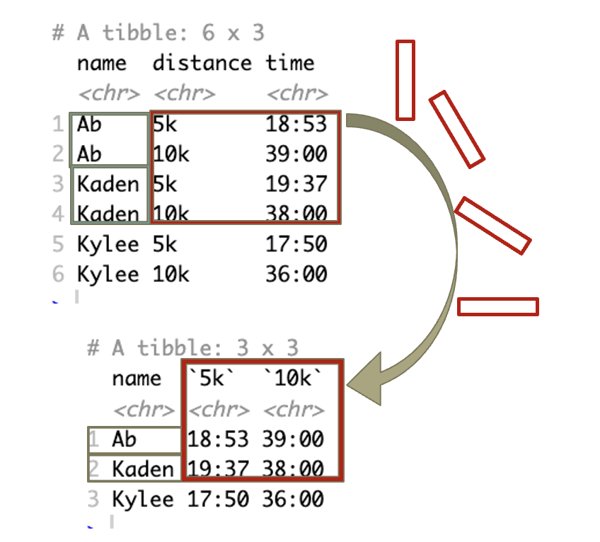
pivot_wider()
Used when observations are split between rows
Decreases number of rows
What would the code for this pivot be?
Notes:
Primary key is student_id + subject_id. But teacher only needs subject_id to be retrieved. Thus, teacher is partially dependent on the table’s primary key.

Slide 16
pivot_wider()
Used when observations are split between rows
Decreases number of rows
What would the code for this pivot be?
Column to take new column names from
table %>% pivot_wider(names_from = distance,
values_from = time)
Column to take values from
Notes:
Primary key is student_id + subject_id. But teacher only needs subject_id to be retrieved. Thus, teacher is partially dependent on the table’s primary key.

Slide 17
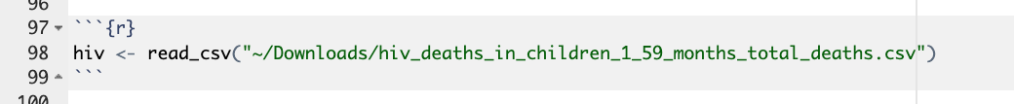
Example
Load the hiv_deaths dataset from http://www.gapminder.org/data/
What are the dimensions of this dataset? Is it tidy?
Notes:
Primary key is student_id + subject_id. But teacher only needs subject_id to be retrieved. Thus, teacher is partially dependent on the table’s primary key.

Slide 18
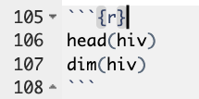
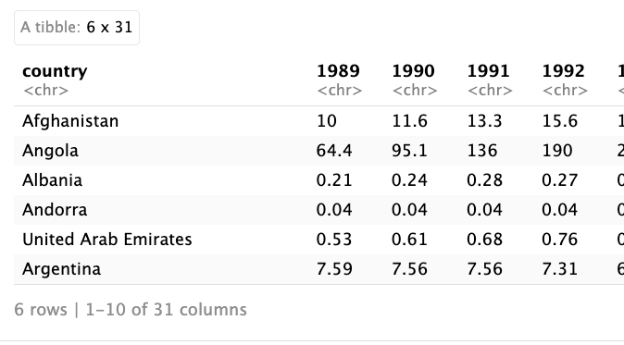

Example
Load the hiv_deaths dataset from http://www.gapminder.org/data/
What are the dimensions of this dataset? Is it tidy?
Notes:
Primary key is student_id + subject_id. But teacher only needs subject_id to be retrieved. Thus, teacher is partially dependent on the table’s primary key.

Slide 19

Example
Fix a data error
Pivot the data table so that it is tidy
Notes:
Primary key is student_id + subject_id. But teacher only needs subject_id to be retrieved. Thus, teacher is partially dependent on the table’s primary key.

Slide 20
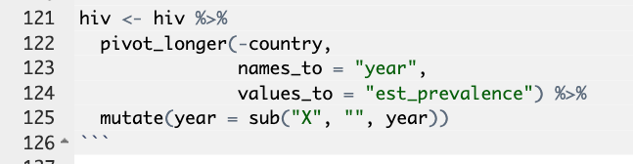
Example
Fix a data error
Pivot the data table so that it is tidy
Notes:
Primary key is student_id + subject_id. But teacher only needs subject_id to be retrieved. Thus, teacher is partially dependent on the table’s primary key.

Slide 21
Example
Now that your data is tidy, think of an interesting question, and answer it with a graph
Notes:
Primary key is student_id + subject_id. But teacher only needs subject_id to be retrieved. Thus, teacher is partially dependent on the table’s primary key.

