Slide 1
Data Science for Everyone – Intro to Coding with R
Dr. Ab Mosca (they/them)
Slides based off slides courtesy of Jordan Crouser (https://jcrouser.github.io/)

Slide 2
Plan for Today
Practice coding with the R programming language

Slide 3
R R Studio R Markdown
R is a programming language
R Studio is an interface for coding
R Markdown is a type of file that allows you to intersperse writing, code, and output

Slide 4
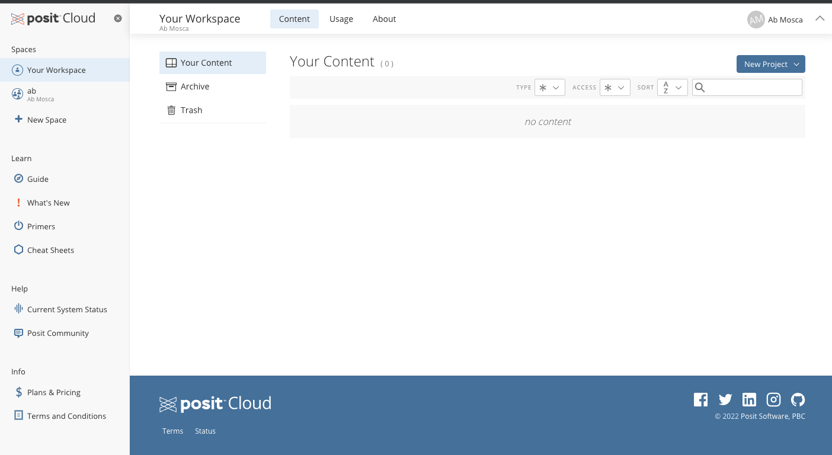
R Studio
Launch R Studio:
https://posit.cloud/

Slide 5
R Studio
Move to your personal space

Slide 6
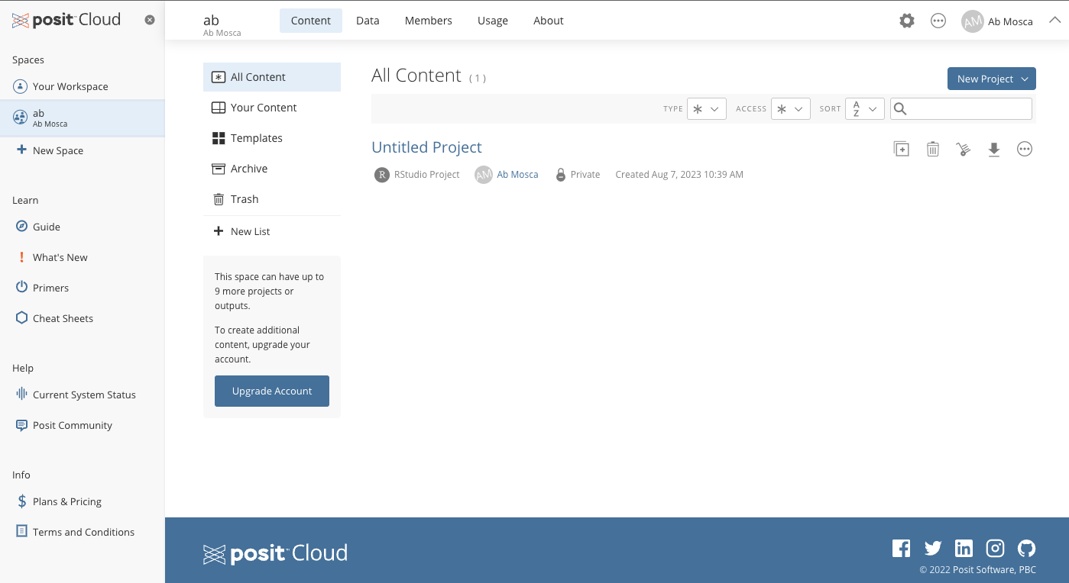
R Studio
Start a new project

Slide 7
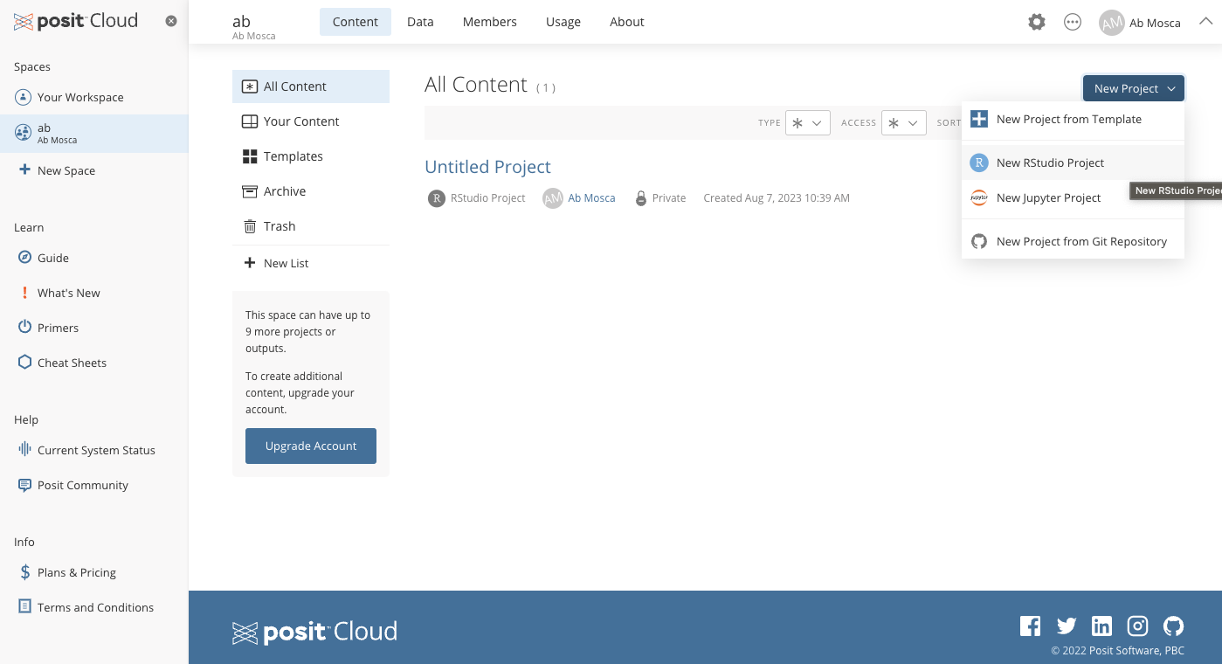
R Studio
Start a new project

Slide 8
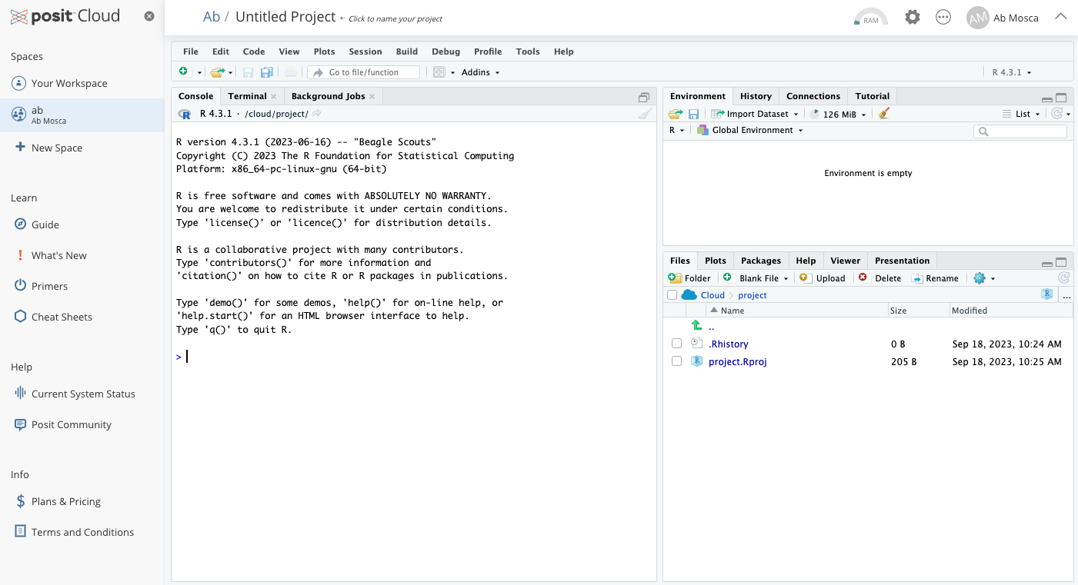
R Studio
New project

Slide 9
R Studio
Console

Slide 10
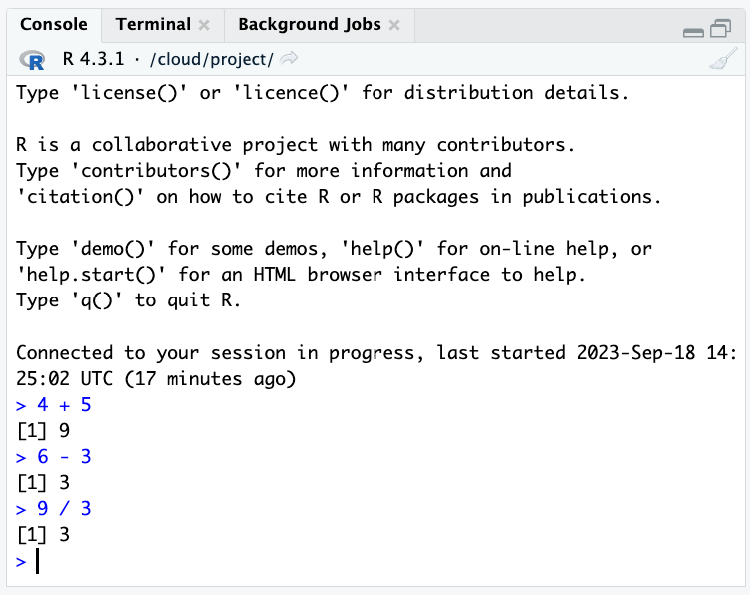
R Studio
Console

Slide 11
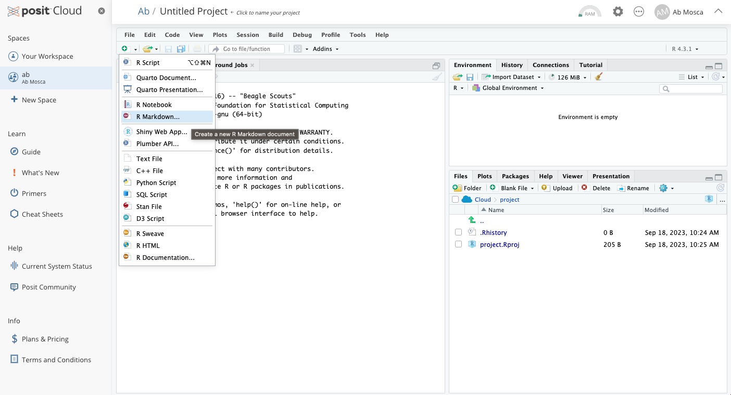
R Studio
New file

Slide 12
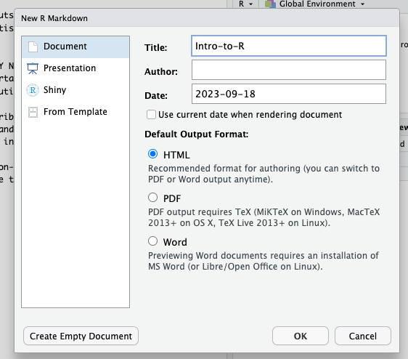
R Studio
New file

Slide 13
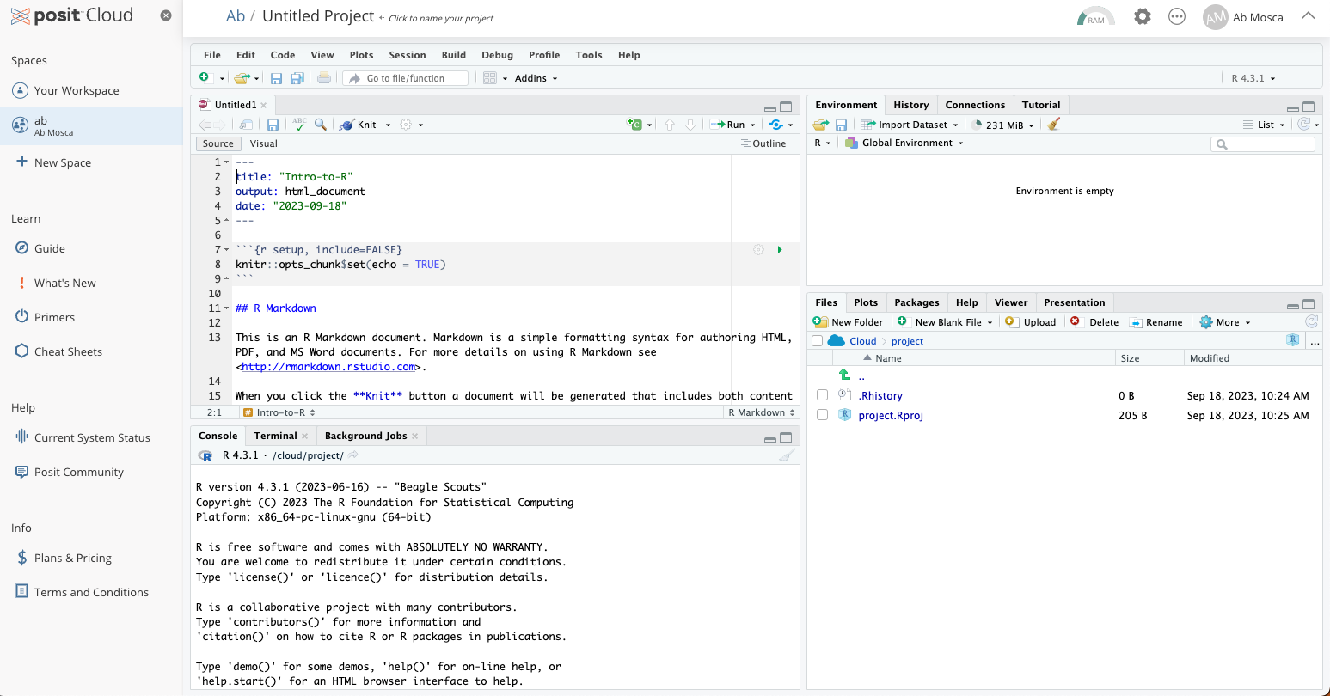
R Studio
New file

Slide 14
R Studio
New file

Slide 15
R Studio
New file - SAVE

Slide 16
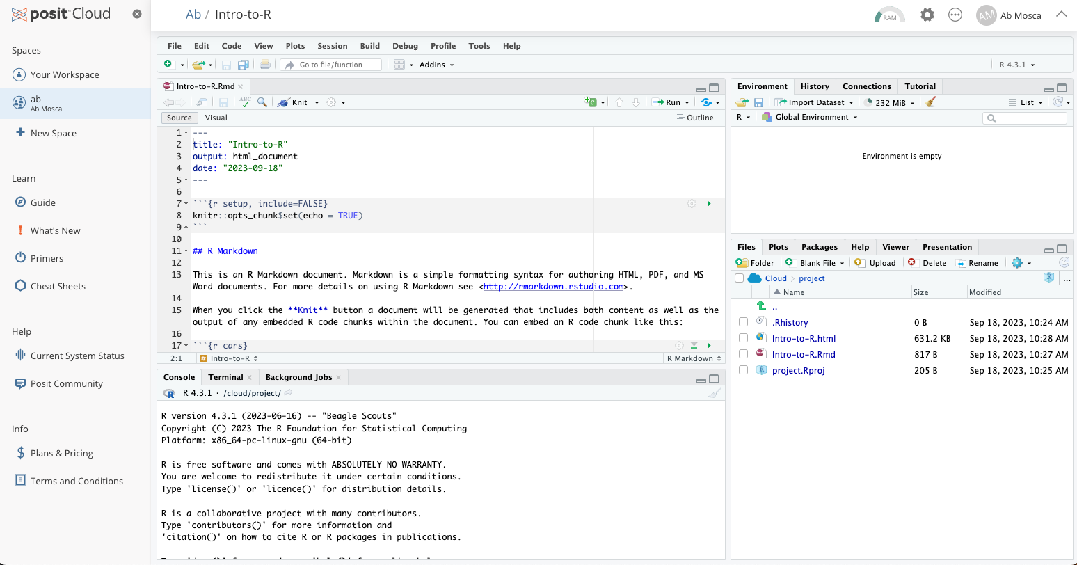
R Studio
New file - saved

Slide 17
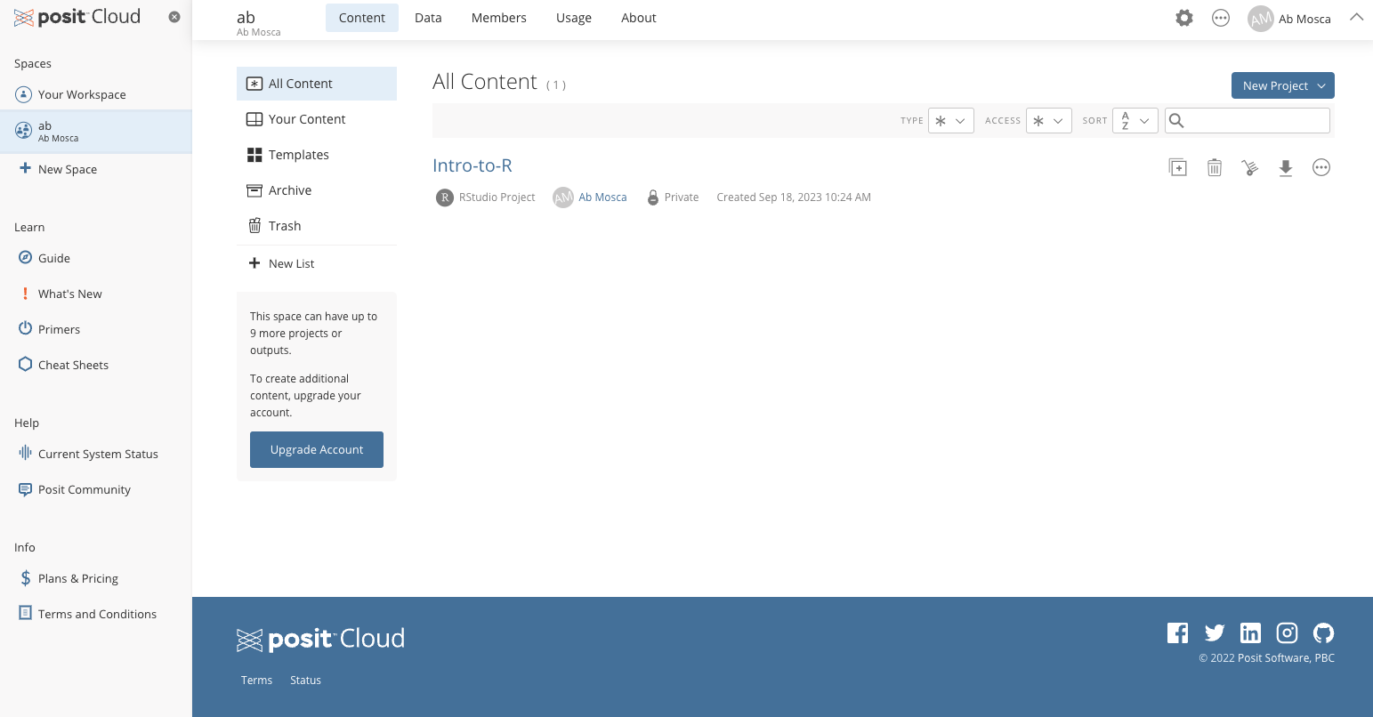
R Studio
New file - saved

Slide 18
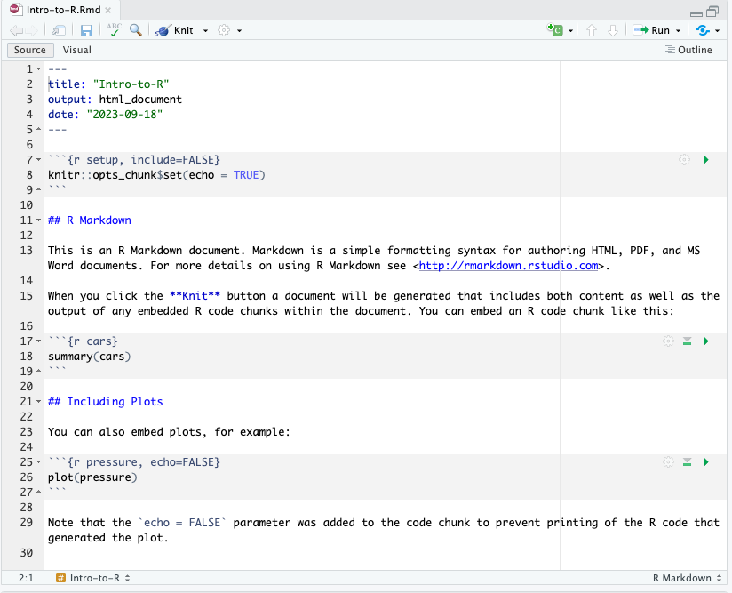
R Markdown
Meta data

Slide 19
R Markdown
Code chunks
type of code
short name
other options
type of code
short name
type of code
short name
other options

Slide 20
R Markdown
Code chunks
run chunk
run all preceding chunks

Slide 21
R Markdown
Text
## == heading
<> == link
** == bold
`` == code

Slide 22
R Markdown
output report
Knit

Slide 23
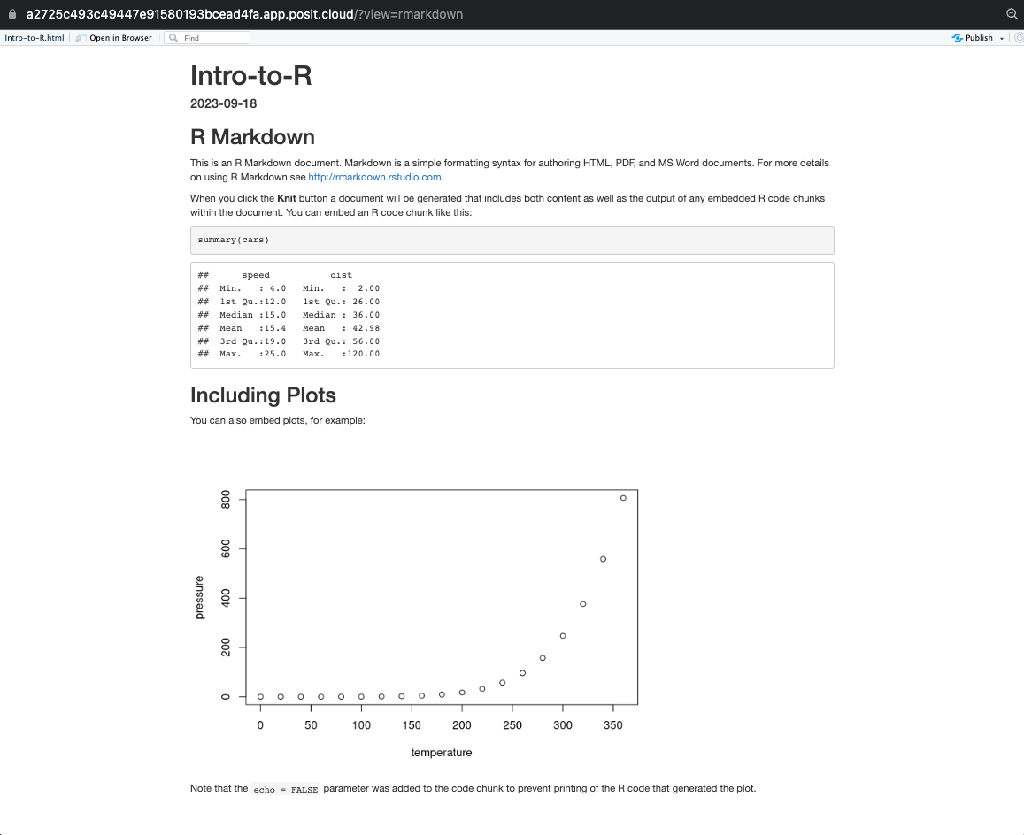
R Markdown
Knit

Slide 24
R Markdown
Knit

Slide 25
R Markdown
Knit

Slide 26
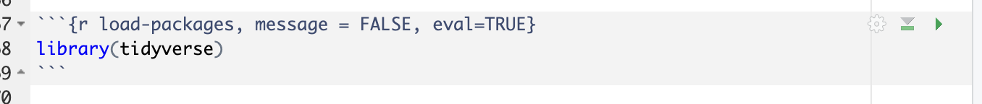
R
Packages
Notes:
R is an open-source programming language, meaning that users can contribute
packages that make our lives easier, and we can use them for free. What is a
package? Think of it as a neat collection of tools (that someone else built) that
help us do common, repetitive tasks more efficiently. For this lab,
and many others in the future, we will use the following R packages (we will cover
more on each of these later):
- `dplyr`: for data wrangling
- `ggplot2`: for data visualization
- `tidyverse`: an umbrella package that encompasses the previous two and many more
If these packages are not already available in your R environment,
you will need to install them.
Note that you can check to see which packages (and which versions) are installed by
inspecting the *Packages* tab in the lower right panel of RStudio.
Next, you need to load these packages in your working environment. We do this with
the `library` function. Run the following line in your console.

Slide 27
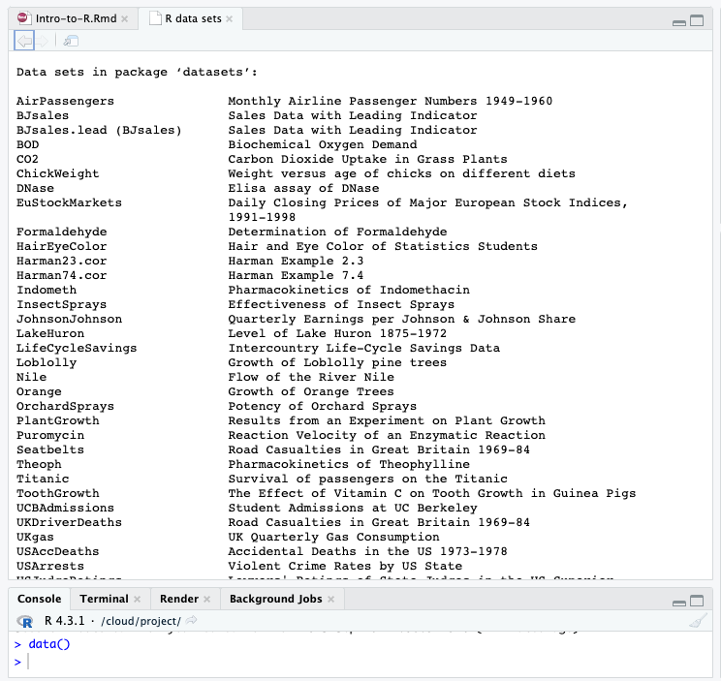
R
Data

Slide 28
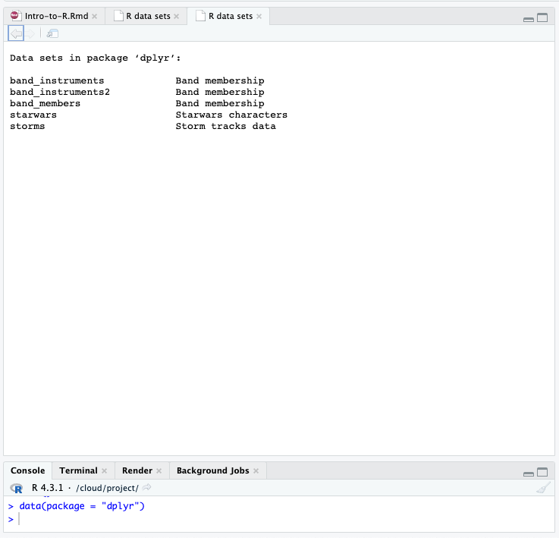
R
Data

Slide 29
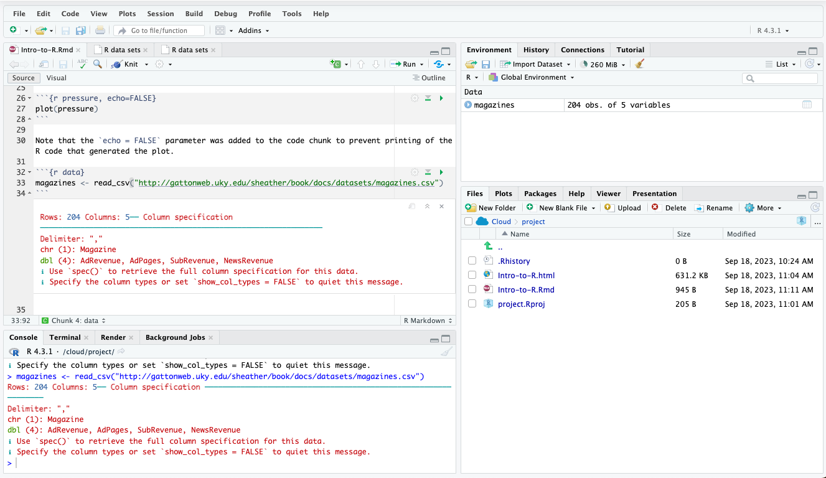
R
Data – reading a CSV
function
variable assignment

Slide 30
R
Data – reading a CSV
clear
saved objects
function
variable assignment

Slide 31
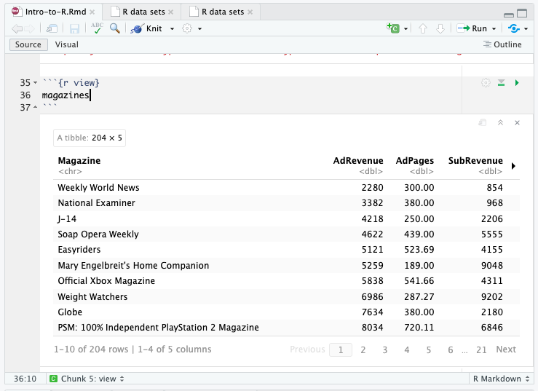
R
Data – viewing

Slide 32
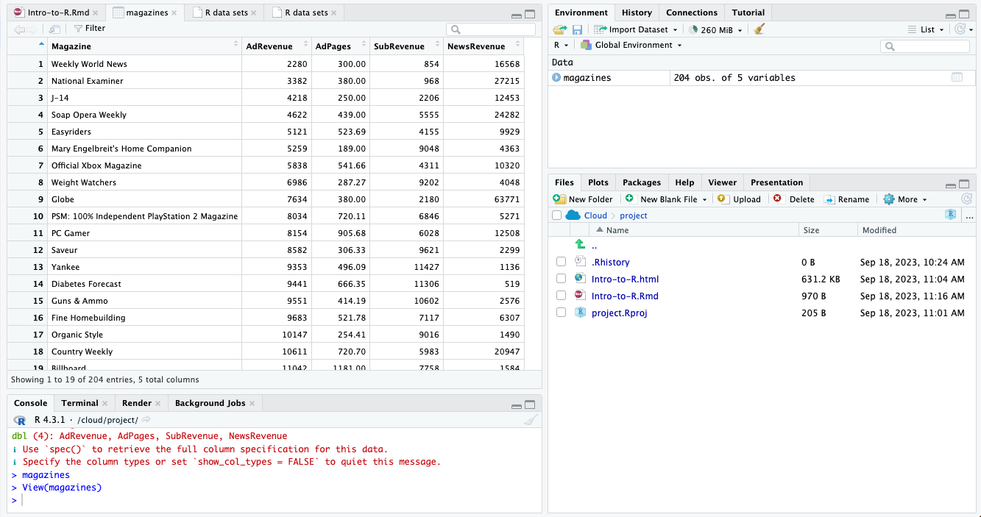
R
Data – viewing
CLICK

Slide 33
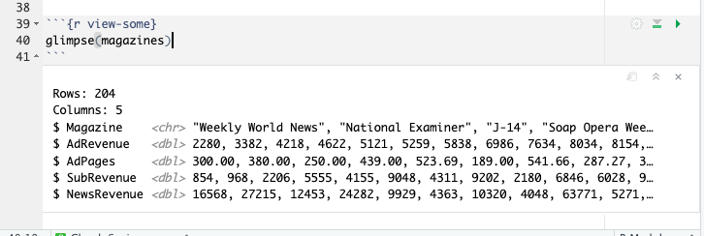
R
Data – viewing

Slide 34
R
Data – viewing

Slide 35
R
Data – viewing

Slide 36
R
Data – viewing

Slide 37
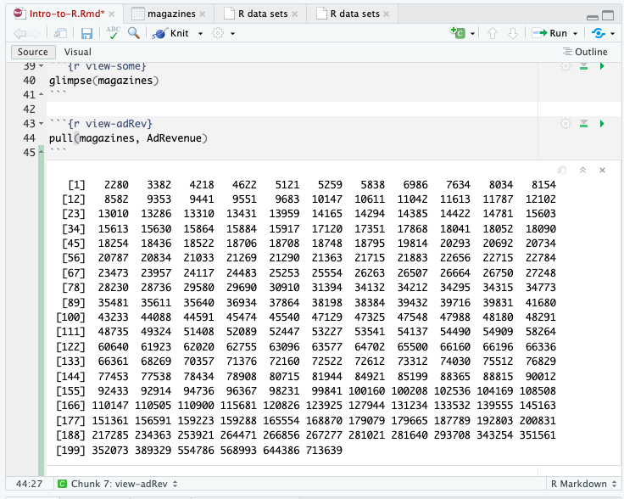
R
Data – single column
column is a vector

Slide 38
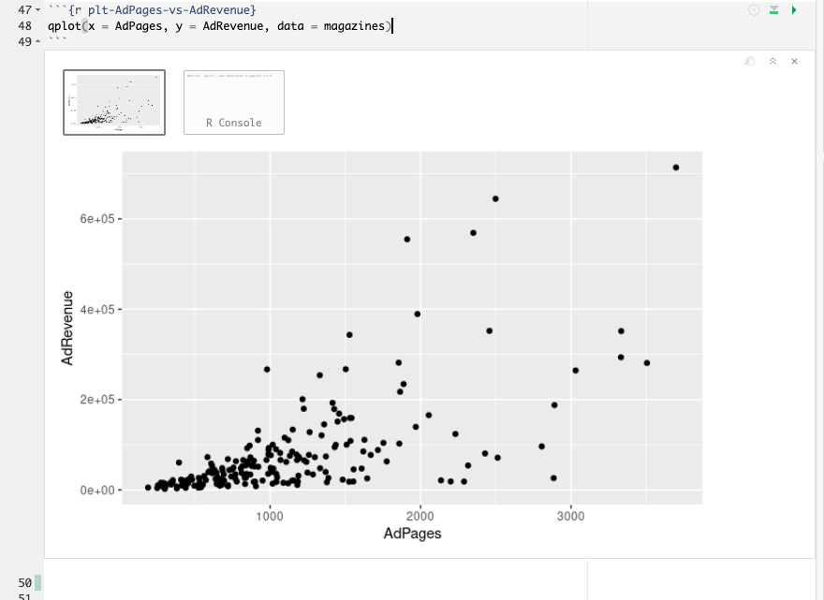
R
Visualization
dataset
“quick plot”
x-axis variable
y-axis variable

Slide 39
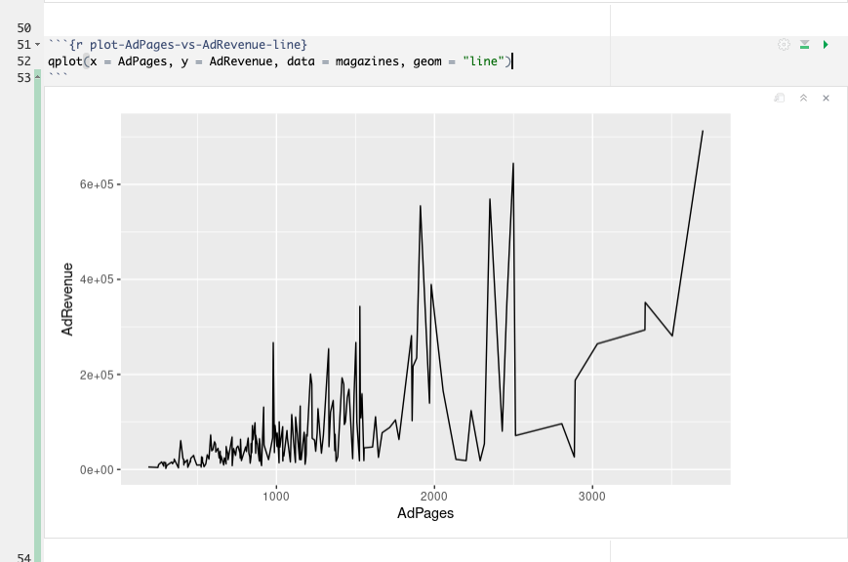
R
Visualization
“geometry”

Slide 40
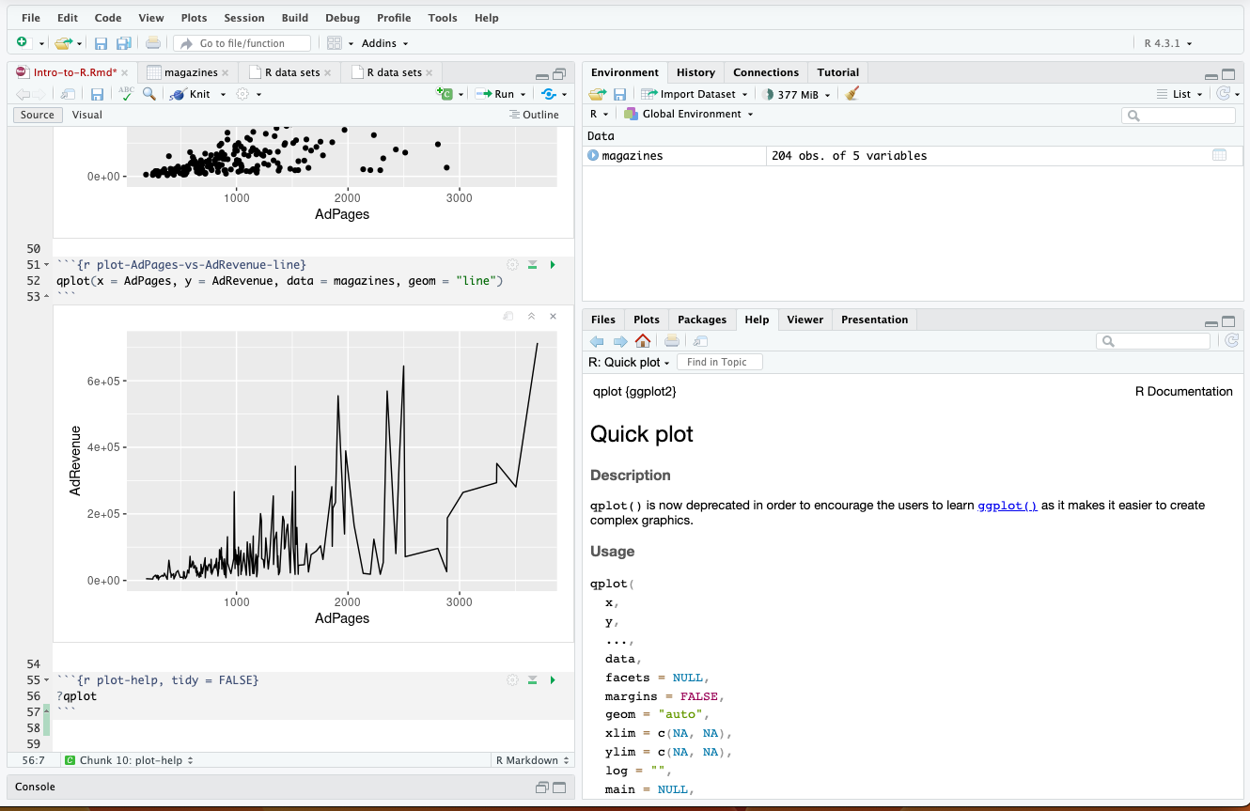
R
Documentation

Slide 41

R
Adding Variables
“pipe”
%>% strings functions together
Takes output of pervious expression and sends it as first parameter to next function in the chain
Ex. x %>% f(y) is equivalent to f(x, y)

Slide 42
R
Adding Variables
change magazines by …
adding new var
set magazines to new dataset

Slide 43
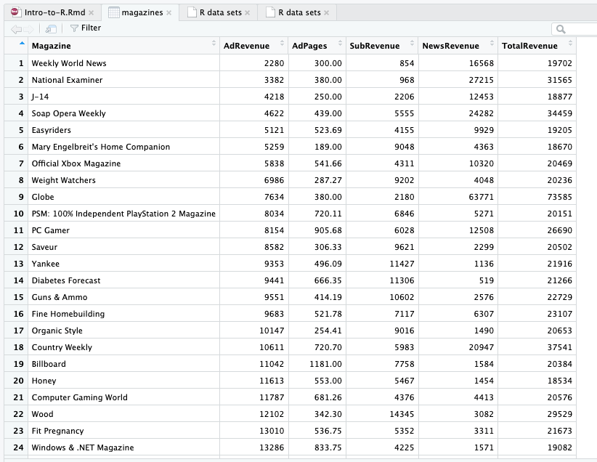
R
Adding Variables

Slide 44
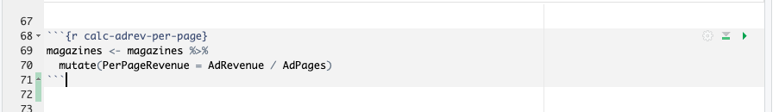
R
Adding Variables
What does this do?

Slide 45
R
Adding Variables
What does this do?

Slide 46
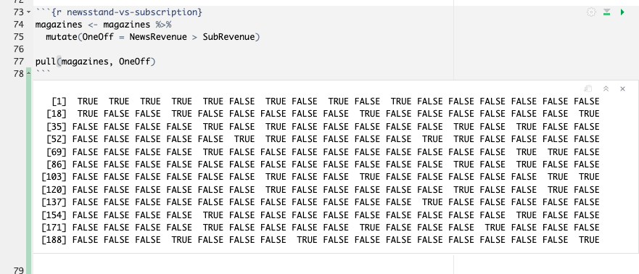
R
What did this do?
Adding Variables

Slide 47
R
Try on your own!
Lab is on the course website under “Labs” tab (https://amosca01.github.io/Intro-DS-F23/)
Go to the “More Practice” section of the lab for today and complete as much as you can
Ask questions when they come up!

