Slide 1
Data Science for Everyone – Iteration
Dr. Ab Mosca (they/them)
Slides based off slides courtesy of Jordan Crouser (https://jcrouser.github.io/)

Slide 2
Plan for Today
Iteration with R (Mapping)
Practice Functions

Slide 3
Iteration
Suppose you have f(val), which returns a value, and you want to use this function on values 1 – 100

Slide 4
Iteration
Suppose you have f(val), which returns a value, and you want to use this function on values 1 – 100
One option for doing this would be to call f(val) for 1 – 100
f(1)
f(2)
f(3)
f(4)
f(4)
f(6)
...okay, I’m already bored

Slide 5
Iteration
Suppose you have f(val), which returns a value, and you want to use this function on a vector of values 1 – 100
One option for doing this would be to call f(val) for 1 – 100
f(1)
f(2)
f(3)
f(4)
f(4)
f(6)
...okay, I’m already bored
Uh-oh…not only am I bored, but
I accidentally called f(4) twice and skipped f(5)
and I’m going to get all my results separately, but I’d really like them in a vector

Slide 6
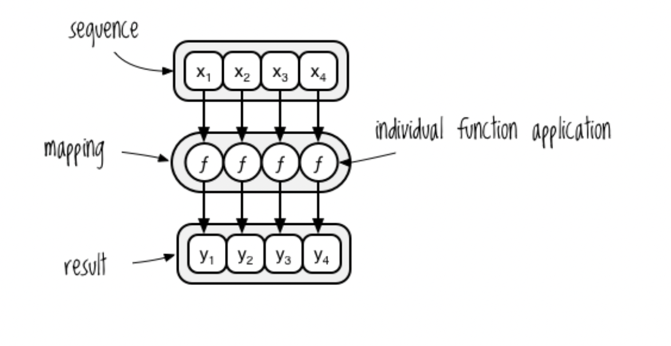
Iteration
What if instead, we could apply f() to our vector of values, and get a vector of results?

Slide 7
Iteration
What if instead, we could apply f() to our vector of values, and get a vector of results?
We call this mapping, and it falls into the category of something called functional programming

Slide 8

The library purrr makes functional programming with R easier
Find the purr cheatsheet here: https://www.rstudio.com/resources/cheatsheets/

Slide 9
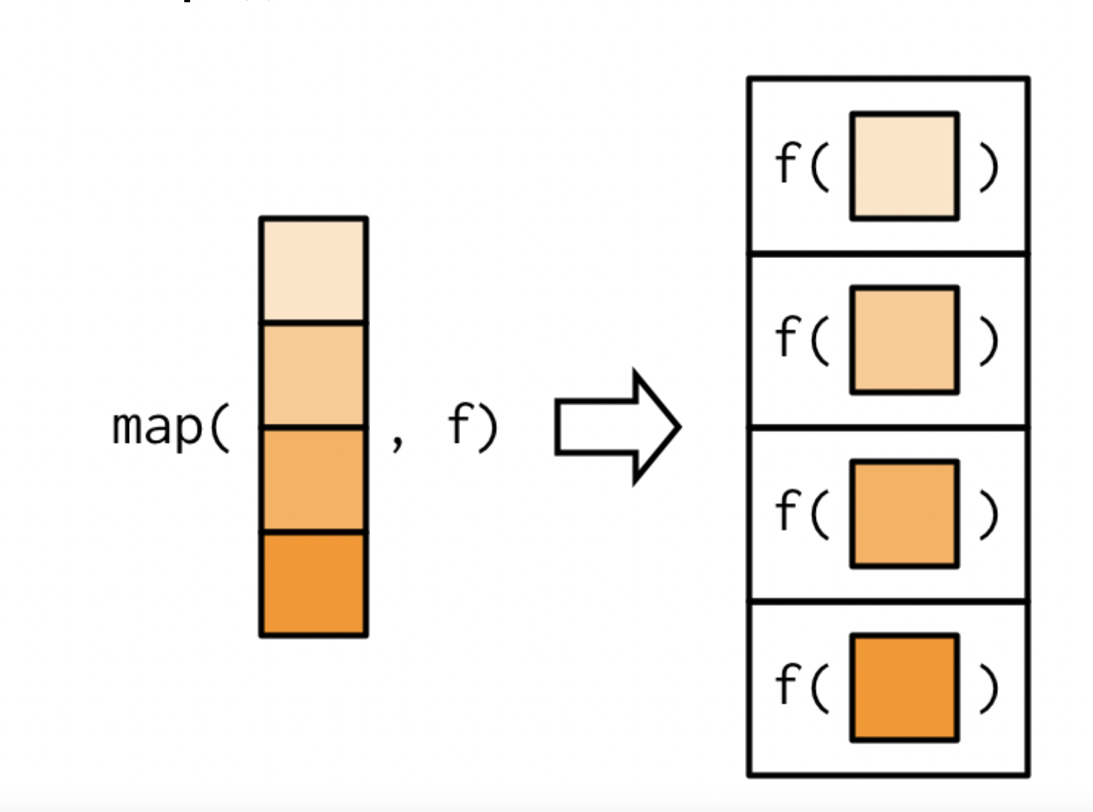
The library purrr makes functional programming with R easier
Find the purr cheatsheet here: https://www.rstudio.com/resources/cheatsheets/
We will mostly use the map() function

Slide 10
The library purrr makes functional programming with R easier
Find the purr cheatsheet here: https://www.rstudio.com/resources/cheatsheets/
We will mostly use the map() function
Output = results vector
Input = vector, function

Slide 11
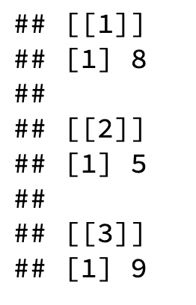

map()
map() example
# vector of values
words <- c("alphabet", "bunny", "cathedral")
# iterate the function over values
# return a list of number of characters per word
map(words, nchar)
# iterate the function over values
# return a vector of number of characters per word
map_int(words, nchar)

Slide 12
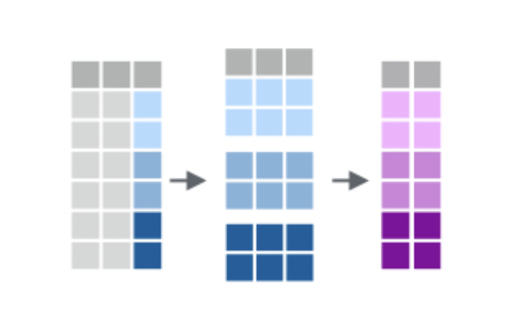
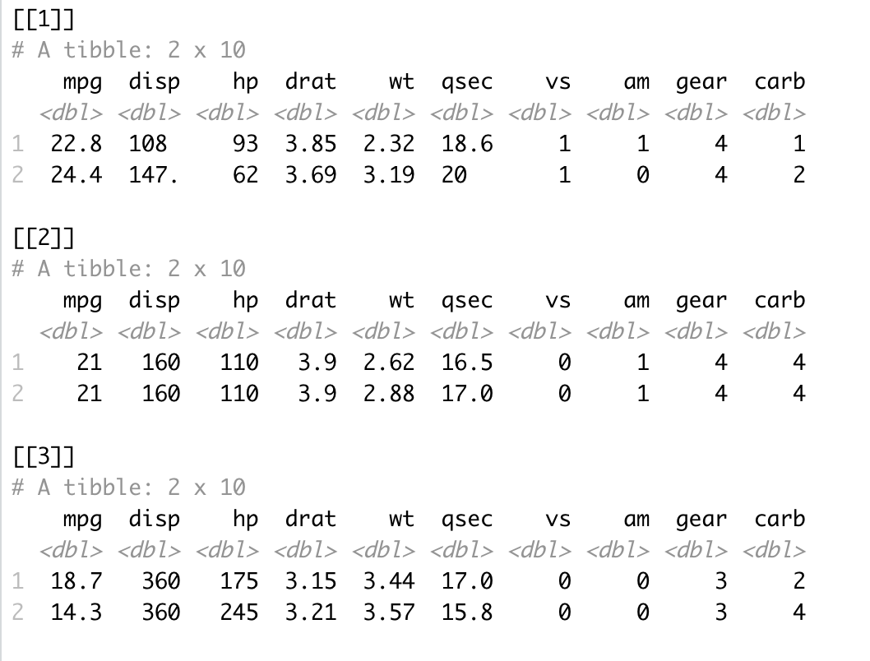
Mapping with and grouping
We can use group_by() and apply different mapping functions to groups within our datasets
Ex. group_by() + group_map()
mtcars %>%
group_by(cyl) %>% # creates a *list* of data frames!
group_map(head, n = 2)

Slide 13
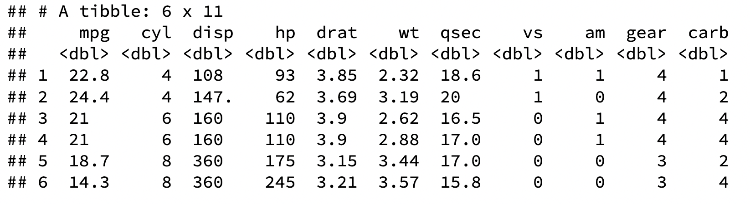
Mapping with and grouping
We can use group_by() and apply different mapping functions to groups within our datasets
Ex. group_split() + map_dfr()
mtcars %>%
group_split(cyl) %>% # creates a grouped data frame
map_dfr(head, n = 2)

Slide 14
Practice
Work with 1-2 other people on the functions_and_iteration lab

