Slide 1
Data Science for Everyone – Functions & Iteration
Dr. Ab Mosca (they/them)
Slides based off slides courtesy of Jordan Crouser (https://jcrouser.github.io/)

Slide 2
Plan for Today
Built in functions
User defined functions

Slide 3
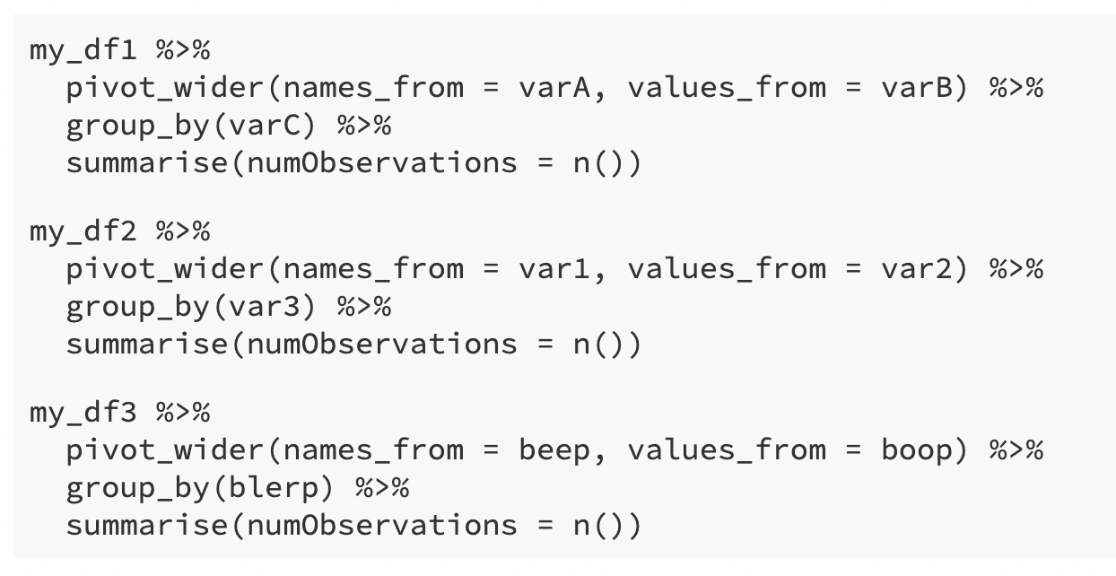
Repetition
Suppose you’re a data scientist given weekly datasets to analyze
The datasets are similar; each is a tbl with three variables
They come un-tidy, so first you must make them tidy
For three weeks use the following code:

Slide 4
Repetition
Work with the person next to you to find similarities in each code chunk above. Is there a common set of steps you take for each dataset?

Slide 5
Repetition

Slide 6
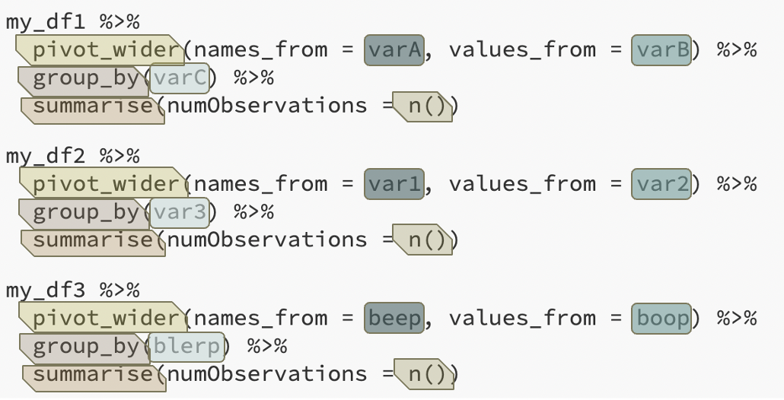
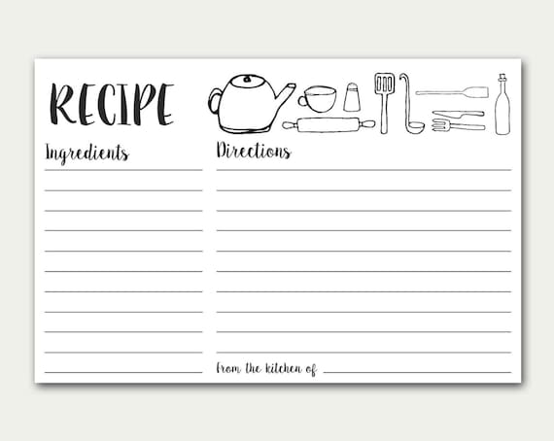
Repetition
tbl
Take tbl and pivot_wider() using names_from v1 and values_from v2
group_by() v3
summarize() using n()
v1, v2, v3

Slide 7
Functions
Format:
function_name(argument1, argument2, …)
Inputs
Arguments
Things like: tbl, string, int, etc.
Output
Things like: tbl, string, int, etc.
We’ve been using built in functions! Ex.
ncol(babynames)
Input = tbl (babynames)
Output = int (number of columns in babynames)

Slide 8
Functions
Format:
function_name(argument1, argument2, …)
Inputs
Arguments
Things like: tbl, string, int, etc.
Output
Things like: tbl, string, int, etc.
We’ve been using built in functions! Ex.
ncol(babynames)
Input = tbl (babynames)
Output = int (number of columns in babynames)
What other built in functions have we used? What is the input and output?

Slide 9
User-defined Functions
We can (temporarily) add functions to R by defining them ourselves
We call these user-defined functions
This is very useful for repetitive tasks

Slide 10
User-defined Functions
Defining your own functions
name_of_function <- function(data, var = "value") {
...
...
<valid R code>
...
...
return(x)
}

Slide 11
User-defined Functions
Defining your own functions
name_of_function <- function(data, var = "value") {
...
...
<valid R code>
...
...
return(x)
}
What you want the function to be called

Slide 12
User-defined Functions
Defining your own functions
name_of_function <- function(data, var = "value") {
...
...
<valid R code>
...
...
return(x)
}
function is the key word that tells R “I’m creating a function”
<- assigns the function definition to the variable name_of_function

Slide 13
User-defined Functions
Defining your own functions
Inputs
arguments: data, var
data is required
var is optional -- has a default value of "value"
name_of_function <- function(data, var = "value") {
...
...
<valid R code>
...
...
return(x)
}
Input / arguments

Slide 14
User-defined Functions
Defining your own functions
Body
Defines what the function should do
Everything between { and }
name_of_function <- function(data, var = "value") {
...
...
<valid R code>
...
...
return(x)
}
Body

Slide 15
User-defined Functions
Defining your own functions
Output
the return value
by default output of last line in function body
here, explicitly the object x
name_of_function <- function(data, var = "value") {
...
...
<valid R code>
...
...
return(x)
}
Output

Slide 16
User-defined Functions
Work with the person next to you to turn our recipe into a function.
tbl
Take tbl and pivot_wider() using names_from v1 and values_from v2
group_by() v3
summarize() using n()
v1, v2, v3
name_of_function <- function(data, var = "value") {
...
<valid R code>
...
return(x)
}

Slide 17
User-defined Functions
Work with the person next to you to turn our recipe into a function.
tbl
Take tbl and pivot_wider() using names_from v1 and values_from v2
group_by() v3
summarize() using n()
v1, v2, v3
clean_data <- function(data, v1, v2, v3) {
data %>%
pivot_wider(names_from = v1, values_from = v2) %>%
group_by(v3) %>%
summarize(numObservations = n())
}

Slide 18
User-defined Functions
Defining your own functions
To use a function you defined, you “call” it with the appropriate arguments
Ex. Let’s call clean_data()to make my_df1 from earlier tidy
# Define clean_data
clean_data <- function(data, v1, v2, v3) {
data %>%
pivot_wider(names_from = v1, values_from = v2) %>%
group_by(v3) %>%
summarize(numObservations = n())
}
# Call clean_data
my_tidy_df1 <- clean_data(my_df1, varA, varB, varC)

Slide 19
User-defined Functions
# Define clean_data
clean_data <- function(data, v1, v2, v3) {
data %>%
pivot_wider(names_from = v1, values_from = v2) %>%
group_by(v3) %>%
summarize(numObservations = n())
}
Work with the person next to you call clean_data for my_df2 and my_df3.

Slide 20
User-defined Functions
# Define clean_data
clean_data <- function(data, v1, v2, v3) {
data %>%
pivot_wider(names_from = v1, values_from = v2) %>%
group_by(v3) %>%
summarize(numObservations = n())
}
Work with the person next to you call clean_data for my_df2 and my_df3.
my_tidy_df2 <- clean_data(my_df2, var1,
var2,
var3)
my_tidy_df3 <- clean_data(my_df3, beep,
boop,
blerp)

Slide 21
Practice
Write a function that uses the babynames dataset to find the year a baby name was most popular. The function should work for any name.
What are the inputs?
What will be returned?
What steps does the function need to take?

Slide 22
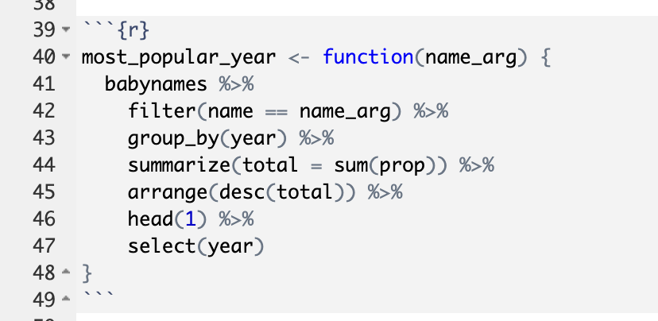
Practice
Write a function that uses the babynames dataset to find the year a baby name was most popular. The function should work for any name.
What are the inputs?
What will be returned?
What steps does the function need to take?

Slide 23
Practice
Write a function that uses the babynames dataset to find the year a baby name was most popular. The function should work for any name.
What are the inputs?
What will be returned?
What steps does the function need to take?
input = name
function’s name
instructions
output = vector

Slide 24
Practice
Use the function you wrote to find the most popular years for:
Olivia
Regina
Rami
Mable

Slide 25
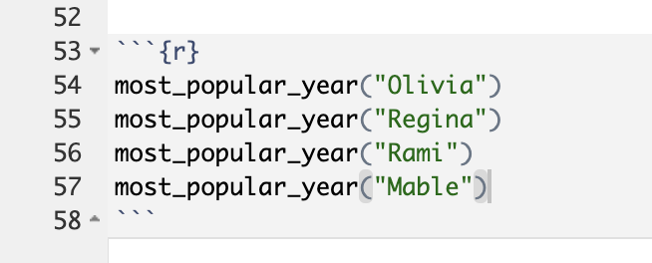
Practice
Use the function you wrote to find the most popular years for:
Olivia - 2014
Regina – 1964
Rami - 2005
Mable - 1905

