Slide 1
Data Science for Everyone – Grammar of Graphics
Dr. Ab Mosca (they/them)
Slides based off slides courtesy of Jordan Crouser (https://jcrouser.github.io/)

Slide 2
Plan for Today
Connect what we know about visualizations to ggplot in R

Slide 3
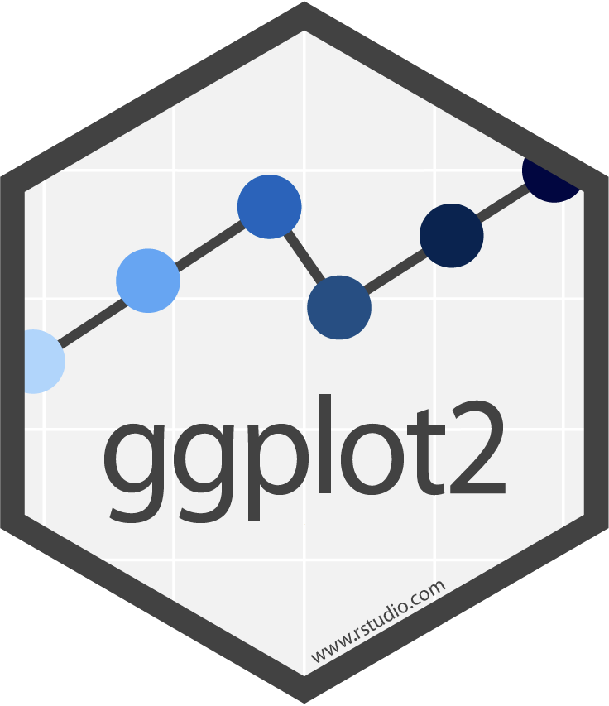
ggplot2
Plot building blocks
data
aesthetic mappings (how we draw that stuff)
geometric objects (the literal stuff we draw)
statistical transformations (underlying model)
scales (range of values, colors, etc.)
faceting (small multiples)
ggplot(data, aes()) +
geom_*
data
aesthetic mapping
geometric object

Slide 4
ggplot2
Plot building blocks
data
aesthetic mappings (how we draw that stuff)
geometric objects (the literal stuff we draw)
statistical transformations (underlying model)
scales (range of values, colors, etc.)
faceting (small multiples)
ggplot(data, aes()) +
geom_*
data
aesthetic mapping
geometric object

Slide 5
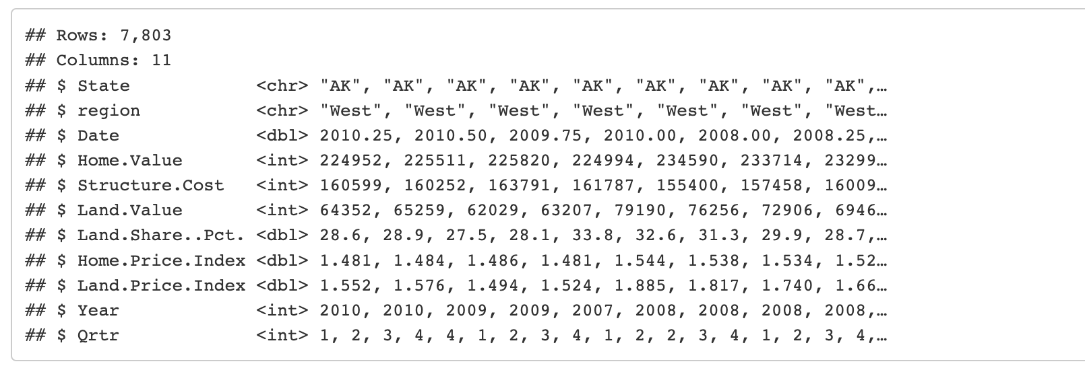
Data
For today, upload the landdata-states.csv from the course website (under Labs tab) to your R Studio working directory
Load the data and look at it
housing_ds <- read_csv(“landdata-states.csv”)
glimpse(housing_ds)

Slide 6
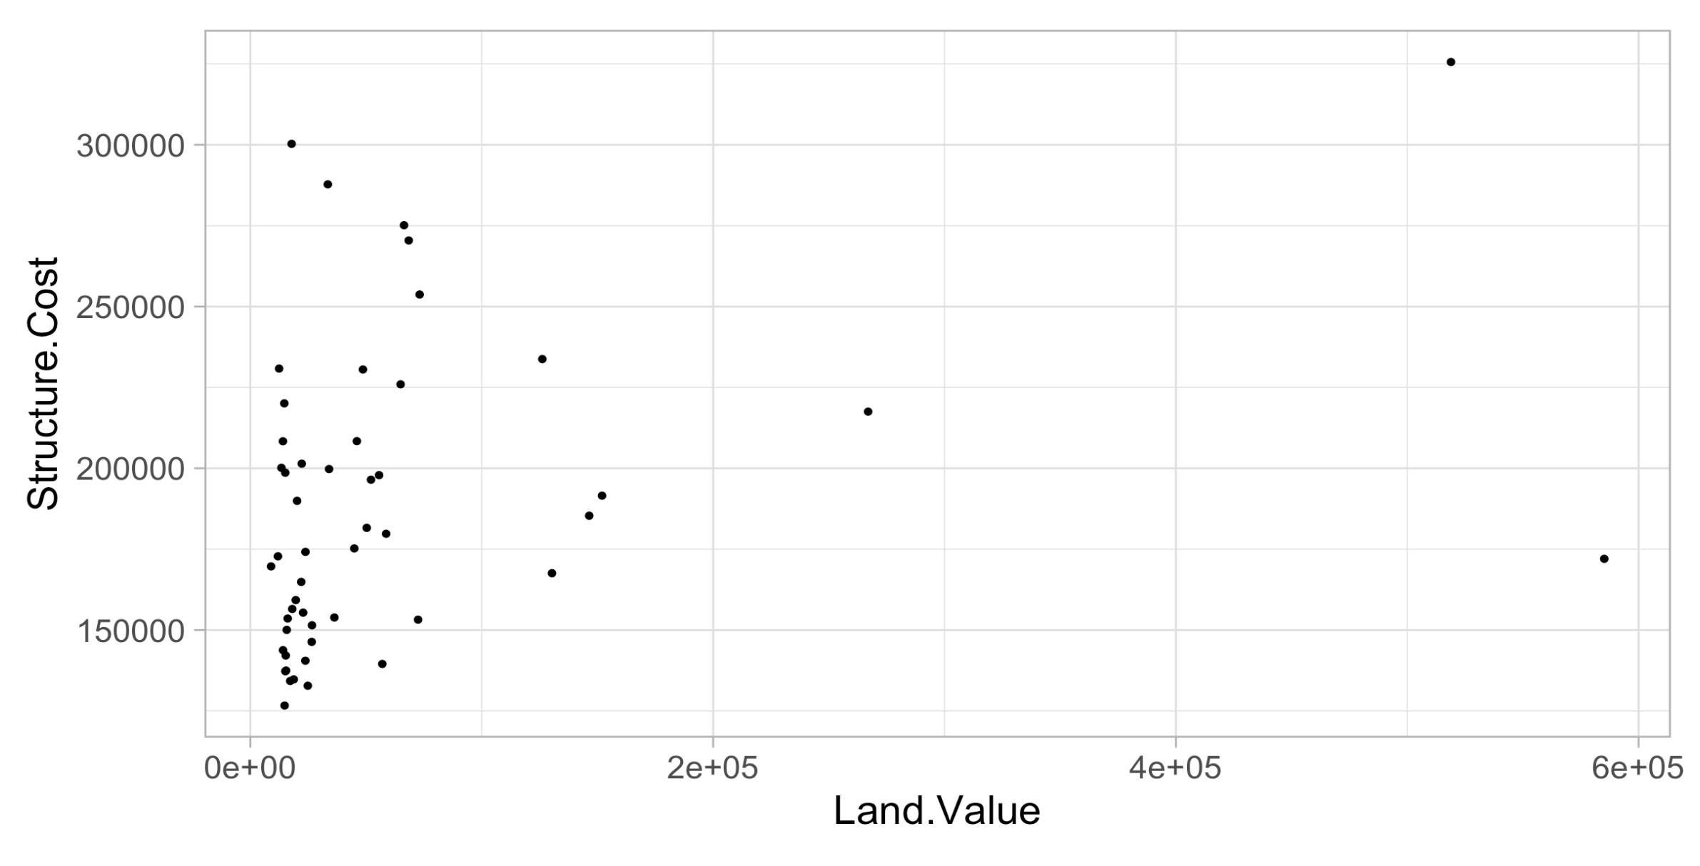
Simple Scatterplot
# filter
hp2013Q1 <- housing %>% filter(Date == 2013.25)
# plot
ggplot(hp2013Q1, aes(x = Land.Value, y = Structure.Cost)) +
geom_point()

Slide 7
Geometric Objects (geom) + Aesthetics
Apply aesthetics to geometric objects
Ex.
position (i.e., on the x and y axes)
color (“outside” color)
fill (“inside” color)
shape (of points)
line type
size

Slide 8
Geometric Objects (geom) + Aesthetics
Apply aesthetics to geometric objects
Ex.
position (i.e., on the x and y axes)
color (“outside” color)
fill (“inside” color)
shape (of points)
line type
size

Slide 9
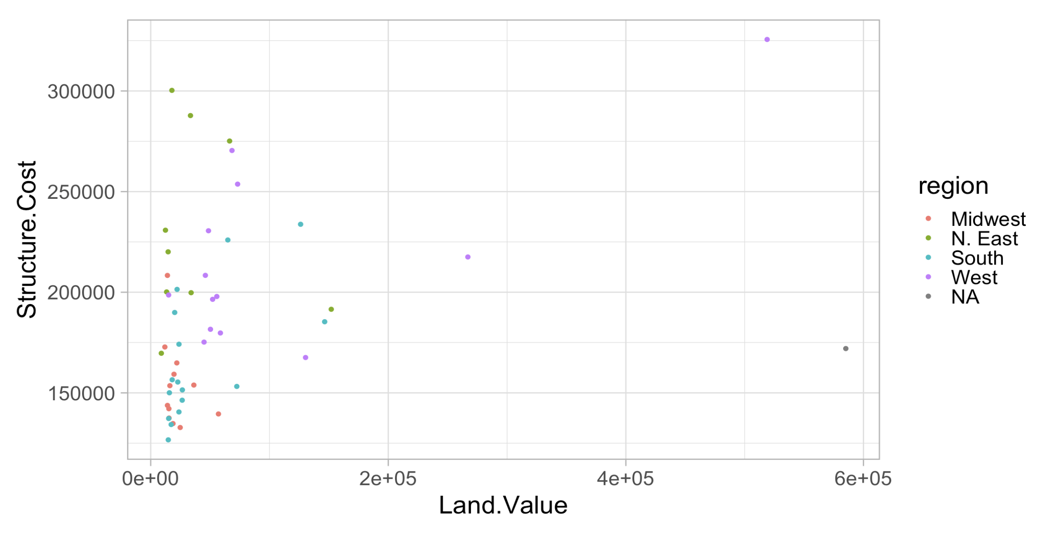
Simple Scatterplot
# filter
hp2013Q1 <- housing %>% filter(Date == 2013.25)
# plot
ggplot(hp2013Q1, aes(x = Land.Value, y = Structure.Cost)) +
geom_point(aes(color = region))

Slide 10
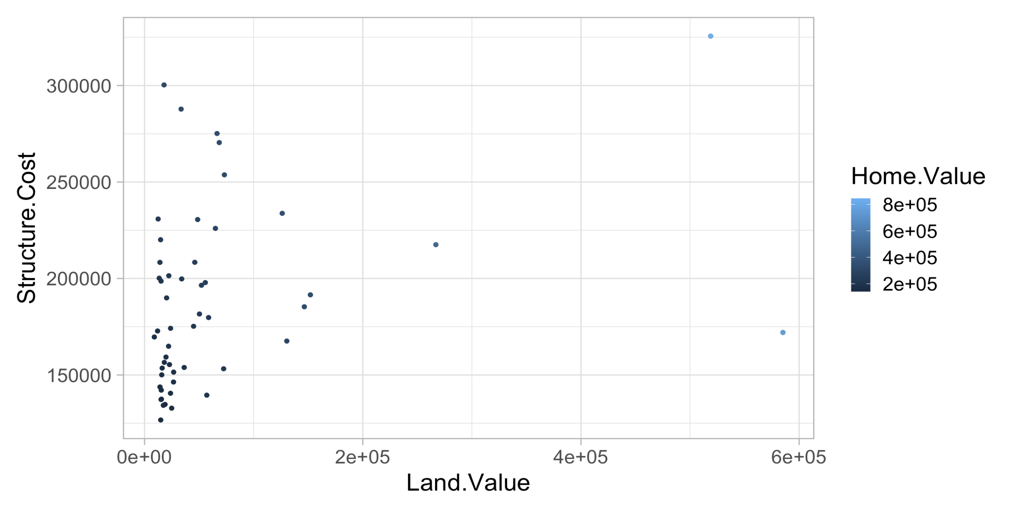
Simple Scatterplot
# filter
hp2013Q1 <- housing %>% filter(Date == 2013.25)
# plot
ggplot(hp2013Q1, aes(x = Land.Value, y = Structure.Cost)) +
geom_point(aes(color = Home.Value))

Slide 11
Simple Scatterplot
# filter
hp2013Q1 <- housing %>% filter(Date == 2013.25)
# plot
ggplot(hp2013Q1, aes(x = Land.Value, y = Structure.Cost)) +
geom_point(aes(color = ??))
Remember visual channels? Is “color” hue or value?

Slide 12
Simple Scatterplot
# filter
hp2013Q1 <- housing %>% filter(Date == 2013.25)
# plot
ggplot(hp2013Q1, aes(x = Land.Value, y = Structure.Cost)) +
geom_point(aes(color = ??))
Remember visual channels? Is “color” hue or value?
Both! If you do not select a specific color pallet, R automatically picks based on data
region is categorical, so use hue
Home.Value is quantitative, so use value

Slide 13
Note: Assignment vs. Aesthetic Mapping
# filter
hp2013Q1 <- housing %>% filter(Date == 2013.25)
# plot
ggplot(hp2013Q1, aes(x = Land.Value, y = Structure.Cost)) +
geom_point(aes(color = ??))
Maps color to variable

Slide 14
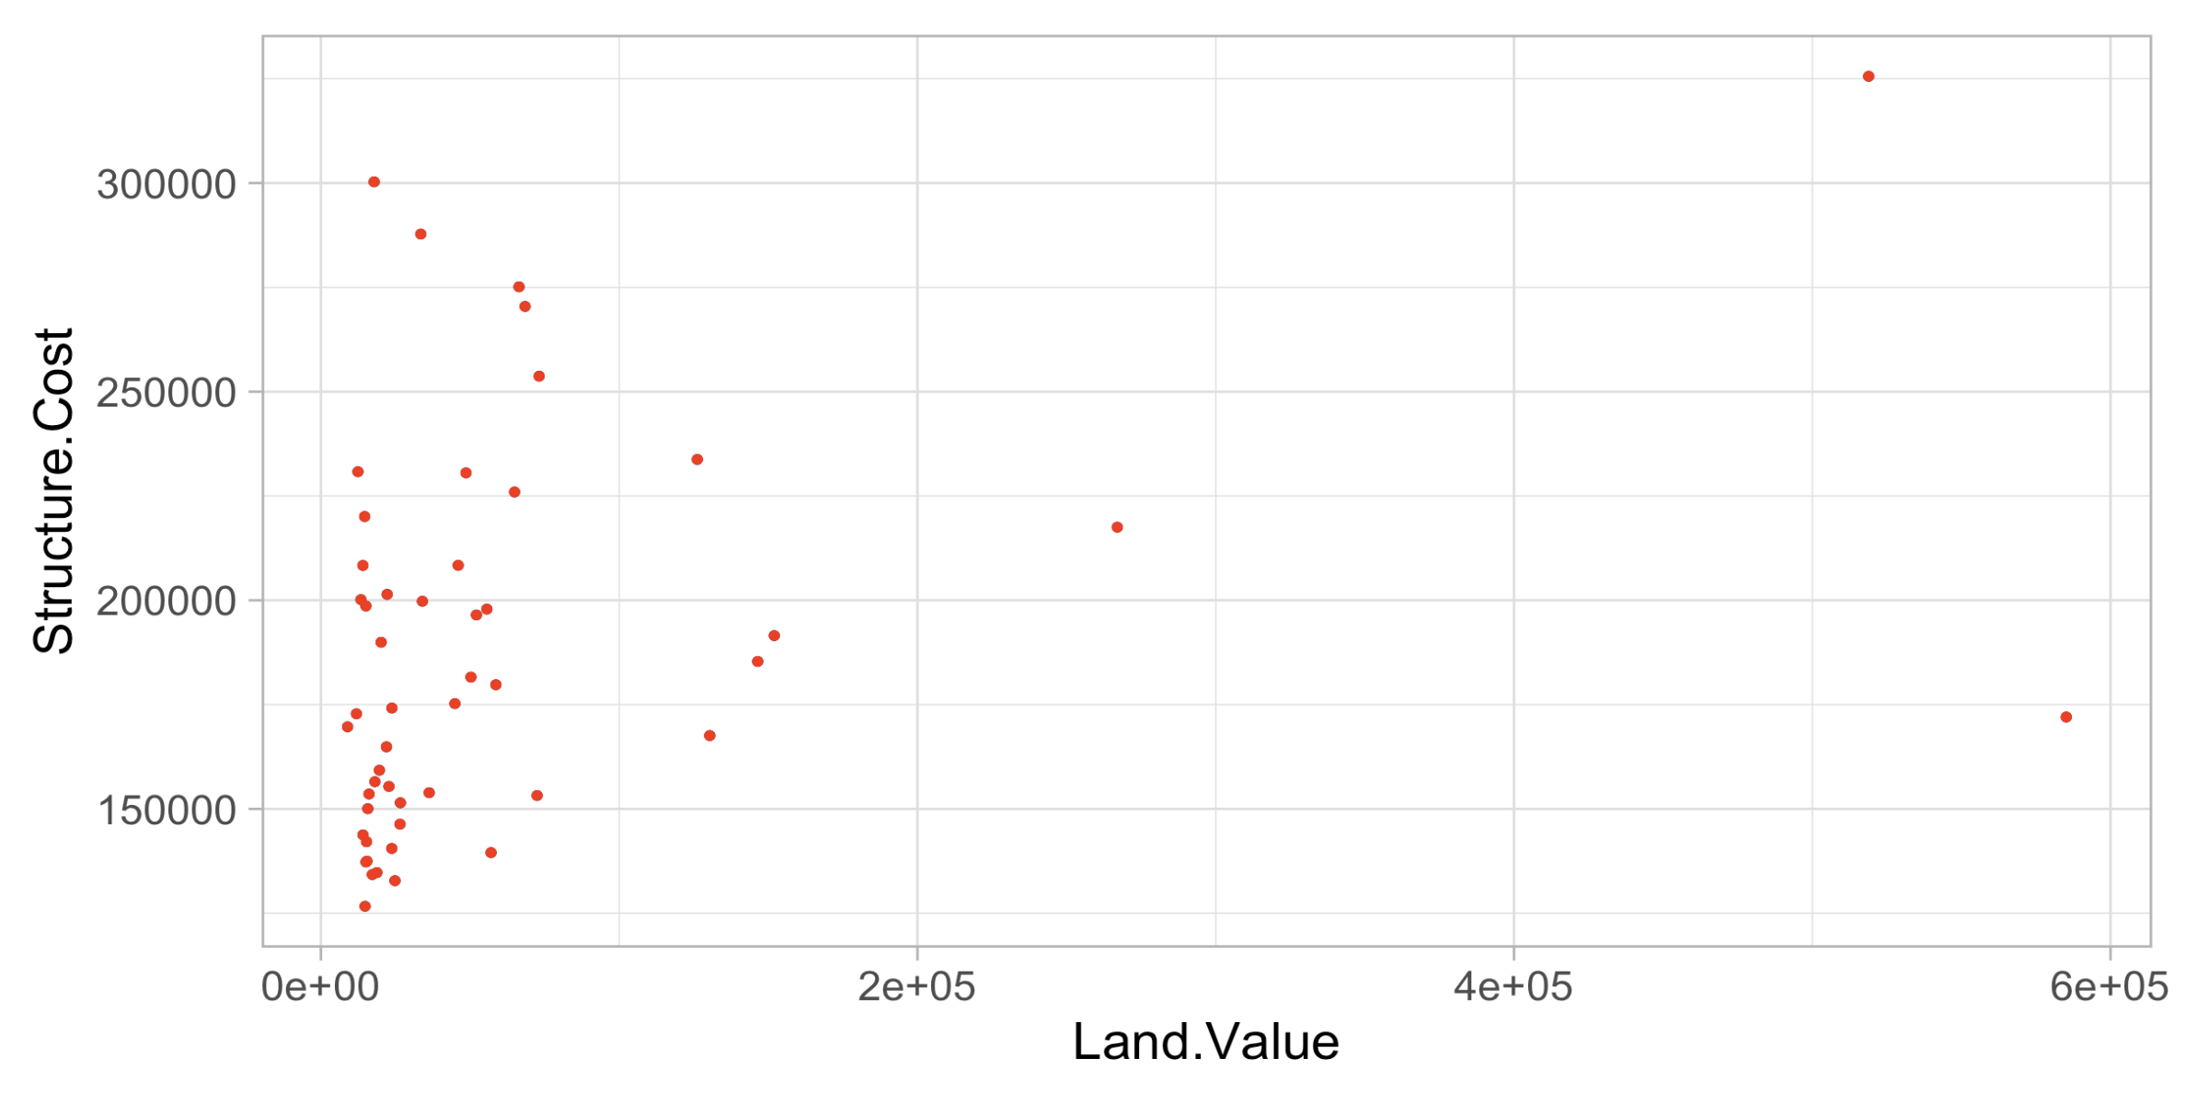
Note: Assignment vs. Aesthetic Mapping
# filter
hp2013Q1 <- housing %>% filter(Date == 2013.25)
# plot
ggplot(hp2013Q1, aes(x = Land.Value, y = Structure.Cost)) +
geom_point(color = red)
Assigns a color to all points

Slide 15
Controlling Aesthetic Mapping
aes() says to map an aesthetic to a variable, it does not specify how

Slide 16
Controlling Aesthetic Mapping
aes() says to map an aesthetic to a variable, it does not specify how
Ex.
# filter
hp2013Q1 <- housing %>% filter(Date == 2013.25)
# plot
ggplot(hp2013Q1, aes(x = Land.Value, y = Structure.Cost)) +
geom_point(aes(color = Home.Value))
Maps color to Home.Value, but doesn’t specify what color

Slide 17
Controlling Aesthetic Mapping
aes() says to map an aesthetic to a variable, it does not specify how
This is controlled through scales
In ggplot scales include:
position
color and fill
size
shape
linetype

Slide 18
Controlling Aesthetic Mapping
aes() says to map an aesthetic to a variable, it does not specify how
This is controlled through scales
In ggplot scales include:
position
color and fill
size
shape
linetype

Slide 19
Controlling Aesthetic Mapping
aes() says to map an aesthetic to a variable, it does not specify how
This is controlled through scales
The following arguments are common to most scales in ggplot2:
name: the first argument specifies the axis or legend title
limits: the minimum and maximum of the scale
breaks: the points along the scale where labels should appear
labels: the text that appears at each break

Slide 20
Controlling Aesthetic Mapping
p1 <- ggplot(hp2013Q1, aes(x = Land.Value, y = Structure.Cost))+
geom_point(aes(color = Home.Value))

Slide 21
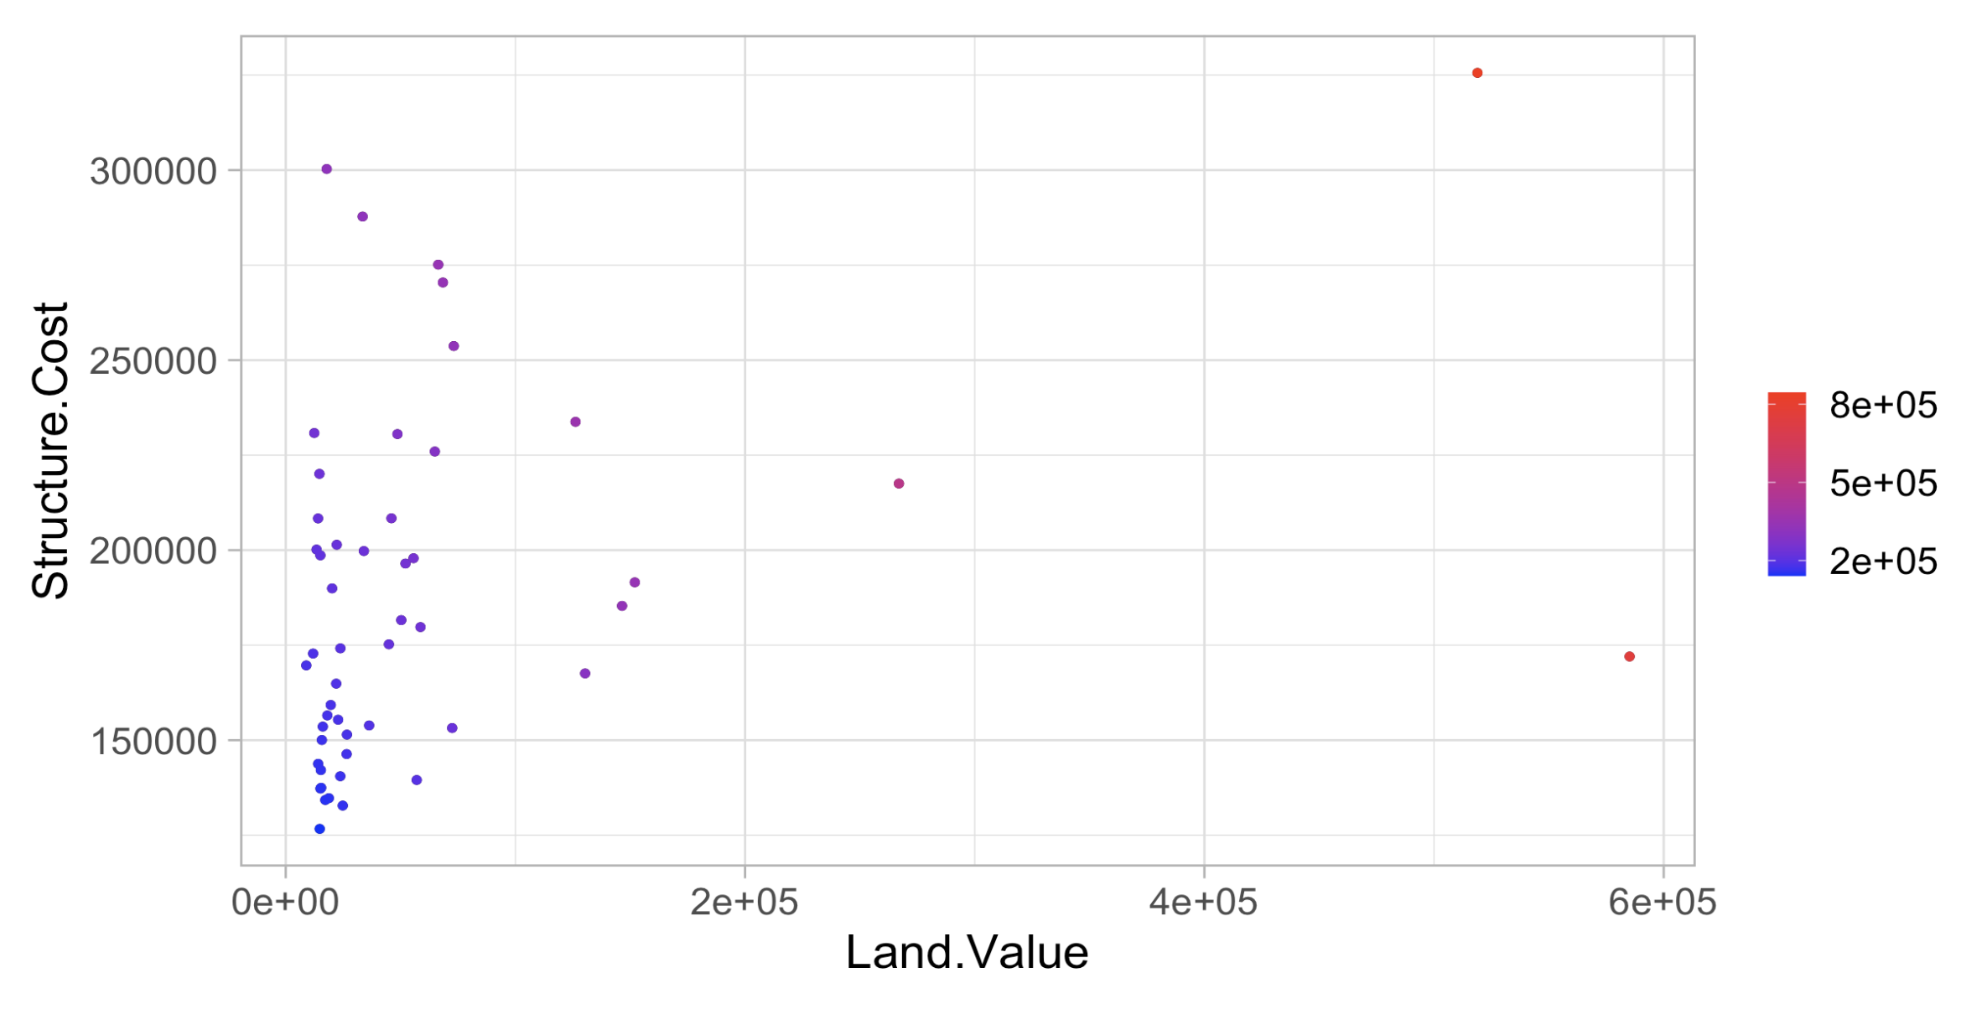
Controlling Aesthetic Mapping
# change color scale
p1 +
scale_color_continuous(name = "",
breaks = c(200001, 500001, 800001),
labels = c(200000, 500000, 800000),
low = "blue", high = "red")

Slide 22
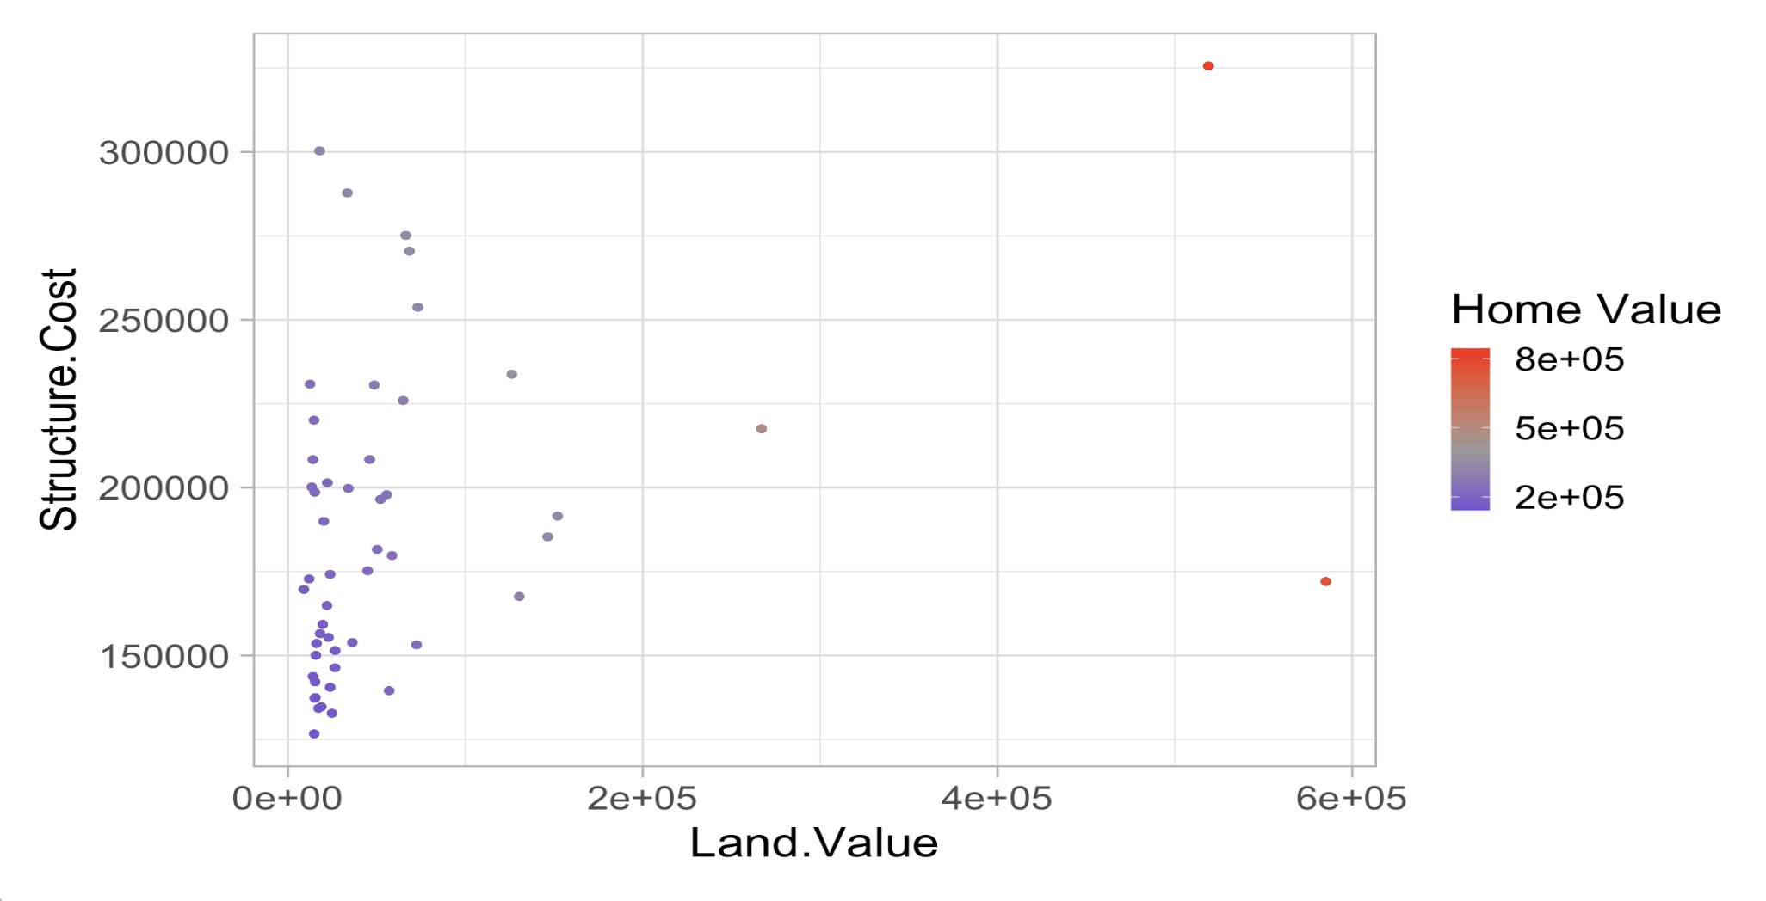
Controlling Aesthetic Mapping
# change color scale
p1 + scale_color_gradient2(name = ”Home Value",
breaks = c(200001, 500001, 800001),
labels = c(200000, 500000, 800000),
low = "blue", high = "red",
mid = "gray60",
midpoint = 400000)

Slide 23
Controlling Aesthetic Mapping – colorbrewer
We can also use built in color maps
Be sure to choose the correct map for your data type

Slide 24
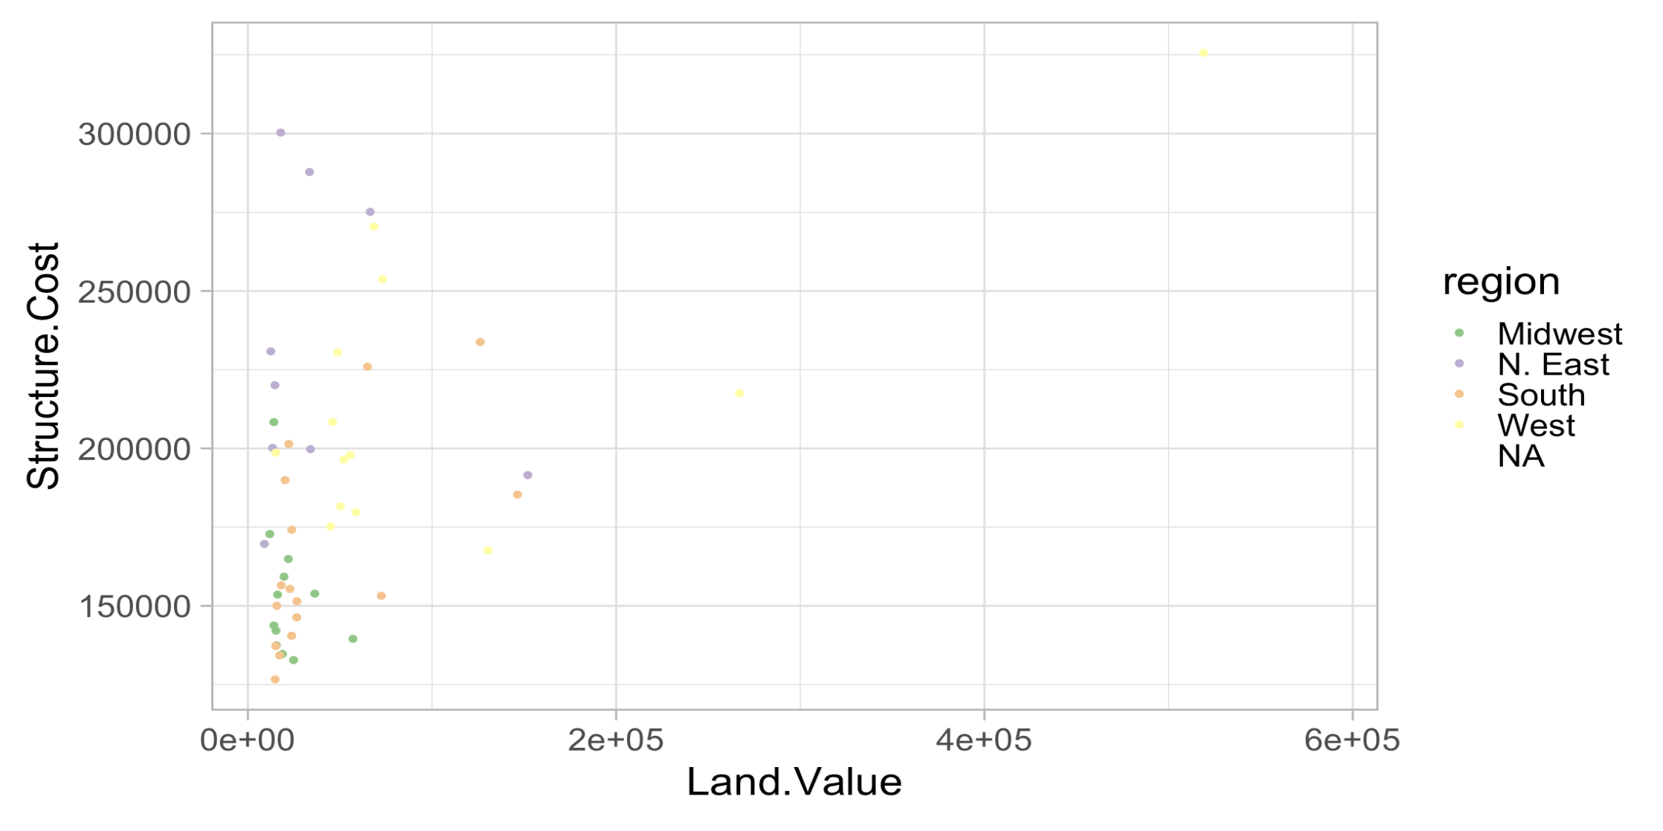
Controlling Aesthetic Mapping – colorbrewer
# use existing color scale
ggplot(hp2013Q1, aes(x = Land.Value, y = Structure.Cost)) +
geom_point(aes(color = region)) +
scale_colour_brewer(palette = "Accent")

Slide 25
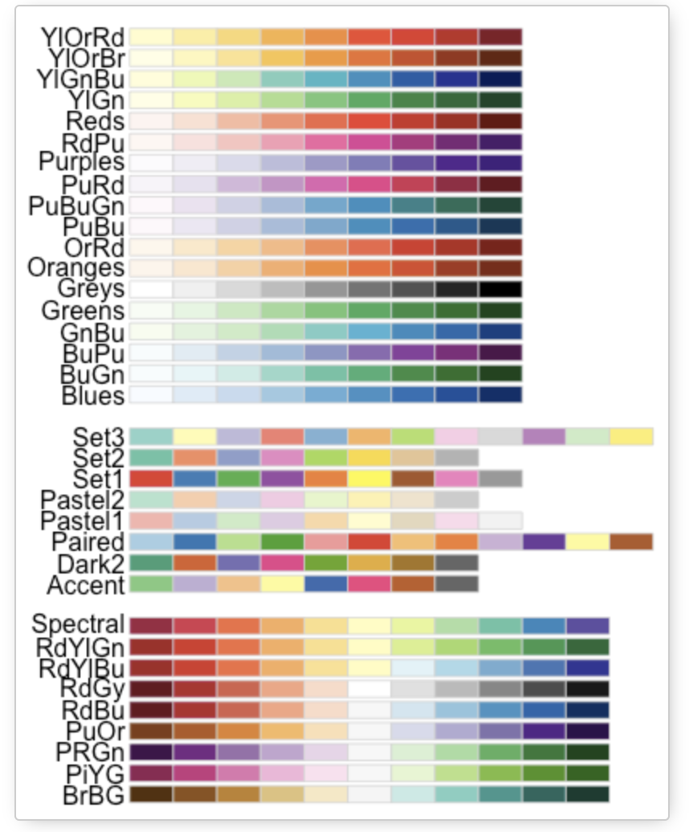
Controlling Aesthetic Mapping – colorbrewer

Slide 26
ggplot2 tips
Cheatsheet: https://www.rstudio.com/resources/cheatsheets/
Now, try it out!
Work with 1-2 other people.
Ask a question you can answer with the landdata dataset. Make a graph to answer your question that uses ggplot2, and a colormap.

