Slide 1
Data Science for Everyone – Data Wrangling – Joins 1
Dr. Ab Mosca (they/them)
Slides based off slides courtesy of Jordan Crouser (https://jcrouser.github.io/)

Slide 2
Plan for Today
Relational data
Inner joins

Slide 3
Single Tables
Until now, we’ve completed analyses by look at data in one table
Often, one table will not have all the data we need for an analysis
In these cases, we use multiple tables that are related

Slide 4
Multiple Tables
Relational Data
Data from two or more tables that is related
Ex. nycflights13 data in R
Dataset (nycflights13) is made up of multiple tables of data
All tables have data related to NYC flights in 2013
Some tables repeat columns
library(nycflights13)
## Warning: package ’nycflights13’ was built under R version 3.6.2
flights
airports
airlines
planes
weather

Slide 5
Multiple Tables
nycflights13 Data
flights, airports, airlines, planes, weather
flights
#> # A tibble: 336,776 x 19
#> year month day dep_time sched_dep_time dep_delay arr_time sched_arr_time
#> <int> <int> <int> <int> <int> <dbl> <int> <int>
#> 1 2013 1 1 517 515 2 830 819
#> 2 2013 1 1 533 529 4 850 830
#> 3 2013 1 1 542 540 2 923 850
#> 4 2013 1 1 544 545 -1 1004 1022
#> 5 2013 1 1 554 600 -6 812 837
#> 6 2013 1 1 554 558 -4 740 728
#> # … with 336,770 more rows, and 11 more variables: arr_delay <dbl>,
#> # carrier <chr>, flight <int>, tailnum <chr>, origin <chr>, dest <chr>,
#> # air_time <dbl>, distance <dbl>, hour <dbl>, minute <dbl>, time_hour <dttm>

Slide 6
Multiple Tables
nycflights13 Data
flights, airports, airlines, planes, weather
airports
#> # A tibble: 1,458 x 8
#> faa name lat lon alt tz dst tzone
#> <chr> <chr> <dbl> <dbl> <dbl> <dbl> <chr> <chr>
#> 1 04G Lansdowne Airport 41.1 -80.6 1044 -5 A America/New_Y…
#> 2 06A Moton Field Municipal Airp… 32.5 -85.7 264 -6 A America/Chica…
#> 3 06C Schaumburg Regional 42.0 -88.1 801 -6 A America/Chica…
#> 4 06N Randall Airport 41.4 -74.4 523 -5 A America/New_Y…
#> 5 09J Jekyll Island Airport 31.1 -81.4 11 -5 A America/New_Y…
#> 6 0A9 Elizabethton Municipal Air… 36.4 -82.2 1593 -5 A America/New_Y…
#> # … with 1,452 more rows

Slide 7
Multiple Tables
nycflights13 Data
flights, airports, airlines, planes, weather
airlines
#> # A tibble: 16 x 2
#> carrier name
#> <chr> <chr>
#> 1 9E Endeavor Air Inc.
#> 2 AA American Airlines Inc.
#> 3 AS Alaska Airlines Inc.
#> 4 B6 JetBlue Airways
#> 5 DL Delta Air Lines Inc.
#> 6 EV ExpressJet Airlines Inc.
#> # … with 10 more rows

Slide 8
Multiple Tables
nycflights13 Data
flights, airports, airlines, planes, weather
planes
#> # A tibble: 3,322 x 9
#> tailnum year type manufacturer model engines seats speed engine
#> <chr> <int> <chr> <chr> <chr> <int> <int> <int> <chr>
#> 1 N10156 2004 Fixed wing mu… EMBRAER EMB-1… 2 55 NA Turbo-…
#> 2 N102UW 1998 Fixed wing mu… AIRBUS INDUST… A320-… 2 182 NA Turbo-…
#> 3 N103US 1999 Fixed wing mu… AIRBUS INDUST… A320-… 2 182 NA Turbo-…
#> 4 N104UW 1999 Fixed wing mu… AIRBUS INDUST… A320-… 2 182 NA Turbo-…
#> 5 N10575 2002 Fixed wing mu… EMBRAER EMB-1… 2 55 NA Turbo-…
#> 6 N105UW 1999 Fixed wing mu… AIRBUS INDUST… A320-… 2 182 NA Turbo-…
#> # … with 3,316 more rows

Slide 9
Multiple Tables
nycflights13 Data
flights, airports, airlines, planes, weather
weather
#> # A tibble: 26,115 x 15
#> origin year month day hour temp dewp humid wind_dir wind_speed wind_gust
#> <chr> <int> <int> <int> <int> <dbl> <dbl> <dbl> <dbl> <dbl> <dbl>
#> 1 EWR 2013 1 1 1 39.0 26.1 59.4 270 10.4 NA
#> 2 EWR 2013 1 1 2 39.0 27.0 61.6 250 8.06 NA
#> 3 EWR 2013 1 1 3 39.0 28.0 64.4 240 11.5 NA
#> 4 EWR 2013 1 1 4 39.9 28.0 62.2 250 12.7 NA
#> 5 EWR 2013 1 1 5 39.0 28.0 64.4 260 12.7 NA
#> 6 EWR 2013 1 1 6 37.9 28.0 67.2 240 11.5 NA
#> # … with 26,109 more rows, and 4 more variables: precip <dbl>, pressure <dbl>,
#> # visib <dbl>, time_hour <dttm>

Slide 10
Multiple Tables
nycflights13 Data
flights
year
month
day
dep_time
sched_dep_time
dep_delay
arr_time
sched_arr_time
arr_delay
carrier
flight
talinum
origin
dest
air_time
distance
hour
minute
time_hour
airports
faa
name
lat
lon
alt
tz
dst
tzone
airlines
carrier
name
planes
tailnum
year
type
manufacturer
model
engines
seats
speed
engine
weather
origin
year
month
day
hour
temp
dewp
humid
wind_dir
wind_speed
wind_gust
precip
pressure
visib
time_hour
Work with the person next to you to find which columns are shared between these different tables

Slide 11
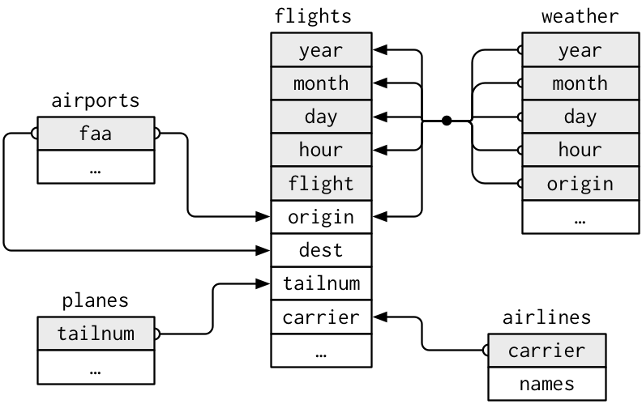
Multiple Tables
nycflights13 Data

Slide 12
Multiple Tables
nycflights13 Data
We use shared columns to join (i.e. connect / merge) tables
Ex. We could join the planes and flights tables on talinum, their shared column

Slide 13
Multiple Tables
nycflights13 Data
We use shared columns to join (i.e. connect / merge) tables
Ex. We could join the planes and flights tables on talinum, their shared column
What other shared columns could we join on?

Slide 14
Joins
Join is the word for connecting or merging two data tables
We join tables on shared columns, which we call the key
Ex.
Table_X
Table_Y
ID | DataX
1 | x1
2 | x2
3 | x3
ID | DataY
1 | y1
2 | y2
4 | y3
Notes:
What’s the key?

Slide 15
Joins
Join is the word for connecting or merging two data tables
We join tables on shared columns, which we call the key
Ex.
Table_X
Table_Y
ID | DataX
1 | x1
2 | x2
3 | x3
ID | DataY
1 | y1
2 | y2
4 | y3
Notes:
What’s the key?

Slide 16
Joins
Join is the word for connecting or merging two data tables
We join tables on shared columns, which we call the key
Ex.
Table_X
Table_Y
ID | DataX
1 | x1
2 | x2
3 | x3
ID | DataY
1 | y1
2 | y2
4 | y3
Notes:
What’s the key?

Slide 17
Joins
Join is the word for connecting or merging two data tables
We join tables on shared columns, which we call the key
Ex.
Different types of joins handle this situation differently
Table_X
Table_Y
ID | DataX
1 | x1
2 | x2
3 | x3
ID | DataY
1 | y1
2 | y2
4 | y3
How could we handle this?
Notes:
What’s the key?

Slide 18
Joins
Join is the word for connecting or merging two data tables
We join tables on shared columns, which we call the key
Ex.
Different types of joins handle this situation differently
Table_X
Table_Y
ID | DataX
1 | x1
2 | x2
3 | x3
ID | DataY
1 | y1
2 | y2
4 | y3
Notes:
What’s the key?

Slide 19
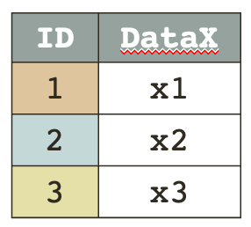
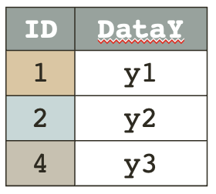
Joins
inner_join()
Resulting table has only rows in both tables
Table_X %>%
inner_join(Table_Y, by = “ID”)
key | DataX | DataY
1 | x1 | y1
2 | x2 | y2
Notes:
What’s the key?

Slide 20
Joins
inner_join()
Resulting table has only rows in both tables
Table_X %>%
inner_join(Table_Y, by = “ID”)
Key
key | DataX | DataY
1 | x1 | y1
2 | x2 | y2
Notes:
What’s the key?

Slide 21
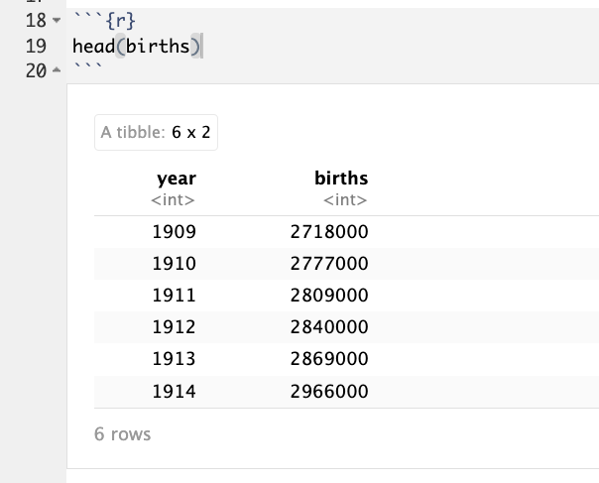
Example
The babynames package comes with other tables
Ex.

Slide 22
Example
babynames comes from the social security administration
births comes from the us census

Slide 23
Example
babynames comes from the social security administration
births comes from the us census
Let’s check that these have the same counts of babies
Rename babynames ssa_births
Rename births census_births
Condense the SSA data so that it is in the same yearly format as the census data

Slide 24
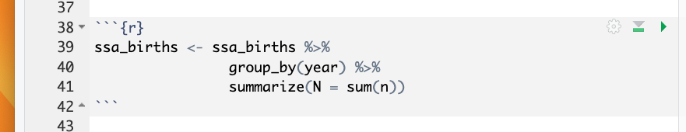
Example
babynames comes from the social security administration
births comes from the us census
Let’s check that these have the same counts of babies
Rename babynames ssa_births
Rename births census_births
Condense the SSA data so that it is in the same yearly format as the census data

Slide 25
Example
Let’s check that these have the same counts of babies
What column do SSA births and Census births share?
Do they have identical values in that column?

Slide 26
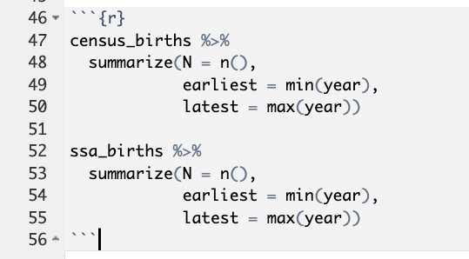
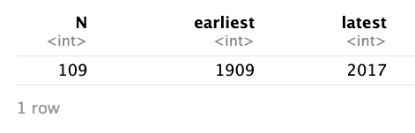
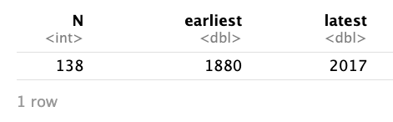
Example
Let’s check that these have the same counts of babies
What column do SSA births and Census births share?
Do they have identical values in that column?

Slide 27
Example
Let’s check that these have the same counts of babies
What column do SSA births and Census births share?
Do they have identical values in that column?
What will happen if we do an inner join?

Slide 28
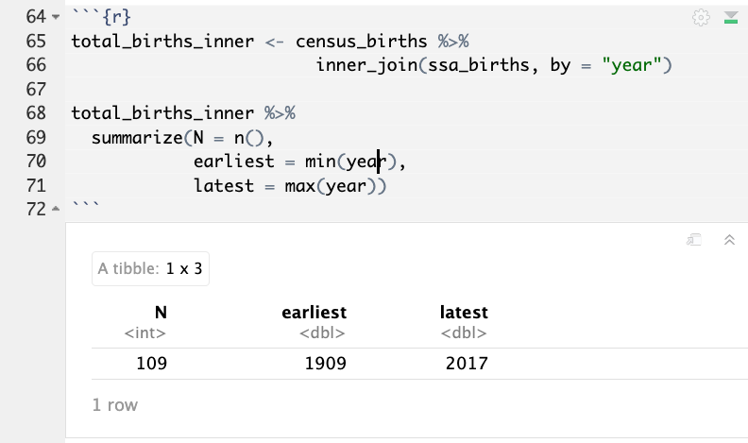
Example
Let’s check that these have the same counts of babies
What column do SSA births and Census births share?
Do they have identical values in that column?
What will happen if we do an inner join?

