Slide 1
Data Science for Everyone – Data Wrangling – Joins 2
Dr. Ab Mosca (they/them)
Slides based off slides courtesy of Jordan Crouser (https://jcrouser.github.io/)

Slide 2
Plan for Today
Left and right joins
Full joins

Slide 3
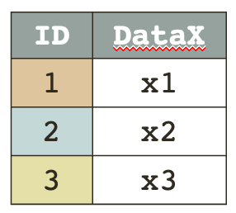
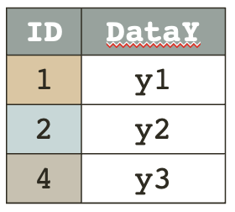
Joins
inner_join()
Resulting table has only rows in both tables
Table_X %>%
inner_join(Table_Y, by = “ID”)
key | DataX | DataY
1 | x1 | y1
2 | x2 | y2
Notes:
What’s the key?

Slide 4

Joins
left_join()
Resulting table has all rows in left table
Table_X %>%
left_join(Table_Y, by = “ID”)
key | DataX | DataY
1 | x1 | y1
2 | x2 | y2
3 | x3 | NA
Notes:
What’s the key?

Slide 5

Joins
right_join()
Resulting table has all rows in right table
Table_X %>%
right_join(Table_Y, by = “ID”)
key | DataX | DataY
1 | x1 | y1
2 | x2 | y2
4 | NA | y3
Notes:
What’s the key?

Slide 6
Joins
full_join()
Resulting table has all rows in both tables
Table_X %>%
full_join(Table_Y, by = “ID”)
key | DataX | DataY
1 | x1 | y1
2 | x2 | y2
3 | x3 | NA
4 | NA | y3
Notes:
What’s the key?

Slide 7
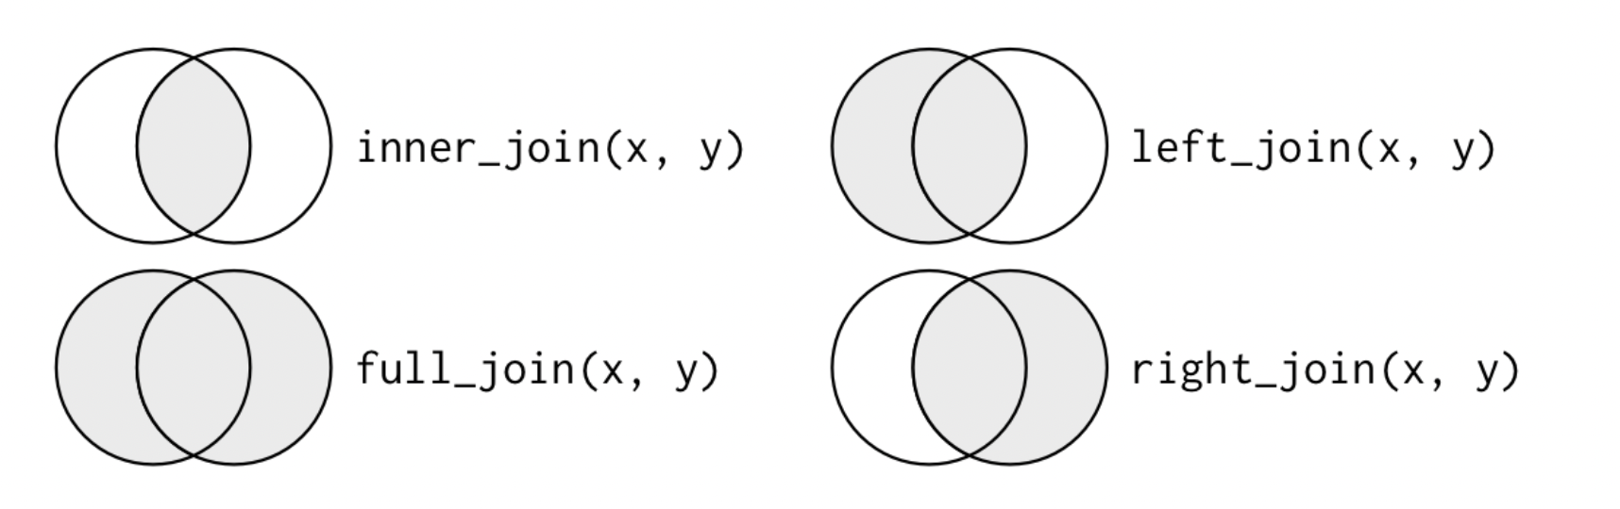
Joins
Another way to visualize joins
Notes:
What’s the key?

