Slide 1
Data Science for Everyone – Grammar of Graphics
Dr. Ab Mosca (they/them)
Slides based off slides courtesy of Jordan Crouser (https://jcrouser.github.io/)

Slide 2
Plan for Today
Connect what we know about visualizations to ggplot in R

Slide 3
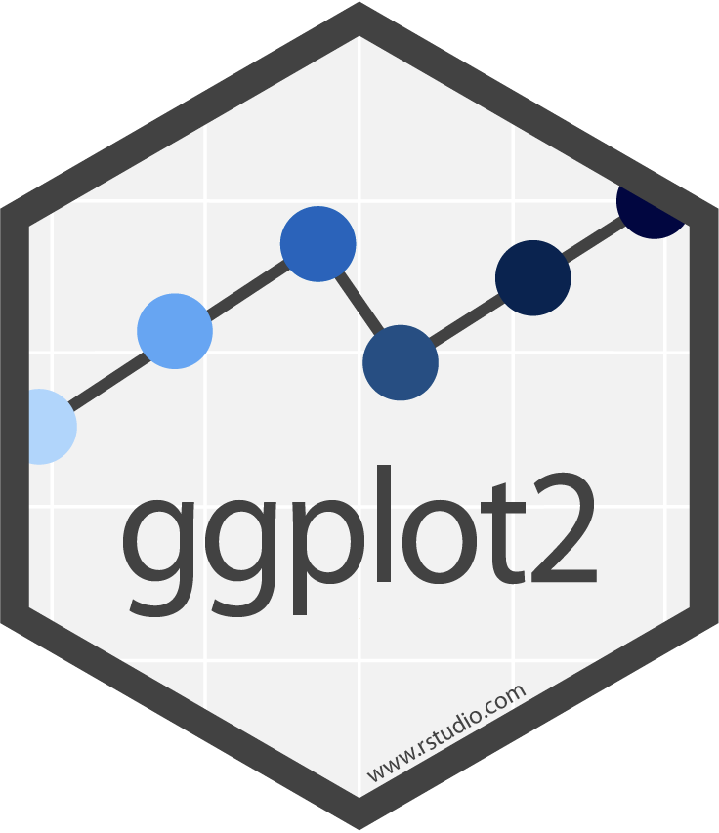
ggplot2
Library for creating plots in R
The “gg” stand for grammar of graphics
Big idea behind a grammar of graphics:
Independently specify plot building blocks and combine them to create graphical displays

Slide 4
ggplot2
Plot building blocks
data
aesthetic mappings (how we draw that stuff)
geometric objects (the literal stuff we draw)
statistical transformations (underlying model)
scales (range of values, colors, etc.)
faceting (small multiples)

Slide 5
ggplot2
Plot building blocks
data
aesthetic mappings (how we draw that stuff)
geometric objects (the literal stuff we draw)
statistical transformations (underlying model)
scales (range of values, colors, etc.)
faceting (small multiples)

Slide 6
ggplot2
Plot building blocks
data
aesthetic mappings (how we draw that stuff)
geometric objects (the literal stuff we draw)
statistical transformations (underlying model)
scales (range of values, colors, etc.)
faceting (small multiples)
ggplot(data, aes()) +
geom_*
data
aesthetic mapping
geometric object

Slide 7
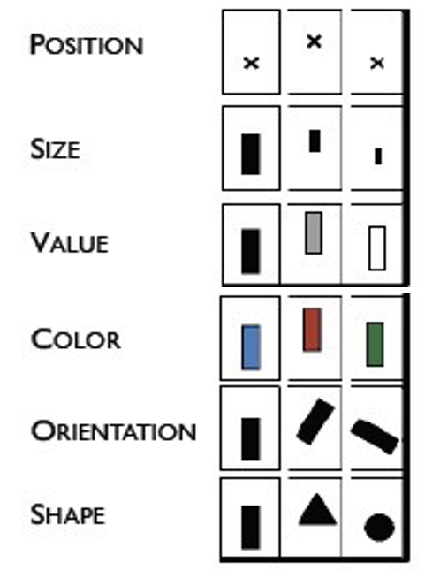
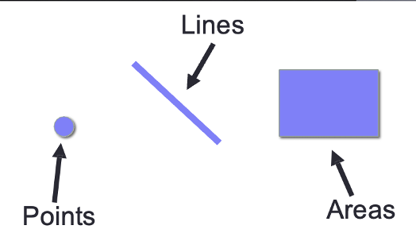
ggplot2
Plot building blocks
data
aesthetic mappings (how we draw that stuff)
geometric objects (the literal stuff we draw)
statistical transformations (underlying model)
scales (range of values, colors, etc.)
faceting (small multiples)
Sound Familiar?
Marks Channels
ggplot(data, aes()) +
geom_*
data
aesthetic mapping
geometric object

Slide 8
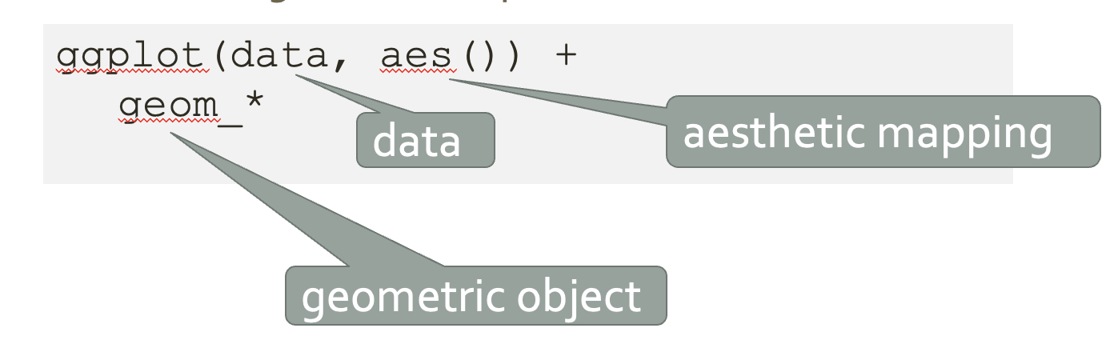
Data
First argument to ggplot is the data you want to plot
We will use the iris dataset
Open a new R Markdown and take a glimpse at the iris dataset
Notes:
https://posit.cloud/spaces/397595/content/6581864

Slide 9
Data
First argument to ggplot is the data you want to plot
We will use the iris dataset
Open a new R Markdown and take a glimpse at the iris dataset
Let’s make a plot with this dataset
Notes:
https://posit.cloud/spaces/397595/content/6581864

Slide 10

Data
First argument to ggplot is the data you want to plot
ggplot(iris)

Slide 11
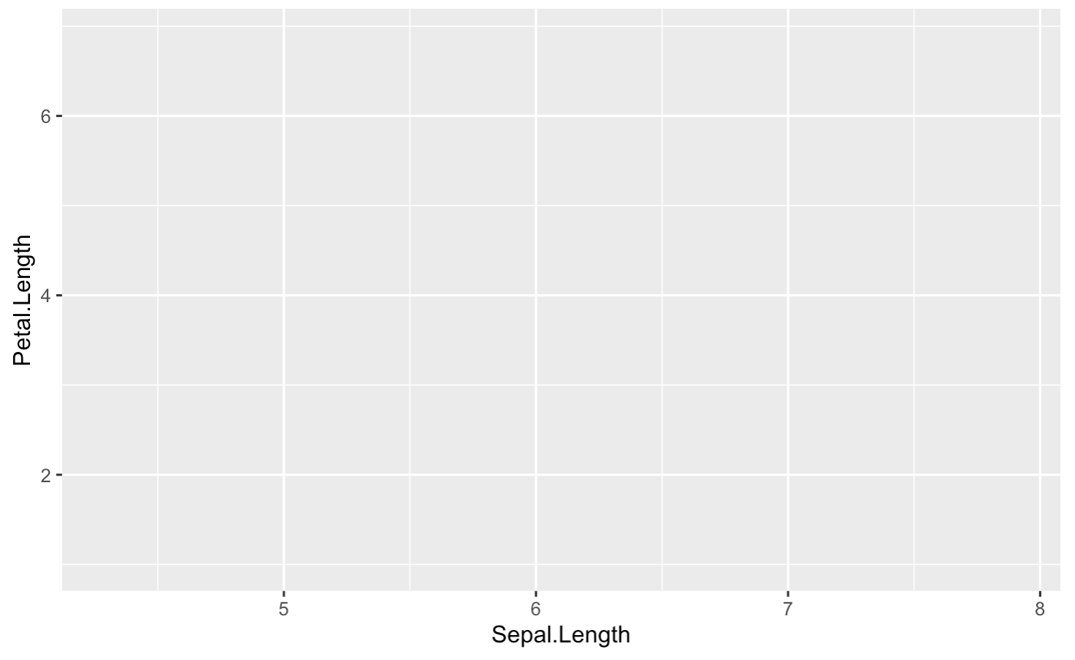
Aesthetic
Mapping (aes())
Second argument is aes, the data to visual channels mapping
ggplot(iris, aes(x = Sepal.Length, y = Petal.Length))

Slide 12
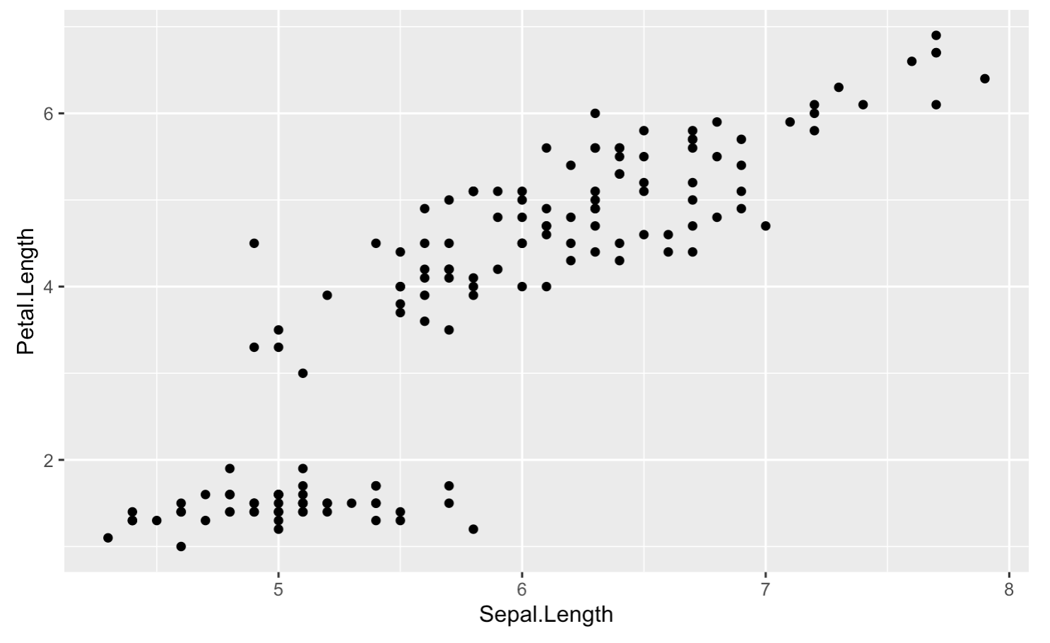
Geometric
Objects (geom)
Last, add geom, which identifies the marks
ggplot(iris, aes(x = Sepal.Length, y = Petal.Length)) +
geom_point()

Slide 13
Geometric
Objects (geom)
Last, add geom, which identifies the marks
ggplot(iris, aes(x = Sepal.Length, y = Petal.Length)) +
geom_point()
Thoughts for a line instead of points?

Slide 14
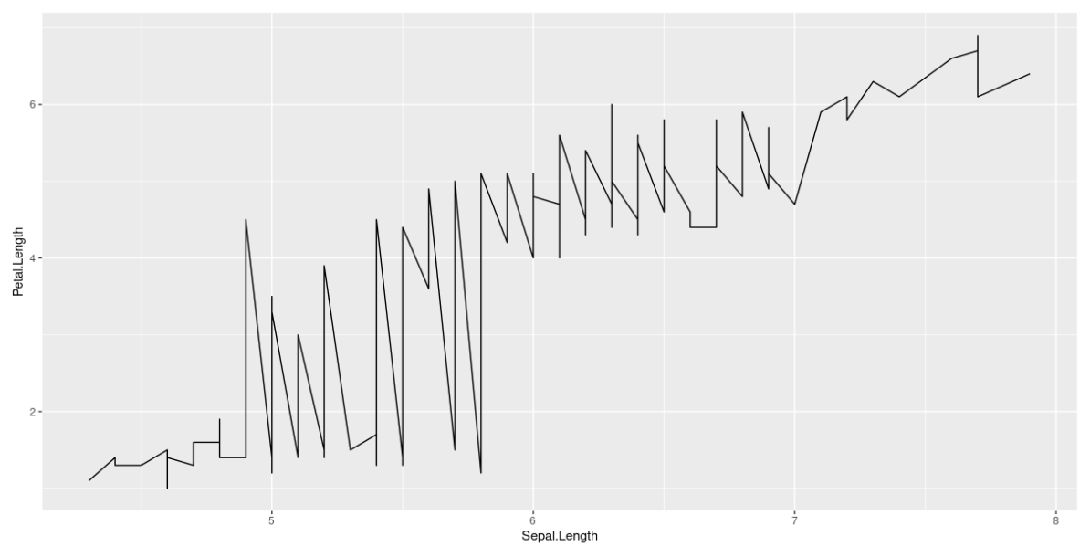
Geometric
Objects (geom)
Last, add geom, which identifies the marks
ggplot(iris, aes(x = Sepal.Length, y = Petal.Length)) +
geom_line()

Slide 15
Geometric
Objects (geom)
Last, add geom, which identifies the marks
ggplot(iris, aes(x = Sepal.Length, y = Petal.Length)) +
geom_point()
Thoughts for a points and a line?

Slide 16
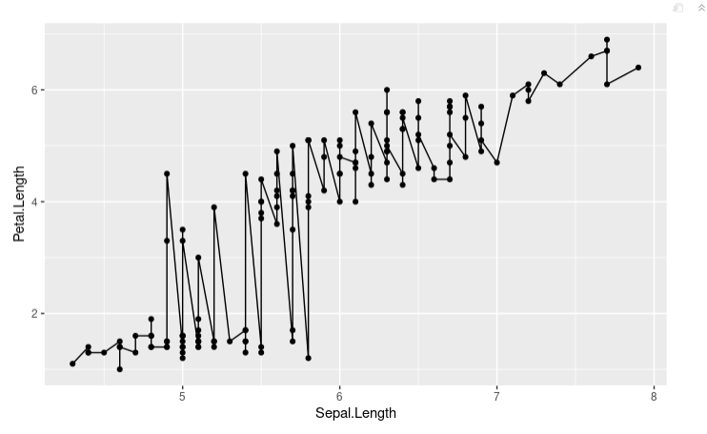
Geometric
Objects (geom)
Last, add geom, which identifies the marks
ggplot(iris, aes(x = Sepal.Length, y = Petal.Length)) +
geom_point() + geom_line()

Slide 17
Geometric
Objects (geom)
Last, add geom, which identifies the marks
ggplot(iris, aes(x = Sepal.Length, y = Petal.Length)) +
geom_point() + geom_line()
No upper limit for geometries, but do make things readable!

Slide 18
Geometric
Objects (geom)
Last, add geom, which identifies the marks
ggplot(iris, aes(x = Sepal.Length, y = Petal.Length)) +
geom_point() + geom_line()
Yikes, what about a smooth line?

Slide 19
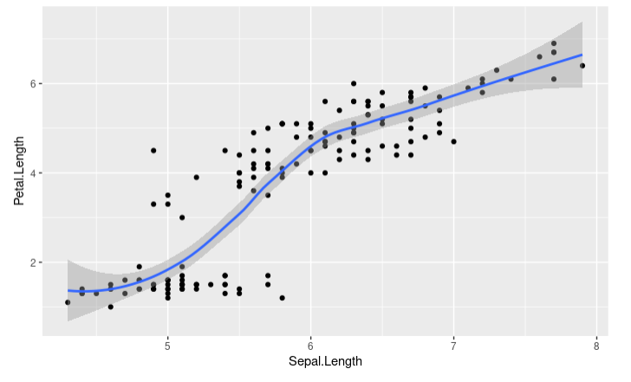
Geometric
Objects (geom)
Last, add geom, which identifies the marks
ggplot(iris, aes(x = Sepal.Length, y = Petal.Length)) +
geom_point() + geom_smooth()
Regression line
Standard Error

Slide 20
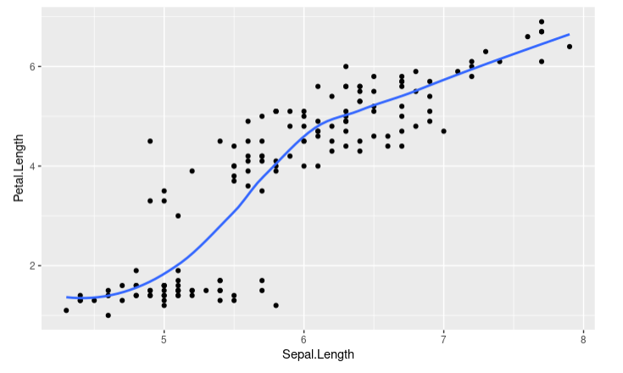
Geometric
Objects (geom)
Last, add geom, which identifies the marks
ggplot(iris, aes(x = Sepal.Length, y = Petal.Length)) +
geom_point() + geom_smooth(se = FALSE)
to remove error bands

Slide 21
Geometric
Objects (geom)
Last, add geom, which identifies the marks
ggplot(iris, aes(x = Sepal.Length, y = Petal.Length)) +
geom_point() + geom_smooth(se = FALSE)
Thoughts for a histogram?

Slide 22
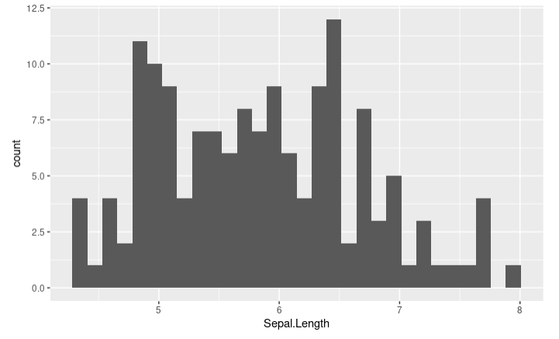
Geometric
Objects (geom)
Last, add geom, which identifies the marks
ggplot(iris, aes(x = Sepal.Length) +
geom_histogram()

Slide 23
Geometric
Objects (geom)
Last, add geom, which identifies the marks
ggplot(iris, aes(x = Sepal.Length) +
geom_histogram()

Slide 24
Geometric
Objects (geom)
Last, add geom, which identifies the marks
ggplot(iris, aes(x = Sepal.Length) +
geom_histogram(binwidth = )
Try out some numbers, what do you notice?

Slide 25
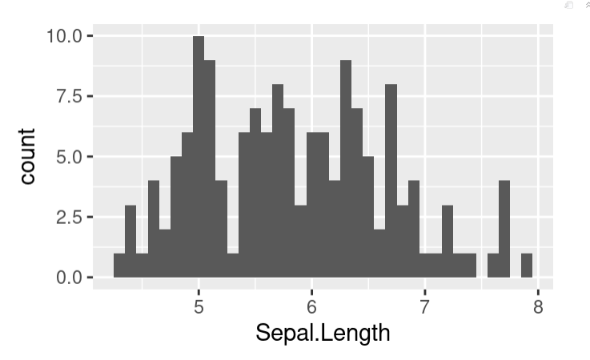
Themes
ggplot(iris, aes(x = Sepal.Length) +
geom_histogram(binwidth = 0.1) +
theme_gray(base_size = 22)

Slide 26
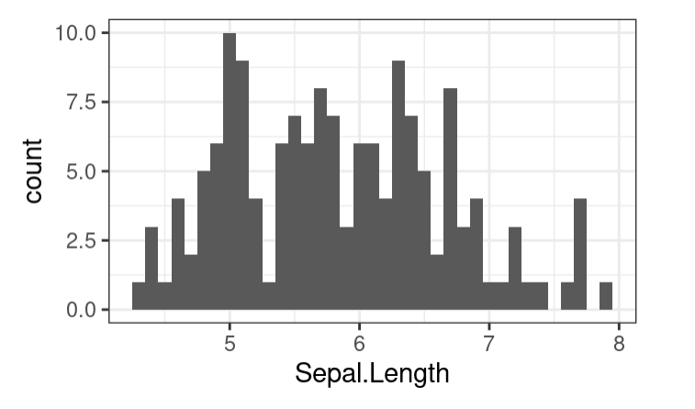
Themes
ggplot(iris, aes(x = Sepal.Length) +
geom_histogram(binwidth = 0.1) +
theme_bw(base_size = 22)

Slide 27
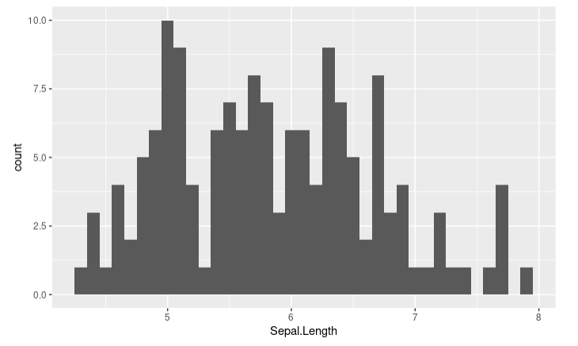
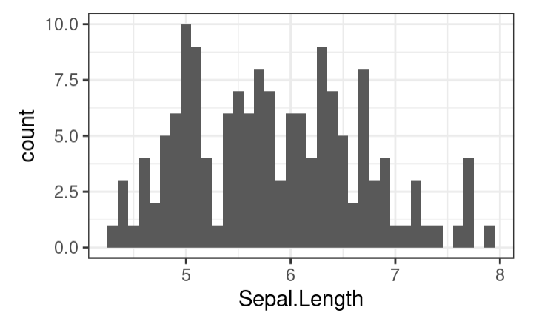
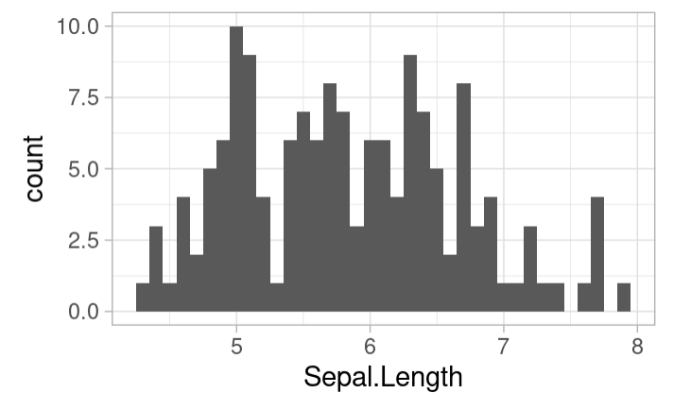
Plots as Objects
plt <- ggplot(iris, aes(x = Sepal.Length) +
geom_histogram(binwidth = 0.1)
plt_bw <- plt + theme_bw(base_size = 22)
plt_bw <- plt + theme_bw(base_size = 22)

Slide 28
Your Turn!
Upload the drinking-water.csv on the course website (under Labs) to your R Studio workspace
Use ggplot to make a scatterplot of “# of Residential Connections” versus “Winter / Year Round Population Served”
Put “# of Residential Connections” on the x-axis
Hint: To refer to a variable with spaces in the name use ` around the name. Ex. x = ` “# of Residential Connections`
What do you notice in the scatterplot?

