Slide 1
Data Science for Everyone – Grammar of Graphics
Dr. Ab Mosca (they/them)
Slides based off slides courtesy of Jordan Crouser (https://jcrouser.github.io/)

Slide 2
Plan for Today
Connect what we know about visualizations to ggplot in R

Slide 3
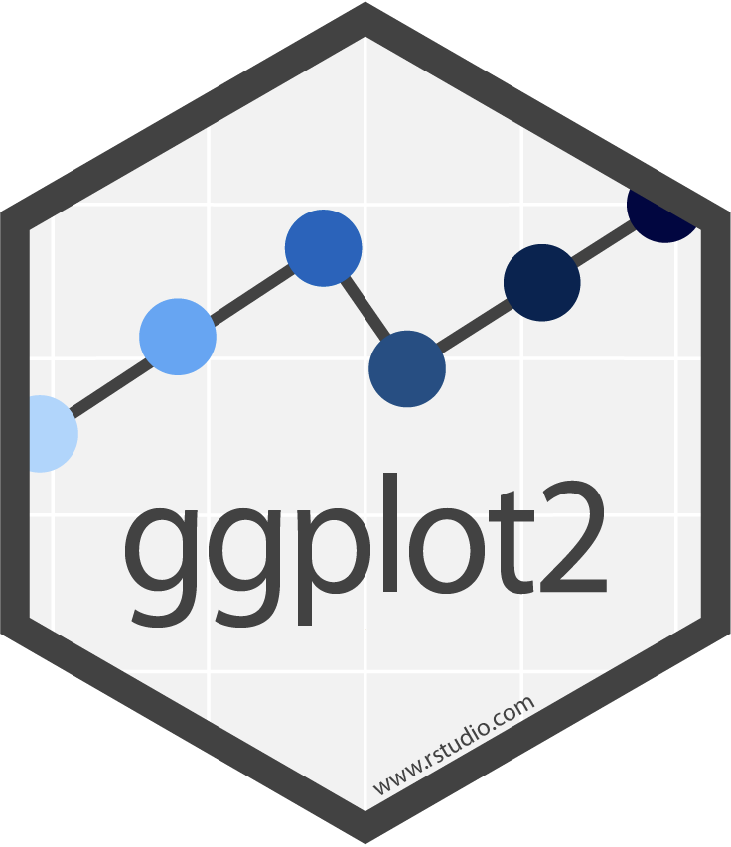
ggplot2
Library for creating plots in R
The “gg” stand for grammar of graphics
Big idea behind a grammar of graphics:
Independently specify plot building blocks and combine them to create graphical displays

Slide 4
ggplot2
Plot building blocks
data
aesthetic mappings (how we draw that stuff)
geometric objects (the literal stuff we draw)
statistical transformations (underlying model)
scales (range of values, colors, etc.)
faceting (small multiples)

Slide 5
ggplot2
Plot building blocks
data
aesthetic mappings (how we draw that stuff)
geometric objects (the literal stuff we draw)
statistical transformations (underlying model)
scales (range of values, colors, etc.)
faceting (small multiples)

Slide 6
ggplot2
Plot building blocks
data
aesthetic mappings (how we draw that stuff)
geometric objects (the literal stuff we draw)
statistical transformations (underlying model)
scales (range of values, colors, etc.)
faceting (small multiples)
ggplot(data, aes()) +
geom_*
data
aesthetic mapping
geometric object

Slide 7
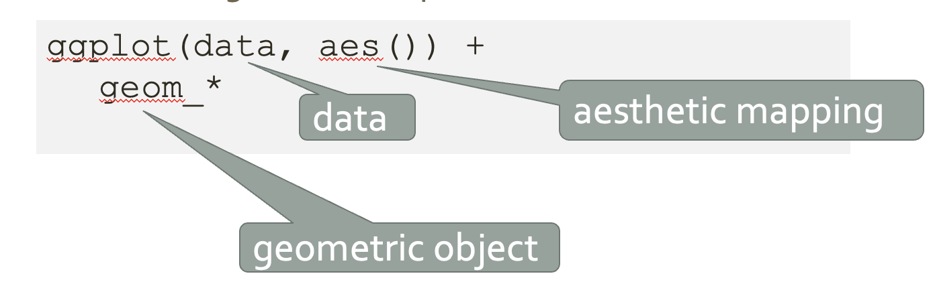
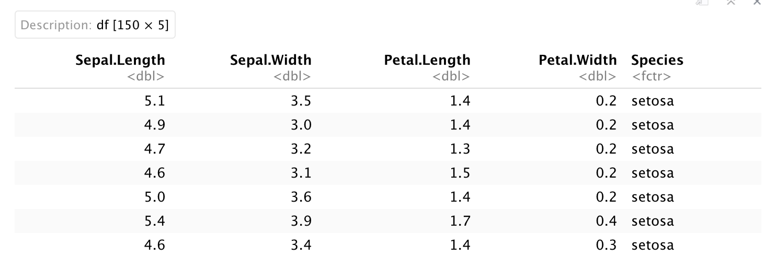

Data
First argument to ggplot is the data you want to plot
ggplot(iris)

Slide 8
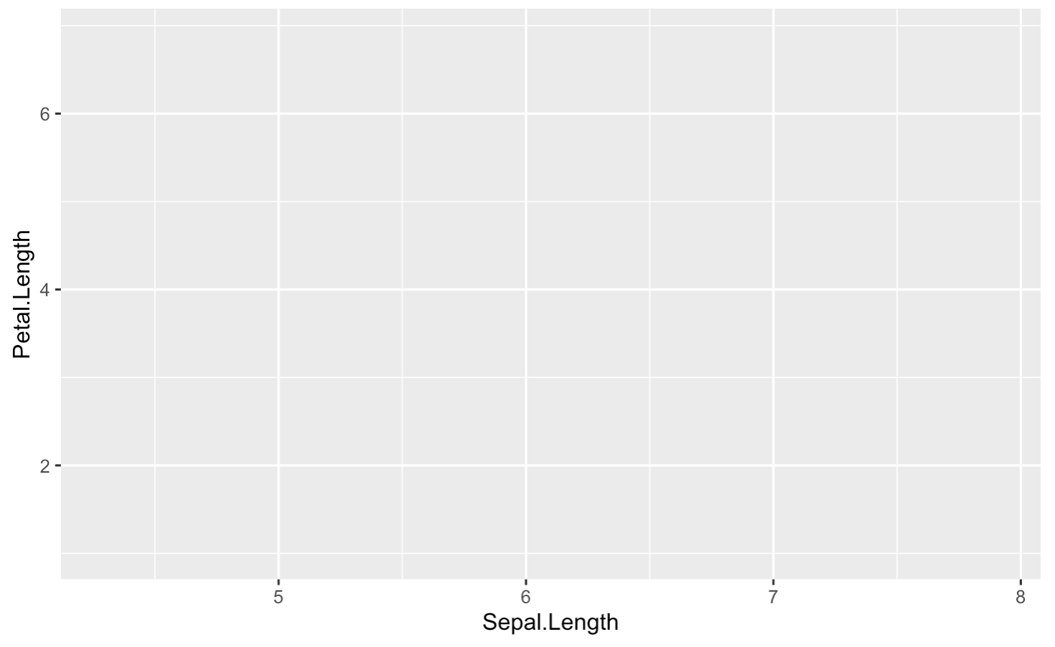
Aesthetic
Mapping (aes())
aes is the data to visual channels mapping
ggplot(iris, aes(x = Sepal.Length, y = Petal.Length))

Slide 9
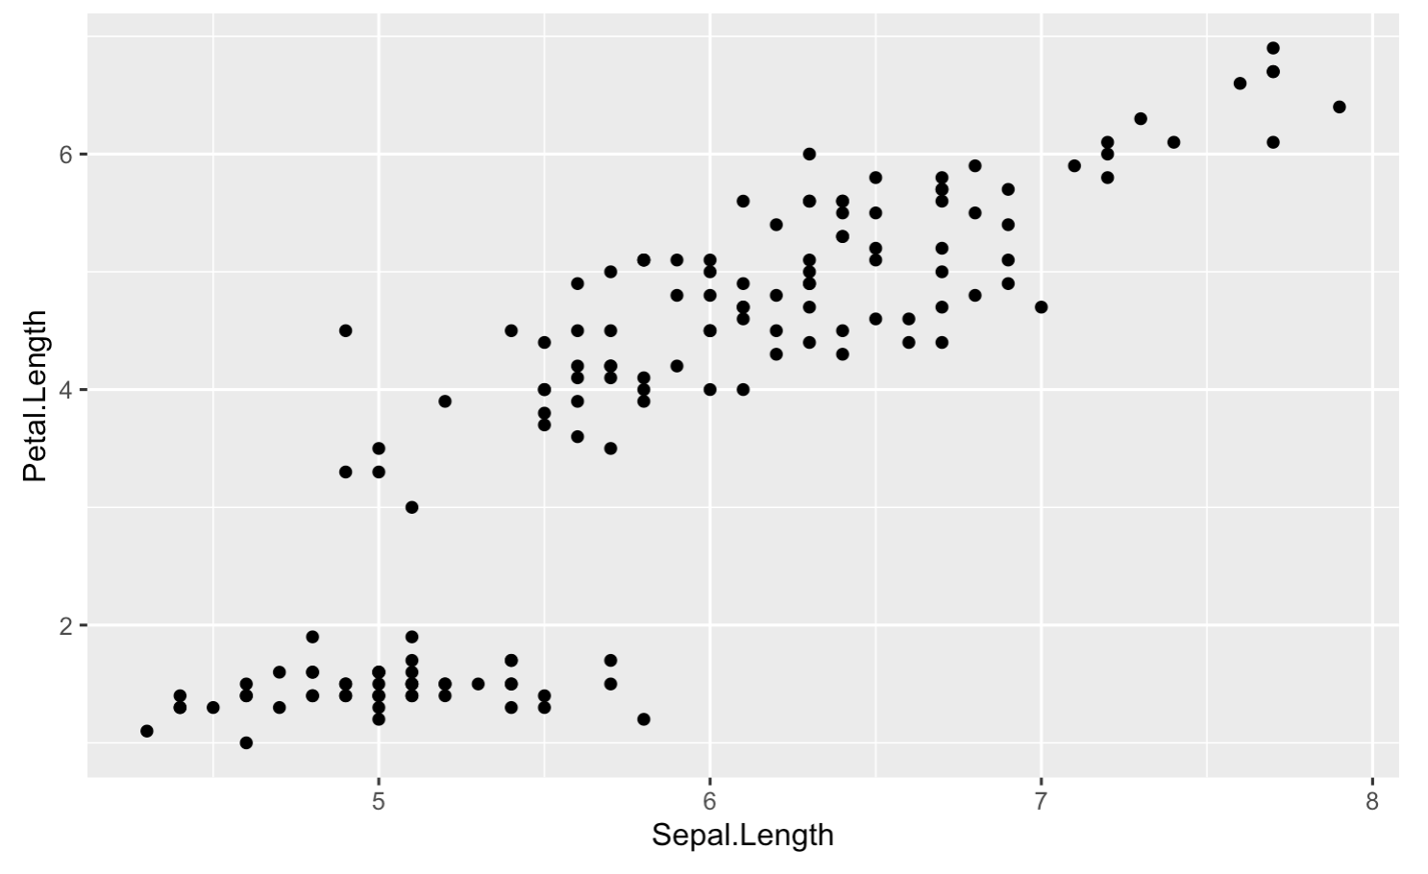
Geometric
Objects (geom)
Geom identifies the marks to use
ggplot(iris, aes(x = Sepal.Length, y = Petal.Length)) +
geom_point()

Slide 10
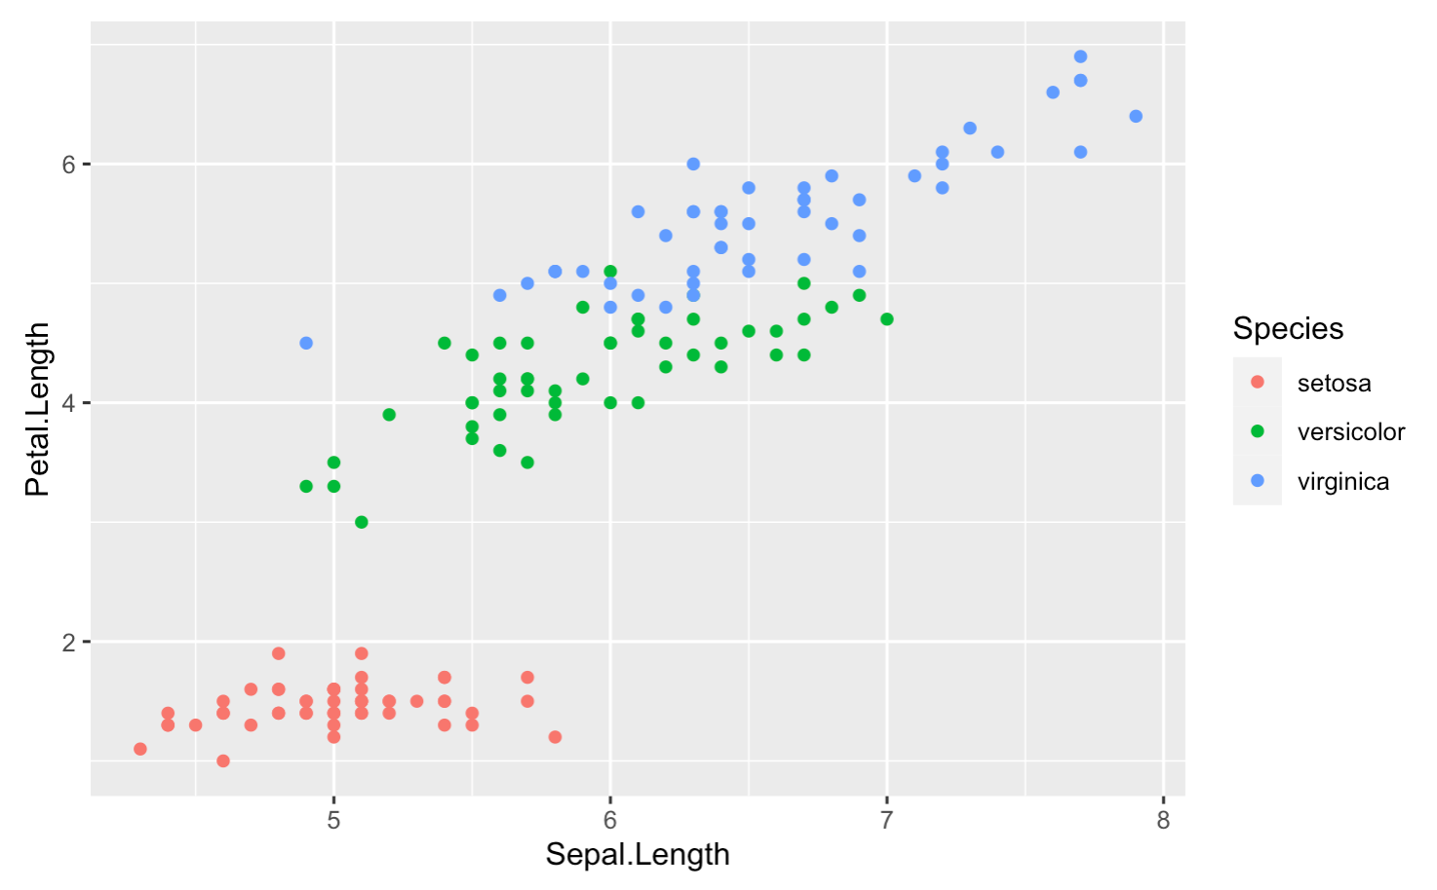
Geometric Objects (geom) + Aesthetics
Apply aesthetics to geometric objects
Ex. Color points
ggplot(iris, aes(x = Sepal.Length, y = Petal.Length)) +
geom_point(aes(color = Species))

Slide 11
ggplot2 tips
Cheatsheet: https://www.rstudio.com/resources/cheatsheets/
Remember building blocks
data
aesthetic mappings
geometric objects
Play around! Try different things in your lab and look at documentation if you get stuck: https://ggplot2.tidyverse.org/

