Slide 1
Intro to Coding with Python– Loops
Dr. Ab Mosca (they/them)
Slides based off slides courtesy of Jordan Crouser (https://jcrouser.github.io/)

Slide 2
Plan for Today
While loops

Slide 3
Loops: a familiar idea
https://xkcd.com/1411/

Slide 4
Loops in computer programming
Sometimes, we want to do the exact same thing multiple times
Ideally, we can write the code we need repeated once, and tell the computer to repeat it as many times as needed

Slide 5
Loops in computer programming
Sometimes, we want to do the exact same thing multiple times
Ideally, we can write the code we need repeated once, and tell the computer to repeat it as many times as needed
Enter: Loops

Slide 6
Loops in computer programming
Sometimes, we want to do the exact same thing multiple times
Ideally, we can write the code we need repeated once, and tell the computer to repeat it as many times as needed
Enter: Loops
A loop is a chunk of code that we tell the computer to continuously repeated for a specified time

Slide 7
Loops in computer programming
Sometimes, we want to do the exact same thing multiple times
Ideally, we can write the code we need repeated once, and tell the computer to repeat it as many times as needed
Enter: Loops
A loop is a chunk of code that we tell the computer to continuously repeated for a specified time
There are three main approaches:
run until some condition is met
run for each item in a list
run a specific number of times

Slide 8
Loops in computer programming
Sometimes, we want to do the exact same thing multiple times
Ideally, we can write the code we need repeated once, and tell the computer to repeat it as many times as needed
Enter: Loops
A loop is a chunk of code that we tell the computer to continuously repeated for a specified time
There are three main approaches:
run until some condition is met
run for each item in a list
run a specific number of times

Slide 9
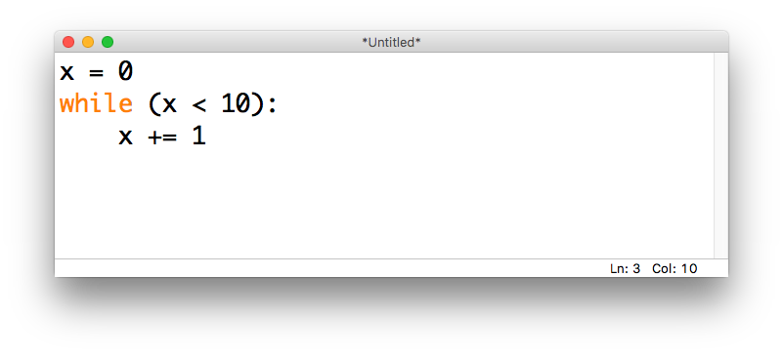
while loops
In a while loop, code repeats until something happens
While loops are paired with a conditional (True/False) statement
use the keyword while

Slide 10
while loops
In a while loop, code repeats until something happens
While loops are paired with a conditional (True/False) statement
conditional statement

Slide 11
while loops
In a while loop, code repeats until something happens
While loops are paired with a conditional (True/False) statement
colon

Slide 12
while loops
In a while loop, code repeats until something happens
While loops are paired with a conditional (True/False) statement
indented code to be repeated

Slide 13
while loops
What happens when we run this code?
Python reads from top down
When it enters the while loop, the indented code block will repeat until the condition is FALSE

Slide 14
while loops
x = 0
What happens when we run this code?
Python reads from top down
When it enters the while loop, the indented code block will repeat until the condition is FALSE

Slide 15
while loops
x = 0
Is 0 < 10? Yes, proceed to indented code chunk
What happens when we run this code?
Python reads from top down
When it enters the while loop, the indented code block will repeat until the condition is FALSE

Slide 16
while loops
x = 1
End of code chunk, check condition again
What happens when we run this code?
Python reads from top down
When it enters the while loop, the indented code block will repeat until the condition is FALSE

Slide 17
while loops
x = 1
Is 1 < 10? Yes, proceed to indented code chunk
What happens when we run this code?
Python reads from top down
When it enters the while loop, the indented code block will repeat until the condition is FALSE

Slide 18
while loops
x = 2
End of code chunk, check condition again
What happens when we run this code?
Python reads from top down
When it enters the while loop, the indented code block will repeat until the condition is FALSE

Slide 19
while loops
x = 2
Is 2 < 10? Yes, proceed to indented code chunk
What happens when we run this code?
Python reads from top down
When it enters the while loop, the indented code block will repeat until the condition is FALSE

Slide 20
while loops
x = 3
End of code chunk, check condition again
What happens when we run this code?
Python reads from top down
When it enters the while loop, the indented code block will repeat until the condition is FALSE

Slide 21
while loops
x = 3
Is 3 < 10? Yes, proceed to indented code chunk
What happens when we run this code?
Python reads from top down
When it enters the while loop, the indented code block will repeat until the condition is FALSE

Slide 22
while loops
x = 4
End of code chunk, check condition again
What happens when we run this code?
Python reads from top down
When it enters the while loop, the indented code block will repeat until the condition is FALSE

Slide 23
while loops
x = 4
Is 4 < 10? Yes, proceed to indented code chunk
What happens when we run this code?
Python reads from top down
When it enters the while loop, the indented code block will repeat until the condition is FALSE

Slide 24
while loops
x = 5
End of code chunk, check condition again
What happens when we run this code?
Python reads from top down
When it enters the while loop, the indented code block will repeat until the condition is FALSE

Slide 25
while loops
x = 5
Is 5 < 10? Yes, proceed to indented code chunk
What happens when we run this code?
Python reads from top down
When it enters the while loop, the indented code block will repeat until the condition is FALSE

Slide 26
while loops
x = 6
End of code chunk, check condition again
What happens when we run this code?
Python reads from top down
When it enters the while loop, the indented code block will repeat until the condition is FALSE

Slide 27
while loops
x = 6
Is 6 < 10? Yes, proceed to indented code chunk
What happens when we run this code?
Python reads from top down
When it enters the while loop, the indented code block will repeat until the condition is FALSE

Slide 28
while loops
x = 7
End of code chunk, check condition again
What happens when we run this code?
Python reads from top down
When it enters the while loop, the indented code block will repeat until the condition is FALSE

Slide 29
while loops
x = 7
Is 7 < 10? Yes, proceed to indented code chunk
What happens when we run this code?
Python reads from top down
When it enters the while loop, the indented code block will repeat until the condition is FALSE

Slide 30
while loops
x = 8
End of code chunk, check condition again
What happens when we run this code?
Python reads from top down
When it enters the while loop, the indented code block will repeat until the condition is FALSE

Slide 31
while loops
x = 8
Is 8 < 10? Yes, proceed to indented code chunk
What happens when we run this code?
Python reads from top down
When it enters the while loop, the indented code block will repeat until the condition is FALSE

Slide 32
while loops
x = 9
End of code chunk, check condition again
What happens when we run this code?
Python reads from top down
When it enters the while loop, the indented code block will repeat until the condition is FALSE

Slide 33
while loops
x = 9
Is 9 < 10? Yes, proceed to indented code chunk
What happens when we run this code?
Python reads from top down
When it enters the while loop, the indented code block will repeat until the condition is FALSE

Slide 34
while loops
x = 10
End of code chunk, check condition again
What happens when we run this code?
Python reads from top down
When it enters the while loop, the indented code block will repeat until the condition is FALSE

Slide 35
while loops
x = 10
Is 10 < 10? No, proceed past loop
What happens when we run this code?
Python reads from top down
When it enters the while loop, the indented code block will repeat until the condition is FALSE

Slide 36
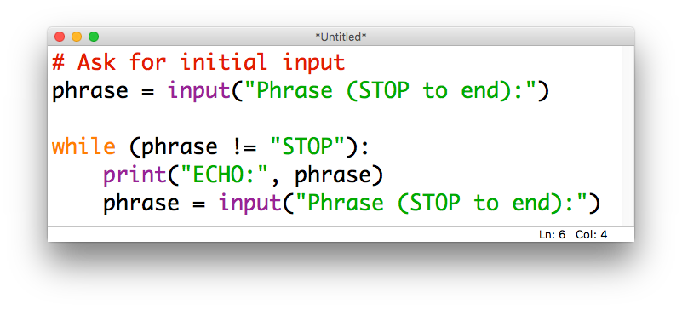
while loops
while loops can be especially useful when combined with the input() function
For example, we may want to continue asking for input until the user tells us they are done:

Slide 37
15 minute activity: compute a sum
Write a program that
Uses a while loop to get a series of numbers from the user
Ask for numbers one at a time and store them in a list
Stop asking when the user enters a blank
Modify your program to compute the running total of the numbers the user has entered
Every time the user enters a new number, print the running total

Slide 38
Discussion
What did you come up with?

Slide 39
15 minute activity: Memory game
Write a program that plays a memory game with the user.
Ask the user for animals one at a time and store them in a list
After the user inputs an animal, check if they already input it previously
If the animal is already in the list print “Repeat! You lose!” and end the game. Otherwise, ask for another animal

Slide 40
Discussion
What did you come up with?

