Slide 1
Intro to Coding with Python– User Input
Dr. Ab Mosca (they/them)
Slides based off slides courtesy of Jordan Crouser (https://jcrouser.github.io/)

Slide 2
Reminder!
First quiz (on PLATO) is out today!
Quizzes (and homeworks) are week long assignments; expect to spend 5-7 hours on them (this is standard for a college class)

Slide 3
Plan for Today
Learn how to get user input
Write a few programs

Slide 4
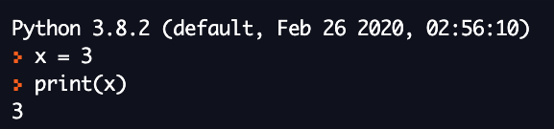
Recall: the print() function
print() outputs information to the console (”the shell”)
Works on lots of different data types (strings, integers, floats, and many more!)
When print() is called on (“passed”) a variable, it outputs the contents

Slide 5
Recall: the print() function
print() outputs information to the console (”the shell”)
Works on lots of different data types (strings, integers, floats, and many more!)
When print() is called on (“passed”) a variable, it outputs the contents

Slide 6
Practice
Write a short program that prints the following:
###########
# CAIS117 #
###########

Slide 7
Discussion
What if we wanted to be able to
print a banner around ANY word?
What would we need?
Notes:
Specifically: what was new?

Slide 8
Discussion
What if we wanted to be able to
print a banner around ANY word?
What would we need?
The word
To be able to count how many characters are in the word
Notes:
Specifically: what was new?

Slide 9

Another function: len()
len() takes in a string and gives back the string’s length (number of characters, including spaces)
Can be called on string literals (“stuff in quotes”) or on variables whose contents are strings
Unlike print(), len() returns a value

Slide 10
Another function: len()
len() takes in a string and gives back the string’s length (number of characters, including spaces)
Can be called on string literals (“stuff in quotes”) or on variables whose contents are strings
Unlike print(), len() returns a value

Slide 11
Another function: len()
len() takes in a string and gives back the string’s length (number of characters, including spaces)
Can be called on string literals (“stuff in quotes”) or on variables whose contents are strings
Unlike print(), len() returns a value

Slide 12
Back to the 4 basic tasks
# characters
string
len()
input
output

Slide 13
Back to the 4 basic tasks
# characters
string
input
output
len(“hello”)
> 5

Slide 14
Back to the 4 basic tasks
# characters
string
input
output
len(“hello”)
> 5

Slide 15
Recall: variables
In CS, a variable is a place to store a piece of data
In Python, variables are:
declared by giving them a name
assigned using the equals sign
Example:
x = 3
declaring
a variable x
assigning
the value 3 to x

Slide 16
Recall: variables
In CS, a variable is a place to store a piece of data
In Python, variables are:
declared by giving them a name
assigned using the equals sign
Example:
x = len(“hello”)
declaring
a variable x
assigning
the return value to x

Slide 17
Recall: variables
In CS, a variable is a place to store a piece of data
In Python, variables are:
declared by giving them a name
assigned using the equals sign
Example:
myStrLen = len(“hello”)
declaring
a variable
assigning
the return value

Slide 18

Discussion
What if we wanted to be able to
print a banner around ANY word?
What would we need?
The word
To be able to count how many characters are in the word (and store answer)
Notes:
Specifically: what was new?

Slide 19
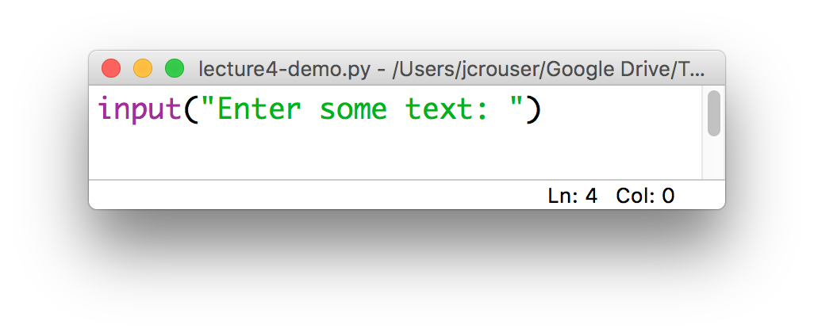
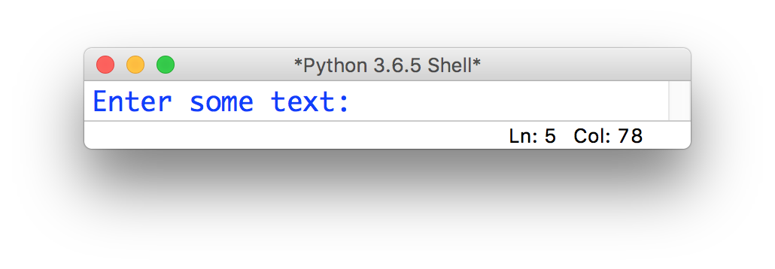
The input() function
Python has a built-in input() function that allows us to ask the user to type in information
The input() function takes in a value, which will be printed to the console as a prompt:

Slide 20
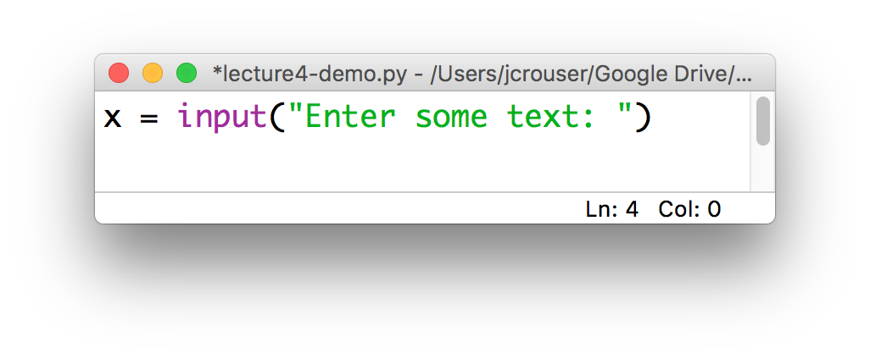
The input() function
In general, we will want to save what the user enters so we can do something with it
This means we need to assign the value returned by the input() function to some variable, e.g.

Slide 21
Discussion
What if we wanted to be able to
print a banner around ANY word?
What would we need?
The word
To be able to count how many characters are in the word (and store answer)
Modify your program from earlier to work for any string
Notes:
Specifically: what was new?

Slide 22
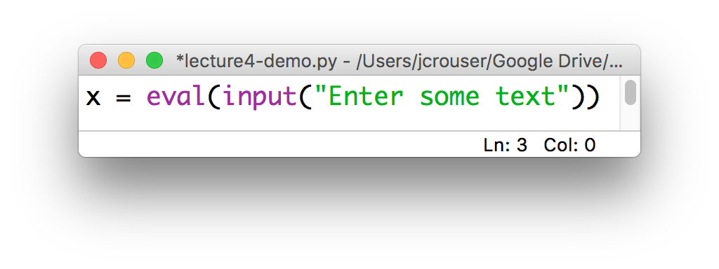
Note: The eval() function
The user’s input is always returned as a string, even if they enter only numeric characters
If we want Python to interpret it as a number, we can use the eval() function
Then we can manipulate x using mathematical operations

Slide 23
Putting it all together
In small groups, write a program that asks the user to input() two strings:
a word
a number
Store the user input in appropriate variables (remember: eval() will return the numeric value of a string)
print() the word the user-specified number of times
Note: try multiplying a string by an int and see what happens
Want a challenge? Also ask the user to input a character (a single letter or symbol), and use that to print a banner around the repeated word

Slide 24
Discussion
What did you come up with?
Notes:
Specifically: what was new?

