Slide 1
Intro to Coding with Python– Numbers
Dr. Ab Mosca (they/them)
Slides based off slides courtesy of Jordan Crouser (https://jcrouser.github.io/)

Slide 2
Plan for Today
More variables
Numeric values and basic operations

Slide 3
(RECAP) Core concept 1: variables
In CS, a variable is a place to store a piece of data
In Python, variables are:
declared by giving them a name
assigned using the equals sign
Example:
x = 3
declaring
a variable x
assigning
the value 3 to x

Slide 4
Keywords
We want to use descriptive variable names
* other languages have their own set of reserved words

Slide 5
Keywords
We want to use descriptive variable names
Some words in Python* are reserved as keywords, and cannot be used as a variable name:
and as assert break class continue def del elif else except exec finally for from global if import in is lambda not or pass raise return try while with yield
* other languages have their own set of reserved words

Slide 6
More about naming variables
Rule 1: variable name must be at least 1 character long
Rule 2: 1st character must be alphabetic
(uppercase letter, lowercase letter, or underscore)
Rule 3: variable names can contain letters, numbers, and underscores (but not spaces or other punctuation)

Slide 7
Naming conventions
These aren’t rules (i.e. Python won’t throw an error), but they make life a lot easier if you follow them

Slide 8
Naming conventions
These aren’t rules (i.e. Python won’t throw an error), but they make life a lot easier
Convention 1: the name of the variable should tell you something about what the variable contains, e.g.
name = “Ab”
is better than
blah = “Ab”

Slide 9
Naming conventions
These aren’t rules (i.e. Python won’t throw an error), but they make life a lot easier
Convention 1: the name of the variable should tell you something about what the variable contains, e.g.
Convention 2: if you want to use multiple words as a variable name, separate them using _underscores_, or camel case e.g.
first_name = “Ab”
lastName = “Mosca”
(but stick to one convention)

Slide 10
Naming conventions
These aren’t rules (i.e. Python won’t throw an error), but they make life a lot easier
Convention 1: the name of the variable should tell you something about what the variable contains, e.g.
Convention 2: if you want to use multiple words as a variable name, separate them using _underscores_, or camel case e.g.
Convention 3: if the value isn’t going to change (i.e. the variable is a constant), use ALL CAPS, e.g.
PI = 3.14159

Slide 11
Notes:
Let’s practice a little…
(show how changing the names of the variables doesn’t change how the program works… but it does change how it reads)
ex.
name,
favorite animal,
least favorite animal
<name> hates <least-fave>, but they <love>*<inp num> <fave-animal>

Slide 12
(RECAP) Core concept 2: numeric values
Two kinds of numbers in CS:
integers (“whole numbers”)
floats (“decimals” or “floating point numbers”)
In Python, the kind of number is implied by whether or not the number contains a decimal point
Example:
x = 3
x = 3.0

Slide 13
Discussion
Why do we care about
whether or not a number has a decimal point?

Slide 14
Math
Basic operators:
addition: +
subtraction: -
multiplication: *
floor division: //
division: /
exponentiation: ** (power)
modular arithmetic: % (modulo)
Negative values are allowed!
x = -3

Slide 15
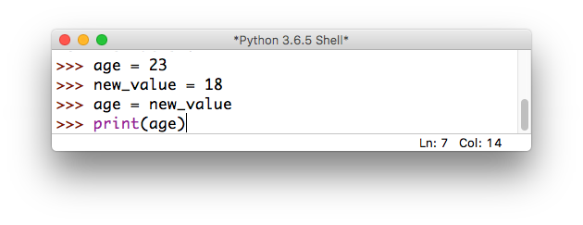
Overwriting variables
What happens if we do the following?

Slide 16
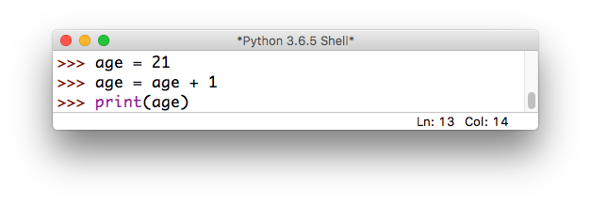
Incrementing variables
What about this?

Slide 17
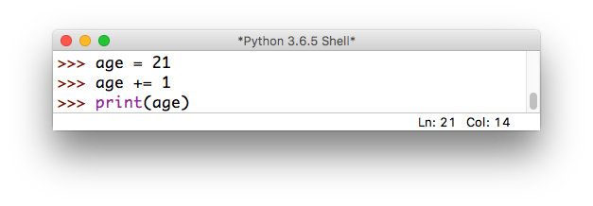
Incrementing variables
There’s a shorthand for this!

Slide 18
Quick exercise
a = 10
b = 20
c = 30
a = b # a =
b = a # b =
c = c * 2 # c =
d = d – 10 # d =
# NameError:
# name 'd' is not defined
these are called
comments:
they are not executed
by the interpreter,
but are useful
for making
code readable

Slide 19
Some more useful shorthand
Simultaneous assignment:
a = 10
b = 20
c = 30
a = b
b = a
c = c * 2

Slide 20
Some more useful shorthand
Simultaneous assignment:
a, b, c = 10, 20, 30
a = b
b = a
c = c * 2

Slide 21
Some more useful shorthand
Simultaneous assignment:
a, b, c = 10, 20, 30
Swapping variables:
a = b
b = a
c = c * 2

Slide 22
Some more useful shorthand
Simultaneous assignment:
a, b, c = 10, 20, 30
Swapping variables:
a, b = b, a
c = c * 2

Slide 23
Exercise: unit conversion
Find a partner, and write a program that asks the user to input() a number representing a file size in Kb
Store the user input in an appropriate variable
Calculate the equivalent size in bits, bytes, Mb, and Gb:
1 byte = 8 bits
1 Kb = 1024 bytes
1 Mb = 1024 Kb
1 Gb = 1024 Mb
print() the converted sizes to the screen (ascending)
Want a challenge? See if you can print the units beside each of the values (try the str() method)

Slide 24
Discussion
What did you come up with?

