Slide 1
Intro to Coding with Python– Mathematical Operators
Dr. Ab Mosca (they/them)
Slides based off slides courtesy of Jordan Crouser (https://jcrouser.github.io/)

Slide 2
Plan for Today
Mathematical operators
Formatting print statements

Slide 3
(RECAP) Core concept 2: numeric values
Two kinds of numbers in CS:
integers (“whole numbers”)
floats (“decimals” or “floating point numbers”)
Basic operators:
addition: +
subtraction: -
multiplication: *
division: /
floor division: //
exponentiation: ** (power)
modular arithmetic: % (modulo)

Slide 4
(RECAP) Core concept 2: numeric values
Two kinds of numbers in CS:
integers (“whole numbers”)
floats (“decimals” or “floating point numbers”)
Basic operators:
addition: +
subtraction: -
multiplication: *
division: /
integer division: //
exponentiation: ** (power)
modular arithmetic: % (modulo)

Slide 5
Reviewing integer operators: // and %
What is the result of the following operations?
21 // 5
21 % 5
9 // 3
9 % 3
13 // 5
13 % 5
139 // 20
139 % 20

Slide 6
Reviewing integer operators: // and %
What is the result of the following operations?
21 // 5
21 % 5
9 // 3
9 % 3
13 // 5
13 % 5
139 // 20
139 % 20
# 4
# 1
# 3
# 0
# 2
# 3
# 6
# 19

Slide 7
Built-in functions that work on numbers
abs(x) # return the absolute value of x
float(x) # return x parsed as a float
int(x) # return x parsed as an int
round(x[, n]) # return x rounded to n digits after the # decimal point. If n is omitted, it # returns the nearest integer value

Slide 8
Aside: what does parsed mean?
abs(x) # return the absolute value of x
float(x) # return x parsed as a float
int(x) # return x parsed as an int
round(x[, n]) # return x rounded to n digits after the # decimal point. If n is omitted, it # returns the nearest integer value

Slide 9
The math module
Lots of other things we might want to do with numerical values are available as functions in the math module
import math
math.floor(f) # round float f down
math.ceil(f) # round float f up
math.sqrt(x) # take the square root of x
And more! Check out: https://docs.python.org/2/library/math.html
In Python, modules are just files containing Python definitions and statements (ex. name.py)
These can be imported using import name
To access name’s functions, type name.function()

Slide 10
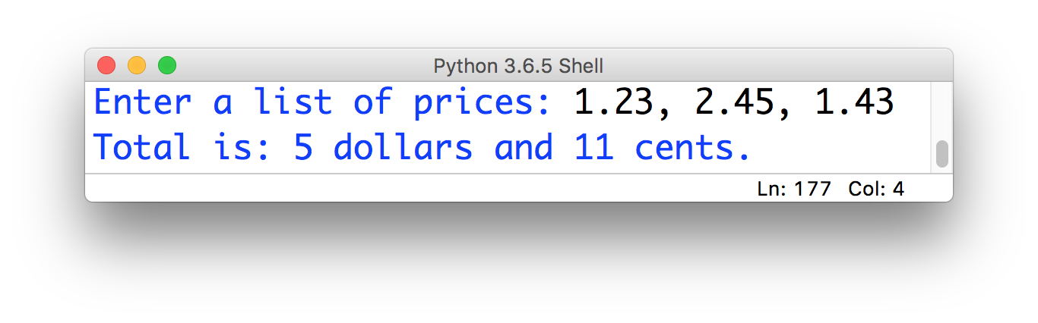
15-minute exercise: dollars and cents
In Python, modules are just files containing Python definitions and statements (ex. math.py)
These can be imported using import math
To access math’s functions, type math.function()
Use built-in functions and functions from the math module to take 3 prices, calculate their sum, and output their total formatted like this:

Slide 11
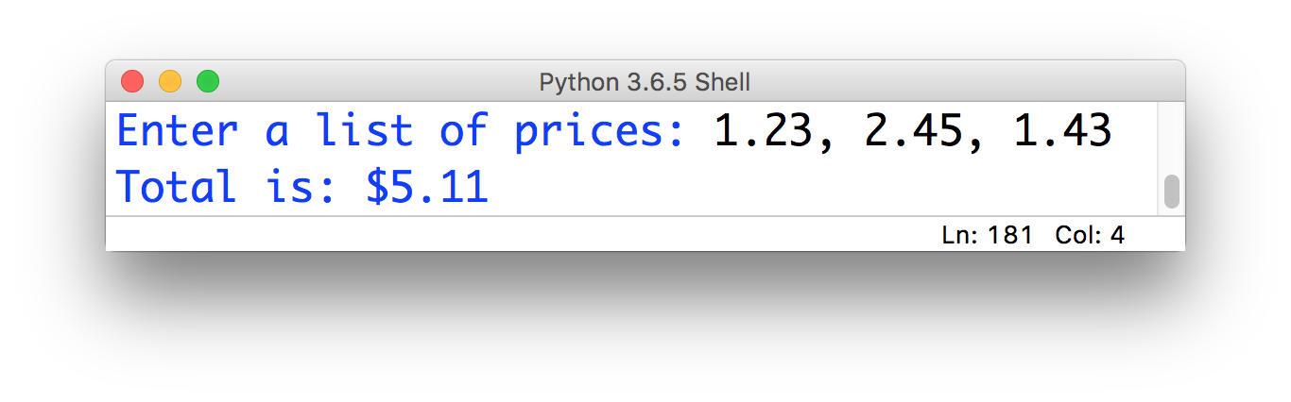
Finishing touches…
What we have now:
What we probably want:

Slide 12
Finishing touches…
What we have now:
What we probably want:
Ideas? What tools do you have to achieve this?

Slide 13
Solution: formatting with .format()
The .format() method (which gets called on a string) might be helpful here!

Slide 14
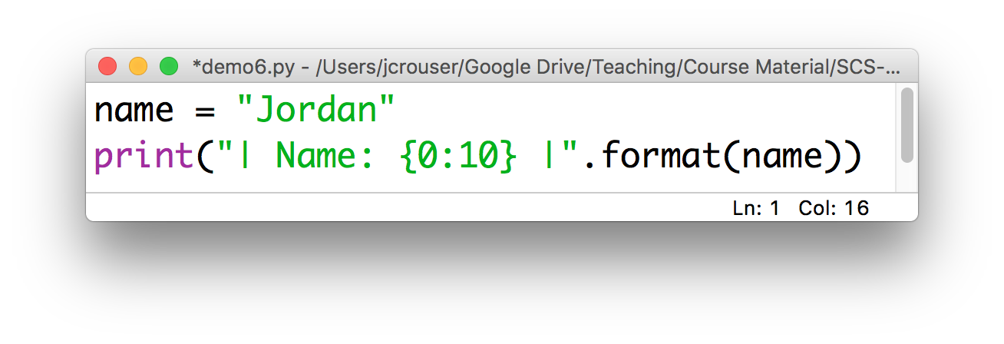
Solution: formatting with .format()
The .format() method (which gets called on a string) might be helpful here!
How it works:
Result: | Name: Jordan |
insert
print (at least)
10 characters

Slide 15
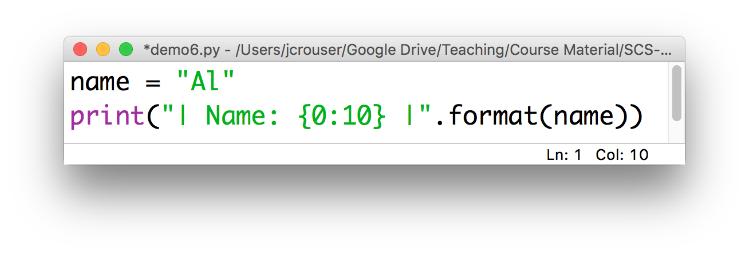
Solution: formatting with .format()
The .format() method (which gets called on a string) might be helpful here!
How it works:
Result: | Name: Al |

Slide 16
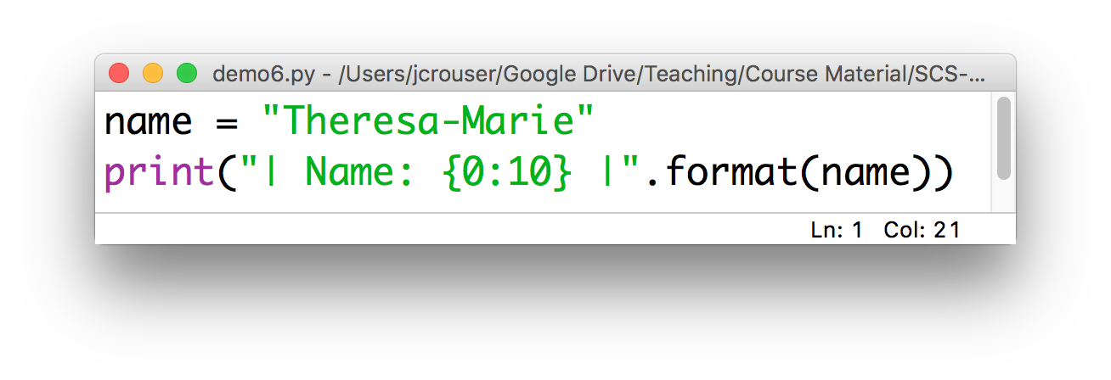
Solution: formatting with .format()
The .format() method (which gets called on a string) might be helpful here!
How it works:
Result: | Name: Theresa-Marie |
doesn’t truncate

Slide 17
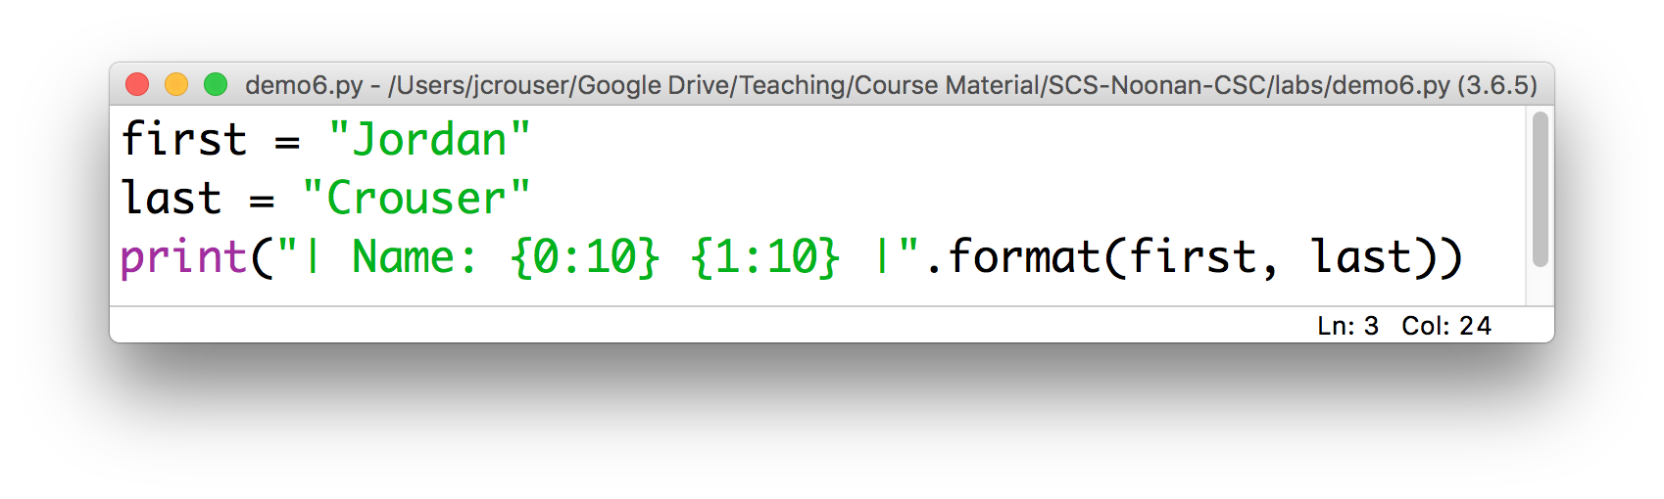
Calling .format() with multiple inputs
Can also handle multiple inputs, e.g.
Result: | Name: Jordan Crouser |
0th 1st
put the
1st thing here
put the
0th thing here

Slide 18
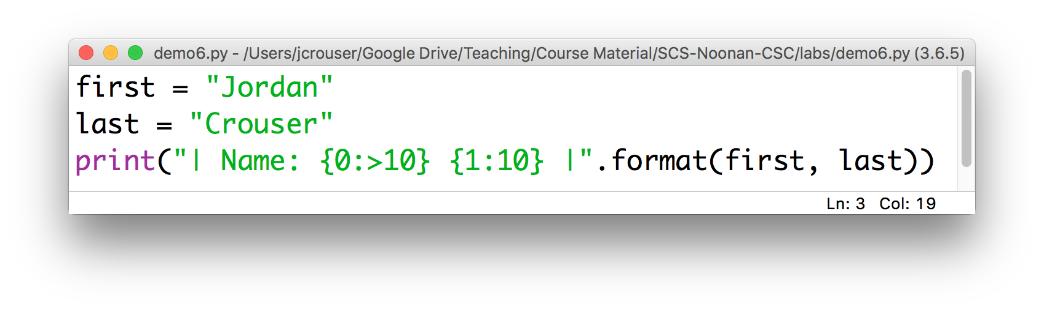
Right-justification with .format()
To align the format to the right instead of to the left, use >
Result: | Name: Jordan Crouser |

Slide 19
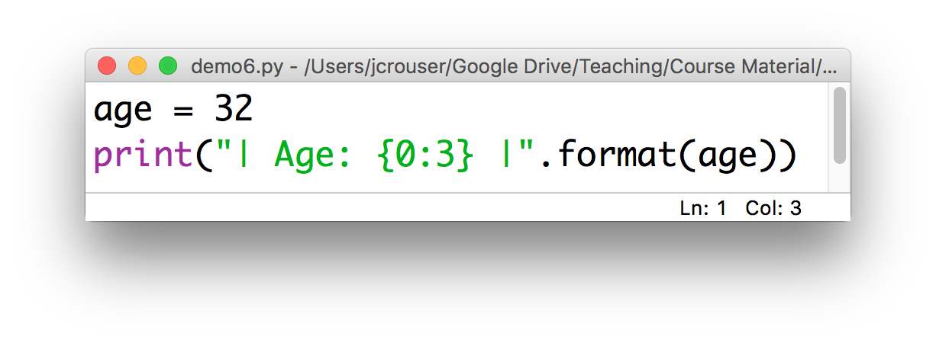
.format() on integers
Calling .format() on an integer works just like with strings, but they’re automatically right-aligned
Result: | Age: 32 |

Slide 20
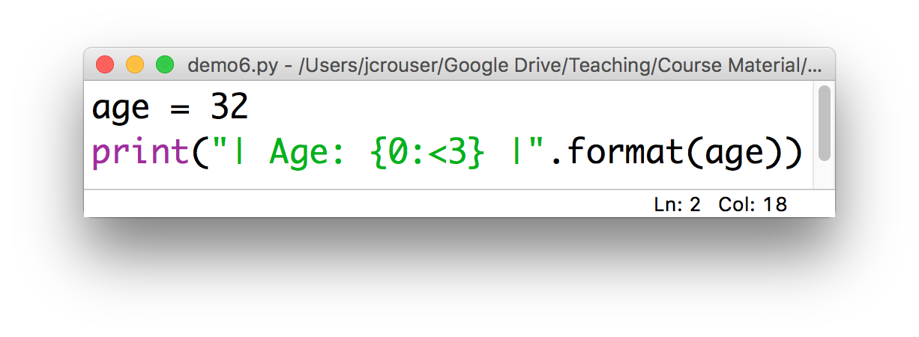
.format() on integers
Use < to left-align:
Result: | Age: 32 |

Slide 21
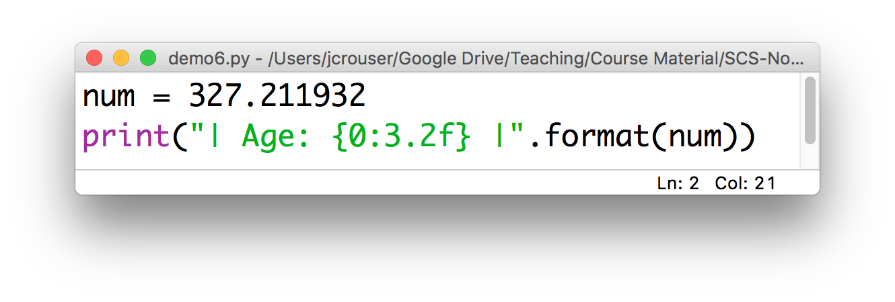
.format() on floats
We need to specify a number of digits before and after the decimal point:
Result: | Age: 327.21 |

Slide 22

Revisiting: dollars and cents
Modify your previous code to use the .format() method so that your output looks like this:

