Slide 1
Intro to Coding with Python– Strings and String Methods
Dr. Ab Mosca (they/them)
Slides based off slides courtesy of Jordan Crouser (https://jcrouser.github.io/)

Slide 2
Reminder
Your first homework is out today!
Start early, work with 1-2 other people
There is a how-to for GitHub Desktop on the course website under ”Demos”

Slide 3
Plan for Today
operations on strings
accessing individual letters
handy methods

Slide 4
(RECAP) Core concept 3: strings
In CS, a sequence of characters that isn’t a number is called a string
In Python, a string is declared using quotation marks
Strings can contain letters, numbers, spaces, and special characters
Example:
x = “Ab”
x = “Bass Hall”

Slide 5
Operations on strings
Concatenation: join two strings together with +, e.g.
“Ab” + “ “ + “Mosca”
Repetition (i.e. self-concatenation): use *, e.g.
3 * “hi”

Slide 6
Multi-line strings
Problem: a string that looks ugly when you try to type it all on one line, e.g.
desc = "This course is an introduction to co
mputer science and computer programming. The programming language Python (Version 3) is u
sed to introduce basic programming skills an
d techniques.”
We can use triple quotes to make a multi-line string, e.g.
desc = ”””This course is an introduction to
computer science and computer programming.
The programming language Python (Version 3)
is used to introduce basic programming
skills and techniques.”””

Slide 7
Escaping quotes
Problem: you have a statement that contains both an apostrophe and double quotes, e.g.
“I can’t!” he said
What’s the issue here?
If we try to wrap it in single quotes, Python thinks the apostrophe should end the string:
s = ‘“I can’t!” he said’
If we try to wrap it in double quotes, Python thinks the double quote at the beginning of the sentence should end the string
s = ““I can’t!” he said”

Slide 8
Escaping quotes
Problem: you have a statement that contains both an apostrophe and double quotes, e.g.
“I can’t!” he said
Solution: protect (“escape”) special characters using a backslash, e.g.
s = ‘“I can\’t!” he said’
or
s = “\“I can’t!\” he said”

Slide 9
Accessing individual letters
One way to think about a string is as a list of letters

Slide 10

Accessing individual letters
One way to think about a string is as a list of letters:
name = “Jordan”
$≈$ [‘J’, ‘o’, ‘r’, ‘d’, ‘a’, ‘n’]
0 1 2 3 4 5

Slide 11
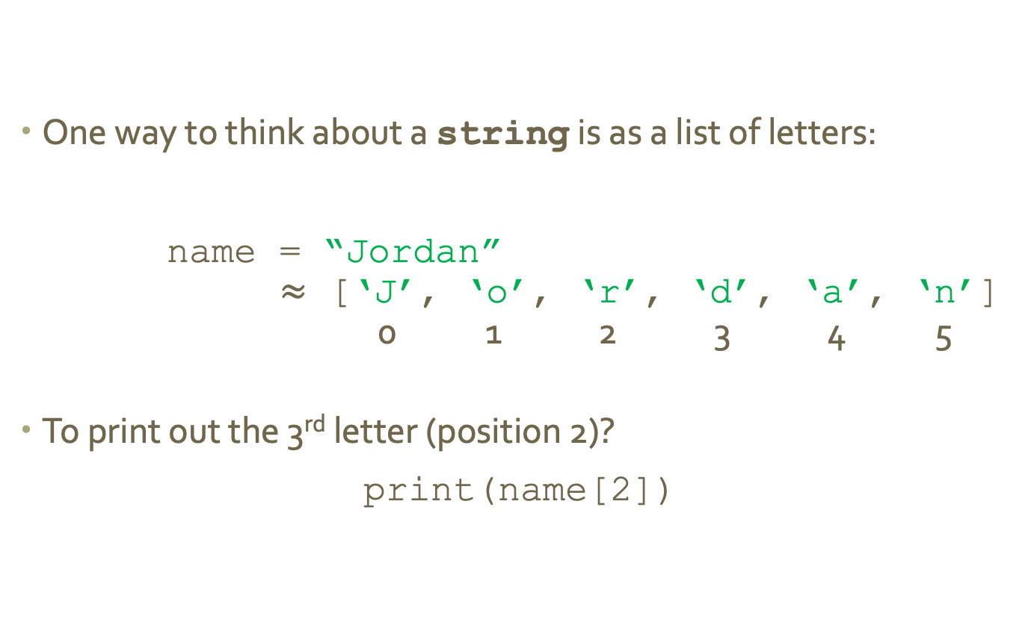
Accessing individual letters
One way to think about a string is as a list of letters:
name = “Jordan”
$≈$ [‘J’, ‘o’, ‘r’, ‘d’, ‘a’, ‘n’]
0 1 2 3 4 5
To print out the 3rd letter (position 2)?
print(name[2])

Slide 12

Accessing individual letters
One way to think about a string is as a list of letters:
name = “Jordan”
$≈$ [‘J’, ‘o’, ‘r’, ‘d’, ‘a’, ‘n’]
0 1 2 3 4 5
How would I print out the last letter?

Slide 13

Accessing individual letters
One way to think about a string is as a list of letters:
name = “Jordan”
$≈$ [‘J’, ‘o’, ‘r’, ‘d’, ‘a’, ‘n’]
0 1 2 3 4 5
How would I print out the last letter?
print(name[5])

Slide 14
“Slicing” (getting a substring)
What about the 2nd - 5th letters (positions 1-4)?
print(name[1:5])
What happens if we do this?
print(name[2:])
What about this?
print(name[-2:])
up to, but
not including
Notes:
Remove the first 2 characters
Remove everything but the last two characters

Slide 15
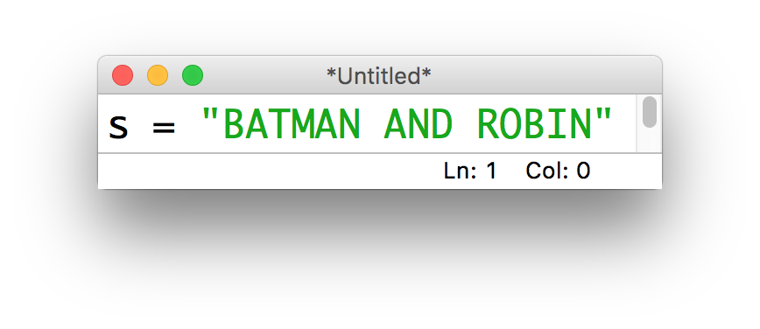
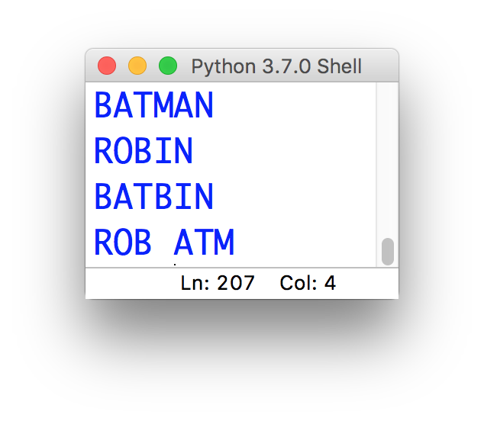
15-minute exercise
Given this string:
Write a short program that uses slicing to produce:

Slide 16
Discussion
What did you come up with?
Notes:
Remove the first 2 characters
Remove everything but the last two characters

Slide 17
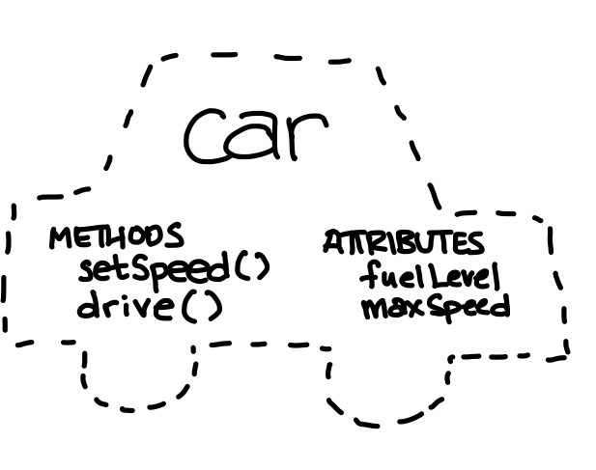
Strings as objects
“object-oriented”

Slide 18
Useful methods for working with strings
s.lower(): convert the string s to lowercase
s.upper(): convert the string s to UPPERCASE
s.strip(): remove whitespace from the start / end of s
s.replace('old', 'new'): replace all occurrences of 'old' in s by 'new'
s.split(c): slice s into pieces using c as a delimiter
s.join(list): opposite of split(), join the elements in the list together using s as the delimiter, e.g.
'-'.join(['a', 'b', 'c']) # a-b-c

Slide 19
Fun fact
strings in python are immutable (along with ints, floats, bools, and a few other built-in types)
This means that when we call a method on them, the original isn’t modified

Slide 20
Work with 1 – 2 other people to write a short program that:
Takes as input from the user a string
Takes as input from the user a character (char1)
Takes as input from the user another character (char2)
Returns that the input string with all occurrences of char1 replaced with char2 and in all caps
15-minute exercise
Input a string: Ab Mosca
Input a character: a
Input another character: o
OB MOSCO

