Slide 1
Intro to Coding with Python– main()
Dr. Ab Mosca (they/them)
Slides based off slides courtesy of Jordan Crouser (https://jcrouser.github.io/)

Slide 2
Plan for Today
The main() function

Slide 3
A reminder from the syllabus
“References”
You should use resources when you need help!
And you must cite them! (Give them credit for helping you)
In-line citations to any resources you used, including page numbers (if a printed resource) or a direct URL (if an online resource).
Ex.

Slide 4
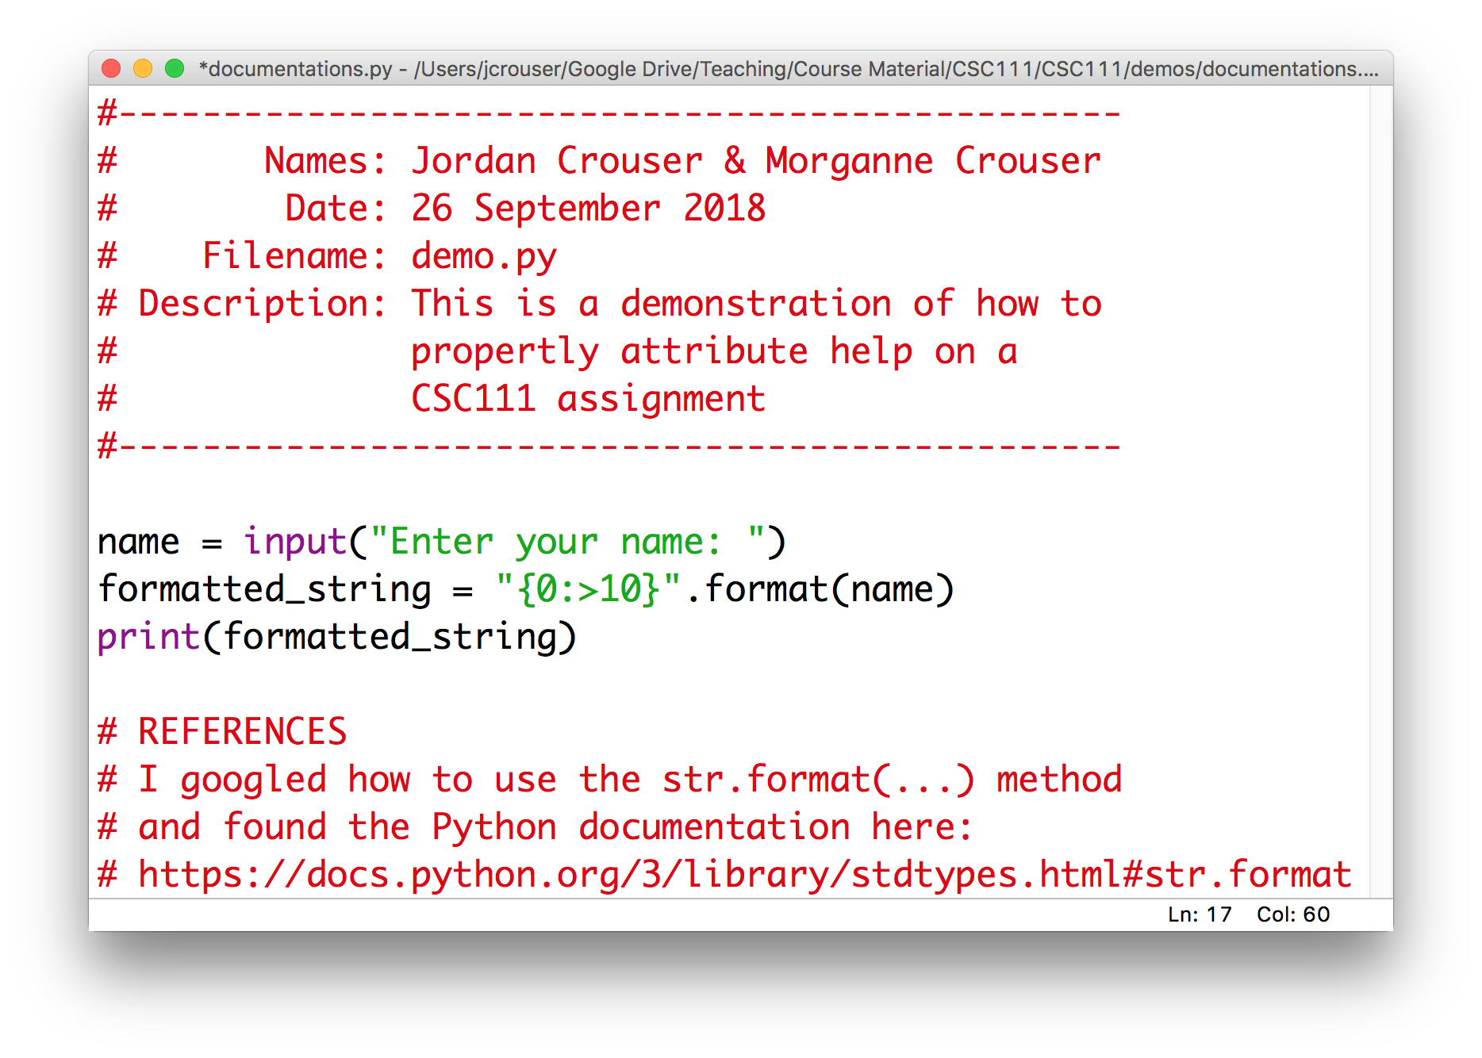
Example

Slide 5
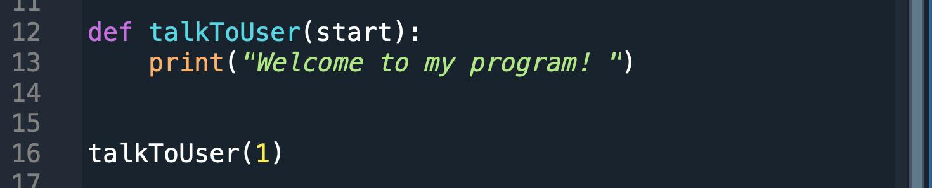
Recap
So far, we’ve been writing code in files as if we were writing it on the console:
When we do this, the Python interpreter executes everything from the top down

Slide 6
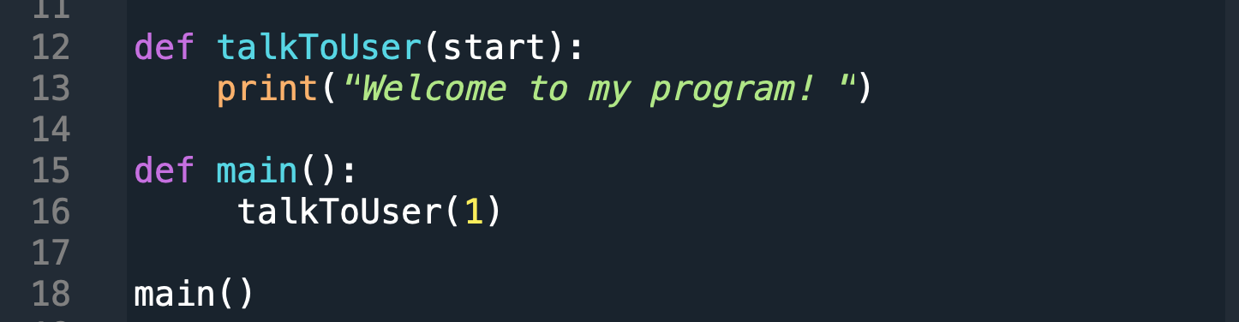
An alternative
It is better practice to write the code you want to execute inside a main() function, e.g.
This lets the interpreter ”read ahead” and then execute

Slide 7
How this works
Remember: the interpreter reads from the top down, which means that it reads the definition first
Notes:
This is a lot like defining a variable (but instead of putting a value in the “box”, we’re going to fill it with code)

Slide 8
How this works
Then it reads each line inside the definition, but these don’t get executed yet

Slide 9
How this works
At this stage, we’ve given python a “recipe” for what we want it to do when we call main()
If we stop here, nothing will actually happen

Slide 10
How this works
The real work happens only when we actually call the main() function
When we do, python goes to the main() function definition and follows the instructions it finds there

Slide 11
Discussion
Why bother?

Slide 12
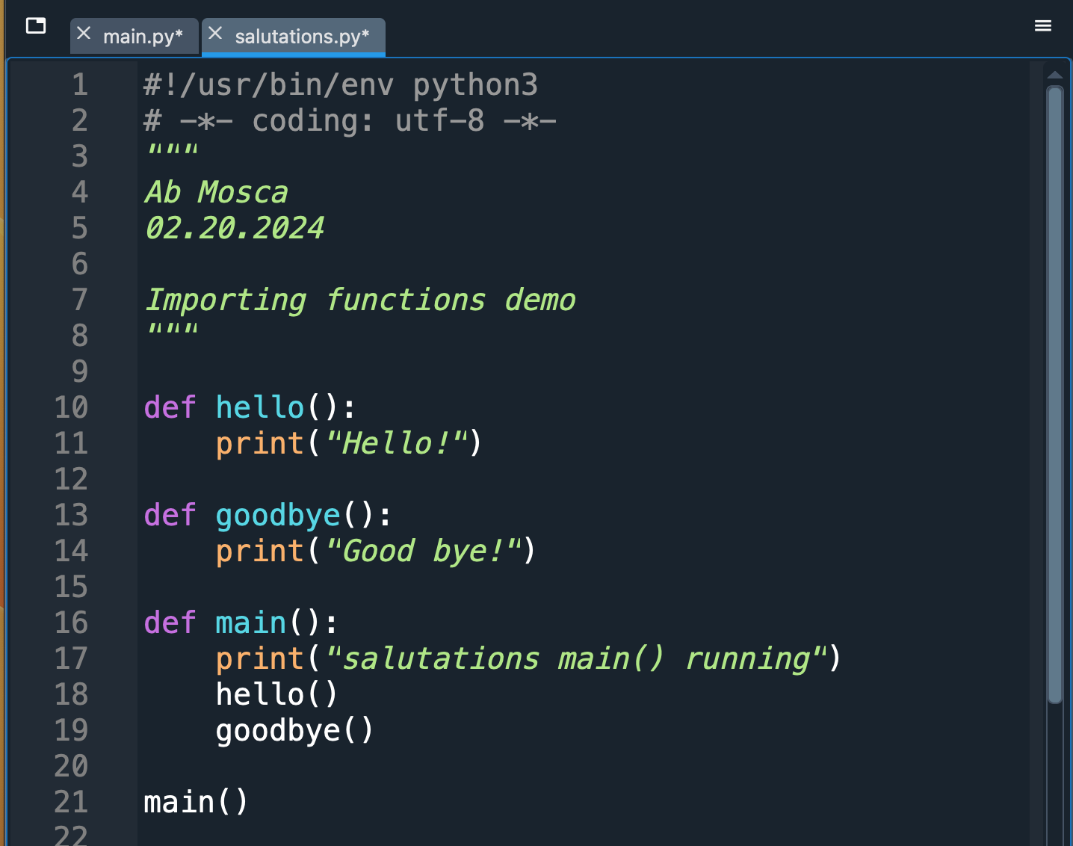
Just one more thing…
Suppose I have code I wrote elsewhere
What happens if someday we want to use the code in this file as part of another program?

Slide 13
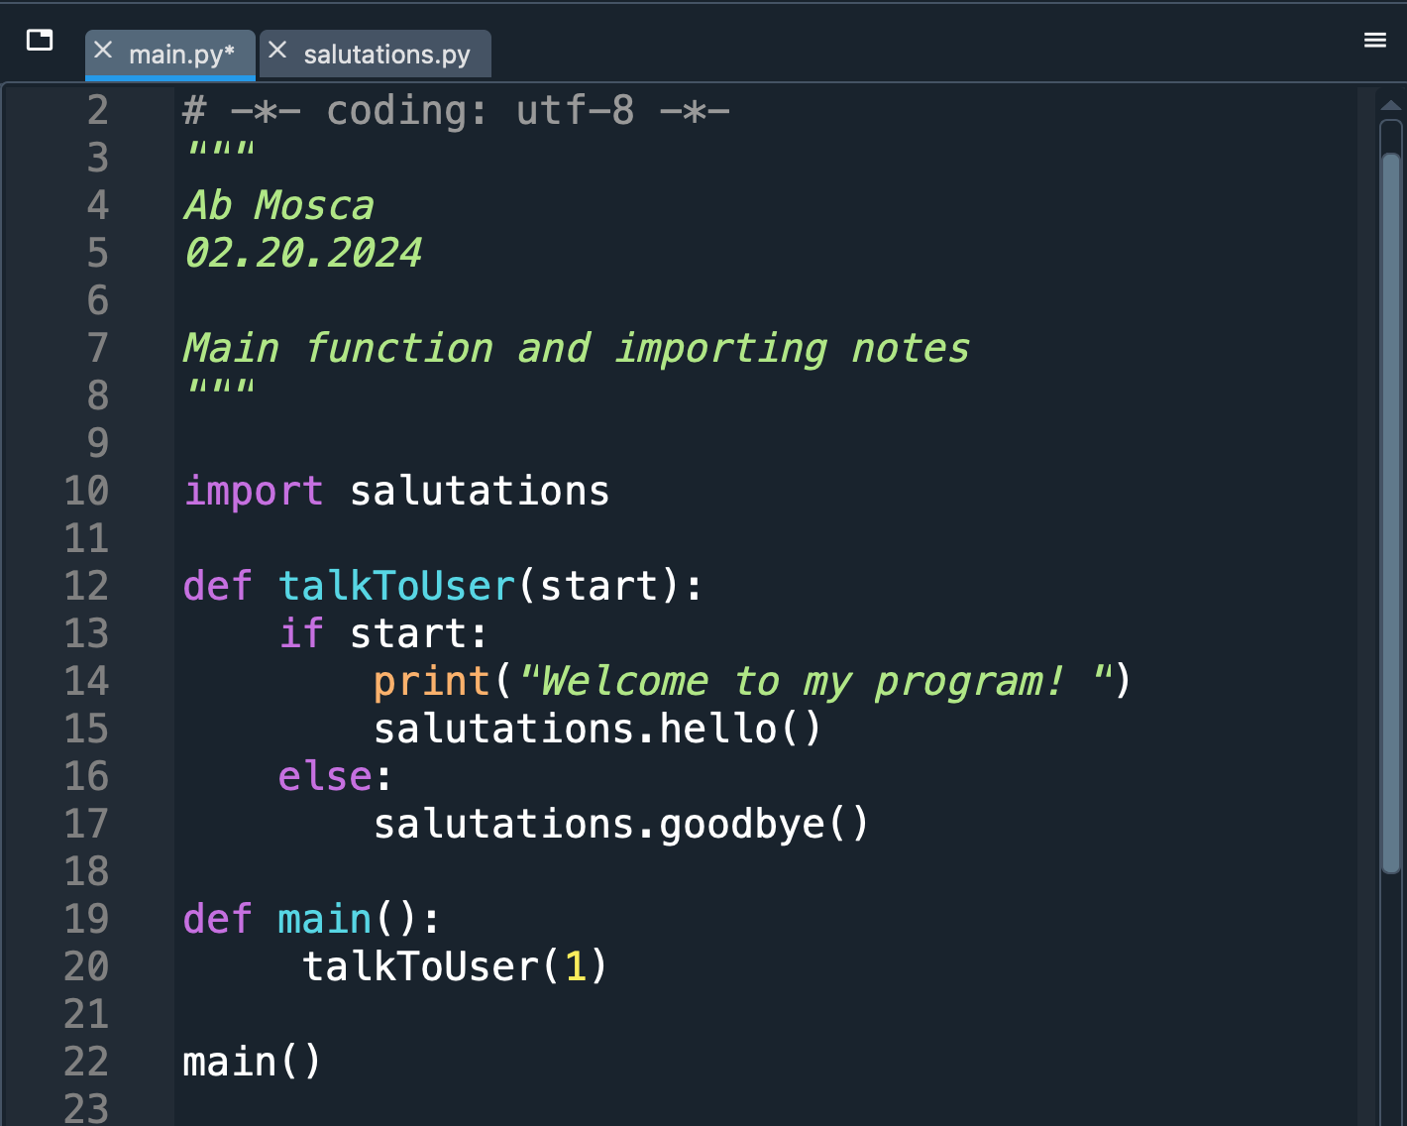
Just one more thing…
What happens if someday we want to use the code in this file as part of another program?

Slide 14
Just one more thing…
What happens if someday we want to use the code in this file as part of another program?

Slide 15
Just one more thing…
What will happen if I run main.py?
What happens if someday we want to use the code in this file as part of another program?

Slide 16
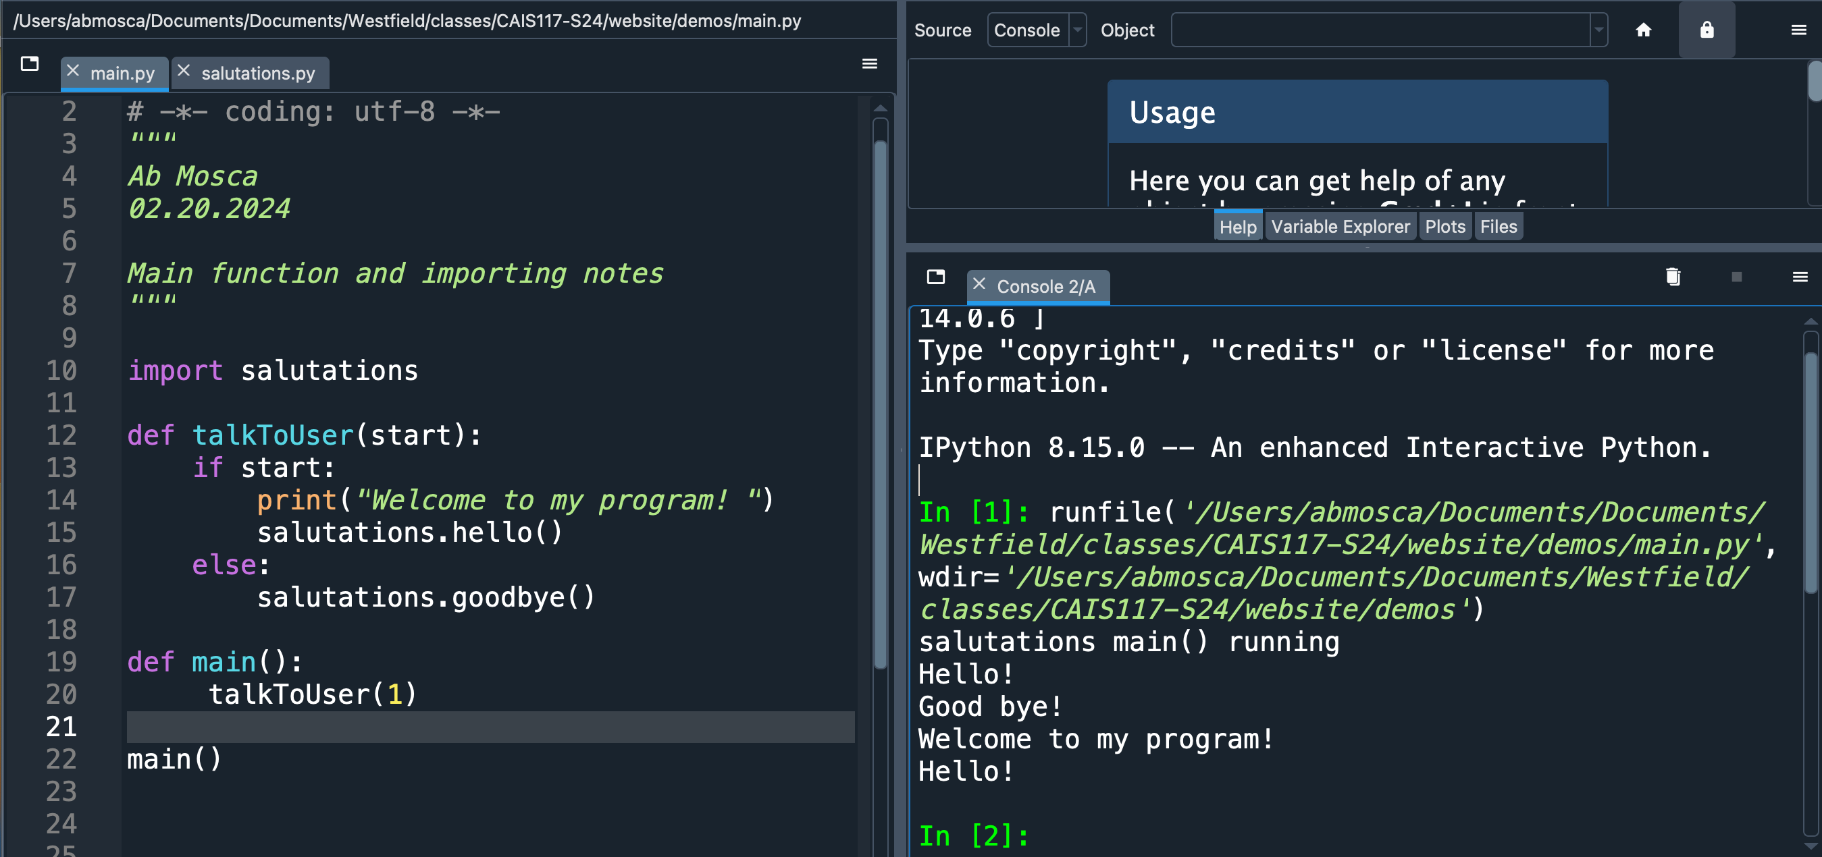
Just one more thing…
What will happen if I run main.py?
What happens if someday we want to use the code in this file as part of another program?

Slide 17
Discussion
What we need: a way to tell python to behave one way when we run it as a “stand-alone” program, and a different way when we import it
Ideas?

Slide 18
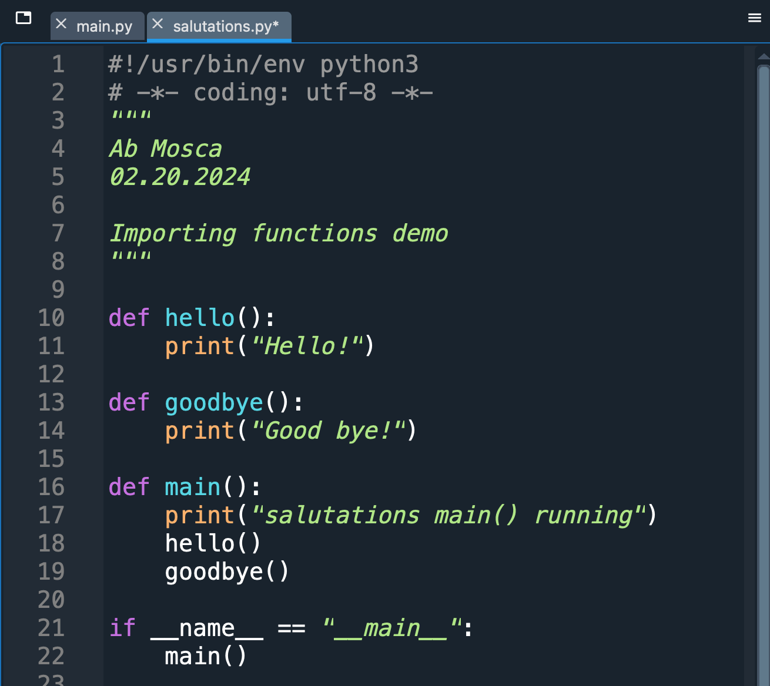
Python convention
We can use an if statement to tell python to call the main() function only if the program is being run directly

Slide 19
Python convention
This is a little bit confusing: we named the function we created to hold our program main()

Slide 20
Python convention
In our if statement, we’re asking whether some variable called __name__ is equal to the string "__main__” (not to mention I don’t recall initializing anything called __name__...)

Slide 21
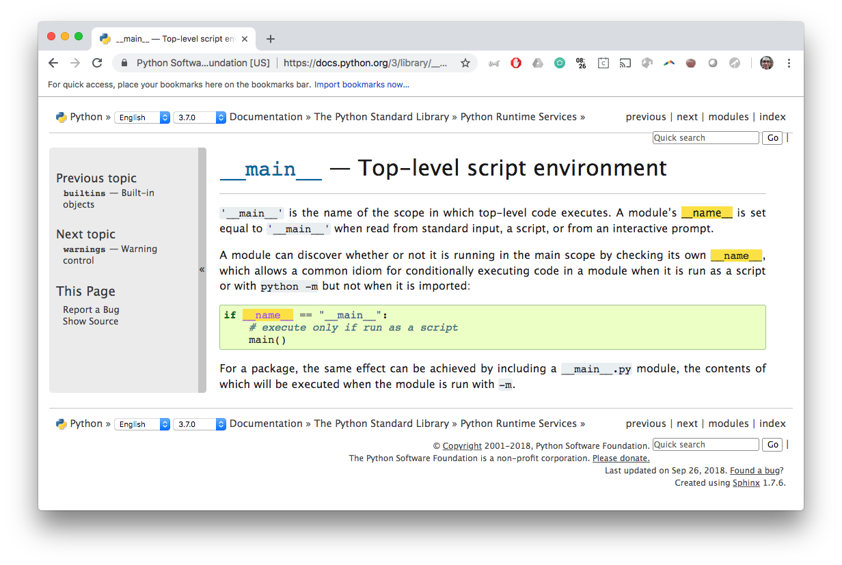
To the documentation!

Slide 23
15-minute exercise
Write a program that contains a main() function, which contains instructions for printing out the phrase:
"Today is not Friday :-("
Use an if statement combined with checking the value of the __name__ variable to call main() only when the program is run directly
Add an else statement so that whenever the program (“module”) is imported, it prints out the phrase:
"Maybe today...?"

Slide 24
Discussion
What did you come up with?

Slide 25
Takeaways
Programs (“modules”) that are well-organized are easier to read, more versatile, and potentially more efficient
The first step we’ll take toward organizing our code is to include a main() function, which includes the instructions we want our program to run
To make it easier to import code we write now into later modules, we will follow the convention of including:
if __name__ == "__main__":
main()
at the end of each module

Slide 26
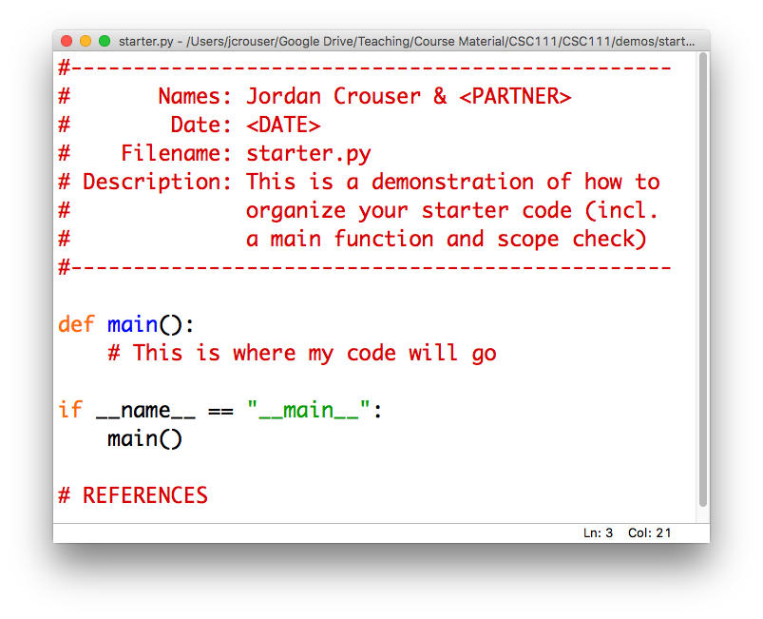
Helpful tip: have a starter template

