Slide 1
Intro to Coding with Python– For Loops
Dr. Ab Mosca (they/them)
Slides based off slides courtesy of Jordan Crouser (https://jcrouser.github.io/)

Slide 2
Plan for Today
For loops

Slide 3
Loops: a familiar idea
https://xkcd.com/1411/

Slide 4
Loops in computer programming
Sometimes, we want to do the exact same thing multiple times
Ideally, we can write the code we need repeated once, and tell the computer to repeat it as many times as needed

Slide 5
Loops in computer programming
Sometimes, we want to do the exact same thing multiple times
Ideally, we can write the code we need repeated once, and tell the computer to repeat it as many times as needed
Enter: Loops

Slide 6
Loops in computer programming
Sometimes, we want to do the exact same thing multiple times
Ideally, we can write the code we need repeated once, and tell the computer to repeat it as many times as needed
Enter: Loops
A loop is a chunk of code that we tell the computer to continuously repeated for a specified time

Slide 7
Loops in computer programming
Sometimes, we want to do the exact same thing multiple times
Ideally, we can write the code we need repeated once, and tell the computer to repeat it as many times as needed
Enter: Loops
A loop is a chunk of code that we tell the computer to continuously repeated for a specified time
There are three main approaches:
run until some condition is met
run for each item in a list
run a specific number of times

Slide 8
Loops in computer programming
Sometimes, we want to do the exact same thing multiple times
Ideally, we can write the code we need repeated once, and tell the computer to repeat it as many times as needed
Enter: Loops
A loop is a chunk of code that we tell the computer to continuously repeated for a specified time
There are three main approaches:
run until some condition is met
run for each item in a list
run a specific number of times

Slide 9
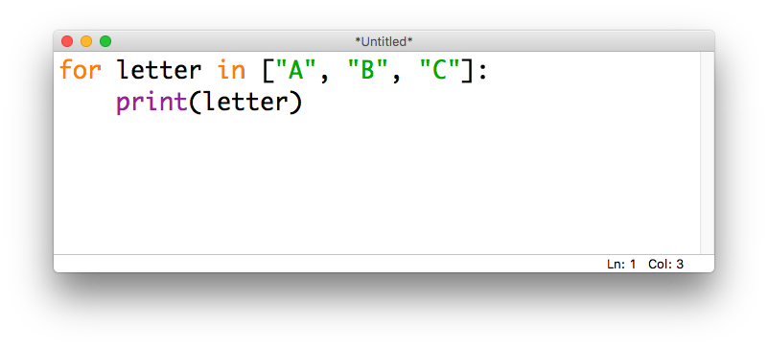
for...in loops
In Python, we use the keywords for and in to loop through a list

Slide 10
for...in loops
In Python, we use the keywords for and in to loop through a list
keyword for

Slide 11
for...in loops
In Python, we use the keywords for and in to loop through a list
variable that will be used in the loop code

Slide 12
for...in loops
In Python, we use the keywords for and in to loop through a list
keyword in

Slide 13
for...in loops
In Python, we use the keywords for and in to loop through a list
list of values to use in loop code

Slide 14
for...in loops
In Python, we use the keywords for and in to loop through a list
colon

Slide 15
for...in loops
In Python, we use the keywords for and in to loop through a list
indented code to be repeated

Slide 16
for...in loops
We can think of this in terms of where the variable letter is pointing:

Slide 17
for...in loops
We can think of this in terms of where the variable letter is pointing:
On the first iteration, letter = “A”

Slide 18
for...in loops
We can think of this in terms of where the variable letter is pointing:
Indented code is run, and python returns to the top of the loop

Slide 19
for...in loops
We can think of this in terms of where the variable letter is pointing:
On the second iteration, letter = “B”

Slide 20
for...in loops
We can think of this in terms of where the variable letter is pointing:
Indented code is run, and python returns to the top of the loop

Slide 21
for...in loops
We can think of this in terms of where the variable letter is pointing:
On the third iteration, letter = “C”

Slide 22
for...in loops
We can think of this in terms of where the variable letter is pointing:
Indented code is run, and python returns to the top of the loop

Slide 23
for...in loops
We can think of this in terms of where the variable letter is pointing:
All letter has been set to all items in the list, so python moves on to un-indented code

Slide 24
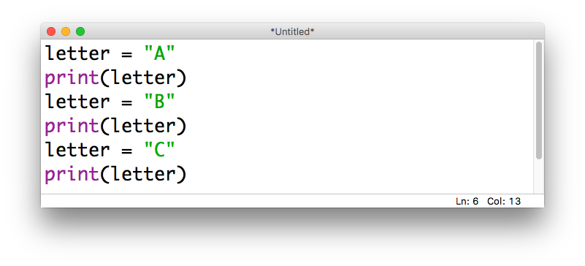
for...in loops: unpacked
We could accomplish the same thing by writing it out as three separate assignments:

Slide 25
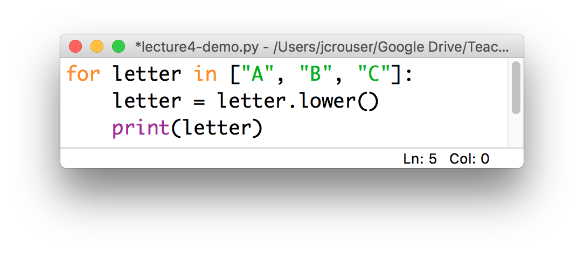
for...in loops: a common “gotcha”
Python will allow you to modify a list while you’re looping through it:
This is generally a bad idea (more on why later)
it’s fine to format the values, etc.
just don’t overwrite the originals!

Slide 26
Demo: compute a sum
Use a for loop to compute
the sum of a list of numbers input by the user

Slide 27
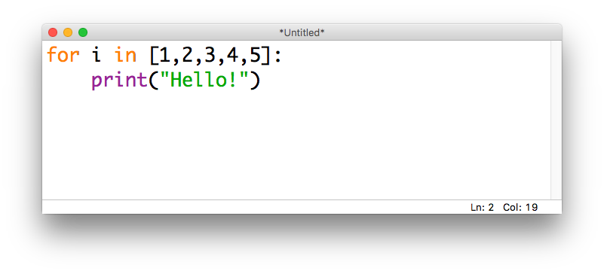
Looping n times
Bad news: there isn’t a way to say “run this loop n times” in Python – we’ll have to find a way around that
If we want a for...in loop to run a specific # of times, we can “trick” it using a list of numbers that’s the right size

Slide 28
Looping n times
Bad news: there isn’t a way to say “run this loop n times” in Python – we’ll have to find a way around that
If we want a for...in loop to run a specific # of times, can “trick” it using a list of numbers that’s the right size
common
practice:
use the
letter i
to denote
the “index”

Slide 29
Looping n times
Bad news: there isn’t a way to say “run this loop n times” in Python – we’ll have to find a way around that
If we want a for...in loop to run a specific # of times, can “trick” it using a list of numbers that’s the right size
common
practice:
use the
letter i
to denote
the “index”
What will this code do?

Slide 30
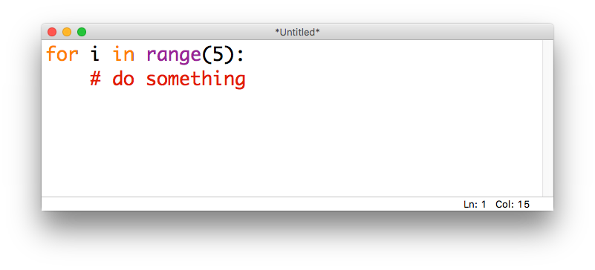
The range() function
The range() function lets us generate lists of integers
Given one integer a, range(a) will generate a list starting at 0 and going up to (but not including) a
For example, if we want a loop to run 5 times:

Slide 31
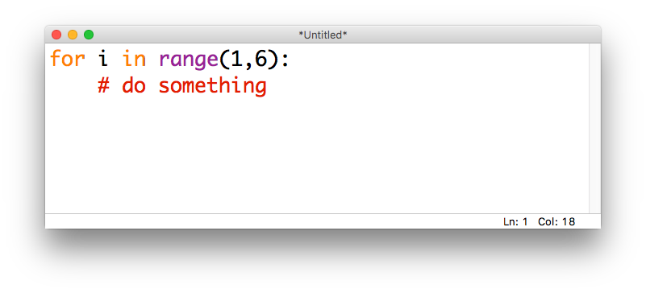
The range() function
Given two integers a,b, range(a,b) will generate a list starting at a and going up to (but not including) b
E.g., if we want to loop over the integers from 1 to 5:

Slide 32
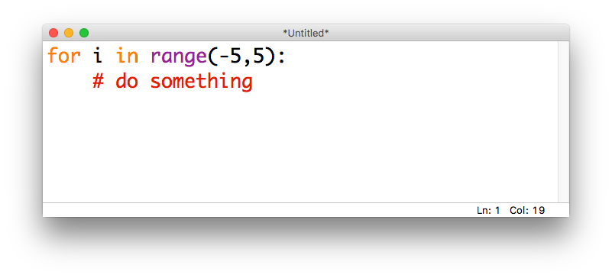
The range() function
These values can be positive or negative (but for now, the second integer should be larger than the first)
E.g., if we want to loop over the integers from -5 to 5:

Slide 33
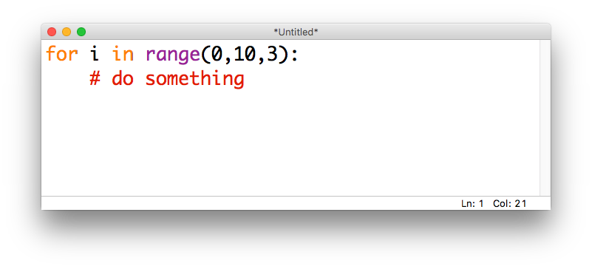
The range() function
Given three integers a,b,c, calling range(a,b,c) will generate a list starting at a and going up to (but not including) b with step size c
E.g., if we want the integers from 0 to 9, counting by 3s:

Slide 34

The range() function
If we want to count down instead of up, we can set b < a and use a negative step size
E.g., if we want to count down from 10 to 1:

Slide 35
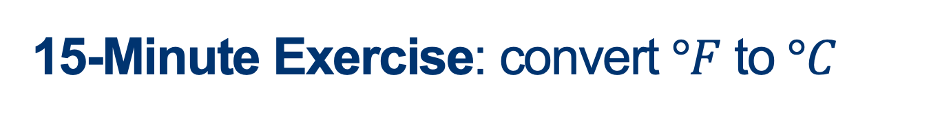
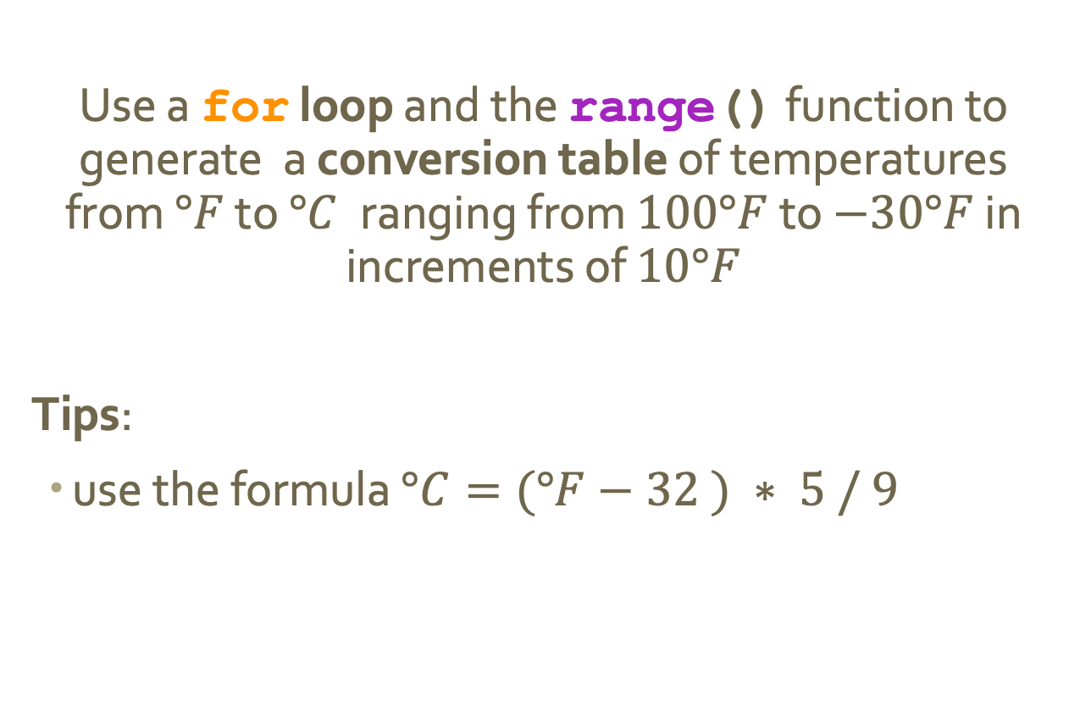
15-Minute Exercise: convert $°F$ to $°C$
Use a for loop and the range() function to generate a conversion table of temperatures from $°F$ to $°C$ranging from $100°F$ to $−30°F$ in increments of $10°F$
Tips:
use the formula $°C=(°F−32 ) ∗ 5 / 9$

Slide 36
Discussion
What did you come up with?

