Slide 1
Intro to Coding with Python– Dictionaries
Dr. Ab Mosca (they/them)
Slides based off slides courtesy of Jordan Crouser (https://jcrouser.github.io/)

Slide 2
Friday
No class this Friday – review material

Slide 3
Plan for Today
Dictionaries
motivation
defining a dictionary
converting multiple lists ←→ dictionaries

Slide 4
Recap: 15-minute exercise
Write a program that:
asks the user to input() names one at a time
adds each new name to a list called friends
and after each new name is added prints the list in alphabetical order
The program should loop until the user types “DONE”

Slide 5
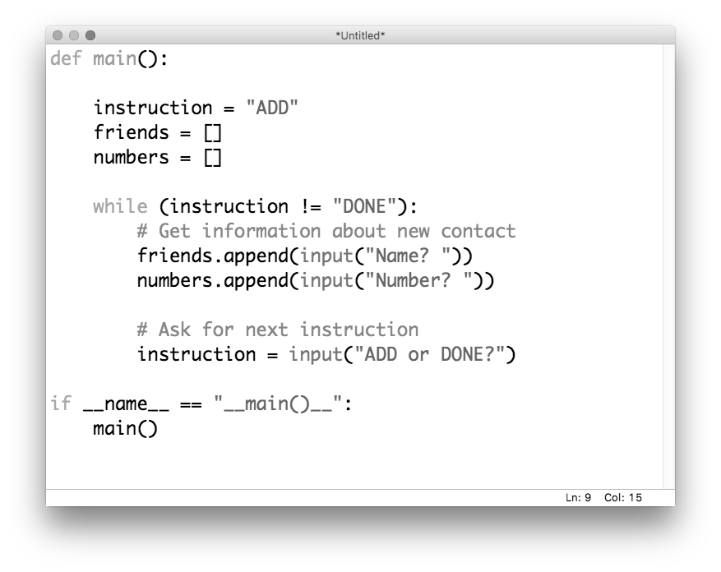
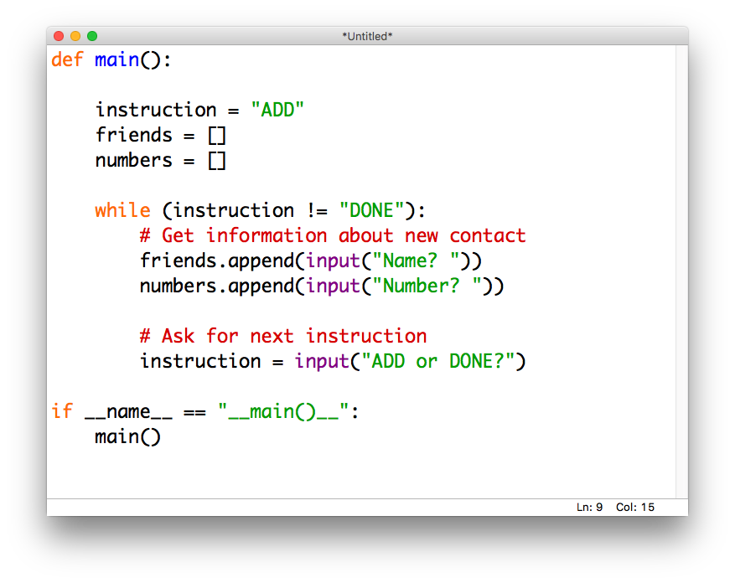
Motivation
Imagine we want to use the previous exercise to create a contact list. Could do it with multiple lists:

Slide 6
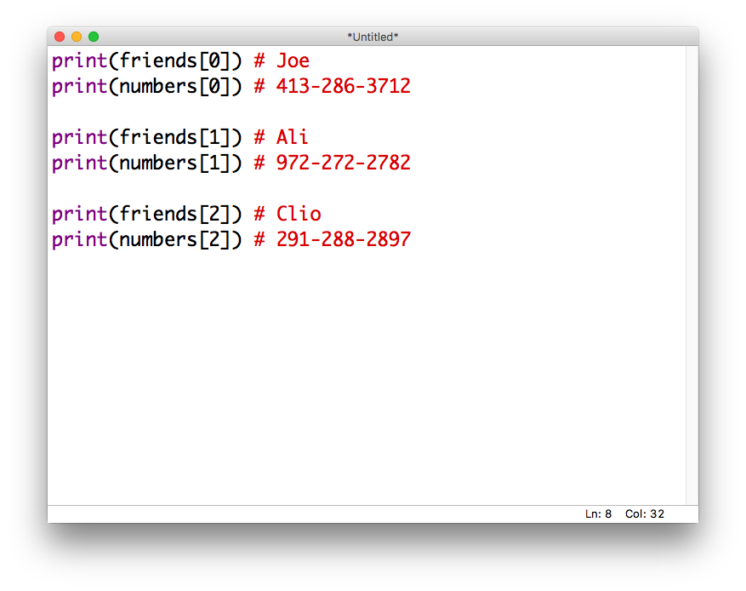
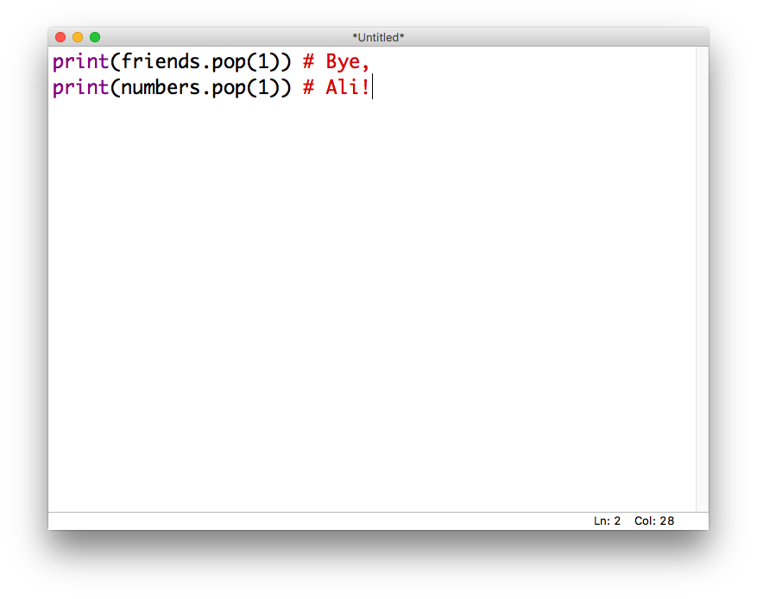
Motivation
If we want to access the data later:
Or worse, modify it…

Slide 7
Motivation
If we want to access the data later:
Or worse, modify it…

Slide 8
What we really want
Each name should “map” to the corresponding number:
“Joe” → “413-286-3712”
“Ali” → “972-272-2782”
“Clio” → “291-288-2897”
That way, we could access the number using the name:
contacts[“Joe”] # “413-286-3712”

Slide 9
Introducing: dictionaries
lists were ordered sets of objects, and we accessed their contents via position (index)
dictionaries are unordered sets, and we can access their contents via keys
We declare them using {…} ← “curly braces” like this:
contacts = {}

Slide 10
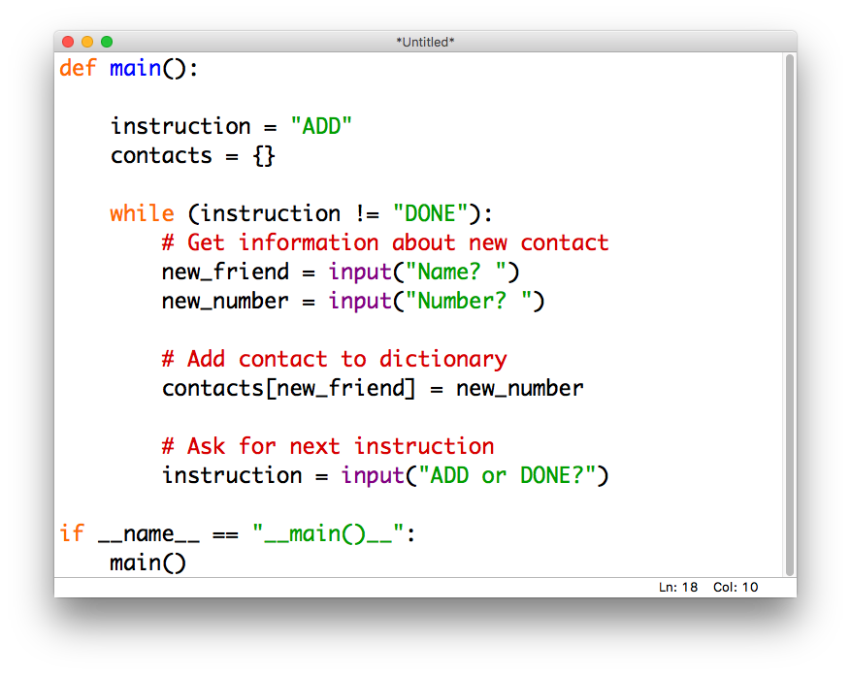
Contacts: take 2

Slide 11
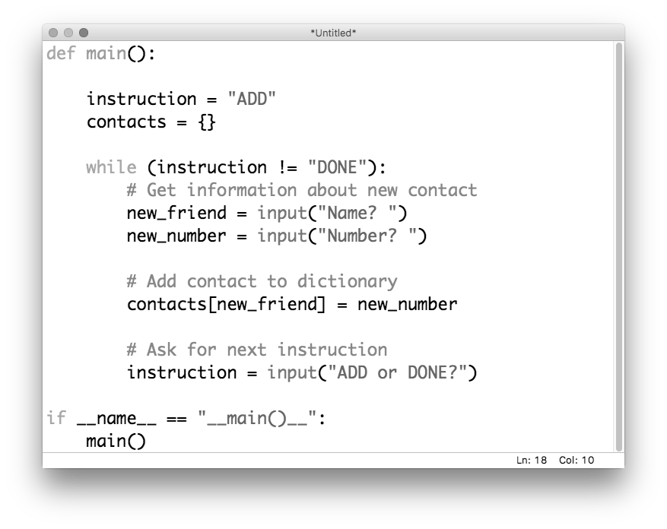
Contacts: take 2

Slide 12
Contacts: take 2

Slide 13
Contacts: take 2

Slide 14
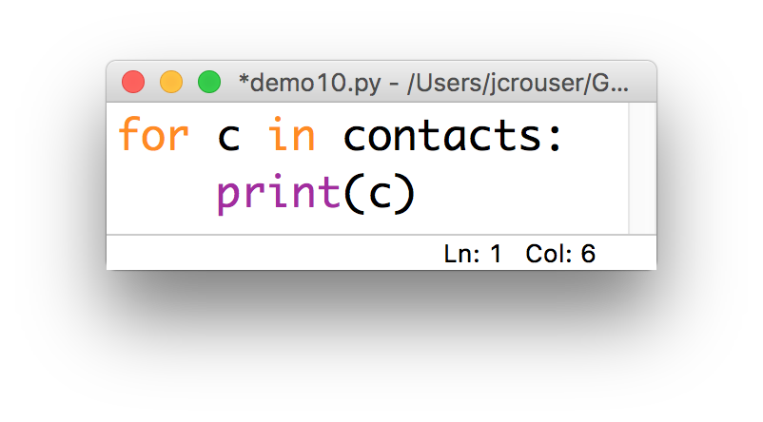
Interesting dilemma
What happens when we iterate over a dictionary?

Slide 15
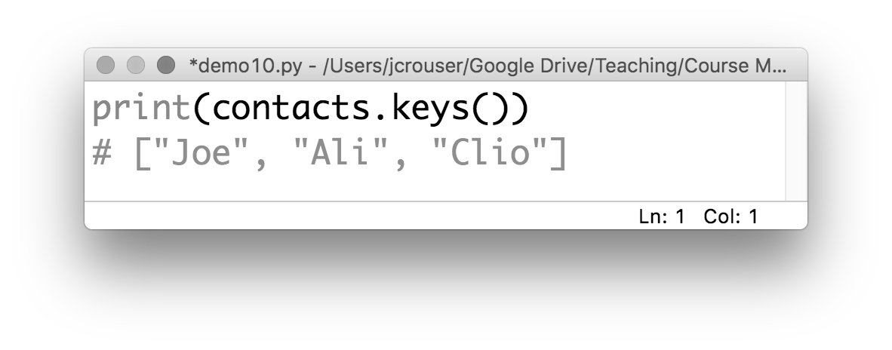
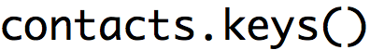
dictionary methods: .keys()
If you want to get a list of the keys in a dictionary

Slide 16
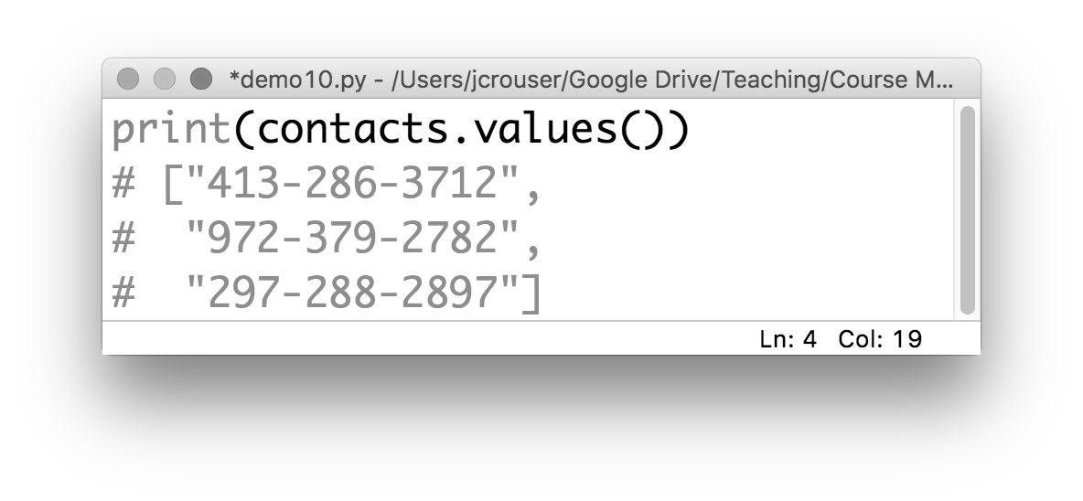
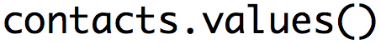
dictionary methods: .values()
If you want a list of the values in a dictionary

Slide 17
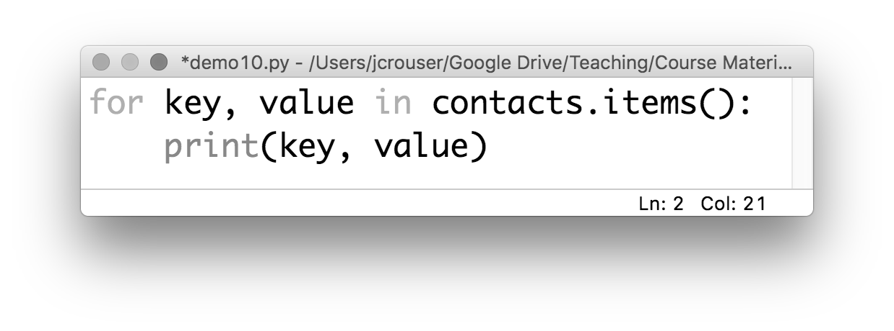
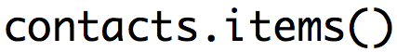
dictionary methods: .items()
If you want a list of the key,value pairs in a dictionary

Slide 18
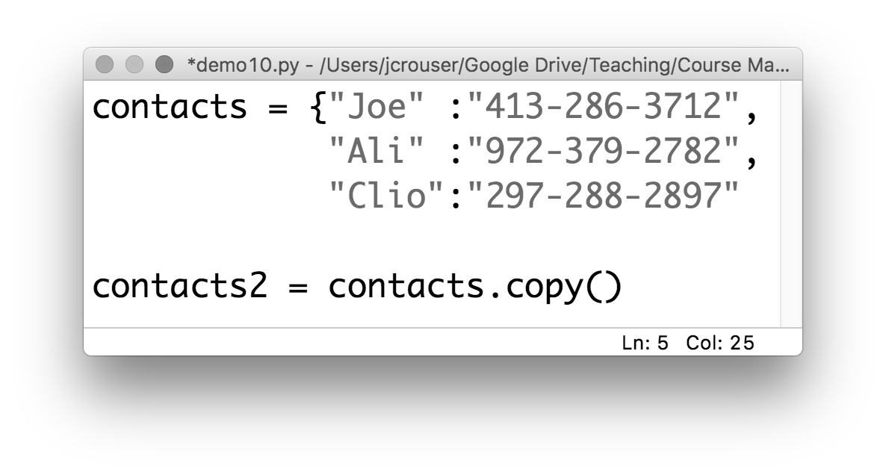
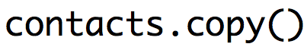
dictionary methods: .copy()
If you want to copy the dictionary :
just like with
a list

Slide 19
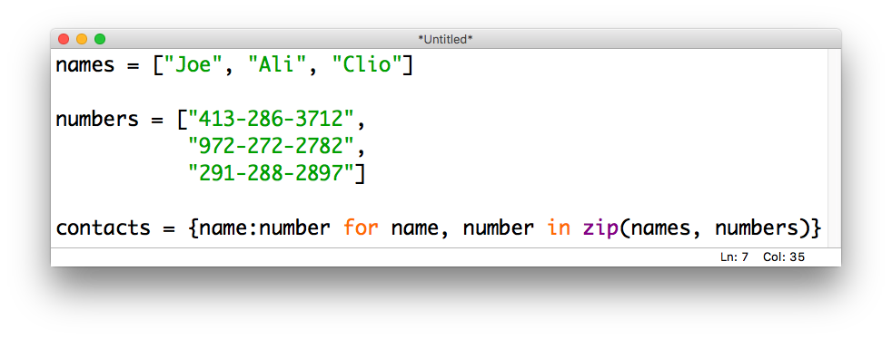
The zip(…) function
If you want to combine two lists into one dictionary, use a comprehension and the zip(…) function:

Slide 20
Recap
strings: immutable ordered collections of characters
lists: mutable ordered collections of objects
dictionaries: mutable unordered collections of objects

Slide 21
15 minute exercise
Write a program that …
Asks the user “ADD or DONE? “
If the user says ADD
Take user input to creates a contact book entry that includes (1) name, (2) number, and (3) address
Ask “ADD or DONE? “ again
If the user says DONE
Quit and print “X’s number is Y and they live at Z” for each entry in the contact book

