Slide 1
Intro to Coding with Python– Interaction
Dr. Ab Mosca (they/them)
Slides based off slides courtesy of Jordan Crouser (https://jcrouser.github.io/)

Slide 2
Plan for Today
Project proposal check-in
Interaction basics
mouse
keyboard

Slide 3
User Centered-Design and Prototyping
Lingering Questions?

Slide 4
Proposal Check-in
Work on the animated fish from last class while I come around to check-in on project proposals
Fish should swim across the screen and flip directions when they hit the edge
20px
5px
40px
60px
80px

Slide 5

Draw stuff
“graphical primitives”
Lines
Points
Areas

Slide 6
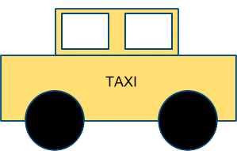
Draw stuff
using the graphics module

Slide 7
Make it move

Slide 8
3. Get input from the user and react

Slide 9
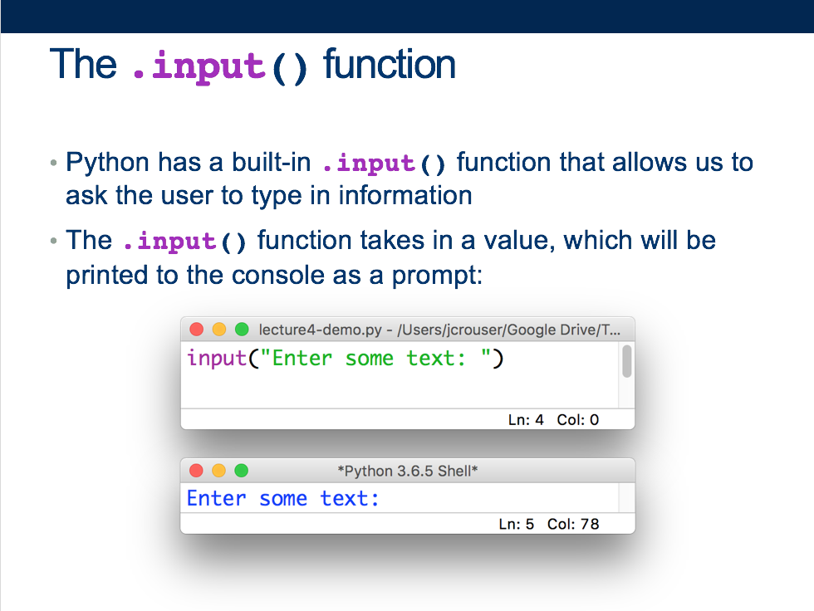
Lecture 4: first experience with user input

Slide 10
Interaction (def.)
Ways for the user to affect change in what’s happening in the program

Slide 11
Interaction (def.)
Ways for the user to affect change in what’s happening in the program
Low level: between human and interface
the set of operations available
happens between the human and the physical computer

Slide 12
Interaction (def.)
Ways for the user to affect change in what’s happening in the program
Low level: between human and interface
the set of operations available
happens between the human and the physical computer
High level: between human and problem space
a cognitive act enabled by the interface
happens between the human and the digital objects

Slide 13
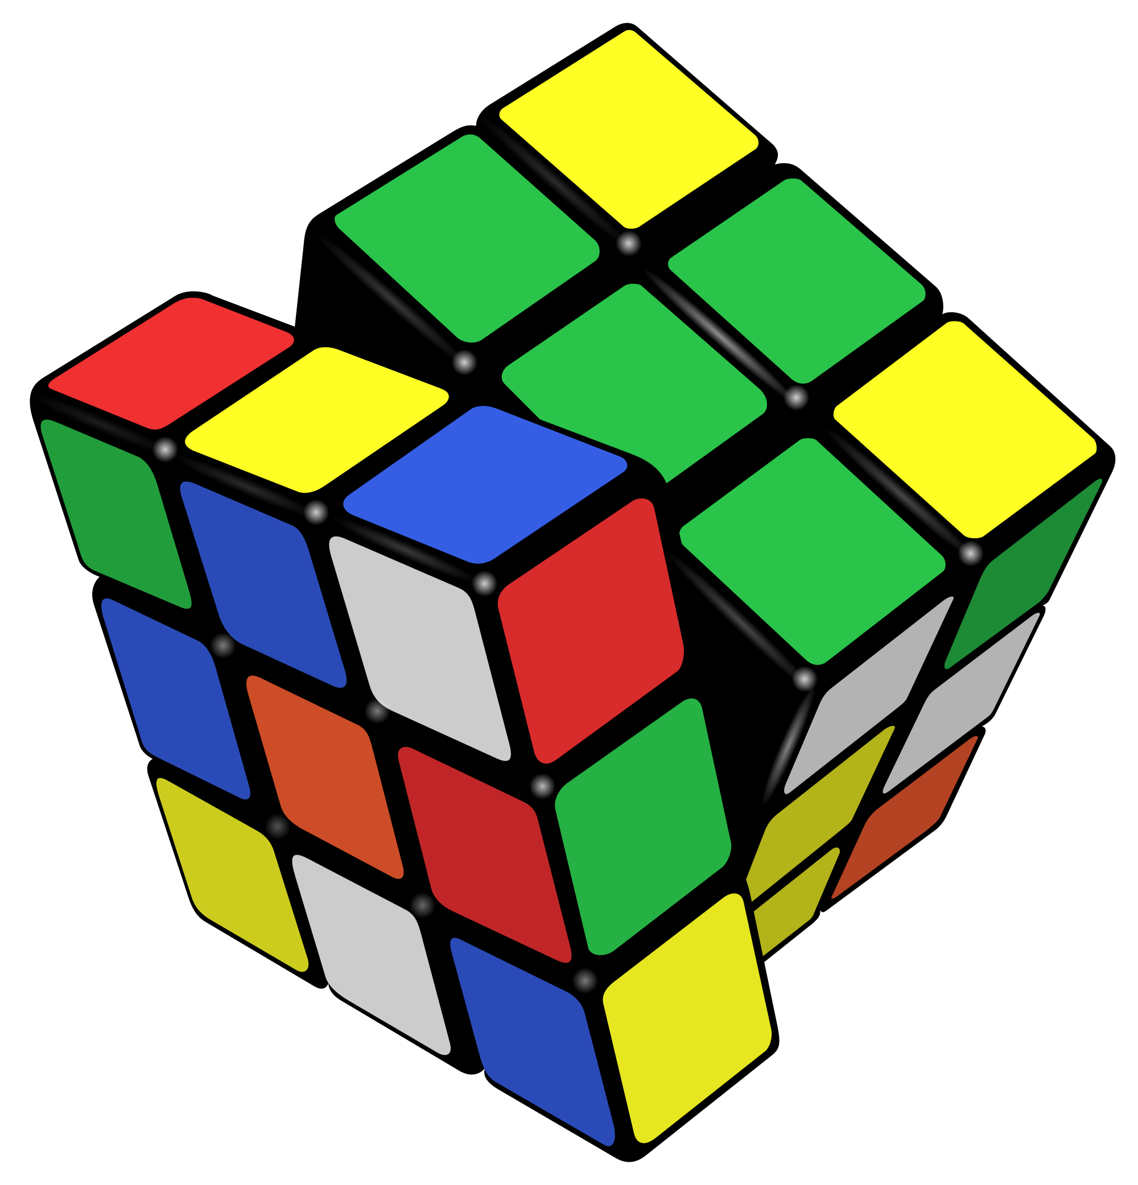
Example: Rubik’s Cube
What low-level interactions can you have?
What high-level interactions can you have?

Slide 14
Low-level vs. high-level interactions

Slide 15
Interaction with graphics objects
The GraphWin object has methods to detect interactions
Mouse:
.getMouse(): stop the program and wait for user to click
.checkMouse(): continuously check if the user has clicked
both return a Point object
Keyboard:
.getKey(): stop the program and wait for user to type
.checkKey(): continuously check if the user has typed
both return a string

Slide 16
Our first interactive graphics program
Notes:
button demo

Slide 17
Notes about keyboard interaction
The strings returned by the .getKey() / .checkKey() methods ae called keycodes
Some keys don’t have an obvious letter attached to them, but their keycodes are still pretty intuitive, e.g.
See also: “space”, “Escape”, “minus”, “underscore”, “equal”, “plus”, “BackSpace”, “Return”, etc.
“Up”
“Left”
“Right”
“Down”

Slide 18
Back to the Fish Tank
Start with your fish from the last two classes
Do the following…

Slide 19

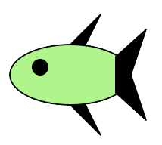
Challenge 1: press ’q’ to quit
Notes:
Our current aquarium probably still quits when the user clicks, but clicking is probably better used for more interesting interactions. Let’s change it so the program quits when the user presses the ‘q’ key.

Slide 20
Challenge 2: fish position
Notes:
Add a fish every time the user clicks (at the position where their mouse was pointing).

Slide 21
Challenge 3: fish frenzy
Notes:
If we hit the spacebar, have the fish swim quickly toward nearest edge of the screen (flipping if necessary)

Slide 22
Activity: Fish Tank
Challenge 1: Quit when the user presses “q”
Challenge 2: Add a fish wherever the user clicks
Challenge 3: If the user presses the space bar, have all the fish swim to the nearest edge of the screen

