Slide 1
Intro to Coding with Python– Handling Exceptions
Dr. Ab Mosca (they/them)
Slides based off slides courtesy of Jordan Crouser (https://jcrouser.github.io/)

Slide 2
Plan for Today
Little algorithm practice
Handling exceptions

Slide 3
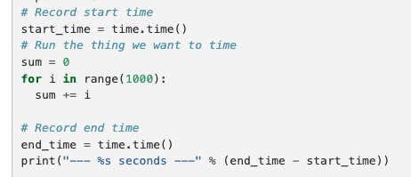
Algorithm Practice
Open the sorting demo on repl.it
Add your code at the bottom of main()
Use the time module to compare sort times on the three sorting algorithms we looked at last class
Ex.
Which algorithm is fastest? Is that what you expected?

Slide 4
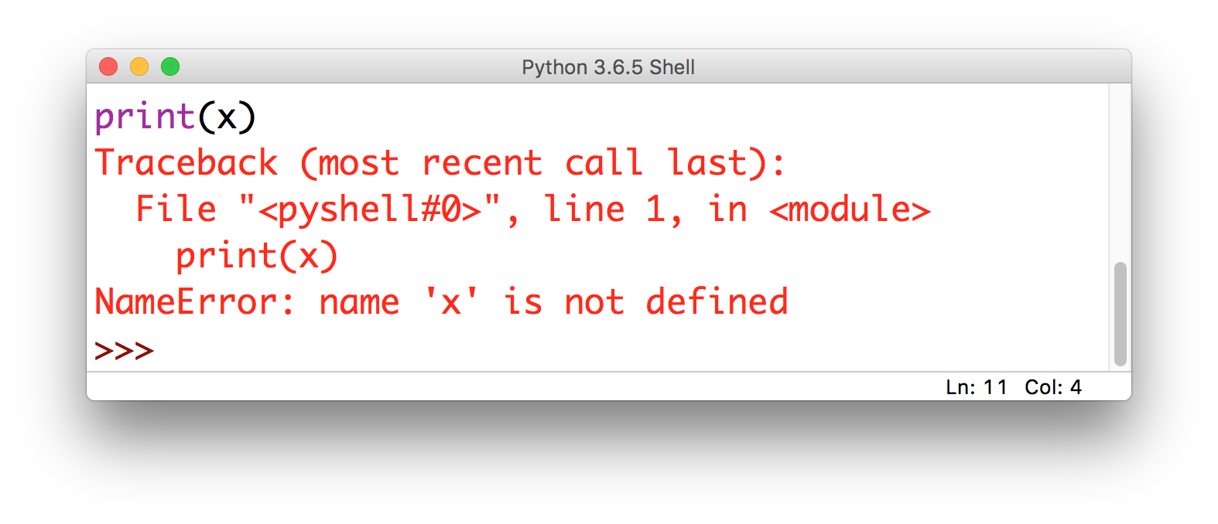
Lecture 10: some problems are obvious
this is called
an Exception

Slide 5
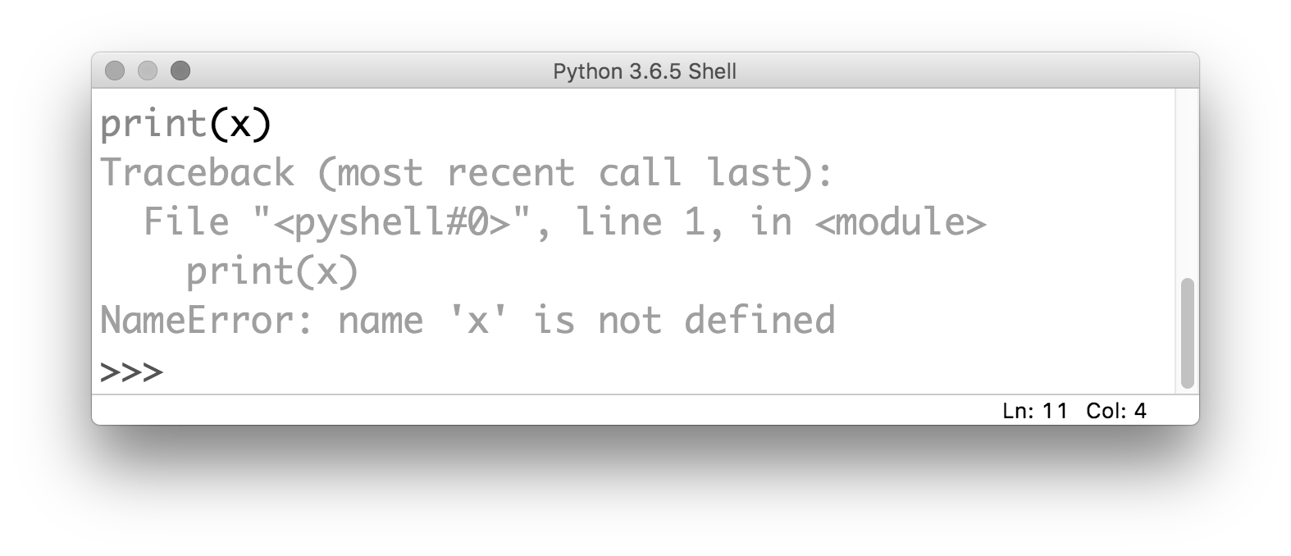
Lecture 10: some problems are obvious
the kind of error gives you
a clue about what the problem is

Slide 6
Lecture 10: some problems are obvious
it also tells you where the problem is
(but be careful!)

Slide 7
Discussion
But there’s a drawback to when your
program throws an Exception…
Notes:
It stops! As of right now, we don’t have any way to recover

Slide 8
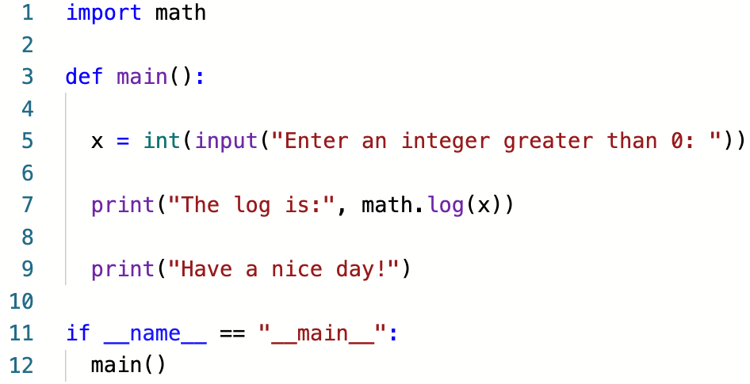
An example
What happens if the user enters
a negative number?

Slide 9
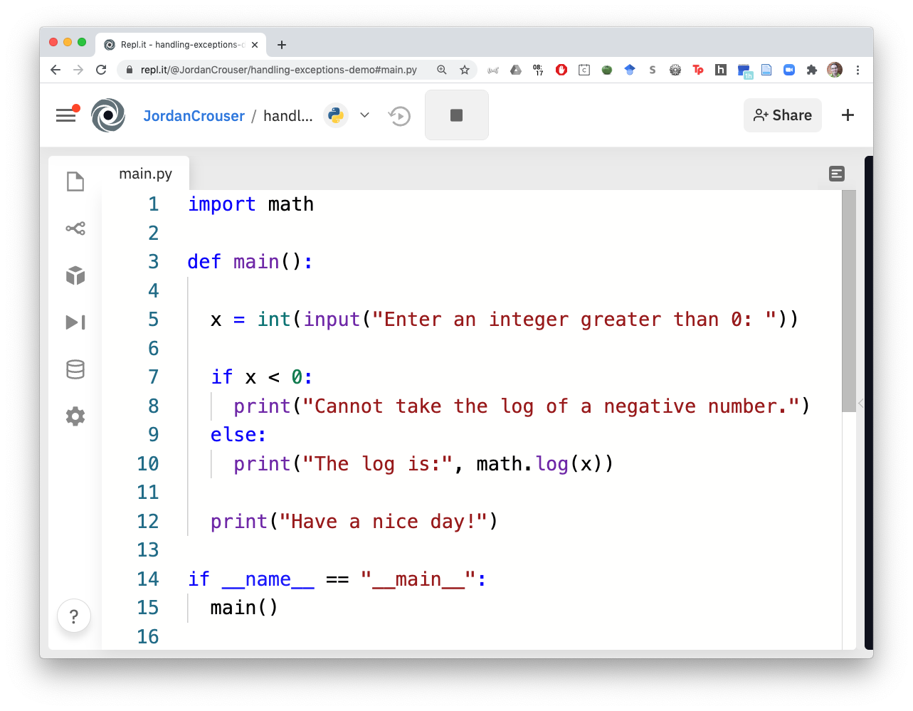
An example
What happens if the
user enters a string?

Slide 10
The try...except block
There are some cases where avoiding an Exception isn’t possible
In this case, we want tell Python:
what we want to happen (what to try)
how to handle it if things go wrong (except)

Slide 11
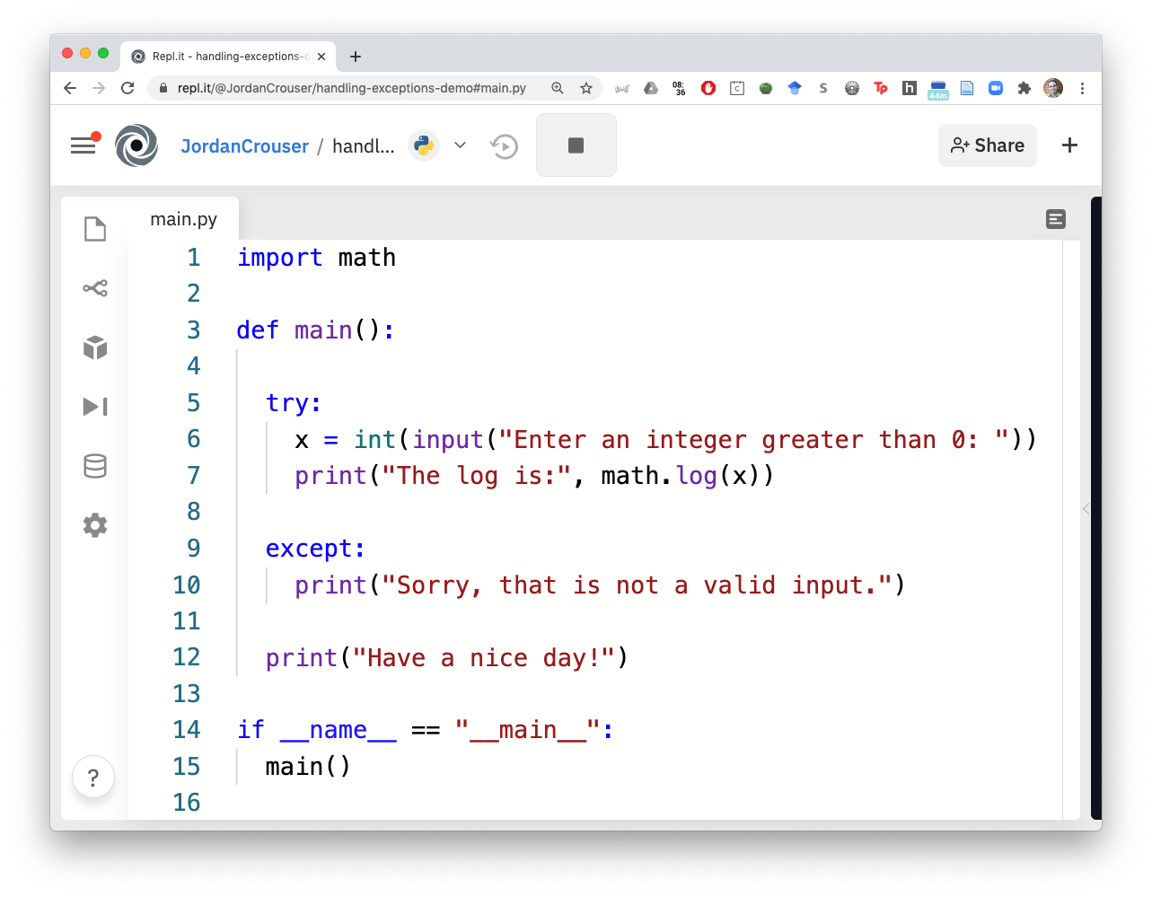
An example
Okay python:
try to do this

Slide 12
An example
except if you can’t;
then do this instead

Slide 13
Your turn!
Given: a (brittle) solution to A2: Clunky Calculator
Objective: find any places that might throw Exceptions, and handle them so the program doesn’t crash!

Slide 14
Takeaways
Even if you can’t avoid all errors, you can design your program to fail gracefully
You can handle multiple different kinds of Exceptions, and you can handle them differently
Think about edge cases to provide specific feedback about what went wrong

