Slide 1
Power Calculation for 2-Sample Tests
Dr. Ab Mosca (they/them)
Slides based off slides courtesy of OpenIntro and John McGreedy of Johns Hopkins University

Slide 2
Plan for Today
Warm-up – Review 2 Sample Hypothesis Tests
Power Calculations

Slide 3
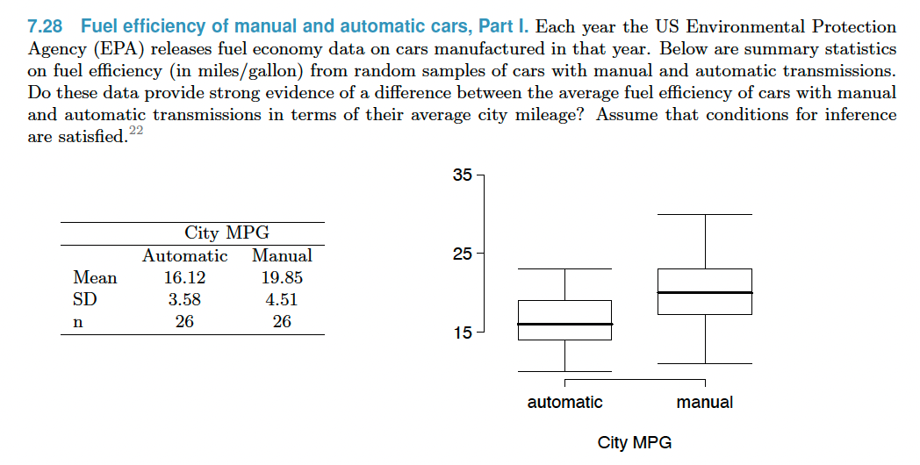

Slide 4
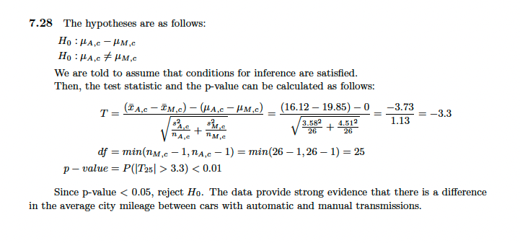

Slide 5
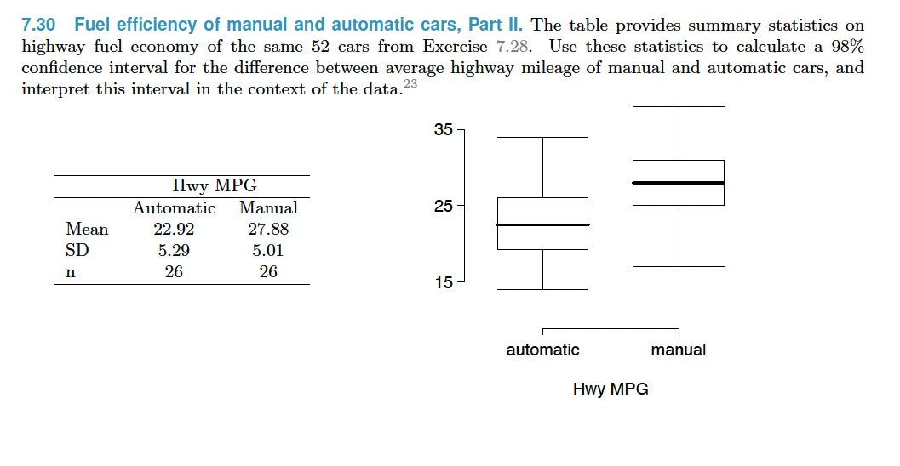
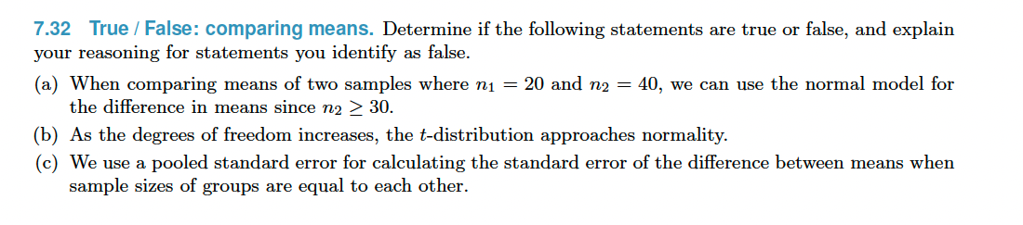

Slide 6
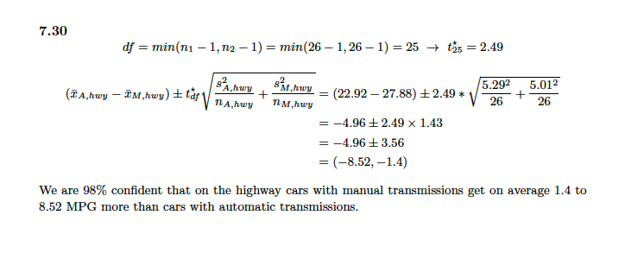
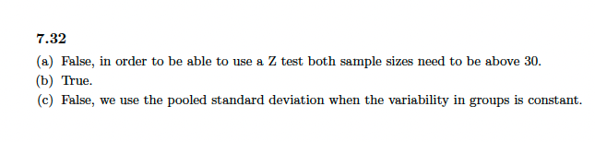

Slide 7
Power
The power of a statistical test is the probably that we detect an effect if there is a real effect

Slide 8
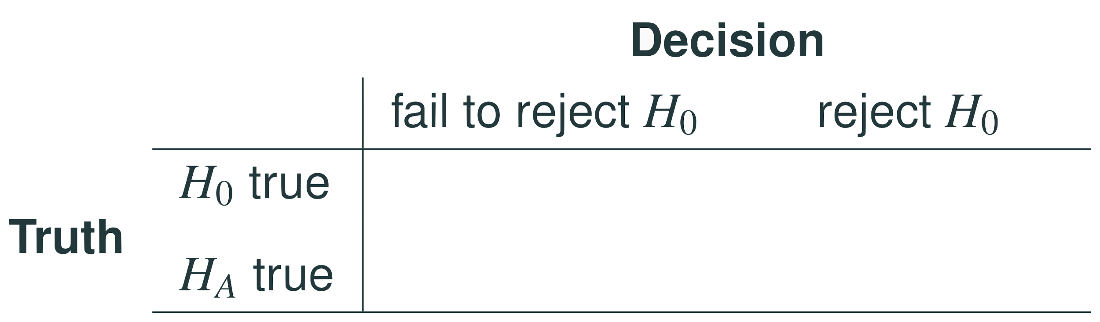
Decision Errors

Slide 9
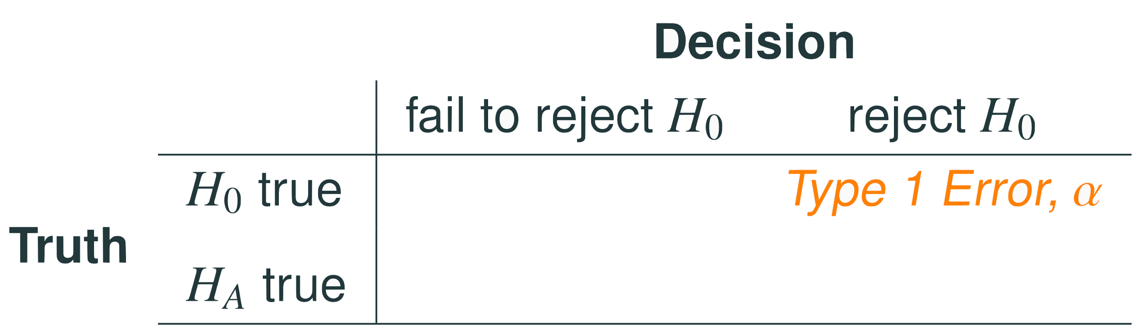
Decision Errors
Type 1 error is rejecting H₀ when you shouldn’t have, and the probability of doing so is α (significance level)

Slide 10
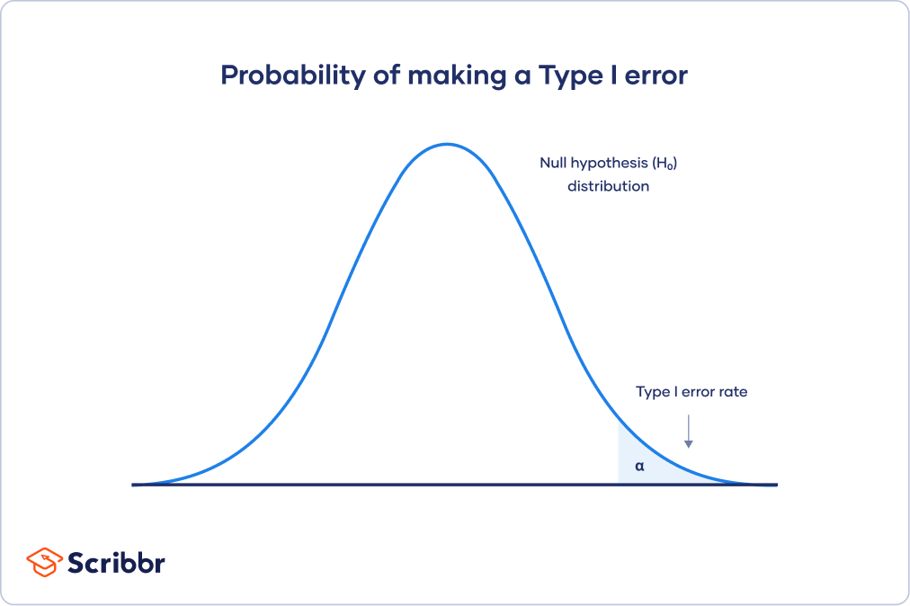
Decision Errors

Slide 11
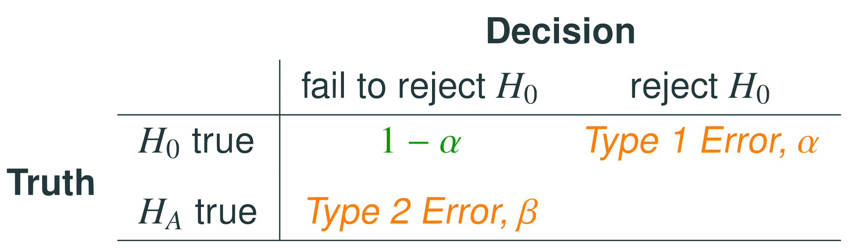
Decision Errors
Type 1 error is rejecting H₀ when you shouldn’t have, and the probability of doing so is α (significance level)
The probability of making a correct decision if H₀ is true is 1 - α

Slide 12

Decision Errors
1 - $α$

Slide 13
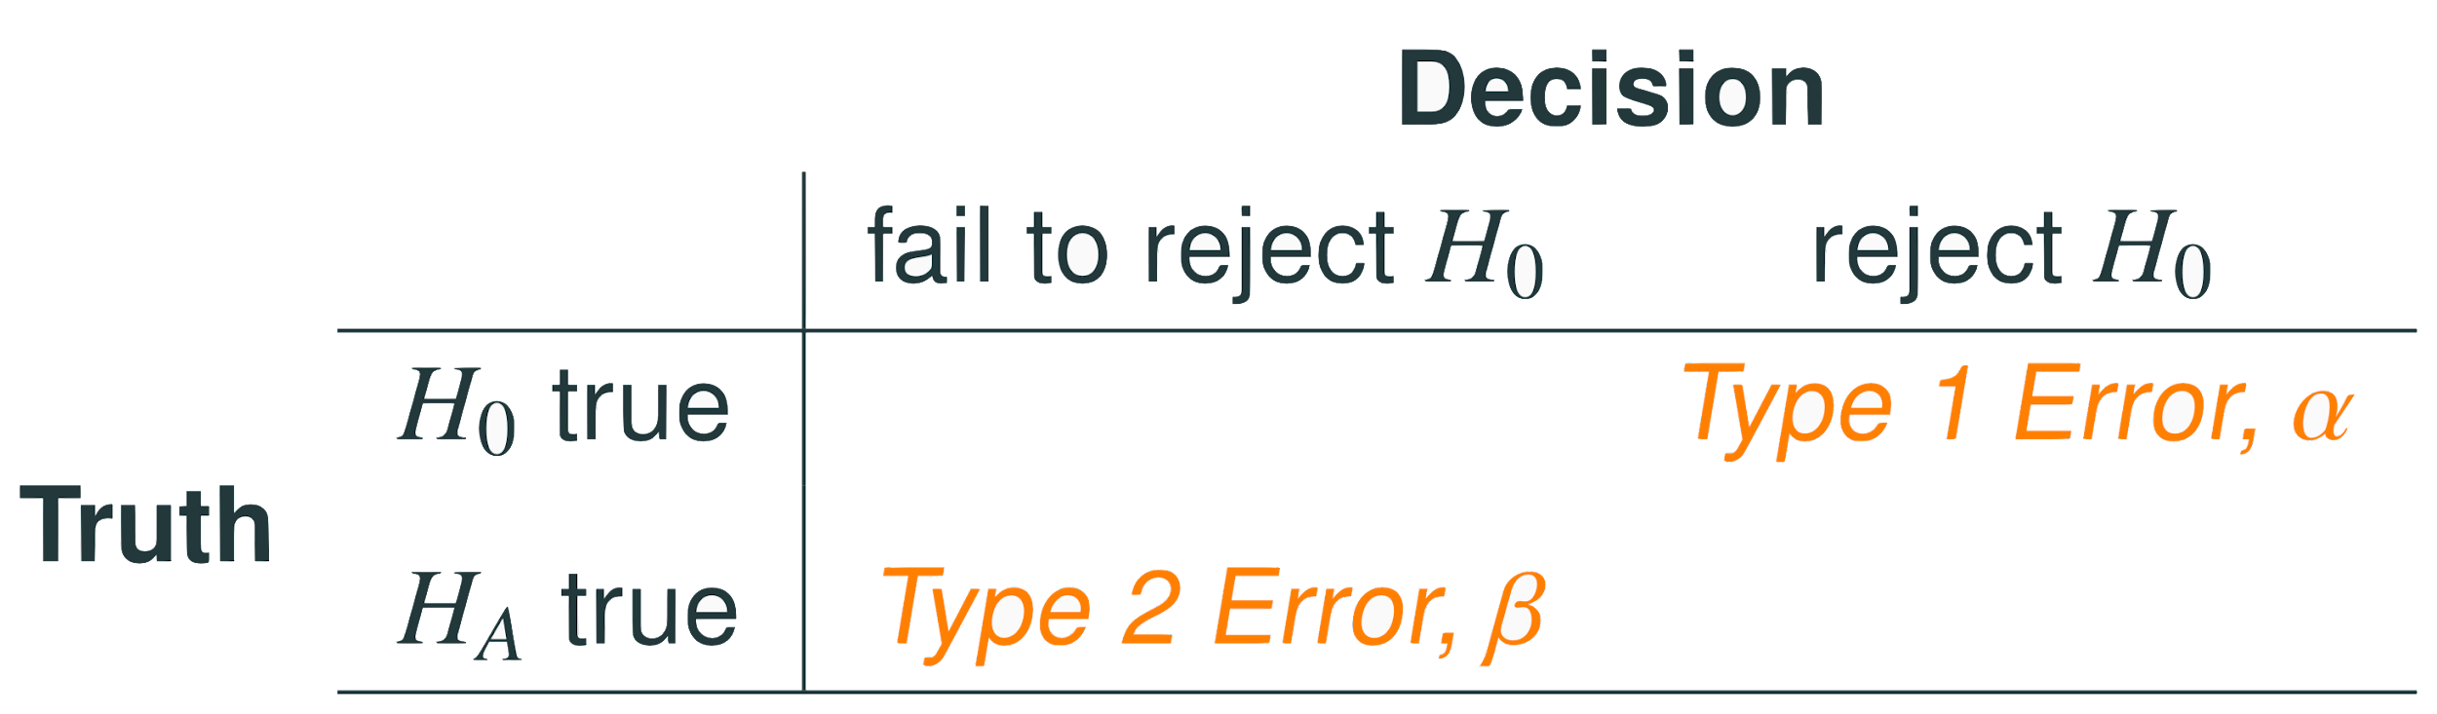
Decision Errors
Type 1 error is rejecting H₀ when you shouldn’t have, and the probability of doing so is α (significance level)
The probability of making a correct decision if H₀ is true is 1 - α
Type 2 error is failing to reject H₀ when you should have, and the probability of doing so is β

Slide 14
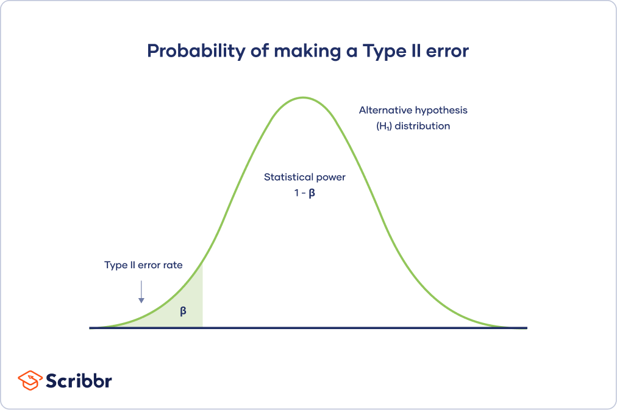
Decision Errors

Slide 15
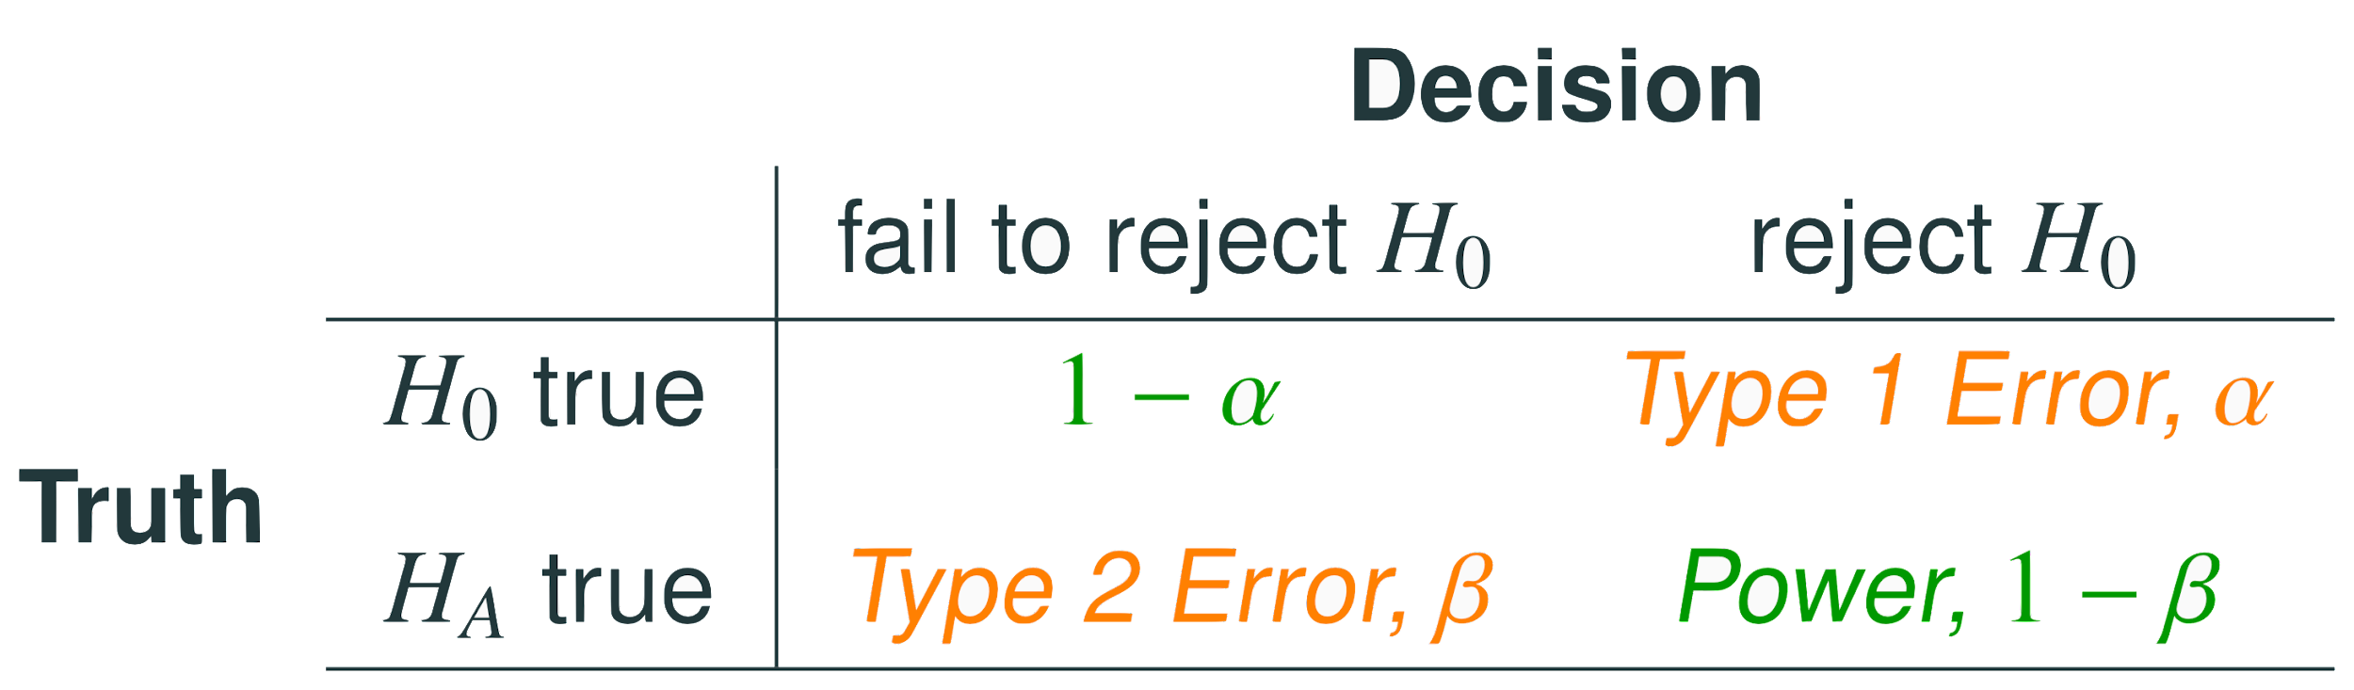
Decision Errors
Type 1 error is rejecting H₀ when you shouldn’t have, and the probability of doing so is α (significance level)
The probability of making a correct decision if H₀ is true is 1 - α
Type 2 error is failing to reject H₀ when you should have, and the probability of doing so is β
The probability of making a correct decision if H₀ is false is 1 − β; we call this the power of a test

Slide 16
Decision Errors

Slide 17
Decision Errors
Type 1 error is rejecting H₀ when you shouldn’t have, and the probability of doing so is α (significance level)
The probability of making a correct decision if H₀ is true is 1 - α
Type 2 error is failing to reject H₀ when you should have, and the probability of doing so is β
The probability of making a correct decision if H₀ is false is 1 − β; we call this the power of a test
There is a trade off between Type I and Type II errors

Slide 18
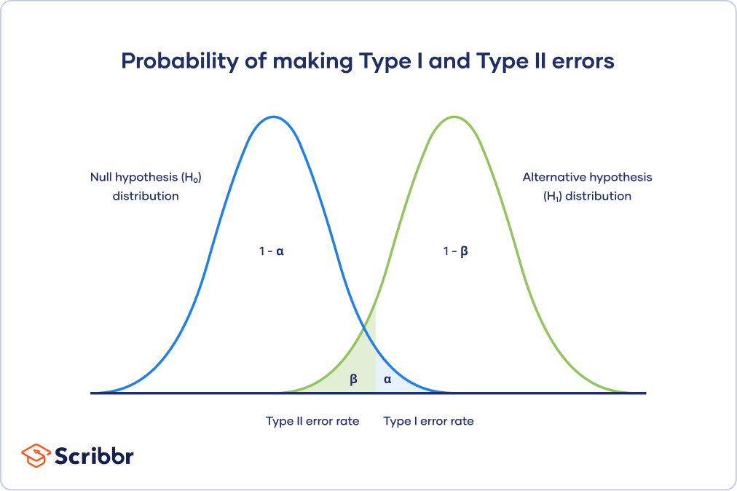
Decision Errors
Notes:
The null hypothesis distribution shows all possible results you’d obtain if the null hypothesis is true. The correct conclusion for any point on this distribution means not rejecting the null hypothesis.
The alternative hypothesis distribution shows all possible results you’d obtain if the alternative hypothesis is true. The correct conclusion for any point on this distribution means rejecting the null hypothesis.
Type I and Type II errors occur where these two distributions overlap. The blue shaded area represents alpha, the Type I error rate, and the green shaded area represents beta, the Type II error rate.

Slide 19
Type 2 error rate
If the alternative hypothesis is actually true, what is the chance that we make a Type 2 Error, i.e. we fail to reject the null hypothesis even when we should reject it?
The answer is not obvious
If the true population average is very close to the null hypothesis value, it will be difficult to detect a difference (and reject H₀)

Slide 20
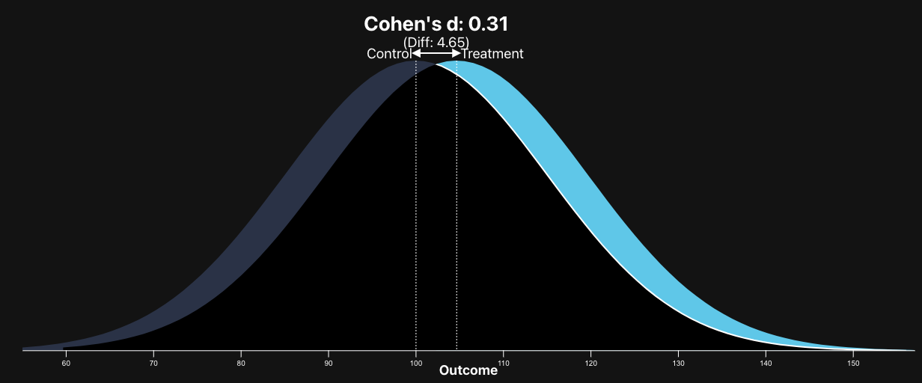
Type 2 error rate

Slide 21
Type 2 error rate
If the alternative hypothesis is actually true, what is the chance that we make a Type 2 Error, i.e. we fail to reject the null hypothesis even when we should reject it?
The answer is not obvious
If the true population average is very close to the null hypothesis value, it will be difficult to detect a difference (and reject H₀)
If the true population average is very different from the null hypothesis value, it will be easier to detect a difference

Slide 22
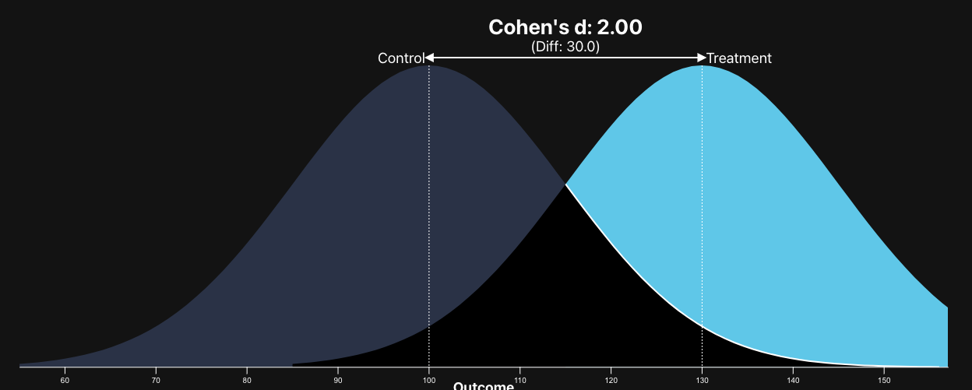
Type 2 error rate

Slide 23
Type 2 error rate
If the alternative hypothesis is actually true, what is the chance that we make a Type 2 Error, i.e. we fail to reject the null hypothesis even when we should reject it?
The answer is not obvious
If the true population average is very close to the null hypothesis value, it will be difficult to detect a difference (and reject H₀)
If the true population average is very different from the null hypothesis value, it will be easier to detect a difference
The difference between the true population value and the null hypothesis value is called effect size (ẟ)
β depends on the effect size

Slide 24
Effect Size
Effect size is the practical significance of the difference between the actual population mean and the null hypothesis mean

Slide 25
Effect Size
Effect size is the practical significance of the difference between the actual population mean and the null hypothesis mean
It differs from statistical significance because it is not influenced by sample size (a larger sample increases the likelihood of a statistically significant difference because variance decreases with increased sample size)
https://medium.com/@dtuk81/sample-sizes-impact-on-effect-size-and-power-fbd5084c7c47

Slide 26
Effect Size
Effect size is the practical significance of the difference between the actual population mean and the null hypothesis mean
It differs from statistical significance because it is not influenced by sample size (a larger sample increases the likelihood of a statistically significant difference because variance decreases with increased sample size)
https://medium.com/@dtuk81/sample-sizes-impact-on-effect-size-and-power-fbd5084c7c47

Slide 27
Example - Blood Pressure (BP)
Suppose a pharmaceutical company has developed a new drug for lowering blood pressure, and they are preparing a clinical trial to test the drug’s effectiveness. They recruit people who are taking a particular standard blood pressure medication, and half of the subjects are given the new drug (treatment) and the other half continue to take their current medication through generic-looking pills to ensure blinding (control).
What are the explanatory and response variables for this experiment? What are the levels of the explanatory variable?

Slide 28
Example - Blood Pressure (BP)
Suppose a pharmaceutical company has developed a new drug for lowering blood pressure, and they are preparing a clinical trial to test the drug’s effectiveness. They recruit people who are taking a particular standard blood pressure medication, and half of the subjects are given the new drug (treatment) and the other half continue to take their current medication through generic-looking pills to ensure blinding (control).
What are the explanatory and response variables for this experiment? What are the levels of the explanatory variable?
 |  | Response: Blood Pressure
Explanatory: Drug | New Drug
 | Current Medication

Slide 29
Example - Blood Pressure (BP)
Suppose a pharmaceutical company has developed a new drug for lowering blood pressure, and they are preparing a clinical trial to test the drug’s effectiveness. They recruit people who are taking a particular standard blood pressure medication, and half of the subjects are given the new drug (treatment) and the other half continue to take their current medication through generic-looking pills to ensure blinding (control).
What are the hypotheses for a two-sided hypothesis test in this context?

Slide 30

Example - Blood Pressure (BP)
Suppose a pharmaceutical company has developed a new drug for lowering blood pressure, and they are preparing a clinical trial to test the drug’s effectiveness. They recruit people who are taking a particular standard blood pressure medication, and half of the subjects are given the new drug (treatment) and the other half continue to take their current medication through generic-looking pills to ensure blinding (control).
What are the hypotheses for a two-sided hypothesis test in this context?

Slide 31
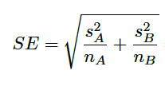
Example - BP, standard error
Suppose researchers would like to run the clinical trial on patients with systolic blood pressures between 140 and 180 mmHg. Suppose previously published studies suggest that the standard deviation of the patients’ blood pressures will be about 12 mmHg and the distribution of patient blood pressures will be approximately symmetric.
If we had 100 patients per group in our study, what would be the approximate standard error for difference in sample means of the treatment and control groups?

Slide 32

Example - BP, standard error
Suppose researchers would like to run the clinical trial on patients with systolic blood pressures between 140 and 180 mmHg. Suppose previously published studies suggest that the standard deviation of the patients’ blood pressures will be about 12 mmHg and the distribution of patient blood pressures will be approximately symmetric.
If we had 100 patients per group in our study, what would be the approximate standard error for difference in sample means of the treatment and control groups?

Slide 33
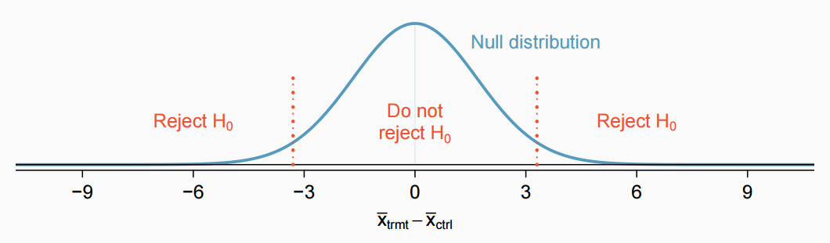
Example - BP, minimum effect size required to reject H₀
For what values of the difference between the observed averages of blood pressure in treatment and control groups (effect size) would we reject the null hypothesis at the 5% significance level?
Find the cutoffs for the observed values that would cause us to reject the null hypothesis.

Slide 34
Example - BP, minimum effect size required to reject H₀
For what values of the difference between the observed averages of blood pressure in treatment and control groups (effect size) would we reject the null hypothesis at the 5% significance level?
The difference should be at least
1.96 * 1.70 = 3.332
or at most
-1.96 * 1.70 = -3.332

Slide 35
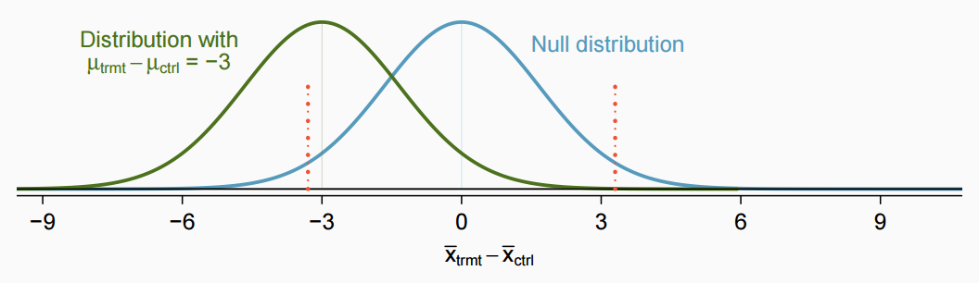
Example - BP, power
Suppose that the company researchers care about finding any effect on blood pressure that is 3 mmHg or larger vs the standard medication. What is the power of the test that can detect this effect?
?
-3.332
3.332

Slide 36


Example - BP, power
Suppose that the company researchers care about finding any effect on blood pressure that is 3 mmHg or larger vs the standard medication. What is the power of the test that can detect this effect?
?
-3.332
3.332

Slide 37
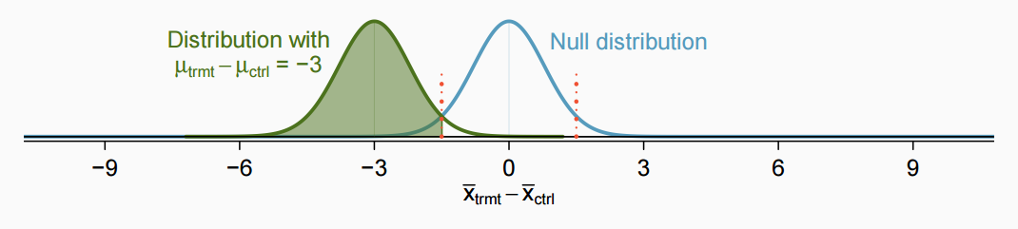

Example - BP, required sample size for 80% power
What sample size will lead to a power of 80% for this test?
Use $α$ = 0.05
First, find Z
80%
Z = ?

Slide 38

Example - BP, required sample size for 80% power
What sample size will lead to a power of 80% for this test?
Use $α$ = 0.05
80%
Z = 0.84

Slide 39

Example - BP, required sample size for 80% power
What sample size will lead to a power of 80% for this test?
Use $α$ = 0.05
Next, find how many SE’s are between the two means.
80%
Z = 0.84

Slide 40
Example - BP, required sample size for 80% power
What sample size will lead to a power of 80% for this test?
Use $α$ = 0.05
80%
Z = 0.84
0.84 * SE
1.96 * SE
distance = 0.84 * SE + 1.96 SE = 2.8 * SE

Slide 41

Example - BP, required sample size for 80% power
What sample size will lead to a power of 80% for this test?
Use $α$ = 0.05
We were given that a difference is practically significant only if it is 3 or greater. Use this, the distance we just found, and the SE equation to find n.
80%
Z = 0.84
2.8 * SE

Slide 42
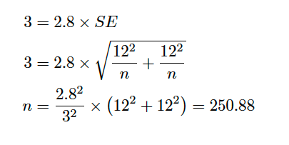
Example - BP, required sample size for 80% power
What sample size will lead to a power of 80% for this test?
Use $α$ = 0.05
80%
Z = 0.84
2.8 * SE

Slide 43
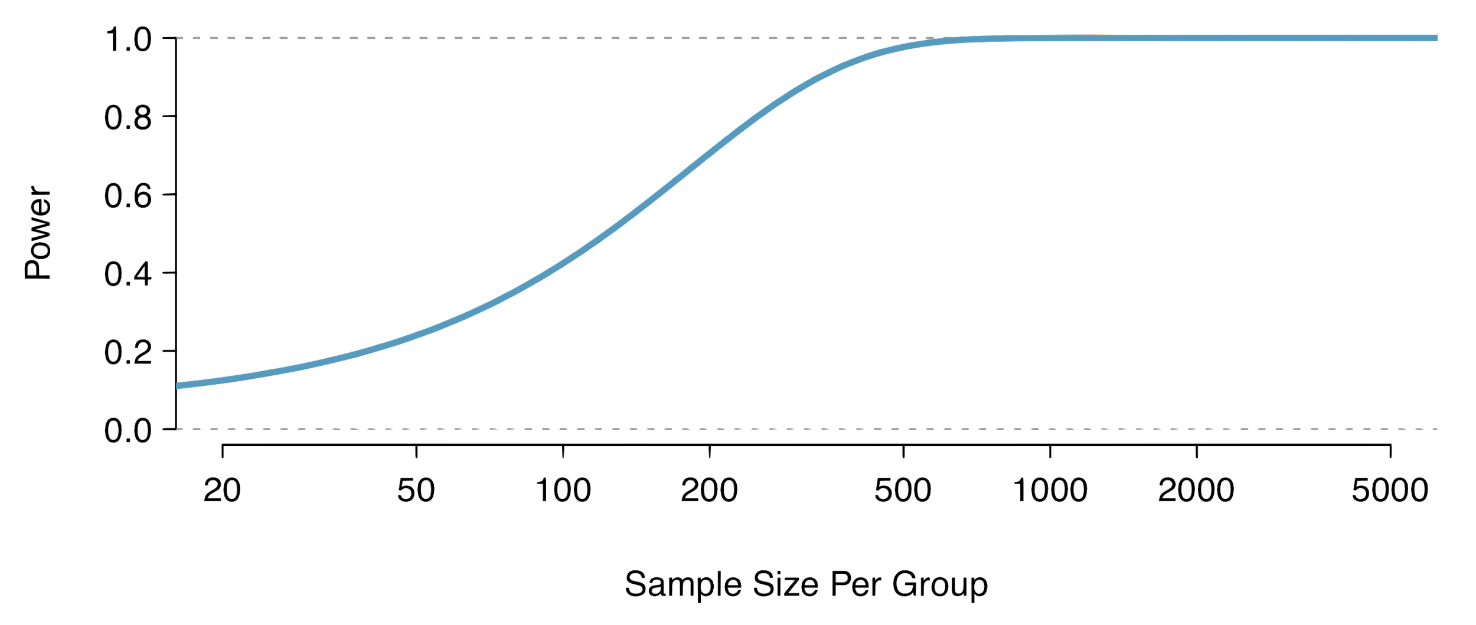
Recap
Calculate required sample size for a desired level of power
Calculate power for a range of sample sizes, then choose the sample size that yields the target power (usually 80% or 90%)

Slide 44
Achieving desired power
There are several ways to increase power (and hence decrease type 2 error rate):

Slide 45
Achieving desired power
There are several ways to increase power (and hence decrease type 2 error rate):
Increase the sample size

Slide 46
Achieving desired power
There are several ways to increase power (and hence decrease type 2 error rate):
Increase the sample size
Decrease the standard deviation of the sample, which essentially has the same effect as increasing the sample size (it will decrease the standard error). With a smaller s we have a better chance of distinguishing the null value from the observed point estimate. This is difficult to ensure but cautious measurement process and limiting the population so that it is more homogenous may help

Slide 47
Achieving desired power
There are several ways to increase power (and hence decrease type 2 error rate):
Increase the sample size
Decrease the standard deviation of the sample, which essentially has the same effect as increasing the sample size (it will decrease the standard error). With a smaller s we have a better chance of distinguishing the null value from the observed point estimate. This is difficult to ensure but cautious measurement process and limiting the population so that it is more homogenous may help
Increase α, which will make it more likely to reject H₀ (but note that this has the side effect of increasing the Type 1 error rate)

Slide 48
Achieving desired power
There are several ways to increase power (and hence decrease type 2 error rate):
Increase the sample size
Decrease the standard deviation of the sample, which essentially has the same effect as increasing the sample size (it will decrease the standard error). With a smaller s we have a better chance of distinguishing the null value from the observed point estimate. This is difficult to ensure but cautious measurement process and limiting the population so that it is more homogenous may help
Increase α, which will make it more likely to reject H₀ (but note that this has the side effect of increasing the Type 1 error rate)
Consider a larger effect size. If the true mean of the population is in the alternative hypothesis but close to the null value, it will be harder to detect a difference

