Slide 1
Hypothesis Testing
Dr. Ab Mosca (they/them)
Slides based off slides courtesy of OpenIntro and John McGreedy of Johns Hopkins University

Slide 2
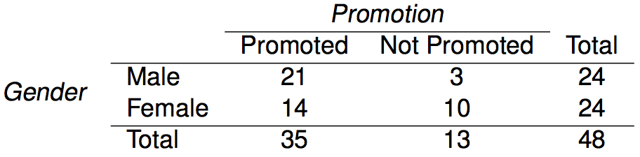
Gender discrimination experiment:

Slide 3
Gender discrimination experiment:
What proportion of Males are promoted? What proportion of Females?

Slide 4
Gender discrimination experiment:
What proportion of Males are promoted? What proportion of Females?
p̂_{males} = 21 / 24 = 0.88
p̂_{females} = 14 / 24 = 0.58

Slide 5
Gender discrimination experiment:
p̂_{males} = 21 / 24 = 0.88
p̂_{females} = 14 / 24 = 0.58
Possible explanations:
Promotion and gender are independent, no gender discrimination, observed difference in proportions is simply due to chance.
Promotion and gender are dependent, there is gender discrimination, observed difference in proportions is not due to chance.

Slide 6
Gender discrimination experiment:
p̂_{males} = 21 / 24 = 0.88
p̂_{females} = 14 / 24 = 0.58
Possible explanations:
Promotion and gender are independent, no gender discrimination, observed difference in proportions is simply due to chance. → null hypothesis (nothing is going on)
Promotion and gender are dependent, there is gender discrimination, observed difference in proportions is not due to chance. → alternative. hypothesis (something is going on)

Slide 7
Gender discrimination experiment:
How do we test which of these explanations is most likely?
p̂_{males} = 21 / 24 = 0.88
p̂_{females} = 14 / 24 = 0.58
Possible explanations:
Promotion and gender are independent, no gender discrimination, observed difference in proportions is simply due to chance. → null hypothesis (nothing is going on)
Promotion and gender are dependent, there is gender discrimination, observed difference in proportions is not due to chance. → alternative. hypothesis (something is going on)

Slide 8
Hypothesis testing

Slide 9
Hypothesis testing framework
We start with a null hypothesis (H₀) that represents the status quo.

Slide 10
Hypothesis testing framework
We start with a null hypothesis (H₀) that represents the status quo.
We also have an alternative hypothesis (H_{A}) that represents our research question, i.e. what we're testing for.

Slide 11
Hypothesis testing framework
We start with a null hypothesis (H₀) that represents the status quo.
We also have an alternative hypothesis (H_{A}) that represents our research question, i.e. what we're testing for.
We conduct a hypothesis test under the assumption that the null hypothesis is true, either via simulation or traditional methods based on the central limit theorem (coming up next...).

Slide 12
Hypothesis testing framework
We start with a null hypothesis (H₀) that represents the status quo.
We also have an alternative hypothesis (H_{A}) that represents our research question, i.e. what we're testing for.
We conduct a hypothesis test under the assumption that the null hypothesis is true, either via simulation or traditional methods based on the central limit theorem (coming up next...).
If the test results suggest that the data do not provide convincing evidence for the alternative hypothesis, we stick with the null hypothesis. If they do, then we reject the null hypothesis in favor of the alternative.

Slide 13
Number of college applications
A survey of Duke students asked how many colleges they applied to. 206 students responded. This sample yielded an average of 9.7 college applications with a standard deviation of 7. The College Board website states that counselors recommend students apply to roughly 8 colleges. Do these data provide convincing evidence that the average number of colleges all Duke students apply to is higher than recommended?
http://www.collegeboard.com/student/apply/the-application/151680.html

Slide 14
Setting the hypotheses
The parameter of interest is the average number of schools applied to by all Duke students.

Slide 15
Setting the hypotheses
The parameter of interest is the average number of schools applied to by all Duke students.
There may be two explanations why our sample mean is higher than the recommended 8 schools.
The true population mean is different.
The true population mean is 8, and the difference between the true population mean and the sample mean is simply due to natural sampling variability

Slide 16
Setting the hypotheses
The parameter of interest is the average number of schools applied to by all Duke students.
There may be two explanations why our sample mean is higher than the recommended 8 schools.
The true population mean is different.
The true population mean is 8, and the difference between the true population mean and the sample mean is simply due to natural sampling variability
We start with the assumption the average number of colleges Duke students apply to is 8 (as recommended)
H₀ : 𝝁 = 8

Slide 17
Setting the hypotheses
The parameter of interest is the average number of schools applied to by all Duke students.
There may be two explanations why our sample mean is higher than the recommended 8 schools.
The true population mean is different.
The true population mean is 8, and the difference between the true population mean and the sample mean is simply due to natural sampling variability
We start with the assumption the average number of colleges Duke students apply to is 8 (as recommended)
H₀ : 𝝁 = 8
We test the claim that the average number of colleges Duke students apply to is greater than 8
H_{A} : 𝝁 > 8

Slide 18
Number of college applications - conditions
Which of the following is not a condition that needs to be met to proceed with this hypothesis test?
Students in the sample should be independent of each other with respect to how many colleges they applied to.
Sampling should have been done randomly.
The sample size should be less than 10% of the population of all Duke students.
There should be at least 10 successes and 10 failures in the sample.
The distribution of the number of colleges students apply to should not be extremely skewed.

Slide 19
Number of college applications - conditions
Which of the following is not a condition that needs to be met to proceed with this hypothesis test?
Students in the sample should be independent of each other with respect to how many colleges they applied to.
Sampling should have been done randomly.
The sample size should be less than 10% of the population of all Duke students.
There should be at least 10 successes and 10 failures in the sample.
The distribution of the number of colleges students apply to should not be extremely skewed.

Slide 20
Test Statistic
In order to evaluate if the observed sample mean is unusual for the hypothesized sampling distribution, we determine how many standard errors away from the null it is, which is also called the test statistic.

Slide 21
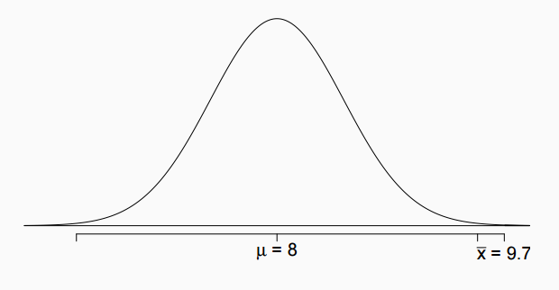
Test Statistic
In order to evaluate if the observed sample mean is unusual for the hypothesized sampling distribution, we determine how many standard errors away from the null it is, which is also called the test statistic.

Slide 22

Test Statistic
In order to evaluate if the observed sample mean is unusual for the hypothesized sampling distribution, we determine how many standard errors away from the null it is, which is also called the test statistic.
$$\overline{x}=N\left(μ, SE\right)$$
$$SE= \frac{s}{\sqrt{n}}$$

Slide 23
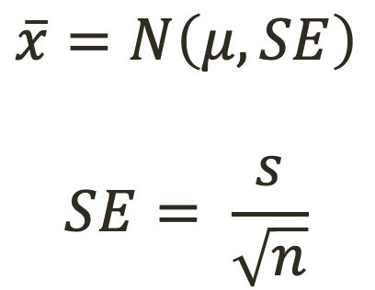
Number of college applications
A survey of Duke students asked how many colleges they applied to. 206 students responded. This sample yielded an average of 9.7 college applications with a standard deviation of 7. The College Board website states that counselors recommend students apply to roughly 8 colleges. Do these data provide convincing evidence that the average number of colleges all Duke students apply to is higher than recommended?
$$\overline{x}=N\left(μ, SE\right)$$
$$SE= \frac{s}{\sqrt{n}}$$
What is SE?
http://www.collegeboard.com/student/apply/the-application/151680.html

Slide 24
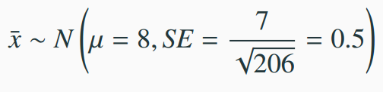
Number of college applications
A survey of Duke students asked how many colleges they applied to. 206 students responded. This sample yielded an average of 9.7 college applications with a standard deviation of 7. The College Board website states that counselors recommend students apply to roughly 8 colleges. Do these data provide convincing evidence that the average number of colleges all Duke students apply to is higher than recommended?
$$\overline{x}=N\left(μ, SE\right)$$
$$SE= \frac{s}{\sqrt{n}}$$
http://www.collegeboard.com/student/apply/the-application/151680.html

Slide 25
Test Statistic
In order to evaluate if the observed sample mean is unusual for the hypothesized sampling distribution, we determine how many standard errors away from the null it is, which is also called the test statistic.

Slide 26

Test Statistic
In order to evaluate if the observed sample mean is unusual for the hypothesized sampling distribution, we determine how many standard errors away from the null it is, which is also called the test statistic.
How many SE’s from $μ$is $\overline{x}$?

Slide 27
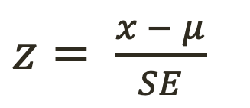
Test Statistic
In order to evaluate if the observed sample mean is unusual for the hypothesized sampling distribution, we determine how many standard errors away from the null it is, which is also called the test statistic.
How many SE’s from $μ$is $\overline{x}$?
$z= \frac{x − μ}{SE}$

Slide 28
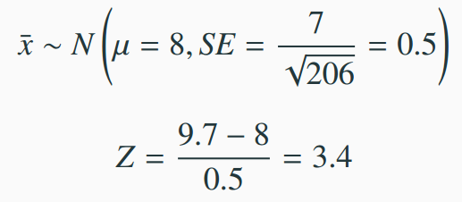
Test Statistic
In order to evaluate if the observed sample mean is unusual for the hypothesized sampling distribution, we determine how many standard errors away from the null it is, which is also called the test statistic.
How many SE’s from $μ$is $\overline{x}$?
$z= \frac{x − μ}{SE}$

Slide 29
Test Statistic
In order to evaluate if the observed sample mean is unusual for the hypothesized sampling distribution, we determine how many standard errors away from the null it is, which is also called the test statistic.
The sample mean is 3.4 standard errors away from the hypothesized value. Is this considered unusually high? That is, is the result statistically significant?

Slide 30
Test Statistic
In order to evaluate if the observed sample mean is unusual for the hypothesized sampling distribution, we determine how many standard errors away from the null it is, which is also called the test statistic.
The sample mean is 3.4 standard errors away from the hypothesized value. Is this considered unusually high? That is, is the result statistically significant?
Yes, and we can quantify how unusual it is using a p-value.

Slide 31
p-values
We then use this test statistic to calculate the p-value, the probability of observing data at least as favorable to the alternative hypothesis as our current data set, if the null hypothesis were true.

Slide 32
p-values
We then use this test statistic to calculate the p-value, the probability of observing data at least as favorable to the alternative hypothesis as our current data set, if the null hypothesis were true.
If the p-value is low (lower than significance level, α, which is usually 5%) we say that it would be very unlikely to observe the data if the null hypothesis were true, and hence reject H₀.

Slide 33
p-values
We then use this test statistic to calculate the p-value, the probability of observing data at least as favorable to the alternative hypothesis as our current data set, if the null hypothesis were true.
If the p-value is low (lower than significance level, α, which is usually 5%) we say that it would be very unlikely to observe the data if the null hypothesis were true, and hence reject H₀.
If the p-value is high (higher than α) we say that it is likely to observe the data even if the null hypothesis were true, and hence do not reject H₀.

Slide 34
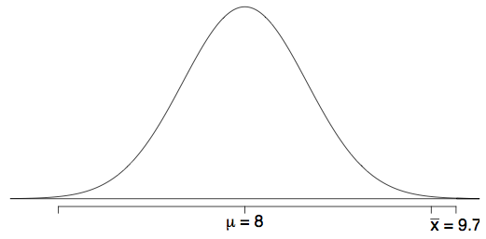
Number of college applications - p-value
p-value: probability of observing data at least as favorable to H_{A} as our current data set (a sample mean greater than 9.7), if in fact H₀ were true (the true population mean was 8).

Slide 35
Number of college applications - p-value
p-value: probability of observing data at least as favorable to H_{A} as our current data set (a sample mean greater than 9.7), if in fact H₀ were true (the true population mean was 8).
P(x̄ > 9.7 | µ = 8) = P(Z > 3.4)

Slide 36
Number of college applications - p-value
p-value: probability of observing data at least as favorable to H_{A} as our current data set (a sample mean greater than 9.7), if in fact H₀ were true (the true population mean was 8).
P(x̄ > 9.7 | µ = 8) = P(Z > 3.4)
What is this probability?

Slide 37
Number of college applications - p-value
p-value: probability of observing data at least as favorable to H_{A} as our current data set (a sample mean greater than 9.7), if in fact H₀ were true (the true population mean was 8).
P(x̄ > 9.7 | µ = 8) = P(Z > 3.4) = 0.0003

Slide 38
Number of college applications - Making a decision
p-value = 0.0003

Slide 39
Number of college applications - Making a decision
p-value = 0.0003
If the true average of the number of colleges Duke students applied to is 8, there is only 0.03% chance of observing a random sample of 206 Duke students who on average apply to 9.7 or more schools.

Slide 40
Number of college applications - Making a decision
p-value = 0.0003
If the true average of the number of colleges Duke students applied to is 8, there is only 0.03% chance of observing a random sample of 206 Duke students who on average apply to 9.7 or more schools.
This is a pretty low probability for us to think that a sample mean of 9.7 or more schools is likely to happen simply by chance.

Slide 41
Number of college applications - Making a decision
p-value = 0.0003
If the true average of the number of colleges Duke students applied to is 8, there is only 0.03% chance of observing a random sample of 206 Duke students who on average apply to 9.7 or more schools.
This is a pretty low probability for us to think that a sample mean of 9.7 or more schools is likely to happen simply by chance.
Since p-value is low (lower than 5%) we reject H₀.

Slide 42
Number of college applications - Making a decision
p-value = 0.0003
If the true average of the number of colleges Duke students applied to is 8, there is only 0.03% chance of observing a random sample of 206 Duke students who on average apply to 9.7 or more schools.
This is a pretty low probability for us to think that a sample mean of 9.7 or more schools is likely to happen simply by chance.
Since p-value is low (lower than 5%) we reject H₀.
The data provide convincing evidence that Duke students apply to more than 8 schools on average.

Slide 43
Number of college applications - Making a decision
p-value = 0.0003
If the true average of the number of colleges Duke students applied to is 8, there is only 0.03% chance of observing a random sample of 206 Duke students who on average apply to 9.7 or more schools.
This is a pretty low probability for us to think that a sample mean of 9.7 or more schools is likely to happen simply by chance.
Since p-value is low (lower than 5%) we reject H₀.
The data provide convincing evidence that Duke students apply to more than 8 schools on average.
The difference between the null value of 8 schools and observed sample mean of 9.7 schools is not due to chance or sampling variability.

Slide 44
Practice
A poll by the National Sleep Foundation found that college students average about 7 hours of sleep per night. A sample of 169 college students taking an introductory statistics class yielded an average of 6.88 hours, with a standard deviation of 0.94 hours. Assuming that this is a random sample representative of all college students (bit of a leap of faith?), a hypothesis test was conducted to evaluate if college students on average sleep less than 7 hours per night. The p-value for this hypothesis test is 0.0485. Which of the following is correct?
Fail to reject H₀, the data provide convincing evidence that college students sleep less than 7 hours on average.
Reject H₀, the data provide convincing evidence that college students sleep less than 7 hours on average.
Reject H₀, the data prove that college students sleep more than 7 hours on average.
Fail to reject H₀, the data do not provide convincing evidence that college students sleep less than 7 hours on average.
Reject H₀, the data provide convincing evidence that college students in this sample sleep less than 7 hours on average.

Slide 45
Practice
A poll by the National Sleep Foundation found that college students average about 7 hours of sleep per night. A sample of 169 college students taking an introductory statistics class yielded an average of 6.88 hours, with a standard deviation of 0.94 hours. Assuming that this is a random sample representative of all college students (bit of a leap of faith?), a hypothesis test was conducted to evaluate if college students on average sleep less than 7 hours per night. The p-value for this hypothesis test is 0.0485. Which of the following is correct?
Fail to reject H₀, the data provide convincing evidence that college students sleep less than 7 hours on average.
Reject H₀, the data provide convincing evidence that college students sleep less than 7 hours on average.
Reject H₀, the data prove that college students sleep more than 7 hours on average.
Fail to reject H₀, the data do not provide convincing evidence that college students sleep less than 7 hours on average.
Reject H₀, the data provide convincing evidence that college students in this sample sleep less than 7 hours on average.

Slide 46
Two-sided hypothesis testing with p-values
If the research question was “Do the data provide convincing evidence that the average amount of sleep college students get per night is different than the national average?”, the alternative hypothesis would be different
H₀: µ = 7
H_{A}: µ ≠ 7

Slide 47
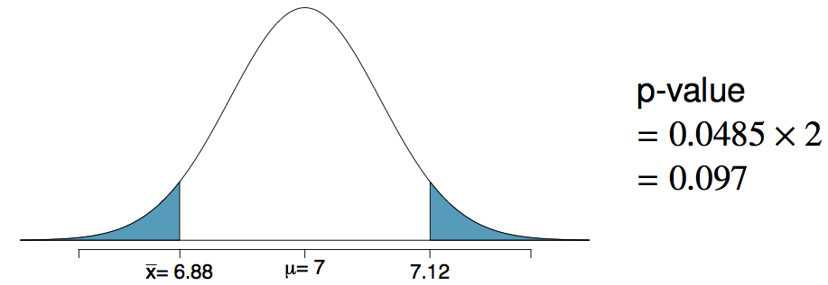
Two-sided hypothesis testing with p-values
If the research question was “Do the data provide convincing evidence that the average amount of sleep college students get per night is different than the national average?”, the alternative hypothesis would be different
H₀: µ = 7
H_{A}: µ ≠ 7
Hence the p-value would change as well:

Slide 48
Choosing a significance level
Choosing a significance level for a test is important in many contexts, and the traditional level is 0.05. However, it is often helpful to adjust the significance level based on the application.
We may select a level that is smaller or larger than 0.05 depending on the consequences of any conclusions reached from the test.

Slide 49
Decision errors
There are two competing hypotheses: the null and the alternative. In a hypothesis test, we make a decision about which might be true, but our choice might be incorrect.

Slide 50
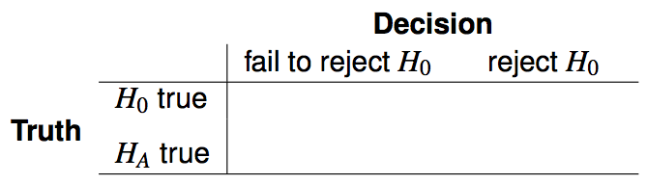
Decision errors (cont.)
There are two competing hypotheses: the null and the alternative. In a hypothesis test, we make a decision about which might be true, but our choice might be incorrect.

Slide 51
Decision errors (cont.)
There are two competing hypotheses: the null and the alternative. In a hypothesis test, we make a decision about which might be true, but our choice might be incorrect.

Slide 52
Decision errors (cont.)
There are two competing hypotheses: the null and the alternative. In a hypothesis test, we make a decision about which might be true, but our choice might be incorrect.

Slide 53

Decision errors (cont.)
There are two competing hypotheses: the null and the alternative. In a hypothesis test, we make a decision about which might be true, but our choice might be incorrect.
A Type 1 Error is rejecting the null hypothesis when H₀ is true.

Slide 54

Decision errors (cont.)
There are two competing hypotheses: the null and the alternative. In a hypothesis test, we make a decision about which might be true, but our choice might be incorrect.
A Type 1 Error is rejecting the null hypothesis when H₀ is true.
A Type 2 Error is failing to reject the null hypothesis when H_{A} is true.

Slide 55
Decision errors (cont.)
There are two competing hypotheses: the null and the alternative. In a hypothesis test, we make a decision about which might be true, but our choice might be incorrect.
A Type 1 Error is rejecting the null hypothesis when H₀ is true.
A Type 2 Error is failing to reject the null hypothesis when H_{A} is true.
We (almost) never know if H₀ or H_{A} is true, but we need to consider all possibilities.

Slide 56
Hypothesis Test Analogy
If think of a hypothesis test as a medical test for illness X, then it makes sense to frame the verdict in terms of the null and alternative hypotheses:
H₀: Patient does not have X
H_{A}: Patient has X
Which type of error is being committed in the following circumstances?
Declaring the patient healthy when they are actually sick
Declaring the patient sick when they are actually healthy

Slide 57
Hypothesis Test Analogy
If think of a hypothesis test as a medical test for illness X, then it makes sense to frame the verdict in terms of the null and alternative hypotheses:
H₀: Patient does not have X
H_{A}: Patient has X
Which type of error is being committed in the following circumstances?
Declaring the patient healthy when they are actually sick
Type 2 error
Declaring the patient sick when they are actually healthy
Type 1 error

Slide 58
Hypothesis Test Analogy
If think of a hypothesis test as a medical test for illness X, then it makes sense to frame the verdict in terms of the null and alternative hypotheses:
H₀: Patient does not have X
H_{A}: Patient has X
Which type of error is being committed in the following circumstances?
Declaring the patient healthy when they are actually sick
Type 2 error
Declaring the patient sick when they are actually healthy
Type 1 error
Which error do you think is the worse error to make?

Slide 59
Hypothesis Test Analogy
If think of a hypothesis test as a medical test for illness X, then it makes sense to frame the verdict in terms of the null and alternative hypotheses:
H₀: Patient does not have X
H_{A}: Patient has X
Which type of error is being committed in the following circumstances?
Declaring the patient healthy when they are actually sick
Type 2 error
Declaring the patient sick when they are actually healthy
Type 1 error
Which error do you think is the worse error to make?
Would a different situation make the worse error change?

Slide 60
Type 1 error rate
As a general rule we reject H₀ when the p-value is less than 0.05, i.e. we use a significance level of 0.05, α = 0.05.

Slide 61
Type 1 error rate
As a general rule we reject H₀ when the p-value is less than 0.05, i.e. we use a significance level of 0.05, α = 0.05.
This means that, for those cases where H₀ is actually true, we do not want to incorrectly reject it more than 5% of those times.

Slide 62
Type 1 error rate
As a general rule we reject H₀ when the p-value is less than 0.05, i.e. we use a significance level of 0.05, α = 0.05.
This means that, for those cases where H₀ is actually true, we do not want to incorrectly reject it more than 5% of those times.
In other words, when using a 5% significance level there is about 5% chance of making a Type 1 error if the null hypothesis is true. P(Type 1 error | H₀ true) = α

Slide 63
Type 1 error rate
As a general rule we reject H₀ when the p-value is less than 0.05, i.e. we use a significance level of 0.05, α = 0.05.
This means that, for those cases where H₀ is actually true, we do not want to incorrectly reject it more than 5% of those times.
In other words, when using a 5% significance level there is about 5% chance of making a Type 1 error if the null hypothesis is true. P(Type 1 error | H₀ true) = α
This is why we prefer small values of α -- increasing α increases the Type 1 error rate.

Slide 64
Choosing a significance level
Choosing a significance level for a test is important in many contexts, and the traditional level is 0.05. However, it is often helpful to adjust the significance level based on the application.
We may select a level that is smaller or larger than 0.05 depending on the consequences of any conclusions reached from the test.
If making a Type 1 Error is dangerous or especially costly, we should choose a small significance level (e.g. 0.01). Under this scenario we want to be very cautious about rejecting the null hypothesis, so we demand very strong evidence favoring H_{A} before we would reject H₀.
If a Type 2 Error is relatively more dangerous or much more costly than a Type 1 Error, then we should choose a higher significance level (e.g. 0.10). Here we want to be cautious about failing to reject H₀ when the null is actually false.

Slide 65
Practice: Facebook interest categories
The same survey asked the 850 respondents how comfortable they are with Facebook creating a list of categories for them. 41% of the respondents said they are comfortable. Do these data provide convincing evidence that the proportion of American Facebook users are comfortable with Facebook creating a list of interest categories for them is different than 50%?
https://www.pewinternet.org/2019/01/16/facebook-algorithms-and-personal-data/

Slide 66
Practice: Facebook interest categories
The same survey asked the 850 respondents how comfortable they are with Facebook creating a list of categories for them. 41% of the respondents said they are comfortable. Do these data provide convincing evidence that the proportion of American Facebook users are comfortable with Facebook creating a list of interest categories for them is different than 50%?
https://www.pewinternet.org/2019/01/16/facebook-algorithms-and-personal-data/
What are the hypothese?

Slide 67
Practice: Facebook interest categories
The same survey asked the 850 respondents how comfortable they are with Facebook creating a list of categories for them. 41% of the respondents said they are comfortable. Do these data provide convincing evidence that the proportion of American Facebook users are comfortable with Facebook creating a list of interest categories for them is different than 50%?
https://www.pewinternet.org/2019/01/16/facebook-algorithms-and-personal-data/
What are the hypothese?
Setting the hypotheses We start with the assumption that 50% of American Facebook users are comfortable with Facebook creating categories of interests for them
H₀: p = 0.50
We test the claim that the proportion of American Facebook users who are comfortable with Facebook creating categories of interests for them is different than 50%.
H_{A}: p ≠ 0.50

Slide 68
Facebook interest categories - conditions
Which of the following is not a condition that needs to be met to proceed with this hypothesis test?
Respondents in the sample should be independent of each other with respect to whether or not they feel comfortable with their interests being categorized by Facebook.
Sampling should have been done randomly.
The sample size should be less than 10% of the population of all American Facebook users.
There should be at least 30 respondents in the sample.
There should be at least 10 expected successes and 10 expected failure.

Slide 69
Facebook interest categories - conditions
Which of the following is not a condition that needs to be met to proceed with this hypothesis test?
Respondents in the sample should be independent of each other with respect to whether or not they feel comfortable with their interests being categorized by Facebook.
Sampling should have been done randomly.
The sample size should be less than 10% of the population of all American Facebook users.
There should be at least 30 respondents in the sample.
There should be at least 10 expected successes and 10 expected failure.

Slide 70

Practice: Facebook interest categories
The same survey asked the 850 respondents how comfortable they are with Facebook creating a list of categories for them. 41% of the respondents said they are comfortable. Do these data provide convincing evidence that the proportion of American Facebook users are comfortable with Facebook creating a list of interest categories for them is different than 50%?
https://www.pewinternet.org/2019/01/16/facebook-algorithms-and-personal-data/
$$p =Binomial\left(\hat{p}, s\right)$$
$$SE= \sqrt{\frac{p(1−p)}{n}}$$
$z= \frac{x − \hat{p}}{SE}$
What is the test statistic?
H₀: p = 0.50
H_{A}: p ≠ 0.50

Slide 71
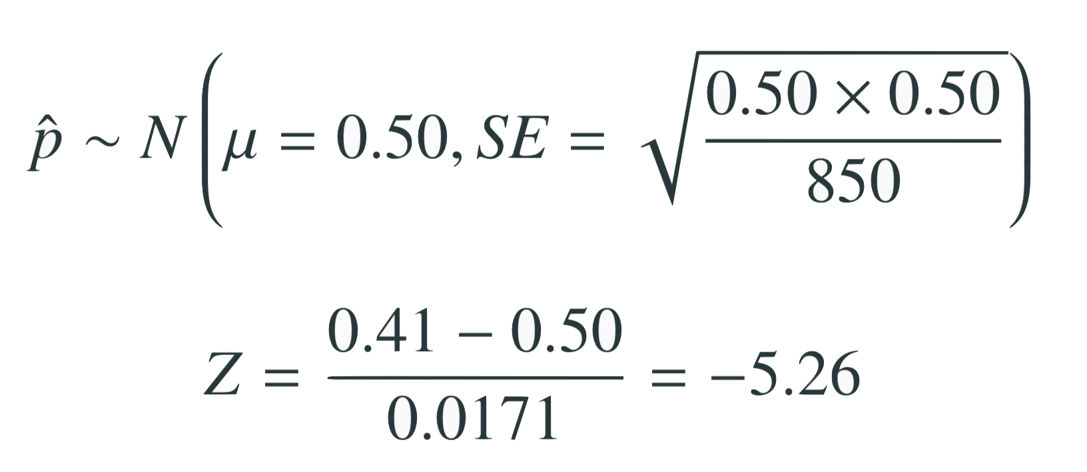
Test statistic
In order to evaluate if the observed sample mean is unusual for the hypothesized sampling distribution, we determine how many standard errors away from the null it is, which is also called the test statistic.
The sample proportion is 5.26 standard errors away from the hypothesized value. Is this considered unusually low? That is, is the result statistically significant?

Slide 72
Test statistic
In order to evaluate if the observed sample mean is unusual for the hypothesized sampling distribution, we determine how many standard errors away from the null it is, which is also called the test statistic.
The sample proportion is 5.26 standard errors away from the hypothesized value. Is this considered unusually low? That is, is the result statistically significant?
Yes, and we can quantify how unusual it is using a p-value: p-value < 0.0001

Slide 73
Facebook interest categories
- Making a decision
p-value < 0.0001
If 50% of all American Facebook users are comfortable with Facebook creating these interest categories, there is less than a 0.01% chance of observing a random sample of 850 American Facebook users where 41% or fewer or 59% of higher feel comfortable with it.
This is a pretty low probability for us to think that the observed sample proportion, or something more extreme, is likely to happen simply by chance.
Since p-value is low (lower than 5%) we reject H₀.
The data provide convincing evidence that the proportion of American Facebook users who are comfortable with Facebook creating a list of interest categories for them is different than 50%.
The difference between the null value of 0.50 and observed sample proportion of 0.41 is not due to chance or sampling variability.

Slide 74
Recap: Hypothesis testing framework
Set the hypotheses.
Check assumptions and conditions.
Calculate a test statistic and a p-value.
Make a decision, and interpret it in context of the research question.

Slide 75

Recap: Hypothesis testing for a population mean
1. Set the hypotheses
H₀: µ = null value
H_{A}: µ < or > or ≠ null value
2. Calculate the point estimate
3. Check assumptions and conditions
Independence: random sample/assignment, 10% condition when sampling without replacement
Normality: nearly normal population or n ≥ 30, no extreme skew -- or use the t distribution (Ch 5)
4. Calculate a test statistic and a p-value (draw a picture!)
5. Make a decision, and interpret it in context
If p-value < α, reject H₀, data provide evidence for H_{A}
If p-value > α, do not reject H₀, data do not provide evidence for H_{A}

