Slide 1
Summarizing Data
Dr. Ab Mosca (they/them)
Slides based off slides courtesy of OpenIntro and John McGreedy of Johns Hopkins University

Slide 2
Numerical Data - Continuous

Slide 3
Graphical Summary

Slide 4
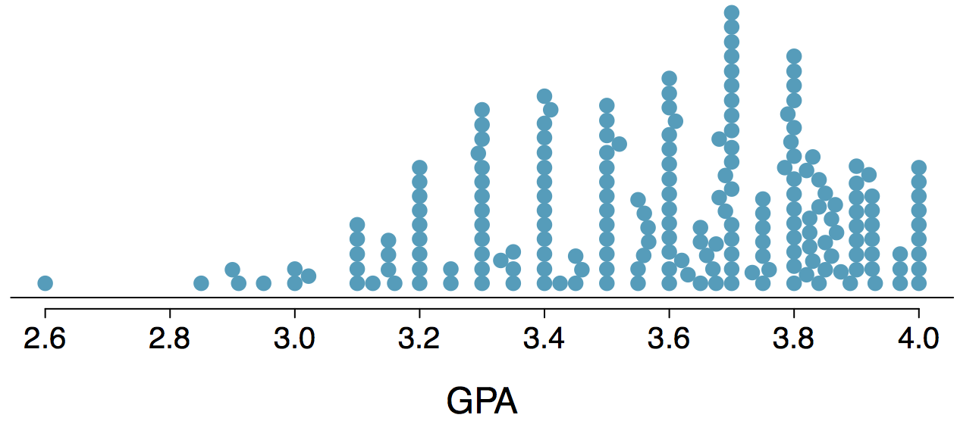
Stacked Dot Plot
Higher bars represent areas where there are more observations, makes it a little easier to judge the center and the shape of the distribution.

Slide 5
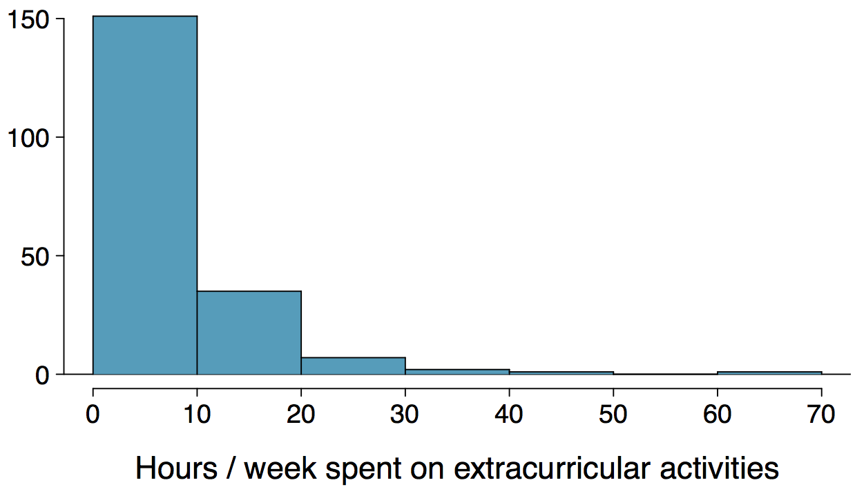
Histograms
Histograms provide a view of the data density. Higher bars represent where the data are relatively more common.
Histograms are especially convenient for describing the shape of the data distribution.
The chosen bin width can alter the story the histogram is telling.

Slide 6
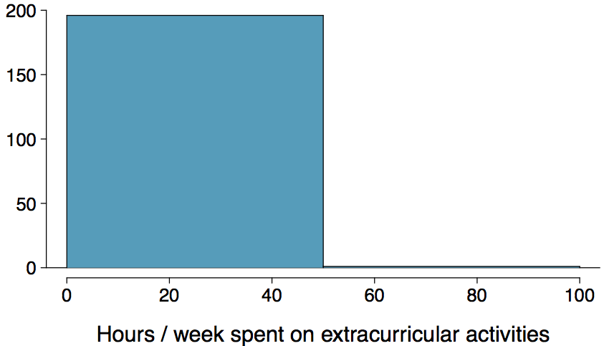
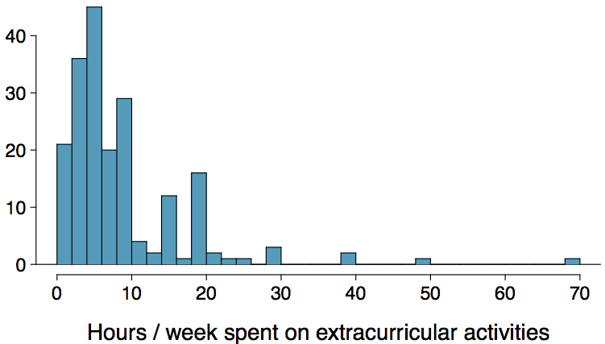
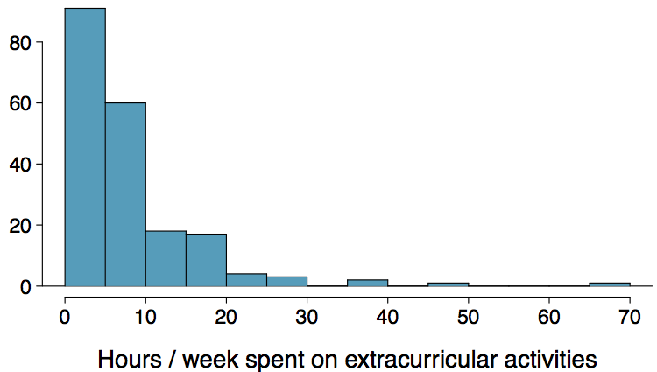
Histograms - Bin Width
Which one(s) of these histograms are useful? Which reveal too much about the data? Which hide too much?

Slide 7
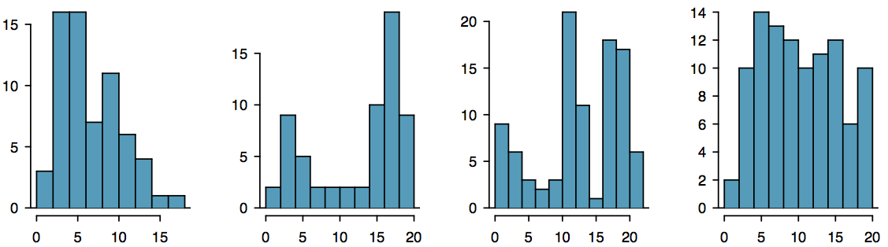
Shape of a Distribution: Modality
Does the histogram have a single prominent peak (unimodal), several prominent peaks (bimodal/multimodal), or no apparent peaks (uniform)?
Note: In order to determine modality, step back and imagine a smooth curve over the histogram -- imagine that the bars are wooden blocks and you drop a limp spaghetti over them, the shape the spaghetti would take could be viewed as a smooth curve.

Slide 8
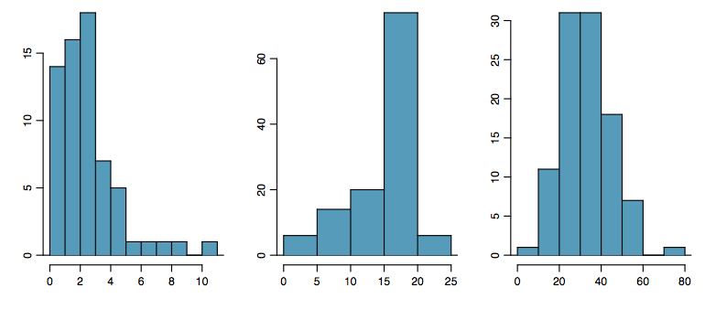
Shape of a Distribution: Skewness
Is the histogram right skewed, left skewed, or symmetric?
Note: Histograms are said to be skewed to the side of the long tail.

Slide 9
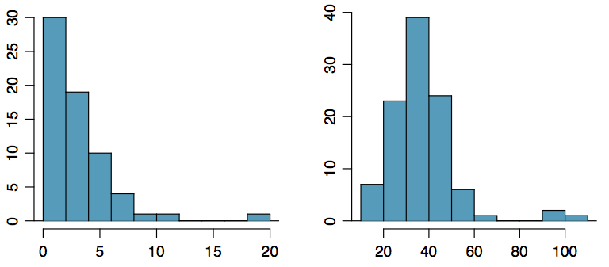
Shape of a Distribution:
Unusual Observations
Are there any unusual observations or potential outliers?

Slide 10
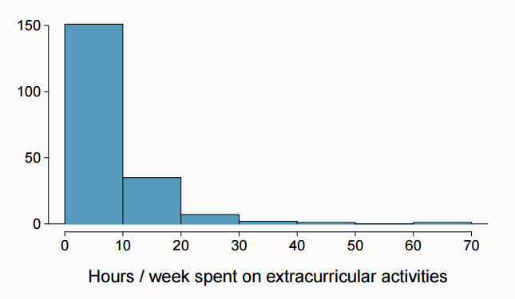
Extracurricular activities
How would you describe the shape of the distribution of hours per week students spend on extracurricular activities?

Slide 11
Extracurricular activities
How would you describe the shape of the distribution of hours per week students spend on extracurricular activities?
Unimodal and right skewed, with a potentially unusual observation at 60 hours/week.

Slide 12
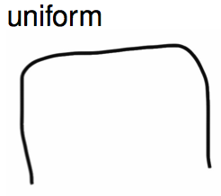
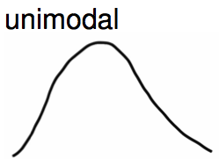
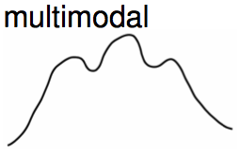
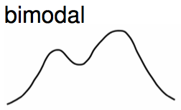
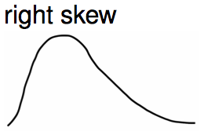
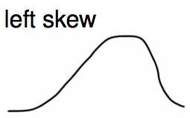
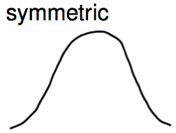
Commonly observed shapes of distributions
Modality
Skewness

Slide 13
Practice
Which of these variables do you expect to be uniformly distributed?
(a) weights of adult females
(b) salaries of a random sample of people from North Carolina
(c) house prices
(d) birthdays of classmates (day of the month)

Slide 14
Practice
Which of these variables do you expect to be uniformly distributed?
(a) weights of adult females
(b) salaries of a random sample of people from North Carolina
(c) house prices
(d) birthdays of classmates (day of the month)

Slide 15
Application Activity:
Shapes of Distributions
Sketch the expected distributions of the following variables:
number of piercings
scores on an exam
IQ scores
Come up with a concise way (1-2 sentences) to teach someone how to determine the expected distribution of any variable.

Slide 16
Numerical Summary

Slide 17

Mean
The sample mean, denoted as x̄, can be calculated as
where x₁, x₂, ..., x_{n} represent the n observed values.
The population mean is also computed the same way but is denoted as µ. It is often not possible to calculate µ since population data are rarely available.
The sample mean is a sample statistic, and serves as a point estimate of the population mean. This estimate may not be perfect, but if the sample is good (representative of the population), it is usually a pretty good estimate.

Slide 18

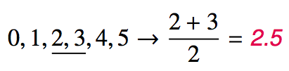
Median
The median is the value that splits the data in half when ordered in ascending order.
If there are an even number of observations, then the median is the average of the two values in the middle.
Since the median is the midpoint of the data, 50% of the values are below it. Hence, it is also the 50th percentile.

Slide 19

Variance
Variance is roughly the average squared deviation from the mean.

Slide 20

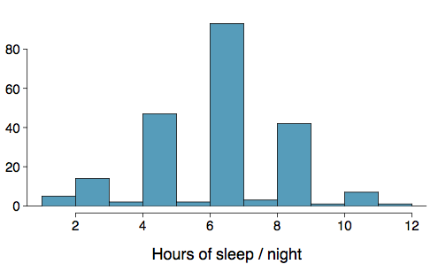
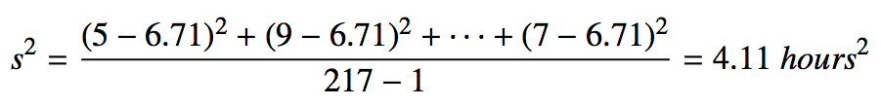
Variance
Variance is roughly the average squared deviation from the mean.
The sample mean is and the sample size is n = 217.
The variance of amount of sleep students get per night can be calculated as:

Slide 21
Variance (cont.)
Why do we use the squared deviation in the calculation of variance?

Slide 22
Variance (cont.)
Why do we use the squared deviation in the calculation of variance?
To get rid of negatives so that observations equally distant from the mean are weighed equally.
To weigh larger deviations more heavily.

Slide 23

Standard Deviation
The standard deviation is the square root of the variance, and has the same units as the data.

Slide 24
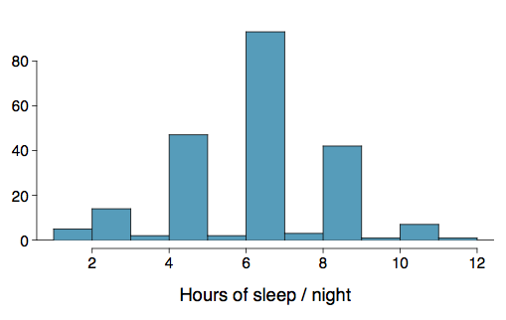

Standard Deviation
The standard deviation is the square root of the variance, and has the same units as the data.
The standard deviation of amount of sleep students get per night can be calculated as:
We can see that all of the data are within 3 standard deviations of the mean.

Slide 25
Q1, Q3, and IQR
The 25th percentile is also called the first quartile, Q1.
The 50th percentile is also called the median.
The 75th percentile is also called the third quartile, Q3.
Between Q1 and Q3 is the middle 50% of the data. The range these data span is called the interquartile range, or the IQR.
IQR = Q3 - Q1

Slide 26
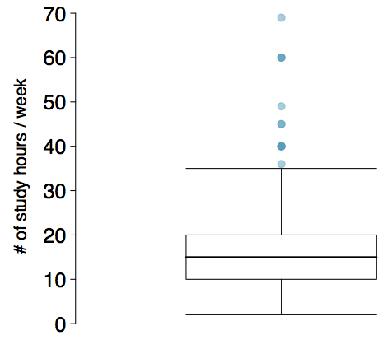
Box Plot
The box in a box plot represents the middle 50% of the data, and the thick line in the box is the median.

Slide 27
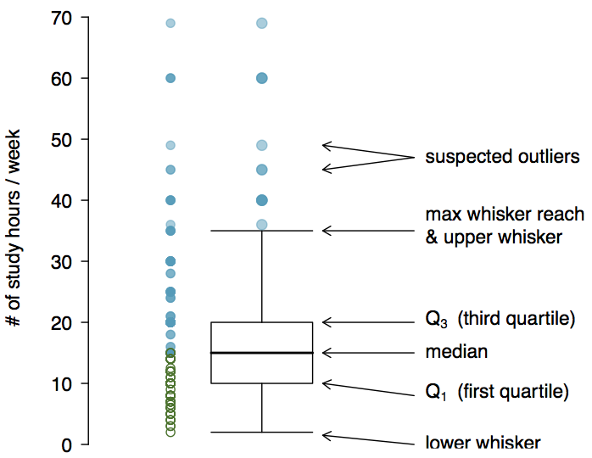
Anatomy of a Box Plot

Slide 28
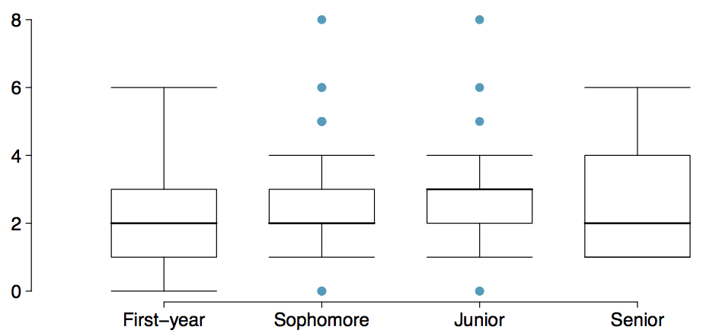
Comparing Numerical Data
Across Groups
Does there appear to be a relationship between class year and number of clubs students are in?

Slide 29
Whiskers and Outliers
Whiskers of a box plot can extend up to 1.5 x IQR away from the quartiles.
max upper whisker reach = Q3 + 1.5 x IQR
max lower whisker reach = Q1 - 1.5 x IQR
IQR: 20 - 10 = 10
max upper whisker reach = 20 + 1.5 x 10 = 35
max lower whisker reach = 10 - 1.5 x 10 = -5
A potential outlier is defined as an observation beyond the maximum reach of the whiskers. It is an observation that appears extreme relative to the rest of the data.

Slide 30
Outliers (cont.)
Why is it important to look for outliers?
Identify extreme skew in the distribution.
Identify data collection and entry errors.
Provide insight into interesting features of the data.

Slide 31
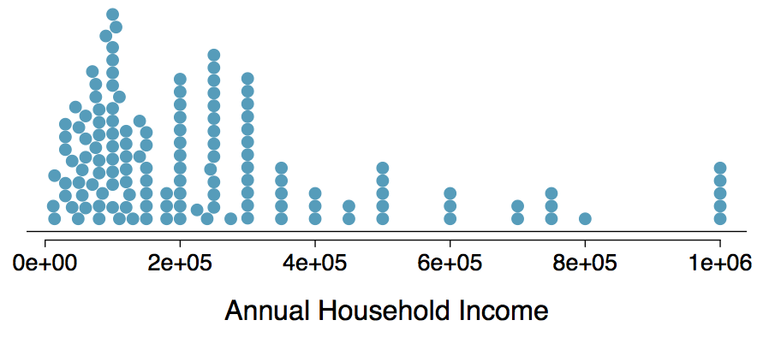
Extreme Observations
How would sample statistics such as mean, median, SD, and IQR of household income be affected if the largest value was replaced with $10 million? What if the smallest value was replaced with $10 million?

Slide 32
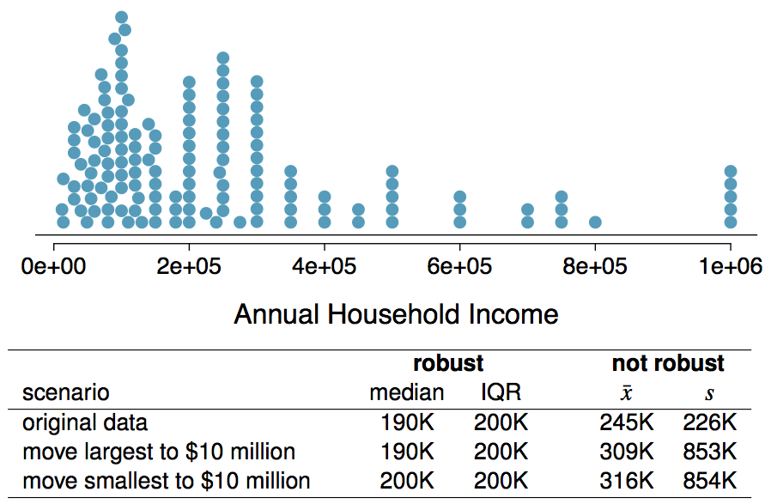
Robust Statistics

Slide 33

Warm up
Draw a bimodal, left skewed distribution
Come up with an example of data that is uniformly distributed
Calculate mean, median, variance, and standard deviation for the following dataset:
14, 3, -2, 8, 0
Draw a boxplot for the dataset above
Give me feedback for hw-01

Slide 34
Robust Statistics
Median and IQR are more robust to skewness and outliers than mean and SD. Therefore,
for skewed distributions it is often more helpful to use median and IQR to describe the center and spread
for symmetric distributions it is often more helpful to use the mean and SD to describe the center and spread

Slide 35
Robust Statistics
Median and IQR are more robust to skewness and outliers than mean and SD. Therefore,
for skewed distributions it is often more helpful to use median and IQR to describe the center and spread
for symmetric distributions it is often more helpful to use the mean and SD to describe the center and spread
If you would like to estimate the typical household income for a student, would you be more interested in the mean or median income?

Slide 36
Robust Statistics
Median and IQR are more robust to skewness and outliers than mean and SD. Therefore,
for skewed distributions it is often more helpful to use median and IQR to describe the center and spread
for symmetric distributions it is often more helpful to use the mean and SD to describe the center and spread
If you would like to estimate the typical household income for a student, would you be more interested in the mean or median income?
Median

Slide 37
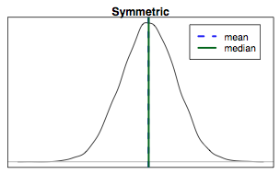
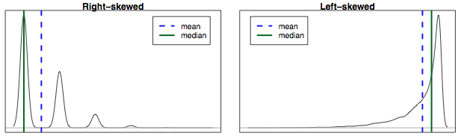
Mean vs. Median
If the distribution is symmetric, center is often defined as the mean: mean ~ median
If the distribution is skewed or has extreme outliers, center is often defined as the median
Right-skewed: mean > median
Left-skewed: mean < median

Slide 38
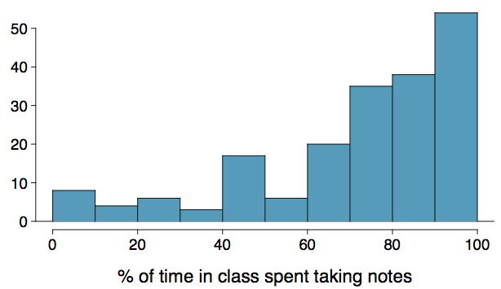
Practice
Which is most likely true for the distribution of percentage of time actually spent taking notes in class versus on Facebook, Twitter, etc.?
(a) mean > median (b) mean ~ median
(c) mean < median (d) impossible to tell

Slide 39
Practice
Which is most likely true for the distribution of percentage of time actually spent taking notes in class versus on Facebook, Twitter, etc.?
median: 80%
mean: 76%
(a) mean > median (b) mean ~ median
(c) mean < median (d) impossible to tell

Slide 40
Discrete Data and Categorical Data

Slide 41
Graphical Summary

Slide 42
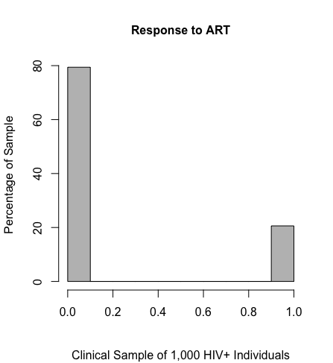
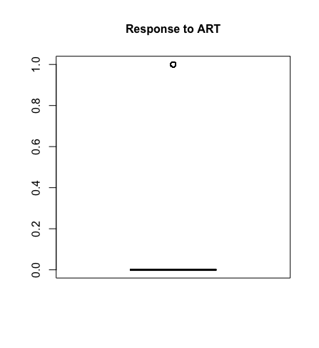
Visual Displays of Binary Data (Not So Useful)

Slide 43
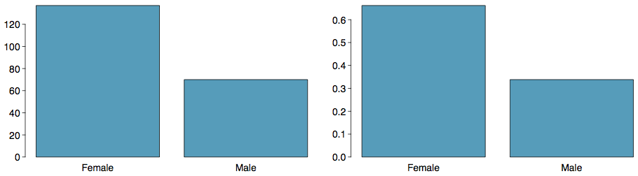
Bar Plots
A bar plot is a common way to display a single categorical variable. A bar plot where proportions instead of frequencies are shown is called a relative frequency bar plot.

Slide 44
Bar Plots
A bar plot is a common way to display a single categorical variable. A bar plot where proportions instead of frequencies are shown is called a relative frequency bar plot.
How are bar plots different than histograms?

Slide 45
Bar Plots
A bar plot is a common way to display a single categorical variable. A bar plot where proportions instead of frequencies are shown is called a relative frequency bar plot.
How are bar plots different than histograms?
Bar plots are used for displaying distributions of categorical variables, while histograms are used for numerical variables. The x-axis in a histogram is a number line, hence the order of the bars cannot be changed, while in a bar plot the categories can be listed in any order (though some orderings make more sense than others, especially for ordinal variables.)

Slide 46
Bar plots with two variables
Stacked bar plot: Graphical display of contingency table information, for counts.
Side-by-side bar plot: Displays the same information by placing bars next to, instead of on top of, each other.
Standardized stacked bar plot: Graphical display of contingency table information, for proportions.

Slide 47
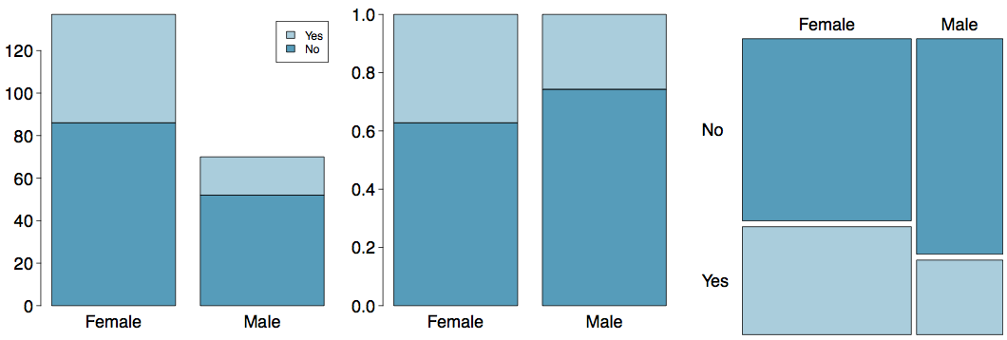
Segmented Bar and Mosaic Plots
What are the differences between the three visualizations shown below?

Slide 48
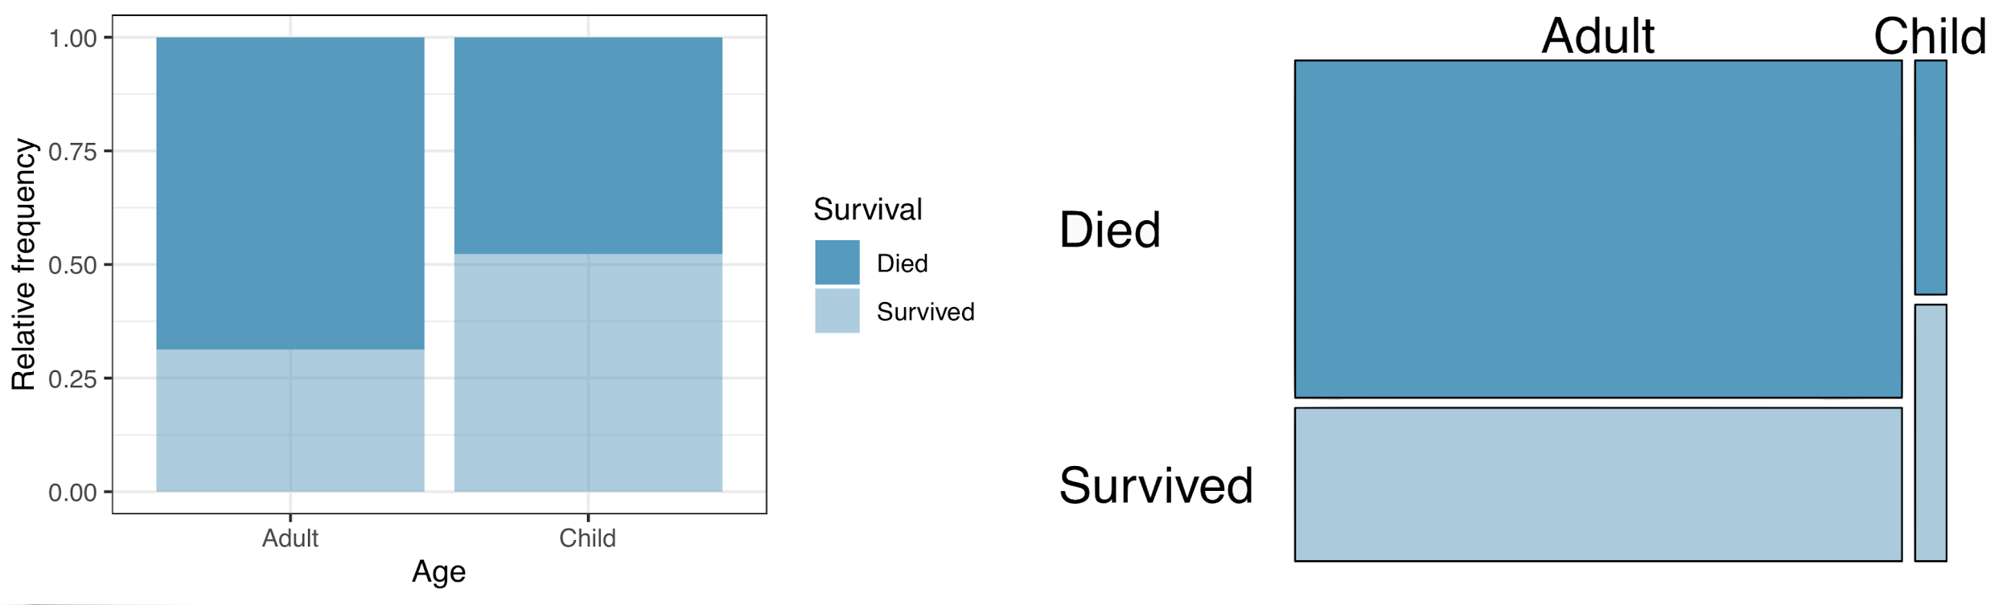
Mosaic plots
What are the differences between the two visualizations shown below?

Slide 49
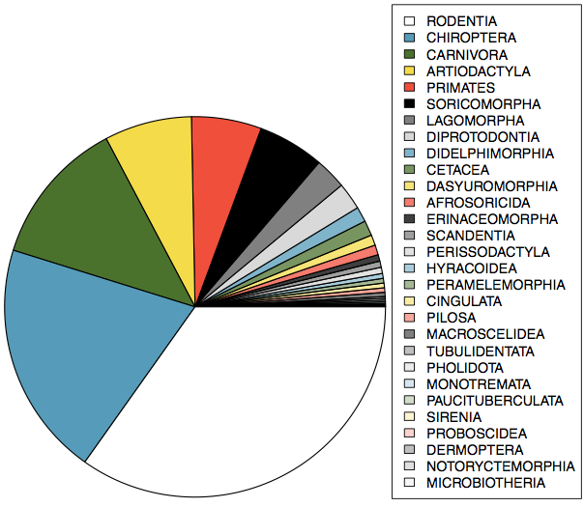
Pie Charts
Can you tell which order encompasses the lowest percentage of mammal species?
http://www.bucknell.edu/msw3

Slide 50
Numerical Summary

Slide 51
Contingency Tables
A table that summarizes data for two categorical variables is called a contingency table.

Slide 52
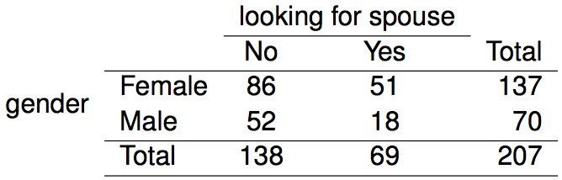
Choosing the
Appropriate Proportion
Does there appear to be a relationship between gender and whether the student is looking for a spouse in college?
To answer this question we examine the row proportions:
% Females looking for a spouse: 51 / 137 ~ 0.37
% Males looking for a spouse: 18 / 70 ~ 0.26

