Slide 1


Slide 2
Assessing Continuous Data: Normal Distribution
Dr. Ab Mosca (they/them)
Slides based off slides courtesy of OpenIntro and John McGreedy of Johns Hopkins University

Slide 3
Plan for Today
Shape of normal distributions
Z Scores
Percentiles
Cutoff points

Slide 4
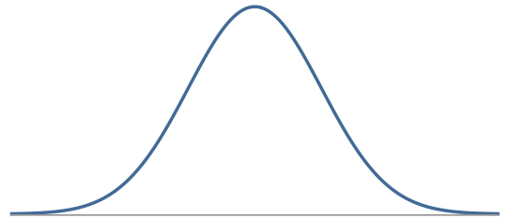
Normal Distribution
Unimodal and symmetric, bell shaped curve
Many variables are nearly normal, but none are exactly normal
Denoted as N(µ, σ) → Normal with mean µ and standard deviation σ

Slide 5
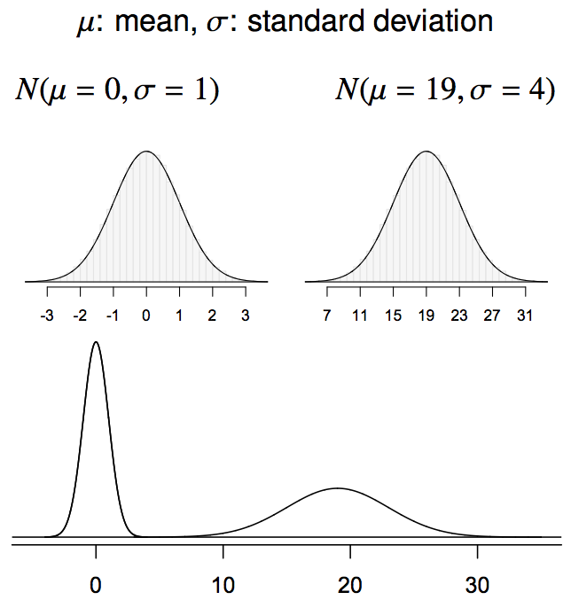
Normal distributions with different parameters

Slide 6
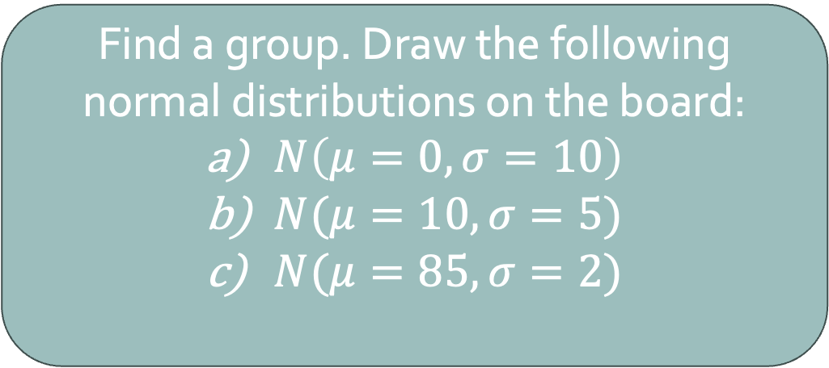
Practice
Find a group. Draw the following normal distributions on the board:
$N\left(μ=0, σ=10\right)$
$N(μ=10, σ=5)$
$N(μ=85, σ=2)$

Slide 7
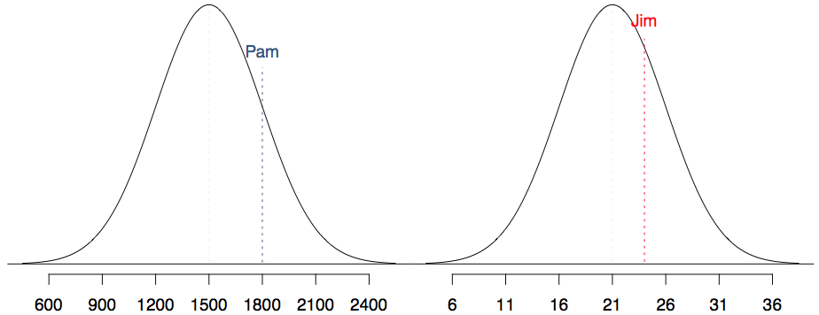
Comparisons
SAT scores are distributed nearly normally with mean 1500 and standard deviation 300. ACT scores are distributed nearly normally with mean 21 and standard deviation 5. A college admissions officer wants to determine which of the two applicants scored better on their standardized test with respect to the other test takers: Pam, who earned an 1800 on her SAT, or Jim, who scored a 24 on his ACT?
SAT
ACT

Slide 8
Comparisons
Since we cannot just compare these two raw scores, we instead compare how many standard deviations beyond the mean each observation is.

Slide 9
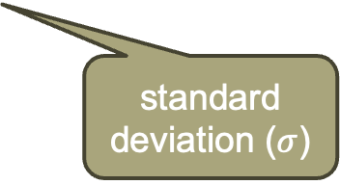
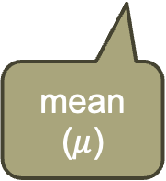
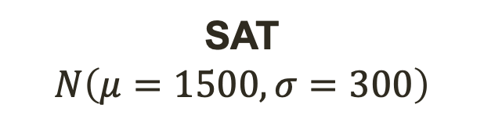
Comparisons
Since we cannot just compare these two raw scores, we instead compare how many standard deviations beyond the mean each observation is.
Pam's score is (1800 - 1500) / 300 = 1 standard deviation above the mean.
Pam’s score
mean ($μ$)
standard deviation ($σ$)
SAT
$$N\left(μ=1500, σ=300\right)$$

Slide 10
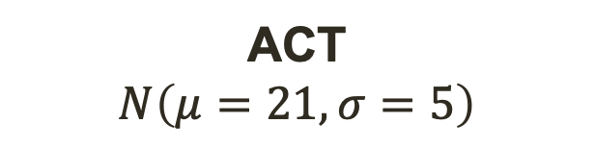
Comparisons
Since we cannot just compare these two raw scores, we instead compare how many standard deviations beyond the mean each observation is.
Pam's score is (1800 - 1500) / 300 = 1 standard deviation above the mean.
Pam’s score
mean ($μ$)
standard deviation ($σ$)
What about Jim’s score?
ACT
$$N\left(μ=21, σ=5\right)$$

Slide 11
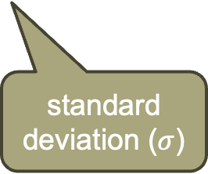
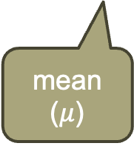
Comparisons
Since we cannot just compare these two raw scores, we instead compare how many standard deviations beyond the mean each observation is.
Pam's score is (1800 - 1500) / 300 = 1 standard deviation above the mean.
Jim's score is (24 - 21) / 5 = 0.6 standard deviations above the mean.
Jim’s score
mean ($μ$)
standard deviation ($σ$)
ACT
$$N\left(μ=21, σ=5\right)$$

Slide 12
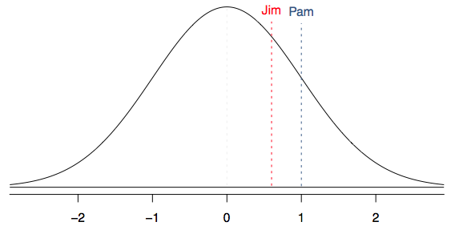
Comparisons
Since we cannot just compare these two raw scores, we instead compare how many standard deviations beyond the mean each observation is.
Pam's score is (1800 - 1500) / 300 = 1 standard deviation above the mean.
Jim's score is (24 - 21) / 5 = 0.6 standard deviations above the mean.
standard deviations from mean

Slide 13
Comparisons
Since we cannot just compare these two raw scores, we instead compare how many standard deviations beyond the mean each observation is.
Pam's score is (1800 - 1500) / 300 = 1 standard deviation above the mean.
Jim's score is (24 - 21) / 5 = 0.6 standard deviations above the mean.
Who did better?
standard deviations from mean

Slide 14
Comparisons
Since we cannot just compare these two raw scores, we instead compare how many standard deviations beyond the mean each observation is.
Pam's score is (1800 - 1500) / 300 = 1 standard deviation above the mean.
Jim's score is (24 - 21) / 5 = 0.6 standard deviations above the mean.
Who did better?
standard deviations from mean

Slide 15
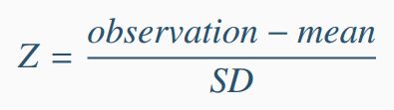
Standardizing with Z scores
These are called standardized scores, or Z scores.
Z score of an observation is the number of standard deviations it falls above or below the mean.
Z scores are defined for distributions of any shape, but only when the distribution is normal can we use Z scores to calculate percentiles (more on this next).
Observations that are more than 2 SD away from the mean (|Z| > 2) are typically considered unusual.

Slide 16
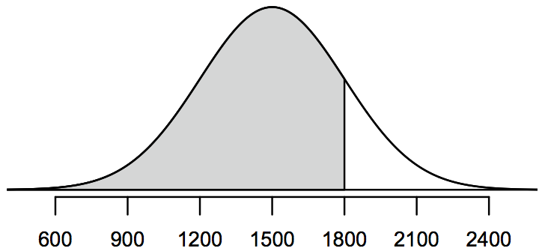
Percentiles
Percentile is the percentage of observations that fall below a given data point.
Graphically, percentile is the area below the probability distribution curve to the left of that observation.

Slide 17
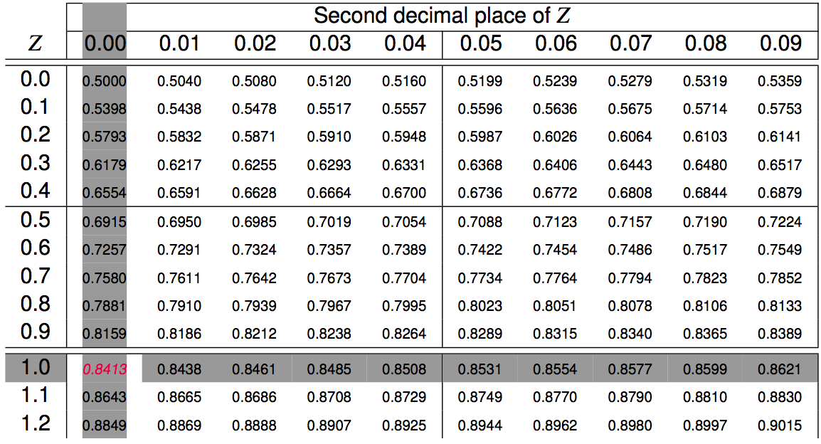
Calculating percentiles -
using tables
Pam’s Z score was 1.0

Slide 18
Calculating percentiles -
using tables
Pam’s Z score was 1.0
84% of observations are less than Pam’s

Slide 19
Quality control
At Heinz ketchup factory the amounts which go into bottles of ketchup are supposed to be normally distributed with mean 36 oz. and standard deviation 0.11 oz. Once every 30 minutes a bottle is selected from the production line, and its contents are noted precisely. If the amount of ketchup in the bottle is below 35.8 oz. or above 36.2 oz., then the bottle fails the quality control inspection. What percent of bottles have less than 35.8 ounces of ketchup?

Slide 20
Quality control
At Heinz ketchup factory the amounts which go into bottles of ketchup are supposed to be normally distributed with mean 36 oz. and standard deviation 0.11 oz. Once every 30 minutes a bottle is selected from the production line, and its contents are noted precisely. If the amount of ketchup in the bottle is below 35.8 oz. or above 36.2 oz., then the bottle fails the quality control inspection. What percent of bottles have less than 35.8 ounces of ketchup?
Let X = amount of ketchup in a bottle: X ~ N(µ = 36, σ = 0.11)

Slide 21
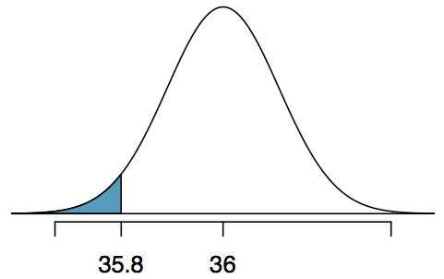
Quality control
At Heinz ketchup factory the amounts which go into bottles of ketchup are supposed to be normally distributed with mean 36 oz. and standard deviation 0.11 oz. Once every 30 minutes a bottle is selected from the production line, and its contents are noted precisely. If the amount of ketchup in the bottle is below 35.8 oz. or above 36.2 oz., then the bottle fails the quality control inspection. What percent of bottles have less than 35.8 ounces of ketchup?
Let X = amount of ketchup in a bottle: X ~ N(µ = 36, σ = 0.11)

Slide 22
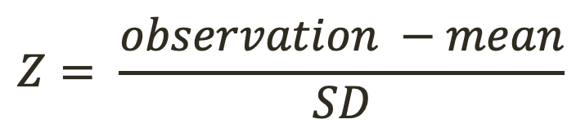
Quality control
At Heinz ketchup factory the amounts which go into bottles of ketchup are supposed to be normally distributed with mean 36 oz. and standard deviation 0.11 oz. Once every 30 minutes a bottle is selected from the production line, and its contents are noted precisely. If the amount of ketchup in the bottle is below 35.8 oz. or above 36.2 oz., then the bottle fails the quality control inspection. What percent of bottles have less than 35.8 ounces of ketchup?
Let X = amount of ketchup in a bottle: X ~ N(µ = 36, σ = 0.11)
$$Z= \frac{observation −mean}{SD}$$

Slide 23
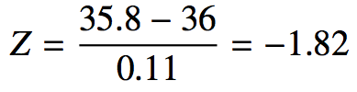
Quality control
At Heinz ketchup factory the amounts which go into bottles of ketchup are supposed to be normally distributed with mean 36 oz. and standard deviation 0.11 oz. Once every 30 minutes a bottle is selected from the production line, and its contents are noted precisely. If the amount of ketchup in the bottle is below 35.8 oz. or above 36.2 oz., then the bottle fails the quality control inspection. What percent of bottles have less than 35.8 ounces of ketchup?
Let X = amount of ketchup in a bottle: X ~ N(µ = 36, σ = 0.11)
$$Z= \frac{observation −mean}{SD}$$

Slide 24
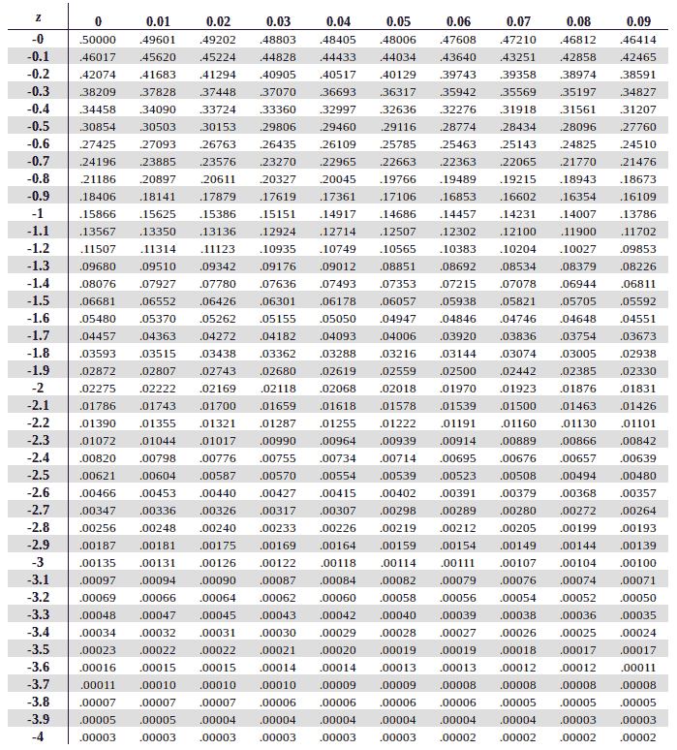
Quality control
At Heinz ketchup factory the amounts which go into bottles of ketchup are supposed to be normally distributed with mean 36 oz. and standard deviation 0.11 oz. Once every 30 minutes a bottle is selected from the production line, and its contents are noted precisely. If the amount of ketchup in the bottle is below 35.8 oz. or above 36.2 oz., then the bottle fails the quality control inspection. What percent of bottles have less than 35.8 ounces of ketchup?
Let X = amount of ketchup in a bottle: X ~ N(µ = 36, σ = 0.11)
$$Z= \frac{observation −mean}{SD}$$
https://www.ztable.net/#google_vignette

Slide 25
Quality control
At Heinz ketchup factory the amounts which go into bottles of ketchup are supposed to be normally distributed with mean 36 oz. and standard deviation 0.11 oz. Once every 30 minutes a bottle is selected from the production line, and its contents are noted precisely. If the amount of ketchup in the bottle is below 35.8 oz. or above 36.2 oz., then the bottle fails the quality control inspection. What percent of bottles have less than 35.8 ounces of ketchup?
3.4% of bottles have less than 35.8 oz of ketchup

Slide 26
Quality control
At Heinz ketchup factory the amounts which go into bottles of ketchup are supposed to be normally distributed with mean 36 oz. and standard deviation 0.11 oz. Once every 30 minutes a bottle is selected from the production line, and its contents are noted precisely. If the amount of ketchup in the bottle is below 35.8 oz. or above 36.2 oz., then the bottle fails the quality control inspection. What percent of bottles have more than 36.2 ounces of ketchup?

Slide 27
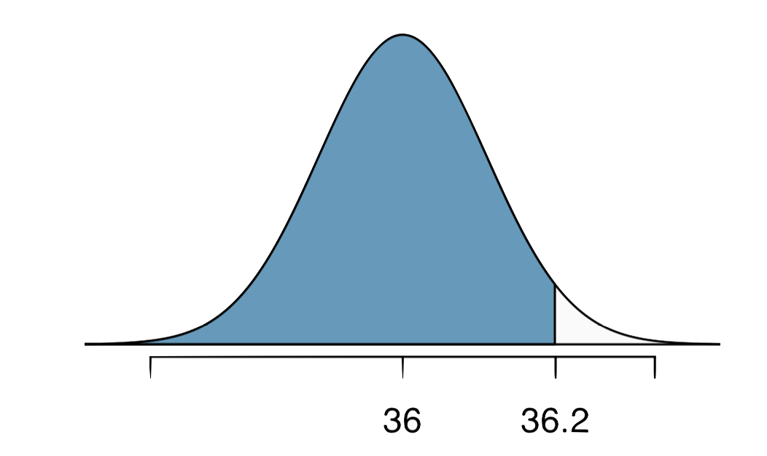
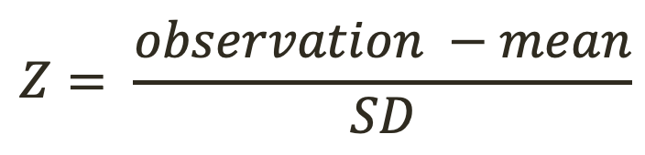
Quality control
At Heinz ketchup factory the amounts which go into bottles of ketchup are supposed to be normally distributed with mean 36 oz. and standard deviation 0.11 oz. Once every 30 minutes a bottle is selected from the production line, and its contents are noted precisely. If the amount of ketchup in the bottle is below 35.8 oz. or above 36.2 oz., then the bottle fails the quality control inspection. What percent of bottles have more than 36.2 ounces of ketchup?
Let X = amount of ketchup in a bottle: X ~ N(µ = 36, σ = 0.11)
$$Z= \frac{observation −mean}{SD}$$

Slide 28
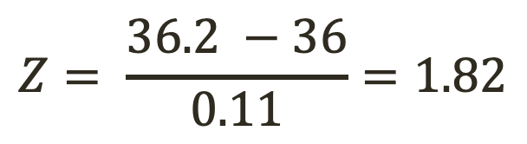
Quality control
At Heinz ketchup factory the amounts which go into bottles of ketchup are supposed to be normally distributed with mean 36 oz. and standard deviation 0.11 oz. Once every 30 minutes a bottle is selected from the production line, and its contents are noted precisely. If the amount of ketchup in the bottle is below 35.8 oz. or above 36.2 oz., then the bottle fails the quality control inspection. What percent of bottles have more than 36.2 ounces of ketchup?
Let X = amount of ketchup in a bottle: X ~ N(µ = 36, σ = 0.11)
$$Z= \frac{observation −mean}{SD}$$
$$Z= \frac{36.2 −36}{0.11}=1.82$$

Slide 29
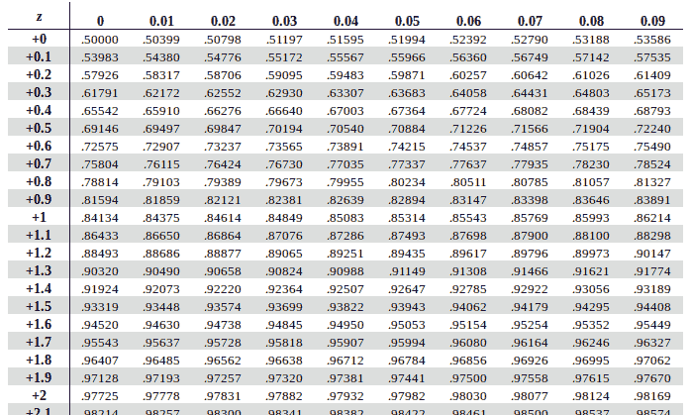
Quality control
At Heinz ketchup factory the amounts which go into bottles of ketchup are supposed to be normally distributed with mean 36 oz. and standard deviation 0.11 oz. Once every 30 minutes a bottle is selected from the production line, and its contents are noted precisely. If the amount of ketchup in the bottle is below 35.8 oz. or above 36.2 oz., then the bottle fails the quality control inspection. What percent of bottles have more than 36.2 ounces of ketchup?
Let X = amount of ketchup in a bottle: X ~ N(µ = 36, σ = 0.11)
$$Z= \frac{observation −mean}{SD}$$
$$Z= \frac{36.2 −36}{0.11}=1.82$$
https://www.ztable.net/#google_vignette

Slide 30
Quality control
At Heinz ketchup factory the amounts which go into bottles of ketchup are supposed to be normally distributed with mean 36 oz. and standard deviation 0.11 oz. Once every 30 minutes a bottle is selected from the production line, and its contents are noted precisely. If the amount of ketchup in the bottle is below 35.8 oz. or above 36.2 oz., then the bottle fails the quality control inspection. What percent of bottles have more than 36.2 ounces of ketchup?
Let X = amount of ketchup in a bottle: X ~ N(µ = 36, σ = 0.11)
$$Z= \frac{observation −mean}{SD}$$
$$Z= \frac{36.2 −36}{0.11}=1.82$$
https://www.ztable.net/#google_vignette

Slide 31
Quality control
At Heinz ketchup factory the amounts which go into bottles of ketchup are supposed to be normally distributed with mean 36 oz. and standard deviation 0.11 oz. Once every 30 minutes a bottle is selected from the production line, and its contents are noted precisely. If the amount of ketchup in the bottle is below 35.8 oz. or above 36.2 oz., then the bottle fails the quality control inspection. What percent of bottles have more than 36.2 ounces of ketchup?
96.6% of bottles have less than 36.2 oz of ketchup
??% of bottles have more than 36.2 oz of ketchup

Slide 32
Quality control
At Heinz ketchup factory the amounts which go into bottles of ketchup are supposed to be normally distributed with mean 36 oz. and standard deviation 0.11 oz. Once every 30 minutes a bottle is selected from the production line, and its contents are noted precisely. If the amount of ketchup in the bottle is below 35.8 oz. or above 36.2 oz., then the bottle fails the quality control inspection. What percent of bottles have more than 36.2 ounces of ketchup?
96.6% of bottles have less than 36.2 oz of ketchup
3.4% of bottles have more than 36.2 oz of ketchup

Slide 33
Quality control
At Heinz ketchup factory the amounts which go into bottles of ketchup are supposed to be normally distributed with mean 36 oz. and standard deviation 0.11 oz. Once every 30 minutes a bottle is selected from the production line, and its contents are noted precisely. If the amount of ketchup in the bottle is below 35.8 oz. or above 36.2 oz., then the bottle fails the quality control inspection. What percent of bottles pass inspection?

Slide 34
Quality control
At Heinz ketchup factory the amounts which go into bottles of ketchup are supposed to be normally distributed with mean 36 oz. and standard deviation 0.11 oz. Once every 30 minutes a bottle is selected from the production line, and its contents are noted precisely. If the amount of ketchup in the bottle is below 35.8 oz. or above 36.2 oz., then the bottle fails the quality control inspection. What percent of bottles pass inspection?
We know:
3.4% of bottles have less than 35.8 oz of ketchup
3.4% of bottles have more than 36.2 oz of ketchup
Lower cut off
Upper cut off

Slide 35
Quality control
At Heinz ketchup factory the amounts which go into bottles of ketchup are supposed to be normally distributed with mean 36 oz. and standard deviation 0.11 oz. Once every 30 minutes a bottle is selected from the production line, and its contents are noted precisely. If the amount of ketchup in the bottle is below 35.8 oz. or above 36.2 oz., then the bottle fails the quality control inspection. What percent of bottles pass inspection?
We know:
3.4% of bottles have less than 35.8 oz of ketchup
3.4% of bottles have more than 36.2 oz of ketchup
So 6.8% of bottles fail inspection and
93.2% of bottles pass inspection
Lower cut off
Upper cut off

Slide 36
Quality control
At Heinz ketchup factory the amounts which go into bottles of ketchup are supposed to be normally distributed with mean 36 oz. and standard deviation 0.11 oz. Once every 30 minutes a bottle is selected from the production line, and its contents are noted precisely. If the amount of ketchup in the bottle is below 35.8 oz. or above 36.2 oz., then the bottle fails the quality control inspection. What percent of bottles pass inspection?
We know:
3.4% of bottles have less than 35.8 oz of ketchup
3.4% of bottles have more than 36.2 oz of ketchup
So 6.8% of bottles fail inspection and
93.2% of bottles pass inspection

Slide 37
Finding cutoff points
Body temperatures of healthy humans are distributed nearly normally with mean 98.2ºF and standard deviation 0.73ºF. What is the cutoff for the lowest 3% of human body temperatures?

Slide 38
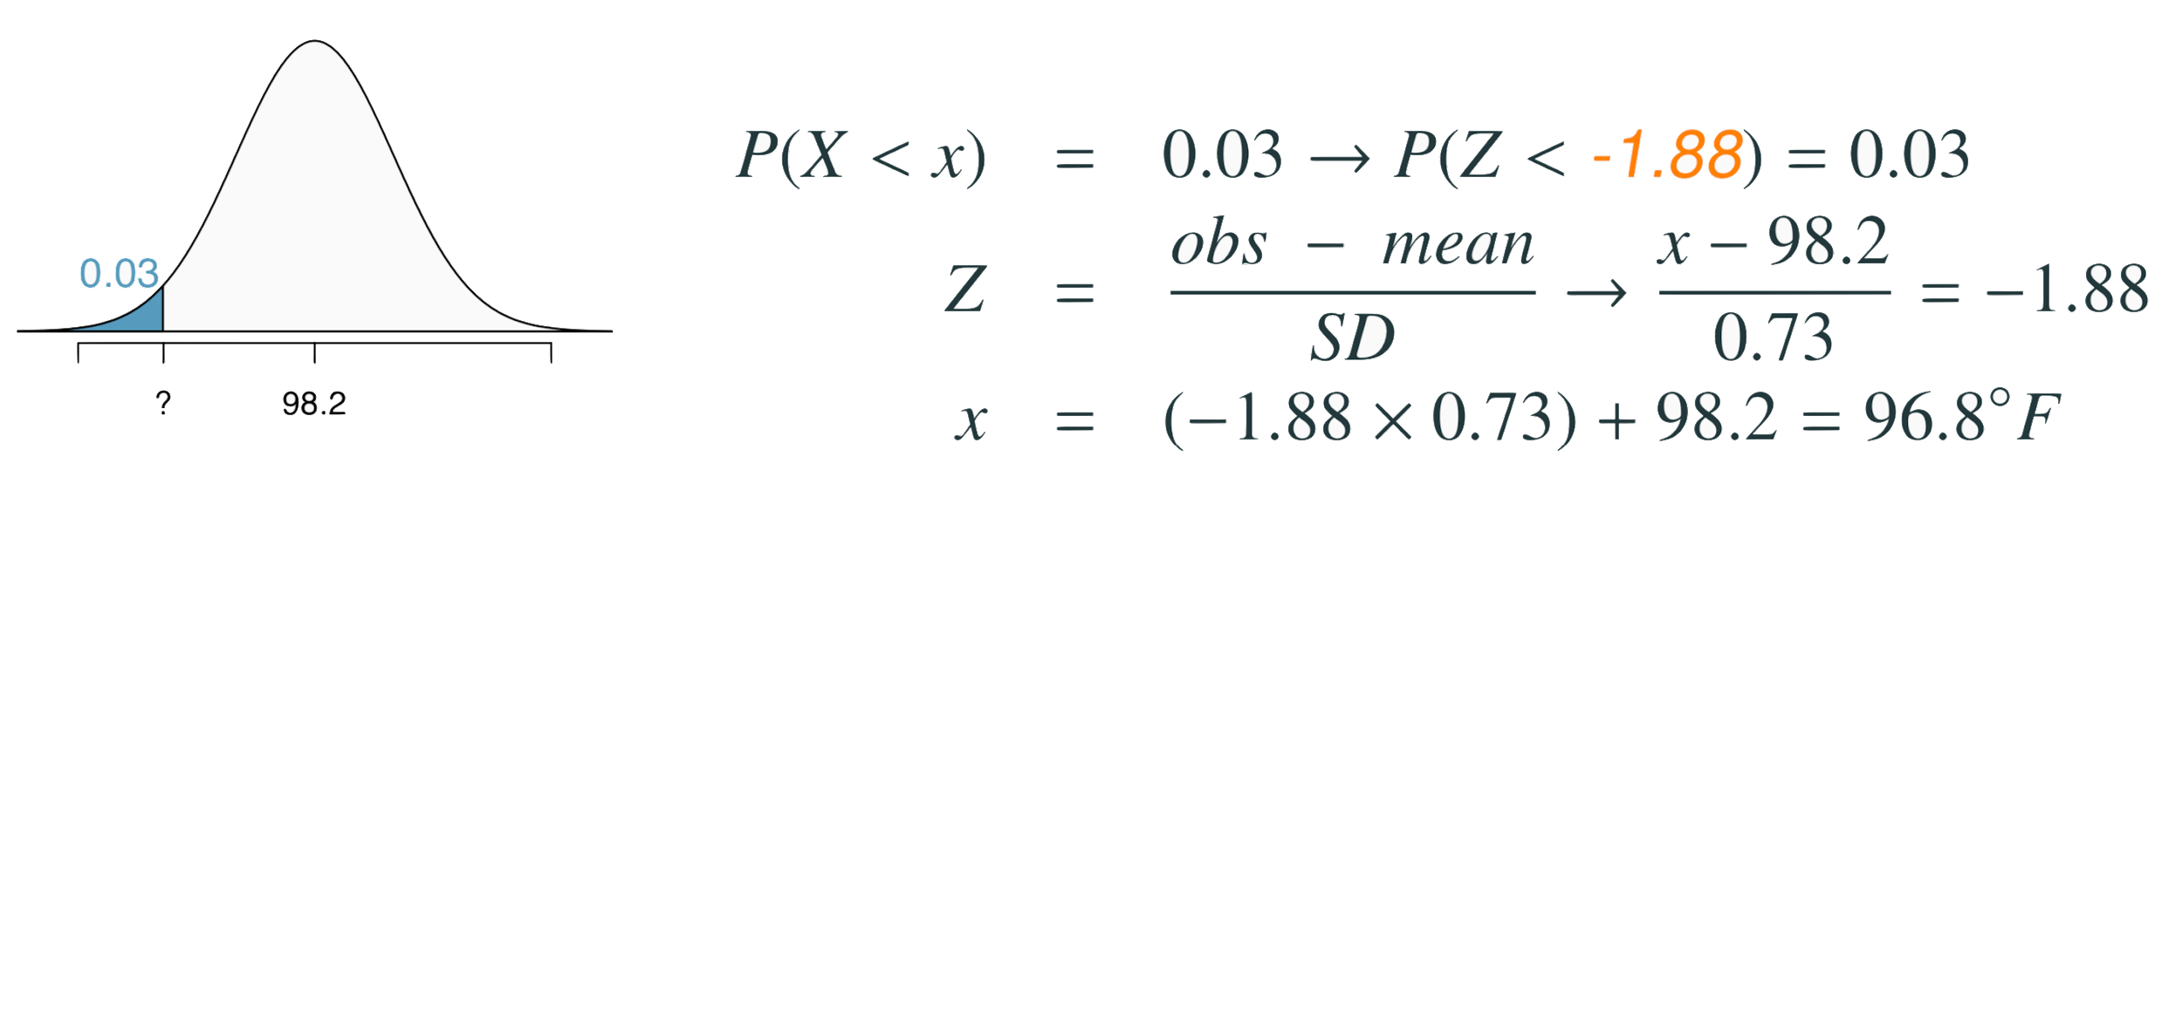
Finding cutoff points
Body temperatures of healthy humans are distributed nearly normally with mean 98.2ºF and standard deviation 0.73ºF. What is the cutoff for the lowest 3% of human body temperatures?

Slide 39
Finding cutoff points
Body temperatures of healthy humans are distributed nearly normally with mean 98.2ºF and standard deviation 0.73ºF. What is the cutoff for the lowest 3% of human body temperatures?
First, we need the Z score that corresponds to 0.03

Slide 40
Finding cutoff points
Body temperatures of healthy humans are distributed nearly normally with mean 98.2ºF and standard deviation 0.73ºF. What is the cutoff for the lowest 3% of human body temperatures?
First, we need the Z score that corresponds to 0.03
Z = -1.88

Slide 41
Finding cutoff points
Body temperatures of healthy humans are distributed nearly normally with mean 98.2ºF and standard deviation 0.73ºF. What is the cutoff for the lowest 3% of human body temperatures?
First, we need the Z score that corresponds to 0.03
Z = -1.88

Slide 42
Finding cutoff points
Body temperatures of healthy humans are distributed nearly normally with mean 98.2ºF and standard deviation 0.73ºF. What is the cutoff for the lowest 3% of human body temperatures?
First, we need the Z score that corresponds to 0.03
Z = -1.88
Now, we solve for the observation that would give us
this Z

Slide 43
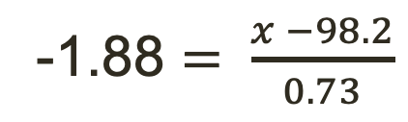
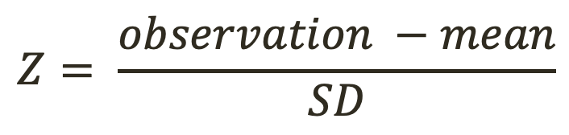
Finding cutoff points
Body temperatures of healthy humans are distributed nearly normally with mean 98.2ºF and standard deviation 0.73ºF. What is the cutoff for the lowest 3% of human body temperatures?
First, we need the Z score that corresponds to 0.03
Z = -1.88
Now, we solve for the observation that would give us
this Z:
$$Z= \frac{observation −mean}{SD}$$
-1.88 $= \frac{x −98.2}{0.73}$

Slide 44
Finding cutoff points
Body temperatures of healthy humans are distributed nearly normally with mean 98.2ºF and standard deviation 0.73ºF. What is the cutoff for the lowest 3% of human body temperatures?
First, we need the Z score that corresponds to 0.03
Z = -1.88
Now, we solve for the observation that would give us
this Z:
x = 96.8
$$Z= \frac{observation −mean}{SD}$$
-1.88 $= \frac{x −98.2}{0.73}$

Slide 45
Finding cutoff points
Body temperatures of healthy humans are distributed nearly normally with mean 98.2ºF and standard deviation 0.73ºF. What is the cutoff for the lowest 3% of human body temperatures?
First, we need the Z score that corresponds to 0.03
Z = -1.88
Now, we solve for the observation that would give us
this Z:
x = 96.8
$$Z= \frac{observation −mean}{SD}$$
96.8 degrees F is the cut off for the lowest 3% of human body temperatures.
-1.88 $= \frac{x −98.2}{0.73}$

Slide 46
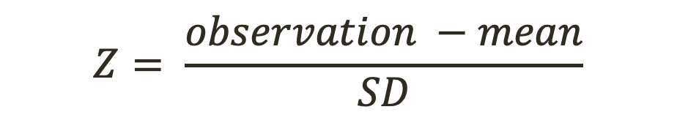
Practice
Body temperatures of healthy humans are distributed nearly normally with mean 98.2ºF and standard deviation 0.73ºF. What is the cutoff for the highest 10% of human body temperatures?
(a) 97.3ºF (c) 99.4ºF
(b) 99.1ºF (d) 99.6ºF
First, we need the Z score that corresponds to 90%
Z = ??
Then, solve for the observation that would give us this Z:
$$Z= \frac{observation −mean}{SD}$$

Slide 47
Practice
Body temperatures of healthy humans are distributed nearly normally with mean 98.2ºF and standard deviation 0.73ºF. What is the cutoff for the highest 10% of human body temperatures?
(a) 97.3ºF (c) 99.4ºF
(b) 99.1ºF (d) 99.6ºF
First, we need the Z score that corresponds to 90%
Z = ??
Then, solve for the observation that would give us this Z:
$$Z= \frac{observation −mean}{SD}$$

Slide 48
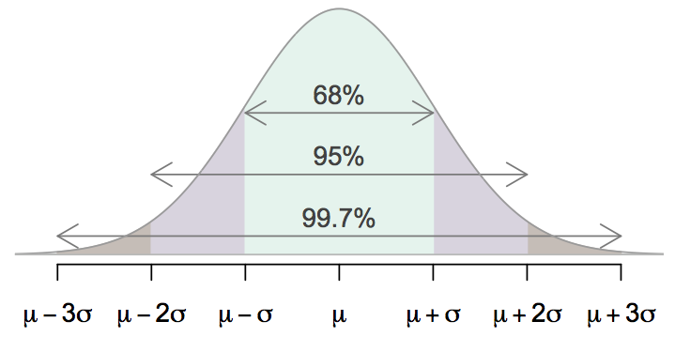
68-95-99.7 Rule
For nearly normally distributed data,
about 68% falls within 1 SD of the mean,
about 95% falls within 2 SD of the mean,
about 99.7% falls within 3 SD of the mean.
It is possible for observations to fall 4, 5, or more standard deviations away from the mean, but these occurrences are very rare if the data are nearly normal.

Slide 49
Describing variability using the 68-95-99.7 Rule
SAT scores are distributed nearly normally with mean 1500 and standard deviation 300.

Slide 50
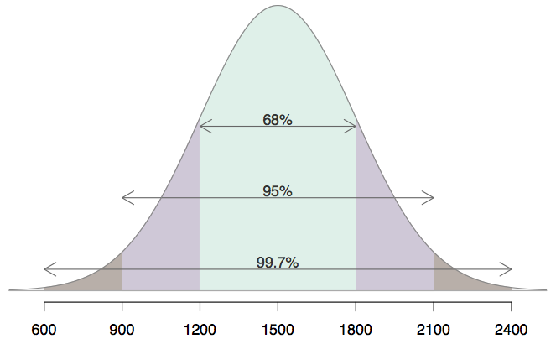
Describing variability using the 68-95-99.7 Rule
SAT scores are distributed nearly normally with mean 1500 and standard deviation 300.
~68% of students score between 1200 and 1800 on the SAT.
~95% of students score between 900 and 2100 on the SAT.
~$99.7% of students score between 600 and 2400 on the SAT.

Slide 51
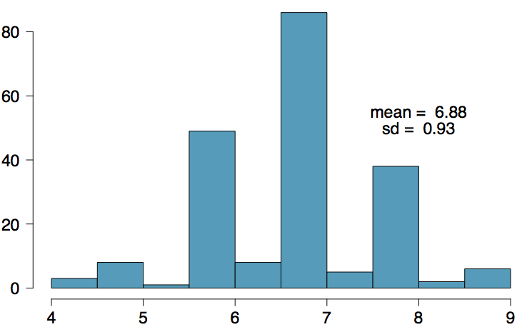
Number of hours of sleep on school nights
Mean = 6.88 hours, SD = 0.92 hrs

Slide 52
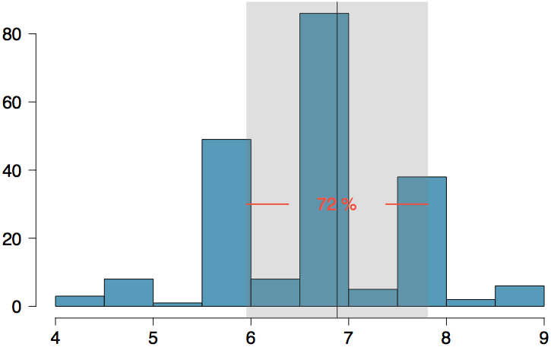
Number of hours of sleep on school nights
Mean = 6.88 hours, SD = 0.92 hrs
72% of the data are within 1 SD of the mean: 6.88 ± 0.93

Slide 53
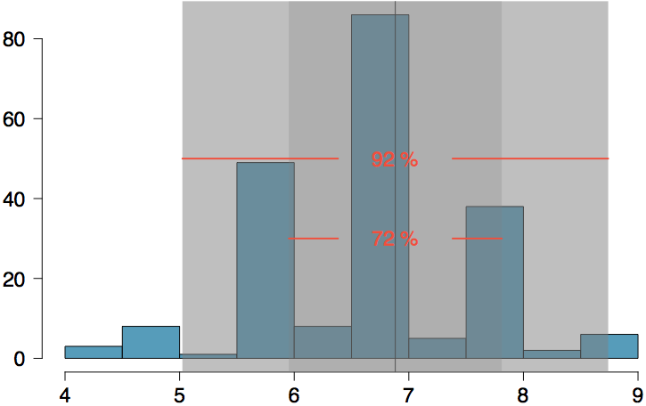
Number of hours of sleep on school nights
Mean = 6.88 hours, SD = 0.92 hrs
72% of the data are within 1 SD of the mean: 6.88 ± 0.93
92% of the data are within 1 SD of the mean: 6.88 ± 2 x 0.93

Slide 54
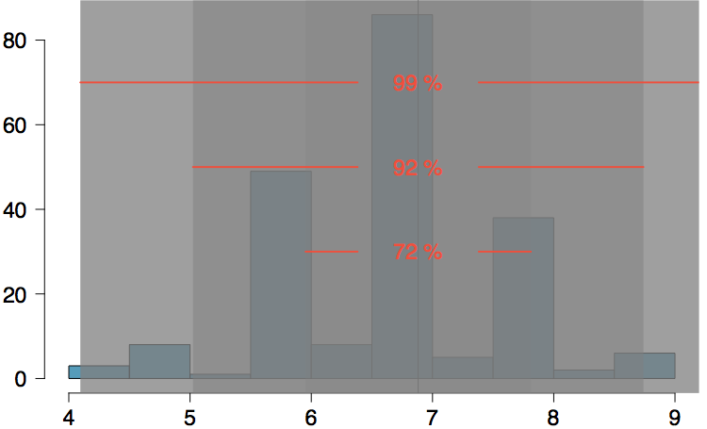
Number of hours of sleep on school nights
Mean = 6.88 hours, SD = 0.92 hrs
72% of the data are within 1 SD of the mean: 6.88 ± 0.93
92% of the data are within 1 SD of the mean: 6.88 ± 2 x 0.93
99% of the data are within 1 SD of the mean: 6.88 ± 3 x 0.93

Slide 55
Practice
Which of the following is false?
Majority of Z scores in a right skewed distribution are negative.
In skewed distributions the Z score of the mean might be different than 0.
For a normal distribution, IQR is less than 2 x SD.
Z scores are helpful for determining how unusual a data point is compared to the rest of the data in the distribution.

Slide 56
Practice
Which of the following is false?
Majority of Z scores in a right skewed distribution are negative.
In skewed distributions the Z score of the mean might be different than 0.
For a normal distribution, IQR is less than 2 x SD.
Z scores are helpful for determining how unusual a data point is compared to the rest of the data in the distribution.

