Slide 1
Inference for a Difference of Two Proportions
Dr. Ab Mosca (they/them)
Slides based off slides courtesy of OpenIntro and John McGreedy of Johns Hopkins University

Slide 2
Inference for Proportions
Last time we looked at CI’s for one-sample proportions, and hypothesis testing for one-sample proportions
Today we’ll look at testing for a difference between two proportions

Slide 3
Melting ice cap
Scientists predict that global warming may have big effects on the polar regions within the next 100 years. One of the possible effects is that the northern ice cap may completely melt. Would this bother you a great deal, some, a little, or not at all if it actually happened?
A great deal
Some
A little
Not at all

Slide 4
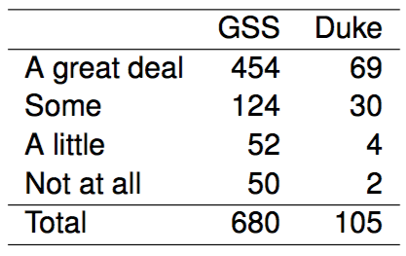
Results from the GSS
The GSS asks the same question, below are the distributions of responses from the 2010 GSS as well as from a group of introductory statistics students at Duke University:

Slide 5
Parameter and point estimate
Parameter of interest: Difference between the proportions of all Duke students and all Americans who would be bothered a great deal by the northern ice cap completely melting.
p_{Duke} - p_{US}

Slide 6
Parameter and point estimate
Parameter of interest: Difference between the proportions of all Duke students and all Americans who would be bothered a great deal by the northern ice cap completely melting.
p_{Duke} - p_{US}
Point estimate: Difference between the proportions of sampled Duke students and sampled Americans who would be bothered a great deal by the northern ice cap completely melting.
p̂_{Duke} - p̂_{US}

Slide 7
Inference for comparing proportions
The details are the same as before…

Slide 8
Inference for comparing proportions
The details are the same as before…
CI: point estimate ± margin of error

Slide 9
Inference for comparing proportions
The details are the same as before…
CI: point estimate ± margin of error
HT: Use Z = (point estimate - null value) / SE to find appropriate p-value.

Slide 10

Inference for comparing proportions
The details are the same as before…
CI: point estimate ± margin of error
HT: Use Z = (point estimate - null value) / SE to find appropriate p-value.
We just need the appropriate standard error of the point estimate , which is the only new concept.

Slide 11

Inference for comparing proportions
The details are the same as before…
CI: point estimate ± margin of error
HT: Use Z = (point estimate - null value) / SE to find appropriate p-value.
We just need the appropriate standard error of the point estimate , which is the only new concept.
Standard error of the difference between two sample proportions

Slide 12
Conditions for CI for difference of proportions
Independence within groups:
The US group is sampled randomly and we're assuming that the Duke group represents a random sample as well.

Slide 13
Conditions for CI for difference of proportions
Independence within groups:
The US group is sampled randomly and we're assuming that the Duke group represents a random sample as well.
n_{Duke} < 10% of all Duke students and 680 < 10% of all Americans.

Slide 14
Conditions for CI for difference of proportions
Independence within groups:
The US group is sampled randomly and we're assuming that the Duke group represents a random sample as well.
n_{Duke} < 10% of all Duke students and 680 < 10% of all Americans.
We can assume that the attitudes of Duke students in the sample are independent of each other, and attitudes of US residents in the sample are independent of each other as well.

Slide 15
Conditions for CI for difference of proportions
Independence within groups:
The US group is sampled randomly and we're assuming that the Duke group represents a random sample as well.
n_{Duke} < 10% of all Duke students and 680 < 10% of all Americans.
We can assume that the attitudes of Duke students in the sample are independent of each other, and attitudes of US residents in the sample are independent of each other as well.
Independence between groups: The sampled Duke students and the US residents are independent of each other.

Slide 16
Conditions for CI for difference of proportions
Independence within groups:
The US group is sampled randomly and we're assuming that the Duke group represents a random sample as well.
n_{Duke} < 10% of all Duke students and 680 < 10% of all Americans.
We can assume that the attitudes of Duke students in the sample are independent of each other, and attitudes of US residents in the sample are independent of each other as well.
Independence between groups: The sampled Duke students and the US residents are independent of each other.
Success-failure: At least 10 observed successes and 10 observed failures in the two groups.

Slide 17
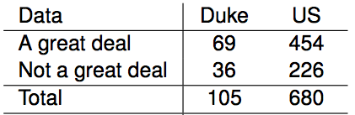
Practice: CI
Construct a 95% confidence interval for the difference between the proportions of Duke students and Americans who would be bothered a great deal by the melting of the northern ice cap (p_{Duke} - p_{US}).

Slide 18

Practice: CI
Construct a 95% confidence interval for the difference between the proportions of Duke students and Americans who would be bothered a great deal by the melting of the northern ice cap (p_{Duke} - p_{US}).
What is ${\hat{p}}_{Duke}$ and ${\hat{p}}_{US}$?

Slide 19
Practice: CI
Construct a 95% confidence interval for the difference between the proportions of Duke students and Americans who would be bothered a great deal by the melting of the northern ice cap (p_{Duke} - p_{US}).
What is ${\hat{p}}_{Duke}$ and ${\hat{p}}_{US}$?

Slide 20

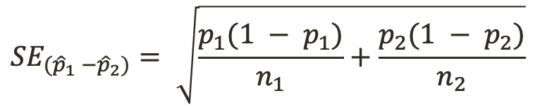
Practice: CI
Construct a 95% confidence interval for the difference between the proportions of Duke students and Americans who would be bothered a great deal by the melting of the northern ice cap (p_{Duke} - p_{US}).
What is the CI?
$${SE}_{({\hat{p}}_{1} −{\hat{p}}_{2})}= \sqrt{\frac{p_{1}(1 − p_{1})}{n_{1}}+\frac{p_{2}(1 − p_{2})}{n_{2}}}$$
$$CI=point estimate ±z∗ × SE$$

Slide 21



Practice: CI
Construct a 95% confidence interval for the difference between the proportions of Duke students and Americans who would be bothered a great deal by the melting of the northern ice cap (p_{Duke} - p_{US}).
What is the CI?
$${SE}_{({\hat{p}}_{1} −{\hat{p}}_{2})}= \sqrt{\frac{p_{1}(1 − p_{1})}{n_{1}}+\frac{p_{2}(1 − p_{2})}{n_{2}}}$$
$$CI=point estimate ±z∗ × SE$$

Slide 22
Practice: CI
Construct a 95% confidence interval for the difference between the proportions of Duke students and Americans who would be bothered a great deal by the melting of the northern ice cap (p_{Duke} - p_{US}).
What is the CI?
What does this tell us about the population?

Slide 23
Practice: CI
Construct a 95% confidence interval for the difference between the proportions of Duke students and Americans who would be bothered a great deal by the melting of the northern ice cap (p_{Duke} - p_{US}).
What is the CI?
What does this tell us about the population?
The difference between the proportion of Duke students and all Americans who would be bothered a great deal by the melting of the northern ice cap is between -11 and 9 percent.

Slide 24
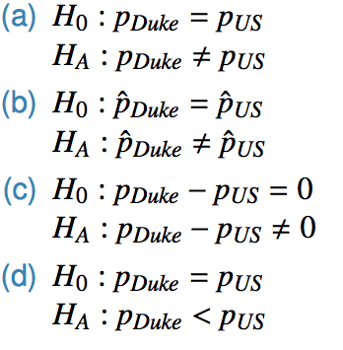
Practice: Hypothesis Testing
Which of the following is the correct set of hypotheses for testing if the proportion of all Duke students who would be bothered a great deal by the melting of the northern ice cap differs from the proportion of all Americans who do?

Slide 25
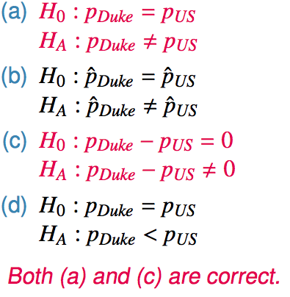
Practice: Hypothesis Testing
Which of the following is the correct set of hypotheses for testing if the proportion of all Duke students who would be bothered a great deal by the melting of the northern ice cap differs from the proportion of all Americans who do?

Slide 26
Flashback to working with one proportion
When constructing a confidence interval for a population proportion, we check if the observed number of successes and failures are at least 10. np̂ ≥ 10 n * (1 - p̂) ≥10

Slide 27
Flashback to working with one proportion
When constructing a confidence interval for a population proportion, we check if the observed number of successes and failures are at least 10. np̂ ≥ 10 n * (1 - p̂) ≥10
When conducting a hypothesis test for a population proportion, we check if the expected number of successes and failures are at least 10. np₀ ≥ 10 n * (1 - p₀) ≥ 10

Slide 28
Pooled estimate of a proportion
In the case of comparing two proportions where H₀: p₁ = p₂, there isn't a given null value we can use to calculated the expected number of successes and failures in each sample.

Slide 29
Pooled estimate of a proportion
In the case of comparing two proportions where H₀: p₁ = p₂, there isn't a given null value we can use to calculated the expected number of successes and failures in each sample.
Therefore, we need to first find a common (pooled) proportion for the two groups, and use that in our analysis.

Slide 30

Pooled estimate of a proportion
In the case of comparing two proportions where H₀: p₁ = p₂, there isn't a given null value we can use to calculated the expected number of successes and failures in each sample.
Therefore, we need to first find a common (pooled) proportion for the two groups, and use that in our analysis.
This simply means finding the proportion of total successes among the total number of observations.
Pooled estimate of a proportion

Slide 31
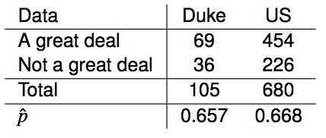

Practice
Calculate the estimated pooled proportion of Duke students and Americans who would be bothered a great deal by the melting of the northern ice cap. Which sample proportion (p̂_{Duke} or p̂_{US}) the pooled estimate is closer to? Why?

Slide 32
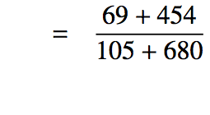


Practice
Calculate the estimated pooled proportion of Duke students and Americans who would be bothered a great deal by the melting of the northern ice cap. Which sample proportion (p̂_{Duke} or p̂_{US}) the pooled estimate is closer to? Why?

Slide 33
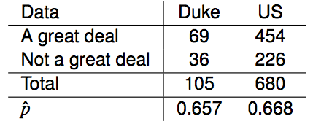
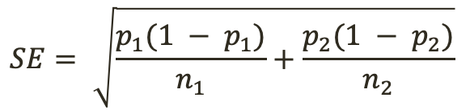
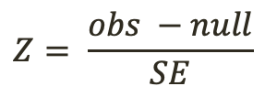


Practice: Hypothesis Testing
Do these data suggest that the proportion of all Duke students who would be bothered a great deal by the melting of the northern ice cap differs from the proportion of all Americans who do? Calculate the test statistic, the p-value, and interpret your conclusion in context of the data.
$$H_{0}: p_{Duke} −p_{US}=0$$
$$H_{A}: p_{Duke} −p_{US}≠0$$
$$Z= \frac{obs −null}{SE}$$
$$SE= \sqrt{\frac{p_{1}(1 − p_{1})}{n_{1}}+\frac{p_{2}(1 − p_{2})}{n_{2}}}$$

Slide 34
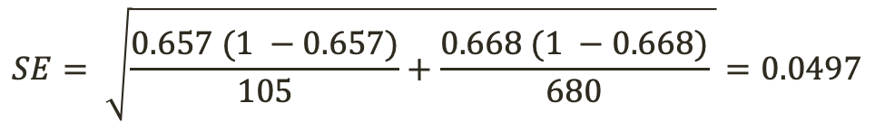

Practice: Hypothesis Testing
Do these data suggest that the proportion of all Duke students who would be bothered a great deal by the melting of the northern ice cap differs from the proportion of all Americans who do? Calculate the test statistic, the p-value, and interpret your conclusion in context of the data.
$$H_{0}: p_{Duke} −p_{US}=0$$
$$SE= \sqrt{\frac{0.657 (1 −0.657)}{105}+\frac{0.668 (1 −0.668)}{680} }=0.0497$$
$$H_{A}: p_{Duke} −p_{US}≠0$$
$$Z= \frac{obs −null}{SE}$$
$Z= \frac{(0.657 −0.668) −0}{0.0497}=−0.221$
$$SE= \sqrt{\frac{p_{1}(1 − p_{1})}{n_{1}}+\frac{p_{2}(1 − p_{2})}{n_{2}}}$$

Slide 35
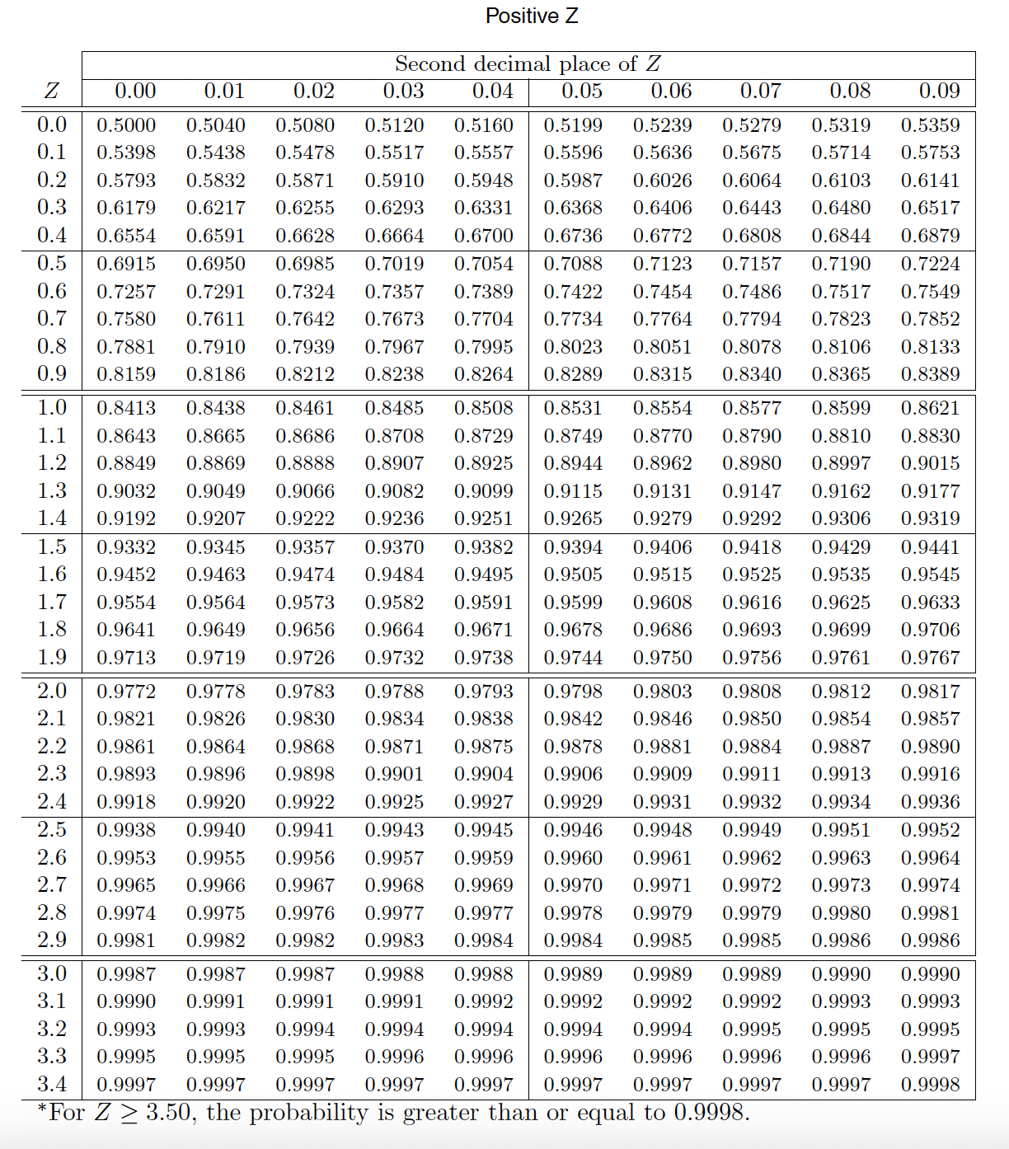

Practice: Hypothesis Testing
Do these data suggest that the proportion of all Duke students who would be bothered a great deal by the melting of the northern ice cap differs from the proportion of all Americans who do? Calculate the test statistic, the p-value, and interpret your conclusion in context of the data.
$$H_{0}: p_{Duke} −p_{US}=0$$
$$SE= \sqrt{\frac{0.657 (1 −0.657)}{105}+\frac{0.668 (1 −0.668)}{680} }=0.0497$$
$$H_{A}: p_{Duke} −p_{US}≠0$$
$$Z= \frac{obs −null}{SE}$$
$Z= \frac{(0.657 −0.668) −0}{0.0497}=−0.221$
$$SE= \sqrt{\frac{p_{1}(1 − p_{1})}{n_{1}}+\frac{p_{2}(1 − p_{2})}{n_{2}}}$$

Slide 36
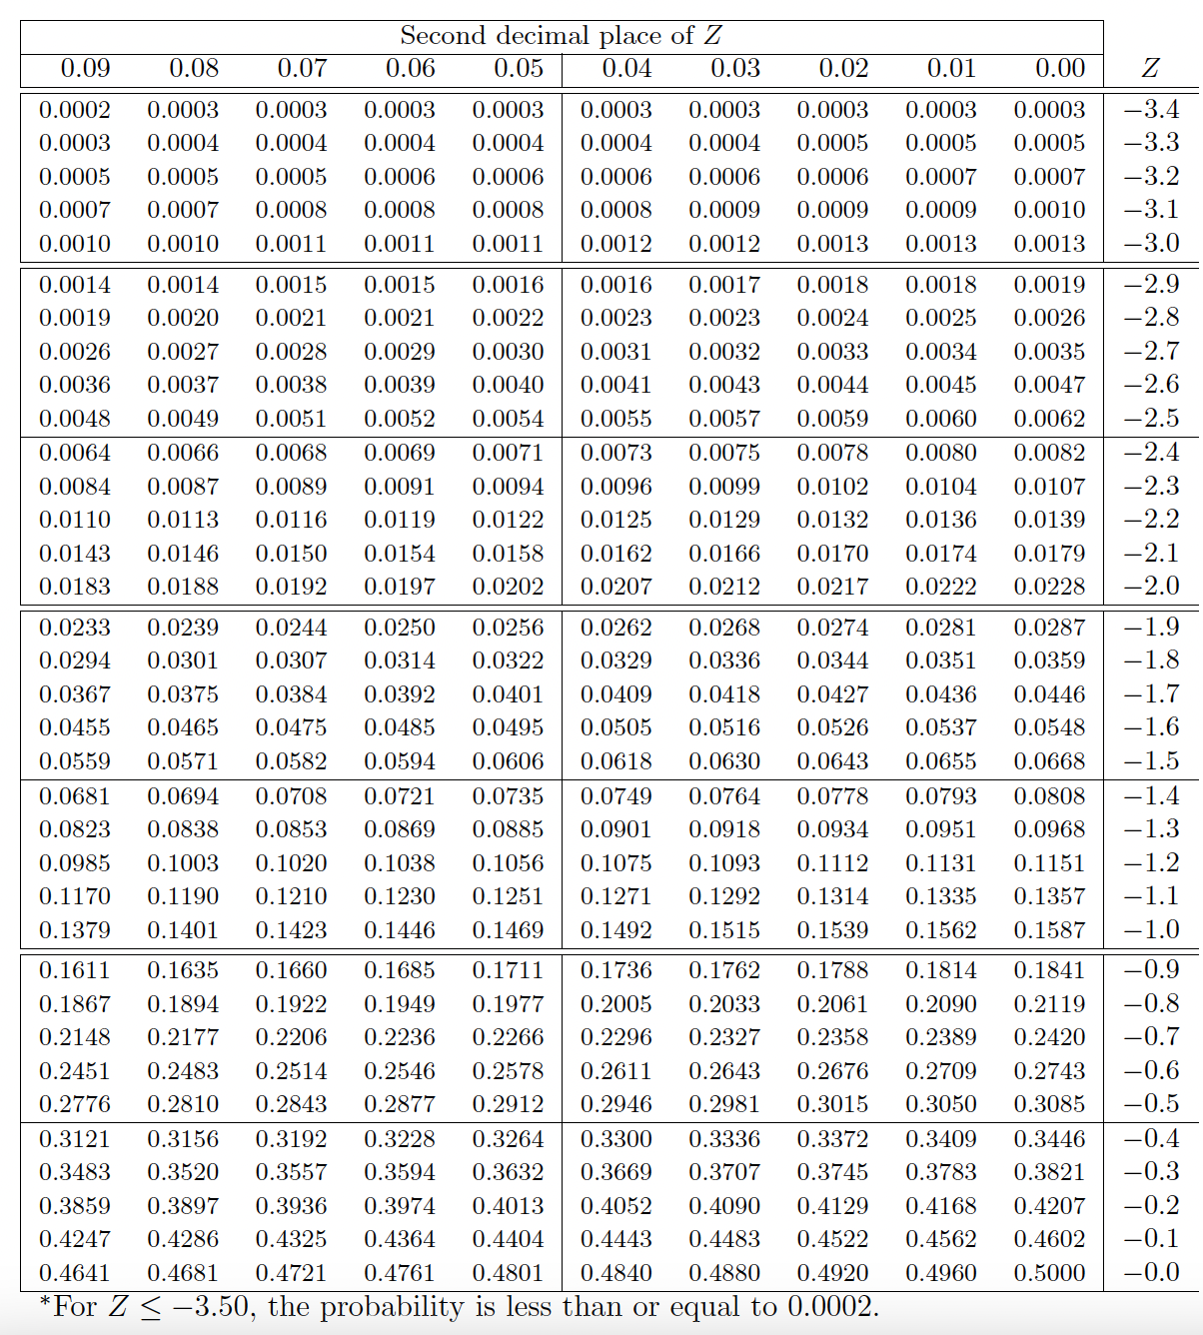
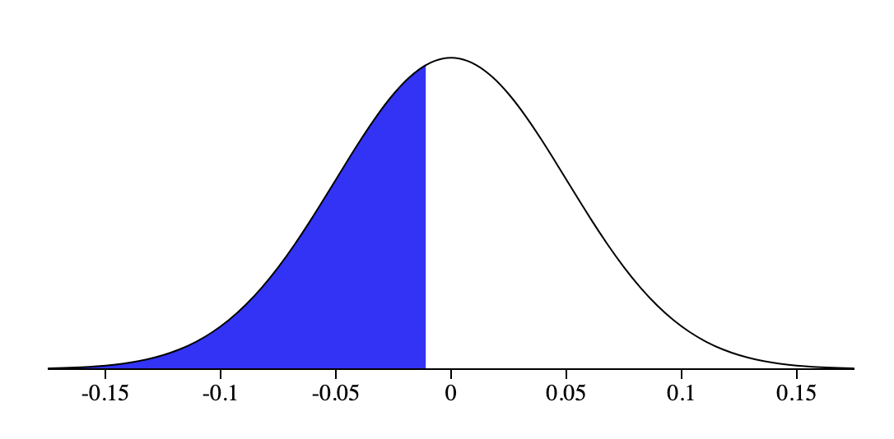
Practice: Hypothesis Testing
Do these data suggest that the proportion of all Duke students who would be bothered a great deal by the melting of the northern ice cap differs from the proportion of all Americans who do? Calculate the test statistic, the p-value, and interpret your conclusion in context of the data.
41%
$$H_{0}: p_{Duke} −p_{US}=0$$
$$SE= \sqrt{\frac{0.657 (1 −0.657)}{105}+\frac{0.668 (1 −0.668)}{680} }=0.0497$$
$$H_{A}: p_{Duke} −p_{US}≠0$$
$$Z= \frac{obs −null}{SE}$$
$Z= \frac{(0.657 −0.668) −0}{0.0497}=−0.221$
$$SE= \sqrt{\frac{p_{1}(1 − p_{1})}{n_{1}}+\frac{p_{2}(1 − p_{2})}{n_{2}}}$$

Slide 37
Practice: Hypothesis Testing
Do these data suggest that the proportion of all Duke students who would be bothered a great deal by the melting of the northern ice cap differs from the proportion of all Americans who do? Calculate the test statistic, the p-value, and interpret your conclusion in context of the data.
41%
$$H_{0}: p_{Duke} −p_{US}=0$$
$$SE= \sqrt{\frac{0.657 (1 −0.657)}{105}+\frac{0.668 (1 −0.668)}{680} }=0.0497$$
$$H_{A}: p_{Duke} −p_{US}≠0$$
$$Z= \frac{obs −null}{SE}$$
$Z= \frac{(0.657 −0.668) −0}{0.0497}=−0.221$
$$SE= \sqrt{\frac{p_{1}(1 − p_{1})}{n_{1}}+\frac{p_{2}(1 − p_{2})}{n_{2}}}$$
We want a 2-tailed test

Slide 38
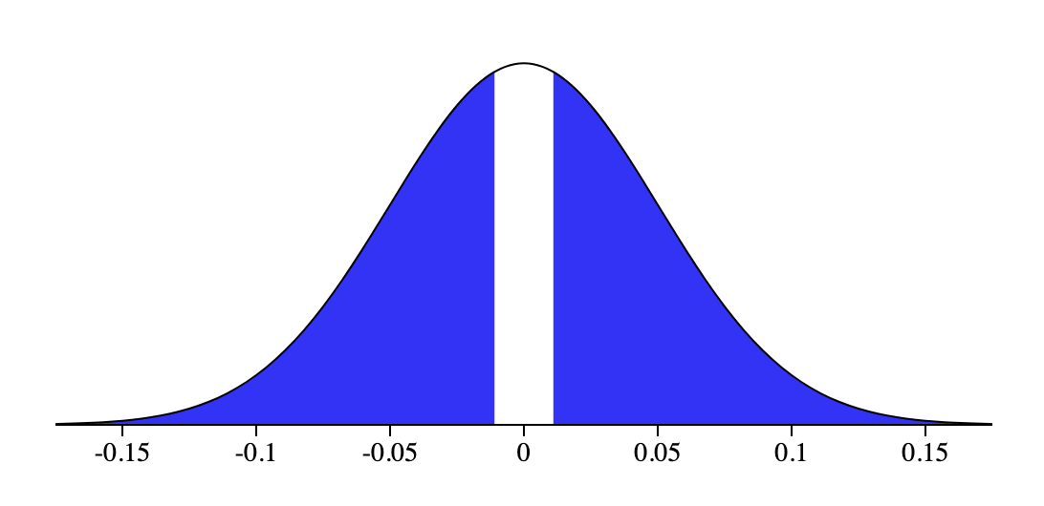


Practice: Hypothesis Testing
Do these data suggest that the proportion of all Duke students who would be bothered a great deal by the melting of the northern ice cap differs from the proportion of all Americans who do? Calculate the test statistic, the p-value, and interpret your conclusion in context of the data.
41%
41%
41%
$$H_{0}: p_{Duke} −p_{US}=0$$
$Z= \frac{(0.657 −0.668) −0}{0.0497}=−0.221$
$$H_{A}: p_{Duke} −p_{US}≠0$$
$$p=2 ∗ 0.41=0.82$$
$$Z= \frac{obs −null}{SE}$$
$$SE= \sqrt{\frac{p_{1}(1 − p_{1})}{n_{1}}+\frac{p_{2}(1 − p_{2})}{n_{2}}}$$

Slide 39

Practice: Hypothesis Testing
Do these data suggest that the proportion of all Duke students who would be bothered a great deal by the melting of the northern ice cap differs from the proportion of all Americans who do? Calculate the test statistic, the p-value, and interpret your conclusion in context of the data.
41%
41%
41%
$$H_{0}: p_{Duke} −p_{US}=0$$
$Z= \frac{(0.657 −0.668) −0}{0.0497}=−0.221$
$$H_{A}: p_{Duke} −p_{US}≠0$$
$$p=2 ∗ 0.41=0.82$$
$$Z= \frac{obs −null}{SE}$$
If $α$ = 0.05, what does this result tell us?
$$SE= \sqrt{\frac{p_{1}(1 − p_{1})}{n_{1}}+\frac{p_{2}(1 − p_{2})}{n_{2}}}$$

Slide 40
Practice: Hypothesis Testing
Do these data suggest that the proportion of all Duke students who would be bothered a great deal by the melting of the northern ice cap differs from the proportion of all Americans who do? Calculate the test statistic, the p-value, and interpret your conclusion in context of the data.
41%
41%
41%
$$H_{0}: p_{Duke} −p_{US}=0$$
$Z= \frac{(0.657 −0.668) −0}{0.0497}=−0.221$
$$H_{A}: p_{Duke} −p_{US}≠0$$
$$p=2 ∗ 0.41=0.82$$
$$Z= \frac{obs −null}{SE}$$
If $α$ = 0.05, what does this result tell us?
$$SE= \sqrt{\frac{p_{1}(1 − p_{1})}{n_{1}}+\frac{p_{2}(1 − p_{2})}{n_{2}}}$$
We fail to reject the null hypothesis; the data do not provide convincing evidence of a difference between Duke students and Americans.

Slide 41
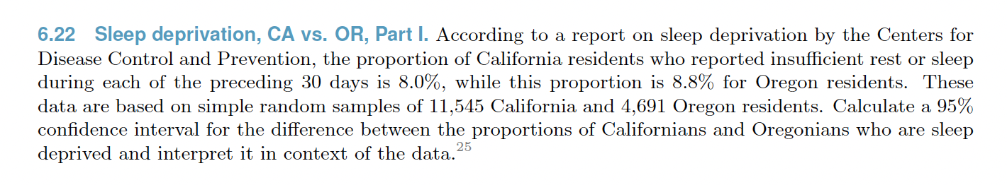
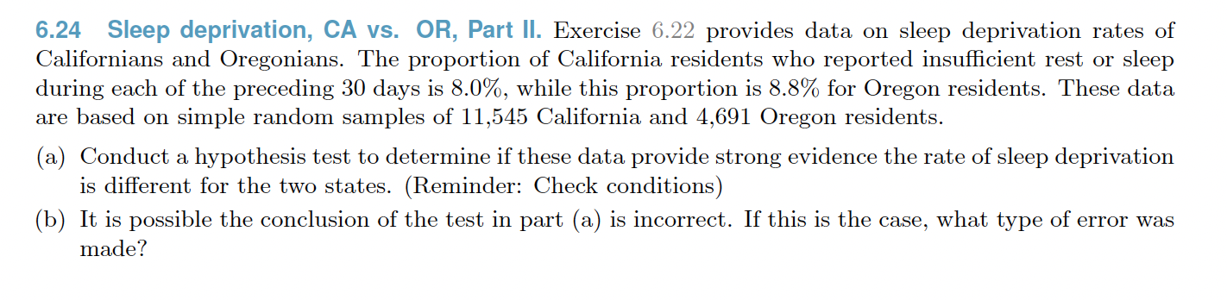
Practice

Slide 42
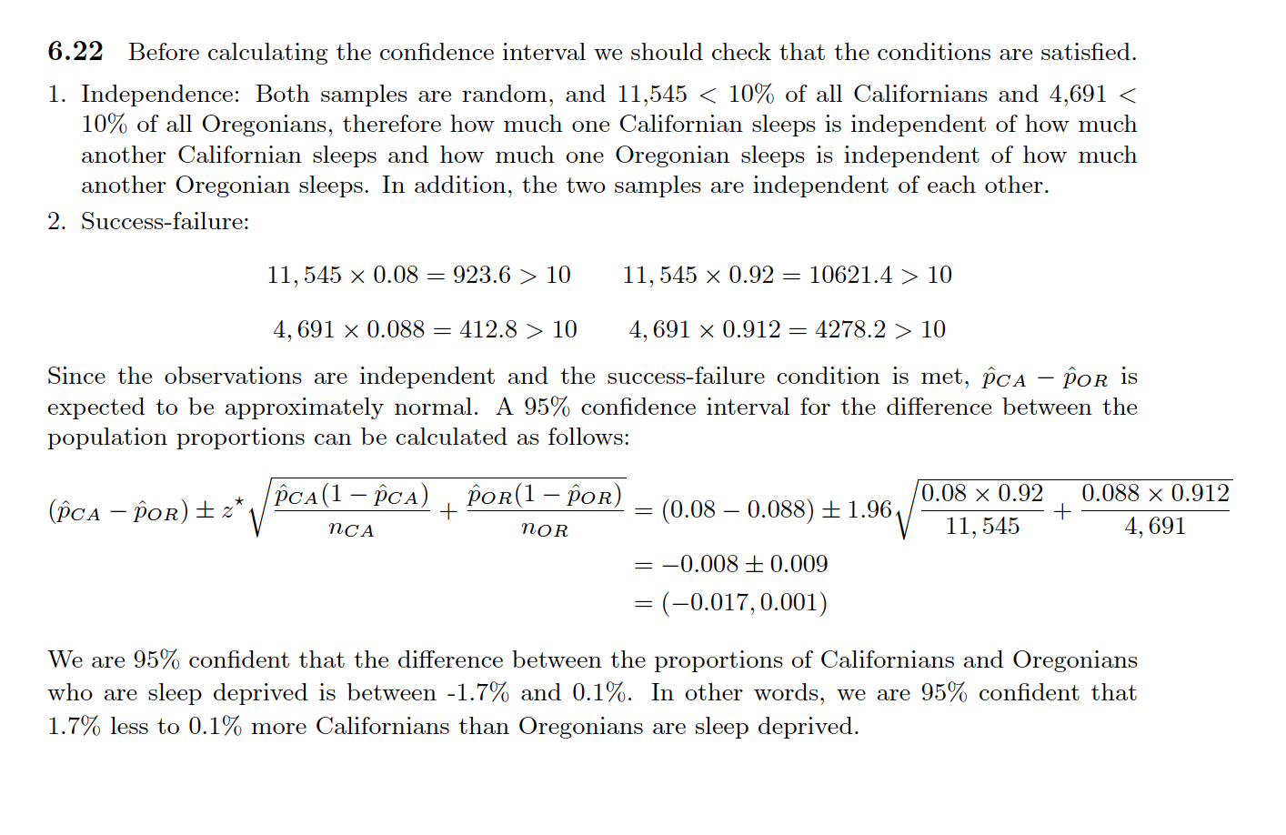
Practice

Slide 43
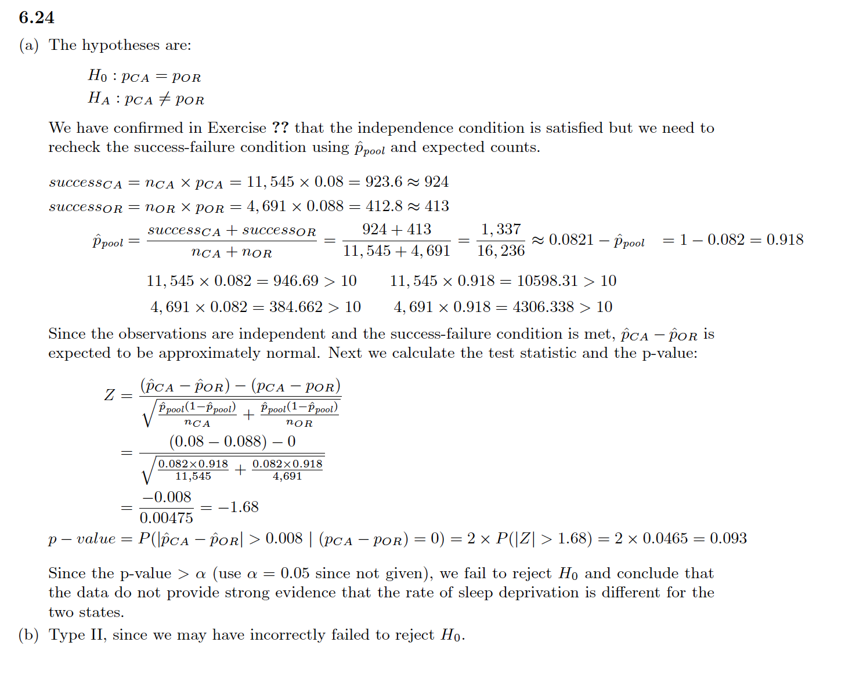
Practice

Slide 44
Recap - comparing two proportions
Population parameter: (p₁ - p₂), point estimate: (p̂₁ - p̂₂)

Slide 45
Recap - comparing two proportions
Population parameter: (p₁ - p₂), point estimate: (p̂₁ - p̂₂)
Conditions:

Slide 46
Recap - comparing two proportions
Population parameter: (p₁ - p₂), point estimate: (p̂₁ - p̂₂)
Conditions:
independence within groups - random sample and 10% condition met for both groups
independence between groups
at least 10 successes and failures in each group - if not → randomization (Section 6.4)

Slide 47


Recap - comparing two proportions
Population parameter: (p₁ - p₂), point estimate: (p̂₁ - p̂₂)
Conditions:
independence within groups - random sample and 10% condition met for both groups
independence between groups
at least 10 successes and failures in each group - if not → randomization (Section 6.4)
for CI: use p̂₁ and p̂₂
for HT:
when H₀: p₁ = p₂: use
when H₀: p₁ - p₂ = (some value other than 0): use p̂₁ and p̂₂ - this is pretty rare

Slide 48
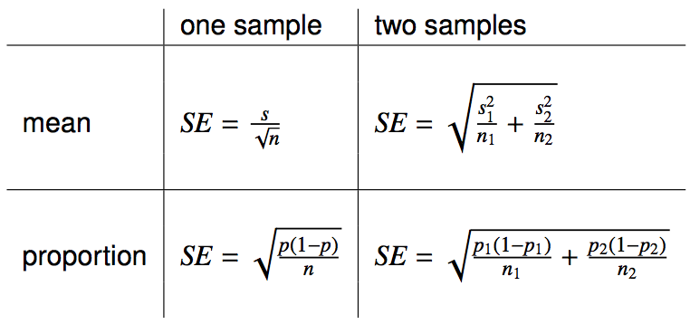
Reference - standard error calculations

Slide 49
Reference - standard error calculations
When working with means, it's very rare that σ is known, so we usually use s.

Slide 50
Reference - standard error calculations
When working with means, it's very rare that σ is known, so we usually use s.
When working with proportions,
if doing a hypothesis test, p comes from the null hypothesis
if constructing a confidence interval, use p̂ instead

