Slide 1
Inference for A Single Proportion
Dr. Ab Mosca (they/them)
Slides based off slides courtesy of OpenIntro and John McGreedy of Johns Hopkins University

Slide 2
Reminders
Mini-project 2 is DUE today
If you have not turned in a final project proposal yet you should ASAP

Slide 3
RECAP: Inference for means
Match the following scenarios to the appropriate test (Z-test, T-test, ANOVA):
Comparing a sample mean to a population mean, N = 50
Comparing a sample mean to a population mean, N = 20
Comparing paired means, N = 100
Comparing paired means, N = 25
Comparing un-paired means, N_{a} = 15, N_{b} = 17
Comparing un-paired means, N_{a} = 55, N_{b} = 56
Comparing more than 2 means, N_{a} = 55, N_{b} = 56, N_{c} = 54, N_{d} = 55

Slide 4
Proportions
We can make similar inferences for proportions instead of means
Today we will start with one-sample proportions, compared to a population proportion
This an analogous to testing whether a one-sample mean differs from a population mean

Slide 5
Motivating Example
The following survey was used to determine if American’s have a good understanding of experimental design.
Two scientists want to know if a certain drug is effective against high blood pressure. The first scientist wants to give the drug to 1000 people with high blood pressure and see how many of them experience lower blood pressure levels. The second scientist wants to give the drug to 500 people with high blood pressure, and not give the drug to another 500 people with high blood pressure, and see how many in both groups experience lower blood pressure levels. Which is the better way to test this drug?
All 1000 get the drug
500 get the drug, 500 don’t

Slide 6
Motivating Example
The following survey was used to determine if American’s have a good understanding of experimental design.
Two scientists want to know if a certain drug is effective against high blood pressure. The first scientist wants to give the drug to 1000 people with high blood pressure and see how many of them experience lower blood pressure levels. The second scientist wants to give the drug to 500 people with high blood pressure, and not give the drug to another 500 people with high blood pressure, and see how many in both groups experience lower blood pressure levels. Which is the better way to test this drug?
All 1000 get the drug
500 get the drug, 500 don’t

Slide 7
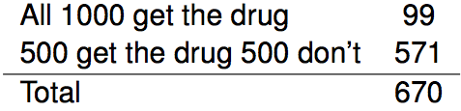
Results from the GSS
Below is the distribution of responses from the 2010 survey:

Slide 8
Parameter and point estimate
We would like to estimate the proportion of all Americans who have good intuition about experimental design, i.e. would answer “500 get the drug 500 don't”? What are the parameter of interest and the point estimate?

Slide 9
Parameter and point estimate
We would like to estimate the proportion of all Americans who have good intuition about experimental design, i.e. would answer “500 get the drug 500 don't”? What are the parameter of interest and the point estimate?
Parameter of interest: proportion of all Americans who have good intuition about experimental design.
p a population proportion

Slide 10
Parameter and point estimate
We would like to estimate the proportion of all Americans who have good intuition about experimental design, i.e. would answer “500 get the drug 500 don't”? What are the parameter of interest and the point estimate?
Parameter of interest: proportion of all Americans who have good intuition about experimental design.
p a population proportion
Point estimate: proportion of sampled Americans who have good intuition about experimental design.
p̂ a sample proportion

Slide 11
Inference on a proportion
What percent of all Americans have good intuition about experimental design, i.e. would answer "500 get the drug 500 don't"?

Slide 12
Inference on a proportion
What percent of all Americans have good intuition about experimental design, i.e. would answer "500 get the drug 500 don't"?
We can answer this research question using a confidence interval, which we know is always of the form
point estimate ± ME

Slide 13

Inference on a proportion
What percent of all Americans have good intuition about experimental design, i.e. would answer "500 get the drug 500 don't"?
We can answer this research question using a confidence interval, which we know is always of the form
point estimate ± ME
And we also know that ME = critical value times the SE of the point estimate.
And:

Slide 14

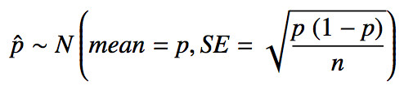
Sample proportions are also nearly normally distributed
Central limit theorem for proportions
Sample proportions will be nearly normally distributed with mean equal to the population mean, p, and standard error equal to
But of course this is true only under certain conditions… remember what they are?

Slide 15
Sample proportions are also nearly normally distributed
Central limit theorem for proportions
Sample proportions will be nearly normally distributed with mean equal to the population mean, p, and standard error equal to
But of course this is true only under certain conditions… remember what they are?
independent observations, at least 10 successes and 10 failures

Slide 16
Sample proportions are also nearly normally distributed
Central limit theorem for proportions
Sample proportions will be nearly normally distributed with mean equal to the population mean, p, and standard error equal to
But of course this is true only under certain conditions… remember what they are?
independent observations, at least 10 successes and 10 failures
_________
Note: If p is unknown (most cases), we use p̂ in the calculation of the standard error.

Slide 17
Back to the example ...
The GSS found that 571 out of 670 (85%) of Americans answered the question on experimental design correctly.
Estimate (using a 95% confidence interval) the proportion of all Americans who have good intuition about experimental design.
Given: n = 670, p̂ = 0.85.

Slide 18
Back to the example ...
The GSS found that 571 out of 670 (85%) of Americans answered the question on experimental design correctly.
Estimate (using a 95% confidence interval) the proportion of all Americans who have good intuition about experimental design.
Given: n = 670, p̂ = 0.85.
First check conditions.
Independence
Success-Failures

Slide 19
Back to the example ...
The GSS found that 571 out of 670 (85%) of Americans answered the question on experimental design correctly.
Estimate (using a 95% confidence interval) the proportion of all Americans who have good intuition about experimental design.
Given: n = 670, p̂ = 0.85.
First check conditions.
Independence: The sample is random, and 670 < 10% of all Americans, therefore we can assume that one respondent's response is independent of another.

Slide 20
Back to the example ...
The GSS found that 571 out of 670 (85%) of Americans answered the question on experimental design correctly.
Estimate (using a 95% confidence interval) the proportion of all Americans who have good intuition about experimental design.
Given: n = 670, p̂ = 0.85.
First check conditions.
Independence: The sample is random, and 670 < 10% of all Americans, therefore we can assume that one respondent's response is independent of another.
Success-failure: 571 people answered correctly (successes) and 99 answered incorrectly (failures), both are greater than 10.

Slide 21
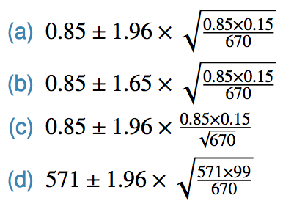
Practice
We are given
n = 670, p̂ = 0.85
We know:
CI = point estimate ± critical value * SE,
Which of the below is the correct calculation of the 95% confidence interval?

Slide 22
Practice
We are given
n = 670, p̂ = 0.85
We know:
CI = point estimate ± critical value * SE,
Which of the below is the correct calculation of the 95% confidence interval?
→ (0.82, 0.88)

Slide 23
Practice
We are given
n = 670, p̂ = 0.85
We know:
CI = point estimate ± critical value * SE,
Which of the below is the correct calculation of the 95% confidence interval?
→ (0.82, 0.88)
What is the interpretation of this interval?

Slide 24
Practice
We are given
n = 670, p̂ = 0.85
We know:
CI = point estimate ± critical value * SE,
Which of the below is the correct calculation of the 95% confidence interval?
→ (0.82, 0.88)
What is the interpretation of this interval?
We are 95% confident that 82 – 88% of all Americans have good intuition about experimental design.

Slide 25
Choosing a sample size
How many people should you sample in order to cut the margin of error of a 95% confidence interval down to 1%?

Slide 26

Choosing a sample size
How many people should you sample in order to cut the margin of error of a 95% confidence interval down to 1%?

Slide 27
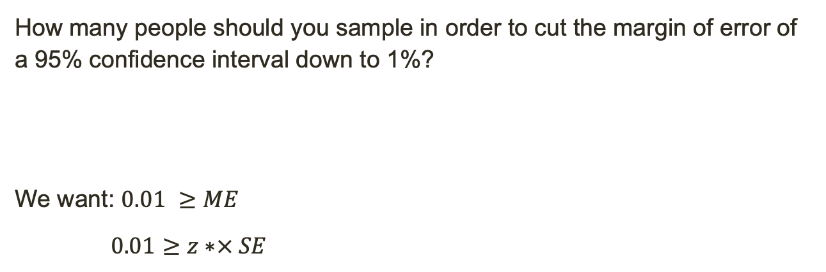
Choosing a sample size
How many people should you sample in order to cut the margin of error of a 95% confidence interval down to 1%?
We want: $0.01 ≥ME$
$0.01≥z∗× SE$

Slide 28
Choosing a sample size
How many people should you sample in order to cut the margin of error of a 95% confidence interval down to 1%?
solve for n

Slide 29

Choosing a sample size
How many people should you sample in order to cut the margin of error of a 95% confidence interval down to 1%?
solve for n

Slide 30

Choosing a sample size
How many people should you sample in order to cut the margin of error of a 95% confidence interval down to 1%?

Slide 31
Choosing a sample size
How many people should you sample in order to cut the margin of error of a 95% confidence interval down to 1%?

Slide 32
What if there isn't a previous study?
... use p̂ = 0.5 why?

Slide 33
What if there isn't a previous study?
... use p̂ = 0.5 why?
if you don't know any better, 50-50 is a good guess

Slide 34
What if there isn't a previous study?
... use p̂ = 0.5 why?
if you don't know any better, 50-50 is a good guess
p̂ = 0.5 gives the most conservative estimate -- highest possible sample size

Slide 35
Hypothesis Testing
The GSS found that 571 out of 670 (85%) of Americans answered the question on experimental design correctly.
Do these data provide convincing evidence that more than 80% of Americans have a good intuition about experimental design?

Slide 36
Hypothesis Testing
The GSS found that 571 out of 670 (85%) of Americans answered the question on experimental design correctly.
Do these data provide convincing evidence that more than 80% of Americans have a good intuition about experimental design?
What are the hypotheses?

Slide 37
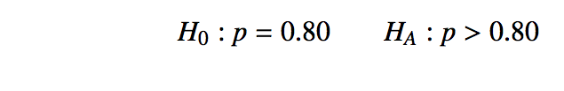
Hypothesis Testing
The GSS found that 571 out of 670 (85%) of Americans answered the question on experimental design correctly.
Do these data provide convincing evidence that more than 80% of Americans have a good intuition about experimental design?
What test should we use?

Slide 38
Hypothesis Testing
The GSS found that 571 out of 670 (85%) of Americans answered the question on experimental design correctly.
Do these data provide convincing evidence that more than 80% of Americans have a good intuition about experimental design?
What test should we use?
- Z-test, N > 50

Slide 39
Hypothesis Testing
The GSS found that 571 out of 670 (85%) of Americans answered the question on experimental design correctly.
Do these data provide convincing evidence that more than 80% of Americans have a good intuition about experimental design?
What test should we use?
- Z-test, N > 50
Do we meet the conditions to use it?

Slide 40
Hypothesis Test for proportions
Success-failure condition:
CI: At least 10 observed successes and failures
HT: At least 10 expected successes and failures, calculated using the null value
Independence:
Observations must be independent of each other

Slide 41
Hypothesis Testing
The GSS found that 571 out of 670 (85%) of Americans answered the question on experimental design correctly.
Do these data provide convincing evidence that more than 80% of Americans have a good intuition about experimental design?
What test should we use?
- Z-test, N > 50
Do we meet the conditions to use it?

Slide 42

Hypothesis Testing
The GSS found that 571 out of 670 (85%) of Americans answered the question on experimental design correctly.
Do these data provide convincing evidence that more than 80% of Americans have a good intuition about experimental design?
What test should we use?
- Z-test, N > 50
Do we meet the conditions to use it? (At least 10 expected successes and failures, calculated using the null value)
- 0.8 * 670 = 536, 0.2 * 670 = 134 → Success-failure condition
- Independent observations

Slide 43
Hypothesis Testing
The GSS found that 571 out of 670 (85%) of Americans answered the question on experimental design correctly.
Do these data provide convincing evidence that more than 80% of Americans have a good intuition about experimental design?
What are the steps for a Z-test?

Slide 44
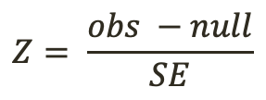
Hypothesis Testing
The GSS found that 571 out of 670 (85%) of Americans answered the question on experimental design correctly.
Do these data provide convincing evidence that more than 80% of Americans have a good intuition about experimental design?
What are the steps for a Z-test?
- Calculate test statistic (z-score)
- Find p-value for that test statistic
$$Z= \frac{obs −null}{SE}$$

Slide 45


CI vs. HT for proportions
Standard error:
CI: calculate using observed sample proportion:
HT: calculate using the null value:

Slide 46
Hypothesis Testing
The GSS found that 571 out of 670 (85%) of Americans answered the question on experimental design correctly.
Do these data provide convincing evidence that more than 80% of Americans have a good intuition about experimental design?
What are the steps for a Z-test?
- Calculate test statistic (z-score)
- Find p-value for that test statistic
$$Z= \frac{obs −null}{SE}$$

Slide 47

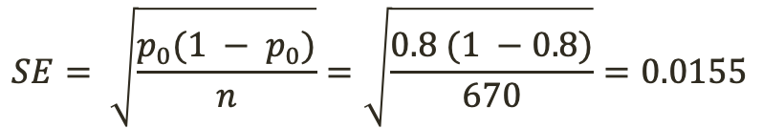

Hypothesis Testing
The GSS found that 571 out of 670 (85%) of Americans answered the question on experimental design correctly.
Do these data provide convincing evidence that more than 80% of Americans have a good intuition about experimental design?
What are the steps for a Z-test?
- Calculate test statistic (z-score)
- Find p-value for that test statistic
$$Z= \frac{obs −null}{SE}$$
$$SE= \sqrt{\frac{p_{0}(1 − p_{0})}{n}}=\sqrt{\frac{0.8 (1 −0.8)}{670}}=0.0155$$
$Z= \frac{obs −null}{SE}$ = $\frac{0.85 − .80}{SE}$
$\text{= }\frac{0.85 − .80}{0.0155}=3.22$

Slide 48


Hypothesis Testing
The GSS found that 571 out of 670 (85%) of Americans answered the question on experimental design correctly.
Do these data provide convincing evidence that more than 80% of Americans have a good intuition about experimental design?
What are the steps for a Z-test?
- Calculate test statistic (z-score)
- Find p-value for that test statistic
$$Z= \frac{obs −null}{SE}$$
$$SE= \sqrt{\frac{p_{0}(1 − p_{0})}{n}}=\sqrt{\frac{0.8 (1 −0.8)}{670}}=0.0155$$
$Z= \frac{obs −null}{SE}$ = $\frac{0.85 − .80}{SE}$
$\text{= }\frac{0.85 − .80}{0.0155}=3.22$
What does this z-score tell us?

Slide 49
Hypothesis Testing
The GSS found that 571 out of 670 (85%) of Americans answered the question on experimental design correctly.
Do these data provide convincing evidence that more than 80% of Americans have a good intuition about experimental design?
What are the steps for a Z-test?
- Calculate test statistic (z-score)
- Find p-value for that test statistic
$$Z= \frac{obs −null}{SE}$$
$$SE= \sqrt{\frac{p_{0}(1 − p_{0})}{n}}=\sqrt{\frac{0.8 (1 −0.8)}{670}}=0.0155$$
$Z= \frac{obs −null}{SE}$ = $\frac{0.85 − .80}{SE}$
$\text{= }\frac{0.85 − .80}{0.0155}=3.22$
What does this z-score tell us?
Our observation is over 3 SE’s away from the null

Slide 50
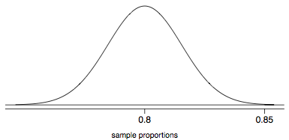
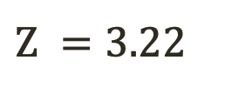
Hypothesis Testing
The GSS found that 571 out of 670 (85%) of Americans answered the question on experimental design correctly.
Do these data provide convincing evidence that more than 80% of Americans have a good intuition about experimental design?
What are the steps for a Z-test?
- Calculate test statistic (z-score)
- Find p-value for that test statistic
$\text{Z} =3.22$
Our observation is over 3 SE’s away from the null

Slide 51
Hypothesis Testing
The GSS found that 571 out of 670 (85%) of Americans answered the question on experimental design correctly.
Do these data provide convincing evidence that more than 80% of Americans have a good intuition about experimental design?
What are the steps for a Z-test?
- Calculate test statistic (z-score)
- Find p-value for that test statistic
$\text{Z} =3.22$
Our observation is over 3 SE’s away from the null
We need to find the proportion of more extreme observations

Slide 52
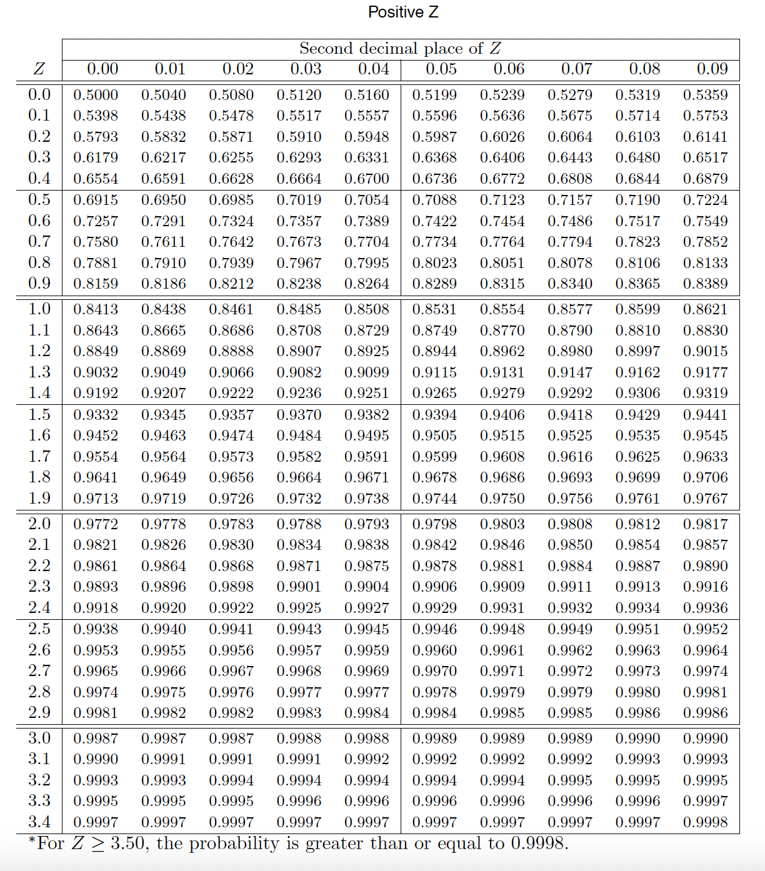
Hypothesis Testing
The GSS found that 571 out of 670 (85%) of Americans answered the question on experimental design correctly.
Do these data provide convincing evidence that more than 80% of Americans have a good intuition about experimental design?
What are the steps for a Z-test?
- Calculate test statistic (z-score)
- Find p-value for that test statistic
$\text{Z} =3.22$
Our observation is over 3 SE’s away from the null
We need to find the proportion of more extreme observations

Slide 53

Hypothesis Testing
The GSS found that 571 out of 670 (85%) of Americans answered the question on experimental design correctly.
Do these data provide convincing evidence that more than 80% of Americans have a good intuition about experimental design?
What are the steps for a Z-test?
- Calculate test statistic (z-score)
- Find p-value for that test statistic
$\text{Z} =3.22$
Our observation is over 3 SE’s away from the null
99.94%
We need to find the proportion of more extreme observations

Slide 54

Hypothesis Testing
The GSS found that 571 out of 670 (85%) of Americans answered the question on experimental design correctly.
Do these data provide convincing evidence that more than 80% of Americans have a good intuition about experimental design?
What are the steps for a Z-test?
- Calculate test statistic (z-score)
- Find p-value for that test statistic
$\text{Z} =3.22$
Our observation is over 3 SE’s away from the null
99.94%
We need to find the proportion of more extreme observations
$$p=1 −0.9994=0.0006$$

Slide 55
Hypothesis Testing
The GSS found that 571 out of 670 (85%) of Americans answered the question on experimental design correctly.
Do these data provide convincing evidence that more than 80% of Americans have a good intuition about experimental design?
What are the steps for a Z-test?
- Calculate test statistic (z-score)
- Find p-value for that test statistic
$\text{Z} =3.22$
Our observation is over 3 SE’s away from the null
99.94%
We need to find the proportion of more extreme observations
$p=1 −0.9994=0.0006$, if $α=0.05$ what is the result of this test?

Slide 56
Hypothesis Testing
The GSS found that 571 out of 670 (85%) of Americans answered the question on experimental design correctly.
Do these data provide convincing evidence that more than 80% of Americans have a good intuition about experimental design?
99.94%
We need to find the proportion of more extreme observations
$p=1 −0.9994=0.0006$, if $α=0.05$ what is the result of this test?
Since the p-value is low, we reject H₀. The data provide convincing evidence that more than 80% of Americans have a good intuition on experimental design.

Slide 57
Practice
11% of 1,001 Americans responding to a 2006 Gallup survey stated that they have objections to celebrating Halloween on religious grounds. At 95% confidence level, the margin of error for this survey is ±3%. A news piece on this study's findings states: "More than 10% of all Americans have objections on religious grounds to celebrating Halloween." At 95% confidence level, is this news piece's statement justified?
Yes
No
Can’t tell

Slide 58
Practice
11% of 1,001 Americans responding to a 2006 Gallup survey stated that they have objections to celebrating Halloween on religious grounds. At 95% confidence level, the margin of error for this survey is ±3%. A news piece on this study's findings states: "More than 10% of all Americans have objections on religious grounds to celebrating Halloween." At 95% confidence level, is this news piece's statement justified?
Yes
No → (8%, 14%) includes 8%, 9%, 10%
Can’t tell

Slide 59
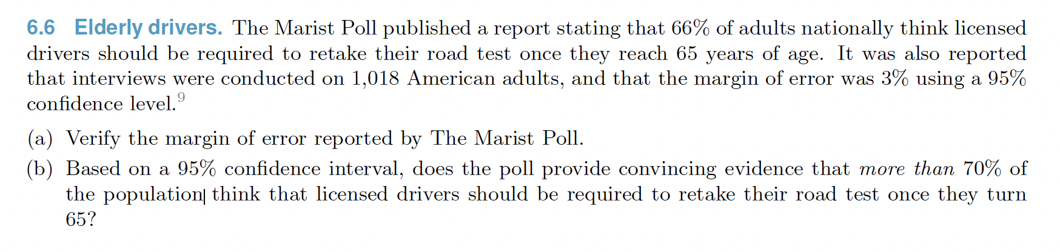
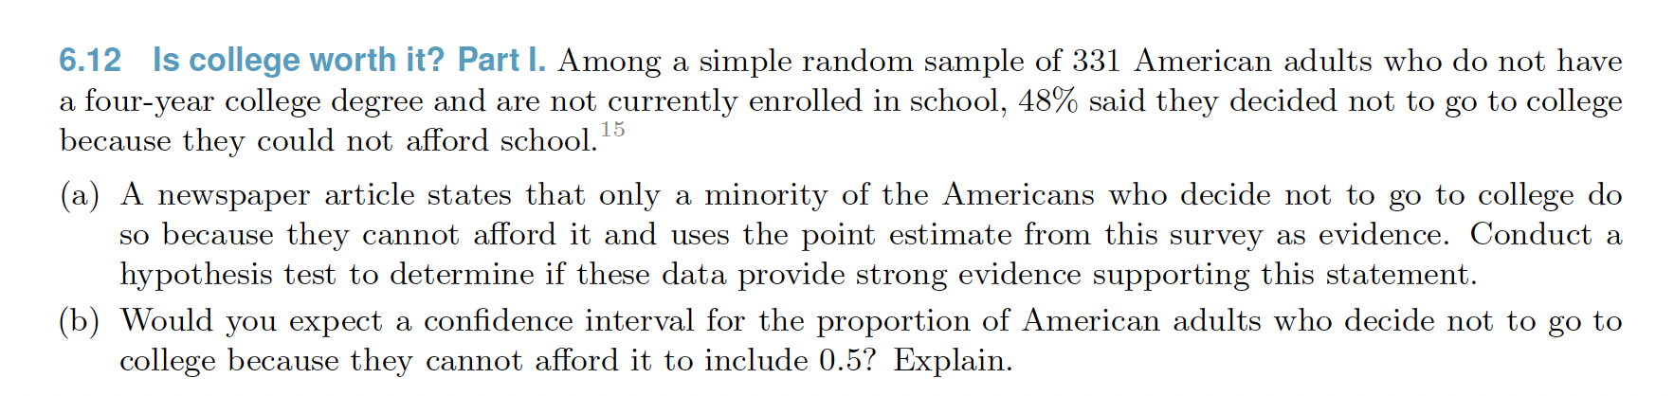
Practice

Slide 60
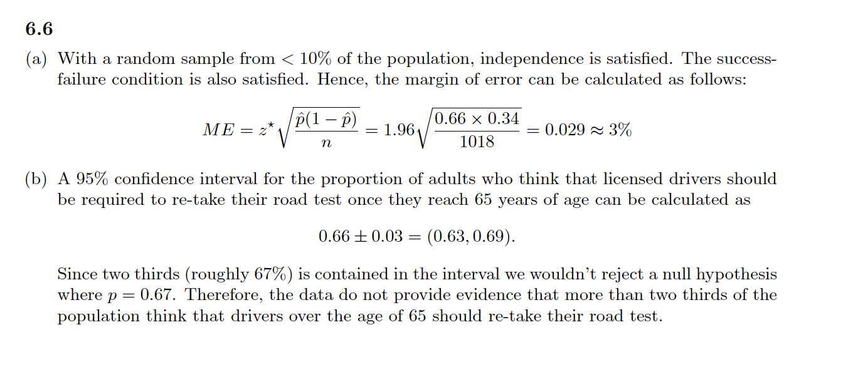
Practice
No, our confidence interval is below 70%, it suggests less than 70% of Americans think drivers should be required to re-take the road test.

Slide 61
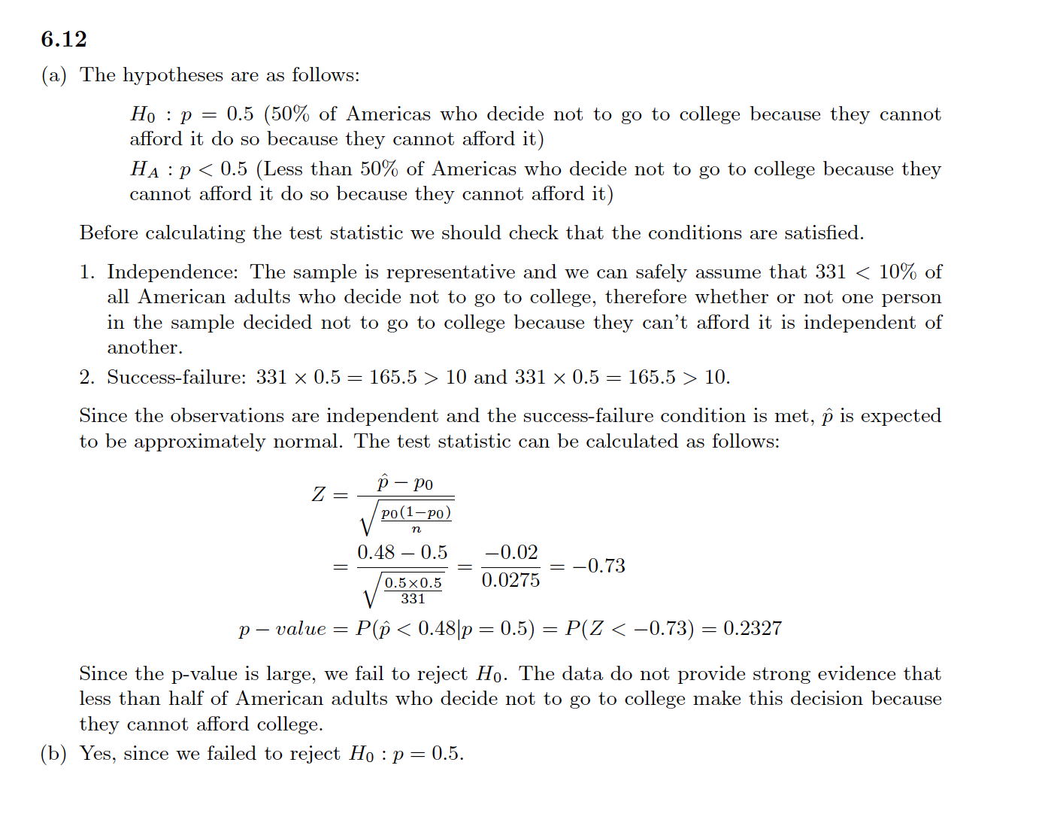
Practice

Slide 62
Recap - inference for one proportion
Population parameter: p, point estimate: p̂

Slide 63
Recap - inference for one proportion
Population parameter: p, point estimate: p̂
Conditions
independence - random sample and 10% condition
at least 10 successes and failures - if not → randomization

Slide 64

Recap - inference for one proportion
Population parameter: p, point estimate: p̂
Conditions
independence - random sample and 10% condition
at least 10 successes and failures - if not → randomization
Standard error:
for CI: use p̂
for HT: use p₀

