Slide 1
Inference for Paired Data
Dr. Ab Mosca (they/them)
Slides based off slides courtesy of OpenIntro and John McGreedy of Johns Hopkins University

Slide 2
Plan for Today
Review small one sample means
Inference for paired data

Slide 3
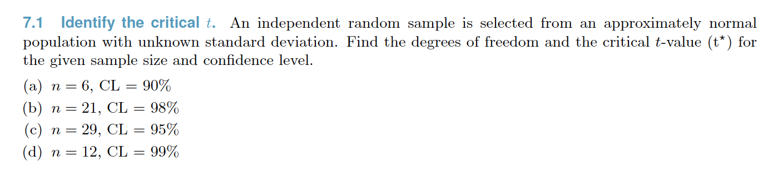
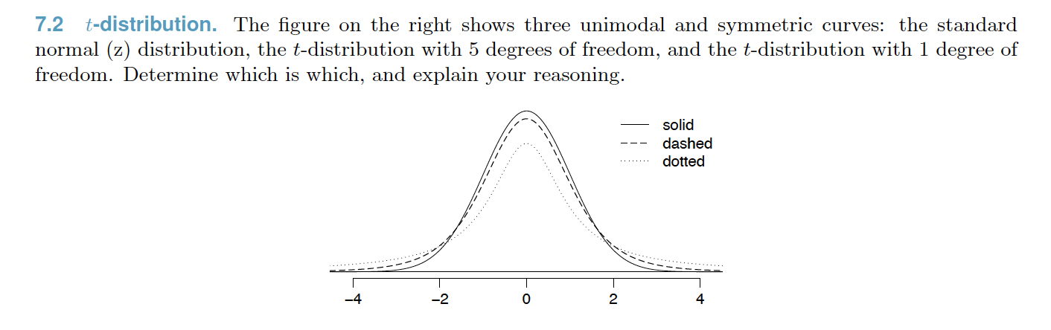
Warm Up

Slide 4
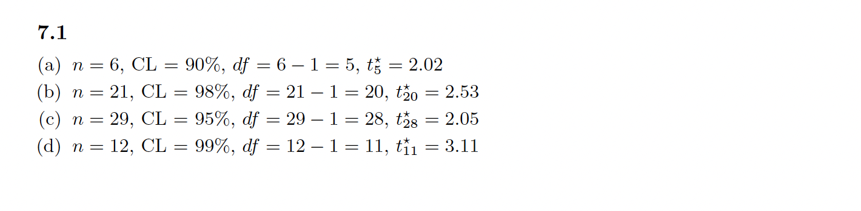
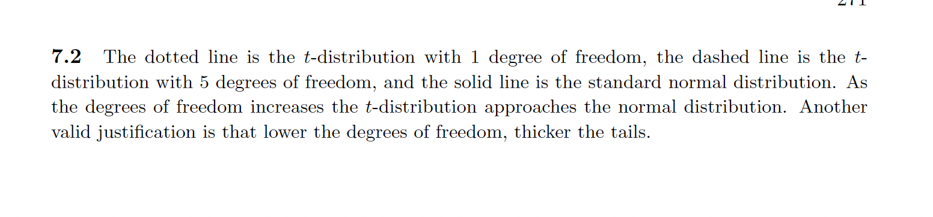
Warm Up

Slide 5
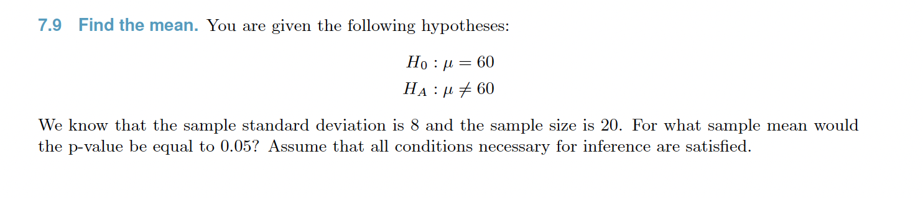
Warm Up

Slide 6
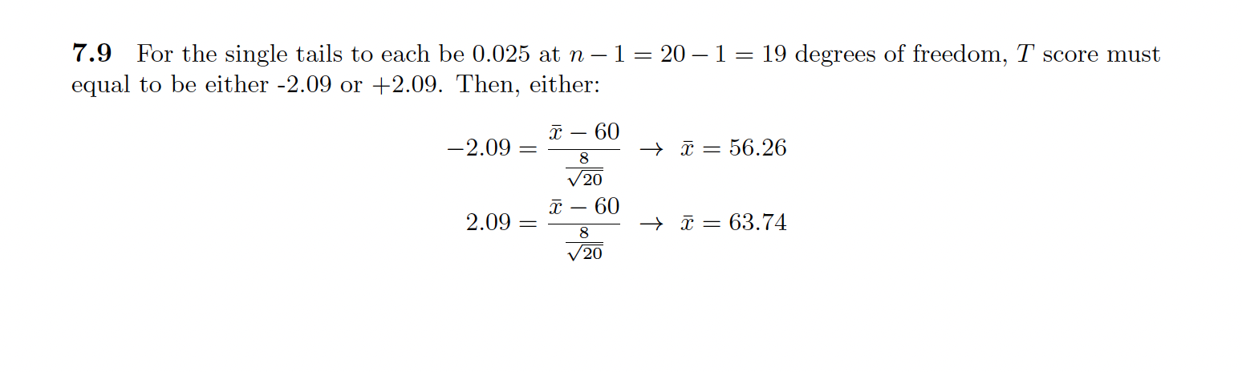
Warm Up

Slide 7
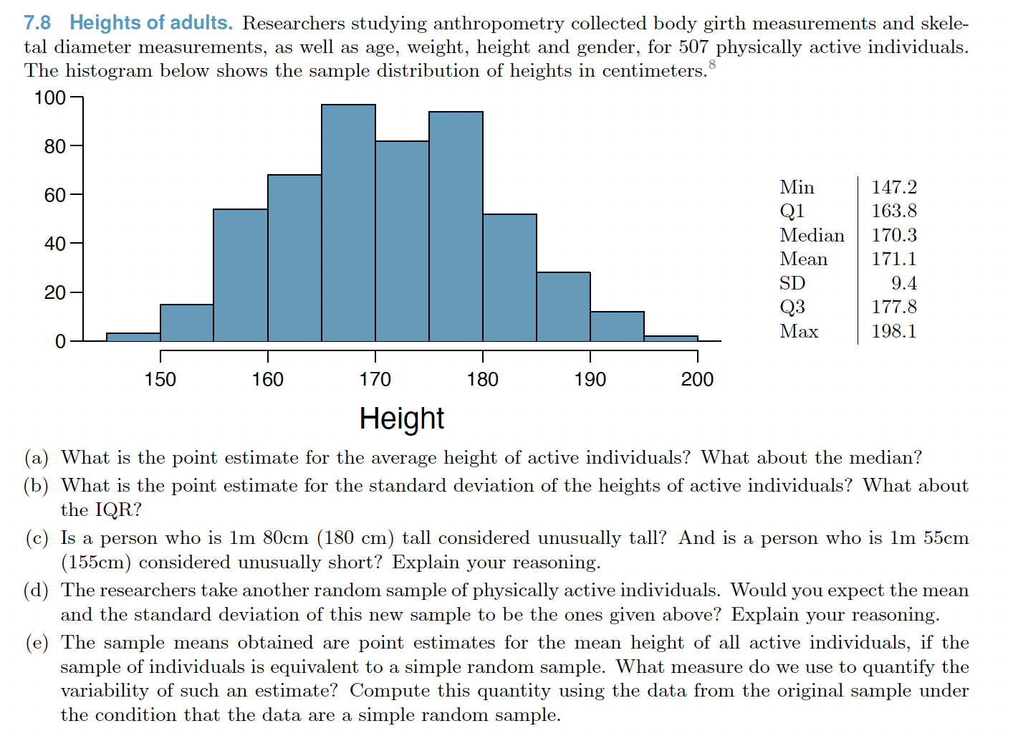
Warm Up

Slide 8
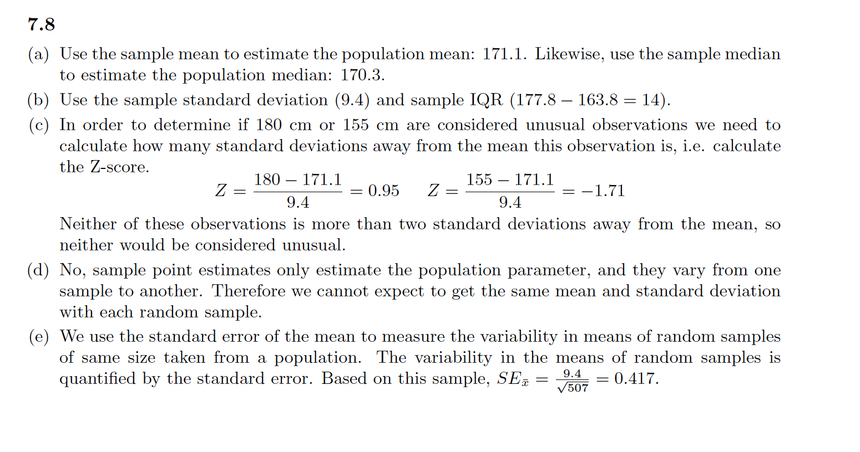
Warm Up

Slide 9
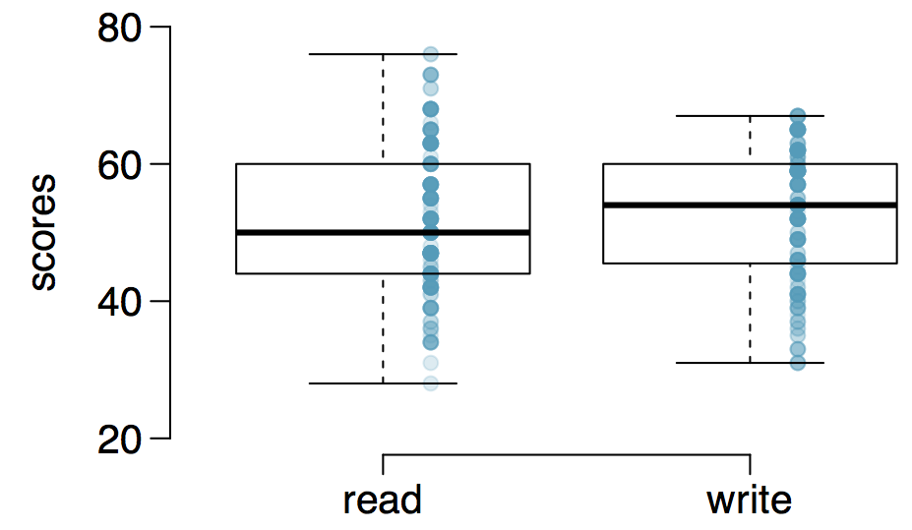
Paired observations
200 observations were randomly sampled from the High School and Beyond survey. The same students took a reading and writing test and their scores are shown below. At a first glance, does there appear to be a difference between the average reading and writing test score?

Slide 10
Paired observations
200 observations were randomly sampled from the High School and Beyond survey. The same students took a reading and writing test and their scores are shown below. At a first glance, does there appear to be a difference between the average reading and writing test score?
No, most of the scores are concentrated in the same range.

Slide 11
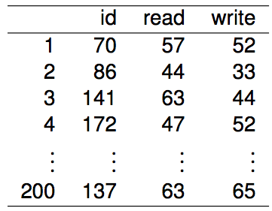
Paired observations
Are the reading and writing scores of each student independent of each other?
(a) Yes (b) No

Slide 12
Paired observations
Are the reading and writing scores of each student independent of each other?
(a) Yes (b) No

Slide 13
Analyzing paired data
When two sets of observations have this special correspondence (not independent), they are said to be paired

Slide 14
Analyzing paired data
When two sets of observations have this special correspondence (not independent), they are said to be paired
To analyze paired data, it is often useful to look at the difference in outcomes of each pair of observations
For example, in the reading and writing test case:
diff = read - write

Slide 15
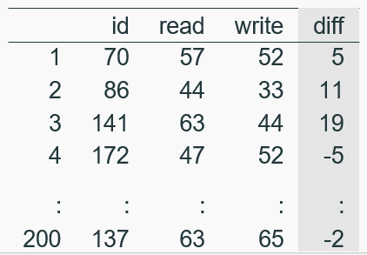
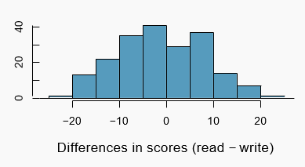
Analyzing paired data
When two sets of observations have this special correspondence (not independent), they are said to be paired
To analyze paired data, it is often useful to look at the difference in outcomes of each pair of observations
diff = read - write
It is important that we always subtract using a consistent order

Slide 16

Parameter and point estimate
Parameter of interest: Average difference between the reading and writing scores of all high school students

Slide 17

Parameter and point estimate
Parameter of interest: Average difference between the reading and writing scores of all high school students
Point estimate: Average difference between the reading and writing scores of sampled high school students

Slide 18
Setting the hypotheses
If in fact there was no difference between the scores on the reading and writing exams, what would you expect the average difference to be?

Slide 19
Setting the hypotheses
If in fact there was no difference between the scores on the reading and writing exams, what would you expect the average difference to be?
0

Slide 20
Setting the hypotheses
If in fact there was no difference between the scores on the reading and writing exams, what would you expect the average difference to be?
0
What are the hypotheses for testing if there is a difference between the average reading and writing scores?

Slide 21


Setting the hypotheses
If in fact there was no difference between the scores on the reading and writing exams, what would you expect the average difference to be?
0
What are the hypotheses for testing if there is a difference between the average reading and writing scores?
H₀ : Average reading and writing exam scores are not different.
H_{A} : Average reading and writing exam scores are different.

Slide 22
Nothing new here
The analysis is no different than what we have done before
We have data from one sample: differences.
We are testing to see if the average difference is different than 0.

Slide 23
Checking assumptions & conditions
Which of the following is true?
Since students are sampled randomly and are less than 10% of all high school students, we can assume that the difference between the reading and writing scores of one student in the sample is independent of another
The distribution of differences is bimodal, therefore we cannot continue with the hypothesis test
In order for differences to be random we should have sampled with replacement
Since students are sampled randomly and are less than 10% all students, we can assume that the sampling distribution of the average difference will be nearly normal

Slide 24
Checking assumptions & conditions
Which of the following is true?
Since students are sampled randomly and are less than 10% of all high school students, we can assume that the difference between the reading and writing scores of one student in the sample is independent of another
The distribution of differences is bimodal, therefore we cannot continue with the hypothesis test
In order for differences to be random we should have sampled with replacement
Since students are sampled randomly and are less than 10% all students, we can assume that the sampling distribution of the average difference will be nearly normal

Slide 25
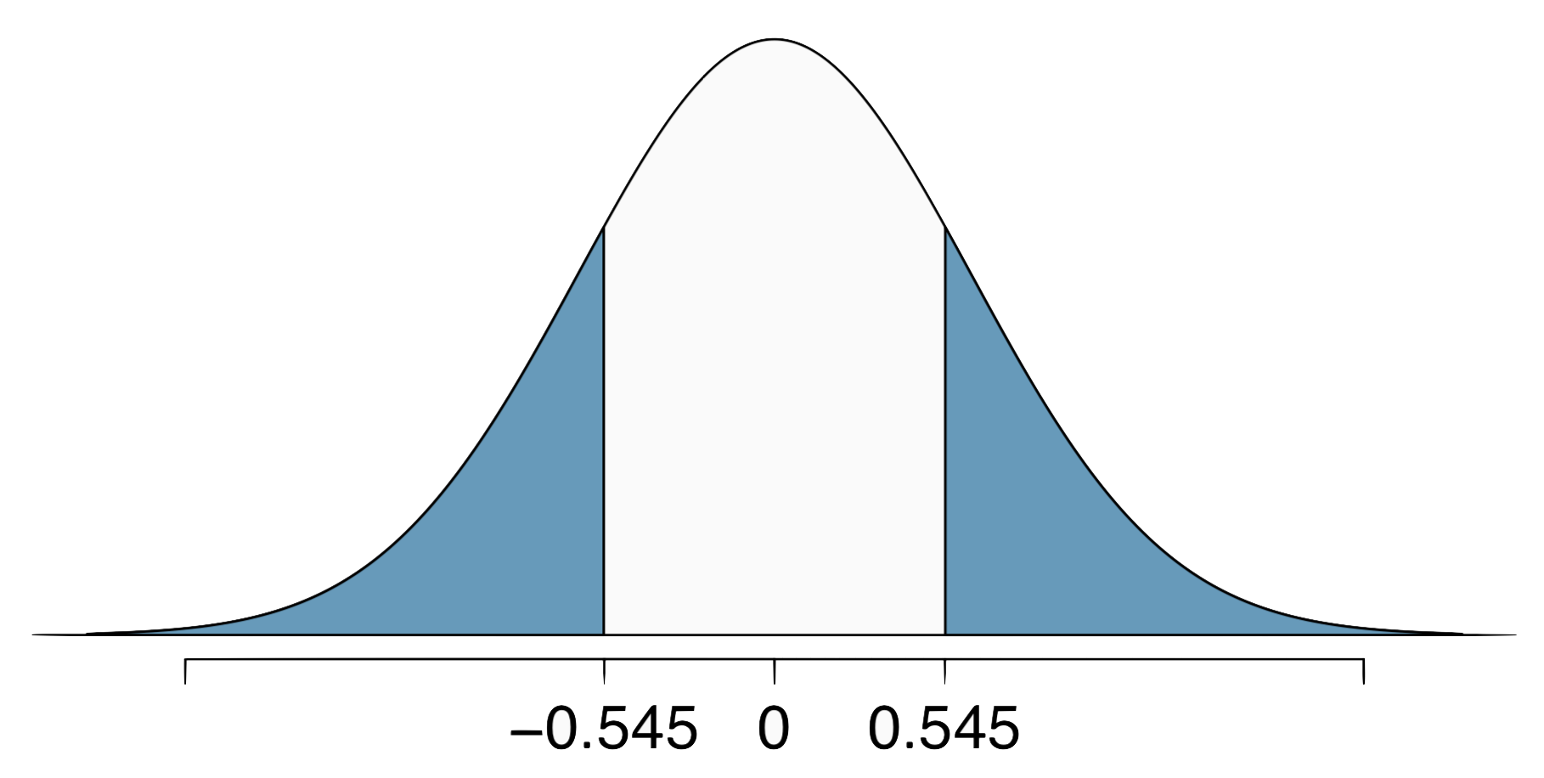

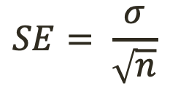
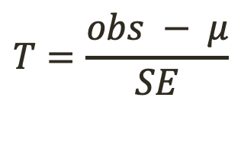
Calculating the test-statistics and the p-value
The observed average difference between the two scores for the 200 observations is -0.545 points and the standard deviation of the difference is 8.887 points. Do these data provide convincing evidence of a difference between the average scores on the two exams? Use α = 0.05
$$T=\frac{obs − μ}{SE}$$
$$SE= \frac{σ}{\sqrt{n}}$$
$$df=n −1$$

Slide 26



Calculating the test-statistics and the p-value
The observed average difference between the two scores for the 200 observations is -0.545 points and the standard deviation of the difference is 8.887 points. Do these data provide convincing evidence of a difference between the average scores on the two exams? Use α = 0.05
$$T=\frac{obs − μ}{SE}$$
$$SE= \frac{σ}{\sqrt{n}}$$
$$df=n −1$$

Slide 27

Calculating the test-statistics and the p-value
The observed average difference between the two scores for the 200 observations is -0.545 points and the standard deviation of the difference is 8.887 points. Do these data provide convincing evidence of a difference between the average scores on the two exams? Use α = 0.05

Slide 28
Calculating the test-statistics and the p-value
The observed average difference between the two scores for the 200 observations is -0.545 points and the standard deviation of the difference is 8.887 points. Do these data provide convincing evidence of a difference between the average scores on the two exams? Use α = 0.05
Since p-value > 0.05, fail to reject, the data do not provide convincing evidence of a difference between the average reading and writing scores

Slide 29
Interpretation of p-value
Which of the following is the correct interpretation of the p-value?
Probability that the average scores on the reading and writing exams are equal
Probability that the average scores on the reading and writing exams are different
Probability of obtaining a random sample of 200 students where the average difference between the reading and writing scores is at least 0.545 (in either direction), if in fact the true average difference between the scores is 0
Probability of incorrectly rejecting the null hypothesis if in fact the null hypothesis is true

Slide 30
Interpretation of p-value
Which of the following is the correct interpretation of the p-value?
Probability that the average scores on the reading and writing exams are equal
Probability that the average scores on the reading and writing exams are different
Probability of obtaining a random sample of 200 students where the average difference between the reading and writing scores is at least 0.545 (in either direction), if in fact the true average difference between the scores is 0
Probability of incorrectly rejecting the null hypothesis if in fact the null hypothesis is true

Slide 31
HT ↔ CI
Suppose we were to construct a 95% confidence interval for the average difference between the reading and writing scores. Would you expect this interval to include 0?
yes
no
cannot tell from the information given

Slide 32
HT ↔ CI
Suppose we were to construct a 95% confidence interval for the average difference between the reading and writing scores. Would you expect this interval to include 0?
yes
no
cannot tell from the information given

Slide 33
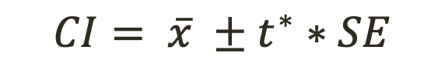
HT ↔ CI
Suppose we were to construct a 95% confidence interval for the average difference between the reading and writing scores. Would you expect this interval to include 0?
yes
no
cannot tell from the information given
Calculate the CI
$$CI= \overline{x} ±t^{∗}∗SE$$

Slide 34
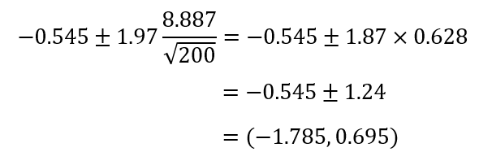
HT ↔ CI
Suppose we were to construct a 95% confidence interval for the average difference between the reading and writing scores. Would you expect this interval to include 0?
yes
no
cannot tell from the information given
Calculate the CI
$$CI= \overline{x} ±t^{∗}∗SE$$

Slide 35
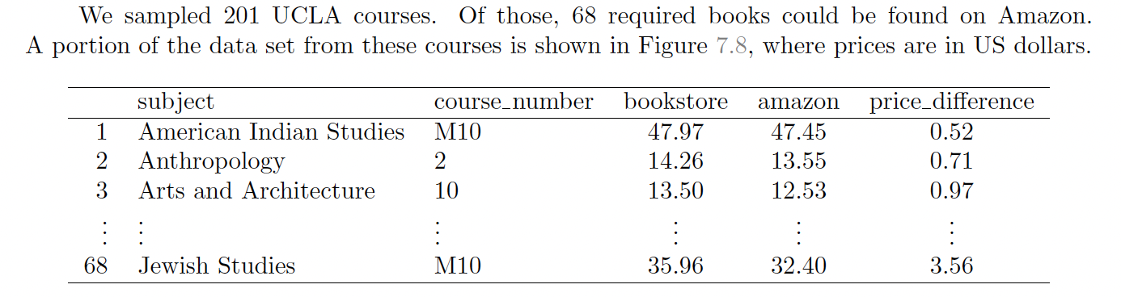
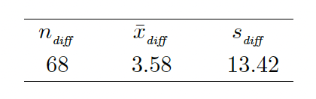
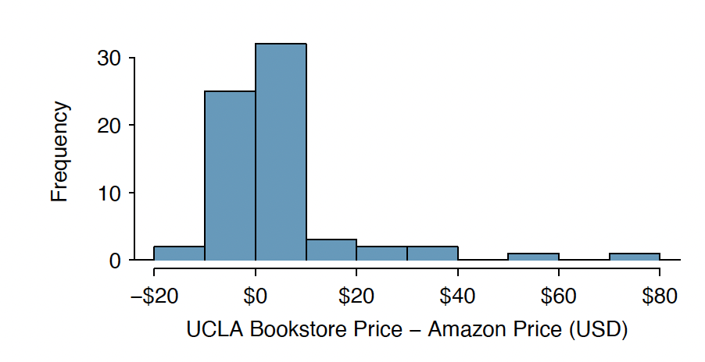
More Practice
What are the null and alternative hypotheses for the research question: Are books on Amazon less expensive than books at the UCLA bookstore?

Slide 36
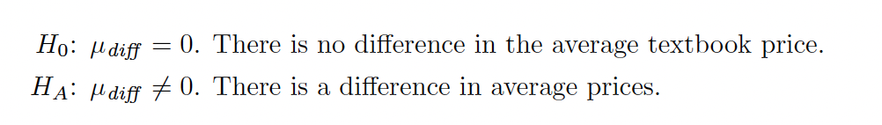
More Practice
What are the null and alternative hypotheses for the research question: Are books on Amazon less expensive than books at the UCLA bookstore?

Slide 37
More Practice
Complete the hypothesis test

Slide 38
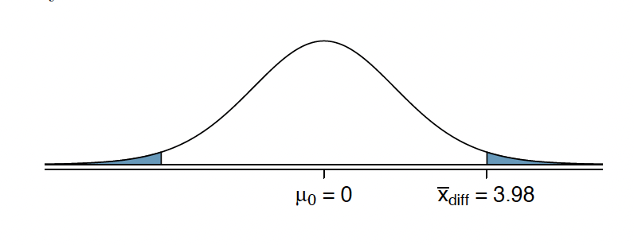
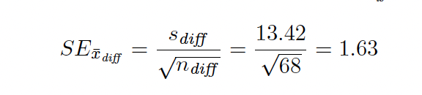

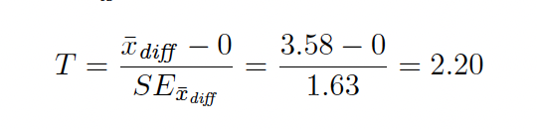
More Practice
Complete the hypothesis test
$$p=0.0156, for two tails p=0.0156∗2=0.0312$$
Reject the null hypothesis.

