Slide 1
Inference for Comparing Many Means
Dr. Ab Mosca (they/them)
Slides based off slides courtesy of OpenIntro and John McGreedy of Johns Hopkins University

Slide 2
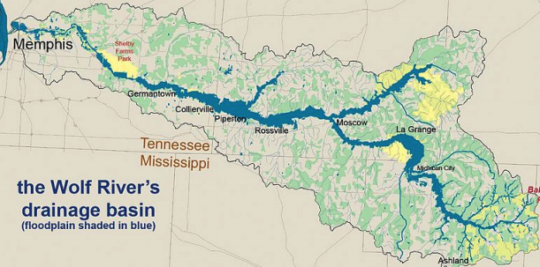
The Wolf River in Tennessee flows past an abandoned site once used by the pesticide industry for dumping wastes, including chlordane (pesticide), aldrin, and dieldrin (both insecticides)

Slide 3
The Wolf River in Tennessee flows past an abandoned site once used by the pesticide industry for dumping wastes, including chlordane (pesticide), aldrin, and dieldrin (both insecticides)
These highly toxic organic compounds can cause various cancers and birth defects

Slide 4
The Wolf River in Tennessee flows past an abandoned site once used by the pesticide industry for dumping wastes, including chlordane (pesticide), aldrin, and dieldrin (both insecticides)
These highly toxic organic compounds can cause various cancers and birth defects
The standard methods to test whether these substances are present in a river is to take samples at six-tenths depth

Slide 5
The Wolf River in Tennessee flows past an abandoned site once used by the pesticide industry for dumping wastes, including chlordane (pesticide), aldrin, and dieldrin (both insecticides)
These highly toxic organic compounds can cause various cancers and birth defects
The standard methods to test whether these substances are present in a river is to take samples at six-tenths depth
But since these compounds are denser than water and their molecules tend to stick to particles of sediment, they are more likely to be found in higher concentrations near the bottom

Slide 6
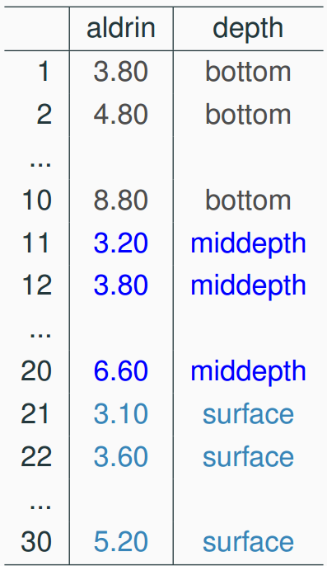
Data
Aldrin concentration (nanograms per liter) at three levels of depth

Slide 7
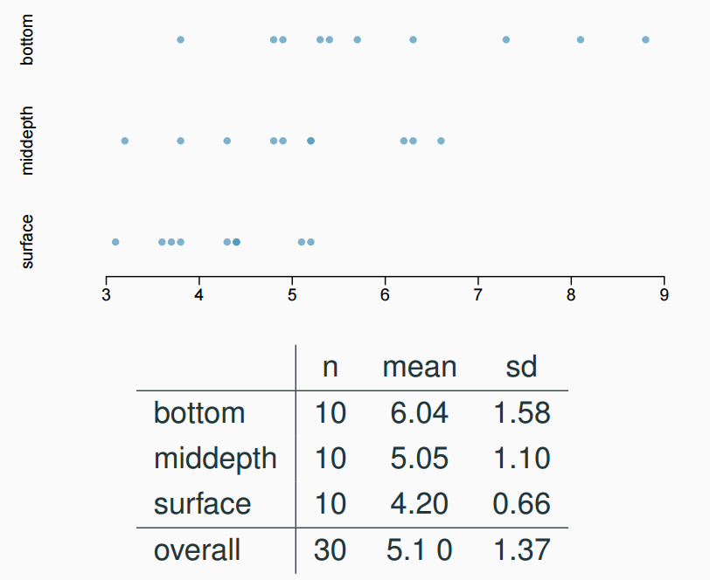
Exploratory analysis
Aldrin concentration (nanograms per liter) at three levels of depth

Slide 8
Research question
Is there a difference between the mean aldrin concentrations among the three levels?

Slide 9
Research question
Is there a difference between the mean aldrin concentrations among the three levels?
To compare means of 2 groups we use a Z or a T statistic

Slide 10
Research question
Is there a difference between the mean aldrin concentrations among the three levels?
To compare means of 2 groups we use a Z or a T statistic
To compare means of 3+ groups we use a new test called ANOVA and a new statistic called F

Slide 11
ANOVA
ANOVA is used to assess whether the mean of the outcome variable is different for different levels of a categorical variable

Slide 12
ANOVA
ANOVA is used to assess whether the mean of the outcome variable is different for different levels of a categorical variable
H₀ : The mean outcome is the same across all categories,
𝜇₁ = 𝜇₂ = … = 𝜇_{k},
where 𝜇_{i} represents the mean of the outcome for observations in category i
H_{A} : At least one mean is different than others

Slide 13
Conditions
The observations should be independent within and between groups
If the data are a simple random sample from less than 10% of the population, this condition is satisfied
Carefully consider whether the data may be independent (e.g. no pairing)
Always important, but sometimes difficult to check

Slide 14
independence
Does this condition appear to be satisfied?

Slide 15
independence
Does this condition appear to be satisfied?
In this study the we have no reason to believe that the aldrin concentration won’t be independent of each other

Slide 16
Conditions
The observations should be independent within and between groups
If the data are a simple random sample from less than 10% of the population, this condition is satisfied
Carefully consider whether the data may be independent (e.g. no pairing)
Always important, but sometimes difficult to check
The observations within each group should be nearly normal
Especially important when the sample sizes are small
How do we check for normality?

Slide 17
Conditions
The observations should be independent within and between groups
If the data are a simple random sample from less than 10% of the population, this condition is satisfied
Carefully consider whether the data may be independent (e.g. no pairing)
Always important, but sometimes difficult to check
The observations within each group should be nearly normal
Especially important when the sample sizes are small
How do we check for normality? – Look at distributions, consider data

Slide 18
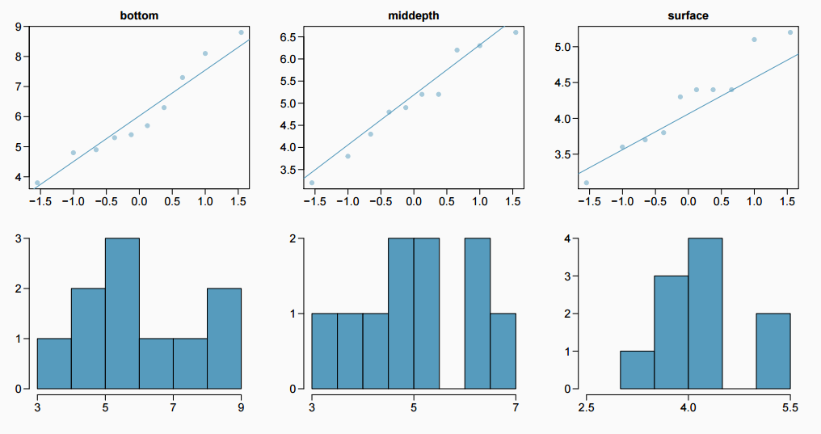
approximately normal
Does this condition appear to be satisfied?

Slide 19
Conditions
The observations should be independent within and between groups
If the data are a simple random sample from less than 10% of the population, this condition is satisfied
Carefully consider whether the data may be independent (e.g. no pairing)
Always important, but sometimes difficult to check
The observations within each group should be nearly normal
Especially important when the sample sizes are small
How do we check for normality? – Look at distributions, consider data
The variability across the groups should be about equal
Especially important when the sample sizes differ between groups
How can we check this condition?

Slide 20
Conditions
The observations should be independent within and between groups
If the data are a simple random sample from less than 10% of the population, this condition is satisfied
Carefully consider whether the data may be independent (e.g. no pairing)
Always important, but sometimes difficult to check
The observations within each group should be nearly normal
Especially important when the sample sizes are small
How do we check for normality? – Look at distributions, consider data
The variability across the groups should be about equal
Especially important when the sample sizes differ between groups
How can we check this condition? – Look at variance in each group

Slide 21
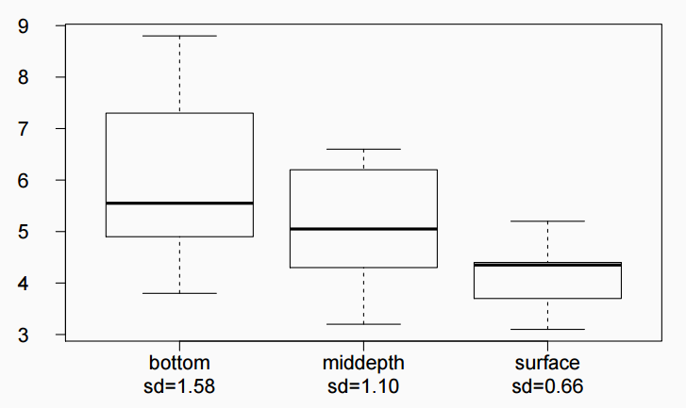
constant variance
Does this condition appear to be satisfied?

Slide 22
z/𝘵 test vs. ANOVA - Purpose
z/𝘵 test
Compare means from two groups to see whether they are so far apart that the observed difference cannot reasonably be attributed to sampling variability
H₀ : 𝜇₁ = 𝜇₂
ANOVA
Compare the means from two or more groups to see whether they are so far apart that the observed differences cannot all reasonably be attributed to sampling variability
H₀ : 𝜇₁ = 𝜇₂ = … = 𝜇_{k}

Slide 23


z/𝘵 test vs. ANOVA - Method
z/𝘵 test
Compute a test statistic (a ratio)
ANOVA
Compute a test statistic (a ratio)

Slide 24
z/𝘵 test vs. ANOVA - Method
z/𝘵 test
Compute a test statistic (a ratio)
ANOVA
Compute a test statistic (a ratio)
Large test statistics lead to small p-values
If the p-value is small enough H₀ is rejected, we conclude that the population means are not equal

Slide 25
z/𝘵 test vs. ANOVA
With only two groups t-test and ANOVA are equivalent, but only if we use a pooled standard variance in the denominator of the test statistic

Slide 26
z/𝘵 test vs. ANOVA
With only two groups t-test and ANOVA are equivalent, but only if we use a pooled standard variance in the denominator of the test statistic
With more than two groups, ANOVA compares the sample means to an overall grand mean

Slide 27
Hypotheses (for surface, middle, bottom measurements)
H₀ : 𝜇_{B} = 𝜇_{M} = 𝜇_{S}
H_{A} : 𝜇_{B} ≠ 𝜇_{M} ≠ 𝜇_{S}
H₀ : 𝜇_{B} ≠ 𝜇_{M} ≠ 𝜇_{S}
H_{A} : 𝜇_{B} = 𝜇_{M} = 𝜇_{S}
H₀ : 𝜇_{B} = 𝜇_{M} = 𝜇_{S}
H_{A} : At least one mean is different
H₀ : 𝜇_{B} = 𝜇_{M} = 𝜇_{S} = 0
H_{A} : At least one mean is different
H₀ : 𝜇_{B} = 𝜇_{M} = 𝜇_{S}
H_{A} : 𝜇_{B} > 𝜇_{M} > 𝜇_{S}

Slide 28
Hypotheses (for surface, middle, bottom measurements)
H₀ : 𝜇_{B} = 𝜇_{M} = 𝜇_{S}
H_{A} : 𝜇_{B} ≠ 𝜇_{M} ≠ 𝜇_{S}
H₀ : 𝜇_{B} ≠ 𝜇_{M} ≠ 𝜇_{S}
H_{A} : 𝜇_{B} = 𝜇_{M} = 𝜇_{S}
H₀ : 𝜇_{B} = 𝜇_{M} = 𝜇_{S}
H_{A} : At least one mean is different
H₀ : 𝜇_{B} = 𝜇_{M} = 𝜇_{S} = 0
H_{A} : At least one mean is different
H₀ : 𝜇_{B} = 𝜇_{M} = 𝜇_{S}
H_{A} : 𝜇_{B} > 𝜇_{M} > 𝜇_{S}

Slide 29
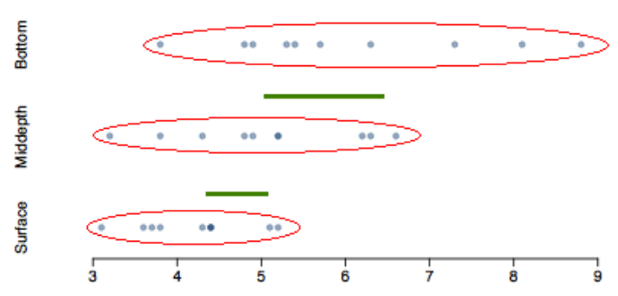
Test statistic
Does there appear to be a lot of variability within groups? How about between groups?

Slide 30
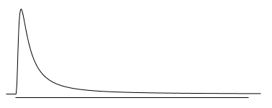
𝑭 distribution and p-value
In order to be able to reject H₀, we need a small p-value, which requires a large F statistic
In order to obtain a large F statistic, variability between sample means needs to be greater than variability within sample means

Slide 31
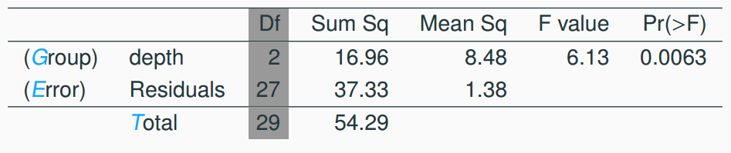
Degrees of freedom associated with ANOVA
groups: df_{G} = k - 1, where k is the number of groups
total: df_{T} = n - 1, where n is the total sample size
error: df_{E} = df_{T} - df_{G}

Slide 32
Degrees of freedom associated with ANOVA
groups: df_{G} = k - 1, where k is the number of groups
total: df_{T} = n - 1, where n is the total sample size
error: df_{E} = df_{T} – df_{G}
Calculate the various degrees of freedom

Slide 33
Degrees of freedom associated with ANOVA
groups: df_{G} = k - 1, where k is the number of groups
total: df_{T} = n - 1, where n is the total sample size
error: df_{E} = df_{T} - df_{G}
df_{G} = k - 1 = 3 - 1 = 2
df_{T} = n - 1 = 30 - 1 = 29
df_{E} = 29 - 2 = 27
Calculate the various degrees of freedom

Slide 34
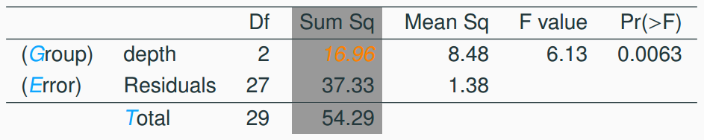

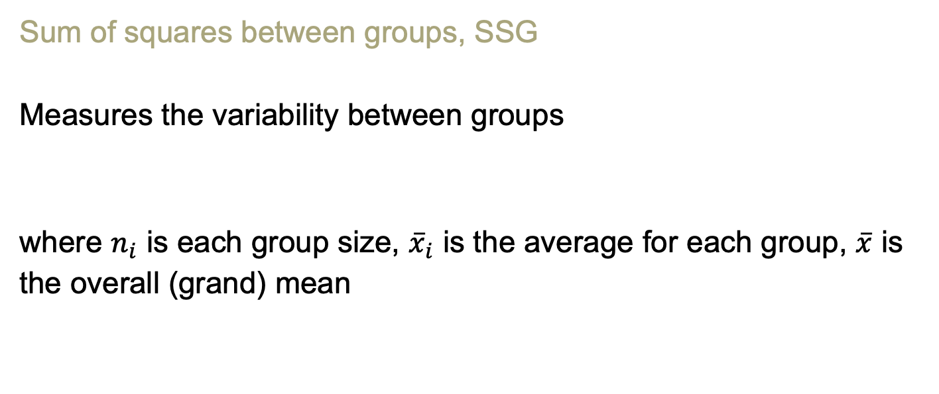
Sum of squares between groups, SSG
Measures the variability between groups
where $n_{i}$ is each group size, ${\overline{x}}_{i}$ is the average for each group, $\overline{x}$ is the overall (grand) mean

Slide 35


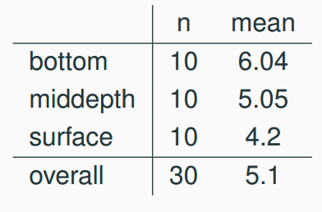
Sum of squares between groups, SSG
Measures the variability between groups
where is each group size, is the average for each group, is the overall (grand) mean
Calculate SSG

Slide 36




Sum of squares between groups, SSG
Measures the variability between groups
where is each group size, is the average for each group, is the overall (grand) mean

Slide 37
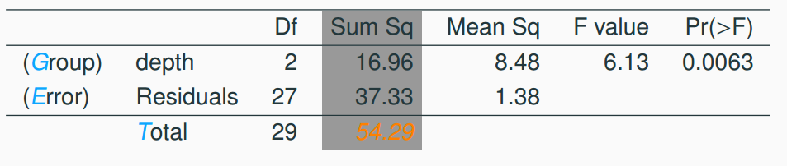
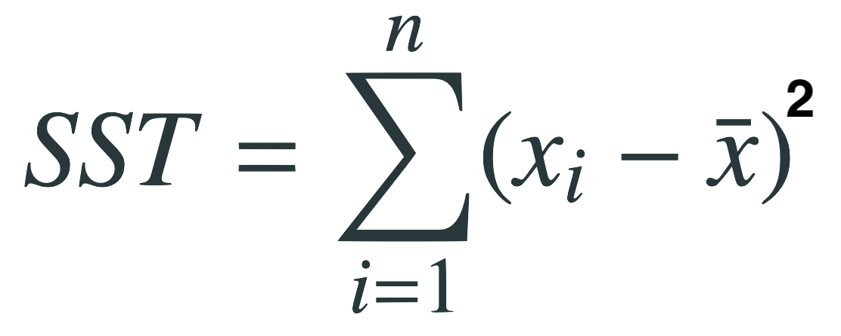
Sum of squares total, SST
Measures the variability between groups
where x_{i} represent each observation in the dataset
Calculate SST

Slide 38
Sum of squares total, SST
Measures the variability between groups
where x_{i} represent each observation in the dataset
SST = (3.8 - 5.1)² + (4.8 - 5.1)² + (4.9 - 5.1)² + … + (5.2 - 5.1)²
= (-1.3)² + (-0.3)² + (-0.2)² + … + (0.1)²
= 1.69 + 0.09 + 0.04 + … + 0.01
= 54.29

Slide 39
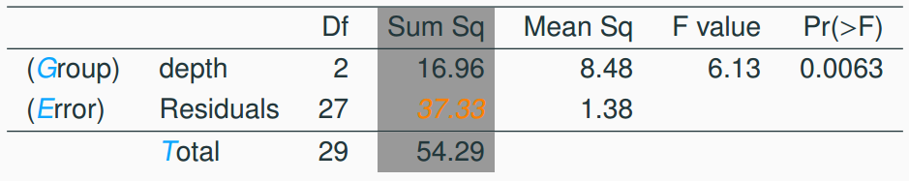
Sum of squares error, SSE
Measures the variability within groups:
SSE = SST - SSG
Calculate SSE

Slide 40
Sum of squares error, SSE
Measures the variability within groups:
SSE = SST - SSG
Calculate SSE
SSE = 54.29 - 16.96 = 37.33

Slide 41
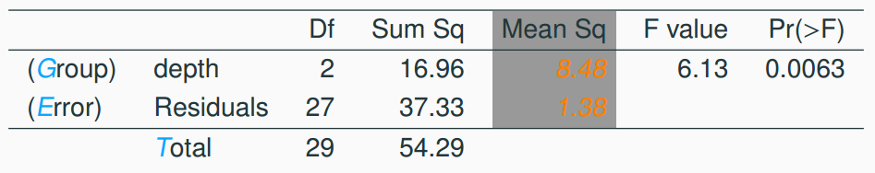
Mean square error
Mean square error is calculated as sum of squares divided by the degrees of freedom
Calculate Mean square error for Group and Error

Slide 42
Mean square error
Mean square error is calculated as sum of squares divided by the degrees of freedom
Calculate Mean square error for Group and Error
MSG = 16.96/2 = 8.48
MSE = 37.33/27 = 1.38

Slide 43
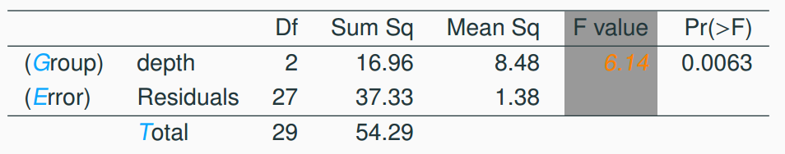

Test statistic, F value
As we discussed before, the F statistic is the ratio of the between group and within group variability
Calculate F

Slide 44

Test statistic, F value
As we discussed before, the F statistic is the ratio of the between group and within group variability
Calculate F

Slide 45
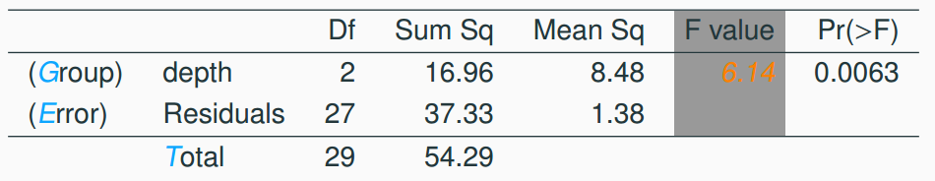
p-value
p-value is the probability of at least as large a ratio between the “between group” and “within group” variability, if in fact the means of all groups are equal. It’s calculated as the area under the F curve, with degrees of freedom df_{G} and df_{E}, above the observed F statistic.

Slide 46
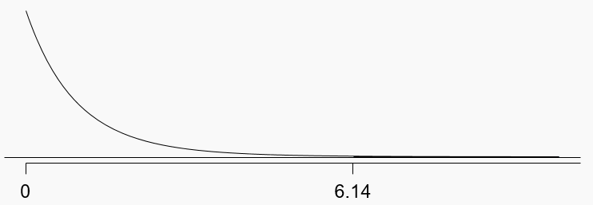
p-value
p-value is the probability of at least as large a ratio between the “between group” and “within group” variability, if in fact the means of all groups are equal. It’s calculated as the area under the F curve, with degrees of freedom df_{G} and df_{E}, above the observed F statistic.
df_{G} = 2; df_{E} = 27

Slide 47
Conclusion - in context
What is the conclusion of the hypothesis test?
The data provide convincing evidence that the average aldrin concentration
is different for all groups
on the surface is lower than the other levels
is different for at least one group
is the same for all groups

Slide 48
Conclusion - in context
What is the conclusion of the hypothesis test?
The data provide convincing evidence that the average aldrin concentration
is different for all groups
on the surface is lower than the other levels
is different for at least one group
is the same for all groups

Slide 49
Conclusion
If p-value is small (less than α), reject H₀. The data provide convincing evidence that at least one mean is different from (but we can’t tell which one)

Slide 50
Conclusion
If p-value is small (less than α), reject H₀. The data provide convincing evidence that at least one mean is different from (but we can’t tell which one)
If p-value is large, fail to reject H₀. The data do not provide convincing evidence that at least one pair of means are different from each other, the observed differences in sample means are attributable to sampling variability (or chance)

Slide 51
Which means differ?
Earlier we concluded that at least one pair of means differ. The natural question that follows is “which ones?”

Slide 52
Which means differ?
Earlier we concluded that at least one pair of means differ. The natural question that follows is “which ones?”
We can do two sample 𝘵 tests for differences in each possible pair of groups

Slide 53
Which means differ?
Earlier we concluded that at least one pair of means differ. The natural question that follows is “which ones?”
We can do two sample 𝘵 tests for differences in each possible pair of groups
Can you see any pitfalls with this approach?

Slide 54
Which means differ?
Earlier we concluded that at least one pair of means differ. The natural question that follows is “which ones?”
We can do two sample 𝘵 tests for differences in each possible pair of groups
Can you see any pitfalls with this approach?
When we run too many tests, the Type 1 Error rate increases
This issue is resolved by using a modified significance level

Slide 55
Multiple comparisons
The scenario of testing many pairs of groups is called multiple comparisons

Slide 56
Multiple comparisons
The scenario of testing many pairs of groups is called multiple comparisons
The Bonferroni correction suggests that a more stringent significance level is more appropriate for these tests:
𝛼* = 𝛼/K
where K is the number of comparisons being considered

Slide 57

Multiple comparisons
The scenario of testing many pairs of groups is called multiple comparisons
The Bonferroni correction suggests that a more stringent significance level is more appropriate for these tests:
𝛼* = 𝛼/K
where K is the number of comparisons being considered
If there are k groups, then usually all possible pairs are compared and

Slide 58
Determining the modified 𝛼
In the aldrin data set depth has 3 levels: bottom, mid-depth, and surface. If α = 0.05, what should be the modified significance level for two sample t tests for determining which pairs of groups have significantly different means?
𝛼* = 0.05
𝛼* = 0.05/2 = 0.025
𝛼* = 0.05/3 = 0.0167
𝛼* = 0.05/6 = 0.0083

Slide 59
Determining the modified 𝛼
In the aldrin data set depth has 3 levels: bottom, mid-depth, and surface. If α = 0.05, what should be the modified significance level for two sample t tests for determining which pairs of groups have significantly different means?
𝛼* = 0.05
𝛼* = 0.05/2 = 0.025
𝛼* = 0.05/3 = 0.0167
𝛼* = 0.05/6 = 0.0083

Slide 60
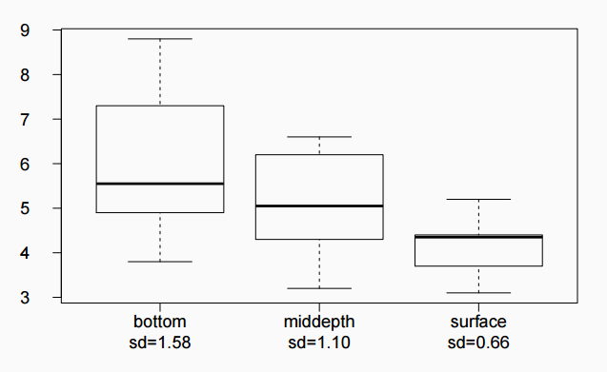
Which means differ?
Based on the box plots below, which means would you expect to be significantly different?
bottom & surface
bottom & mid-depth
mid-depth & surface
bottom & mid-depth;
mid-depth & surface
bottom & mid-depth;
bottom & surface;
mid-depth & surface

Slide 61


Which means differ? (cont.)
If the ANOVA assumption of equal variability across groups is satisfied, we can use the data from all groups to estimate variability:
Estimate any within-group standard deviation with , which is s_{pooled}
Use the error degrees of freedom, n − k, for t-distributions
Difference in two means: after ANOVA

Slide 62
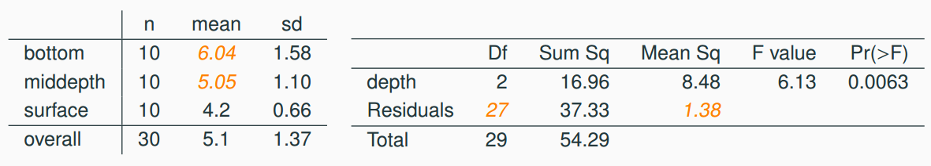
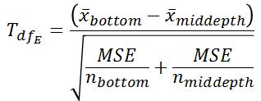
Is there a difference between the average aldrin concentration at the bottom and at mid depth?

Slide 63

Is there a difference between the average aldrin concentration at the bottom and at mid depth?

Slide 64
Is there a difference between the average aldrin concentration at the bottom and at mid depth?

Slide 65

Is there a difference between the average aldrin concentration at the bottom and at mid depth?

Slide 66
Is there a difference between the average aldrin concentration at the bottom and at mid depth?
Fail to reject H₀, the data do not provide convincing evidence of a difference between the average aldrin concentrations at bottom and mid depth

Slide 67
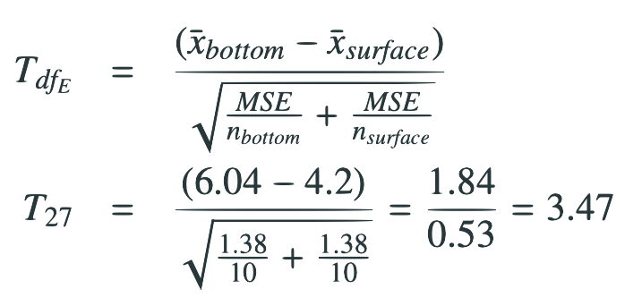
Pairwise comparisons
Is there a difference between the average aldrin concentration at the bottom and at surface?

Slide 68
Pairwise comparisons
Is there a difference between the average aldrin concentration at the bottom and at surface?

Slide 69

Pairwise comparisons
Is there a difference between the average aldrin concentration at the bottom and at surface?

Slide 70
Pairwise comparisons
Is there a difference between the average aldrin concentration at the bottom and at surface?

Slide 71
Pairwise comparisons
Is there a difference between the average aldrin concentration at the bottom and at surface?
Reject H₀, the data provide convincing evidence of a difference between the average aldrin concentrations at bottom and surface

