Slide 1
Inference for Difference Between Many Proportions
Dr. Ab Mosca (they/them)
Slides based off slides courtesy of OpenIntro and John McGreedy of Johns Hopkins University

Slide 2
Chi-Square Test of Independence

Slide 3
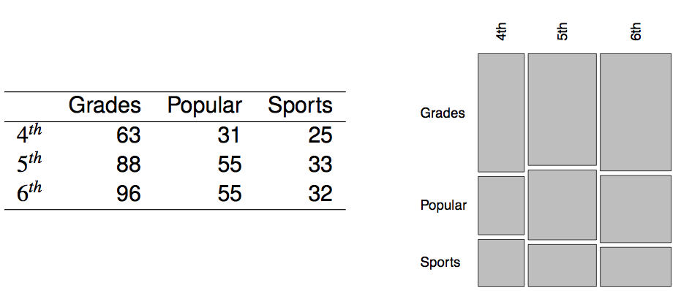
Popular kids
In the dataset popular, students in grades 4-6 were asked whether good grades, athletic ability, or popularity was most important to them. A two-way table separating the students by grade and by choice of most important factor is shown below. Do these data provide evidence to suggest that goals vary by grade?

Slide 4
Chi-square test of independence
The hypotheses are:
H₀: Grade and goals are independent. Goals do not vary by grade.
H_{A}: Grade and goals are dependent. Goals vary by grade.

Slide 5
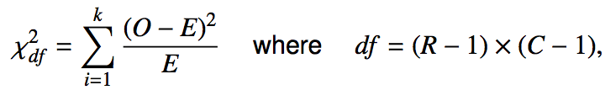
Chi-square test of independence
The hypotheses are:
H₀: Grade and goals are independent. Goals do not vary by grade.
H_{A}: Grade and goals are dependent. Goals vary by grade.
The test statistic is calculated as
where k is the number of cells, R is the number of rows, and C is the number of columns.
_______________
Note: we calculate df differently for one-way and two-way tables.

Slide 6
Chi-square test of independence
The hypotheses are:
H₀: Grade and goals are independent. Goals do not vary by grade.
H_{A}: Grade and goals are dependent. Goals vary by grade.
The test statistic is calculated as
where k is the number of cells, R is the number of rows, and C is the number of columns.
_______________
Note: we calculate df differently for one-way and two-way tables.
The p-value is the area under the χ²_{df} curve, above the calculated test statistic.

Slide 7

Expected counts in two-way tables

Slide 8
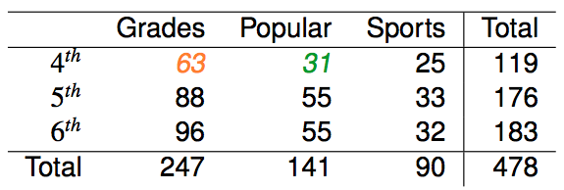
Expected counts in two-way tables

Slide 9

Expected counts in two-way tables

Slide 10

Expected counts in two-way tables

Slide 11
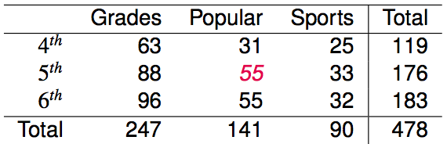
Expected counts in two-way tables
What is the expected count for the highlighted cell?
176 x 141 / 478
119 x 141 / 478
176 x 247 / 478
176 x 478 / 478

Slide 12
Expected counts in two-way tables
What is the expected count for the highlighted cell?
176 x 141 / 478
119 x 141 / 478
176 x 247 / 478
176 x 478 / 478
→ 52
more than expected # of 5th graders
have a goal of being popular

Slide 13
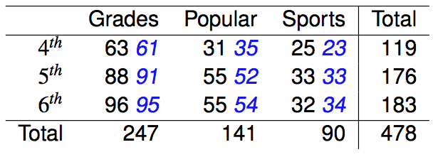
Calculating the test statistic in two-way tables
Expected counts are shown in blue next to the observed counts.

Slide 14

Calculating the test statistic in two-way tables
Expected counts are shown in blue next to the observed counts.

Slide 15
Calculating the test statistic in two-way tables
Expected counts are shown in blue next to the observed counts.

Slide 16
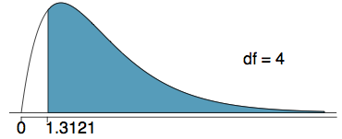
Calculating the p-value
Which of the following is the correct p-value for this hypothesis test?
χ²_{df} = 1.3121 df = 4
more than 0.3
between 0.3 and 0.2
between 0.2 and 0.1
between 0.1 and 0.05
less than 0.001

Slide 17
Calculating the p-value
Which of the following is the correct p-value for this hypothesis test?
χ²_{df} = 1.3121 df = 4
more than 0.3
between 0.3 and 0.2
between 0.2 and 0.1
between 0.1 and 0.05
less than 0.001

Slide 18
Conclusion
Do these data provide evidence to suggest that goals vary by grade?
H₀: Grade and goals are independent. Goals do not vary by grade.
H_{A}: Grade and goals are dependent. Goals vary by grade.

Slide 19
Conclusion
Do these data provide evidence to suggest that goals vary by grade?
H₀: Grade and goals are independent. Goals do not vary by grade.
H_{A}: Grade and goals are dependent. Goals vary by grade.
Since the p-value is large, we fail to reject H₀.The data do not provide convincing evidence that grade and goals are dependent. It doesn't appear that goals vary by grade.

Slide 20
Find more resources at openintro.org/os, including
Slides
Videos
Statistical Software Labs
Discussion Forums (free support for students and teachers)
Learning Objectives
Teachers only content is also available for Verified Teachers, including
Exercise solutions
Sample exams
Ability to request a free desk copy for a course
Statistics Teachers email group
Questions? Contact us.

Slide 21
Extra Slides from the OS3 section on chi-square test of independence

Slide 22
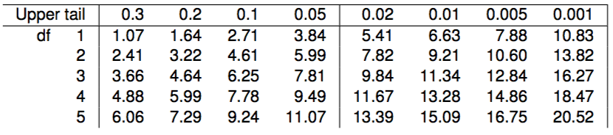
Calculating the p-value
Which of the following is the correct p-value for this hypothesis test?
χ²_{df} = 1.3121 df = 4
more than 0.3
between 0.3 and 0.2
between 0.2 and 0.1
between 0.1 and 0.05
less than 0.001

Slide 23
Calculating the p-value
Which of the following is the correct p-value for this hypothesis test?
χ²_{df} = 1.3121 df = 4
more than 0.3
between 0.3 and 0.2
between 0.2 and 0.1
between 0.1 and 0.05
less than 0.001

Slide 24
Chi-Square test of GOF

Slide 25
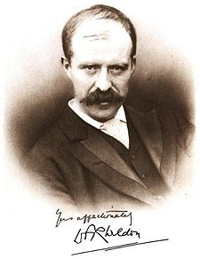
Weldon's dice
Walter Frank Raphael Weldon (1860 - 1906), was an English evolutionary biologist and a founder of biometry. He was the joint founding editor of Biometrika, with Francis Galton and Karl Pearson.
In 1894, he rolled 12 dice 26,306 times, and recorded the number of 5s or 6s (which he considered to be a success).
It was observed that 5s or 6s occurred more often than expected, and Pearson hypothesized that this was probably due to the construction of the dice. Most inexpensive dice have hollowed-out pips, and since opposite sides add to 7, the face with 6 pips is lighter than its opposing face, which has only 1 pip.

Slide 26
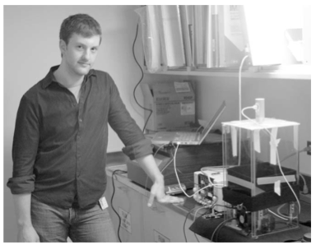
Labby's dice
In 2009, Zacariah Labby (U of Chicago), repeated Weldon's experiment using a homemade dice-throwing, pip counting machine.
www.youtube.com/watch?v=95EErdouO2w
The rolling-imaging process took about 20 seconds per roll.
Each day there were ~150 images to process manually.
At this rate Weldon's experiment was repeated in a little more than six full days.
Recommended reading: galton.uchicago.edu/about/docs/labby09dice.pdf

Slide 27
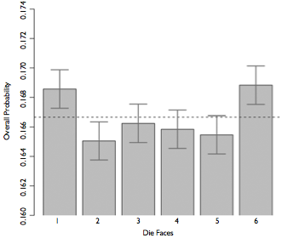
Labby's dice (cont.)
Labby did not actually observe the same phenomenon that Weldon observed (higher frequency of 5s and 6s).
Automation allowed Labby to collect more data than Weldon did in 1894, instead of recording "successes" and "failures", Labby recorded the individual number of pips on each die.

Slide 28
Expected counts
Labby rolled 12 dice 26,306 times. If each side is equally likely to come up, how many 1s, 2s, ..., 6s would he expect to have observed?
1/6
12/6
26,306 / 6
12 x 26,306 / 6

Slide 29
Expected counts
Labby rolled 12 dice 26,306 times. If each side is equally likely to come up, how many 1s, 2s, ..., 6s would he expect to have observed?
1/6
12 / 6
26,306 / 6
12 x 26,306 / 6 = 52,612

Slide 30
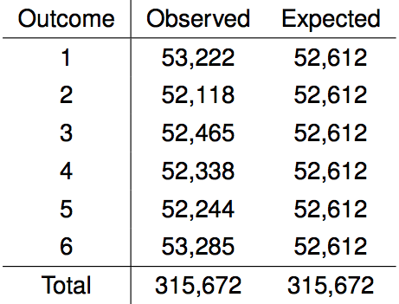
Summarizing Labby's results
The table below shows the observed and expected counts from Labby's experiment.

Slide 31
Summarizing Labby's results
The table below shows the observed and expected counts from Labby's experiment.
Why are the expected counts the same for all outcomes but the observed counts are different? At a first glance, does there appear to be an inconsistency between the observed and expected counts?

Slide 32
Setting the hypotheses
Do these data provide convincing evidence of an inconsistency between the observed and expected counts?

Slide 33
Setting the hypotheses
Do these data provide convincing evidence of an inconsistency between the observed and expected counts?
H₀: There is no inconsistency between the observed and the expected counts. The observed counts follow the same distribution as the expected counts.

Slide 34
Setting the hypotheses
Do these data provide convincing evidence of an inconsistency between the observed and expected counts?
H₀: There is no inconsistency between the observed and the expected counts. The observed counts follow the same distribution as the expected counts.
H_{A}: There is an inconsistency between the observed and the expected counts. The observed counts do not follow the same distribution as the expected counts. There is a bias in which side comes up on the roll of a die.

Slide 35
Evaluating the hypotheses
To evaluate these hypotheses, we quantify how different the observed counts are from the expected counts.

Slide 36
Evaluating the hypotheses
To evaluate these hypotheses, we quantify how different the observed counts are from the expected counts.
Large deviations from what would be expected based on sampling variation (chance) alone provide strong evidence for the alternative hypothesis.

Slide 37
Evaluating the hypotheses
To evaluate these hypotheses, we quantify how different the observed counts are from the expected counts.
Large deviations from what would be expected based on sampling variation (chance) alone provide strong evidence for the alternative hypothesis.
This is called a goodness of fit test since we're evaluating how well the observed data fit the expected distribution.

Slide 38

Anatomy of a test statistic
The general form of a test statistic is

Slide 39
Anatomy of a test statistic
The general form of a test statistic is
This construction is based on
identifying the difference between a point estimate and an expected value if the null hypothesis was true, and
standardizing that difference using the standard error of the point estimate.

Slide 40
Anatomy of a test statistic
The general form of a test statistic is
This construction is based on
identifying the difference between a point estimate and an expected value if the null hypothesis was true, and
standardizing that difference using the standard error of the point estimate.
These two ideas will help in the construction of an appropriate test statistic for count data.

Slide 41
Chi-square statistic
When dealing with counts and investigating how far the observed counts are from the expected counts, we use a new test statistic called the chi-square (χ²) statistic.

Slide 42
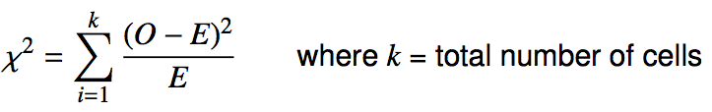
Chi-square statistic
When dealing with counts and investigating how far the observed counts are from the expected counts, we use a new test statistic called the chi-square (χ²) statistic.
χ² statistic

Slide 43
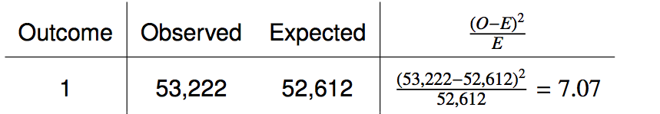
Calculating the chi-square statistic

Slide 44
Calculating the chi-square statistic

Slide 45
Calculating the chi-square statistic

Slide 46

Calculating the chi-square statistic

Slide 47
Calculating the chi-square statistic

Slide 48
Calculating the chi-square statistic

Slide 49

Calculating the chi-square statistic

Slide 50
Why square?
Squaring the difference between the observed and the expected outcome does two things:

Slide 51
Why square?
Squaring the difference between the observed and the expected outcome does two things:
Any standardized difference that is squared will now be positive.

Slide 52
Why square?
Squaring the difference between the observed and the expected outcome does two things:
Any standardized difference that is squared will now be positive.
Differences that already looked unusual will become much larger after being squared.

Slide 53
Why square?
Squaring the difference between the observed and the expected outcome does two things:
Any standardized difference that is squared will now be positive.
Differences that already looked unusual will become much larger after being squared.
When have we seen this before?

Slide 54
The chi-square distribution
In order to determine if the χ² statistic we calculated is considered unusually high or not we need to first describe its distribution.

Slide 55
The chi-square distribution
In order to determine if the χ² statistic we calculated is considered unusually high or not we need to first describe its distribution.
The chi-square distribution has just one parameter called degrees of freedom (df), which influences the shape, center, and spread of the distribution.

Slide 56
The chi-square distribution
In order to determine if the χ² statistic we calculated is considered unusually high or not we need to first describe its distribution.
The chi-square distribution has just one parameter called degrees of freedom (df), which influences the shape, center, and spread of the distribution.
Remember
So far we've seen three other continuous distributions:
normal distribution: unimodal and symmetric with two parameters: mean and standard deviation
T distribution: unimodal and symmetric with one parameter: degrees of freedom
F distribution: unimodal and right skewed with two parameters: degrees of freedom or numerator (between group variance) and denominator (within group variance)

Slide 57
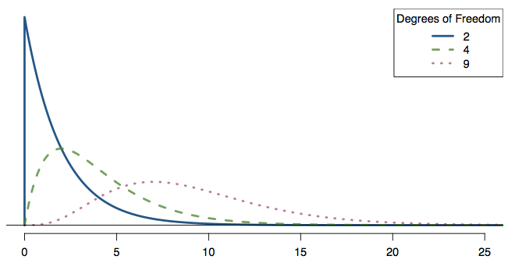
Practice
Which of the following is false?
As the df increases,
the center of the χ² distribution increases as well
the variability of the χ² distribution increases as well
the shape of the χ² distribution becomes more skewed (less like a normal)

Slide 58
Practice
Which of the following is false?
As the df increases,
the center of the χ² distribution increases as well
the variability of the χ² distribution increases as well
the shape of the χ² distribution becomes more skewed (less like a normal)

Slide 59
Finding areas under the chi-square curve
p-value = tail area under the chi-square distribution (as usual)

Slide 60
Finding areas under the chi-square curve
p-value = tail area under the chi-square distribution (as usual)
For this we can use technology, or a chi-square probability table.

Slide 61
Finding areas under the chi-square curve
Estimate the shaded area under the chi-square curve with df = 6.

Slide 62
Finding areas under the chi-square curve
Estimate the shaded area under the chi-square curve with df = 6.
> pchisq(q = 10, df = 6, lower.tail = FALSE)
[1] 0.124652

Slide 63
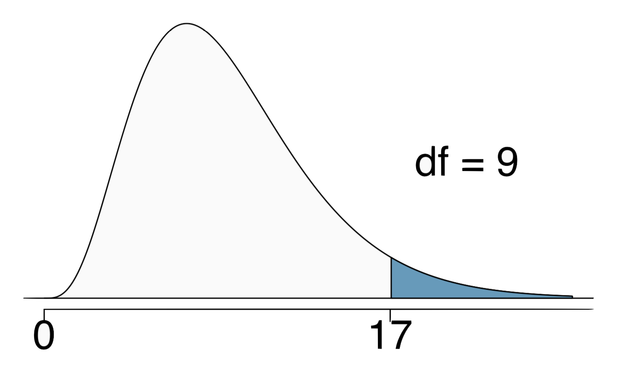
Finding areas under the chi-square curve
Estimate the shaded area above a cutoff value of 17 for the chi-square curve with df = 9.
(a) 0.05
(b) 0.02
(c) between 0.02 and 0.05
(d) between 0.05 and 0.1
(e) between 0.01 and 0.02

Slide 64
Finding areas under the chi-square curve
Estimate the shaded area above a cutoff value of 17 for the chi-square curve with df = 9.
(a) 0.05
(b) 0.02
(c) between 0.02 and 0.05
(d) between 0.05 and 0.1
(e) between 0.01 and 0.02
> pchisq(q = 17, df = 9, lower.tail = FALSE)
[1] 0.04871598

Slide 65
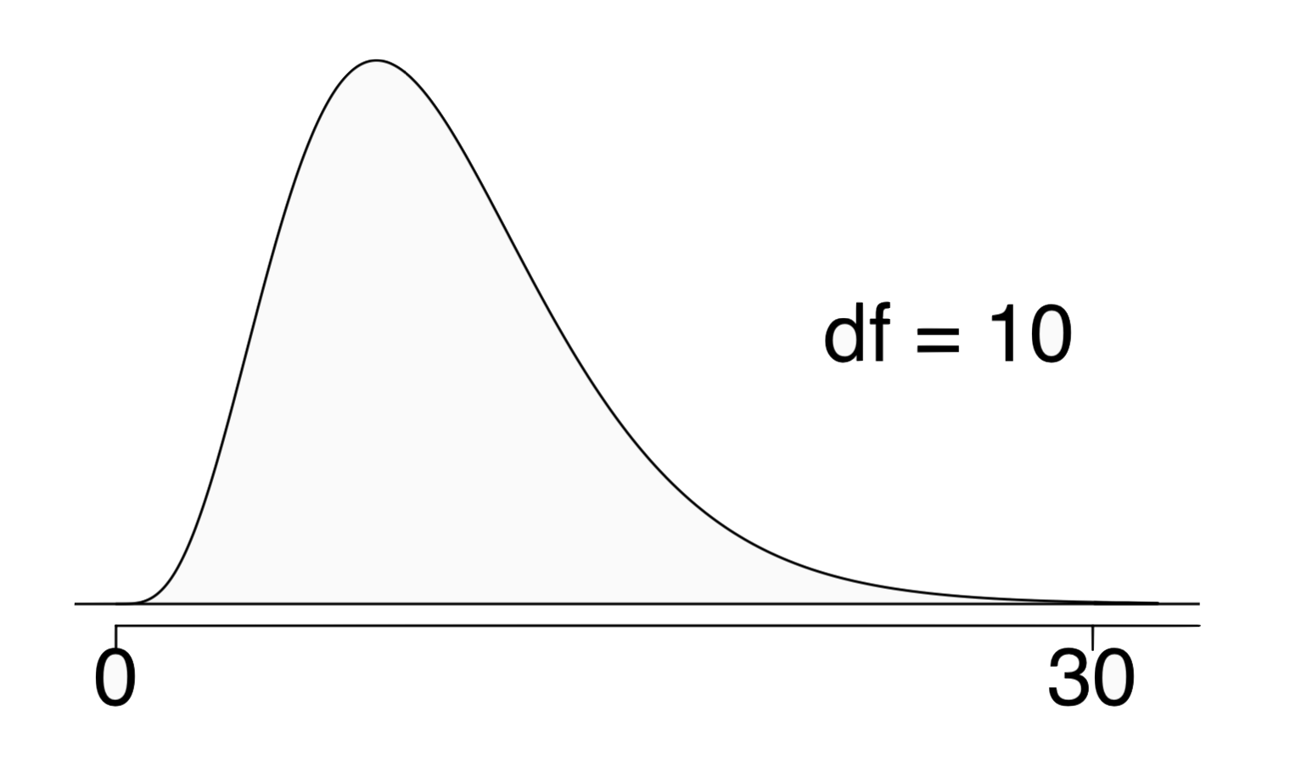
Finding areas under the chi-square curve
Estimate the shaded area above a cutoff value of 30 for the chi-square curve with df = 10.
(a) greater than 0.3
(b) between 0.005 and 0.001
(c) less than 0.001
(d) greater than 0.001
(e) cannot tell using this table

Slide 66
Finding areas under the chi-square curve
Estimate the shaded area above a cutoff value of 30 for the chi-square curve with df = 10.
(a) greater than 0.3
(b) between 0.005 and 0.001
(c) less than 0.001
(d) greater than 0.001
(e) cannot tell using this table
> pchisq(q = 30, df = 10, lower.tail = FALSE)
[1] 0.0008566412

Slide 67
Back to Labby's dice
The research question was: Do these data provide convincing evidence of an inconsistency between the observed and expected counts?

Slide 68
Back to Labby's dice
The research question was: Do these data provide convincing evidence of an inconsistency between the observed and expected counts?
The hypotheses were:
H₀: There is no inconsistency between the observed and the expected counts. The observed counts follow the same distribution as the expected counts.
H_{A}: There is an inconsistency between the observed and the expected counts. The observed counts do not follow the same distribution as the expected counts. There is a bias in which side comes up on the roll of a die.

Slide 69
Back to Labby's dice
The research question was: Do these data provide convincing evidence of an inconsistency between the observed and expected counts?
The hypotheses were:
H₀: There is no inconsistency between the observed and the expected counts. The observed counts follow the same distribution as the expected counts.
H_{A}: There is an inconsistency between the observed and the expected counts. The observed counts do not follow the same distribution as the expected counts. There is a bias in which side comes up on the roll of a die.
We had calculated a test statistic of χ² = 24.67.

Slide 70
Back to Labby's dice
The research question was: Do these data provide convincing evidence of an inconsistency between the observed and expected counts?
The hypotheses were:
H₀: There is no inconsistency between the observed and the expected counts. The observed counts follow the same distribution as the expected counts.
H_{A}: There is an inconsistency between the observed and the expected counts. The observed counts do not follow the same distribution as the expected counts. There is a bias in which side comes up on the roll of a die.
We had calculated a test statistic of χ² = 24.67.
All we need is the df and we can calculate the tail area (the p-value) and make a decision on the hypotheses.

Slide 71
Degrees of freedom for a goodness of fit test
When conducting a goodness of fit test to evaluate how well the observed data follow an expected distribution, the degrees of freedom are calculated as the number of cells (k) minus 1. df = k - 1

Slide 72
Degrees of freedom for a goodness of fit test
When conducting a goodness of fit test to evaluate how well the observed data follow an expected distribution, the degrees of freedom are calculated as the number of cells (k) minus 1. df = k - 1
For dice outcomes, k = 6, therefore df = 6 - 1 = 5

Slide 73
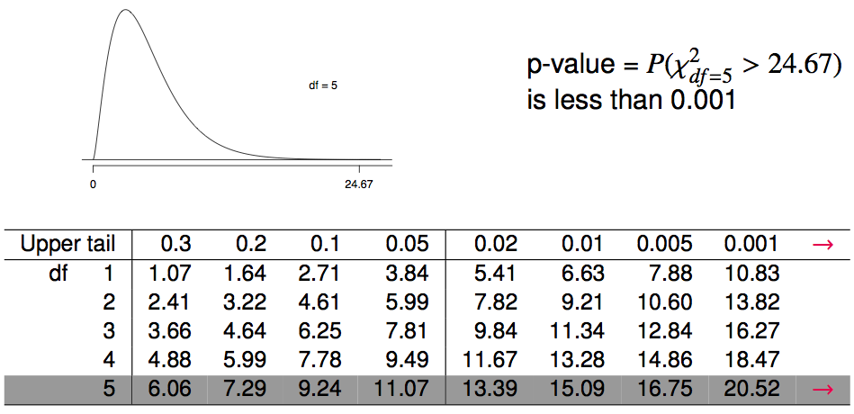
Finding a p-value for a chi-square test
The p-value for a chi-square test is defined as the tail area above the calculated test statistic.

Slide 74
Conclusion of the hypothesis test
We calculated a p-value less than 0.001. At 5% significance level, what is the conclusion of the hypothesis test?
Reject H₀, the data provide convincing evidence that the dice are fair.
Reject H₀, the data provide convincing evidence that the dice are biased.
Fail to reject H₀, the data provide convincing evidence that the dice are fair.
Fail to reject H₀, the data provide convincing evidence that the dice are biased.

Slide 75
Conclusion of the hypothesis test
We calculated a p-value less than 0.001. At 5% significance level, what is the conclusion of the hypothesis test?
Reject H₀, the data provide convincing evidence that the dice are fair.
Reject H₀, the data provide convincing evidence that the dice are biased.
Fail to reject H₀, the data provide convincing evidence that the dice are fair.
Fail to reject H₀, the data provide convincing evidence that the dice are biased.

Slide 76
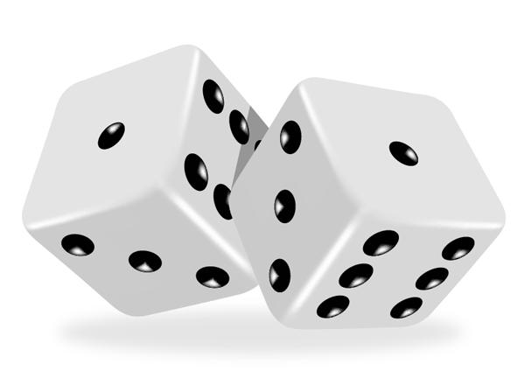

Turns out...
The 1-6 axis is consistently shorter than the other two (2-5 and 3-4), thereby supporting the hypothesis that the faces with one and six pips are larger than the other faces.
Pearson's claim that 5s and 6s appear more often due to the carved-out pips is not supported by these data.
Dice used in casinos have flush faces, where the pips are filled in with a plastic of the same density as the surrounding material and are precisely balanced.

Slide 77
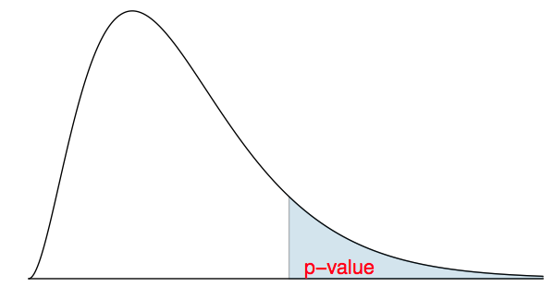
Recap: p-value for a chi-square test
The p-value for a chi-square test is defined as the tail area above the calculated test statistic.
This is because the test statistic is always positive, and a higher test statistic means a stronger deviation from the null hypothesis.

Slide 78
Conditions for the chi-square test
Independence: Each case that contributes a count to the table must be independent of all the other cases in the table.

Slide 79
Conditions for the chi-square test
Independence: Each case that contributes a count to the table must be independent of all the other cases in the table.
Sample size: Each particular scenario (i.e. cell) must have at least 5 expected cases.

Slide 80
Conditions for the chi-square test
Independence: Each case that contributes a count to the table must be independent of all the other cases in the table.
Sample size: Each particular scenario (i.e. cell) must have at least 5 expected cases.
df > 1: Degrees of freedom must be greater than 1.

Slide 81
Conditions for the chi-square test
Independence: Each case that contributes a count to the table must be independent of all the other cases in the table.
Sample size: Each particular scenario (i.e. cell) must have at least 5 expected cases.
df > 1: Degrees of freedom must be greater than 1.
Failing to check conditions may unintentionally affect the test's error rates.

Slide 82
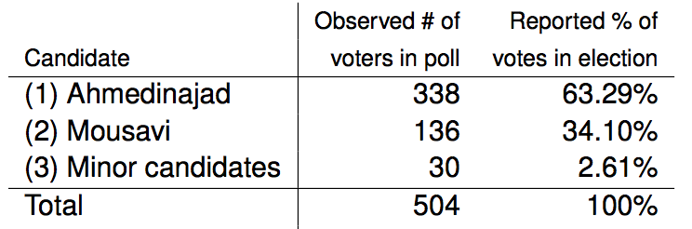
2009 Iran Election
There was lots of talk of election fraud in the 2009 Iran election. We'll compare the data from a poll conducted before the election (observed data) to the reported votes in the election to see if the two follow the same distribution.

Slide 83
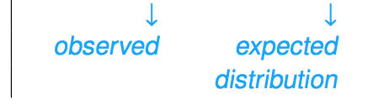
2009 Iran Election
There was lots of talk of election fraud in the 2009 Iran election. We'll compare the data from a poll conducted before the election (observed data) to the reported votes in the election to see if the two follow the same distribution.

Slide 84
Hypotheses
What are the hypotheses for testing if the distributions of reported and polled votes are different?

Slide 85
Hypotheses
What are the hypotheses for testing if the distributions of reported and polled votes are different?
H₀: The observed counts from the poll follow the same distribution as the reported votes.
H_{A}: The observed counts from the poll do not follow the same distribution as the reported votes.

Slide 86
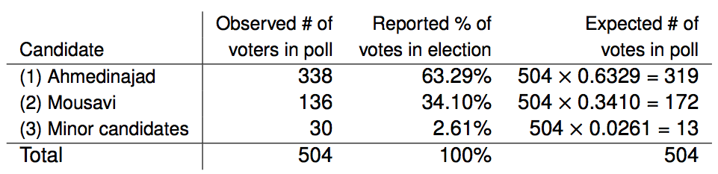
Calculation of the test statistic

Slide 87

Calculation of the test statistic

Slide 88

Calculation of the test statistic

Slide 89

Calculation of the test statistic

Slide 90

Calculation of the test statistic

Slide 91
Conclusion
Based on these calculations what is the conclusion of the hypothesis test?
p-value is low, H₀ is rejected. The observed counts from the poll do not follow the same distribution as the reported votes.
p-value is high, H₀ is not rejected. The observed counts from the poll follow the same distribution as the reported votes.
p-value is low, H₀ is rejected. The observed counts from the poll follow the same distribution as the reported votes
p-value is low, H₀ is not rejected. The observed counts from the poll do not follow the same distribution as the reported votes.

Slide 92
Conclusion
Based on these calculations what is the conclusion of the hypothesis test?
p-value is low, H₀ is rejected. The observed counts from the poll do not follow the same distribution as the reported votes.
p-value is high, H₀ is not rejected. The observed counts from the poll follow the same distribution as the reported votes.
p-value is low, H₀ is rejected. The observed counts from the poll follow the same distribution as the reported votes
p-value is low, H₀ is not rejected. The observed counts from the poll do not follow the same distribution as the reported votes.

Slide 93
Find more resources at openintro.org/os, including
Slides
Videos
Statistical Software Labs
Discussion Forums (free support for students and teachers)
Learning Objectives
Teachers only content is also available for Verified Teachers, including
Exercise solutions
Sample exams
Ability to request a free desk copy for a course
Statistics Teachers email group
Questions? Contact us.

Slide 94
Extra Slides from the OS3 section on testing for goodness of fit

Slide 95
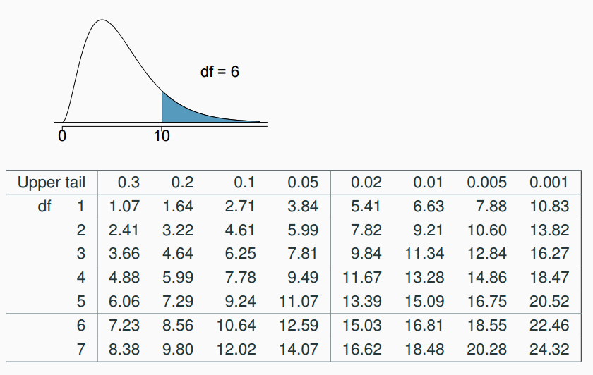
Finding areas under the chi-square curve
Estimate the shaded area under the chi-square curve with df = 6.

Slide 96
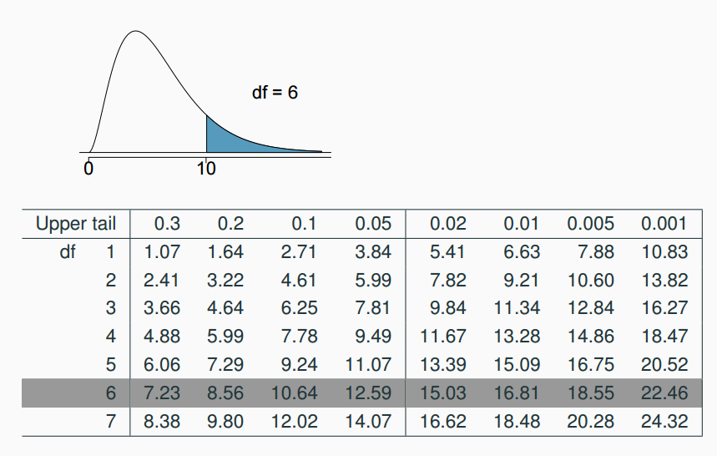
Finding areas under the chi-square curve (cont.)
Estimate the shaded area under the chi-square curve with df = 6.

Slide 97
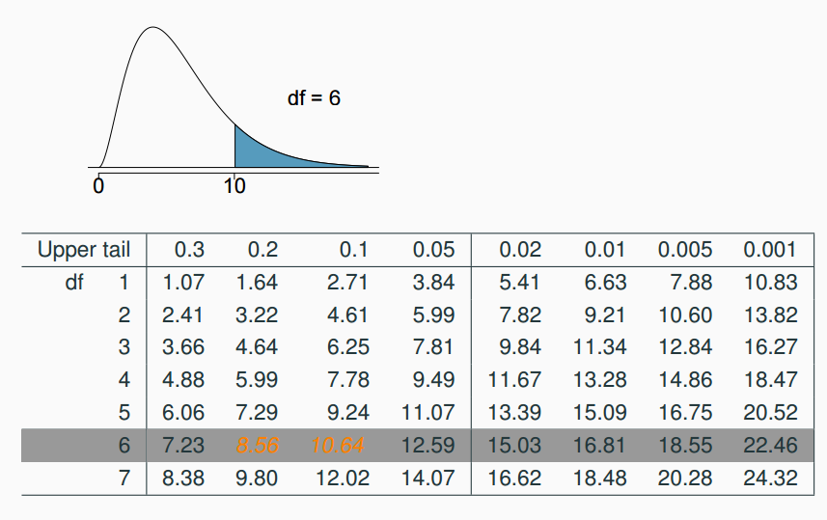
Finding areas under the chi-square curve (cont.)
Estimate the shaded area under the chi-square curve with df = 6.

Slide 98
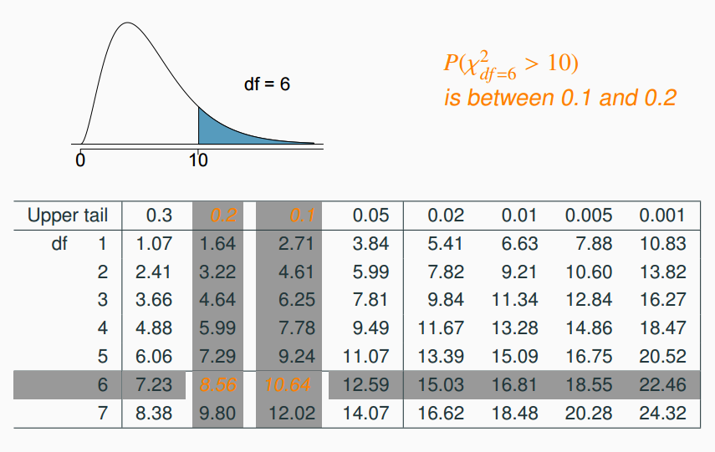
Finding areas under the chi-square curve (cont.)
Estimate the shaded area under the chi-square curve with df = 6.

Slide 99
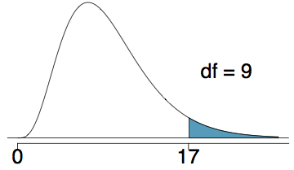
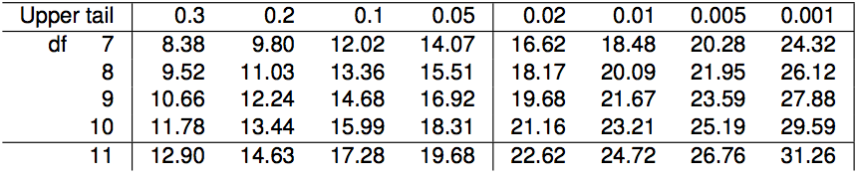
Finding areas under the chi-square curve (cont.)
Estimate the shaded area (above 17) under the χ² curve with df = 9.
between 0.01 and 0.02
0.02
between 0.02 and 0.05
0.05
between 0.05 and 0.10

Slide 100
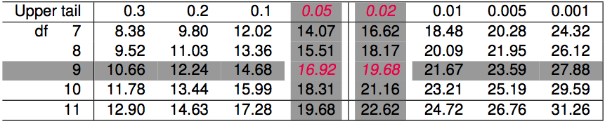
Finding areas under the chi-square curve (cont.)
Estimate the shaded area (above 17) under the χ² curve with df = 9.
between 0.01 and 0.02
0.02
between 0.02 and 0.05
0.05
between 0.05 and 0.10

Slide 101
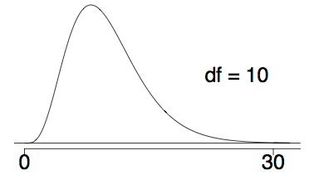
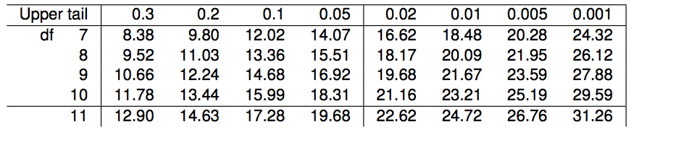
Finding areas under the chi-square curve (one more)
Estimate the shaded area (above 30) under the χ² curve with df = 10.
between 0.005 and 0.001
less than 0.001
greater than 0.001
greater than 0.3
cannot tell using this table

Slide 102
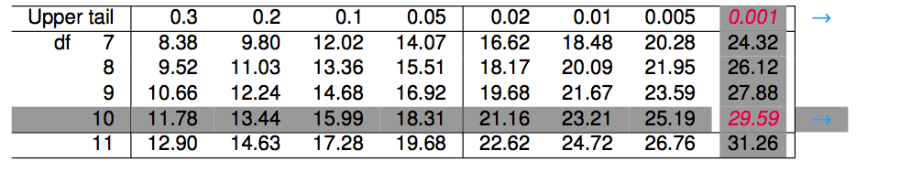
Finding areas under the chi-square curve (one more)
Estimate the shaded area (above 30) under the χ² curve with df = 10.
greater than 0.3
between 0.005 and 0.001
less than 0.001
greater than 0.001
cannot tell using this table

Slide 103
Finding the tail areas using computation
While probability tables are very helpful in understanding how probability distributions work, and provide quick reference when computational resources are not available, they are somewhat archaic.

Slide 104
Finding the tail areas using computation
While probability tables are very helpful in understanding how probability distributions work, and provide quick reference when computational resources are not available, they are somewhat archaic.
Using R: pchisq(q = 30, df = 10, lower.tail = FALSE) # 0.0008566412

Slide 105
Finding the tail areas using computation
While probability tables are very helpful in understanding how probability distributions work, and provide quick reference when computational resources are not available, they are somewhat archaic.
Using R: pchisq(q = 30, df = 10, lower.tail = FALSE) # 0.0008566412
Using a web applet: http://bitly.com/dist_calc

Slide 106
Finding a p-value for a chi-square test
The p-value for a chi-square test is defined as the tail area above the calculated test statistic.

