Slide 1
Elementary Statistics-MATH 108: Data
Dr. Ab Mosca (they/them)
Slides based off slides courtesy of OpenIntro and John McGreedy of Johns Hopkins University

Slide 2
Reminder
hw-01 is released today and due next week
Check the course website for instructions, submit on PLATO

Slide 3
Plan for Today
Data types
Data tables
Data ethics

Slide 4
Data Types

Slide 5
Brainstorm
What information could we collect about folks in this class?

Slide 6
Brainstorm
What information could we collect about folks in this class?
Would all of the information we get be formatted similarly or differently?

Slide 7
Categorizing Data
All Data
Numerical
Continuous
Discrete
Categorical
Nominal
Ordinal

Slide 8
Categorizing Data
All Data
Numerical
Continuous
Discrete
Categorical
Nominal
Ordinal

Slide 9
Numerical - Continuous
Continuous data (incremental measurements)
Blood pressure, mmHg
Weight, lbs (kgs, oz, etc.)
Height, ft (cm, in, etc.)
Age, years (months)
Income level, dollars/year (Euro by year, etc.)
A defining characteristic of continuous data is that a one-unit change in the value means the same thing across the entire range of data values

Slide 10
Numerical - Continuous
Continuous data (incremental measurements)
Blood pressure, mmHg
Weight, lbs (kgs, oz, etc.)
Height, ft (cm, in, etc.)
Age, years (months)
Income level, dollars/year (Euro by year, etc.)
A defining characteristic of continuous data is that a one-unit change in the value means the same thing across the entire range of data values
What other examples can you think of? Brainstorm with whoever is near you

Slide 11
Numerical – Discrete (Binary)
Binary (dichotomous) data: takes on only two values, “yes” or “no”
Binary (dichotomous) data (“yes/no” data)
Polio: Yes/No
Remission: Yes/No
Quit smoking: Yes/No
Etc.

Slide 12
Numerical – Discrete (Binary)
Binary (dichotomous) data: takes on only two values, “yes” or “no”
Binary (dichotomous) data (“yes/no” data)
Polio: Yes/No
Remission: Yes/No
Quit smoking: Yes/No
Etc.
What other examples can you think of? Brainstorm with whoever is near you

Slide 13
Categorizing Data
All Data
Numerical
Continuous
Discrete
Categorical
Nominal
Ordinal

Slide 14
Categorical - Nominal
Categorical data: an extension of binary data to include more than 2 possible values
Nominal categorical data: no inherent order to categories
Gender Identity
Race/ethnicity
Country of birth
Religious affiliation

Slide 15
Categorical - Nominal
Categorical data: an extension of binary data to include more than 2 possible values
Nominal categorical data: no inherent order to categories
Gender Identity
Race/ethnicity
Country of birth
Religious affiliation
What other examples can you think of? Brainstorm with whoever is near you

Slide 16
Categorical - Ordinal
Categorical data: an extension of binary data to include more than 2 possible values
Ordinal categorical data: order to categories
Income level categorized into four categories, least to greatest
Degree of agreement, five categories from strongly disagree to strongly agree

Slide 17
Categorical - Ordinal
Categorical data: an extension of binary data to include more than 2 possible values
Ordinal categorical data: order to categories
Income level categorized into four categories, least to greatest
Degree of agreement, five categories from strongly disagree to strongly agree
What other examples can you think of? Brainstorm with whoever is near you

Slide 18
Practice
Work with whoever is near you to categorize the data we decided to collect about the class into data types
All Data
Numerical
Continuous
Discrete
Categorical
Nominal
Ordinal

Slide 19
Data Tables

Slide 20
Classroom survey
Practice
A survey was conducted on students in an introductory statistics course. Below are a few of the questions on the survey, and the corresponding variables the data from the responses were stored in:
gender: What is your gender?
intro_extra: Are you an introvert or an extrovert?
sleep: How many hours do you sleep at night, on average?
bedtime: What time do you usually go to bed?
countries: How many countries have you visited?
dread: On a scale of 1-5, how much do you dread being here?

Slide 21
Classroom survey
Practice
gender: What is your gender?
intro_extra: Are you an introvert or an extrovert?
sleep: How many hours do you sleep at night, on average?
bedtime: What time do you usually go to bed?
countries: How many countries have you visited?
dread: On a scale of 1-5, how much do you dread being here?
What is the data type for each of these?

Slide 22
Classroom survey
Practice
gender: What is your gender?
categorical – nominal
intro_extra: Are you an introvert or an extrovert?
numerical – discrete, OR categorical – nominal
sleep: How many hours do you sleep at night, on average?
numerical – continuous
bedtime: What time do you usually go to bed?
numerical – continuous
countries: How many countries have you visited?
numerical – continuous
dread: On a scale of 1-5, how much do you dread being here?
categorical – ordinal

Slide 23
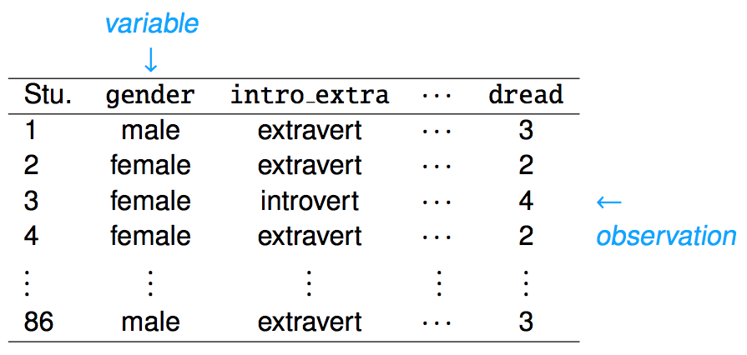
Classroom survey
Data Table
Often, collected data is stored in one or more tables

Slide 24
Classroom survey
Data Table
Often, collected data is stored in one or more tables
One column in a table represents one datum collected, and is called a variable (or attribute)

Slide 25
Classroom survey
Data Table
Often, collected data is stored in one or more tables
One column in a table represents one datum collected, and is called a variable (or attribute)
One row in a table contains values for each datum collected about one item, and is called an observation

Slide 26
What are the variables in this data set?
What does one observation represent?
Practice
MA DCR Precipitation Database
STATION | YEAR |  | JAN | CITY | Region Composite Station | Region | Basin Name
GRA220 | 1908 |  | 3.05 | Westfield | Yes | Connecticut River | WESTFIELD
GRA220 | 1909 |  | 4.06 | Westfield | Yes | Connecticut River | WESTFIELD
GRA220 | 1910 |  | 6.4 | Westfield | Yes | Connecticut River | WESTFIELD
GRA220 | 1911 |  | 2.06 | Westfield | Yes | Connecticut River | WESTFIELD
 |  |  |  | . . .
https://www.mass.gov/info-details/precipitation-data

Slide 27
What are the variables in this data set?
What does one observation represent?
Practice
MA DCR Precipitation Database
Variables →
STATION | YEAR |  | JAN | CITY | Region Composite Station | Region | Basin Name
GRA220 | 1908 |  | 3.05 | Westfield | Yes | Connecticut River | WESTFIELD
GRA220 | 1909 |  | 4.06 | Westfield | Yes | Connecticut River | WESTFIELD
GRA220 | 1910 |  | 6.4 | Westfield | Yes | Connecticut River | WESTFIELD
GRA220 | 1911 |  | 2.06 | Westfield | Yes | Connecticut River | WESTFIELD
 |  |  |  | . . .
row == one instance of rainfall collection
https://www.mass.gov/info-details/precipitation-data

Slide 28
What are the variables in this data set?
What does one observation represent?
Practice
MA Undergraduate Enrollment
Year | Segment | Unduplicated Headcount
2020 | State Universities | 36053
2020 | University of Massachusetts | 56857
2020 | Community Colleges | 67685
 | . . .
https://www.mass.edu/datacenter/2020enrollmentestimates.asp

Slide 29
What are the variables in this data set?
What does one observation represent?
Practice
MA Undergraduate Enrollment
Variables →
Year | Segment | Unduplicated Headcount
2020 | State Universities | 36053
2020 | University of Massachusetts | 56857
2020 | Community Colleges | 67685
 | . . .
row == one segment in one year
https://www.mass.edu/datacenter/2020enrollmentestimates.asp

Slide 30
What are the variables in this data set?
What does one observation represent?
Practice
MA Outdoor Advertisement Signs
PermitHoldersName | SignCity | RoadIntendedToFace | Active | SignType
Clear Channel Outdoor | Worcester | Rt 122 | 1 | Traditional
Clear Channel Outdoor | Worcester | Rt. 290 | 1 | Digital
Murray Marketing, Inc | Worcester | I-290 | 1 | Digital
Lamar Central Outdoor, LLC | Westfield | Southampton Rd | 1 | Traditional
 | . . .
https://geo-massdot.opendata.arcgis.com/datasets/MassDOT::outdoor-advertising-outdoor-advertisement-signs/explore?location=42.046332%2C-71.718750%2C8.93

Slide 31
What are the variables in this data set?
What does one observation represent?
Practice
MA Outdoor Advertisement Signs
Variables →
PermitHoldersName | SignCity | RoadIntendedToFace | Active | SignType
Clear Channel Outdoor | Worcester | Rt 122 | 1 | Traditional
Clear Channel Outdoor | Worcester | Rt. 290 | 1 | Digital
Murray Marketing, Inc | Worcester | I-290 | 1 | Digital
Lamar Central Outdoor, LLC | Westfield | Southampton Rd | 1 | Traditional
 | . . .
row == one outdoor advertisement sign
https://geo-massdot.opendata.arcgis.com/datasets/MassDOT::outdoor-advertising-outdoor-advertisement-signs/explore?location=42.046332%2C-71.718750%2C8.93

Slide 32
Types of Variables
All Variables
Numerical
Continuous
Discrete
Categorical
Nominal
Ordinal

Slide 33
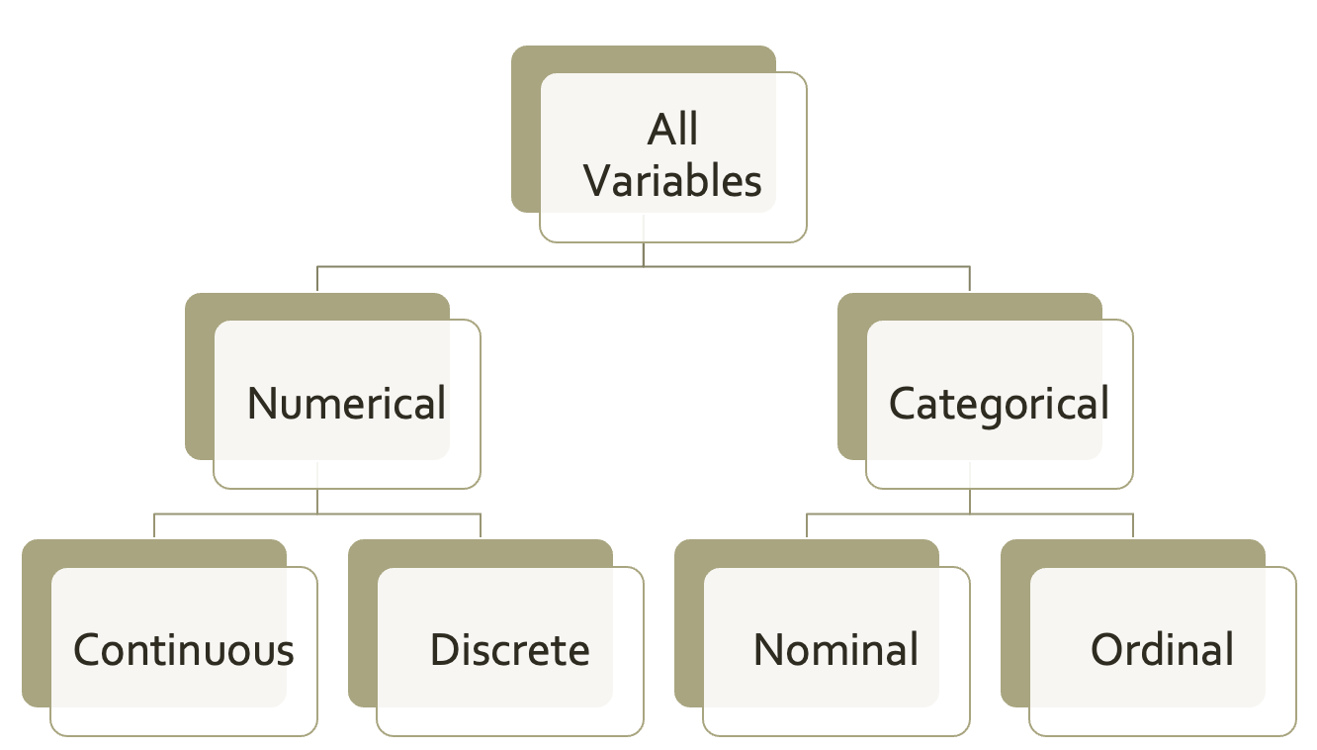
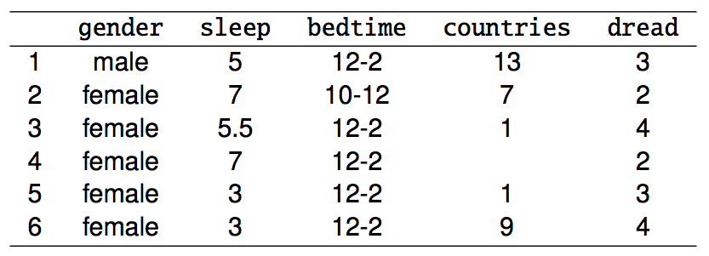
What are the types of these variables?
Types of Variables

Slide 34
What are the types of these variables?
Types of Variables
nominal
continuous
continuous
continuous
ordinal

Slide 35
What are the types of these variables?
Types of Variables
MA DCR Precipitation Database
STATION | YEAR |  | JAN | CITY | Region Composite Station | Region | Basin Name
GRA220 | 1908 |  | 3.05 | Westfield | Yes | Connecticut River | WESTFIELD
GRA220 | 1909 |  | 4.06 | Westfield | Yes | Connecticut River | WESTFIELD
GRA220 | 1910 |  | 6.4 | Westfield | Yes | Connecticut River | WESTFIELD
GRA220 | 1911 |  | 2.06 | Westfield | Yes | Connecticut River | WESTFIELD
 |  |  |  | . . .

Slide 36
What are the types of these variables?
Types of Variables
MA DCR Precipitation Database
STATION | YEAR |  | JAN | CITY | Region Composite Station | Region | Basin Name
GRA220 | 1908 |  | 3.05 | Westfield | Yes | Connecticut River | WESTFIELD
GRA220 | 1909 |  | 4.06 | Westfield | Yes | Connecticut River | WESTFIELD
GRA220 | 1910 |  | 6.4 | Westfield | Yes | Connecticut River | WESTFIELD
GRA220 | 1911 |  | 2.06 | Westfield | Yes | Connecticut River | WESTFIELD
 |  |  |  | . . .
nominal
continuous
continuous
nominal
discrete
nominal
nominal

Slide 37
What are the types of these variables?
Types of Variables
MA Undergraduate Enrollment
Year | Segment | Unduplicated Headcount
2020 | State Universities | 36053
2020 | University of Massachusetts | 56857
2020 | Community Colleges | 67685
 | . . .

Slide 38
What are the types of these variables?
Types of Variables
MA Undergraduate Enrollment
Year | Segment | Unduplicated Headcount
2020 | State Universities | 36053
2020 | University of Massachusetts | 56857
2020 | Community Colleges | 67685
 | . . .
continuous
nominal
continuous

Slide 39
What are the types of these variables?
Types of Variables
MA Outdoor Advertisement Signs
PermitHoldersName | SignCity | RoadIntendedToFace | Active | SignType
Clear Channel Outdoor | Worcester | Rt 122 | 1 | Traditional
Clear Channel Outdoor | Worcester | Rt. 290 | 1 | Digital
Murray Marketing, Inc | Worcester | I-290 | 1 | Digital
Lamar Central Outdoor, LLC | Westfield | Southampton Rd | 1 | Traditional
 | . . .

Slide 40
What are the types of these variables?
Types of Variables
MA Outdoor Advertisement Signs
PermitHoldersName | SignCity | RoadIntendedToFace | Active | SignType
Clear Channel Outdoor | Worcester | Rt 122 | 1 | Traditional
Clear Channel Outdoor | Worcester | Rt. 290 | 1 | Digital
Murray Marketing, Inc | Worcester | I-290 | 1 | Digital
Lamar Central Outdoor, LLC | Westfield | Southampton Rd | 1 | Traditional
 | . . .
nominal
nominal
nominal
discrete
nominal

Slide 41
Data Ethics

Slide 42
Responsible Consumption
What details should we look for when evaluating a data set?
Brainstorm with the person next to you and come up with at least 3 things

Slide 43
Responsible Consumption
What details should we look for when evaluating a data set?
Who published the data?
Who collected the data?
Who funded collection of the data?
Who (or what) is included in the dataset?
Who (or what) is missing from the dataset?
Was the data transparently collected?
Was the data legally collected?
Are there any privacy issues?

Slide 44
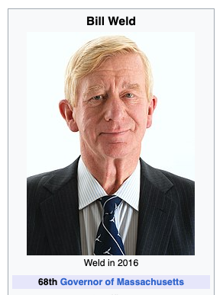

Responsible Collection and Use
What can go wrong?
Disclosure and Reidentification
https://mdsr-book.github.io/mdsr2e/ch-ethics.html
Notes:
The ability to link multiple data sets and to use public information to identify individuals is a growing problem. A glaring example of this occurred in 1996 when then-Governor of Massachusetts William Weld collapsed while attending a graduation ceremony at Bentley College. An MIT graduate student used information from a public data release by the Massachusetts Group Insurance Commission to identify Weld’s subsequent hospitalization records.
The disclosure of this information was highly publicized and led to many changes in data releases. This was a situation where the right balance was not struck between disclosure (to help improve health care and control costs) and nondisclosure (to help ensure private information is not made public). There are many challenges to ensure disclosure avoidance (Zaslavsky and Horton 1998; Ohm 2010). This remains an active and important area of research.
The Health Insurance Portability and Accountability Act (HIPAA) was passed by the United States Congress in 1996—the same year as Weld’s illness. The law augmented and clarified the role that researchers and medical care providers had in maintaining protected health information (PHI). The HIPAA regulations developed since then specify procedures to ensure that individually identifiable PHI is protected when it is transferred, received, handled, analyzed, or shared. As an example, detailed geographic information (e.g., home or office location) is not allowed to be shared unless there is an overriding need. For research purposes, geographic information might be limited to state or territory, though for certain rare diseases or characteristics even this level of detail may lead to disclosure. Those whose PHI is not protected can file a complaint with the Office of Civil Rights.
The HIPAA structure, while limited to medical information, provides a useful model for disclosure avoidance that is relevant to other data scientists. Parties accessing PHI need to have privacy policies and procedures. They must identify a privacy official and undertake training of their employees. If there is a disclosure they must mitigate the effects to the extent practical. There must be reasonable data safeguards to prevent intentional or unintentional use. Covered entities may not retaliate against someone for assisting in investigations of disclosures. Organizations must maintain records and documentation for six years after their last use of the data. Similar regulations protect information collected by the statistical agencies of the United States.

Slide 45



Responsible Collection and Use
What can go wrong?
Unsafe storage
https://mdsr-book.github.io/mdsr2e/ch-ethics.html
Notes:
Inadvertent disclosures of data can be even more damaging than planned disclosures. Stories abound of protected data being made available on the internet with subsequent harm to those whose information is made accessible. Such releases may be due to misconfigured databases, malware, theft, or by posting on a public forum. Each individual and organization needs to practice safe computing, to regularly audit their systems, and to implement plans to address computer and data security. Such policies need to ensure that protections remain even when equipment is transferred or disposed of.

Slide 46

Responsible Collection and Use
What can go wrong?
Scraping and Terms of Use
https://mdsr-book.github.io/mdsr2e/ch-ethics.html
Notes:
A different issue arises relating to legal status of material on the Web. Consider Zillow.com, an online real-estate database company that combines data from a number of public and private sources to generate house price and rental information on more than 100 million homes across the United States. Zillow has made access to their database available through an API (see Section 6.4.2) under certain restrictions. The terms of use for Zillow are provided in a legal document. They require that users of the API consider the data on an “as is” basis, not replicate functionality of the Zillow website or mobile app, not retain any copies of the Zillow data, not separately extract data elements to enhance other data files, and not use the data for direct marketing.
Another common form for terms of use is a limit to the amount or frequency of access. Zillow’s API is limited to 1,000 calls per day to the home valuations or property details. Another example: The Weather Underground maintains an API focused on weather information. They provide no-cost access limited to 500 calls per day and 10 calls per minute and with no access to historical information. They have a for-pay system with multiple tiers for accessing more extensive data.
Data points are not just content in tabular form. Text is also data. Many websites have restrictions on text mining. Slate.com, for example, states that users may not:
“Engage in unauthorized spidering, scraping, or harvesting of content or information, or use any other unauthorized automated means to compile information.”
Apparently, it violates the Slate.com terms of use to compile a compendium of Slate articles (even for personal use) without their authorization.
To get authorization, you need to ask for it. Albert Y. Kim of Smith College published data with information for 59,946 San Francisco OkCupid users (a free online dating website) with the permission of the president of OkCupid (Kim and Escobedo-Land 2015). To help minimize possible damage, he also removed certain variables (e.g., username) that would make it more straightforward to reidentify the profiles. Contrast the concern for privacy taken here to the careless doxing of OkCupid users mentioned above.

Slide 47
Responsible Collection and Use
Reproducibility
A reproducible analysis records each and every step, no matter how trivial seeming, in a data analysis. The main elements of a reproducible analysis plan (as described by Project TIER include:
Data: all original data files in the form in which they originated,
Metadata: codebooks and other information needed to understand the data,
Commands: the computer code needed to extract, transform, and load the data—then run analyses, fit models, generate graphical displays, and
Map: a file that maps between the output and the results in the report.
https://mdsr-book.github.io/mdsr2e/ch-ethics.html

Slide 48
Investigate
Work with a few people
Find an article from a news source (ex. New York Times, Washington Post, FiveThirtyEight) that includes data
See if you can
Find who collected the data
Find who funded the data collection
Find the original data set
How difficult was it to find these things?
Be prepared to share

