Slide 1
Collecting Data
Dr. Ab Mosca (they/them)
Slides based off slides courtesy of OpenIntro and John McGreedy of Johns Hopkins University

Slide 2
Populations and Samples

Slide 3
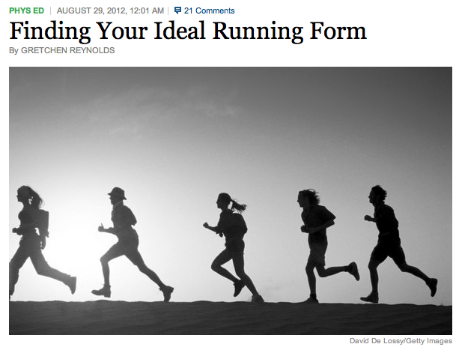
Populations and Samples
Research Question: Can people become better, more efficient runners on their own, merely by running?
http://well.blogs.nytimes.com/2012/08/29/finding-your-ideal-running-form

Slide 4
Populations and Samples
Research Question: Can people become better, more efficient runners on their own, merely by running?
Population of Interest: All people
http://well.blogs.nytimes.com/2012/08/29/finding-your-ideal-running-form

Slide 5
Populations and Samples
Research Question: Can people become better, more efficient runners on their own, merely by running?
Population of Interest: All people
http://well.blogs.nytimes.com/2012/08/29/finding-your-ideal-running-form
Sample: Group of adult women who recently joined a running group

Slide 6
Populations and Samples
Research Question: Can people become better, more efficient runners on their own, merely by running?
Population of Interest: All people
http://well.blogs.nytimes.com/2012/08/29/finding-your-ideal-running-form
Sample: Group of adult women who recently joined a running group
Population to which results can be generalized: Adult women, if the data are randomly sampled

Slide 7
Anecdotal evidence and early smoking research
Anti-smoking research started in the 1930s and 1940s when cigarette smoking became increasingly popular. While some smokers seemed to be sensitive to cigarette smoke, others were completely unaffected.
Anti-smoking research was faced with resistance based on anecdotal evidence such as "My uncle smokes three packs a day and he's in perfectly good health", evidence based on a limited sample size that might not be representative of the population.
It was concluded that "smoking is a complex human behavior, by its nature difficult to study, confounded by human variability."
In time researchers were able to examine larger samples of cases (smokers), and trends showing that smoking has negative health impacts became much clearer.
Brandt, The Cigarette Century (2009), Basic Books.

Slide 8
Census
Wouldn't it be better to just include everyone and "sample" the entire population?
This is called a census.

Slide 9
Census
Wouldn't it be better to just include everyone and "sample" the entire population?
This is called a census.
There are problems with taking a census:
It can be difficult to complete a census: there always seem to be some individuals who are hard to locate or hard to measure. And these difficult-to-find people may have certain characteristics that distinguish them from the rest of the population.
Populations rarely stand still. Even if you could take a census, the population changes constantly, so it's never possible to get a perfect measure.
Taking a census may be more complex than sampling.

Slide 10
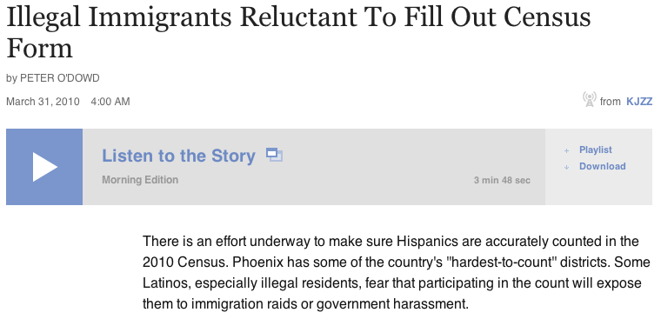
http://www.npr.org/templates/story/story.php?storyId=125380052

Slide 11
Exploratory analysis to inference
Sampling is natural.

Slide 12
Exploratory analysis to inference
Sampling is natural.
Think about sampling something you are cooking - you taste (examine) a small part of what you're cooking to get an idea about the dish as a whole.

Slide 13
Exploratory analysis to inference
Sampling is natural.
Think about sampling something you are cooking - you taste (examine) a small part of what you're cooking to get an idea about the dish as a whole.
When you taste a spoonful of soup and decide the spoonful you tasted isn't salty enough, that's exploratory analysis.

Slide 14
Exploratory analysis to inference
Sampling is natural.
Think about sampling something you are cooking - you taste (examine) a small part of what you're cooking to get an idea about the dish as a whole.
When you taste a spoonful of soup and decide the spoonful you tasted isn't salty enough, that's exploratory analysis.
If you generalize and conclude that your entire soup needs salt, that's an inference.

Slide 15
Exploratory analysis to inference
Sampling is natural.
Think about sampling something you are cooking - you taste (examine) a small part of what you're cooking to get an idea about the dish as a whole.
When you taste a spoonful of soup and decide the spoonful you tasted isn't salty enough, that's exploratory analysis.
If you generalize and conclude that your entire soup needs salt, that's an inference.
For your inference to be valid, the spoonful you tasted (the sample) needs to be representative of the entire pot (the population).
If your spoonful comes only from the surface and the salt is collected at the bottom of the pot, what you tasted is probably not representative of the whole pot.
If you first stir the soup thoroughly before you taste, your spoonful will more likely be representative of the whole pot.

Slide 16
Sampling bias
Non-response: If only a small fraction of the randomly sampled people choose to respond to a survey, the sample may no longer be representative of the population.

Slide 17
Sampling bias
Non-response: If only a small fraction of the randomly sampled people choose to respond to a survey, the sample may no longer be representative of the population.
Voluntary response: Occurs when the sample consists of people who volunteer to respond because they have strong opinions on the issue. Such a sample will also not be representative of the population.

Slide 18
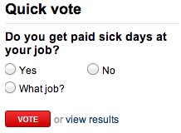
Sampling bias
Non-response: If only a small fraction of the randomly sampled people choose to respond to a survey, the sample may no longer be representative of the population.
Voluntary response: Occurs when the sample consists of people who volunteer to respond because they have strong opinions on the issue. Such a sample will also not be representative of the population.

Slide 19
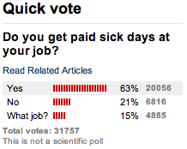
Sampling bias
Non-response: If only a small fraction of the randomly sampled people choose to respond to a survey, the sample may no longer be representative of the population.
Voluntary response: Occurs when the sample consists of people who volunteer to respond because they have strong opinions on the issue. Such a sample will also not be representative of the population.

Slide 20
Sampling bias
Non-response: If only a small fraction of the randomly sampled people choose to respond to a survey, the sample may no longer be representative of the population.
Voluntary response: Occurs when the sample consists of people who volunteer to respond because they have strong opinions on the issue. Such a sample will also not be representative of the population.
Convenience sample: Individuals who are easily accessible are more likely to be included in the sample.

Slide 21
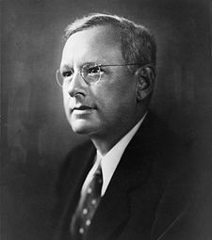
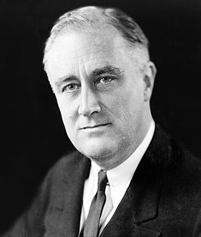
Sampling bias example:
Landon vs. FDR
A historical example of a biased sample yielding misleading results
In 1936, Landon sought the Republican presidential nomination opposing the re-election of FDR.

Slide 22

The Literary Digest Poll
The Literary Digest polled about 10 million Americans, and got responses from about 2.4 million.
The poll showed that Landon would likely be the overwhelming winner and FDR would get only 43% of the votes.
Election result: FDR won, with 62% of the votes.
The magazine was completely discredited because of the poll, and was soon discontinued.

Slide 23
The Literary Digest Poll -
what went wrong?
The magazine had surveyed
its own readers,
registered automobile owners, and
registered telephone users.
These groups had incomes well above the national average of the day (remember, this is Great Depression era) which resulted in lists of voters far more likely to support Republicans than a truly typical voter of the time, i.e. the sample was not representative of the American population at the time.

Slide 24
Large samples are preferable, but...
The Literary Digest election poll was based on a sample size of 2.4 million, which is huge, but since the sample was biased, the sample did not yield an accurate prediction.
Back to the soup analogy: If the soup is not well stirred, it doesn't matter how large a spoon you have, it will still not taste right. If the soup is well stirred, a small spoon will suffice to test the soup.

Slide 25
Practice
A school district is considering whether it will no longer allow high school students to park at school after two recent accidents where students were severely injured. As a first step, they survey parents by mail, asking them whether or not the parents would object to this policy change. Of 6,000 surveys that go out, 1,200 are returned. Of these 1,200 surveys that were completed, 960 agreed with the policy change and 240 disagreed. Which of the following statements are true?
Some of the mailings may have never reached the parents.
The school district has strong support from parents to move forward with the policy approval.
It is possible that majority of the parents of high school students disagree with the policy change.
The survey results are unlikely to be biased because all parents were mailed a survey.
(a) Only I (b) I and II (c) I and III (d) III and IV (e) Only IV

Slide 26
Practice
A school district is considering whether it will no longer allow high school students to park at school after two recent accidents where students were severely injured. As a first step, they survey parents by mail, asking them whether or not the parents would object to this policy change. Of 6,000 surveys that go out, 1,200 are returned. Of these 1,200 surveys that were completed, 960 agreed with the policy change and 240 disagreed. Which of the following statements are true?
Some of the mailings may have never reached the parents.
The school district has strong support from parents to move forward with the policy approval.
It is possible that majority of the parents of high school students disagree with the policy change.
The survey results are unlikely to be biased because all parents were mailed a survey.
(a) Only I (b) I and II (c) I and III (d) III and IV (e) Only IV

Slide 27
Observational studies
Researchers collect data in a way that does not directly interfere with how the data arise.
Results of an observational study can generally be used to establish an association between the explanatory and response variables.

Slide 28
Obtaining good samples
Almost all statistical methods are based on the notion of implied randomness.
If observational data are not collected in a random framework from a population, these statistical methods – the estimates and errors associated with the estimates – are not reliable.
Most commonly used random sampling techniques are simple, stratified, and cluster sampling.

Slide 29
Prospective vs.
Retrospective Studies
A prospective study identifies individuals and collects information as events unfold.
Example: The Nurses Health Study has been recruiting registered nurses and then collecting data from them using questionnaires since 1976.
Retrospective studies collect data after events have taken place.
Example: Researchers reviewing past events in medical records.

Slide 30
Obtaining Good Samples
Almost all statistical methods are based on the notion of implied randomness.
If observational data are not collected in a random framework from a population, these statistical methods -- the estimates and errors associated with the estimates -- are not reliable.
Most commonly used random sampling techniques are simple, stratified, and cluster sampling.

Slide 31
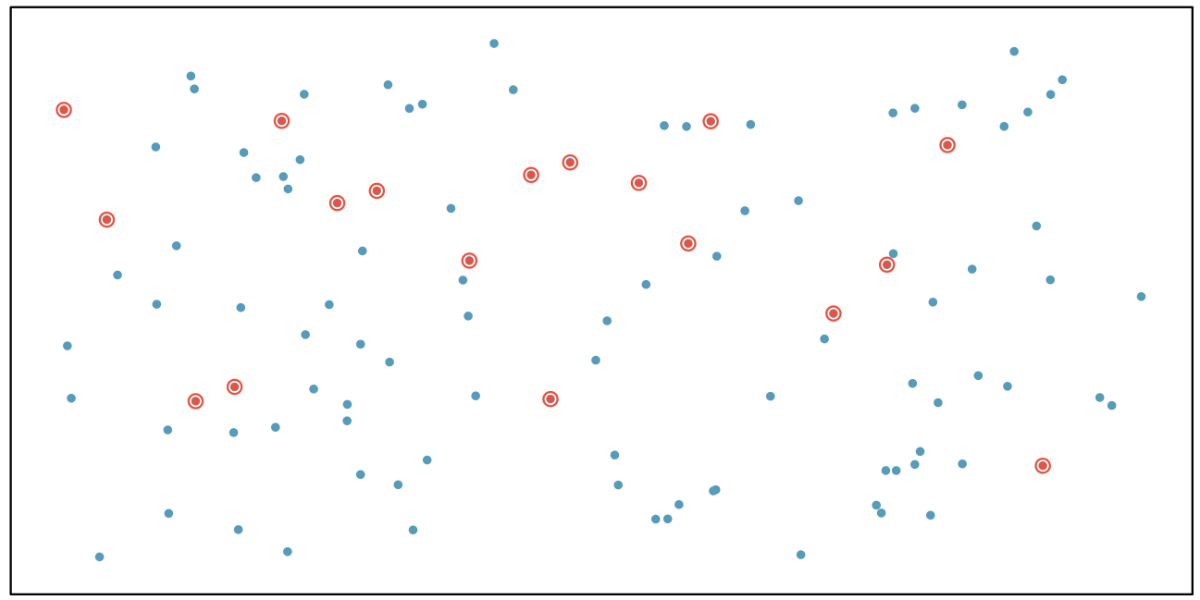
Simple Random Sample
Randomly select cases from the population, where there is no implied connection between the points that are selected.

Slide 32
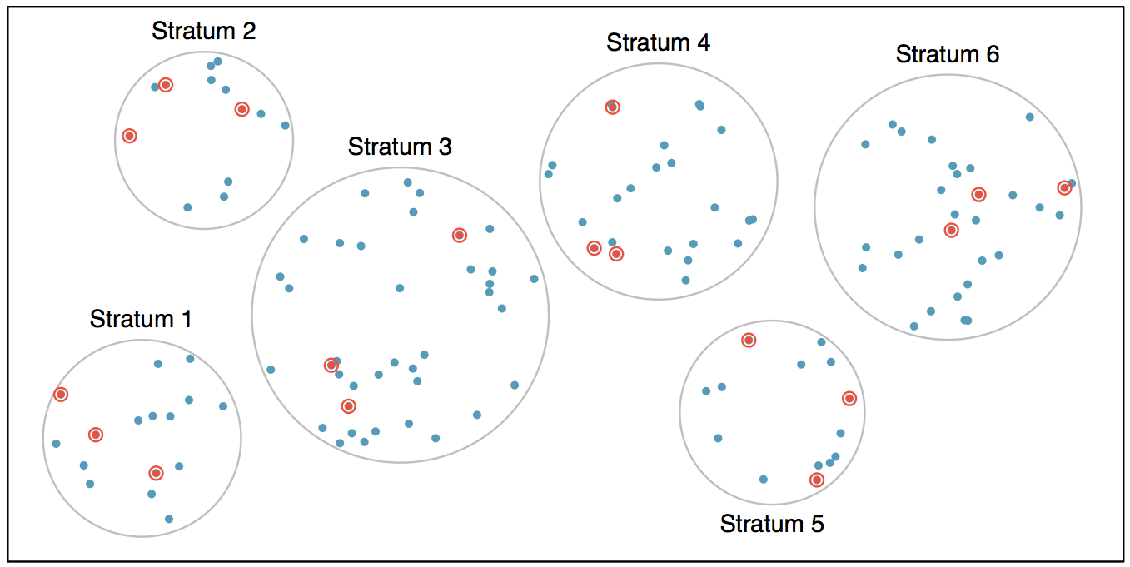
Stratified Sample
Strata are made up of similar observations. We take a simple random sample from each stratum.

Slide 33
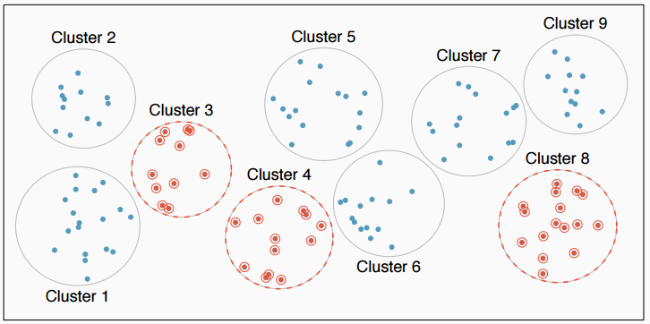
Cluster Sample
Clusters are usually not made up of homogeneous observations. We take a simple random sample of clusters, and then sample all observations in that cluster. Usually preferred for economical reasons.

Slide 34
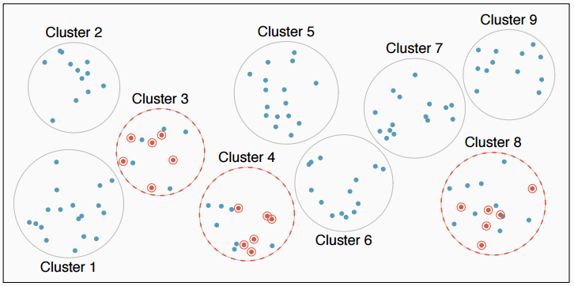
Multistage Sample
Clusters are usually not made up of homogeneous observations. We take a simple random sample of clusters, and then take a simple random sample of observations from the sampled clusters

Slide 35
Practice
A city council has requested a household survey be conducted in a suburban area of their city. The area is broken into many distinct and unique neighborhoods, some including large homes, some with only apartments. Which approach would likely be the least effective?
(a) Simple random sampling
(b) Cluster sampling
(c) Stratified sampling
(d) Blocked sampling

Slide 36
Practice
A city council has requested a household survey be conducted in a suburban area of their city. The area is broken into many distinct and unique neighborhoods, some including large homes, some with only apartments. Which approach would likely be the least effective?
(a) Simple random sampling
(b) Cluster sampling
(c) Stratified sampling
(d) Blocked sampling

Slide 37
Study Design

Slide 38
Experiments

Slide 39
Principles of experimental design
Control: Compare treatment of interest to a control group.
Randomize: Randomly assign subjects to treatments, and randomly sample from the population whenever possible.
Replicate: Within a study, replicate by collecting a sufficiently large sample. Or replicate the entire study.
Block: If there are variables that are known or suspected to affect the response variable, first group subjects into blocks based on these variables, and then randomize cases within each block to treatment groups.

Slide 40
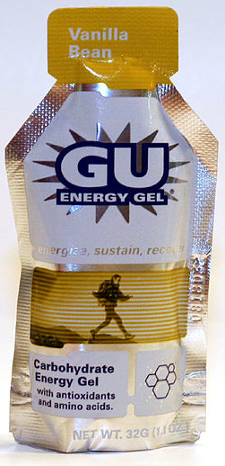
More on Blocking
We would like to design an experiment to investigate if energy gels makes you run faster:

Slide 41
More on Blocking
We would like to design an experiment to investigate if energy gels makes you run faster:
Treatment: energy gel
Control: no energy gel

Slide 42
More on Blocking
We would like to design an experiment to investigate if energy gels makes you run faster:
Treatment: energy gel
Control: no energy gel
It is suspected that energy gels might affect pro and amateur athletes differently, therefore we block for pro status:

Slide 43
More on Blocking
We would like to design an experiment to investigate if energy gels makes you run faster:
Treatment: energy gel
Control: no energy gel
It is suspected that energy gels might affect pro and amateur athletes differently, therefore we block for pro status:
Divide the sample to pro and amateur
Randomly assign pro athletes to treatment and control groups
Randomly assign amateur athletes to treatment and control groups
Pro/amateur status is equally represented in the resulting treatment and control groups

Slide 44
More on Blocking
We would like to design an experiment to investigate if energy gels makes you run faster:
Treatment: energy gel
Control: no energy gel
It is suspected that energy gels might affect pro and amateur athletes differently, therefore we block for pro status:
Divide the sample to pro and amateur
Randomly assign pro athletes to treatment and control groups
Randomly assign amateur athletes to treatment and control groups
Pro/amateur status is equally represented in the resulting treatment and control groups
Why is this important? Can you think of other variables to block for?

Slide 45
Practice
A study is designed to test the effect of light level and noise level on exam performance of students. The researcher also believes that light and noise levels might have different effects on males and females, so wants to make sure both genders are equally represented in each group. Which of the below is correct?
There are 3 explanatory variables (light, noise, gender) and 1 response variable (exam performance)
There are 2 explanatory variables (light and noise), 1 blocking variable (gender), and 1 response variable (exam performance)
There is 1 explanatory variable (gender) and 3 response variables (light, noise, exam performance)
There are 2 blocking variables (light and noise), 1 explanatory variable (gender), and 1 response variable (exam performance)

Slide 46
Practice
A study is designed to test the effect of light level and noise level on exam performance of students. The researcher also believes that light and noise levels might have different effects on males and females, so wants to make sure both genders are equally represented in each group. Which of the below is correct?
There are 3 explanatory variables (light, noise, gender) and 1 response variable (exam performance)
There are 2 explanatory variables (light and noise), 1 blocking variable (gender), and 1 response variable (exam performance)
There is 1 explanatory variable (gender) and 3 response variables (light, noise, exam performance)
There are 2 blocking variables (light and noise), 1 explanatory variable (gender), and 1 response variable (exam performance)

Slide 47
Difference Between Blocking and Explanatory Variables
Factors are conditions we can impose on the experimental units.
Blocking variables are characteristics that the experimental units come with, that we would like to control for.
Blocking is like stratifying, except used in experimental settings when randomly assigning, as opposed to when sampling.

Slide 48
More Experimental Design Terminology...
Placebo: fake treatment, often used as the control group for medical studies
Placebo effect: experimental units showing improvement simply because they believe they are receiving a special treatment
Blinding: when experimental units do not know whether they are in the control or treatment group
Double-blind: when both the experimental units and the researchers who interact with the patients do not know who is in the control and who is in the treatment group

Slide 49
Practice
What is the main difference between observational studies and experiments?
Experiments take place in a lab while observational studies do not need to.
In an observational study we only look at what happened in the past.
Most experiments use random assignment while observational studies do not.
Observational studies are completely useless since no causal inference can be made based on their findings.

Slide 50
Practice
What is the main difference between observational studies and experiments?
Experiments take place in a lab while observational studies do not need to.
In an observational study we only look at what happened in the past.
Most experiments use random assignment while observational studies do not.
Observational studies are completely useless since no causal inference can be made based on their findings.

Slide 51
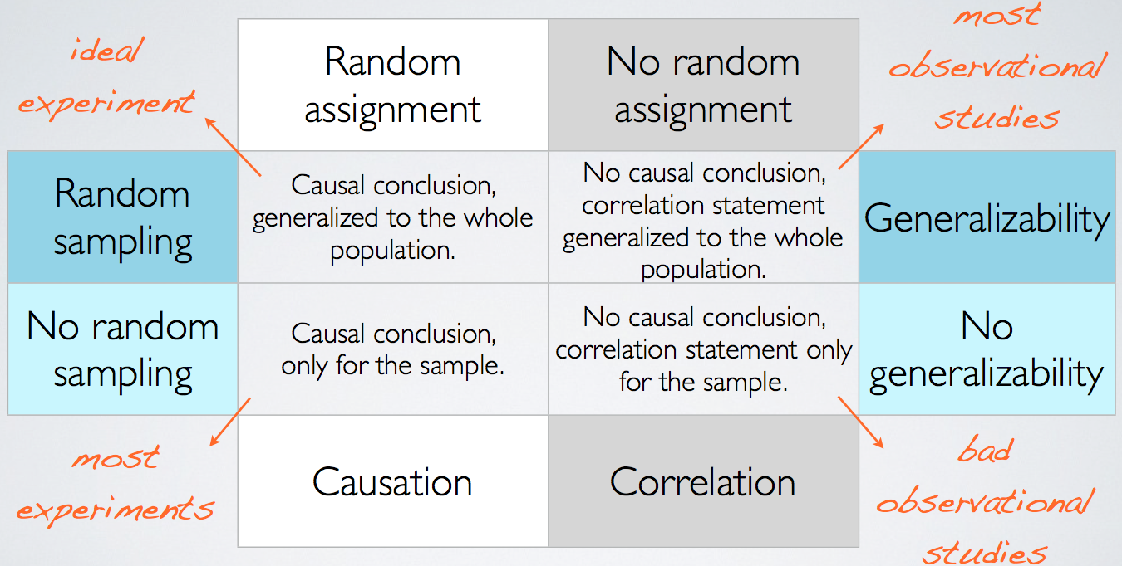
Random Assignment
vs. Random Sampling

