Slide 1
Data
Dr. Ab Mosca (they/them)
Slides based off slides courtesy of OpenIntro and John McGreedy of Johns Hopkins University

Slide 2
Data Types

Slide 3
Brainstorm
What information could we collect about folks in this class?

Slide 4
Brainstorm
What information could we collect about folks in this class?
Of the categories we chose, would the information we get be formatted similarly or differently?

Slide 5
Categorizing Data
All Data
Numerical
Continuous
Discrete
Categorical
Nominal
Ordinal

Slide 6
Numerical - Continuous
Continuous data (incremental measurements)
Blood pressure, mmHg
Weight, lbs (kgs, oz, etc.)
Height, ft (cm, in, etc.)
Age, years (months)
Income level, dollars/year (Euro by year, etc.)
A defining characteristic of continuous data is that a one-unit change in the value means the same thing across the entire range of data values

Slide 7
Numerical – Discrete (Binary)
Binary (dichotomous) data: takes on only two values, “yes” or “no”
Binary (dichotomous) data (“yes/no” data)
Polio: Yes/No
Remission: Yes/No
Sex or Sex Assigned at Birth
Male/Female (or as yes/no, “is subject male?”)
Quit smoking: Yes/No
Etc.

Slide 8
Categorical - Nominal
Categorical data: an extension of binary data to include more than 2 possible values
Nominal categorical data: no inherent order to categories
Gender Identity
Race/ethnicity
Country of birth
Religious affiliation

Slide 9
Categorical - Ordinal
Categorical data: an extension of binary data to include more than 2 possible values
Ordinal categorical data: order to categories
Income level categorized into four categories, least to greatest
Degree of agreement, five categories from strongly disagree to strongly agree

Slide 10
Data Tables

Slide 11
Classroom survey
A survey was conducted on students in an introductory statistics course. Below are a few of the questions on the survey, and the corresponding variables the data from the responses were stored in:
gender: What is your gender?
intro_extra: Are you an introvert or an extrovert?
sleep: How many hours do you sleep at night, on average?
bedtime: What time do you usually go to bed?
countries: How many countries have you visited?
dread: On a scale of 1-5, how much do you dread being here?

Slide 12
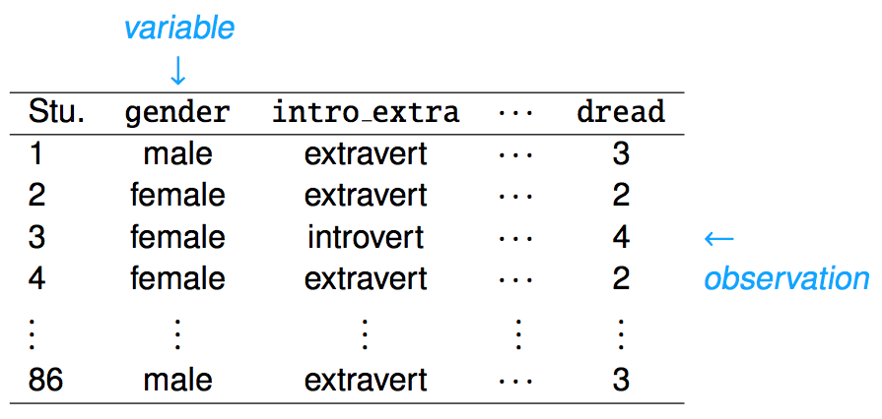
Data matrix
Data collected on students in a statistics class on a variety of variables:

Slide 13
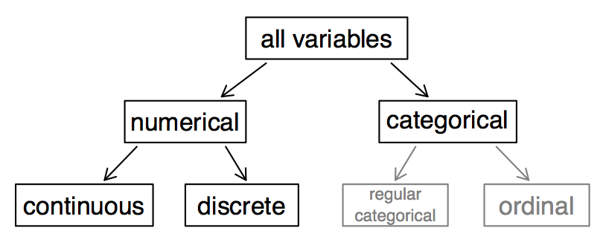
Types of variables

Slide 14
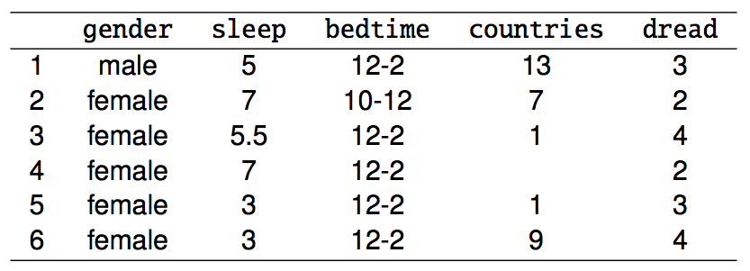
Types of variables (cont.)
gender:

Slide 15
Types of variables (cont.)
gender: categorical

Slide 16
Types of variables (cont.)
gender: categorical
sleep:

Slide 17
Types of variables (cont.)
gender: categorical
sleep: numerical, continuous

Slide 18
Types of variables (cont.)
gender: categorical
sleep: numerical, continuous
bedtime:

Slide 19
Types of variables (cont.)
gender: categorical
sleep: numerical, continuous
bedtime: categorical, ordinal

Slide 20
Types of variables (cont.)
gender: categorical
sleep: numerical, continuous
bedtime: categorical, ordinal
countries:

Slide 21
Types of variables (cont.)
gender: categorical
sleep: numerical, continuous
bedtime: categorical, ordinal
countries: numerical, discrete

Slide 22
Types of variables (cont.)
gender: categorical
sleep: numerical, continuous
bedtime: categorical, ordinal
countries: numerical, discrete
dread:

Slide 23
Types of variables (cont.)
gender: categorical
sleep: numerical, continuous
bedtime: categorical, ordinal
countries: numerical, discrete
dread: categorical, ordinal - could also be used as numerical

Slide 24
Practice
What type of variable is a telephone area code?
(a) numerical, continuous
(b) numerical, discrete
(c) categorical
(d) categorical, ordinal

Slide 25
Practice
What type of variable is a telephone area code?
(a) numerical, continuous
(b) numerical, discrete
(c) categorical
(d) categorical, ordinal

Slide 26
More Practice

