Slide 1
Summarizing Data
Dr. Ab Mosca (they/them)
Slides based off slides courtesy of OpenIntro and John McGreedy of Johns Hopkins University

Slide 2
Numerical Data - Continuous

Slide 3
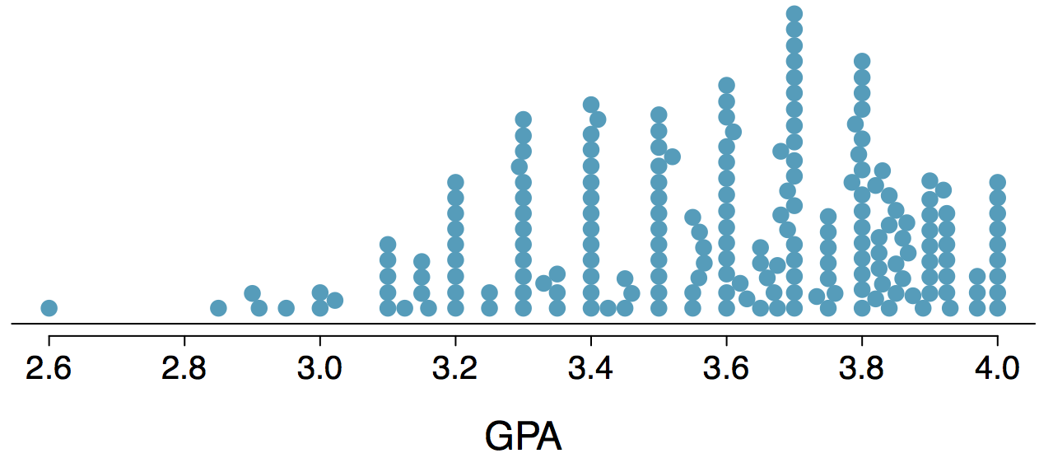
Stacked Dot Plot
Higher bars represent areas where there are more observations, makes it a little easier to judge the center and the shape of the distribution.

Slide 4
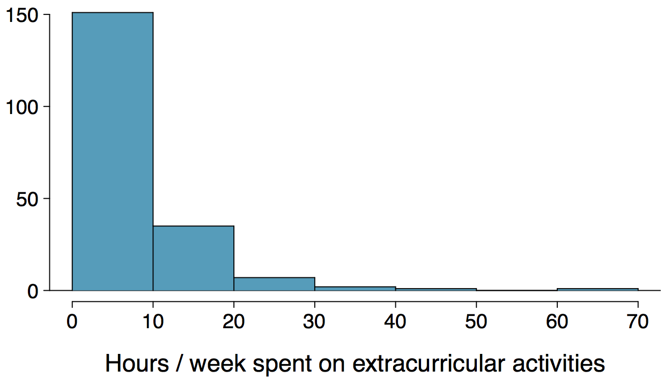
Histograms - Extracurricular Hours
Histograms provide a view of the data density. Higher bars represent where the data are relatively more common.
Histograms are especially convenient for describing the shape of the data distribution.
The chosen bin width can alter the story the histogram is telling.

Slide 5
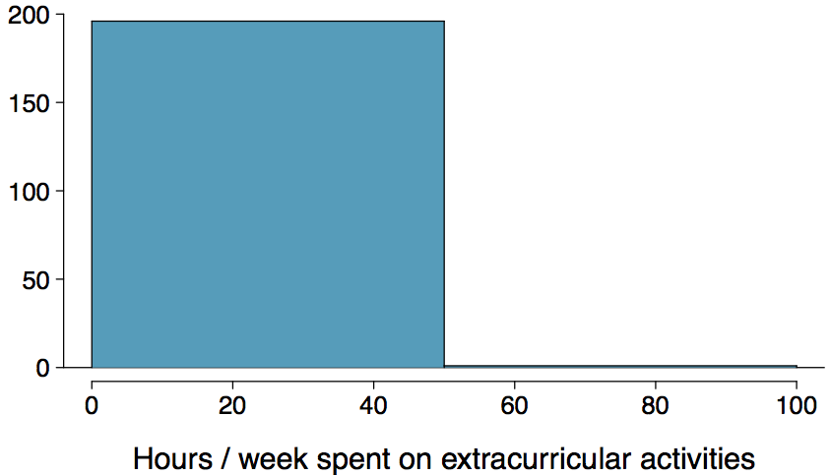
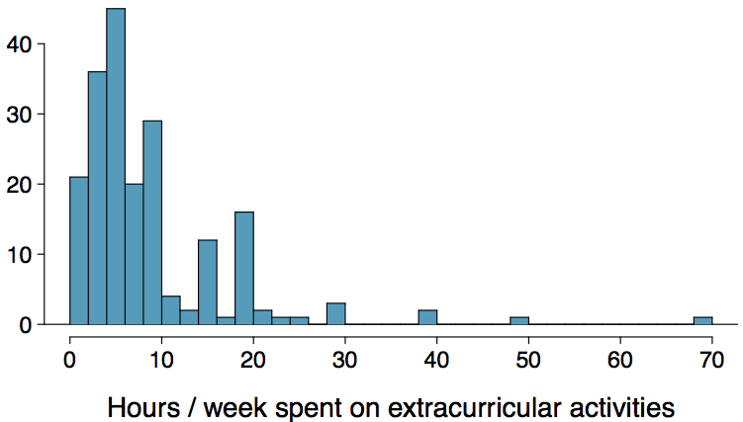
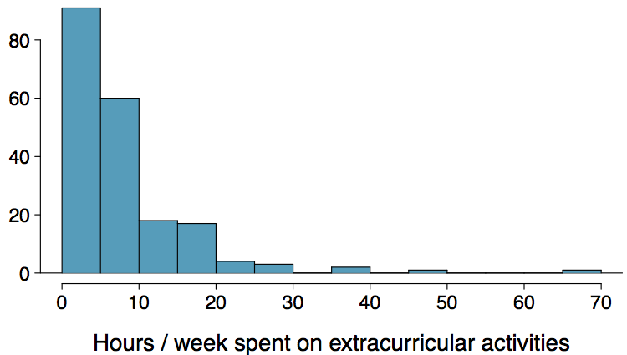
Bin Width
Which one(s) of these histograms are useful? Which reveal too much about the data? Which hide too much?

Slide 6
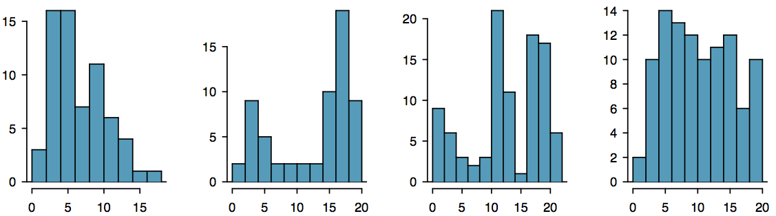
Shape of a Distribution: Modality
Does the histogram have a single prominent peak (unimodal), several prominent peaks (bimodal/multimodal), or no apparent peaks (uniform)?
Note: In order to determine modality, step back and imagine a smooth curve over the histogram -- imagine that the bars are wooden blocks and you drop a limp spaghetti over them, the shape the spaghetti would take could be viewed as a smooth curve.

Slide 7
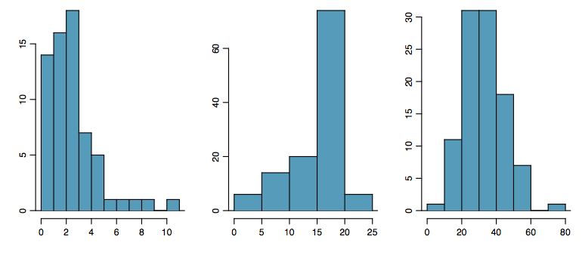
Shape of a Distribution: Skewness
Is the histogram right skewed, left skewed, or symmetric?
Note: Histograms are said to be skewed to the side of the long tail.

Slide 8
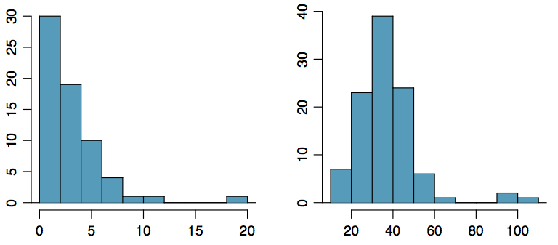
Shape of a Distribution:
Unusual Observations
Are there any unusual observations or potential outliers?

Slide 9
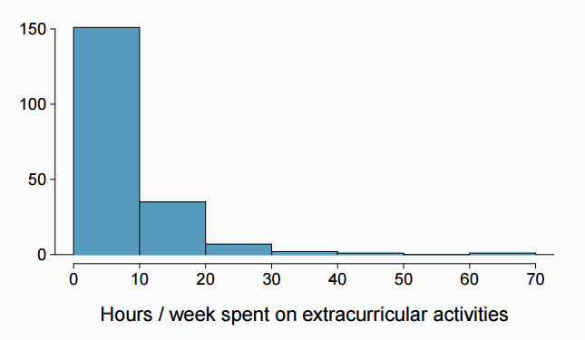
Extracurricular activities
How would you describe the shape of the distribution of hours per week students spend on extracurricular activities?

Slide 10
Extracurricular activities
How would you describe the shape of the distribution of hours per week students spend on extracurricular activities?
Unimodal and right skewed, with a potentially unusual observation at 60 hours/week.

Slide 11
Commonly observed shapes of distributions
Modality

Slide 12
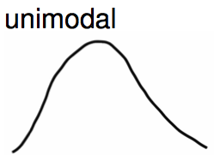
Commonly observed shapes of distributions
Modality

Slide 13
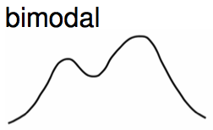
Commonly observed shapes of distributions
Modality

Slide 14
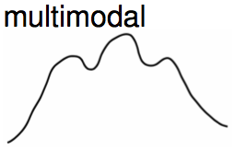
Commonly observed shapes of distributions
Modality

Slide 15
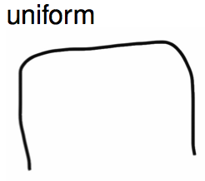
Commonly observed shapes of distributions
Modality

Slide 16
Commonly observed shapes of distributions
Modality
Skewness

Slide 17
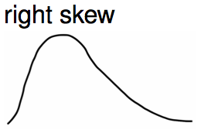
Commonly observed shapes of distributions
Modality
Skewness

Slide 18
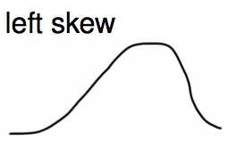
Commonly observed shapes of distributions
Modality
Skewness

Slide 19
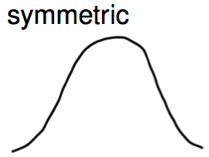
Commonly observed shapes of distributions
Modality
Skewness

Slide 20
Practice
Which of these variables do you expect to be uniformly distributed?
(a) weights of adult females
(b) salaries of a random sample of people from North Carolina
(c) house prices
(d) birthdays of classmates (day of the month)

Slide 21
Practice
Which of these variables do you expect to be uniformly distributed?
(a) weights of adult females
(b) salaries of a random sample of people from North Carolina
(c) house prices
(d) birthdays of classmates (day of the month)

Slide 22
Application Activity:
Shapes of Distributions
Sketch the expected distributions of the following variables:
number of piercings
scores on an exam
IQ scores
Come up with a concise way (1-2 sentences) to teach someone how to determine the expected distribution of any variable.

Slide 23

Mean
The sample mean, denoted as x̄, can be calculated as
where x₁, x₂, ..., x_{n} represent the n observed values.
The population mean is also computed the same way but is denoted as µ. It is often not possible to calculate µ since population data are rarely available.
The sample mean is a sample statistic, and serves as a point estimate of the population mean. This estimate may not be perfect, but if the sample is good (representative of the population), it is usually a pretty good estimate.

Slide 24

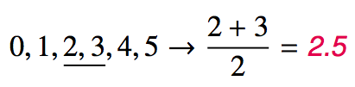
Median
The median is the value that splits the data in half when ordered in ascending order.
If there are an even number of observations, then the median is the average of the two values in the middle.
Since the median is the midpoint of the data, 50% of the values are below it. Hence, it is also the 50th percentile.

Slide 25

Variance
Variance is roughly the average squared deviation from the mean.

Slide 26

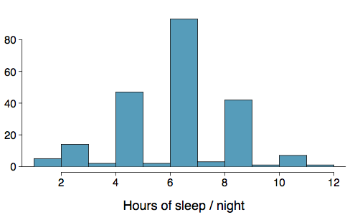
Variance
Variance is roughly the average squared deviation from the mean.
The sample mean is and the sample size is n = 217.

Slide 27
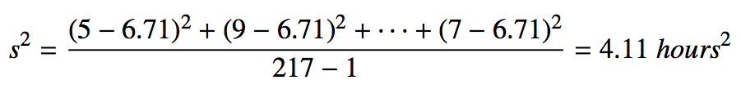
Variance
Variance is roughly the average squared deviation from the mean.
The sample mean is and the sample size is n = 217.
The variance of amount of sleep students get per night can be calculated as:

Slide 28
Variance (cont.)
Why do we use the squared deviation in the calculation of variance?

Slide 29
Variance (cont.)
Why do we use the squared deviation in the calculation of variance?
To get rid of negatives so that observations equally distant from the mean are weighed equally.
To weigh larger deviations more heavily.

Slide 30

Standard Deviation
The standard deviation is the square root of the variance, and has the same units as the data.

Slide 31
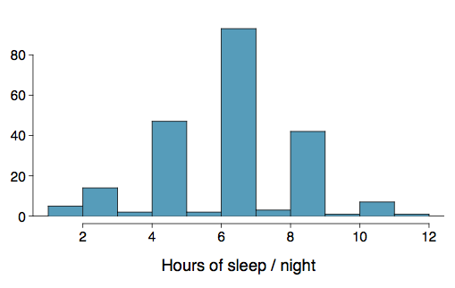

Standard Deviation
The standard deviation is the square root of the variance, and has the same units as the data.
The standard deviation of amount of sleep students get per night can be calculated as:

Slide 32
Standard Deviation
The standard deviation is the square root of the variance, and has the same units as the data.
The standard deviation of amount of sleep students get per night can be calculated as:
We can see that all of the data are within 3 standard deviations of the mean.

Slide 33
Q1, Q3, and IQR
The 25th percentile is also called the first quartile, Q1.
The 50th percentile is also called the median.
The 75th percentile is also called the third quartile, Q3.
Between Q1 and Q3 is the middle 50% of the data. The range these data span is called the interquartile range, or the IQR.
IQR = Q3 - Q1

Slide 34
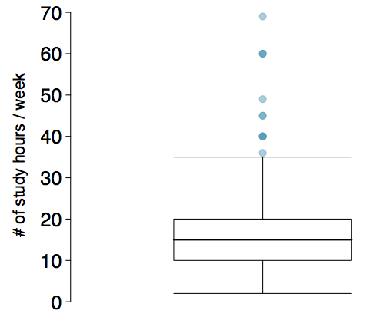
Box Plot
The box in a box plot represents the middle 50% of the data, and the thick line in the box is the median.

Slide 35
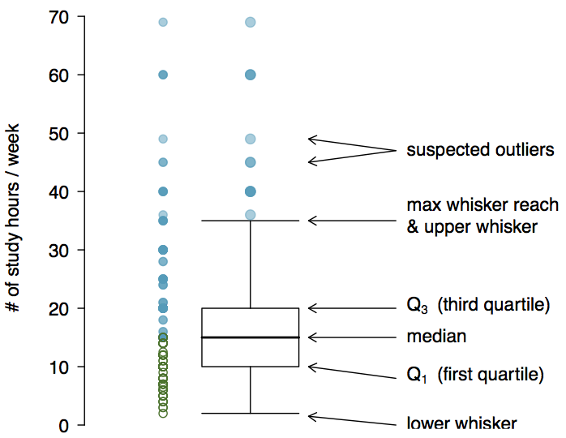
Anatomy of a Box Plot

Slide 36
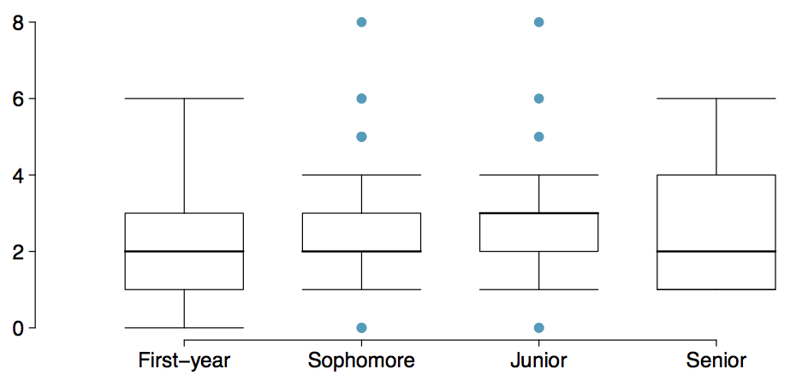
Comparing Numerical Data
Across Groups
Does there appear to be a relationship between class year and number of clubs students are in?

Slide 37
Whiskers and Outliers
Whiskers of a box plot can extend up to 1.5 x IQR away from the quartiles.
max upper whisker reach = Q3 + 1.5 x IQR
max lower whisker reach = Q1 - 1.5 x IQR

Slide 38
Whiskers and Outliers
Whiskers of a box plot can extend up to 1.5 x IQR away from the quartiles.
max upper whisker reach = Q3 + 1.5 x IQR
max lower whisker reach = Q1 - 1.5 x IQR
IQR: 20 - 10 = 10
max upper whisker reach = 20 + 1.5 x 10 = 35
max lower whisker reach = 10 - 1.5 x 10 = -5

Slide 39
Whiskers and Outliers
Whiskers of a box plot can extend up to 1.5 x IQR away from the quartiles.
max upper whisker reach = Q3 + 1.5 x IQR
max lower whisker reach = Q1 - 1.5 x IQR
IQR: 20 - 10 = 10
max upper whisker reach = 20 + 1.5 x 10 = 35
max lower whisker reach = 10 - 1.5 x 10 = -5
A potential outlier is defined as an observation beyond the maximum reach of the whiskers. It is an observation that appears extreme relative to the rest of the data.

Slide 40
Outliers (cont.)
Why is it important to look for outliers?

Slide 41
Outliers (cont.)
Why is it important to look for outliers?
Identify extreme skew in the distribution.
Identify data collection and entry errors.
Provide insight into interesting features of the data.

Slide 42
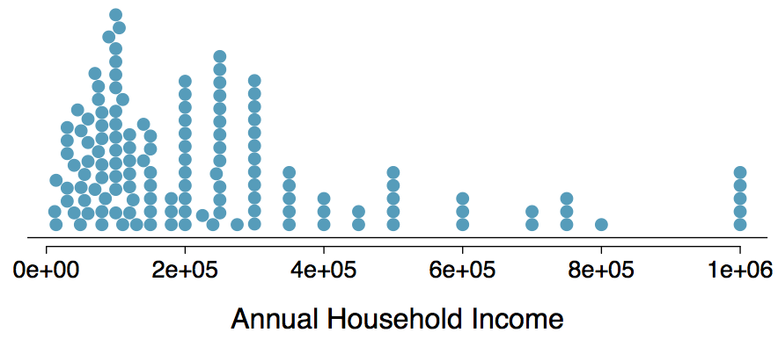
Extreme Observations
How would sample statistics such as mean, median, SD, and IQR of household income be affected if the largest value was replaced with $10 million? What if the smallest value was replaced with $10 million?

Slide 43
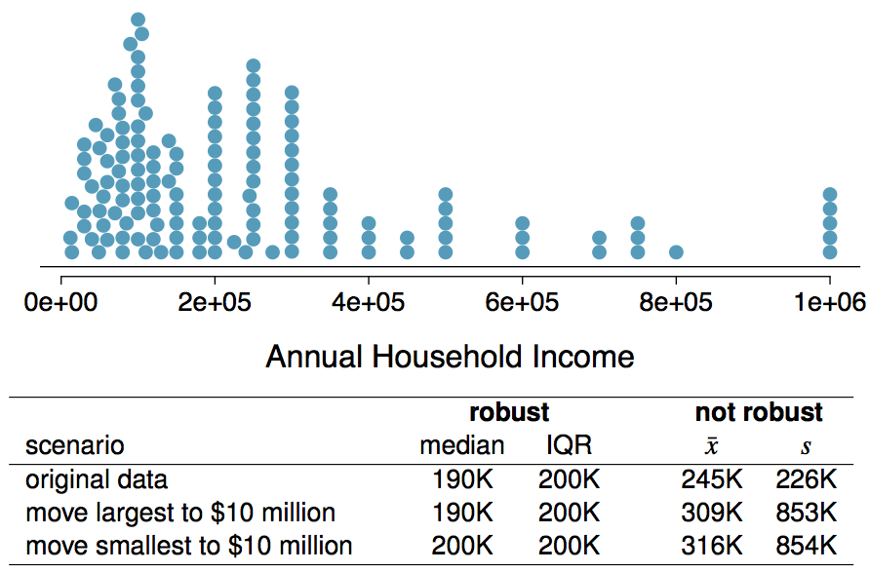
Robust Statistics

Slide 44
Robust Statistics
Median and IQR are more robust to skewness and outliers than mean and SD. Therefore,
for skewed distributions it is often more helpful to use median and IQR to describe the center and spread
for symmetric distributions it is often more helpful to use the mean and SD to describe the center and spread

Slide 45
Robust Statistics
Median and IQR are more robust to skewness and outliers than mean and SD. Therefore,
for skewed distributions it is often more helpful to use median and IQR to describe the center and spread
for symmetric distributions it is often more helpful to use the mean and SD to describe the center and spread
If you would like to estimate the typical household income for a student, would you be more interested in the mean or median income?

Slide 46
Robust Statistics
Median and IQR are more robust to skewness and outliers than mean and SD. Therefore,
for skewed distributions it is often more helpful to use median and IQR to describe the center and spread
for symmetric distributions it is often more helpful to use the mean and SD to describe the center and spread
If you would like to estimate the typical household income for a student, would you be more interested in the mean or median income?
Median

Slide 47
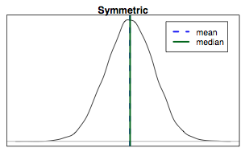
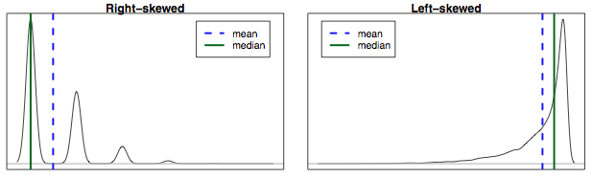
Mean vs. Median
If the distribution is symmetric, center is often defined as the mean: mean ~ median
If the distribution is skewed or has extreme outliers, center is often defined as the median
Right-skewed: mean > median
Left-skewed: mean < median

Slide 48
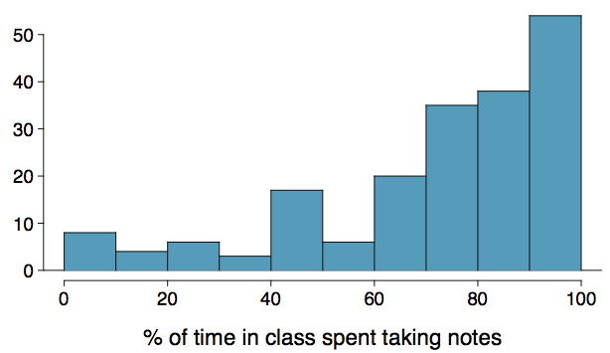
Practice
Which is most likely true for the distribution of percentage of time actually spent taking notes in class versus on Facebook, Twitter, etc.?
(a) mean > median (b) mean ~ median
(c) mean < median (d) impossible to tell

Slide 49
Practice
Which is most likely true for the distribution of percentage of time actually spent taking notes in class versus on Facebook, Twitter, etc.?
median: 80%
mean: 76%
(a) mean > median (b) mean ~ median
(c) mean < median (d) impossible to tell

Slide 50
Discrete Data and Categorical Data

Slide 51
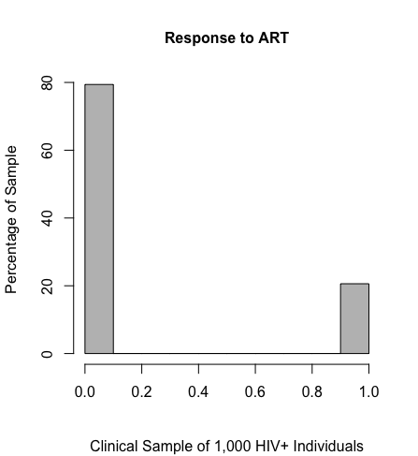
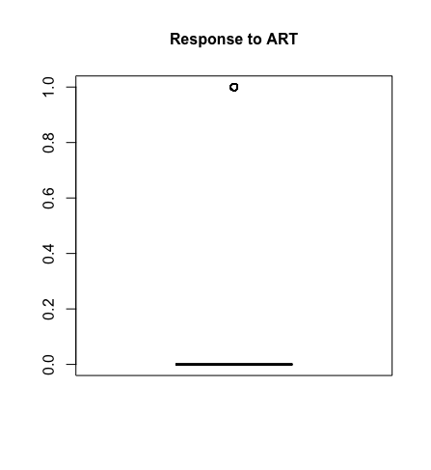
Visual Displays of Binary Data (Not So Useful)

Slide 52
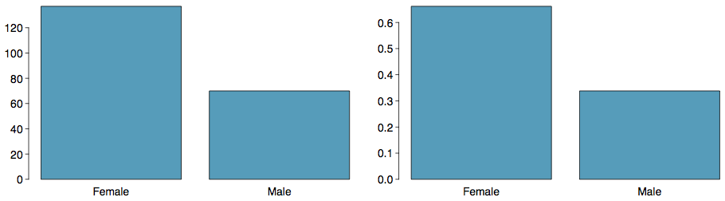
Bar Plots
A bar plot is a common way to display a single categorical variable. A bar plot where proportions instead of frequencies are shown is called a relative frequency bar plot.

Slide 53
Bar Plots
A bar plot is a common way to display a single categorical variable. A bar plot where proportions instead of frequencies are shown is called a relative frequency bar plot.
How are bar plots different than histograms?

Slide 54
Bar Plots
A bar plot is a common way to display a single categorical variable. A bar plot where proportions instead of frequencies are shown is called a relative frequency bar plot.
How are bar plots different than histograms?
Bar plots are used for displaying distributions of categorical variables, while histograms are used for numerical variables. The x-axis in a histogram is a number line, hence the order of the bars cannot be changed, while in a bar plot the categories can be listed in any order (though some orderings make more sense than others, especially for ordinal variables.)

Slide 55
Bar plots with two variables
Stacked bar plot: Graphical display of contingency table information, for counts.
Side-by-side bar plot: Displays the same information by placing bars next to, instead of on top of, each other.
Standardized stacked bar plot: Graphical display of contingency table information, for proportions.

Slide 56
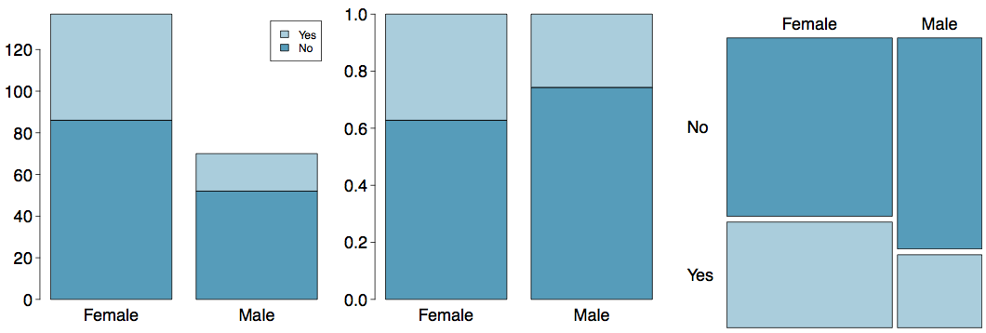
Segmented Bar and Mosaic Plots
What are the differences between the three visualizations shown below?

Slide 57
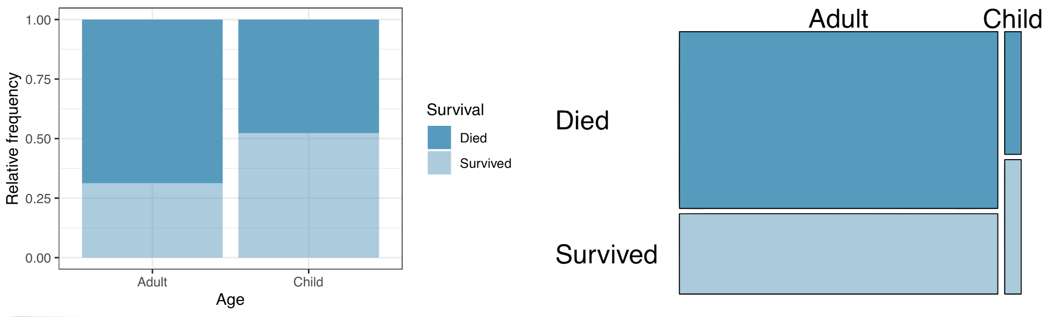
Mosaic plots
What are the differences between the two visualizations shown below?

Slide 58
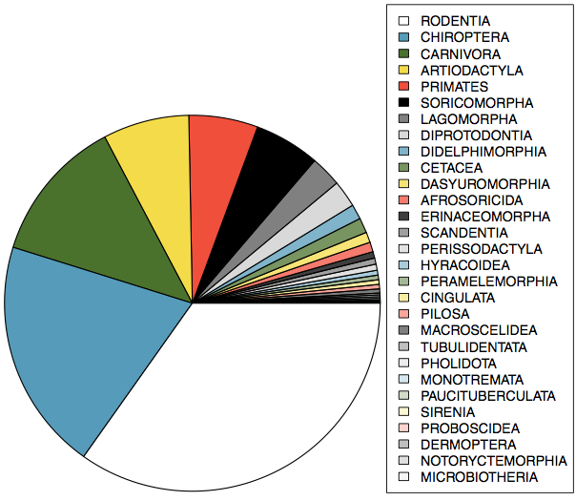
Pie Charts
Can you tell which order encompasses the lowest percentage of mammal species?
http://www.bucknell.edu/msw3

Slide 59
Contingency Tables
A table that summarizes data for two categorical variables is called a contingency table.

Slide 60
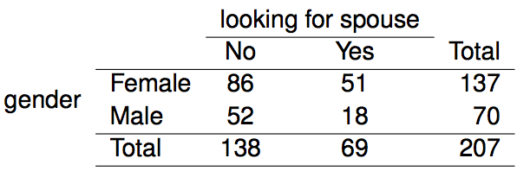
Contingency Tables
A table that summarizes data for two categorical variables is called a contingency table.
The contingency table below shows the distribution of students' genders and whether or not they are looking for a spouse while in college.

Slide 61
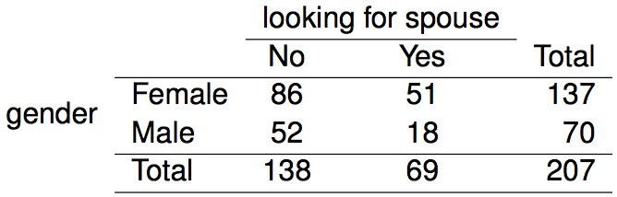
Choosing the
Appropriate Proportion
Does there appear to be a relationship between gender and whether the student is looking for a spouse in college?

Slide 62
Choosing the
Appropriate Proportion
Does there appear to be a relationship between gender and whether the student is looking for a spouse in college?
To answer this question we examine the row proportions:

Slide 63
Choosing the
Appropriate Proportion
Does there appear to be a relationship between gender and whether the student is looking for a spouse in college?
To answer this question we examine the row proportions:
% Females looking for a spouse: 51 / 137 ~ 0.37

Slide 64
Choosing the
Appropriate Proportion
Does there appear to be a relationship between gender and whether the student is looking for a spouse in college?
To answer this question we examine the row proportions:
% Females looking for a spouse: 51 / 137 ~ 0.37
% Males looking for a spouse: 18 / 70 ~ 0.26

Slide 65
p-hat, Generally Speaking
Response to therapy in a random sample of 1,000 HIV-positive patients from a citywide clinical population
The sample proportion $\hat{p }$is just a sample mean of data that takes on two values, 0 and 1
Generally, binary data values are given a value of x=1 for observations that have the outcome, and x=0 for observations that do not have the outcome

Slide 66
Example: Treatment Response to ART, HIV+ Individuals—2
Response to therapy in a random sample of 1,000 HIV-positive patients from a citywide clinical population
So, with 206 of the 1,000 responding, we have x_{i}=1 for 206 observations, and x_{i}=0 for 794 observations
$$\hat{p}=\frac{\sum_{i=1}^{n}{x_{i}}}{n}=\frac{\sum_{i=1}^{1000}{x_{i}}}{1,000}=\frac{206}{1,000}=0.206 or 20.6\%$$

Slide 67
Standard Deviation of Binary Data
There is a formula for the standard deviation of binary data:
$$s=\sqrt{\hat{p}(1−\hat{p})}$$
Unlike with continuous sample values, this quantity is not particularly useful in understanding the distribution; however, it is relevant to note that the variability of the sample values is dependent on the value of the summary statistic, $\hat{p}$

Slide 68
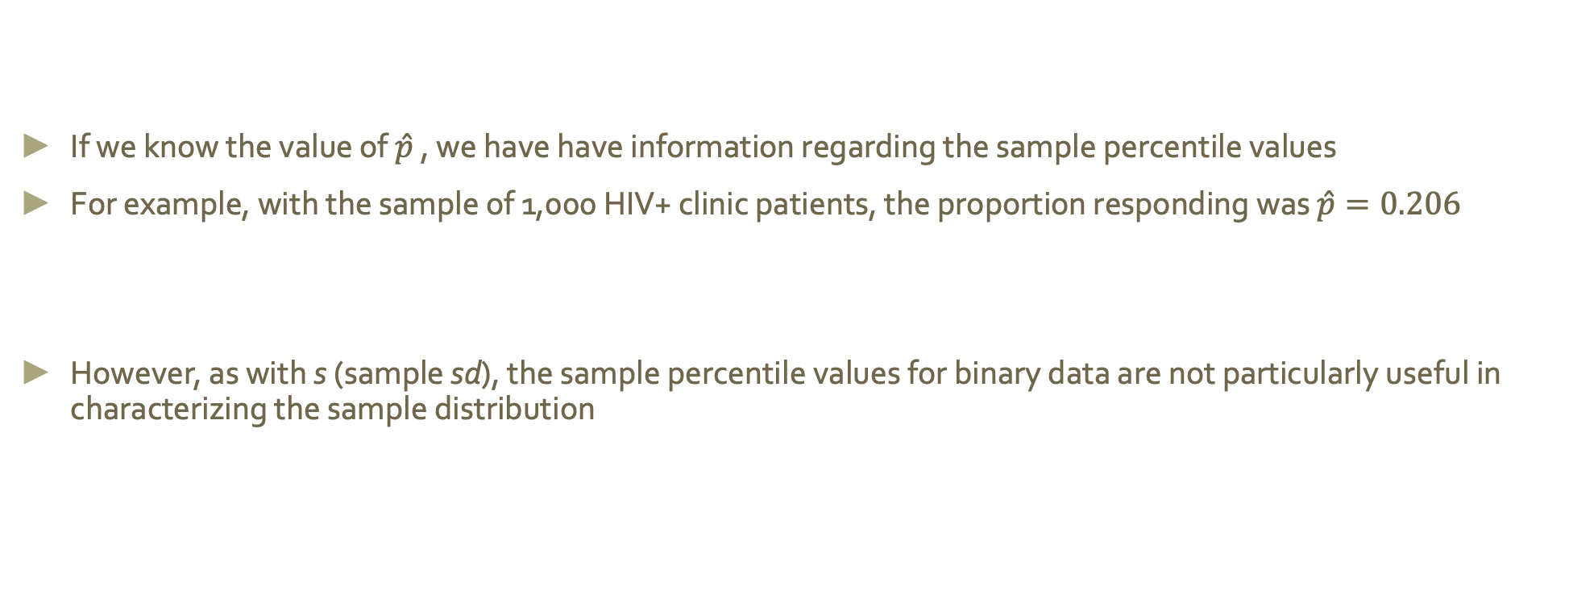
Percentiles of Binary Data
If we know the value of $\hat{p}$ , we have have information regarding the sample percentile values
For example, with the sample of 1,000 HIV+ clinic patients, the proportion responding was $\hat{p}=0.206$
However, as with s (sample sd), the sample percentile values for binary data are not particularly useful in characterizing the sample distribution

