Slide 1
Inference for a Difference in Two Means
Dr. Ab Mosca (they/them)
Slides based off slides courtesy of OpenIntro and John McGreedy of Johns Hopkins University

Slide 2
Plan for Today
Recap tests we’ve look at so far
Introduce inference for a difference of means
Use some statistical tools

Slide 3
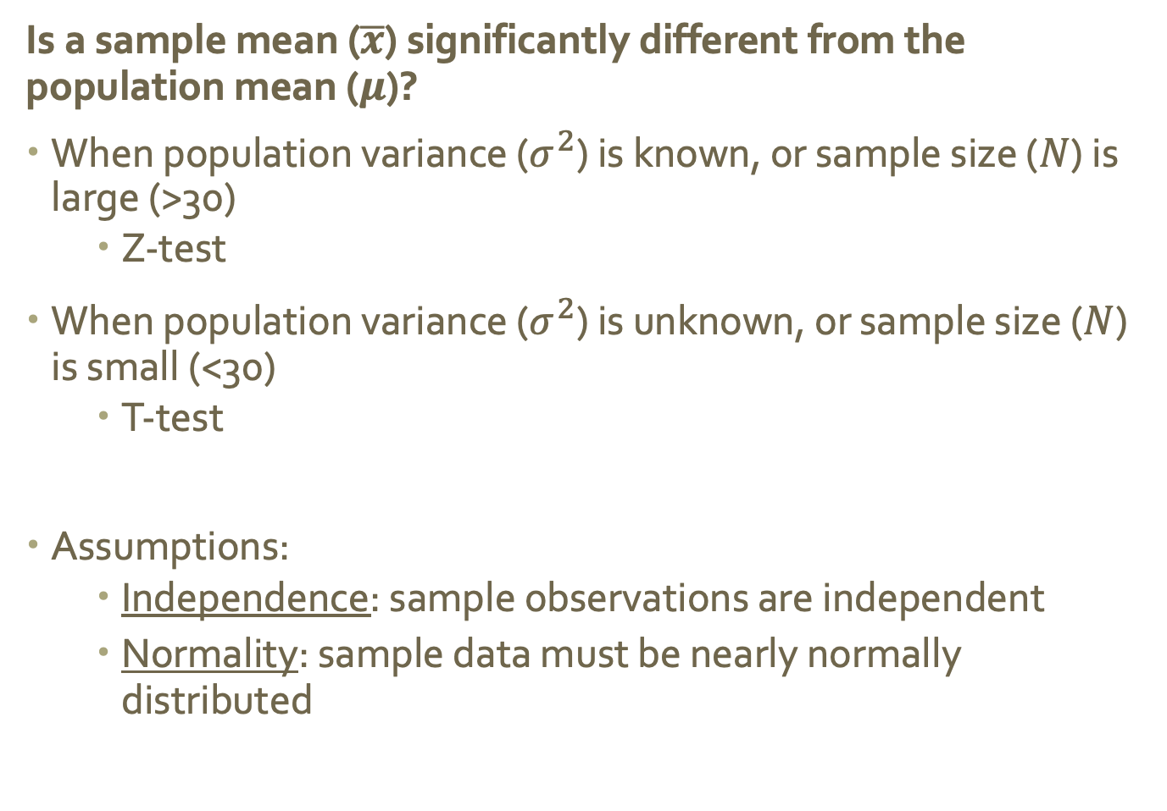
Inference so far…
Is a sample mean ($\overline{x}$) significantly different from the population mean ($μ$)?
When population variance ($σ^{2}$) is known, or sample size ($N$) is large (>30)
Z-test
When population variance ($σ^{2}$) is unknown, or sample size ($N$) is small (<30)
T-test
Assumptions:
Independence: sample observations are independent
Normality: sample data must be nearly normally distributed
Notes:
Independence. The sample observations must be independent, The most common way to satisfy
this condition is when the sample is a simple random sample from the population. If the
data come from a random process, analogous to rolling a die, this would also satisfy the
independence condition.
Normality. When a sample is small, we also require that the sample observations come from a
normally distributed population. We can relax this condition more and more for larger and
larger sample sizes. This condition is obviously vague, making it di cult to evaluate, so next
we introduce a couple rules of thumb to make checking this condition easier.

Slide 4
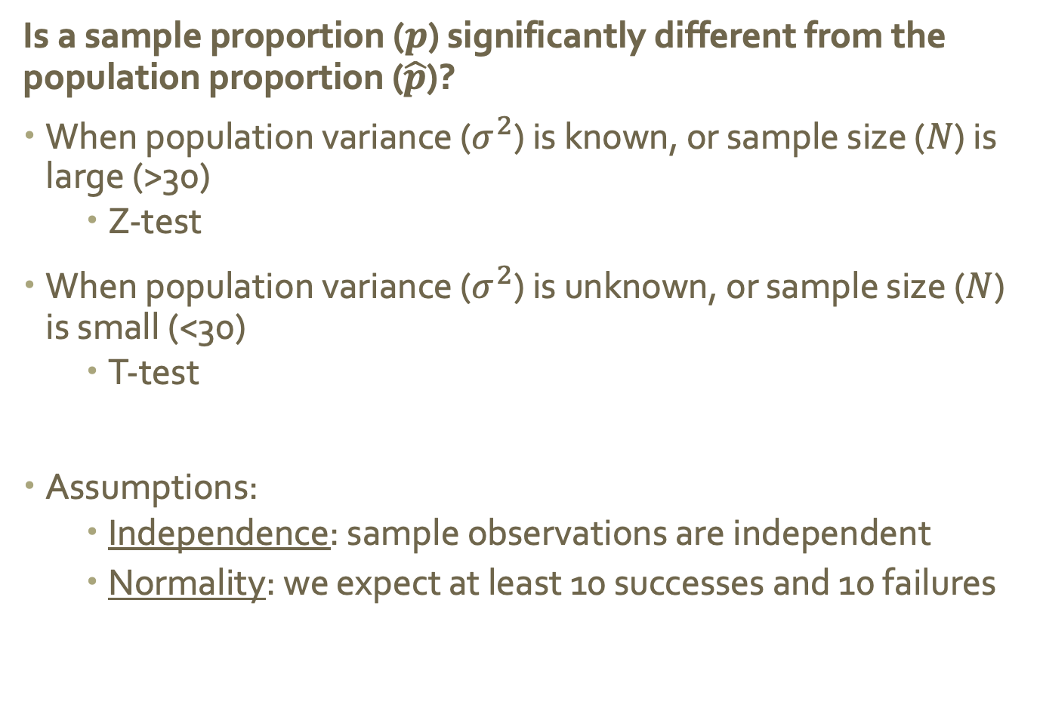
Inference so far…
Is a sample proportion ($p$) significantly different from the population proportion ($\hat{p}$)?
When population variance ($σ^{2}$) is known, or sample size ($N$) is large (>30)
Z-test
When population variance ($σ^{2}$) is unknown, or sample size ($N$) is small (<30)
T-test
Assumptions:
Independence: sample observations are independent
Normality: we expect at least 10 successes and 10 failures

Slide 5
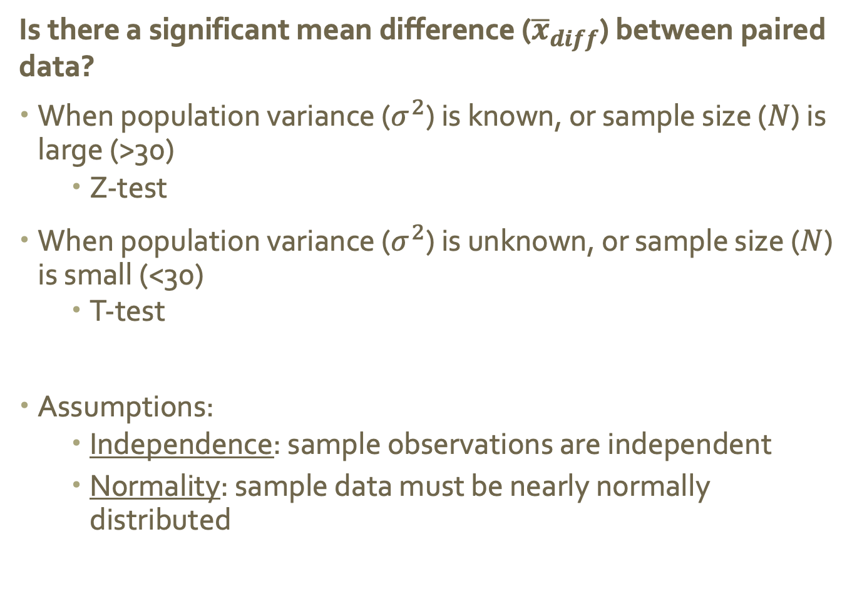
Inference so far…
Is there a significant mean difference (${\overline{x}}_{diff}$) between paired data?
When population variance ($σ^{2}$) is known, or sample size ($N$) is large (>30)
Z-test
When population variance ($σ^{2}$) is unknown, or sample size ($N$) is small (<30)
T-test
Assumptions:
Independence: sample observations are independent
Normality: sample data must be nearly normally distributed
Notes:
Independence. The sample observations must be independent, The most common way to satisfy
this condition is when the sample is a simple random sample from the population. If the
data come from a random process, analogous to rolling a die, this would also satisfy the
independence condition.
Normality. When a sample is small, we also require that the sample observations come from a
normally distributed population. We can relax this condition more and more for larger and
larger sample sizes. This condition is obviously vague, making it di cult to evaluate, so next
we introduce a couple rules of thumb to make checking this condition easier.

Slide 6
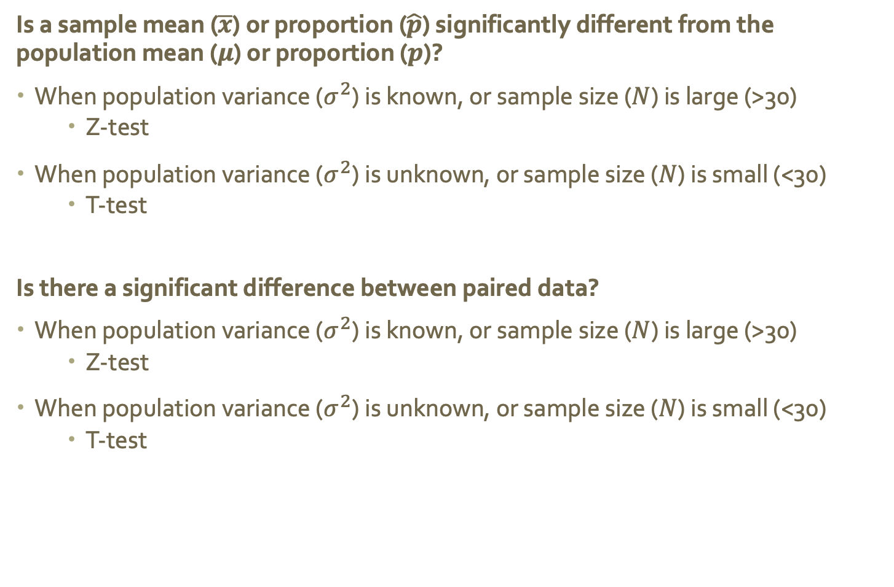
Inference so far…
Is a sample mean ($\overline{x}$) or proportion ($\hat{p}$) significantly different from the population mean ($μ$) or proportion ($p$)?
When population variance ($σ^{2}$) is known, or sample size ($N$) is large (>30)
Z-test
When population variance ($σ^{2}$) is unknown, or sample size ($N$) is small (<30)
T-test
Is there a significant difference between paired data?
When population variance ($σ^{2}$) is known, or sample size ($N$) is large (>30)
Z-test
When population variance ($σ^{2}$) is unknown, or sample size ($N$) is small (<30)
T-test
Come up with a research question and hypotheses for comparing a sample mean/proportion to the population mean/proportion, and for paired data.

Slide 7
Another Type of Question
What if we wanted to answer a questions like these?
Do juniors and seniors at WSU spend different amounts of time working?
Are pumpkins heavier than butternut squash on average?

Slide 8
Another Type of Question
What if we wanted to answer a questions like these?
Do juniors and seniors at WSU spend different amounts of time working?
Are pumpkins heavier than butternut squash on average?
Do our current tools work?

Slide 9
Another Type of Question
What if we wanted to answer a questions like these?
Do juniors and seniors at WSU spend different amounts of time working?
Are pumpkins heavier than butternut squash on average?
No! In these cases we want to compare unpaired means
Do our current tools work?

Slide 10
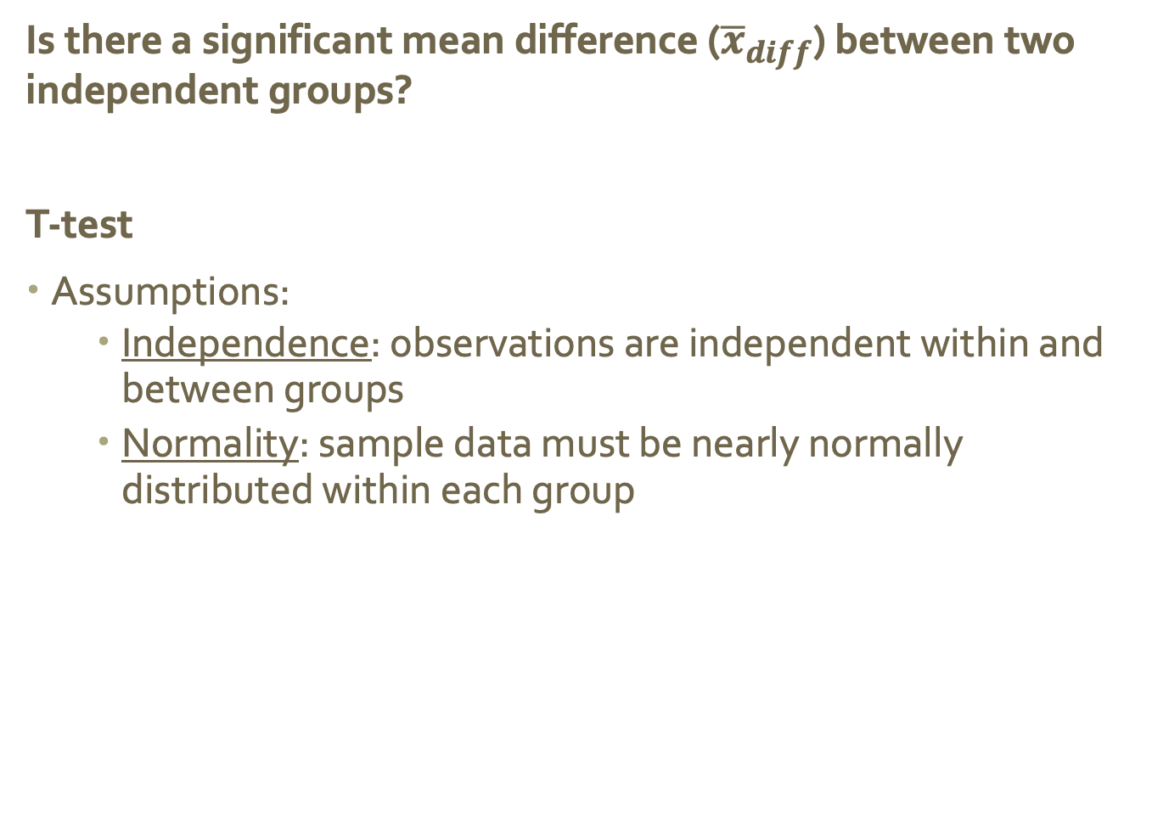
Another Type of Question
Is there a significant mean difference (${\overline{x}}_{diff}$) between two independent groups?
T-test
Assumptions:
Independence: observations are independent within and between groups
Normality: sample data must be nearly normally distributed within each group

Slide 11
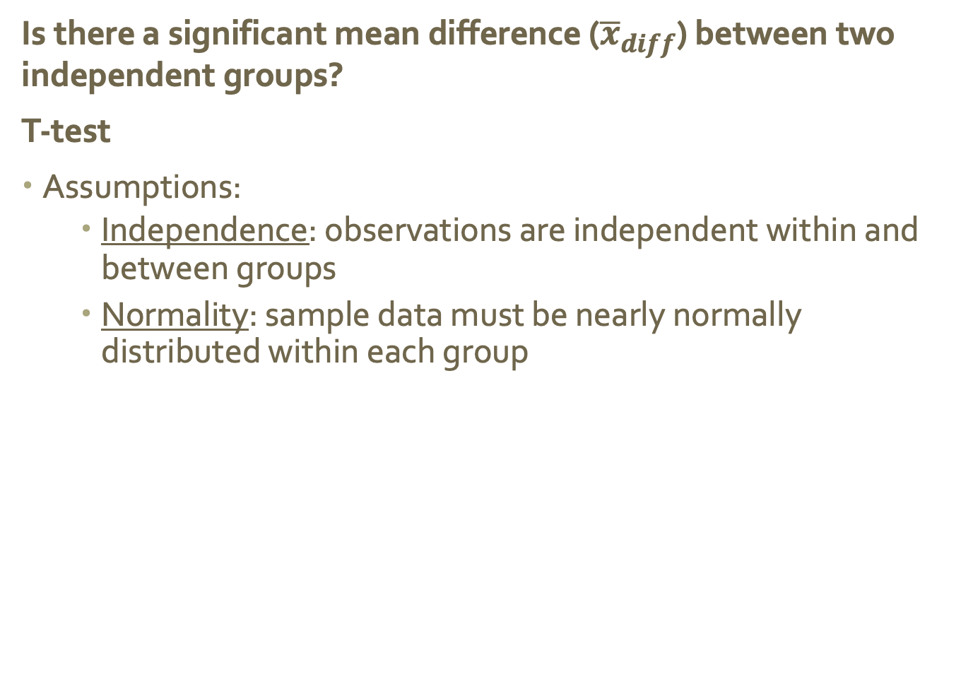
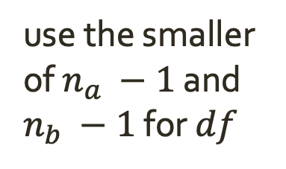
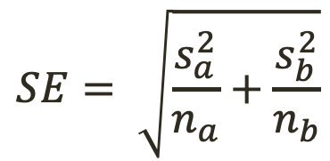
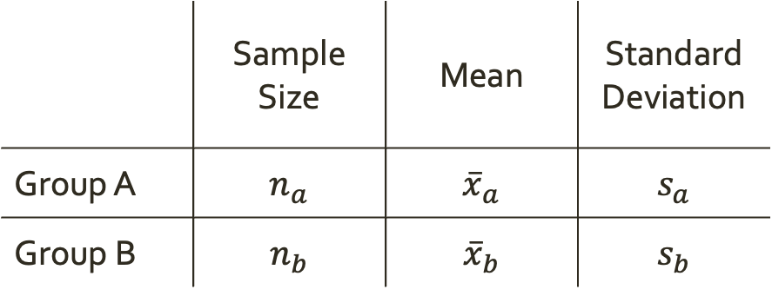
Another Type of Question
Is there a significant mean difference (${\overline{x}}_{diff}$) between two independent groups?
T-test
Assumptions:
Independence: observations are independent within and between groups
Normality: sample data must be nearly normally distributed within each group
 | Sample Size | Mean | Standard Deviation
Group A | $$n_{a}$$ | $${\overline{x}}_{a}$$ | $$s_{a}$$
Group B | $$n_{b}$$ | $${\overline{x}}_{b}$$ | $$s_{b}$$
$$SE= \sqrt{\frac{s_{a}^{2}}{n_{a}}+\frac{s_{b}^{2}}{n_{b}}}$$
use the smaller of $n_{a} −1$ and $n_{b} −1$ for $df$

Slide 12

Ex. Diamonds
Weights of diamonds are measured in carats
1 carat = 100 points, 0.99 carats = 99 points, etc.
The difference between the size of a 0.99 carat diamond and a 1 carat diamond is undetectable to the naked human eye, but does the price of a 1 carat diamond tend to be higher than the price of a 0.99 diamond?
We are going to test to see if there is a difference between the average prices of 0.99 and 1 carat diamonds
In order to be able to compare equivalent units, we divide the prices of 0.99 carat diamonds by 99 and 1 carat diamonds by 100, and compare the average point prices

Slide 13
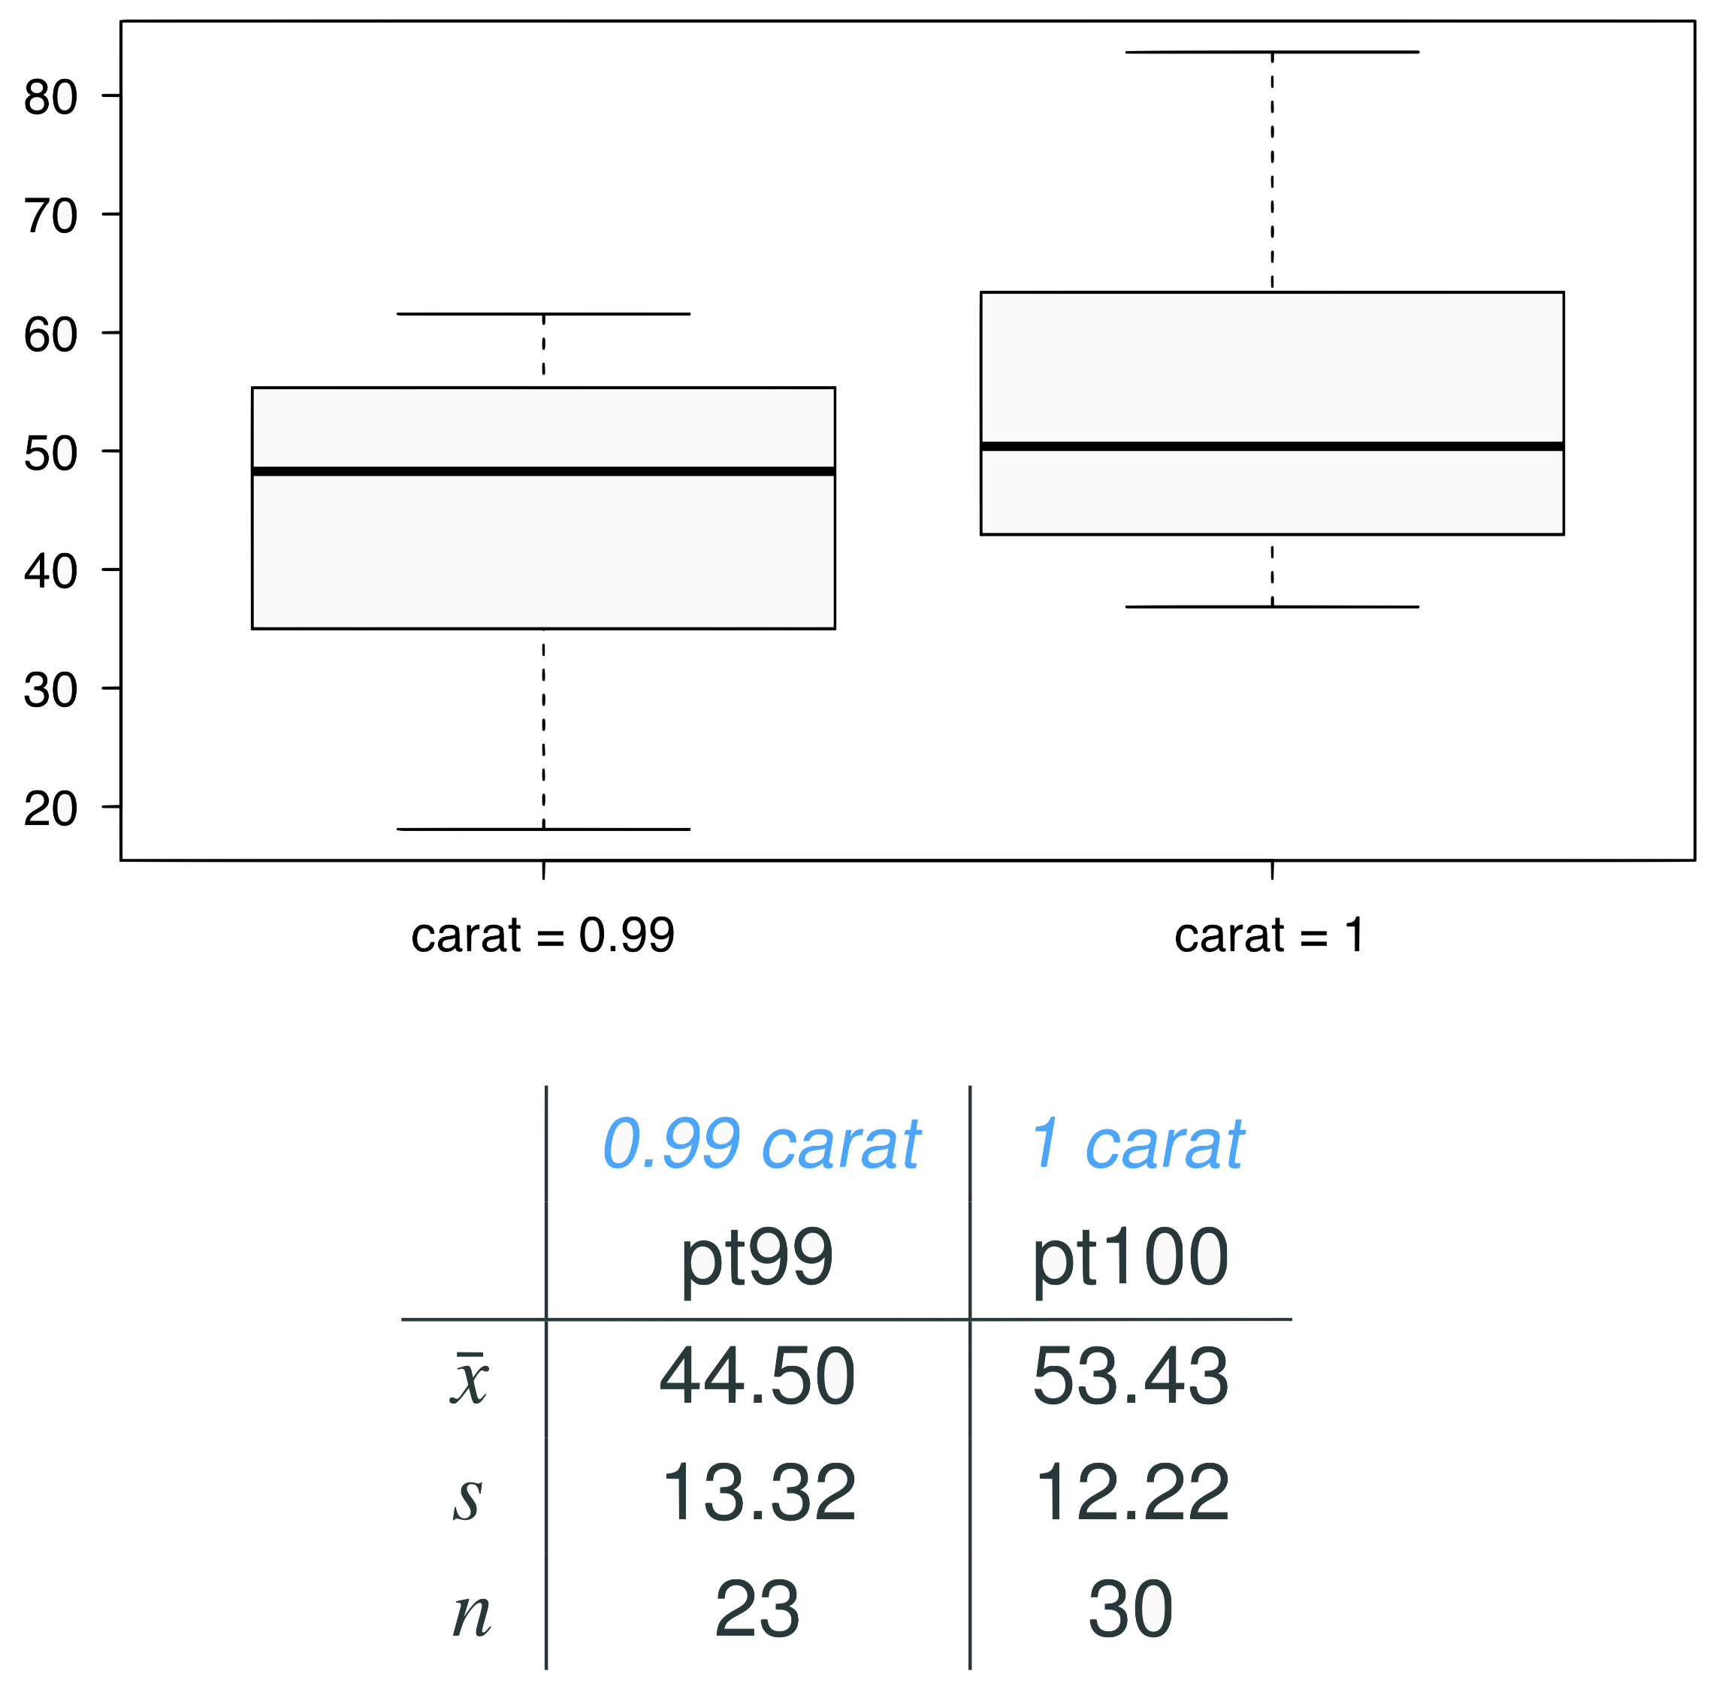
Data
Note: These data are a random sample from the diamonds data set in ggplot2 R package.

Slide 14

Parameter and point estimate
Parameter of interest: Average difference between the point prices of all 0.99 carat and 1 carat diamonds

Slide 15

Parameter and point estimate
Parameter of interest: Average difference between the point prices of all 0.99 carat and 1 carat diamonds
Point estimate: Average difference between the point prices of sampled 0.99 carat and 1 carat diamonds

Slide 16


Hypotheses
Which of the following is the correct set of hypotheses for testing if the average point price of 1 carat diamonds (pt100) is higher than the average point price of 0.99 carat diamonds (pt99)?
H₀ : 𝞵_{pt99} = 𝞵_{pt100}
H_{A} : 𝞵_{pt99} ≠ 𝞵_{pt100}
H₀ : 𝞵_{pt99} = 𝞵_{pt100}
H_{A} : 𝞵_{pt99} > 𝞵_{pt100}
H₀ : 𝞵_{pt99} = 𝞵_{pt100}
H_{A} : 𝞵_{pt99} < 𝞵_{pt100}
H₀ :
H_{A} :

Slide 17
Hypotheses
Which of the following is the correct set of hypotheses for testing if the average point price of 1 carat diamonds (pt100) is higher than the average point price of 0.99 carat diamonds (pt99)?
H₀ : 𝞵_{pt99} = 𝞵_{pt100}
H_{A} : 𝞵_{pt99} ≠ 𝞵_{pt100}
H₀ : 𝞵_{pt99} = 𝞵_{pt100}
H_{A} : 𝞵_{pt99} > 𝞵_{pt100}
H₀ : 𝞵_{pt99} = 𝞵_{pt100}
H_{A} : 𝞵_{pt99} < 𝞵_{pt100}
H₀ :
H_{A} :

Slide 18
Conditions
Which of the following does not need to be satisfied in order to conduct this hypothesis test using theoretical methods?
Point price of one 0.99 carat diamond in the sample should be independent of another, and the point price of one 1 carat diamond should independent of another as well
Point prices of 0.99 carat and 1 carat diamonds in the sample should be independent.
Distributions of point prices of 0.99 and 1 carat diamonds should not be extremely skewed
Both sample sizes should be at least 30

Slide 19
Conditions
Which of the following does not need to be satisfied in order to conduct this hypothesis test using theoretical methods?
Point price of one 0.99 carat diamond in the sample should be independent of another, and the point price of one 1 carat diamond should independent of another as well
Point prices of 0.99 carat and 1 carat diamonds in the sample should be independent.
Distributions of point prices of 0.99 and 1 carat diamonds should not be extremely skewed
Both sample sizes should be at least 30

Slide 20
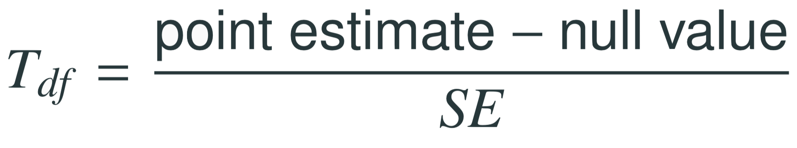
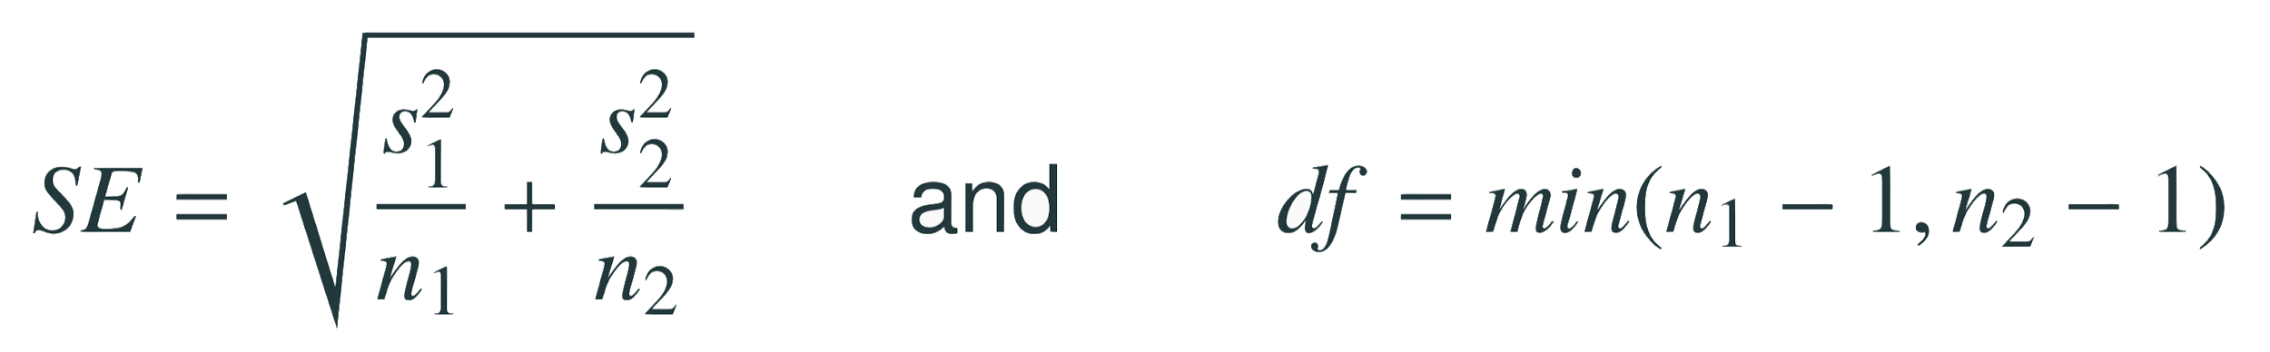
Test statistics
Test statistic for inference on the difference of two small sample means
The test statistic for inference on the difference of two means where σ₁ and σ₂ are unknown is the T statistic.
where
Note: The calculation of the df is actually much more complicated. For simplicity we’ll use the above formula to estimate the true df when conducting the analysis by hand

Slide 21
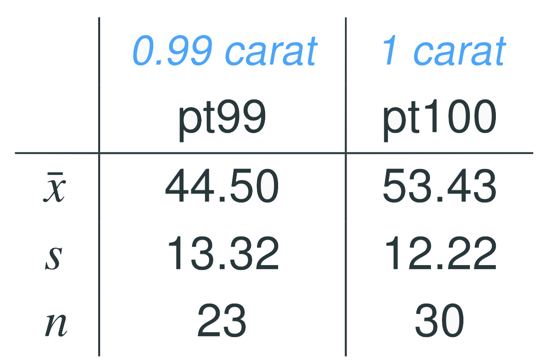
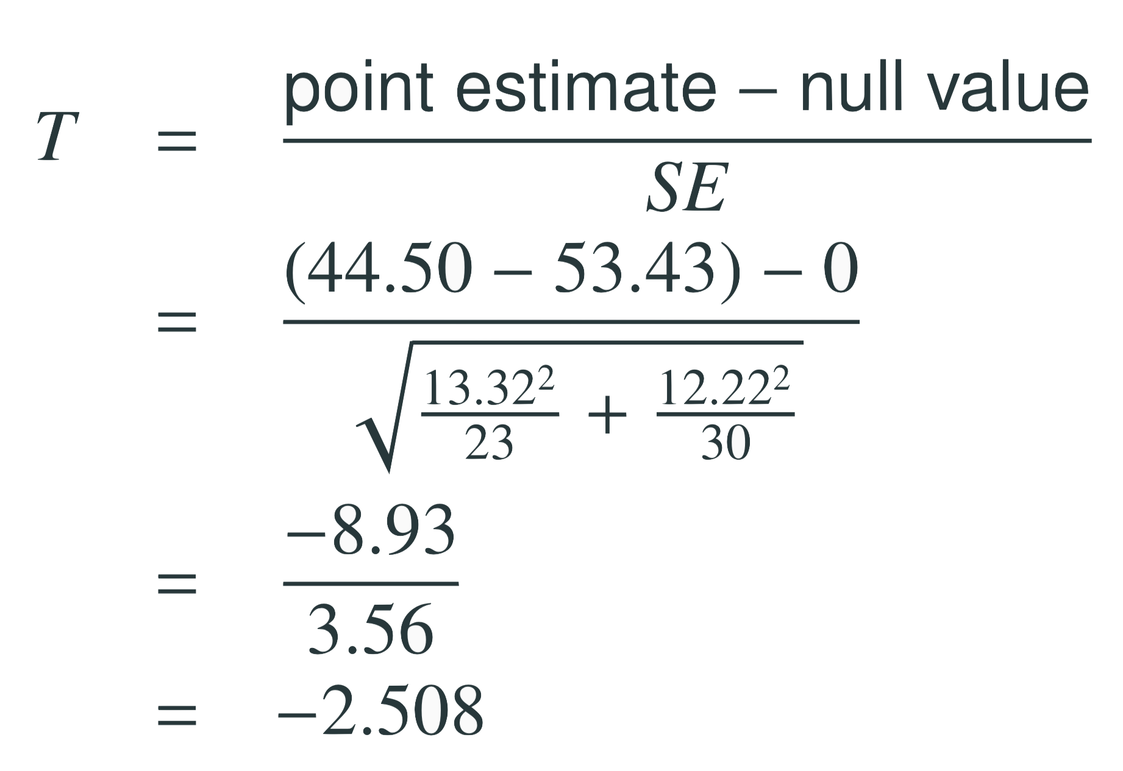
Test statistics (cont.)
Find T

Slide 22
Test statistics (cont.)
Find T
T

Slide 23
Test statistics (cont.)
Which of the following is the correct df for this hypothesis test?
22
23
30
29
52

Slide 24



Test statistics (cont.)
Which of the following is the correct df for this hypothesis test?
22
23
30
29
52

Slide 25


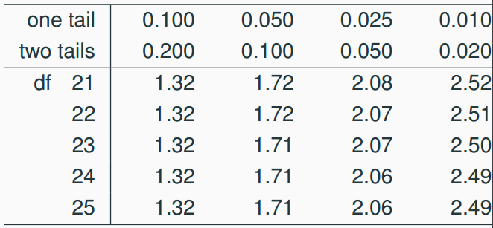
p-value
Which of the following is the correct p-value for this hypothesis test?
between 0.005 and 0.01
between 0.01 and 0.025
between 0.02 and 0.05
between 0.01 and 0.02

Slide 26
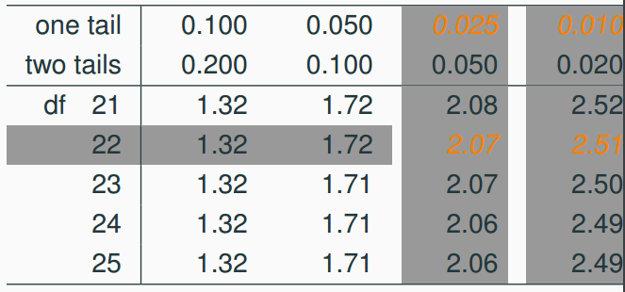
p-value
Which of the following is the correct p-value for this hypothesis test?
between 0.005 and 0.01
between 0.01 and 0.025
between 0.02 and 0.05
between 0.01 and 0.02

Slide 27
Synthesis
What is the conclusion of the hypothesis test? How (if at all) would this conclusion change your behavior if you went diamond shopping?

Slide 28
Synthesis
What is the conclusion of the hypothesis test? How (if at all) would this conclusion change your behavior if you went diamond shopping?
p-value is smaller than 0.05 so we reject H₀. The data provide convincing evidence to suggest that the point price of 0.99 carat diamonds is lower than the point price of 1 carat diamonds
Maybe buy a 0.99 carat diamond? It looks like a 1 carat, but is significantly cheaper

Slide 29
Equivalent confidence level
If our confidence level for the one-sided test was α = 0.05, what is the equivalent confidence level for a two-sided hypothesis test?
90%
92.5%
95%
97.5%

Slide 30
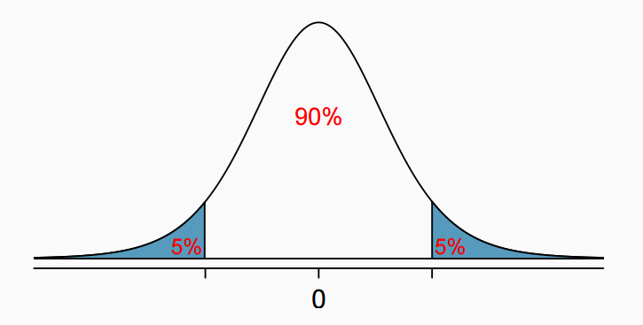
Equivalent confidence level
If our confidence level for the one-sided test was α = 0.05, what is the equivalent confidence level for a two-sided hypothesis test?
90%
92.5%
95%
97.5%

Slide 31
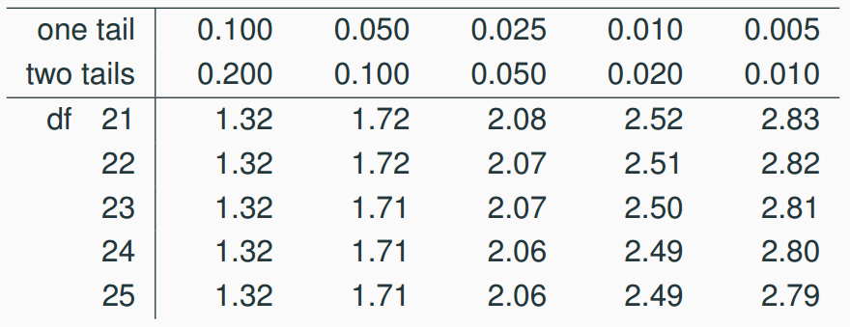
Critical value
What is the appropriate 𝙩* for a confidence interval for the average difference between the point prices of 0.99 and 1 carat diamonds?
1.32
1.72
2.07
2.82

Slide 32
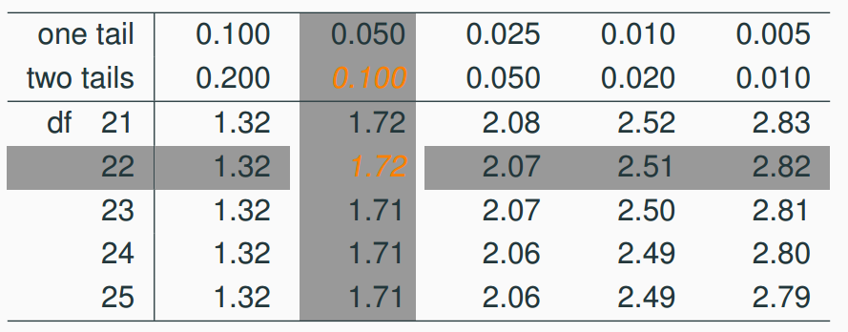
Critical value
What is the appropriate 𝙩* for a confidence interval for the average difference between the point prices of 0.99 and 1 carat diamonds?
1.32
1.72
2.07
2.82

Slide 33

Confidence interval
Calculate the confidence interval for the difference in diamond prices.
$CI=point estimate ± t_{df}^{∗} ∗SE$

Slide 34


Confidence interval
Calculate the confidence interval for the difference in diamond prices.
$CI=point estimate ± t_{df}^{∗} ∗SE$

Slide 35
Confidence interval
What does this 90% CI mean?

Slide 36
Confidence interval
What does this 90% CI mean?
We are 90% confident that the average point price of a 0.99 carat diamond is $15.05 to $2.81 lower than the average point price of a 1 carat diamond

Slide 37

Recap: Inference using difference of two small sample means
If σ₁ or σ₂ is unknown, difference between the sample means follow a 𝙩-distribution with $SE= \sqrt{\frac{s_{a}^{2}}{n_{a}}+\frac{s_{b}^{2}}{n_{b}}}$

Slide 38

Recap: Inference using difference of two small sample means
If σ₁ or σ₂ is unknown, difference between the sample means follow a 𝙩-distribution with $SE= \sqrt{\frac{s_{a}^{2}}{n_{a}}+\frac{s_{b}^{2}}{n_{b}}}$
Conditions:
Independence
Normality

Slide 39
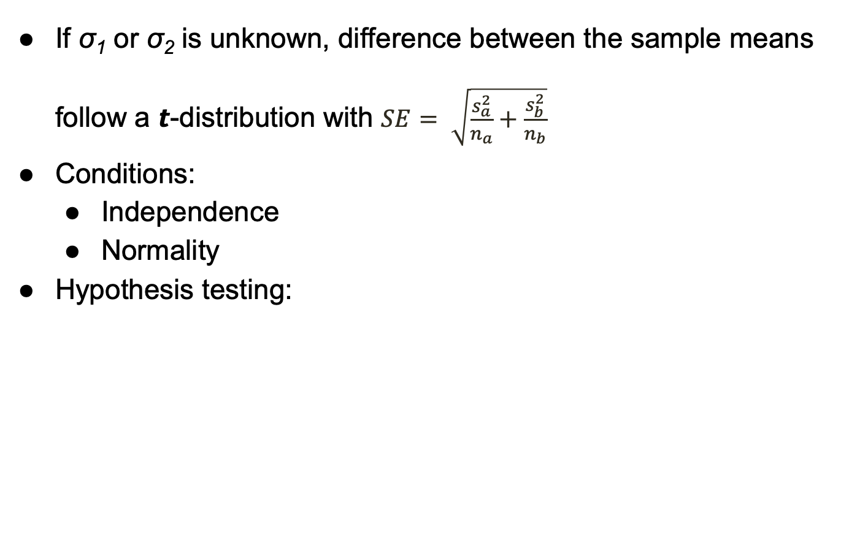
Recap: Inference using difference of two small sample means
If σ₁ or σ₂ is unknown, difference between the sample means follow a 𝙩-distribution with $SE= \sqrt{\frac{s_{a}^{2}}{n_{a}}+\frac{s_{b}^{2}}{n_{b}}}$
Conditions:
Independence
Normality
Hypothesis testing:

Slide 40

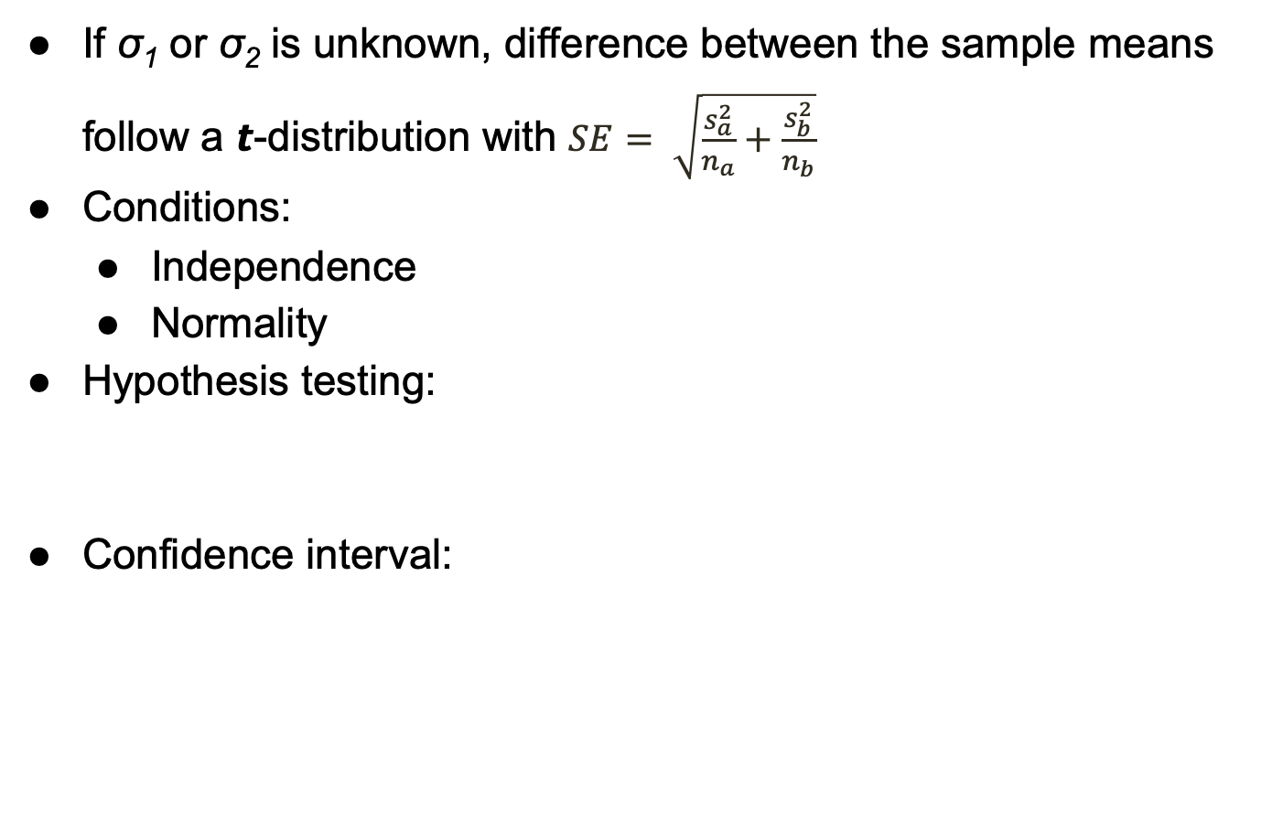
Recap: Inference using difference of two small sample means
If σ₁ or σ₂ is unknown, difference between the sample means follow a 𝙩-distribution with $SE= \sqrt{\frac{s_{a}^{2}}{n_{a}}+\frac{s_{b}^{2}}{n_{b}}}$
Conditions:
Independence
Normality
Hypothesis testing:
Confidence interval:

Slide 41
Statistical Tools
How do we analyze data when there is too much to calculate by hand?
Notes:
Calculate Average price & get vis

Slide 42
Statistical Tools
How do we analyze data when there is too much to calculate by hand?
Option 1: Use excel or some other coding-free software
Option 2: Learn to use a statistical software (like R, SAS, SPSS)
Notes:
Calculate Average price & get vis

Slide 43
Statistical Tools
How do we analyze data when there is too much to calculate by hand?
Option 1: Use excel or some other coding-free software
Option 2: Learn to use a statistical software (like R, SAS, SPSS)
Ex. With R https://www.kaggle.com/datasets/neuromusic/avocado-prices
Notes:
Calculate Average price & get vis

